Slide 1
Red Alert Honour
BUC e-honours

Slide 2
What do you do if
There is a Fire in your house ?

Slide 4
Stay Calm
Alert Others
Attempt to out small fires
Evacuate
Feel Doors/Door Handles
Drop and Crawl (21)
Escape first then call 999

Slide 5
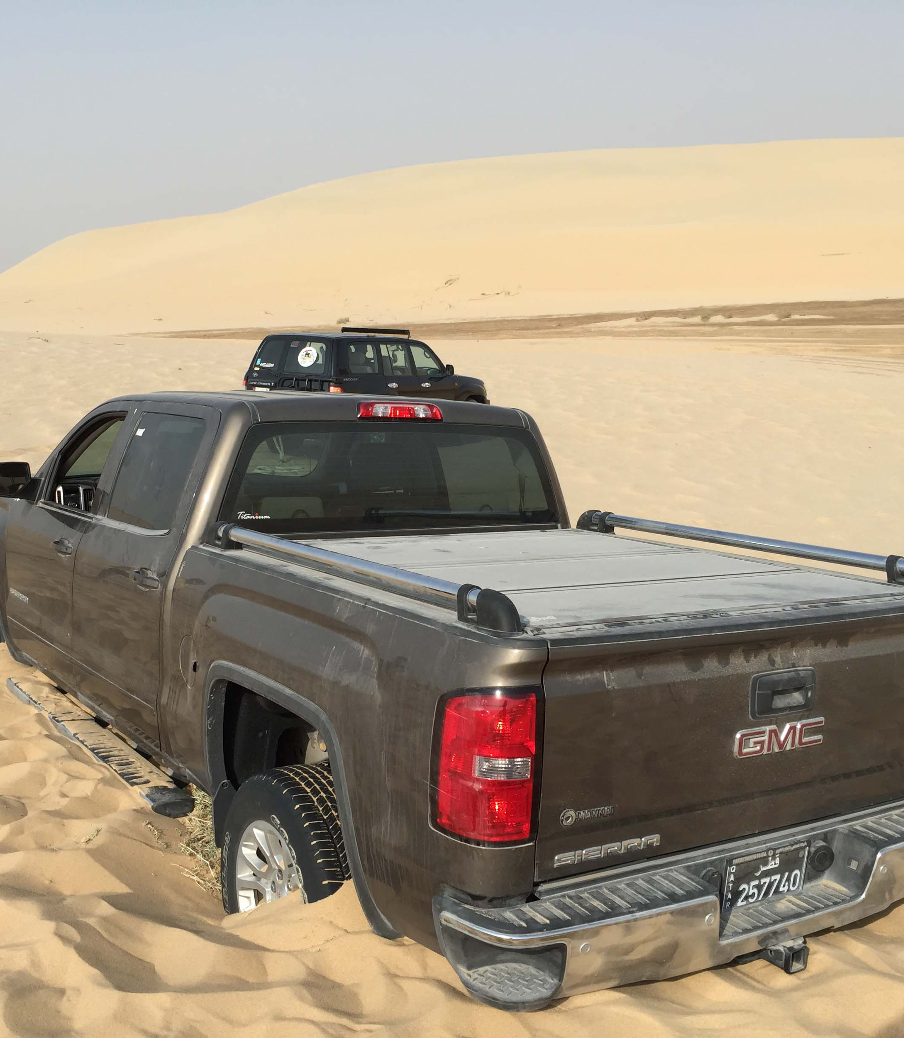
What do you do if
you are stranded in a car in a desert ?

Slide 6
Desert
Find Shade (11)
Stay Hydrated
Don't Shed Your Clothes
Stay Near The Car

Slide 7
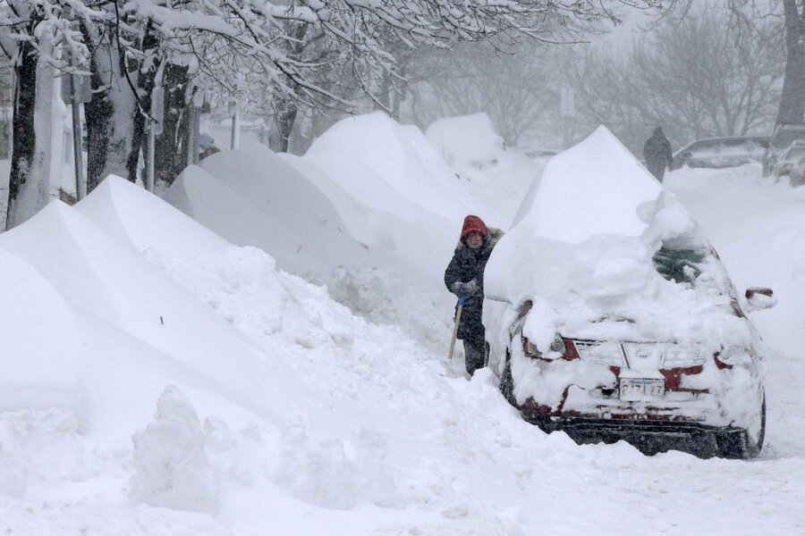
What do you do if
you are stranded in a car in a blizzard ? (6)

Slide 8
In a Blizzard
Keep Doors And Windows Closed
01
Use Water A Little At A Time
02
Do Not Run Engine More Than 10mins In Every Hour
03
Clear Snow Off Roof/Hood/Windows
04

Slide 9
What do you do if
You are in a Motor Vehicle Accident ?

Slide 10
Car Accident
Is Everyone OK ?
Stay Out of Traffic
Move Car To Side
Position Reflective Triangle

Slide 11
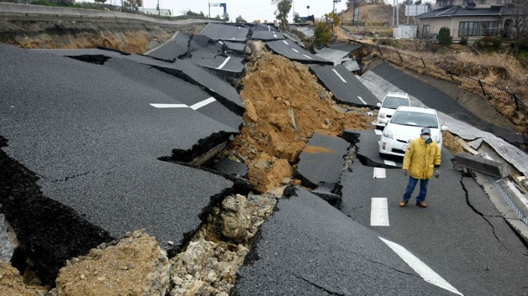
What do you do if
You are in an earthquake ?

Slide 13
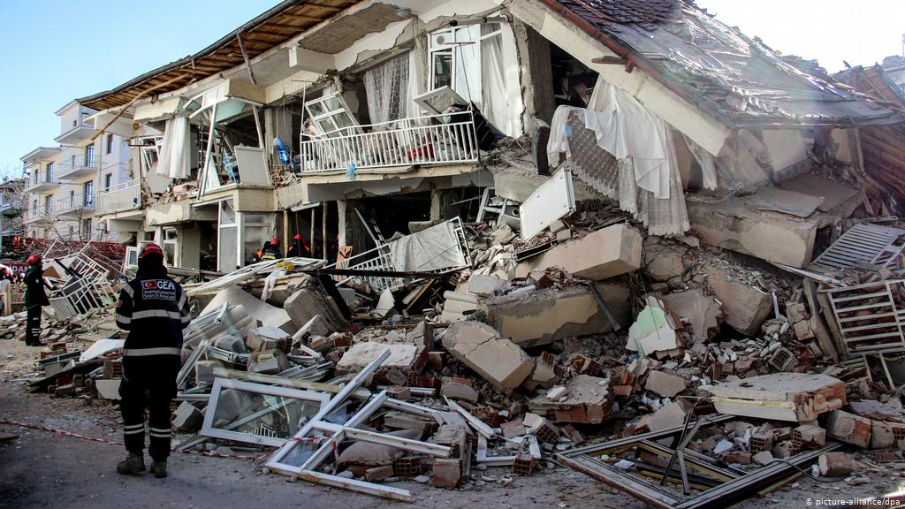
EarthquakeS
Exit Building When Shaking Stops
If Outside Stay Away from Buildings and Powerlines
Beware of Aftershock (Days or Weeks Later) (17)
Call 999 For Serious Problems Only
Mains, Gas Lines, Water Lines

Slide 14
What do you do if
You are in a Flood ?

Slide 15
Flood
Disconnect Appliances (7)
Turn Off Main Breaker
Fill Bathtub with Water – Why? (5)
Don't Cross Flood Streams
Float On Your Back - Feet First
Do Not Try To Stand In Swift Water
Use Arms To Guide You

Slide 16
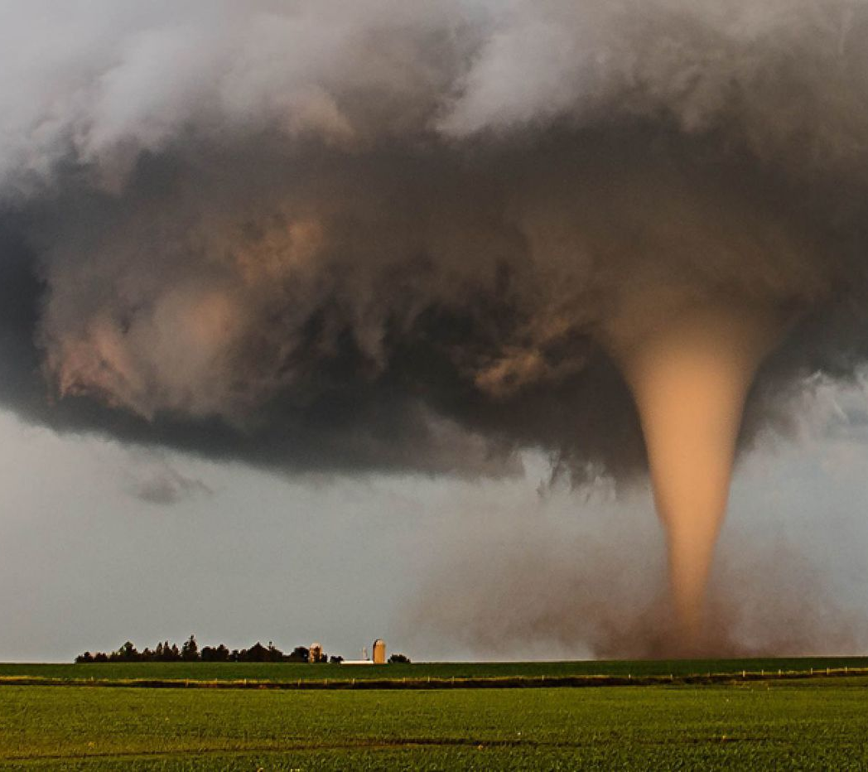
What do you do if
You are in a Tornado ?

Slide 17
Tornado
Go
Go To a Basement Or Storm Shelter
Get
Get To The Lowest Floor (13)
Stay In
Stay In A Room With No Windows
Use
Use A Mattress To Protect Yourself (16)

Slide 18
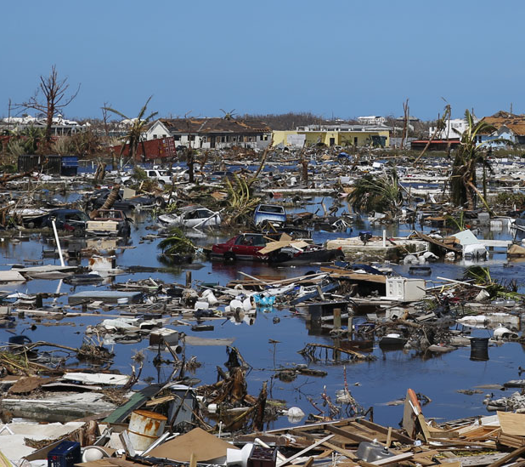
What do you do if
You are in a Hurricane ?

Slide 19
Hurricane
Put Up Shutters
Evacuate if Advised
Move to high ground
Look Out for Storm Surge
Have Non-perishable Food And Water
Fill Bathtub
Fill Cars with Fuel
Turn off Electriciy

Slide 20
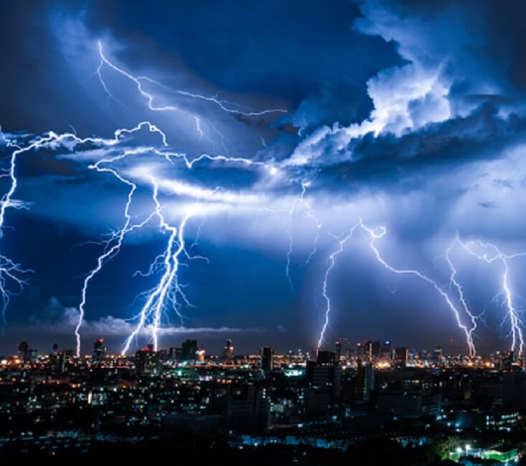
What do you do if
You are in a Thunderstorm ? (14)

Slide 22
Thunder Storm
2 Deaths In UK Each Year
30 Yearly Injuries
No Showers Or Baths
Do Not Use Landline Phone
Do Not Lie On The Ground
Get Inside A Building Or Car
Stay Away From Windows
Stay Away From Trees And Metal

Slide 23
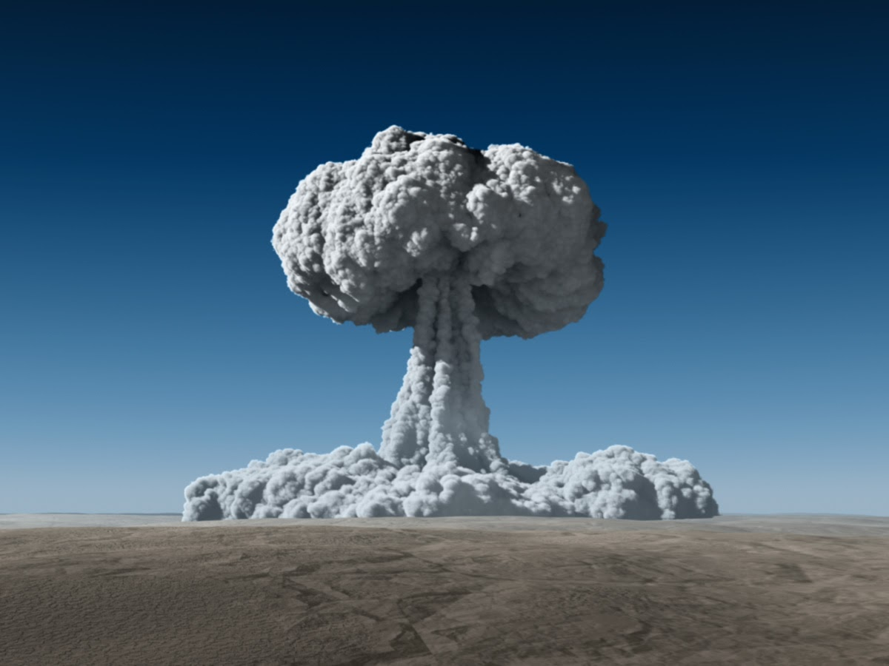
What do you do if
You are in AN Atomic Emergency ? (9)

Slide 24
Atomic Emergency
Evacuate If Possible
Get Underground If Possible
Potassium Iodide (KI) Tablets
Cover Nose, Mouth & Eyes with Cloth (18)

Slide 25
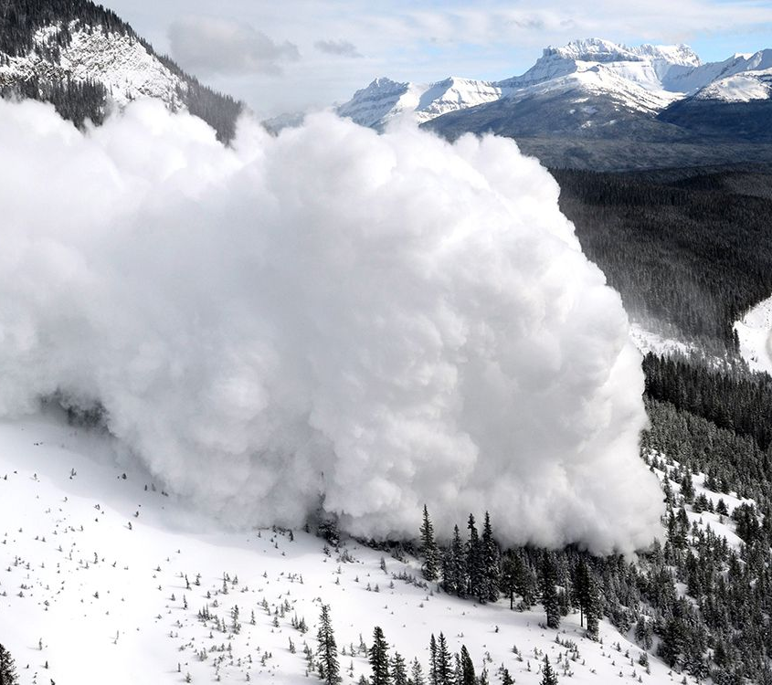
What do you do if
You are in AN Avalanche ?

Slide 26
Rock Or Snow Avalanche
Curl
1
Curl into Tight Ball
Face down
2
Face down Hill
Cover
3
Cover Head with Hands
Carry
4
Always Carry A Radio Beacon
Carry
5
Always carry a Shovel

Slide 27
What do you do if
Your boat or canoe capsizes in open water ?

Slide 29
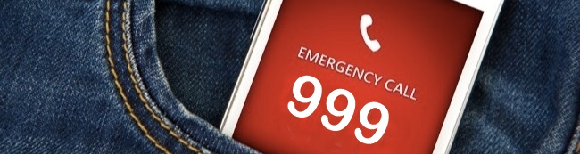
Telephone Call In An Emergency
What Info Should Be Given ?

Slide 30
Info To Give in An Emergency Call
Name
Number
Location Of Emergency (2)
Nature of Emergency
Dangers and Injuries
Do not Hang up the call till the Responder has hung up. (10)

Slide 31
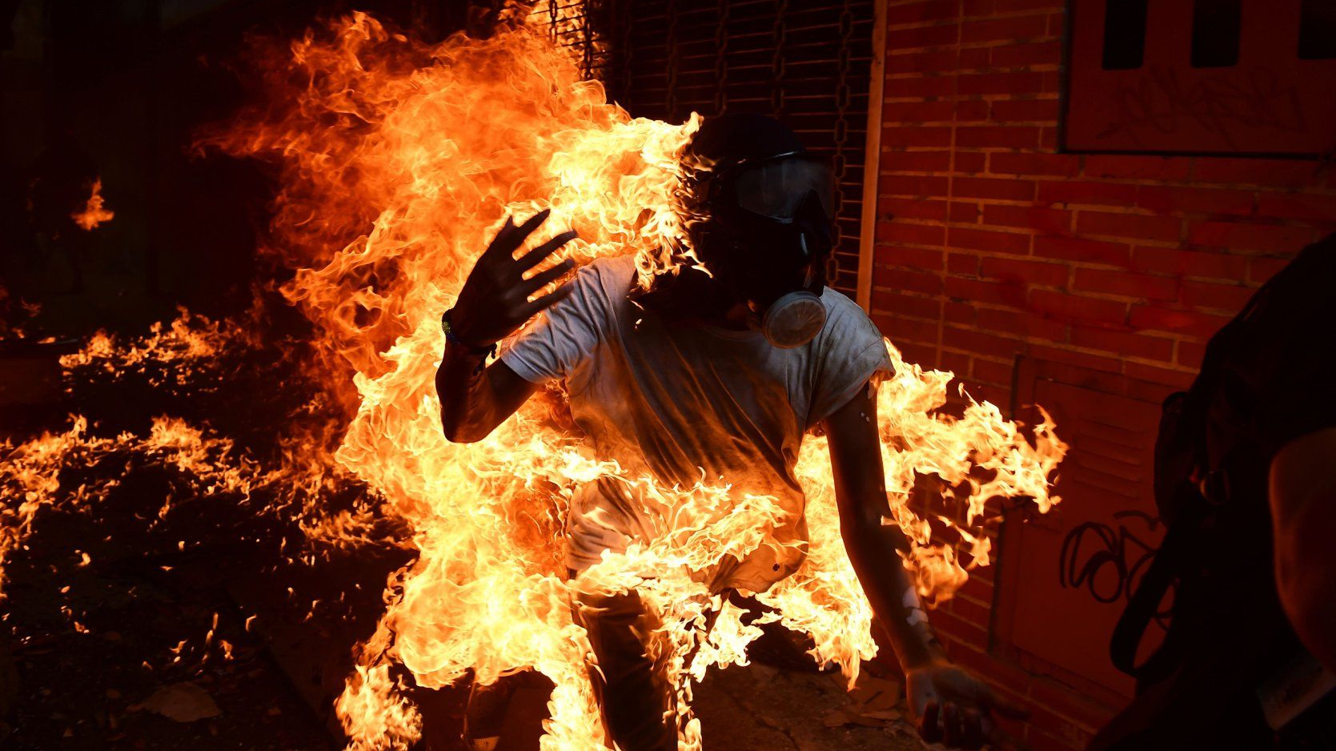
What First Aid DO you Need if
Someone’s clothes catch on fire ?

Slide 32
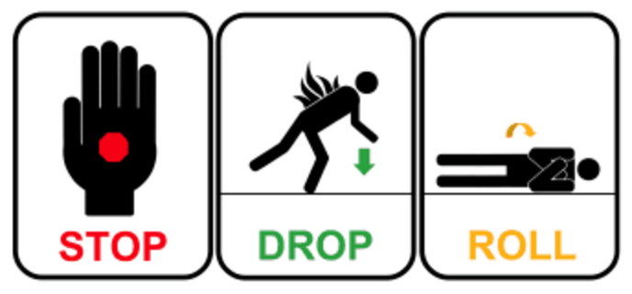

Slide 33
What First Aid DO you Need if
Someone’s got a severely bleeding wound ?

Slide 35
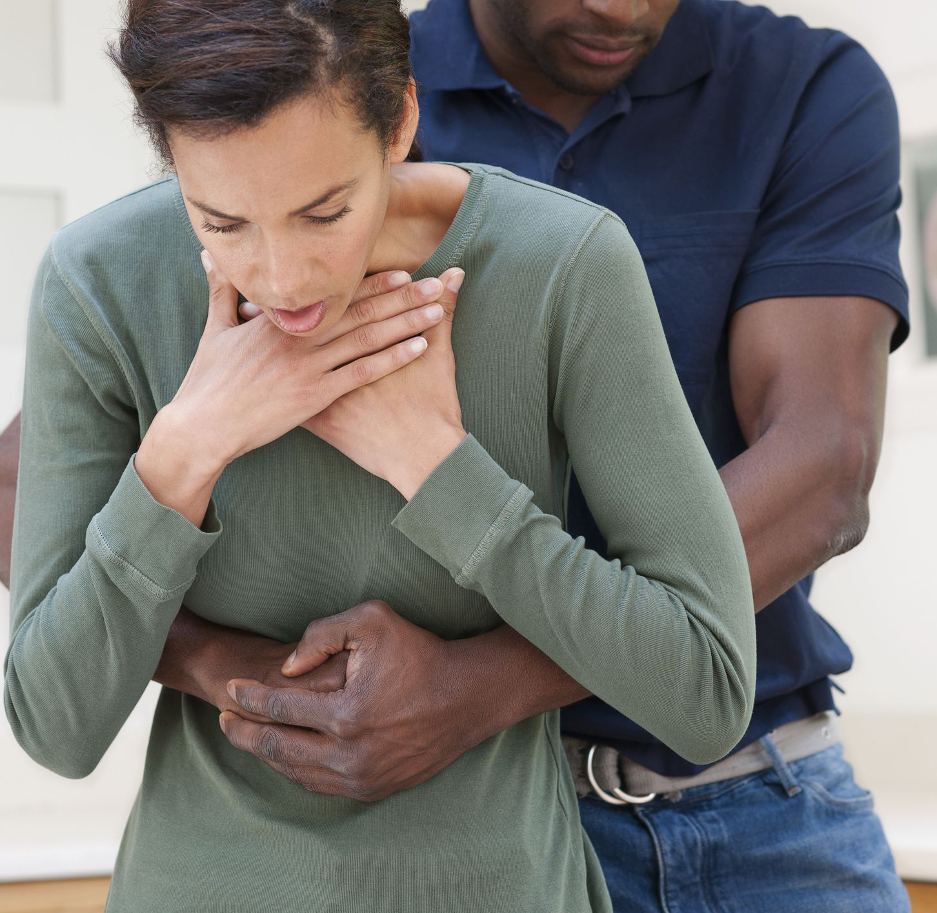
What First Aid DO you Need if
Someone is choking ?

Slide 37
What Else Can You Do if
Someone is choking ?

Slide 39
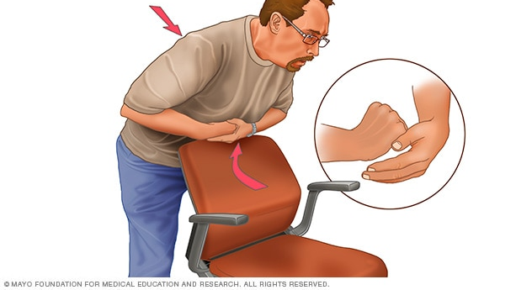
On Yourself
Make a Fist And Place above navel (19)
Grab Fist with other hand
Bend Over Hard Surface
Shove Fist Inward and Upward

Slide 40
What First Aid DO you Need if
Someone Swallows Poison ?

Slide 42
Homework
Question 4 a: Draw an escape route for your family in case of fire in your home when your normal exits are blocked (4)
Question 4 B: Practice with your family a home fire drill

Slide 44
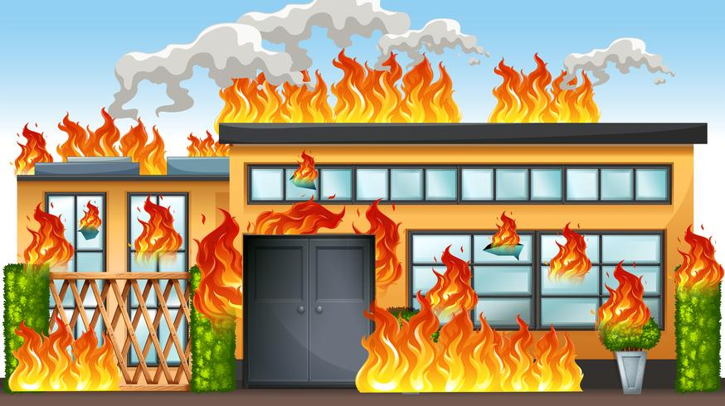
How to Get People out a Burning Building

Slide 45
Have an Evacuation Plan In Place (12)
Practise The Plan – Fire Drill (8)
Remain Calm – Think I Know What To Do
Touch Those Panicking ON Shoulder
Tell Them What To Do – Shout If No Response
Get People Calmly Walking Out The Building
Beware Of The Danger Of A Stampede (15)

Slide 46
Abduction Prevention
Parents Should Always know where Kids Are (1)
Never Leave Children Alone In Cars
Create a Family Code Word (3)
Have Kids FingerPrints Taken
Keep Current Photos Of Kids
Keep A Mental Note Of What Your Kids Are Wearing (20)
GPS APPS Can Be Useful
SCream Fire!!!!!! If Someone Try’s To Abduct you

