Slide 1
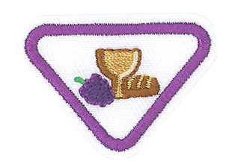
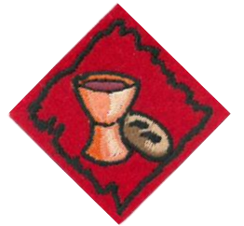
Jesus’ Special Supper Award
Communion Service Award

Slide 2
1. Tell the story of the Last Supper.
2. Explain why Jesus washed the disciples’ feet as a servant.
3. Explain what the bread and the juice represents.
4. What happened at the end of the special supper?
5. Have a prayer thanking Jesus for HIS love.
6. Make a craft to illustrate the Last Supper.

Slide 3
1. What was the Passover service about?
2. What is the Communion service about?
3. Why did Jesus have this special service with his disciples?
4. Why do we still take communion today?
5. What does the washing of the feet mean?
6. What does the bread symbolize?
7. What does the grape juice symbolize?
8. How is the service meaningful to me today and how does it help me be able to serve others?

Slide 4
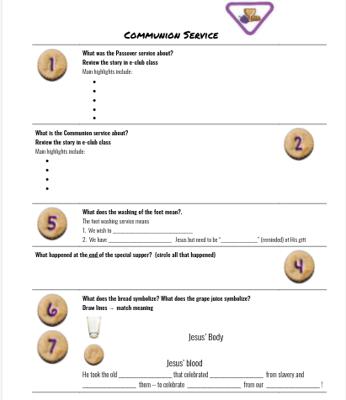
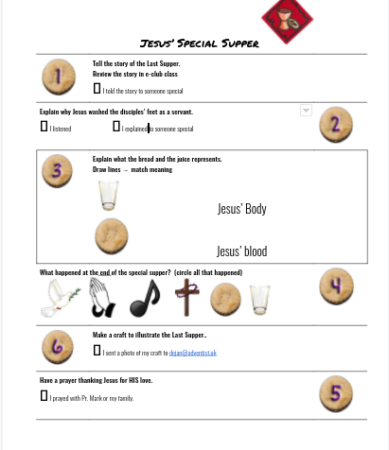
Worksheets
Instructions
The patch is for YOUR award
The number means the requirement #
“NA” means it isn’t on your worksheet!
“EC” mean “extra credit”
#1
#1

Slide 5
Name the Symbol
& What it ADVERTISES!

Slide 6
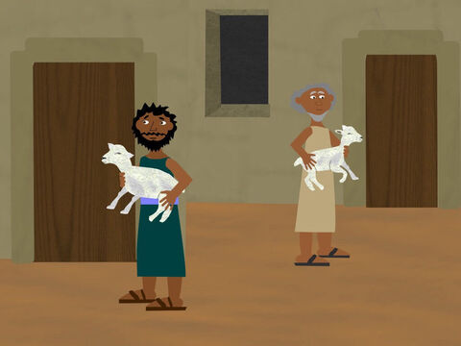
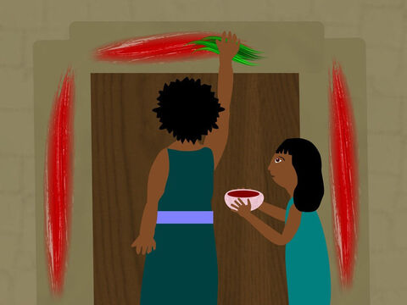
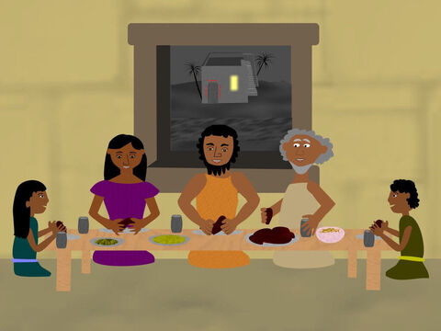
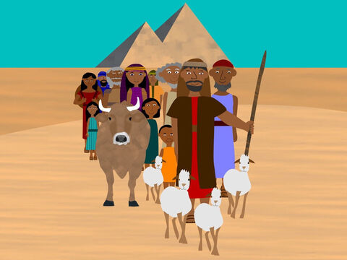
Remember?
#1
#1

Slide 7
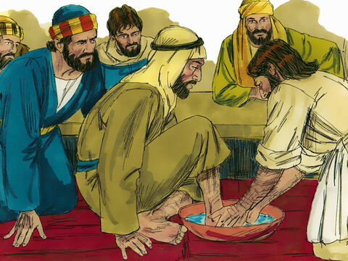
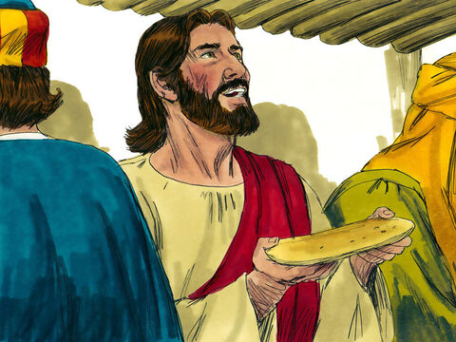
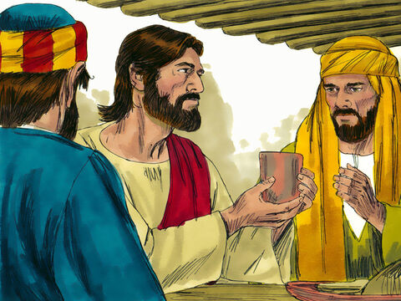
Remember?
#1
#2

Slide 8
Theme!
OUR FREEDOM!
#1
#1-2

Slide 9
Footwashing ~ John 13
#2
#5

Slide 10
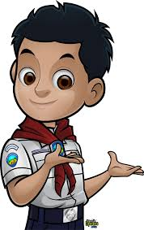
Footwashing
#2
#5
Do you think the disciples had stinky feet?
What ITEMS are in a footwashing?
WHEN/WHERE/WHY do people do footwashing?
Basin & towel
Before Communion
Many places
To serve
We should wash others’ feet

Slide 11
Explain why Jesus washed the disciples’ feet as a servant. / What does the washing of the feet mean? (John 13:6-9, 12-15 NLT)
6 When Jesus came to Simon Peter, Peter said to him, “Lord, are you going to wash my feet?”
7 Jesus replied, “You don’t understand now what I am doing, but someday you will.”
8 “No,” Peter protested, “you will never ever wash my feet!”
Jesus replied, “Unless I wash you, you won’t belong to me.”
#2
#5

Slide 12
Explain why Jesus washed the disciples’ feet as a servant. / What does the washing of the feet mean? (John 13:6-9, 12-15 NLT)
9 Simon Peter exclaimed, “Then wash my hands and head as well, Lord, not just my feet!”
10 Jesus replied, “A person who has bathed all over does not need to wash, except for the feet, to be entirely clean.
#2
#5

Slide 13
Explain why Jesus washed the disciples’ feet as a servant. / What does the washing of the feet mean? (John 13:12-15 NLT)
12 After washing their feet, he put on his robe again and sat down and asked, “Do you understand what I was doing? 13 You call me ‘Teacher’ and ‘Lord,’ and you are right, because that’s what I am. 14 And since I, your Lord and Teacher, have washed your feet, you ought to wash each other’s feet. 15 I have given you an example to follow. Do as I have done to you.
Jesus wanted to be our example! No one is “too important” to take care of other people’s needs
The foot washing service means 1. We wish to serve
2. We have accepted Jesus but need to be “recleaned” (reminded) of His gift
#2
#5

Slide 14
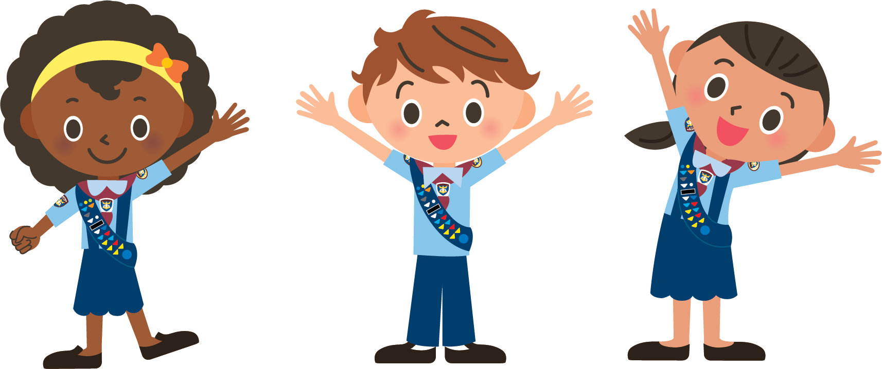
Ever been surprised on your birthday?
SURPRISE!
Passover → Communion/Lord’s Supper

Slide 15
The Bread & Grape Juice

Slide 16
The Bread & Juice
#3
#6-7
Did you know the original Communion came AFTER Potluck?
Matthew 26:17–29; Mark 14:12–25; Luke 22:7–38; and I Corinthians 11:23–25

Slide 17
Explain what the bread and the juice represent/symbolize. 1 Corinthians 11 NLT
23 For I pass on to you what I received from the Lord himself. On the night when he was betrayed, the Lord Jesus took some bread 24 and gave thanks to God for it. Then he broke it in pieces and said, “This is my body, which is given for you. Do this in remembrance of me.”
#3
#6-7

Slide 18
Explain what the bread and the juice represent/symbolize.
1 Corinthians 11 NLT
25 In the same way, he took the cup of wine after supper, saying, “This cup is the new covenant between God and his people—an agreement confirmed with my blood. Do this in remembrance of me as often as you drink it.” 26 For every time you eat this bread and drink this cup, you are announcing the Lord’s death until he comes again.
#3
#6-7

Slide 19
Explain what the bread and the juice represent/symbolize.
1 Corinthians 11 NLT
25 In the same way, he took the cup of wine after supper, saying, “This cup is the new covenant between God and his people—an agreement confirmed with my blood. Do this in remembrance of me as often as you drink it.” 26 For every time you eat this bread and drink this cup, you are announcing the Lord’s death until he comes again.
Bread = His Body
Grape Juice = His blood
He took the old symbols that celebrated freedom from slavery and REUSED them -- to celebrate freedom from our sins!
#3
#6-7

Slide 20
Why do we still take communion today?
25 In the same way, he took the cup of wine after supper, saying, “This cup is the new covenant between God and his people—an agreement confirmed with my blood. Do this in remembrance of me as often as you drink it.” 26 For every time you eat this bread and drink this cup, you are announcing the Lord’s death until he comes again.
To tell people about Jesus’ death & resurrection
#NA
#4

Slide 21
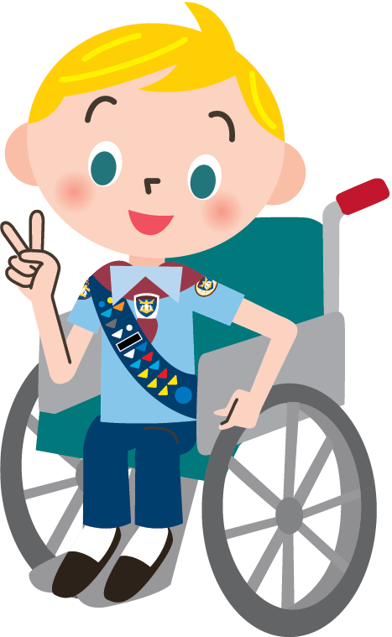
Did you ever wonder...
Why the Pastor broke up some of the communion bread but the rest was already all tiny?
Why the communion bread was SO SMALL?
Why they didn’t find a better communion bread recipe?

Slide 22
Did you ever wonder...
How they didn’t spill the juice putting it in those tiny cups?
Why there wasn’t just a little more...mom still looked thirsty!
Who gets all the leftovers?

Slide 23
What happened next?
#4
#NA

Slide 24
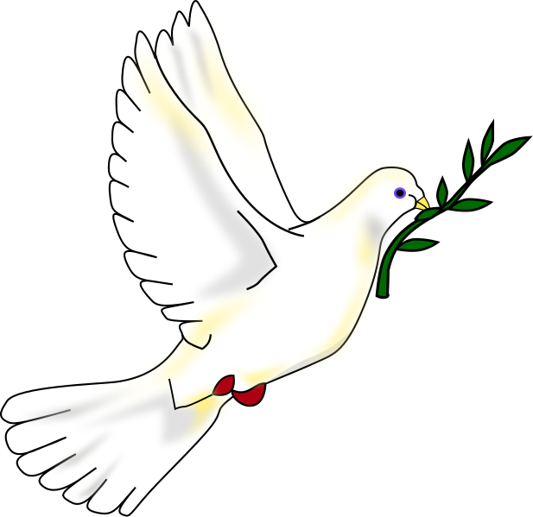
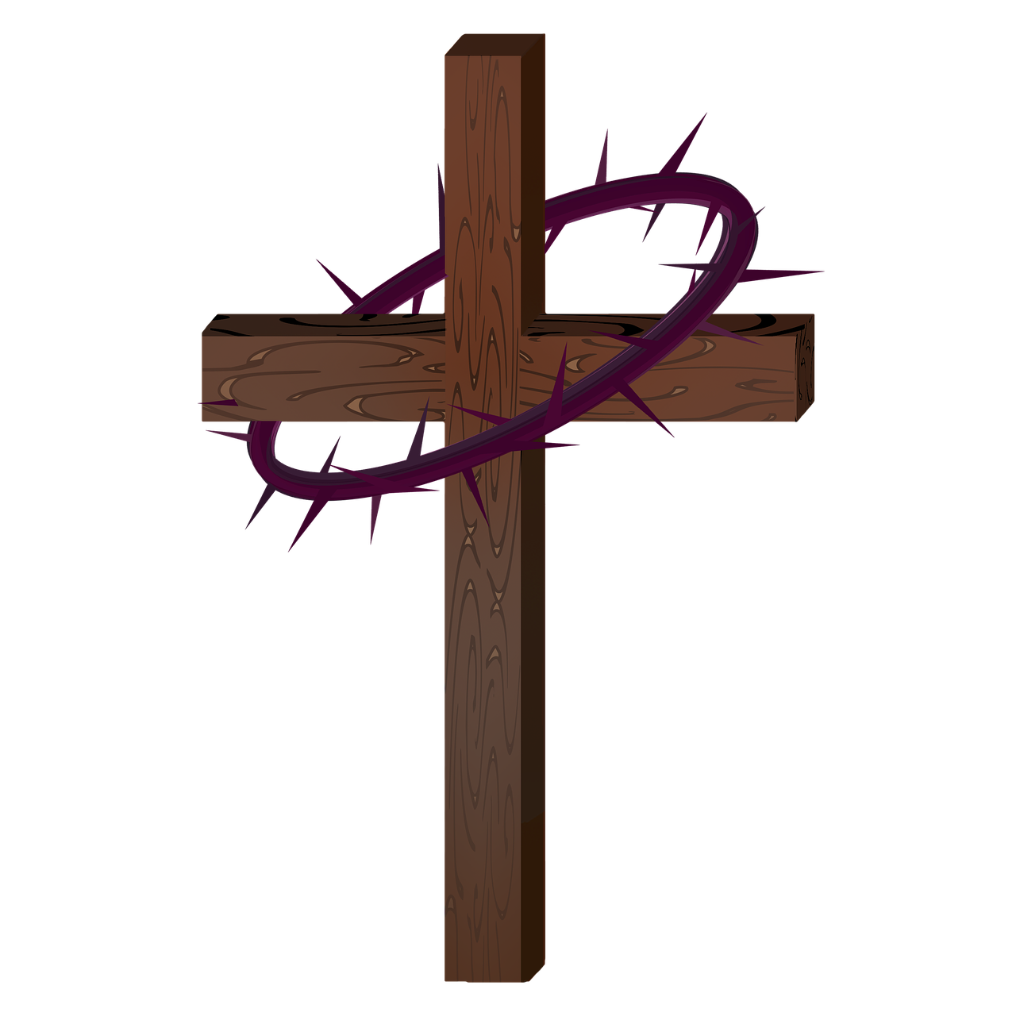
What happened at the end of the special supper?
Promises
Prayer
Songs
Jesus’ death and resurrection
#4
#NA

Slide 25
Make a craft
#6
#EC

Slide 26
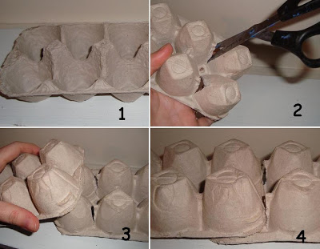
Have two egg Cartons
Cut the “high Point” on one of the egg cartons (last two).
Slide the other Egg carton over
Now you’re ready!
#6
#EC

Slide 27
Photo parts and final product
#6
#EC

Slide 28
Photo parts and final product
#6
#EC

Slide 29
Evaluate
#NA
#3, 8

Slide 30
When I think of communion...
What SOUNDS do I like the best?
The songs we sing
The words of the pastor
The water sounds of footwashing
The crunch of the bread

Slide 31
When I think of communion...
What SMELLS do I like the best?
Feet ;)
Bread & juice
Potluck afterwards

Slide 32
What do I think is the most meaningful part of the service?
The songs
The prayers
The Bible words

Slide 33
Why do YOU think Jesus had this special service with his disciples?
For the memories
To train them
To help them know how to lead others

Slide 34
How does Communion help me serve others?
Watching the leaders serve us the bread and juice
Attitude man!
Wanna be like Jesus

Slide 35
Memory Game!
Remember the ORDER of Bible Story events!

Slide 36
Which happened first?
Passover
Communion
A- Passover

Slide 37
Which happened first?
Lamb slain or
Jesus gives the grape juice?
A- Lamb slain!

Slide 38
Which happened first?
Jesus broke the bread
Jesus washed the disciples’ feet
B- Jesus washed feet!

Slide 39
Which happened first?
Songs and prayer as they left the upper room
Jesus talked about grape juice = His blood
B- Jesus talked about grape juice

Slide 40
Which happened first?
The blood on the doorposts
Jesus’ death on the cross
A- The blood on the doorposts

Slide 41
Which happened first?
Freedom from our sins because of Jesus’ blood
Freedom from slavery because of the lambs’ blood
B- Freedom from slavery

Slide 42
Homework:
Retell the story of the Last Supper.
Explain how the service is meaningful to kids today
Find ways it can help me learn how to serve others.
#1
#8

Slide 43
Prayer thanking Jesus for HIS love.
#5
#NA

Slide 44
Thank you!

Slide 46
Free templates for all your presentation needs
For PowerPoint and Google Slides
100% free for personal or commercial use
Ready to use, professional and customizable
Blow your audience away with attractive visuals

