Slide 1

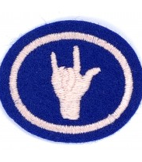
Sign Language Pathfinder Honour
British Sign

Slide 2
Requirements
Learn
Learn the manual alphabet used by the deaf.
Have
Have a minimum of three hours of instruction in signing.
Send and receive
Send and receive finger spelling at the rate of five words per minute, using a minimum of 25 letters.
Learn
Learn at least 100 signs from one or more reference books on signing.
Learn and present in
Learn and present in sign language (not finger spelling) at least two simple songs.
Do
Do one of the following:
Explain
Explain the difference between Ameslan and signed English and demonstrate the use of both.
Read and give
Read and give an oral or written report on a school in your country or state specializing in deaf education.

Slide 3
Signed English
Ameslan
Ameslan, stands for "American Sign Language," is an old term used in the 1960s
In Signed English every word of a spoken sentence is signed. It uses English language grammar and not the grammar of deaf sign languages.
The order of the signs match spoken word order.
Vs
https://youtu.be/pTbgFXZ0kbI

Slide 4
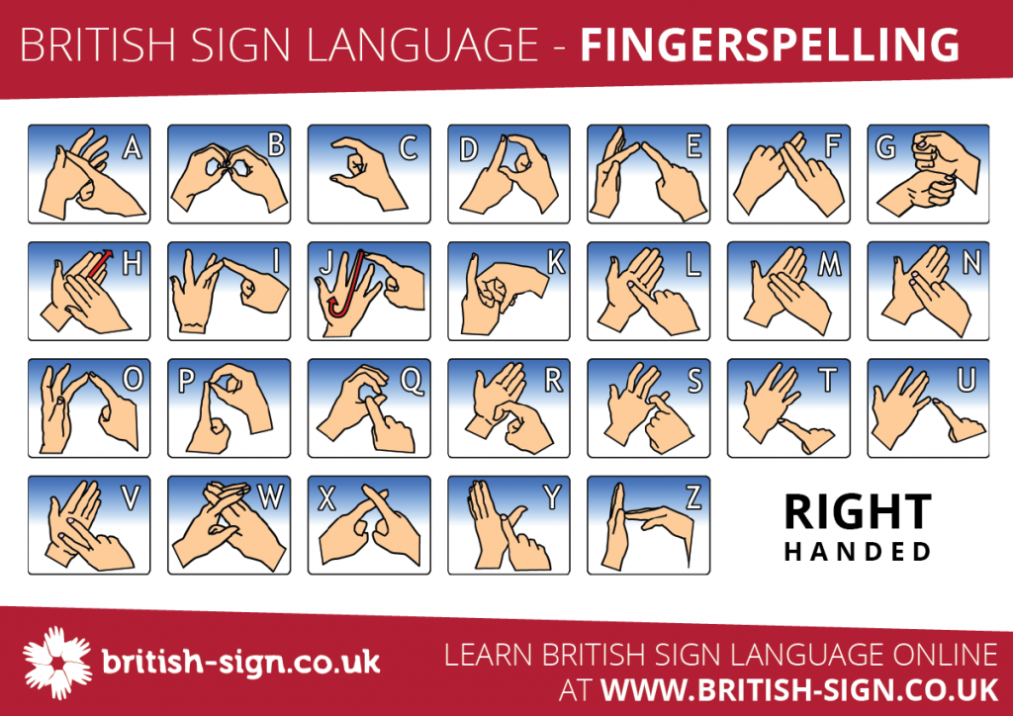

Slide 5
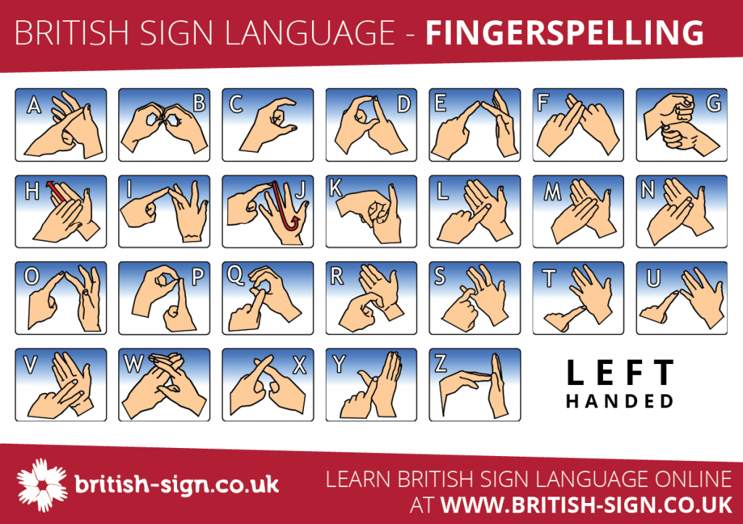

Slide 6
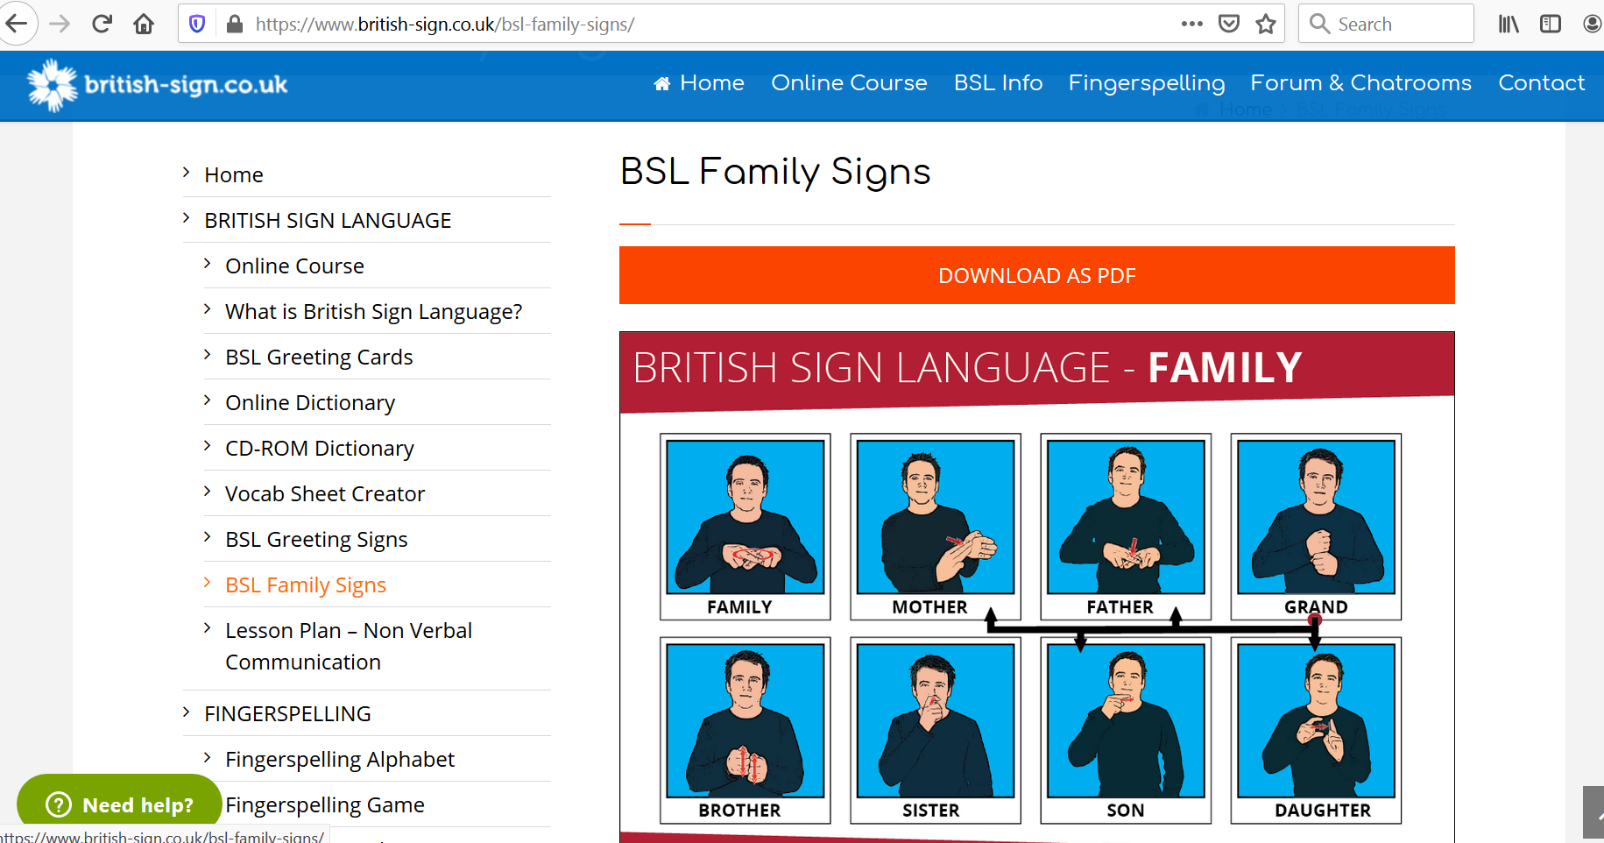
100 signs
Dictionary - https://www.signbsl.com/
https://www.signlanguageforum.com/bsl/fingerspelling/fingerspelling-game/

Slide 7
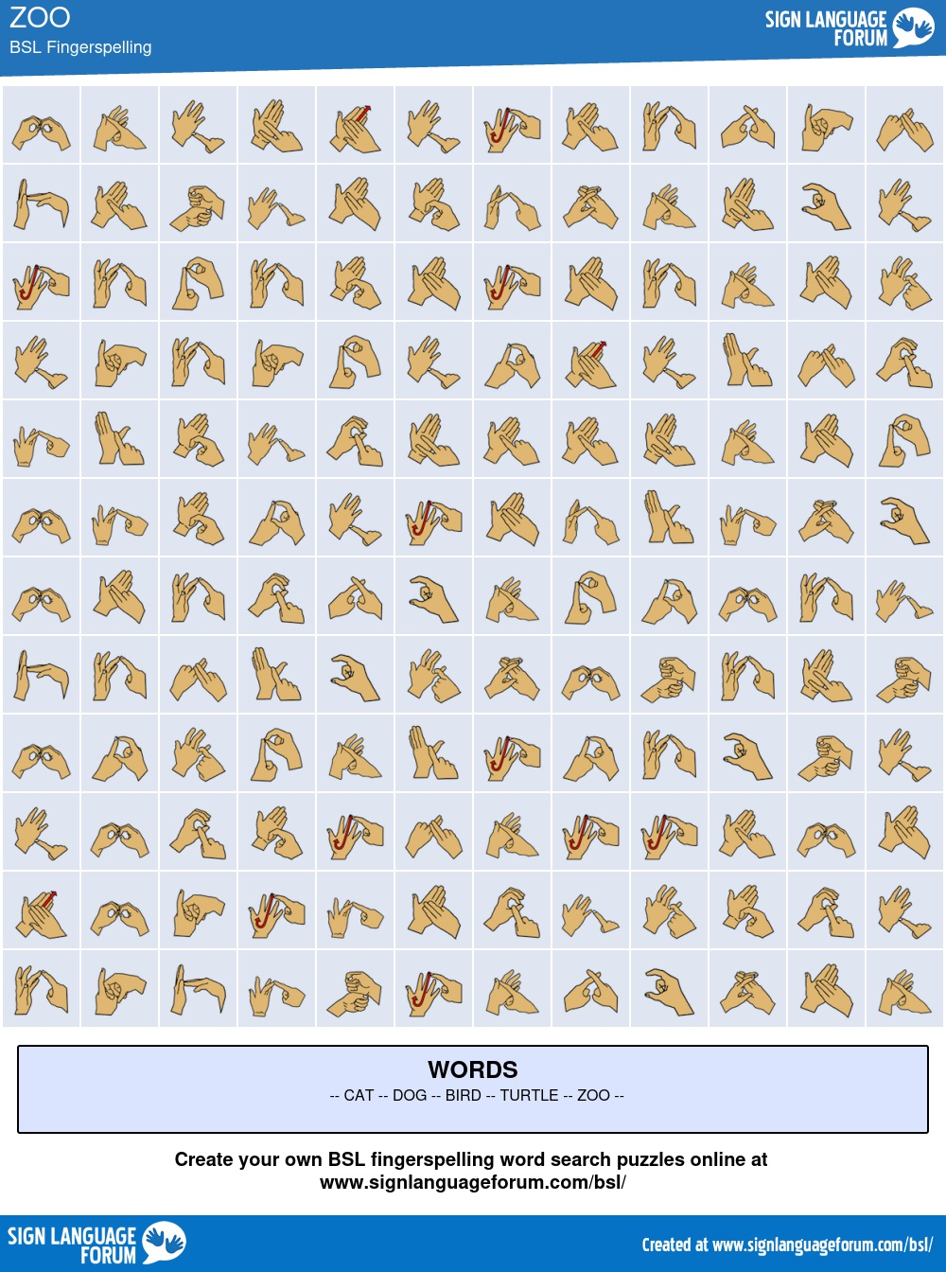

Slide 8
BSL Songs on YouTube
Rainbow Colours Song

Slide 9
INSPIRING - https://www.youtube.com/watch?v=2Euof4PnjDk
https://www.bslzone.co.uk/

Slide 10

Requirements
Send and receive finger spelling at the rate of five words per minute, using a minimum of 25 letters.
Learn at least 100 signs from online dictionary
Learn and present in sign language (not finger spelling) one more song.
Read and give an oral or written report on a school in your country or state specializing in deaf education.
This Photo by Unknown Author is licensed under CC BY-SA

