Slide 1

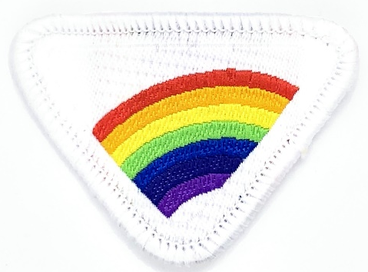
RAINBOW PROMISE e-AWARD
By: Louise McQueen

Slide 2
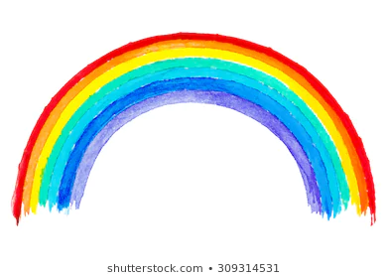
WHAT IS A RAINBOW?

Slide 3
WHAT IS THE RAINBOW HONOUR?
1. Show the two elements that make a rainbow.
2. Find who saw their very first rainbow in Gen. 9:8-17.
3. What is a covenant?
4. What does the rainbow promise us?
5. What colors make up the rainbow? Create your own rainbow with the colors in their right order.
6. Where will we find a rainbow in heaven?

Slide 4
Who was the very first person to see a rainbow?
Can you tell me?

Slide 5
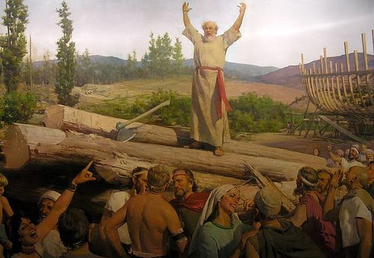
GENESIS 9:8-17

Slide 6
God gave people on earth time to say sorry (repent) with specific warnings
These are called signs
Noah Preached for 120 years
The message was to repent – say sorry
The ark was built far from the sea
The animals went inside in an orderly fashion (two by two)

Slide 7
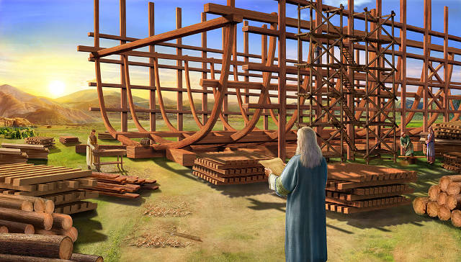
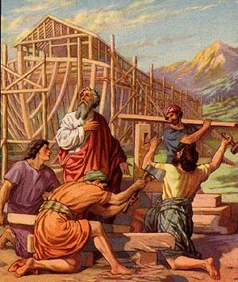
Noah was instructed by God to build an ARK

Slide 8
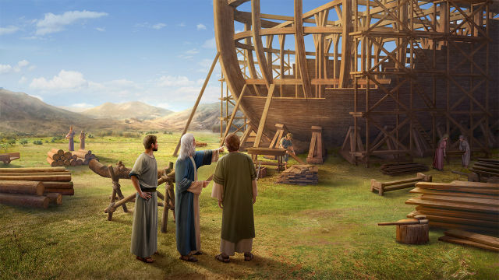
God gave Noah specific instructions

Slide 9
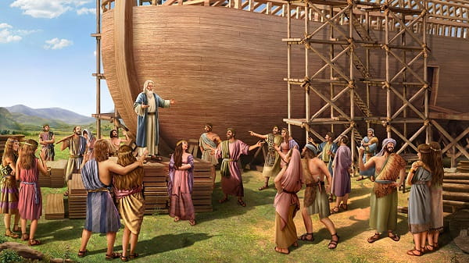
The people helped him build but they mocked him and laughed at him.

Slide 10
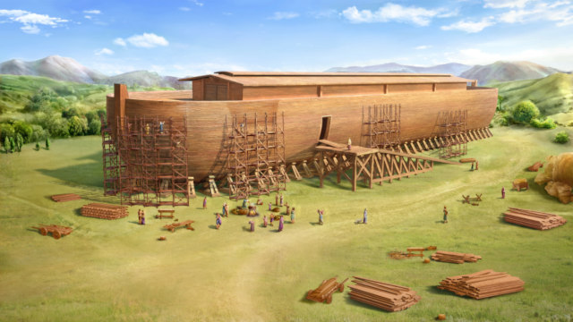
The final product was absolutely beautiful

Slide 11
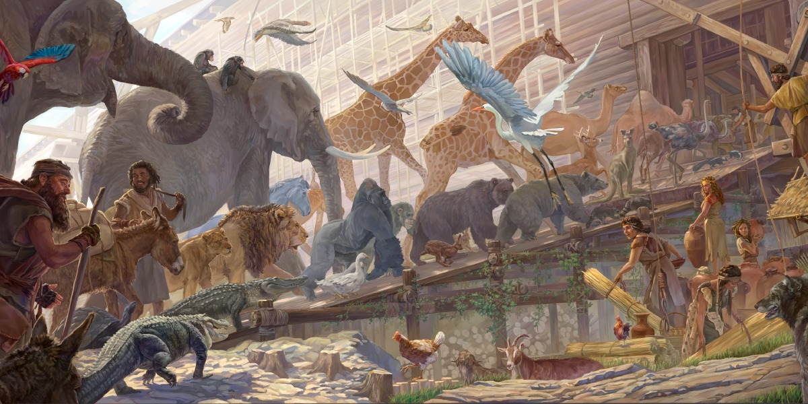
God’s last warning sign to the people was the animals entering the ark

Slide 12
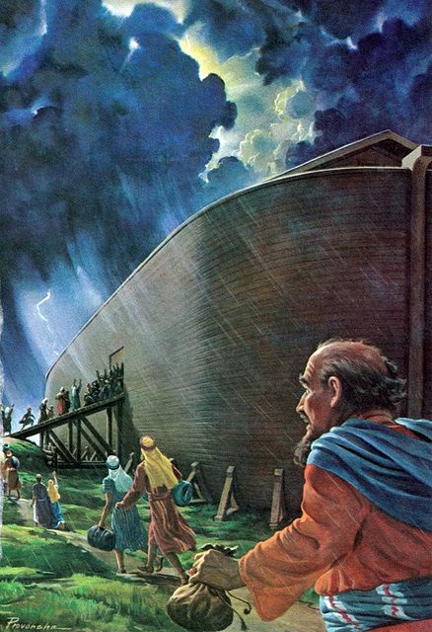
GOD SHUT THE DOOR

Slide 13
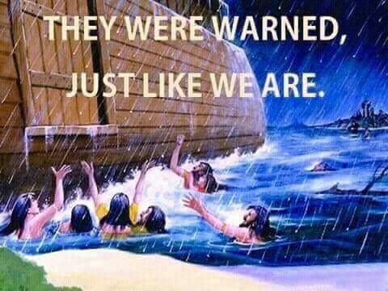

Slide 14
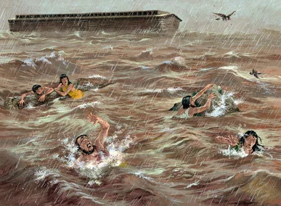
TOO LATE

Slide 15
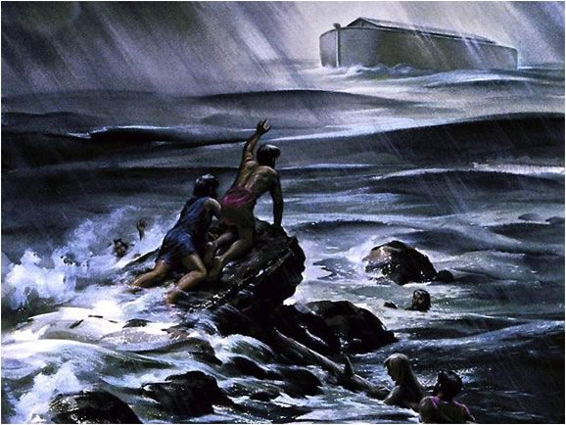

Slide 16
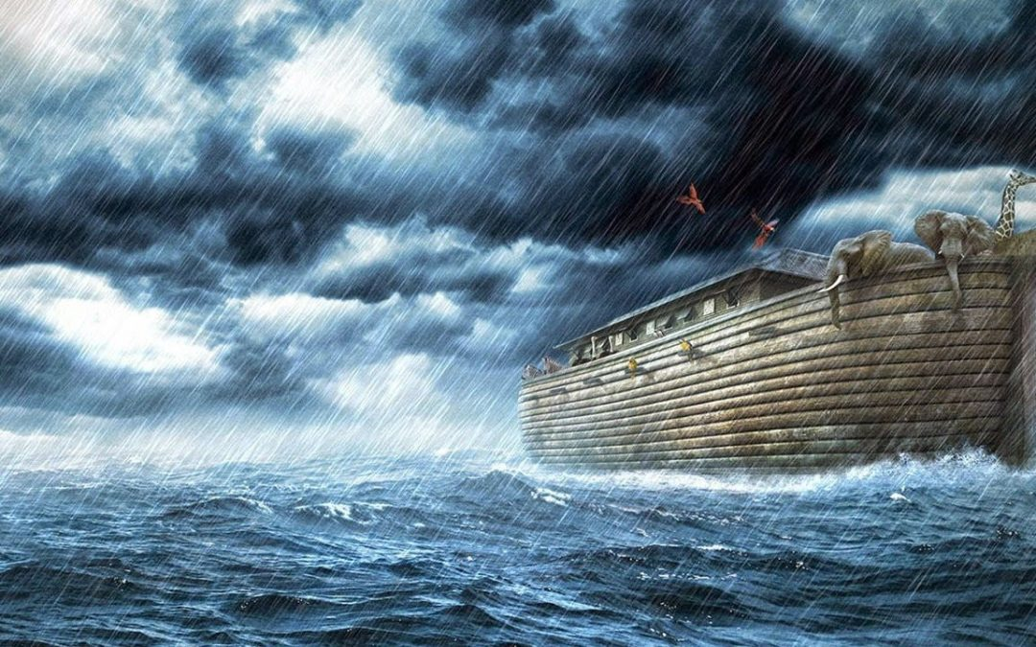
The ark floated on the water

Slide 17
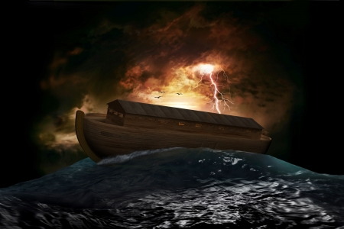
God kept everyone inside safe from the storms and flood

Slide 18
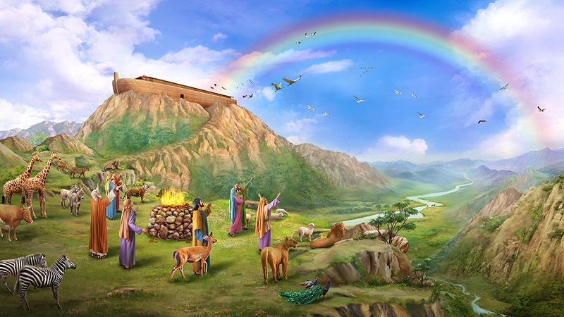
GOD’S PROMISE TO MAN

Slide 19
What are the TWO elements that make a rainbow?
💦 +💡 = 🌈

Slide 20
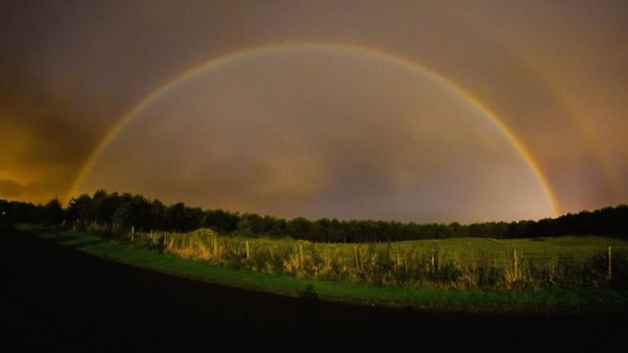
What are the two elements that make a rainbow?
Water and Light
To make a rainbow, you need two items:
1) rain or another source of water drops
2) a strong light source
Most rainbows we see are caused by sunlight, but the moon when it is bright can also produce bows, called moonbows.

Slide 21
WHAT IS A COVENANT?
Does anyone know what this word means?

Slide 22
WHAT IS A COVENANT?
covenant.
A covenant is literally, a contract.
An agreement or a promise.
In the Bible it means an agreement between God and his people, in which God makes promises to his people and, usually, requires certain conduct from them.
In the Old Testament, God made agreements with Noah, Abraham, and Moses.

Slide 23
WHAT DOES THE RAINBOW PROMISE US?
Do you know?

Slide 24
WHAT DOES THE RAINBOW PROMISE US?
God put the rainbow in the sky as the sign of His promise that He would never again destroy the earth with flood.
(Genesis 9:13–17)

Slide 25
WHAT COLOURS MAKE UP THE RAINBOW?
There are seven colors in the rainbow:
RED
ORANGE
YELLOW
GREEN
BLUE
INDIGO
VIOLET
Roy G. Biv.

Slide 26
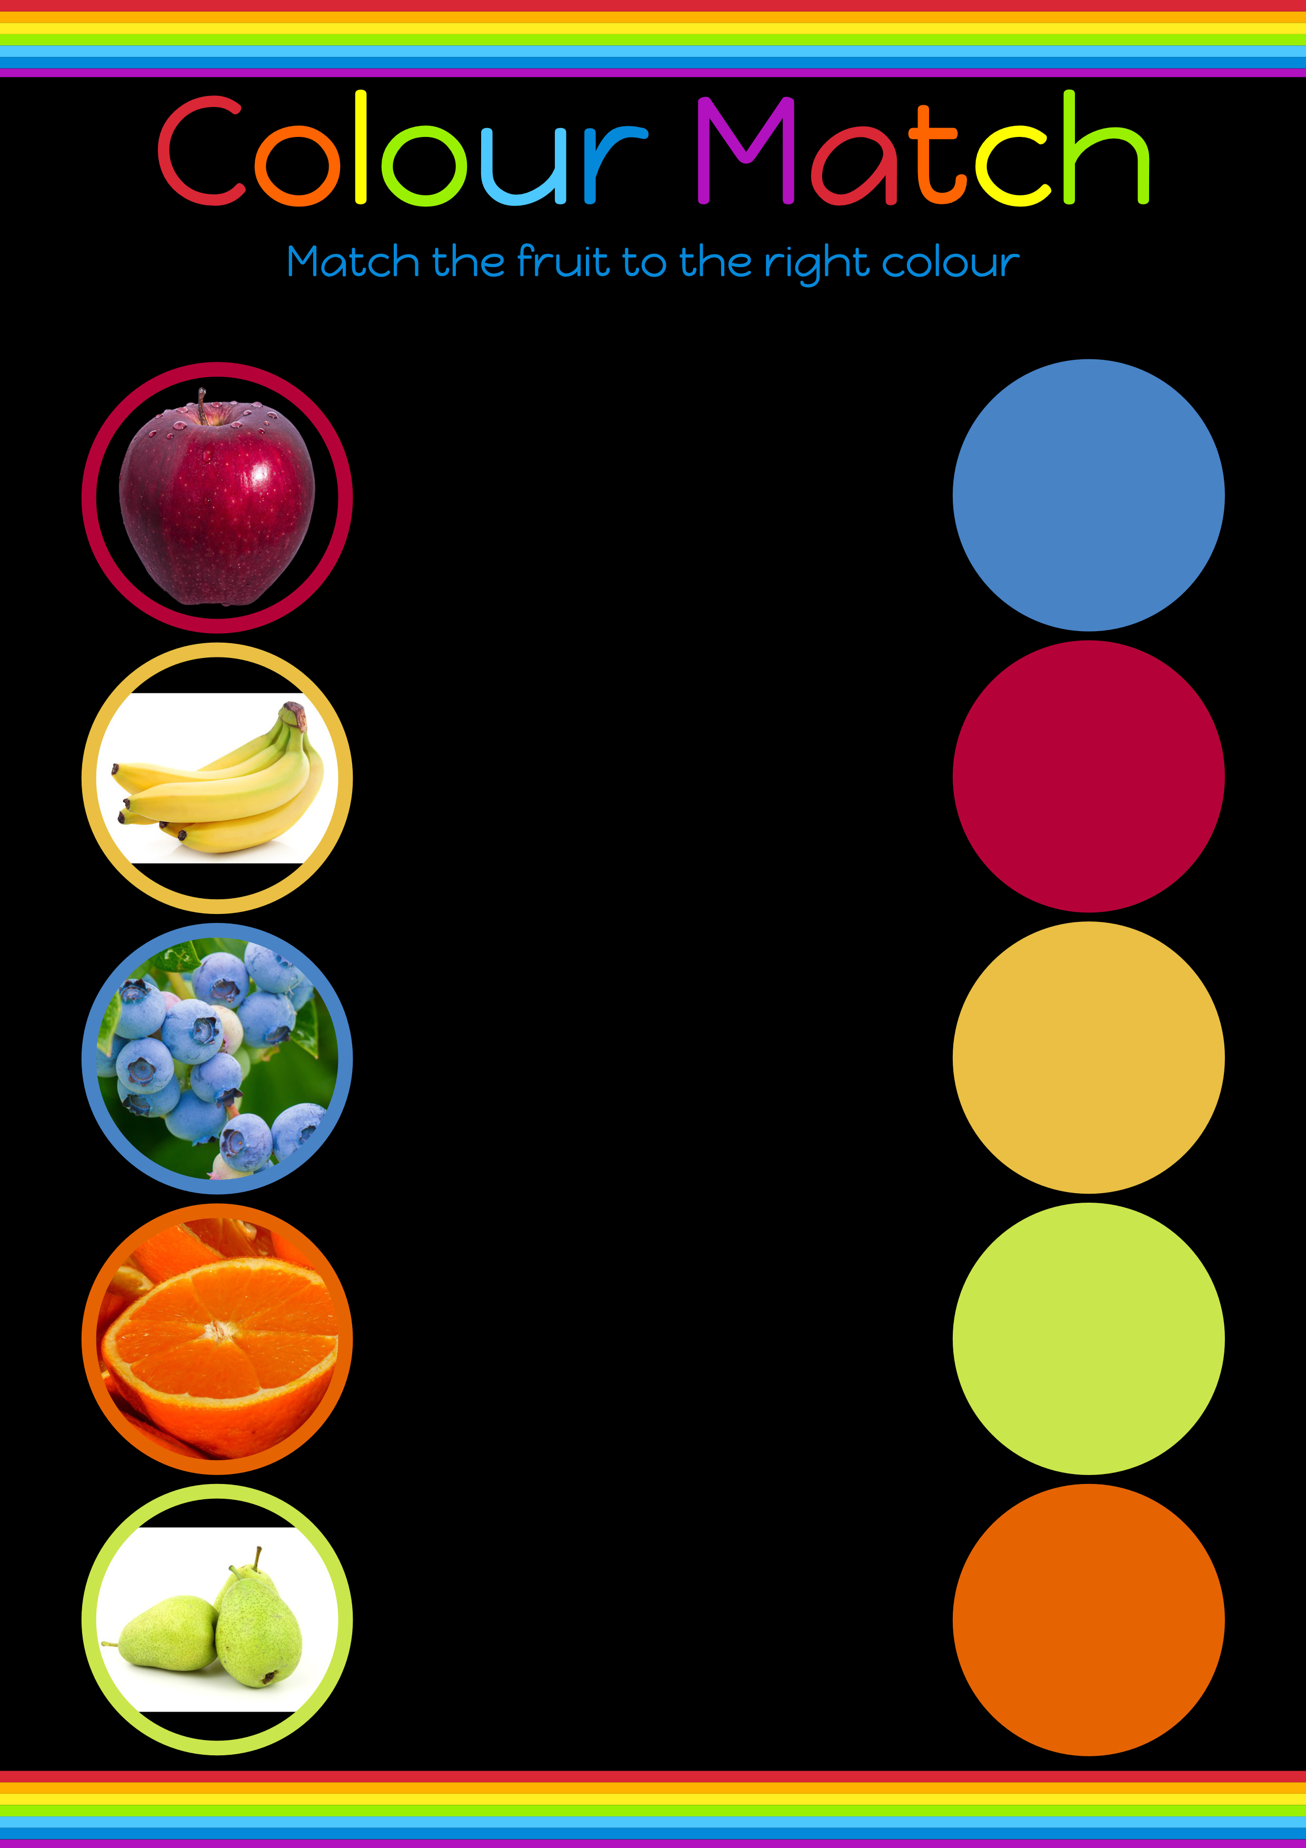

Slide 27
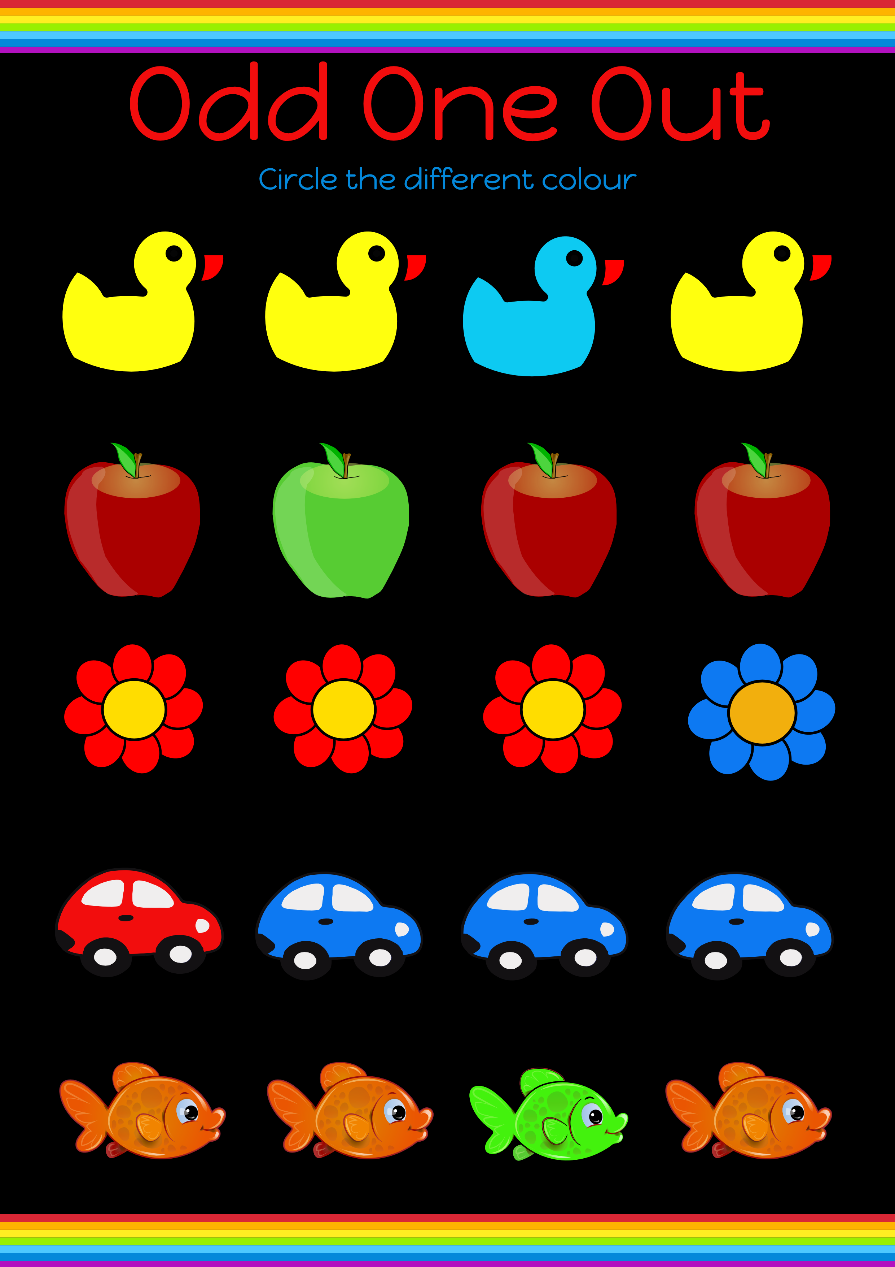

Slide 28
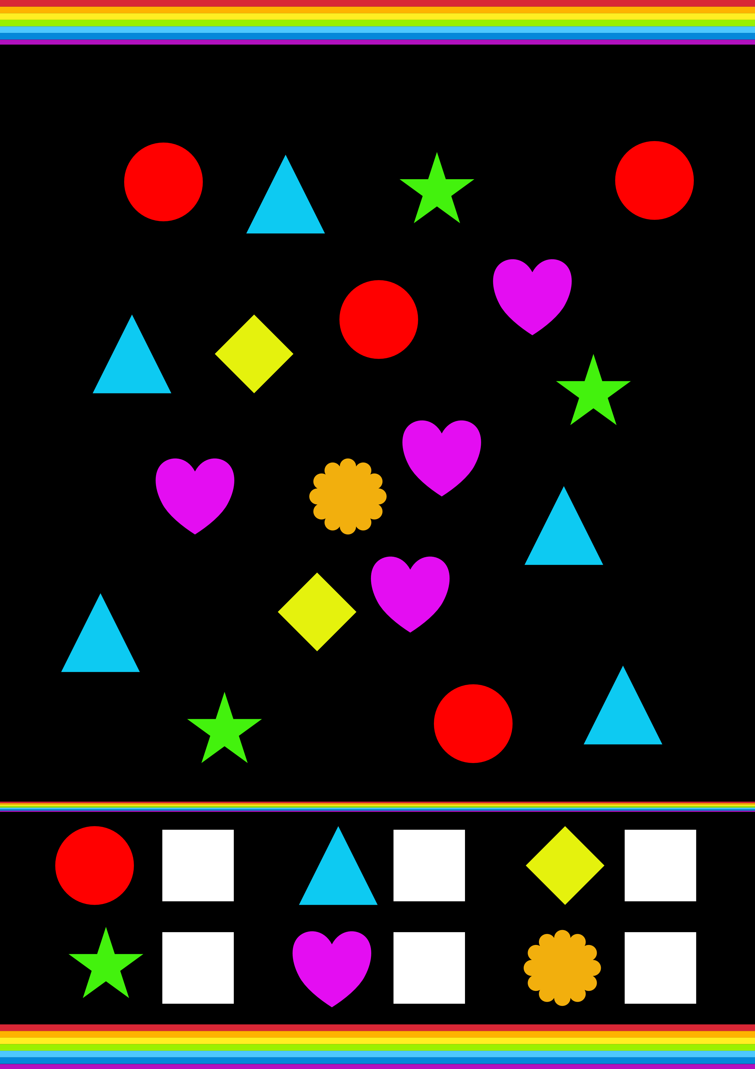
Count the coloured shapes

Slide 29
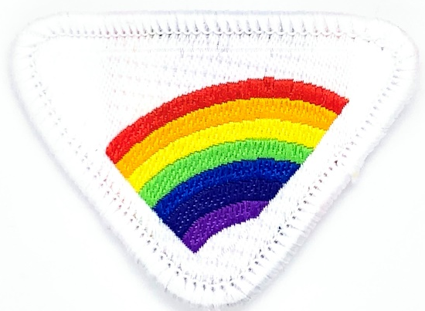
WHERE WILL WE FIND A RAINBOW IN HEAVEN?
There is a rainbow around the throne of God (Revelation 4:3).

Slide 30
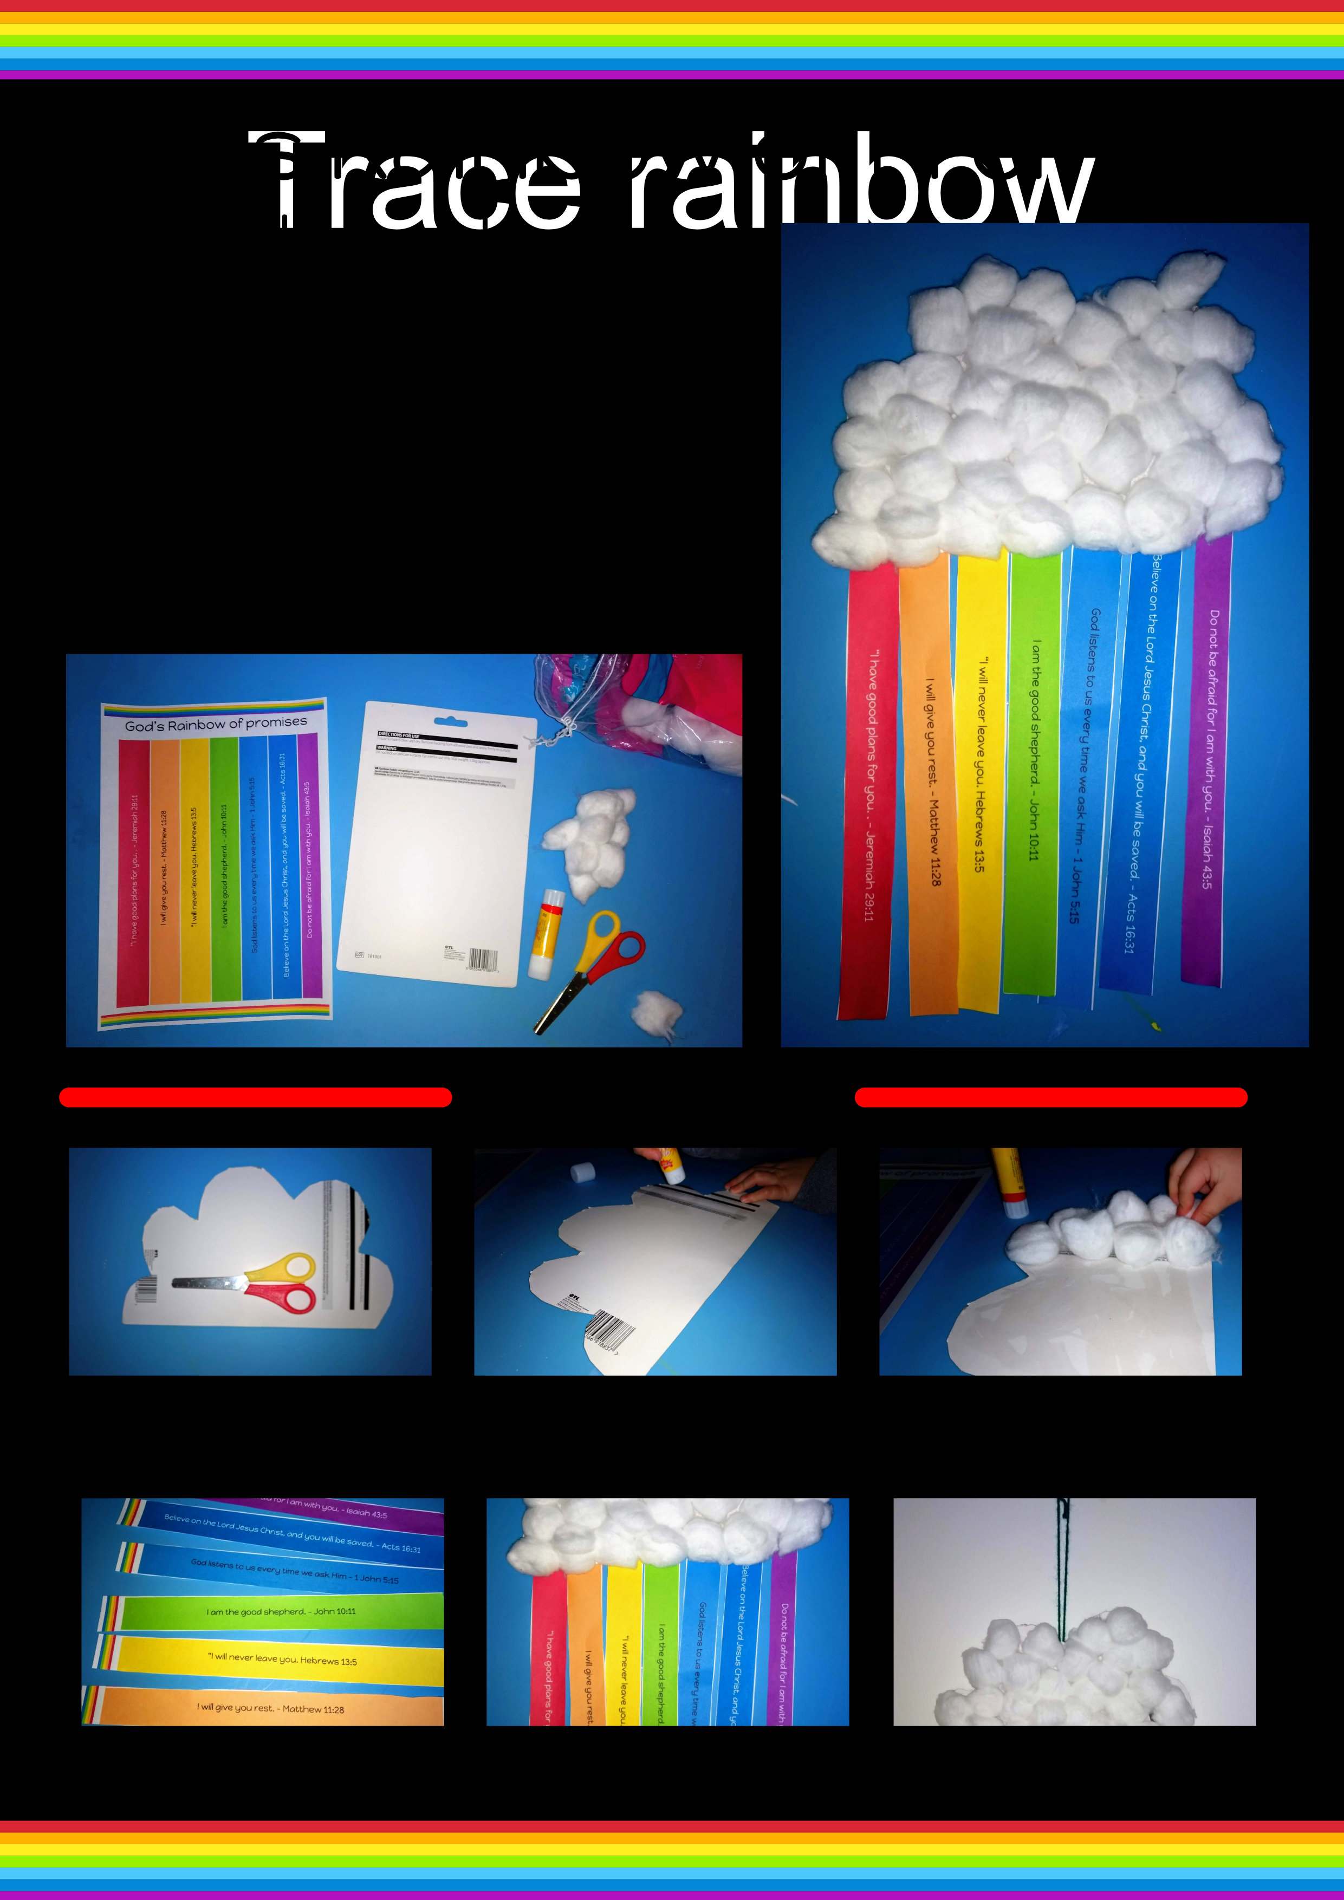
God’s Rainbow of Promises
Here’s an activity you can try at home. We’ll put all the resources on the website so you can do it when your parents can help you.
You’ll need:
Promise template page
Some cardboard
Cotton wool or tissue paper
Glue
Scissors
Colour printer or colouring pencils

Slide 31


Download a copy of this video, the powerpoint presentation, the worksheet and other resources from: https://youth.adventistchurch.org.uk/e-club-rainbow-award

