Slide 1
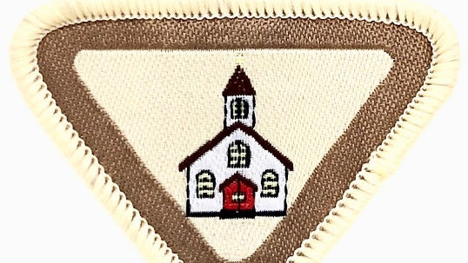
My Church
Adventurer Award
18th April 2020

Slide 2
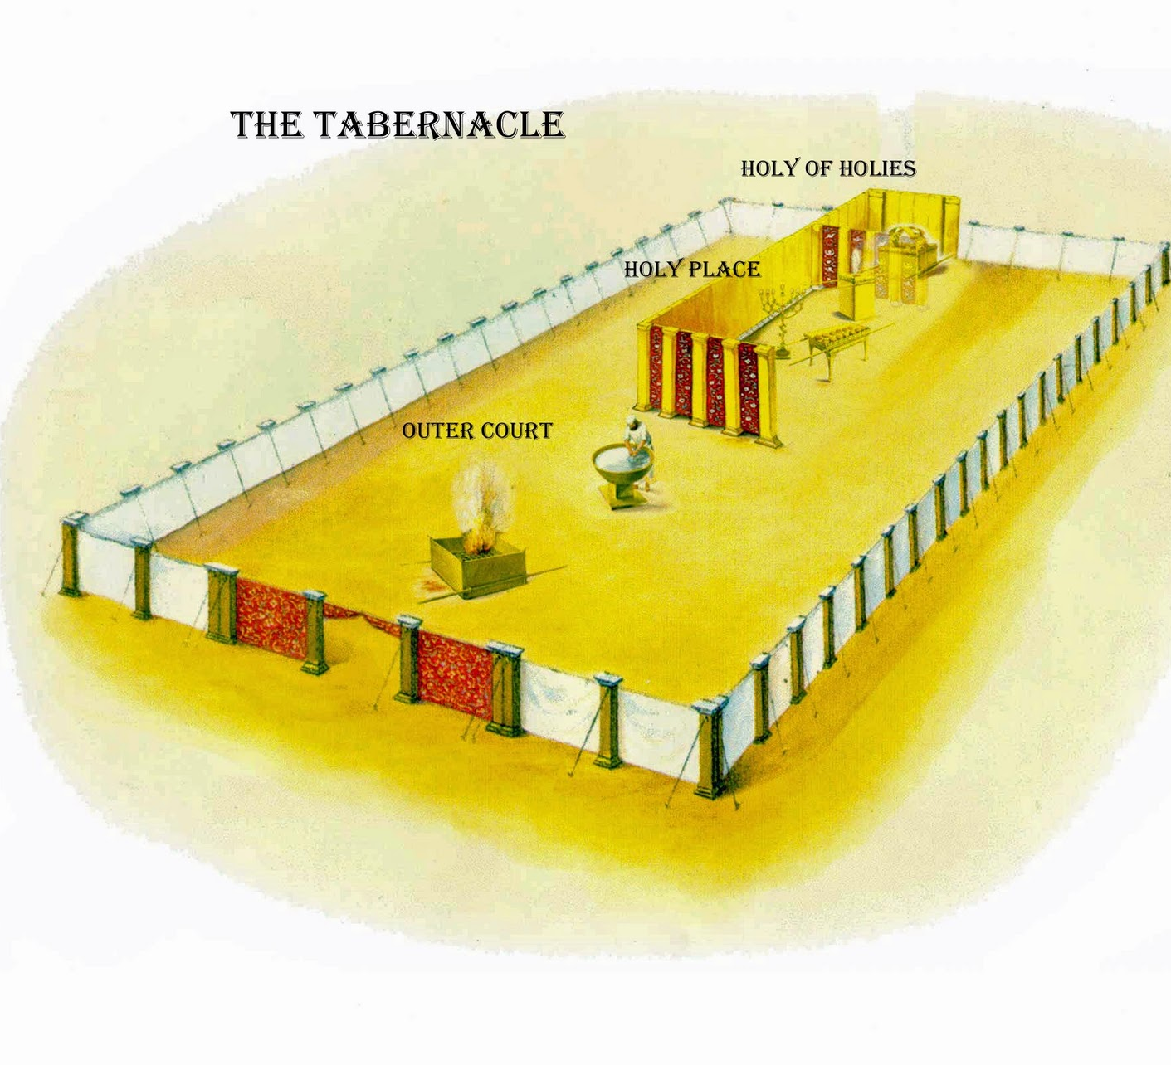
Exodus 25:8 And let them make Me a sanctuary, that I may dwell among them.

Slide 3

Understand the meaning and memorize
1Corinthians 3:16
Do you not know that you are the temple of God and that the Spirit of God dwells in you?
licensed under CC BY-NC

Slide 4


Song Time!

Slide 5

https://www.youtube.com/watch?v=4LiTy7ndOzw
Lord, Prepare me, to be a Sanctuary.
Pure and Holy
Tried and True
And with thanksgiving, I'll be a living Sanctuary, for you.

Slide 6

Well done!
licensed under CC BY-NC-ND

Slide 7



Map with
church in centre
Road
road
My road
This Photo by Unknown Author is licensed under CC BY-NC-ND
My Church Name
Road
My Church Address

Slide 8

Interview with Pastor
Why did you decide to become a Pastor?
Was there something that happened in your life that caused you to want to be a pastor?
At what age did you decide to become a Pastor?
Can I be a pastor, if God calls me?
How can I prepare for a life to serve God?
How can I be a minister right now?
This Photo by Unknown Author is licensed under CC BY-ND

Slide 9

This Photo by Unknown Author is licensed under CC BY-NC-ND

Slide 10

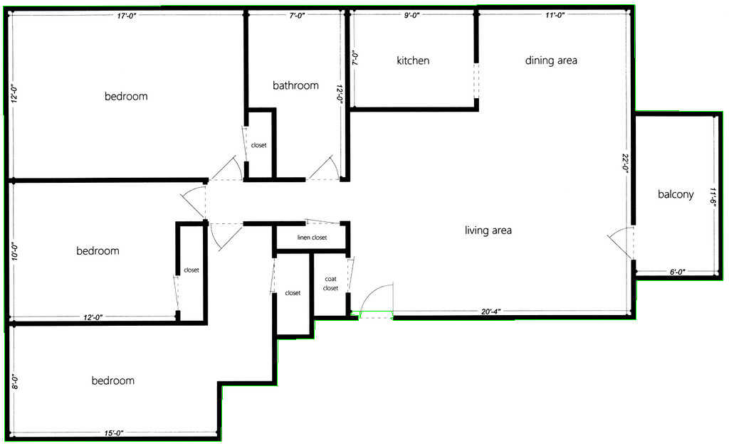
Church floor plan
a. Sanctuary
b. Church Office
c. Your Sabbath School Room
d. Fellowship Hall
e. Restrooms
f. Adventurer Room
g. Community Service Room
This Photo by Unknown Author is licensed under CC BY-SA

Slide 11
CHURCH TOUR

Slide 12
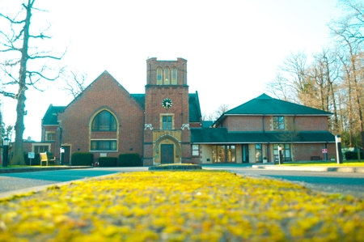
MY CHURCH TOUR

Slide 13
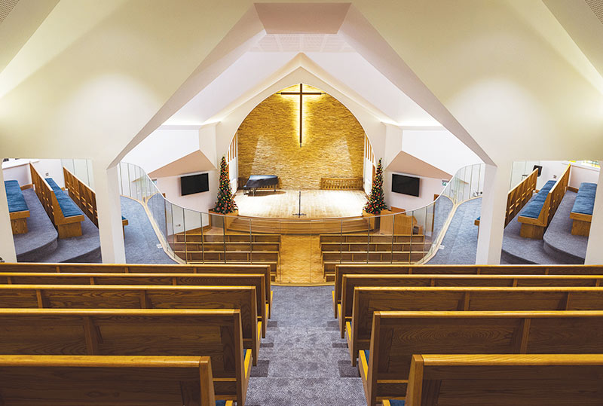

Slide 14
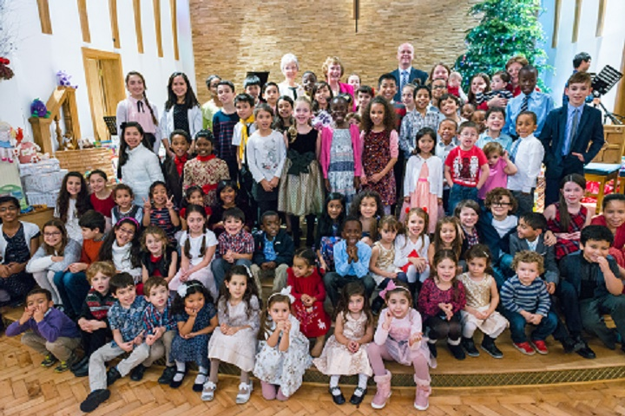

Slide 15
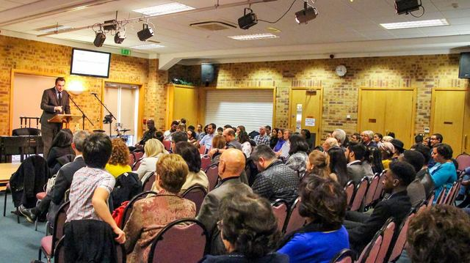

Slide 16
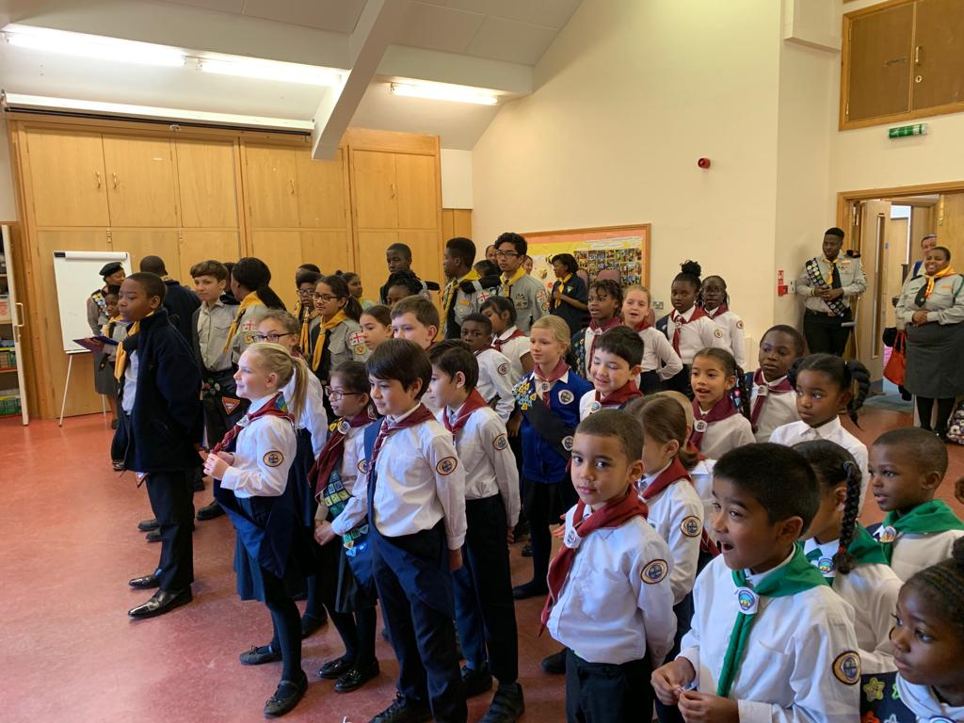

Slide 17
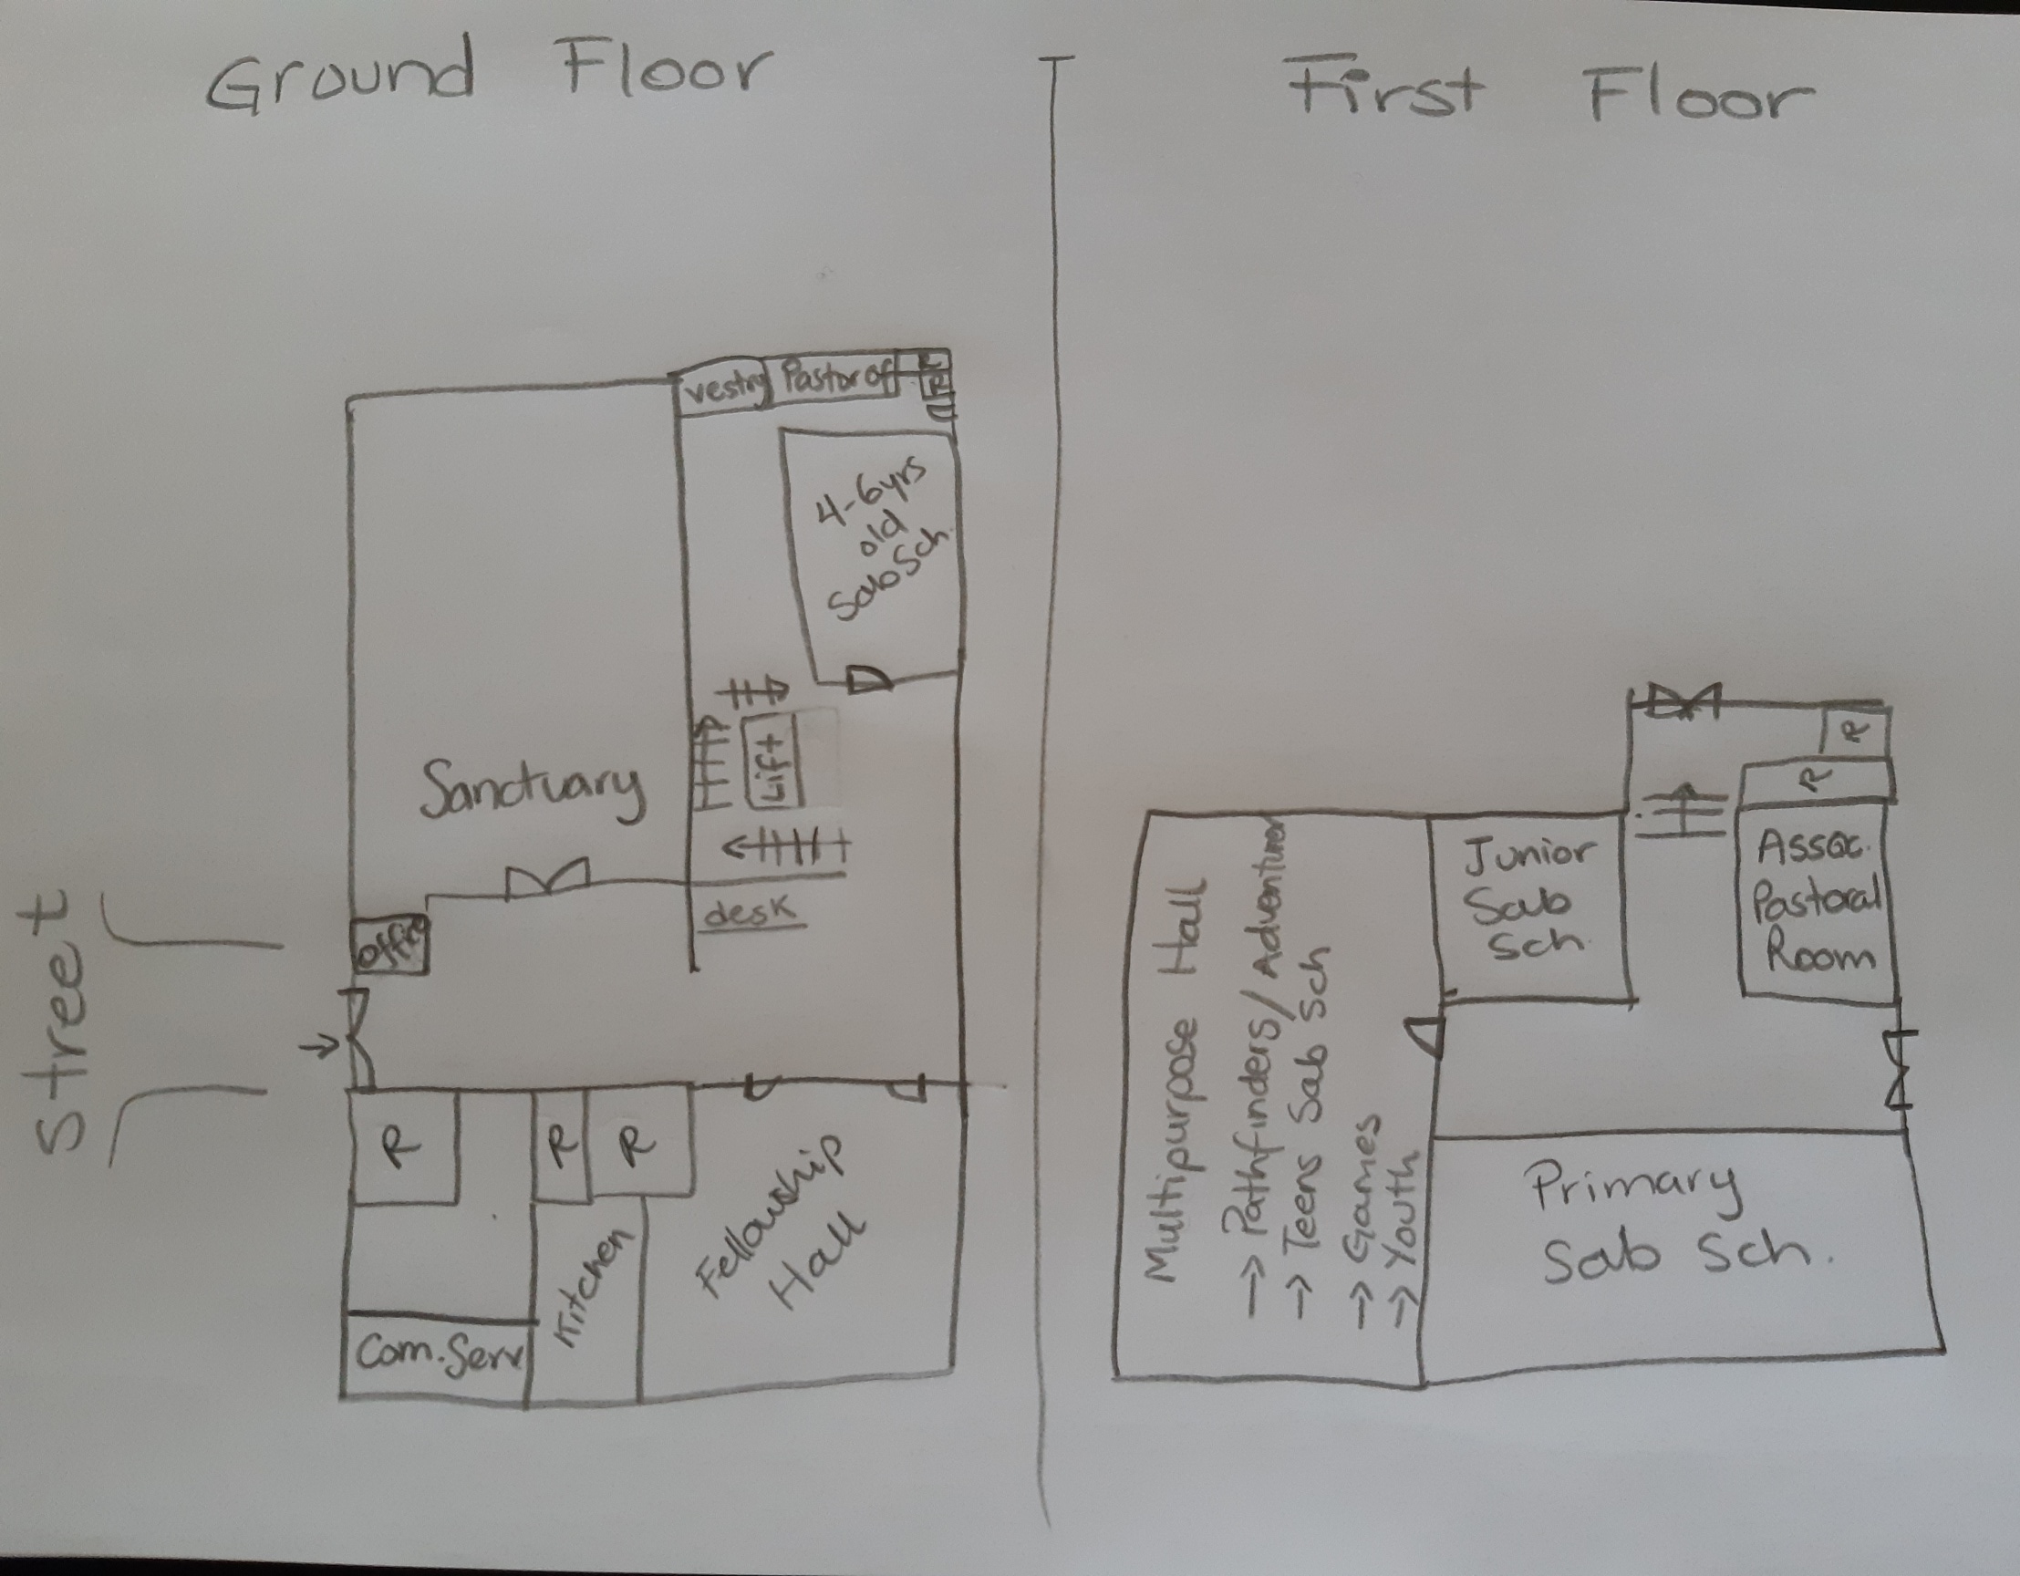
Church floor plan
a. Sanctuary
b. Church Office
c. Your Sabbath School Room
d. Fellowship Hall
e. Restrooms
f. Adventurer Room
g. Community Service Room

Slide 18
So far…
You as Temple
Pastor
Church Building

Slide 19

Church Board.....
What is that
licensed under CC BY-NC-ND

Slide 20


What is a church board and what is its function?
Group of Church members who have been chosen to lead the church.
Evangelism
Discipleship

Slide 21

Name 10 members on the church board.
What position(s) do they hold?
licensed under CC BY-SA-NC

Slide 22
  _ Elders
  _Head Deacon
  _Head Deaconess
  _Treasurer
  _Clerk
  _Adventist Community Services Leader
  _Youth Ministry Leader
  _Children Ministry Leader
  _Music Coordinator
  _Adventurer Director
  _Pathfinder Director
  _Family Ministry Leader
  _Health Ministry Leader
  _Personal Ministries Leader
  _Sabbath School Superintendent
  _Stewardship Ministries Leader
  _Women Ministries Leader
  _Young Adults Leader

Slide 23



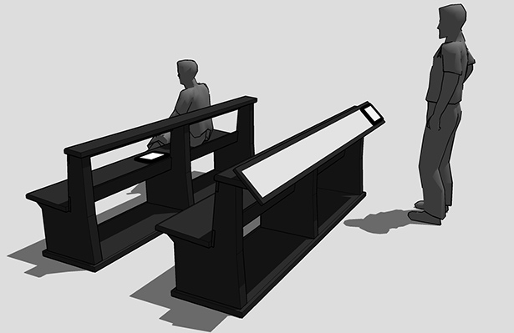

Explain how you can help God in your church every week starting this week?
This Photo by Unknown Author is licensed under CC BY-SA
This Photo by Unknown Author is licensed under CC BY-NC-ND
licensed under CC BY
licensed under CC BY
licensed under CC BY-SA
licensed under CC BY-SA

Slide 24

Love one another
This Photo by Unknown Author is licensed under CC BY

Slide 25
So far…
You as Temple
Pastor
Church Building
Church Board
Your Help
Love one Another

Slide 26
Requirements
1. Understand the meaning and memorize I Corinthians 3:16 and learn the song “Lord, Prepare Me to Be a Sanctuary.”
2. Know the name of your church, and write the address. As a club, draw a mural with the church in the center and include each Adventurer’s house in relation to your church, naming all roads and streets as a map to the church.
3. Interview a Pastor
4. Draw the floor plan of your church. If your church has the following, label them on your map.
a. Sanctuary
b. Church Office
c. Your Sabbath School Room
d. Fellowship Hall
e. Restrooms
f. Adventurer Room
g. Community Service Room
5. What is a church board and what is its function?
6. Name 10 members on the church board. What position(s) do they hold?
7. Explain how you can help God in your church every week starting this week?

Slide 27

This Photo by Unknown Author is licensed under CC BY-NC

