Slide 1
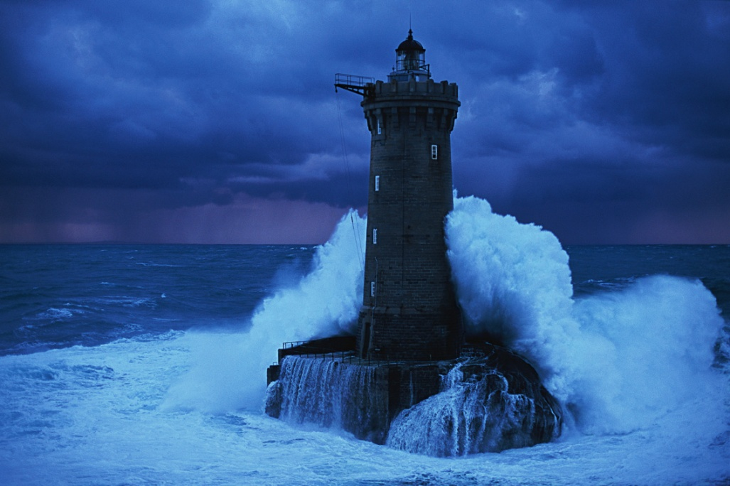
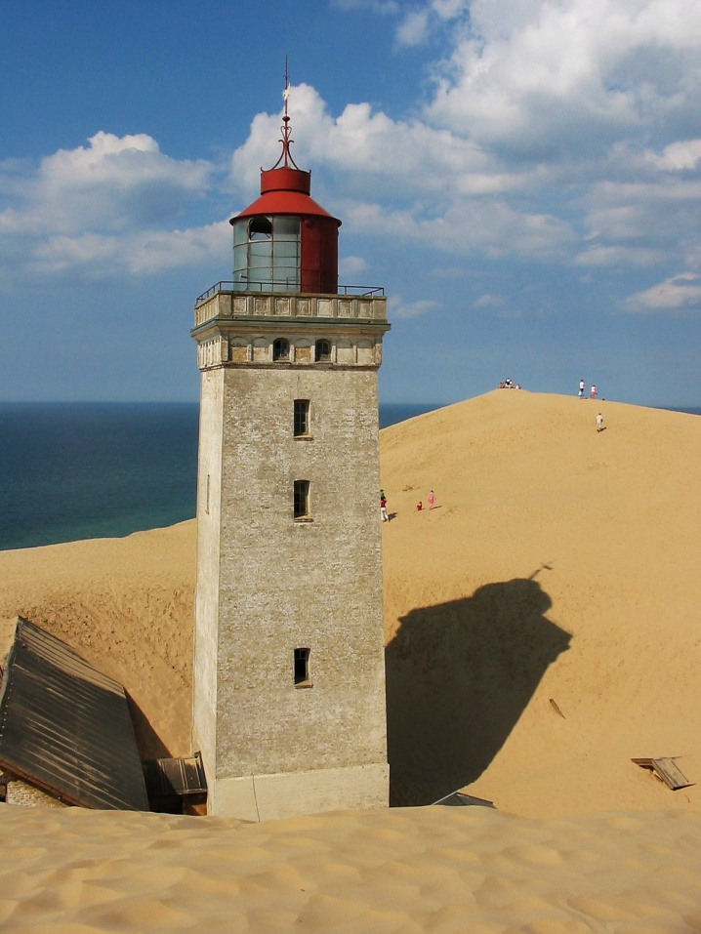
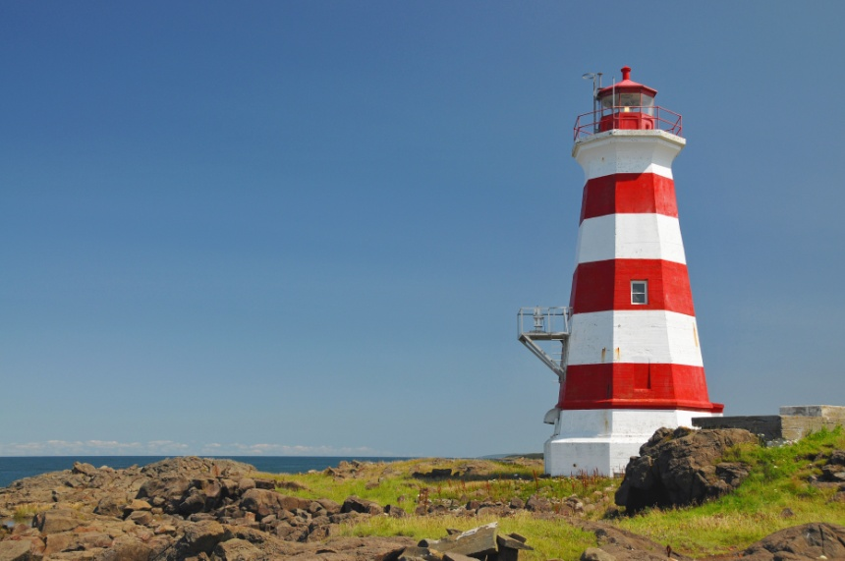
This Photo by Unknown Author is licensed under CC BY-SA
lighthouses

Slide 2
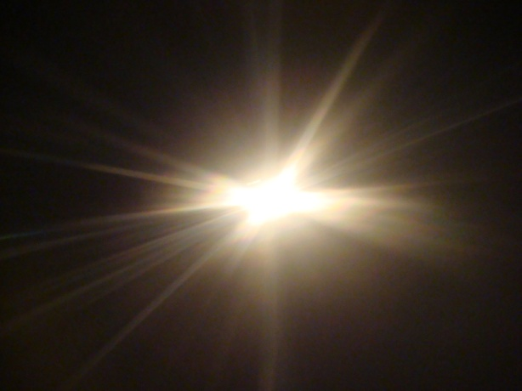
What is the function of a lighthouse?
The function of a lighthouse is to serve as
a navigational aid to ships
by sending a beam of light,
which provides signals

Slide 3
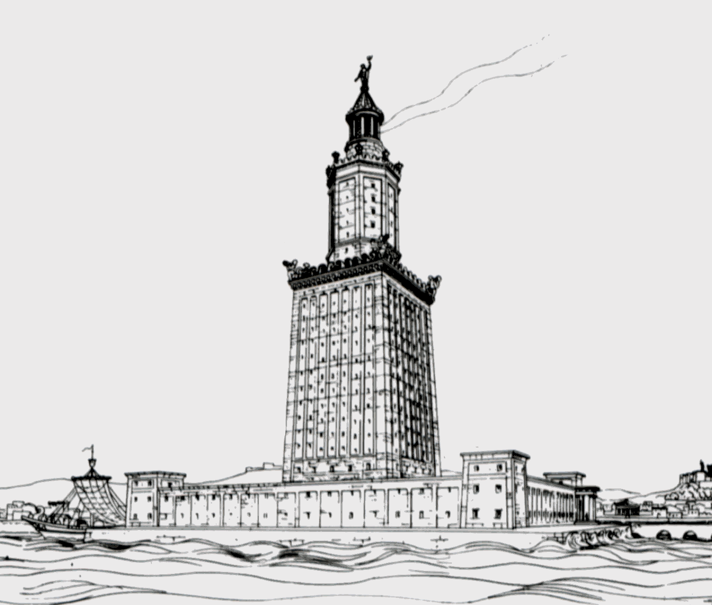
When were the first lighthouses of record built?
This Photo by Unknown Author is licensed under CC BY-SA

Slide 4

Pharologists
Phare…… French
Faro Italian and Spanish
Farol Portuguese
Fyr Swedish, Danish and Norwegian
Far Romanian

Slide 5
Do all lighthouses have keepers?
If not how are they run?
In the United Kingdom there are no more manned lighthouses
Even automated lighthouses need occasional maintenance and in the United Kingdom this is
undertaken by Trinity House.
There are also light ships located around the coast line.
The beacons are powered by solar panels on some of them and the beacon lights are automated
so that they turn on as darkness falls.

Slide 6
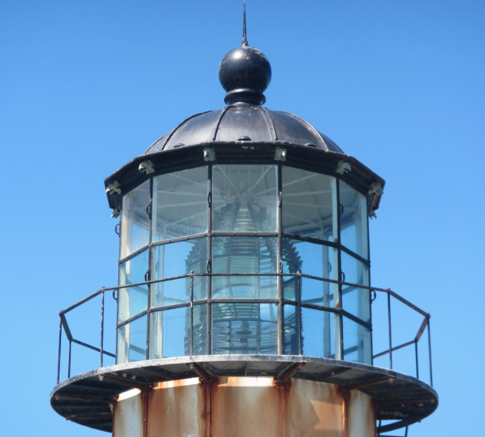

Fresnel lenses

Slide 7
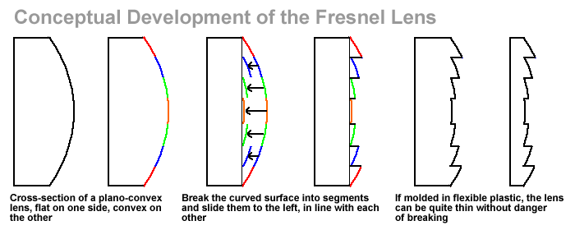
This Photo by Unknown Author is licensed under CC BY-SA

Slide 8
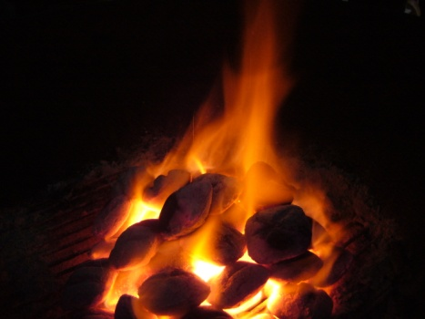
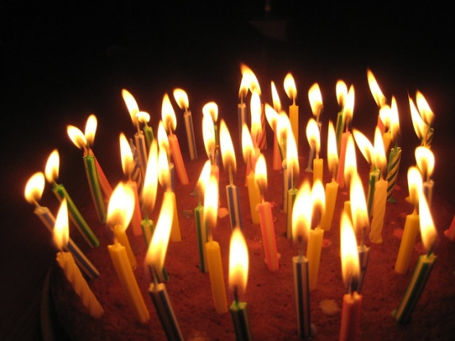
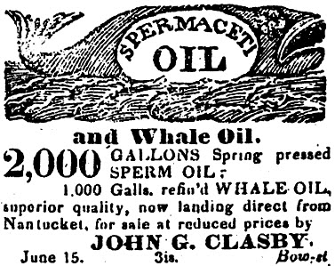

Throughout history what fuels have been used for lighthouse lights?
Wood
Coal
Whale oil
Lard
Kerosene
Lots and lots of candles

Slide 9
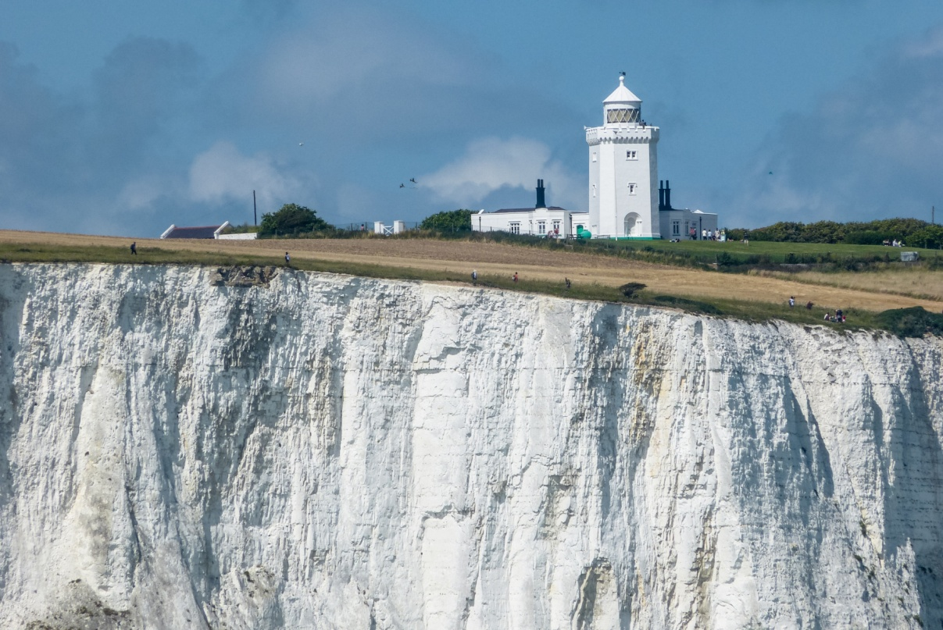
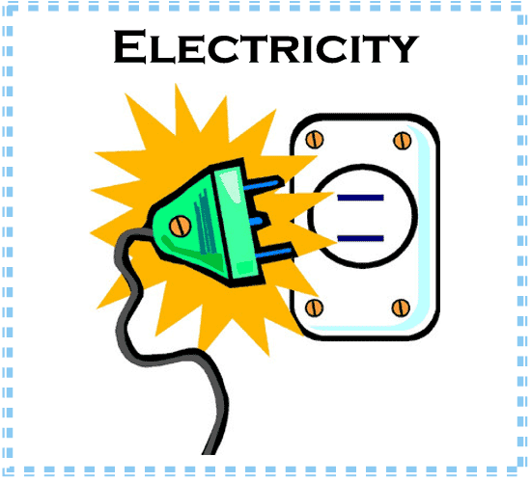
First lighthouse to use electricity?
In the United Kingdom – Cliffs of Dover – South Foreland
This was also the first lighthouse to provide ship to shore transmissions

Slide 10
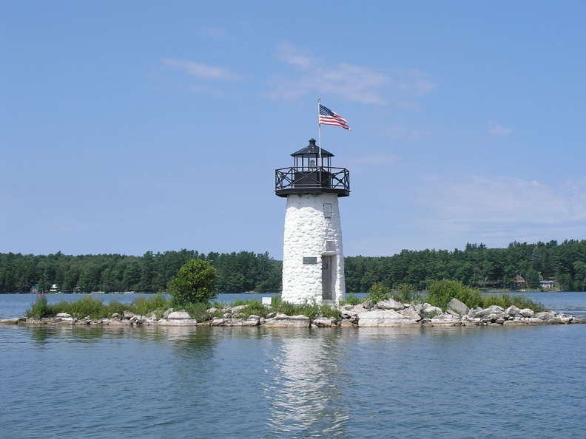
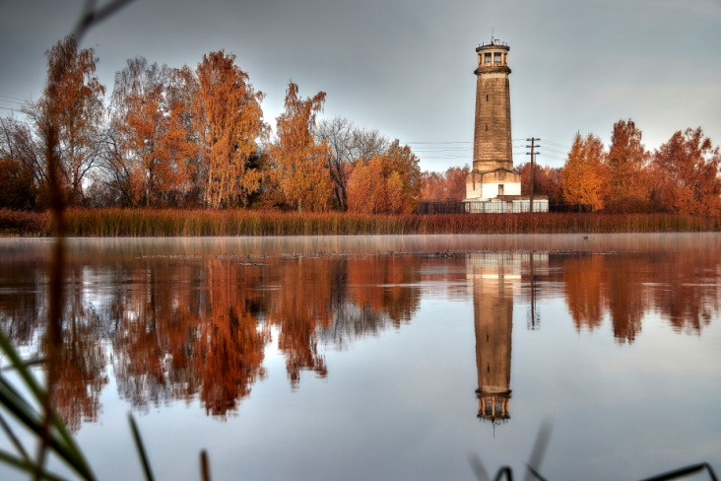
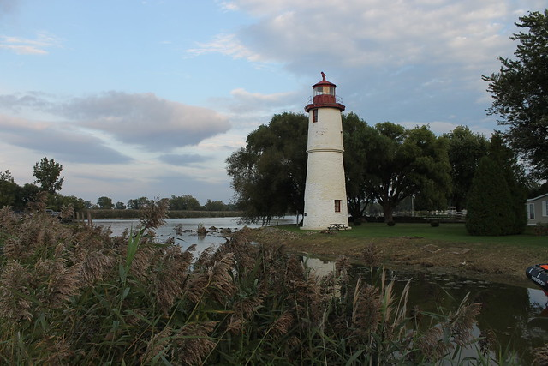
Are all lighthouses located along sea shores?

Slide 11

Who is responsible for the upkeep of lighthouses in the United Kingdom?
Trinity House has three main functions: It is the General Lighthouse Authority for England, Wales, the Channel Islands and Gibraltar, responsible for a range of general aids to navigation, 'signs of the sea', from lighthouses to radar beacons.

Slide 12
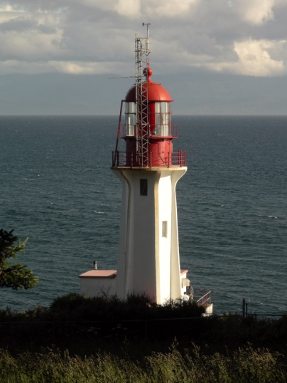
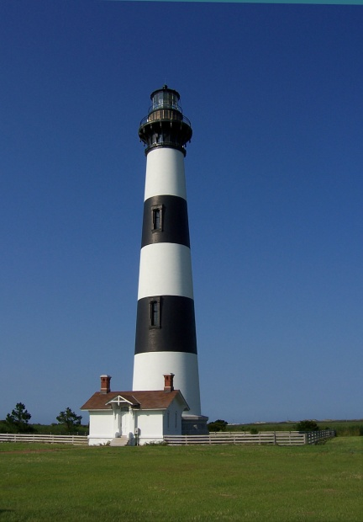
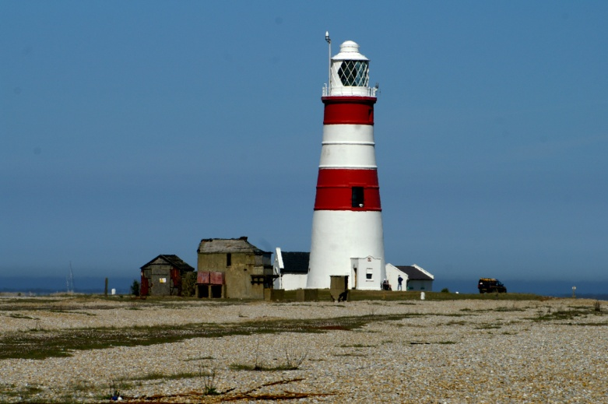
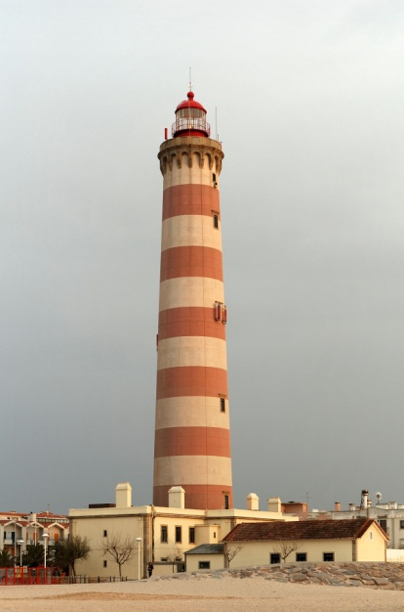
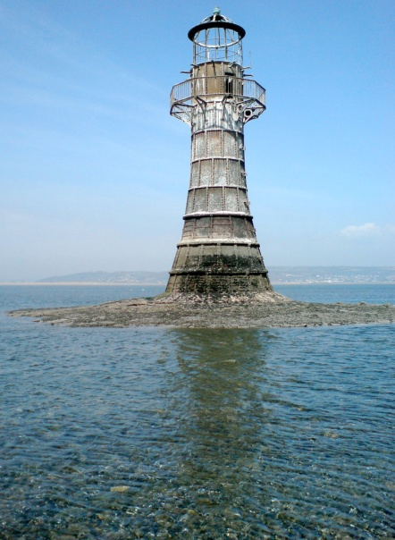
Why do lighthouses have different colours and markings?
DAYMARKS

Slide 13
foghorn

Slide 14
Navigation aid
Warning of rocks, headlands and other dangers to
shipping
Audible signal when visibility is low
Very deep pitch – deep sounds are more audible to human ears
at a greater distance than higher pitched ones
ALSO VERY LOUD!
Height above sea level is also important
as it determines the distance at which a
foghorn can be heard
Some can be heard up to 9.6km (6 miles) away

Slide 15
Biblical references to ‘lights’
Genesis 1:14-16
Psalm 136:7
Ezekiel 32:8
Luke 8:16
Luke 11:33
Acts 16:29
Why is God’s word like a lighthouse?

Slide 16
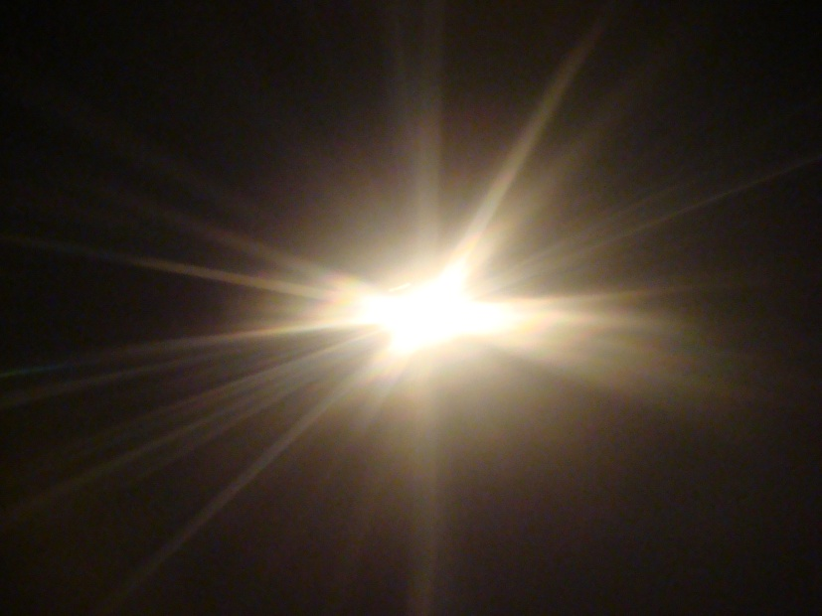
Memorise:- John 8:12
Then Jesus spoke to them again, saying,
‘I am the light of the world.
He who follows Me shall not walk in darkness,
But have the light of life’
This Photo by Unknown Author is licensed under CC BY-SA

Slide 17
Write a poem or story about a lighthouse light
Include thoughts of God’s “light”
Consider the full text of Psalm 136:7-9

Slide 18
Draw or photograph five lighthouse forms/types being used today
Octagonal- has 8 sides
Conical – round with taper, like an inverted ice cream cone
Cylindrical – round having close to the same diameter at the top as the bottom
Square – 4 sided
Skeletal – base made of steel beams and posts rather than being composed of solid walls
Sparkplug – short, squat, and round like the sparkplug in an engine

Slide 19
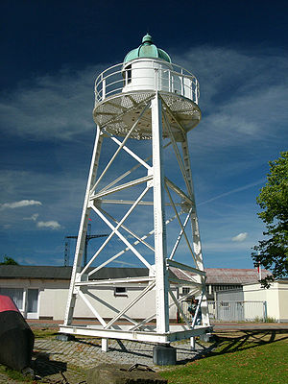
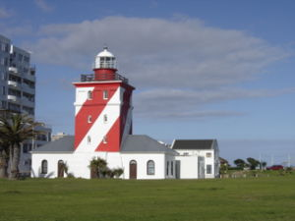
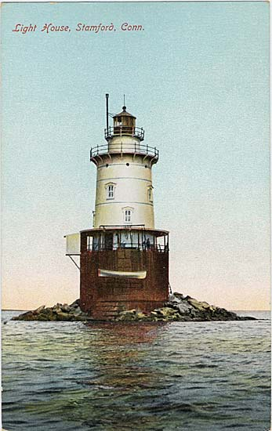
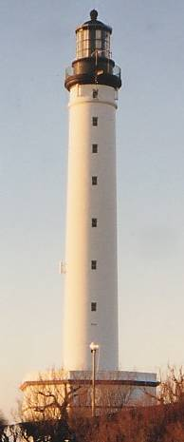
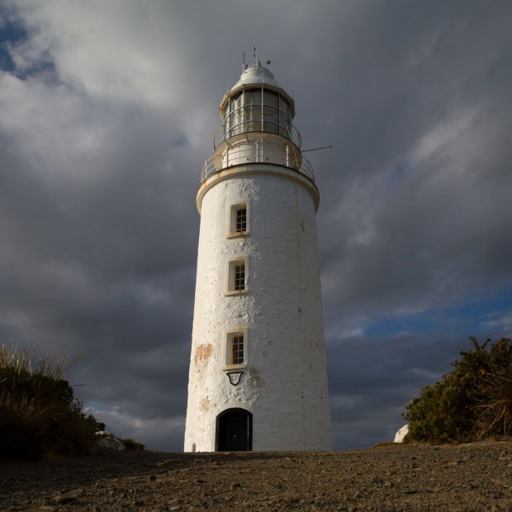
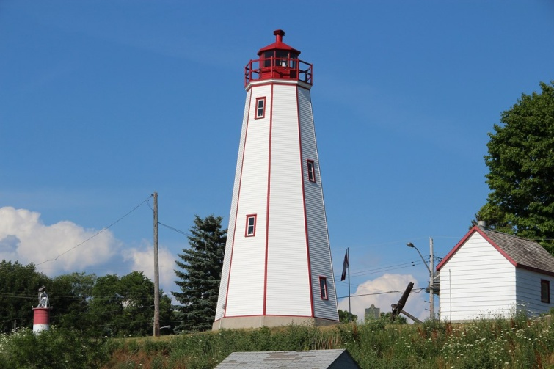
This Photo by Unknown Author is licensed under CC BY-NC

Slide 20
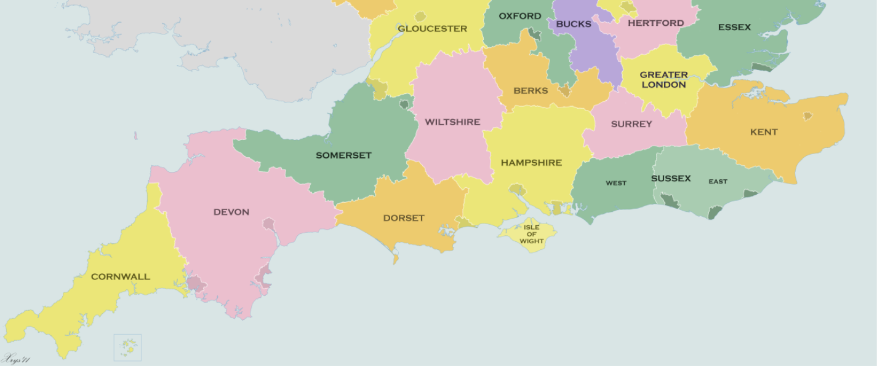
Do you know the 5 nearest lighthouses to your location?

Slide 21
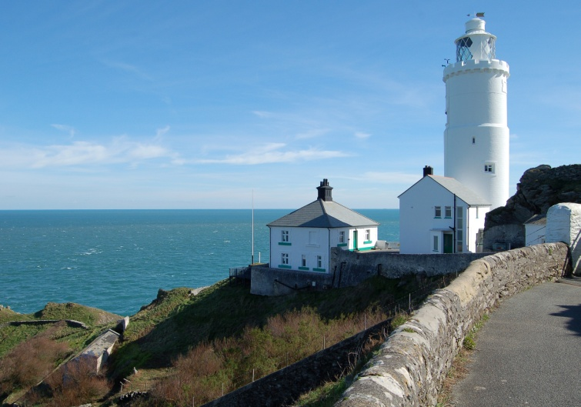
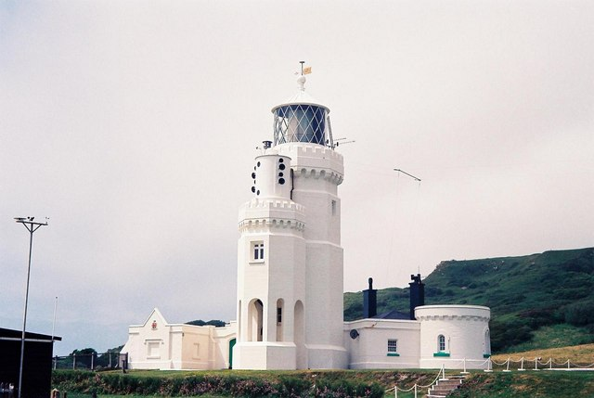
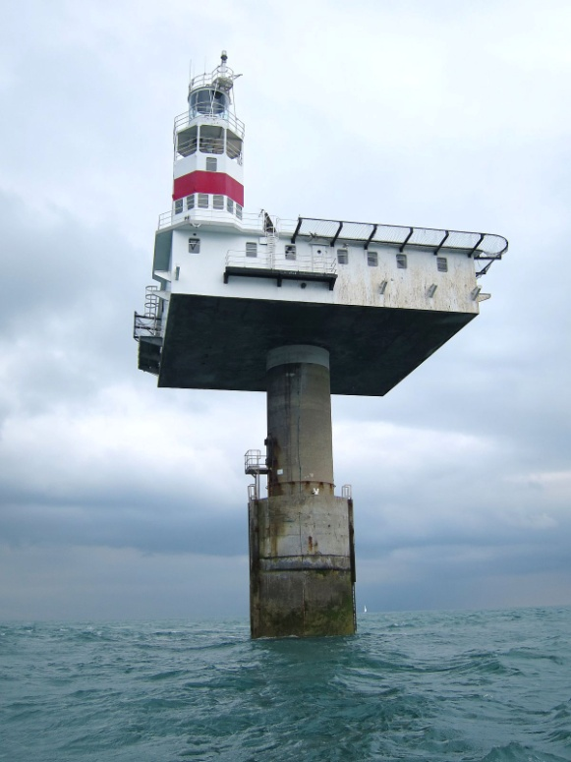
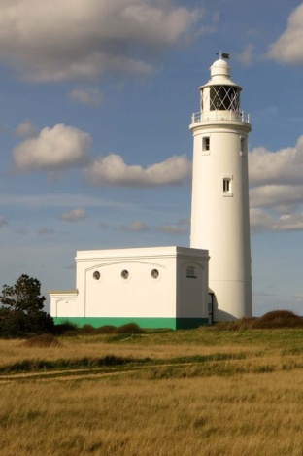
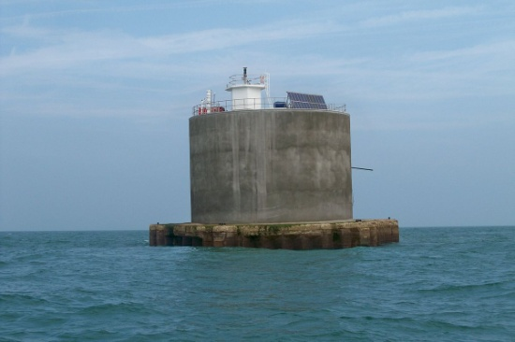
This Photo by Unknown Author is licensed under CC BY-SA

Slide 22
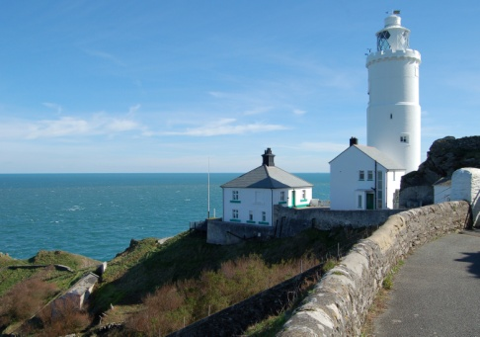
St Catherines
Royal Sovereign
Straight point
Hurst Point
Nab Tower

