Slide 1


Listening Award by Rumbi Sithole

Slide 2

Why is it important to listen?

Slide 3

Memorise 2 ‘listening’ bible verses

Slide 4





Guess the word
1
2
3
4
5

Slide 5
Proverbs 1:8
Listen, my son, to your father’s instruction and do not forsake your mother’s teaching.

Slide 6




Guess the word
1
2
3
4

Slide 7
Jeremiah 13:15
Hear and pay attention, do not be arrogant, for the Lord has spoken

Slide 8



1 Samuel 3
Samuel
Eli the priest
Temple

Slide 9
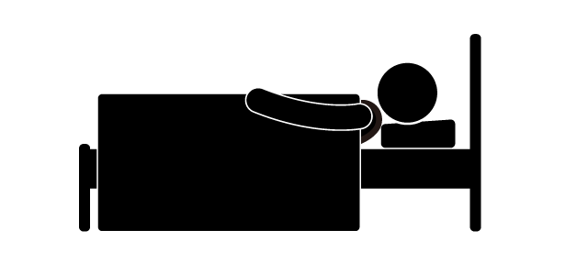
1
Samuel
Eli
Samuel

Slide 10
1
Samuel
Here I am
Eli
Samuel

Slide 11

I did not call; lie down again
Here I am you called me

Slide 12
2
Samuel!
Eli
Samuel

Slide 13
I did not call my son; lie down again
Here I am you called me

Slide 14
3
Samuel
Eli
Samuel

Slide 15

Go lie down; and it shall be if He calls you, that you must say, “Speak Lord for Your servant hears”
Here I am for you did call me

Slide 16

4
Speak Lord for Your servant hears
Samuel! Samuel!

Slide 17
The Lord spoke to Samuel
“See, I am about to do something in Israel that will make the ears of everyone who hears about it tingle”
Homework: Read 1 Samuel 3

Slide 18
7 principles of listening
1. Listen to God
2. Always be ready to listen
3. Be patient
4. Be obedient
5. Be kind
6. Be respectful
7. Be attentive

Slide 19
1. Listen to God

Slide 20
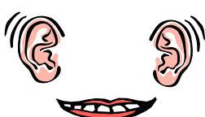
2. Always be ready to listen

Slide 21


3. Be patient

Slide 22

4. Be obedient

Slide 23

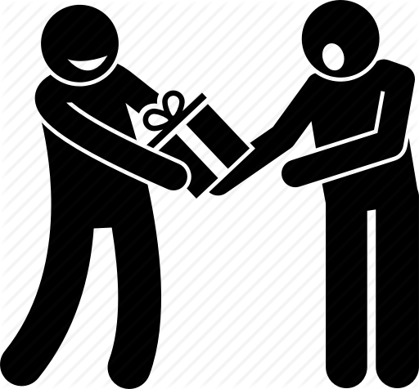
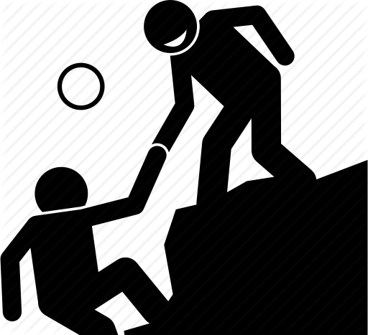
5. Be kind

Slide 24
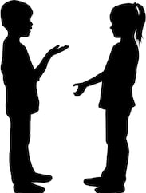


6. Be respectful

Slide 25
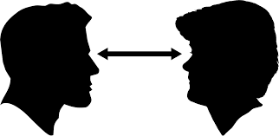
7. Be attentive

Slide 26
Can you remember the 7 principles of listening?
1.
2.
3.
4.
5.
6.
7.

Slide 27
7 principles of listening
1. Listen to God
2. Always be ready to listen
3. Be patient
4. Be obedient
5. Be kind
6. Be respectful
7. Be attentive

Slide 28

Listening Craft
Paper telephone
What you need:
2 plastic or paper cups – a tin can works great too
String
A friend to hold the other end of the string telephone
Instructions:
Make a small hole in the bottom of both cups.
If you would like you can decorate your cups.
Thread your string through the cup and tie a knot to keep the string from pulling back through.
Finished
How to play
You take one cup and your friend takes the other. Walk far enough apart to make the string tight. Depending on how long you cut your string will depend on how far you need to stand apart (make sure that the string is not touching anything else)
One friend holds the cup to their mouth and talks, while the other friend holds it to their ear and listens.

Slide 29


Listening Game
Guess what it is
Hands up

Slide 30

Listening Award
I hope you enjoyed it!

