Slide 1

Courtesy Award
By Dionne Corrodus-Weekes

Slide 2
Today we will be…..
Explaining what “courtesy” means.
Reciting and explaining the Golden Rule.
Demonstrating good table manners.
Using good telephone manners
Sharing an experience
Showing acts of courtesy

Slide 3
Courtesy
Everyone has it but not everyone uses it

Slide 4
Explain what “courtesy” means

Slide 5
Explaining what “courtesy” means.
Good manners
Considering the feelings of others
Being the kind of person that others will like and respect

Slide 6
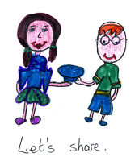
Courtesy Involves……..
Sharing
Being helpful to others
Saying 'please' and 'thank you’
Not grabbing and keeping good things to yourself
Respecting other people's property and their rooms
Helping the family by doing your chores
Cleaning up after yourself

Slide 7
The Golden Rule

Slide 8

"Always do to others as you would wish them to do to you if you were in their place."
The Golden Rule

Slide 9
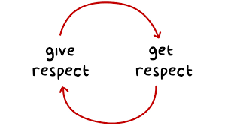
“Do unto others, as you would have them do unto you….”

Slide 10
"Always do to others as you would wish them to do to you if you were in their place."
The Golden Rule

Slide 11
Setting the Table

Slide 12
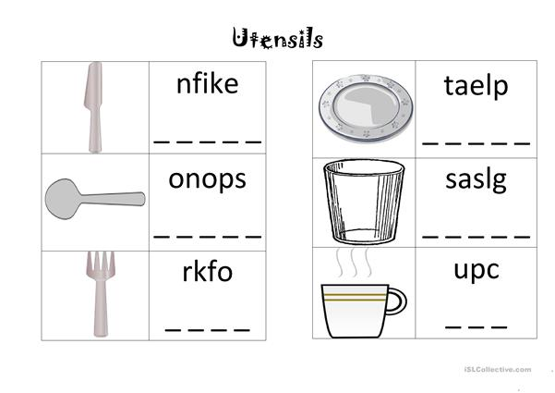

Slide 13
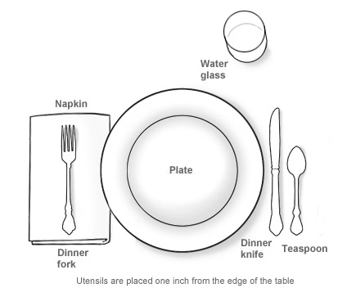

Slide 14
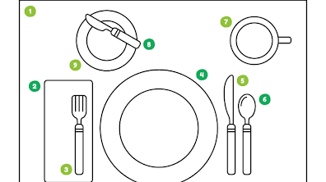

Slide 15
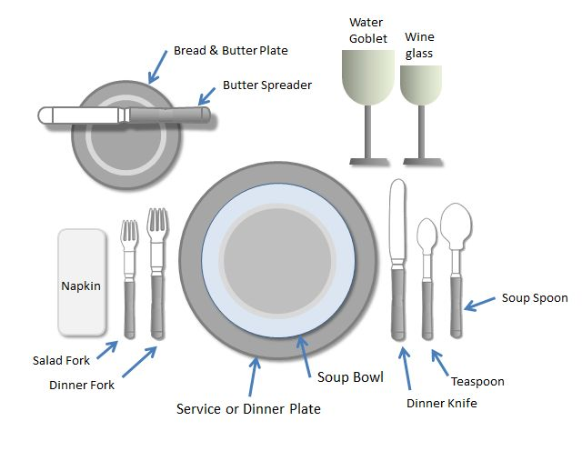

Slide 16
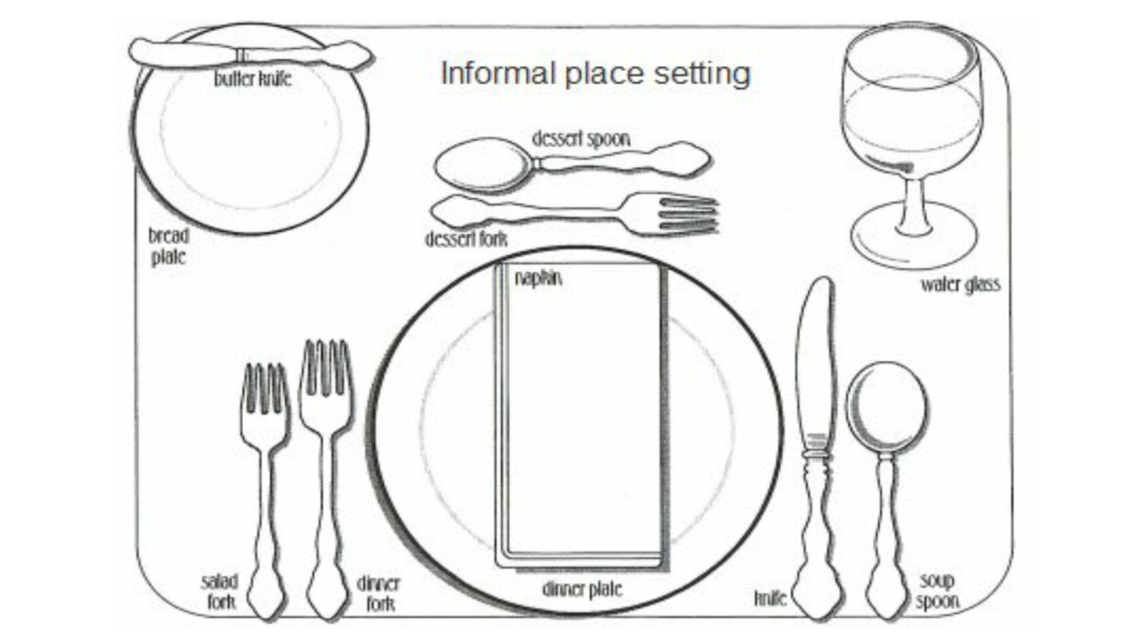

Slide 17

Correctly ask for and pass food

Slide 18
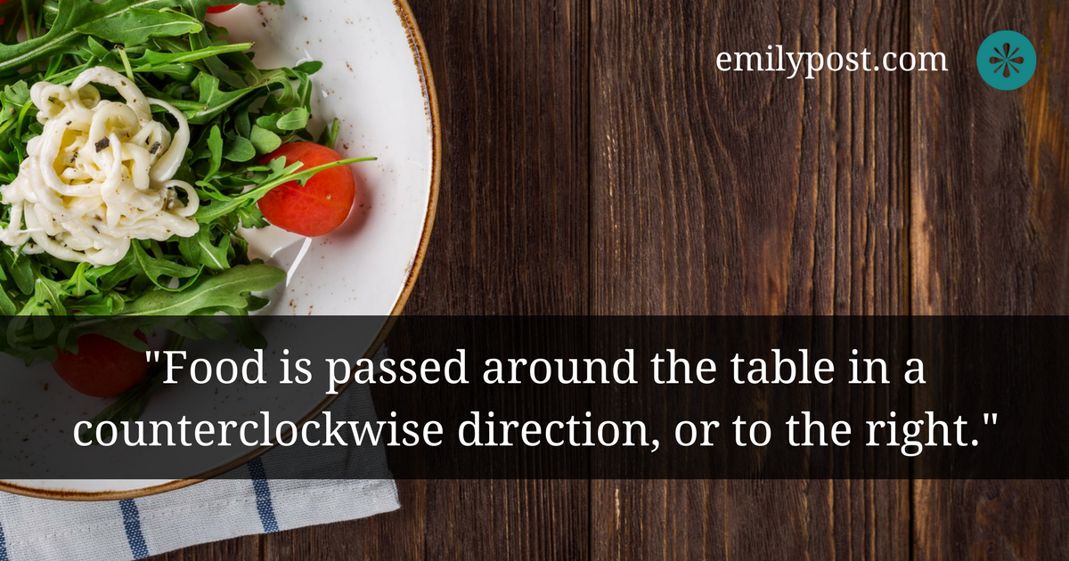


Slide 19
3 Steps to Asking & Passing
When someone says, "Please pass the (what you would like passed to you)," reach for it only if you are the closest one to it. Take the item and place it next to your neighbour.
Continue passing the item in this manner until it reaches the person who asked for it.
Refrain from helping yourself along the way, before the person who asked for it gets the chance.
Wait politely until they have served themselves. Then ask for the bowl to be passed back to you.

Slide 20
Let's Practise
“Thank you for the meal, it was delicious !”
Your Turn Together “Thank you for the meal, it was delicious !”

Slide 21
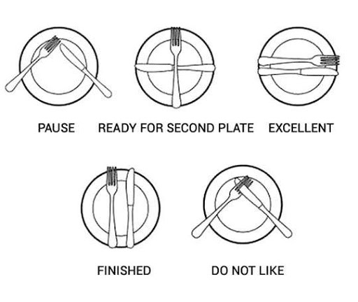

Slide 22
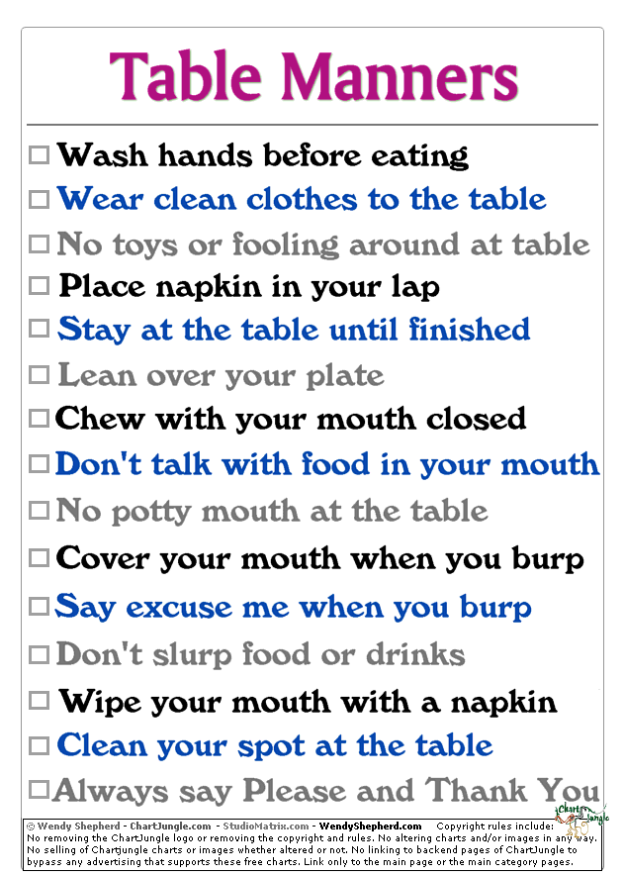


Slide 23
Properly excuse yourself from the table

Slide 24
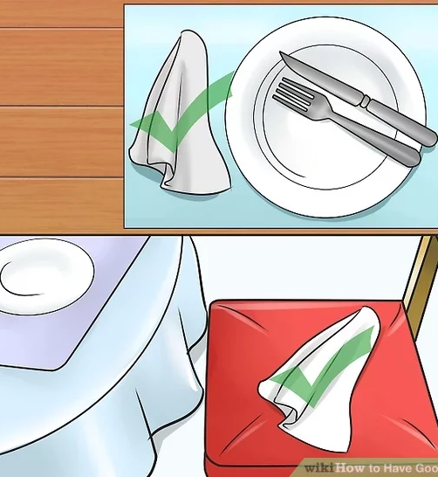
Excuse me from the table please?
Place your napkin next to your plate on the table when you wish to leave.
Wait for your host to indicate the meal is complete.
Then stand up.
Push your chair back in
Thank your host for a delicious meal.

Slide 25
Let's Practise
“Thank you for the meal, it was delicious !”
Your Turn Together “Thank you for the meal, it was delicious !”

Slide 26
Requirement 4
Make a telephone call using good telephone manners

Slide 27
Make a telephone call to an adult you know

Slide 28

Make a telephone call to an adult you know

Slide 29
Make a telephone call to a friend you know

Slide 30
Make a telephone call to friend you know

Slide 31
Be able to answer the phone correctly

Slide 32
Let’s Practise: simple phrases to use to answer the telephone?
A simple, “Hello,” or a longer, “Good Morning, Good Afternoon.”
Let us discuss: Why should we use a polite tone?
Let us now practise how to answer the telephone with a polite tone of voice
Your turn: “Hello,” or a longer, “Good Morning, Smith residence.”

Slide 33
Let’s Practice: when someone’s not available?
“They’re not available right now.”
Let us discuss why should we let someone who calls know that our parents are not available?
Let us practise: letting someone who calls know our parents are not available?
Your Turn: “They’re not available right now.”

Slide 34
Let’s Practise: Taking a message
May I take a message please? May I take your name, number and reason for calling? (If there are difficult words), can you please spell …Thank you, I will pass the message on.
Let us discuss, where should the actual message be left so that it doesn't get lost or overlooked?
Let us practise taking down a message, including the name, phone number, and reason for calling
Your turn: May I take a message please? Can I first take your name, your number and reason for calling, please? Once given => “Thank you”

Slide 35
Let’s Practise: Finding out who is calling
“May I ask who’s calling, please?” (before they let the caller know if the person they asked for is available).
Let us discuss: Finding out who is calling also gives you the opportunity to tell someone that you’re too busy to talk right now and that you’ll call them back without having to go the phone yourself.
Let us Practise: Please may I ask who’s calling?”

Slide 36
Let’s Practise: When the person is available
“Just a moment please and I’ll get her.” Or kindly hold, I will get him”….”Here she is”
Let us practise: “Just a moment please and I’ll get her.” Or kindly hold, I will get him
Let us discuss: Before handing the phone over
Here she is,”
Let us discuss: If it takes a while for the person asked for to get to the phone, before they answer
“Would you mind calling back in 10 mins, it may be a while before they can get to answer the call. Thank you, Bye!

Slide 37
Answering the phone
Greet the person nicely – Good Morning, Good Afternoon, Good Night
Find out who is speaking – “Who is speaking please?”
Always write down messages including phone numbers - May I take a message please?
Organise with your family where the messages are to be put, eg. by the phone or on the fridge.
Let the family member know that they have a message.

Slide 38
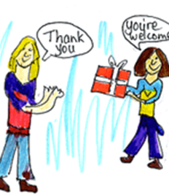
Courtesy is Important

Slide 39
Lets Talk………..
How would you feel if someone:
talked to your friend but turned his back to you?
using good manners pushed you out of the way to get the seat you were about to sit on?
let the door slam in your face as you were about to walk through it?
shared your things but never shared anything of theirs?
never said 'please' or 'thank you’?
didn't pass your phone message to your friend?

Slide 40

Demonstrating good manners
You are walking past an adult you know.
Borrow something, not just taking.
Returning borrowed things
Waiting your turn before you speak.
Rather than pushing past someone.
Someone is carrying something bulky or heavy.
Respecting your own and other people's property
Notes:
Good Morning/Afternoon Mr or Miss….
Please may I borrow your….
Thank you very much for lending me…
Wait until they are finished speaking
Say 'excuse me’, please. “Thank you.”
Would you like some help? Can I get the door open for you?
Be protective of the things of others as if it were your own.

Slide 41

“Courtesy” in practice …..
Saying good morning/afternoon if you are walking past an adult who you know.
Asking if you can borrow something, not just taking. Please may I
Returning things that you have borrowed. Thank you
Waiting your turn before you speak.
Saying 'excuse me,' rather than pushing past someone.
Holding the door open for the person coming in, especially if he is carrying something.
Respecting your own and other people's property, especially school/church property.
Saying 'please' and 'thank you'.

Slide 42
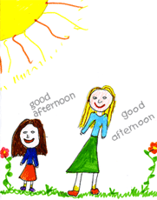
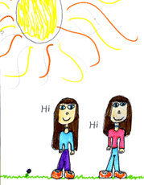
Using Courtesy Nicely

Slide 43
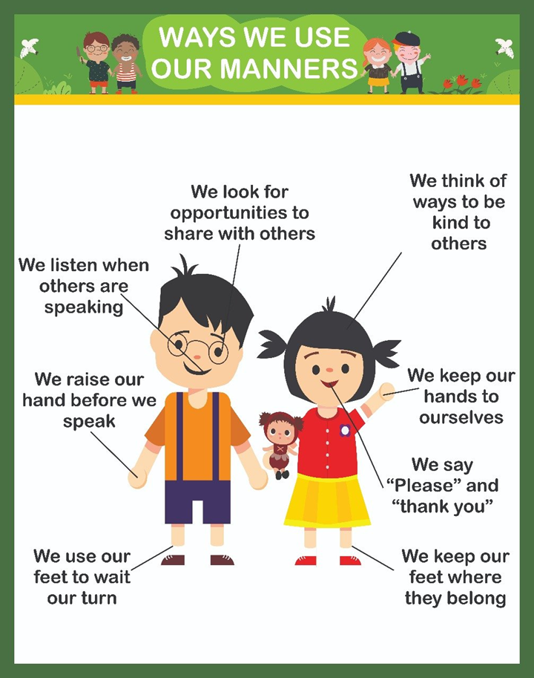
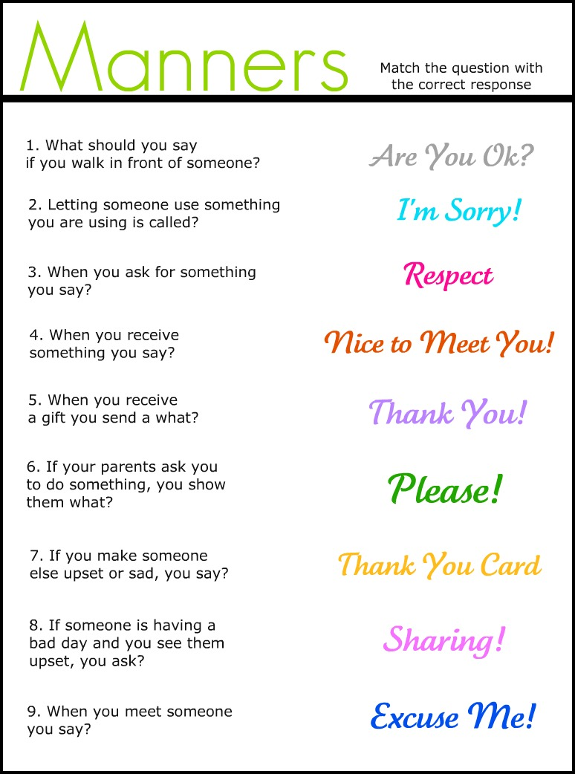

Slide 44
Together we
Explained what “courtesy” means.
Recited and explain the Golden Rule.
Demonstrated good table manners.
Used good telephone manners

Slide 45

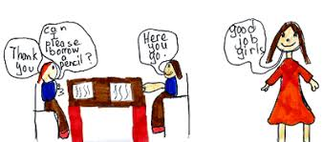
“Courtesy” is…
Good manners
Considering the feelings of others
Being the kind of person that others will like and respect

Slide 46
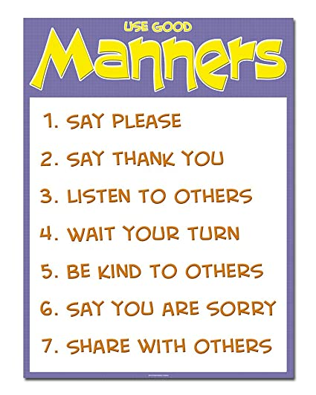


Slide 47
Courtesy In Practice
Respect
Respect other people.
Be
Be polite to others.
Don't use
Don't use bad language - it is offensive to others.
Let
Let an older person have your seat on buses, trains and trams if there is nowhere for them to sit.
Queue up
Queue up quietly and don't push.
Put
Put your rubbish into bins, don't leave it for someone else to clean up.

Slide 48
Courtesy In Practice
Have
Have fun but don't be so loud that you attract the wrong kind of attention.
Respect
Respect property.
Don't make
Don't make fun of anyone - everyone has feelings.
Don't run in
Don't run in shopping centres or where there are other people.
Spend
Spend time talking and listening to the people you are with
Don't talk on
Don't talk on your mobile phone when you are with other people.

Slide 49
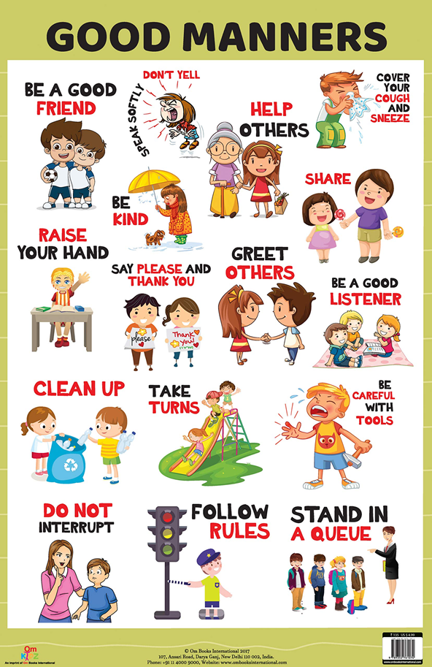


Courtesy Is Having

Slide 50
In closing
Manners! Manners! Don't be rude be nice
When tempted use courtesy to think twice!
Chew with your mouth closed, cover it when you sneeze.
Use courtesy around other people please.
Use courtesy in the shops and in the street
People will think you're a treat.
In eating or drinking outdoors or at dinner
Use courtesy always and you'll be a winner!

