Slide 1


Prayer Warrior e-AWARD
By: Jimmy Musonda

Slide 2
WHAT IS THE GREATEST WEAPON IN THE WHOLE WORLD?

Slide 3
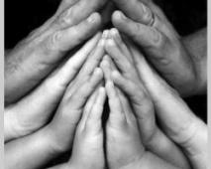
PRAYER

Slide 4
The word prayer is found 154 times in the New International Version Bible.
93 times in the old testament
61 in the New testament

Slide 5
REQUIREMENTS FOR PRAYER WARRIOR AWARD
1. Read what Paul said about the armor of God (Ephesians 6:11-18) and make a poster or craft showing the armor of God:
2. Name 5 Bible Old Testament prayer warriors and read one of their stories from the Bible. How were their lives changed by talking with God?
3. Discuss how and where to pray.

Slide 6
4. Learn who we should pray for and write a prayer of your own. Read this prayer in the Adventurer Club, Sabbath School Class, or during church service.
5. Discuss why you pray.
6. Take a prayer walk with the Adventurers or your family. Talk about the way you felt during the walk.

Slide 7
1. Read what Paul said about the armour of God (Ephesians 6:11-18) and make a poster or craft showing the armour of God:

Slide 8
Put on the whole _______________, that you may be able to stand against the wiles of the ________. ¹² For we do not wrestle against ______ and ______ , but against principalities, against powers, against the rulers of the darkness of this age, against spiritual hosts of _____________ in the heavenly places.

Slide 9
¹³ Therefore take up the whole ________________, that you may be able to withstand in the evil day, and having _________, to stand

Slide 10
¹⁴ Stand therefore, having girded your waist with ________, having put on the _______________ of righteousness, ¹⁵ and having shod your feet with the preparation of the _______________ of peace; ¹⁶ above all, taking the _________________ with which you will be able to quench all the fiery darts of the wicked one.

Slide 11
¹⁷ And take the helmet of salvation, and the sword of the Spirit, which is the _______________; ¹⁸ praying always with ____________ and supplication in the Spirit, being __________to this end with all perseverance and supplication for all the ________"

Slide 12
Ephesians 6:11-18
"Put on the whole armour of God, that you may be able to stand against the wiles of the devil. ¹² For we do not wrestle against flesh and blood , but against principalities, against powers, against the rulers of the darkness of this age, against spiritual hosts of wickedness in the heavenly places.

Slide 13
¹³ Therefore take up the whole armour of God, that you may be able to withstand in the evil day, and having done all, to stand
¹⁴ Stand therefore, having girded your waist with truth, having put on the breastplate of righteousness, ¹⁵ and having shod your feet with the preparation of the gospel of peace;

Slide 14
¹⁶ above all, taking the shield of faith with which you will be able to quench all the fiery darts of the wicked one. ¹⁷ And take the helmet of salvation, and the sword of the Spirit, which is the word of God; ¹⁸ praying always with all prayer and supplication in the Spirit, being watchful to this end with all perseverance and supplication for all the saints"

Slide 15
make a poster
Or
craft showing the armour of God

Slide 16
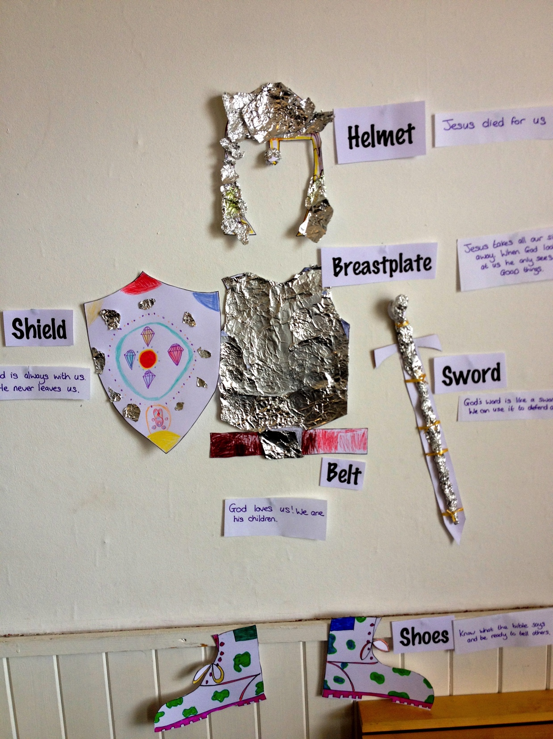

Slide 17
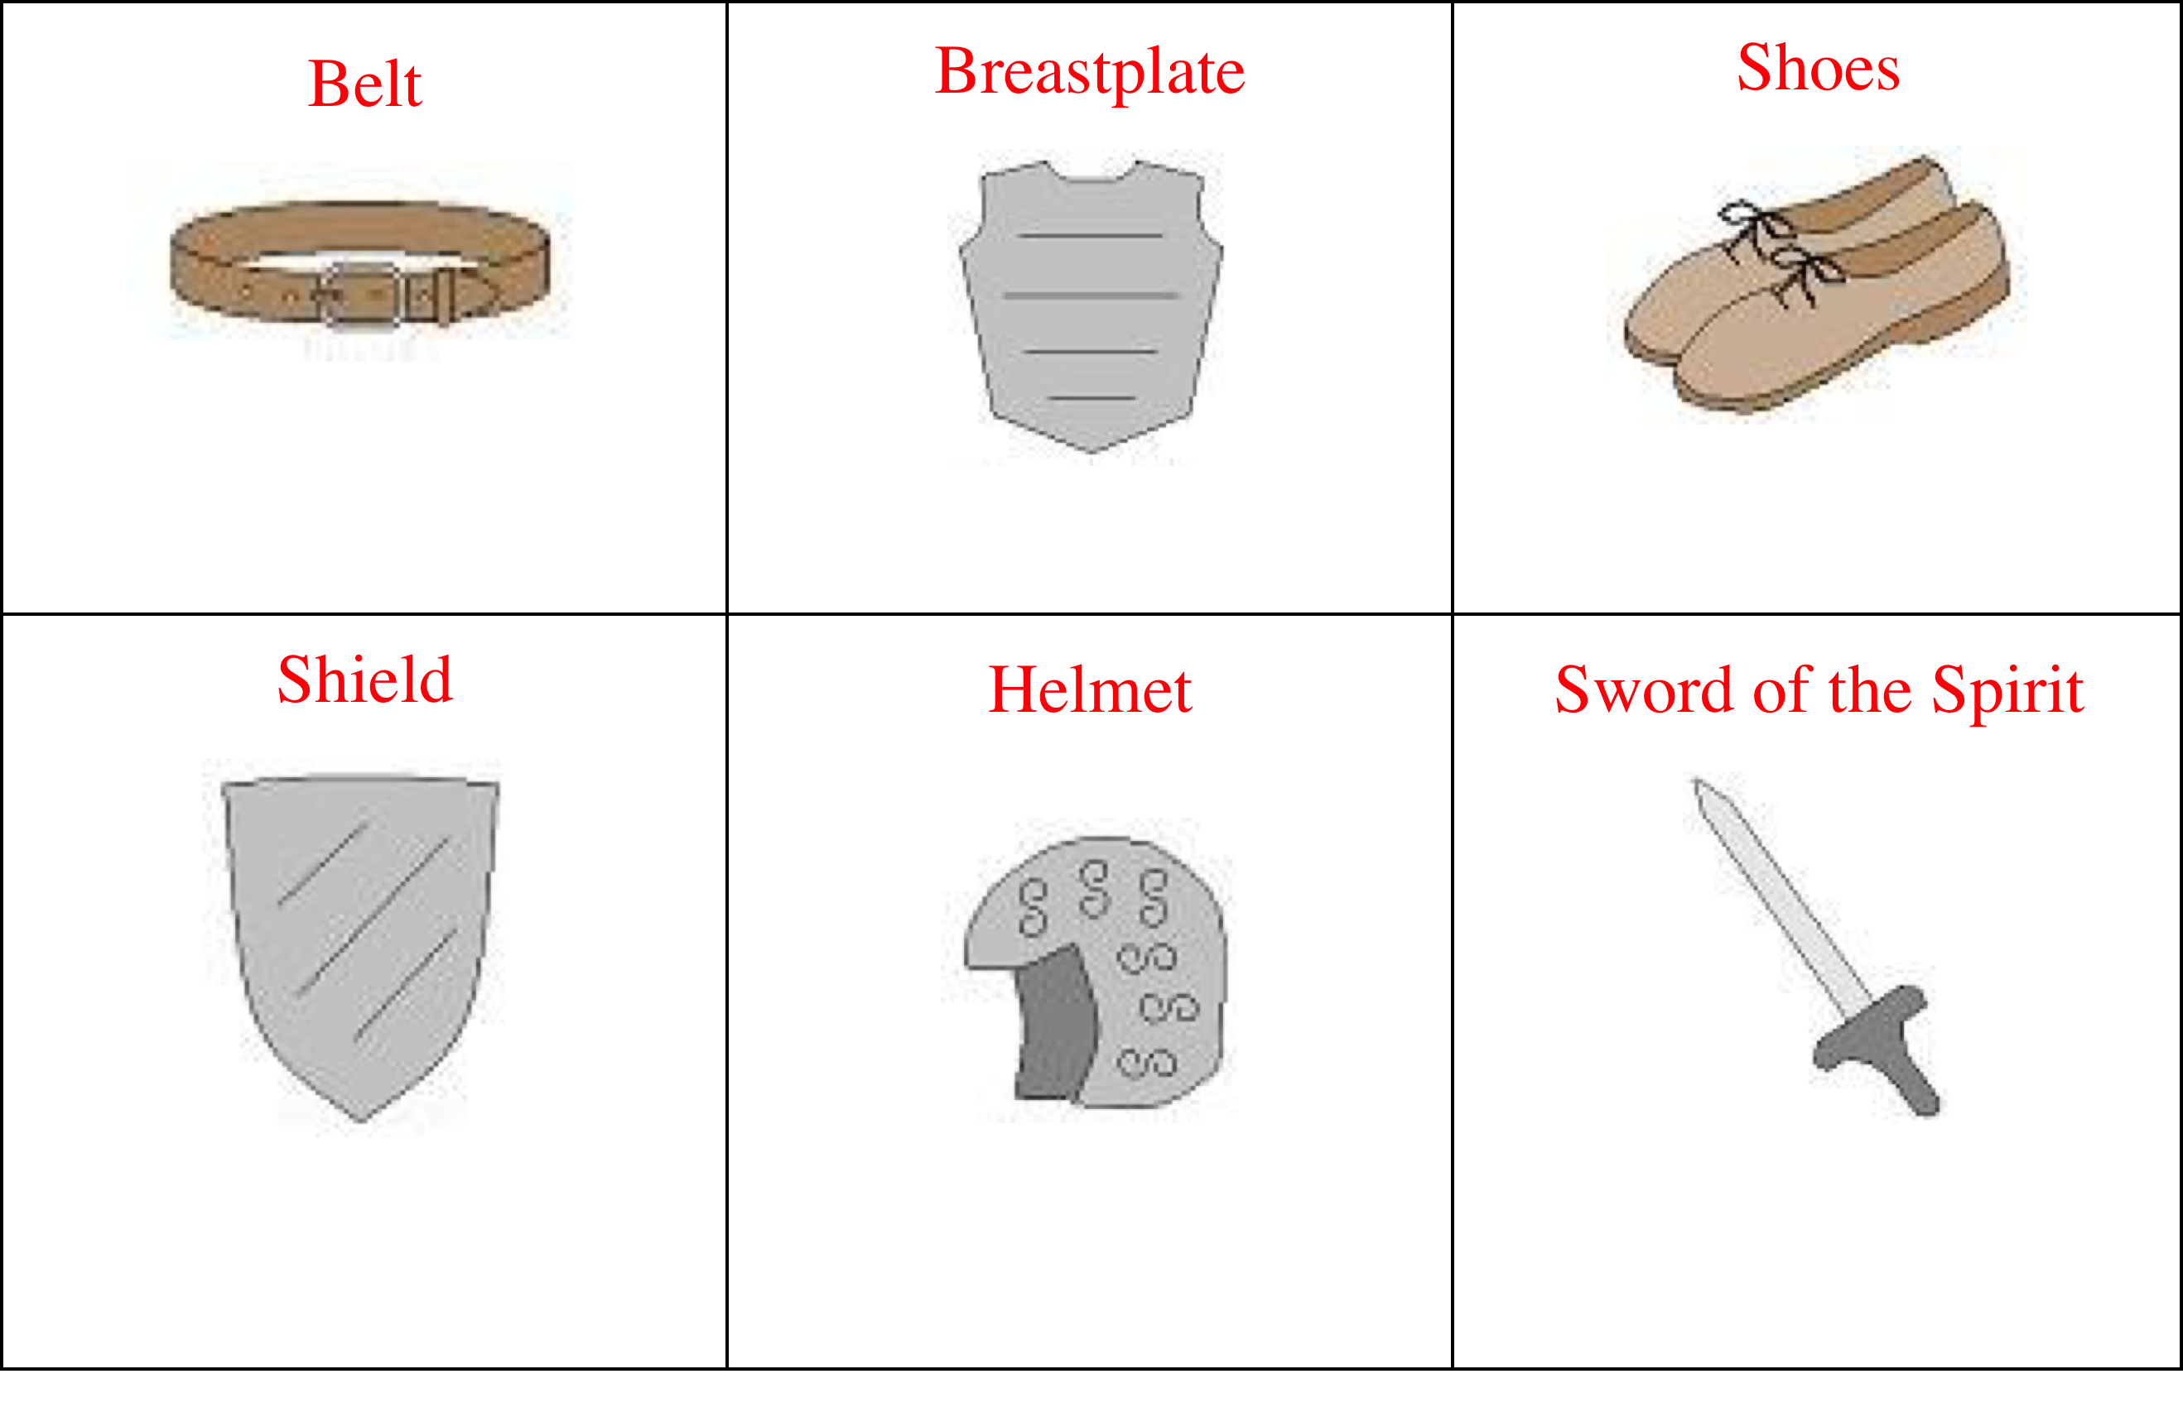

Slide 18
2. Name 5 Bible Old Testament prayer warriors and read one of their stories from the Bible. How were their lives changed by talking with God?

Slide 19
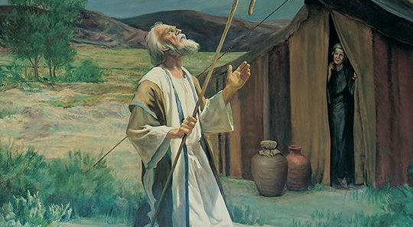
Abraham (Gen. 12)

Slide 20
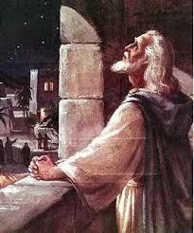
David (Psalms 41 & 1 Samuel 17)

Slide 21
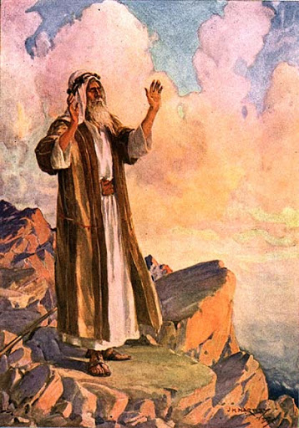
Moses (Exodus 16)

Slide 22
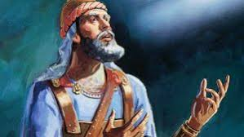
Joshua (Joshua 5)

Slide 23
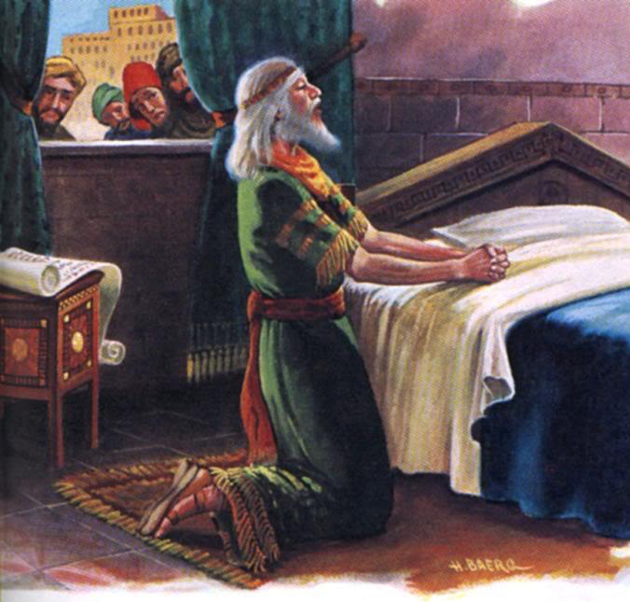
Daniel (Daniel 6)

Slide 24
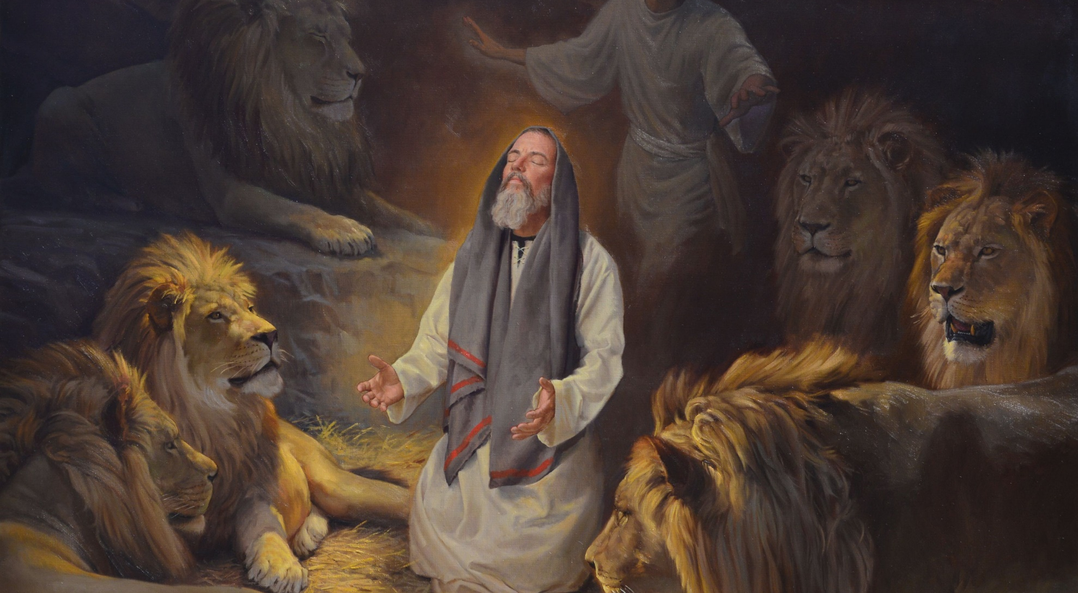
Daniel in the Lion’s Den

Slide 25
3. Discuss how and where to pray.

Slide 26
a. Ways -
Pray out loud or silently;
Pray with others or by yourself;
Sing;
Journaling (writing down your prayers);
Telephone prayer ( pray with someone on the phone).

Slide 27
b. Places –
By your bed;
At the breakfast table;
In the car;
On your bike;
While taking a walk;
In Sabbath School;
At a hospital;
Or anywhere!

Slide 28
4. Learn who we should pray for and write a prayer of your own. Read this prayer in the Adventurer Club, Sabbath School Class, or during church service.

Slide 29
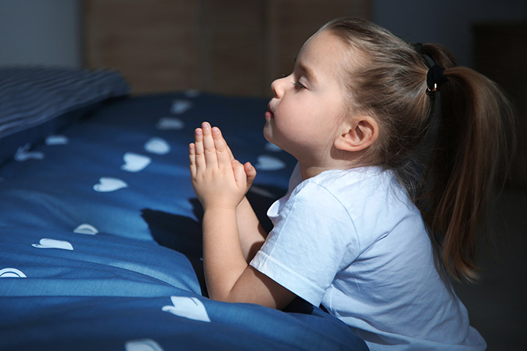
Pray for yourself

Slide 30
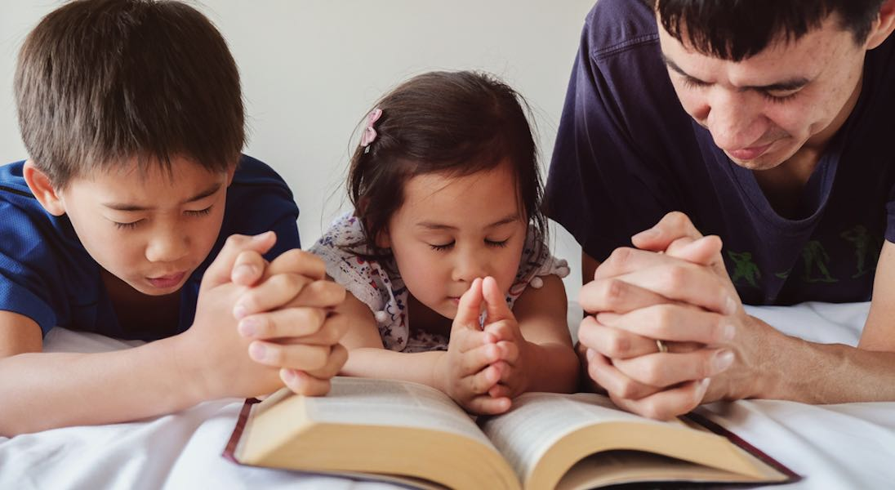
Family members

Slide 31
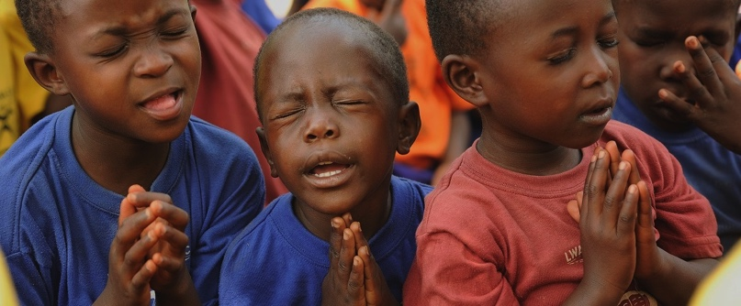
Friends

Slide 32
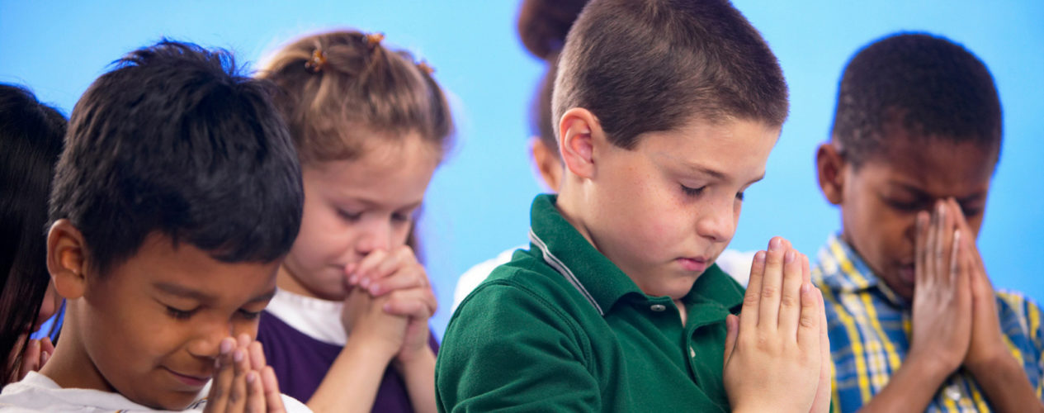
Enemies

Slide 33
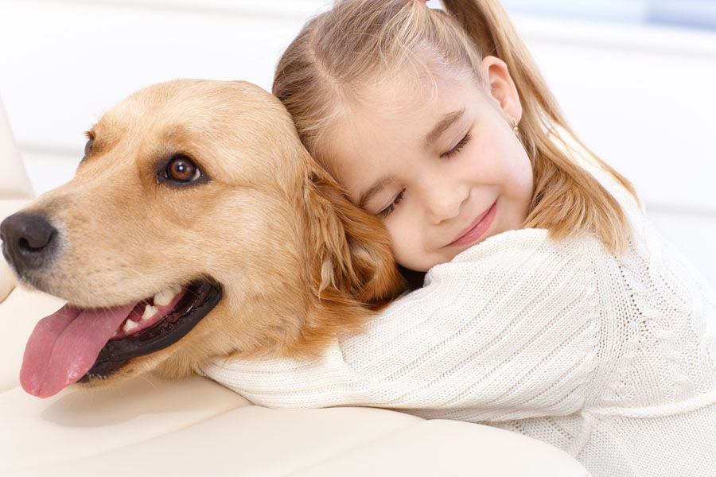
Pets

Slide 34
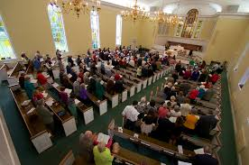
Church family

Slide 35
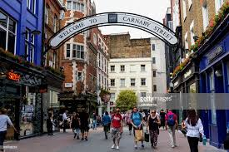
People not going to church

Slide 36
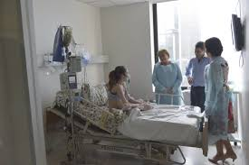
The sick

Slide 37
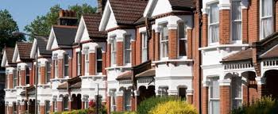
Neighbours.

Slide 38
5. Discuss why you pray.

Slide 39


Slide 40
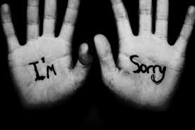

Slide 41


Slide 42
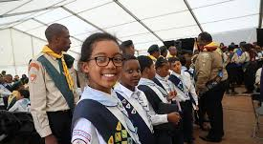
Pray for others and yourself.

Slide 43
6. Take a prayer walk with the Adventurers or your family. Talk about the way you felt during the walk.

