Slide 1

Visual Media Critic
E-Honour for Pathfinders

Slide 2
Requirement 1:
1. As a group, create a list of the various types of visual media. Then participate in an in-depth discussion on how varying types of media can be used to spread the gospel of Christ. Present a summary of your discussion to a different group, or share your conclusions online.

Slide 3
Requirement 2:
2. Read Patriarchs and Prophets, chapter 41, The Apostasy at Jordan, the two paragraphs beginning with “Keep thy heart with all diligence …”. Discuss how this relates to visual media consumption and how your senses and your awareness of the surroundings are impacted.

Slide 4
Requirement 3:
3. Compare and contrast the various ratings systems for video games, movies, and television programs with the guidance provided in Philippians 4:8.

Slide 5
Requirement 4:
4. Discuss the importance of parental involvement in the selection of media.

Slide 6
Requirement 5:
5. Discuss the impact violence in visual media plays in shaping society and its expectations.

Slide 7
Requirement 6:
6. Follow the current news for three days and evaluate the sources and accuracy of what has been reported. Evaluate on a scale of one to five where each report falls, with one representing pure entertainment and five representing strictly informational news. Prepare and present your findings to your group.

Slide 8
Requirement 7:
7. Search the writings of Ellen White for counsel on the wise use of time. Select and read a passage discovered during your search.

Slide 9
Requirement 8:
8. Keep a detailed record of the amount of time and types of all visual media you consume during a four-day period. Include the following data in your records:
a. Time spent viewing
b. Media rating and rating organization (if available)
c. The plot or theme
d. Purity of content vs sexual and/or violent themes
e. The message that was presented by the media

Slide 10
Requirement 8:
Prepare a graph or chart illustrating your findings. What changes, if any, do you need to make to your viewing habits? Evaluate how being a Christian should affect your use of media. Be detailed and honest, taking into account what you have experienced in this honour. Share your evaluation in a letter, report, or journal with a trusted friend or leader.

Slide 11
Requirement 9:
9. View a media presentation with your family. After the viewing, interview your family members using the following questions:
a. Did you find the presentation entertaining?
b. Did you learn anything valuable?
c. Would you watch the presentation again? Why or why not?
d. Did you feel your time was well spent in watching the media?

Slide 12
Requirement 10:
10. Create a speech, presentation, or game that shows what you have learned about the critique of visual media while earning this honour. Share this presentation with a group.

Slide 13
Definitions…

Slide 14
What is a critic?
A critic is a professional who communicates an assessment and an opinion of various forms of creative works such as art, literature, music, cinema, theatre, fashion, architecture, and food. Does, what they assess, achieve its purpose and its creator's intention.
Critical thinking is the analysis of facts to form a judgment.
Edward M. Glaser. "Defining Critical Thinking". The International Center for the Assessment of Higher Order Thinking (ICAT, US)/Critical Thinking Community. Retrieved 22 March 2017.

Slide 15
What is Media?
media
^{[ mee-dee-uh ]}
noun
a plural of medium.
(usually used with a plural verb) the means of communication, as radio and television, newspapers, magazines, and the Internet, that reach or influence people widely.

Slide 16
Types of Visual Media
Requirement 1:
Types of visual media include
digital and printed images,
photography,
graphic design,
fashion, videos,
architectural structures and fine arts.

Slide 17


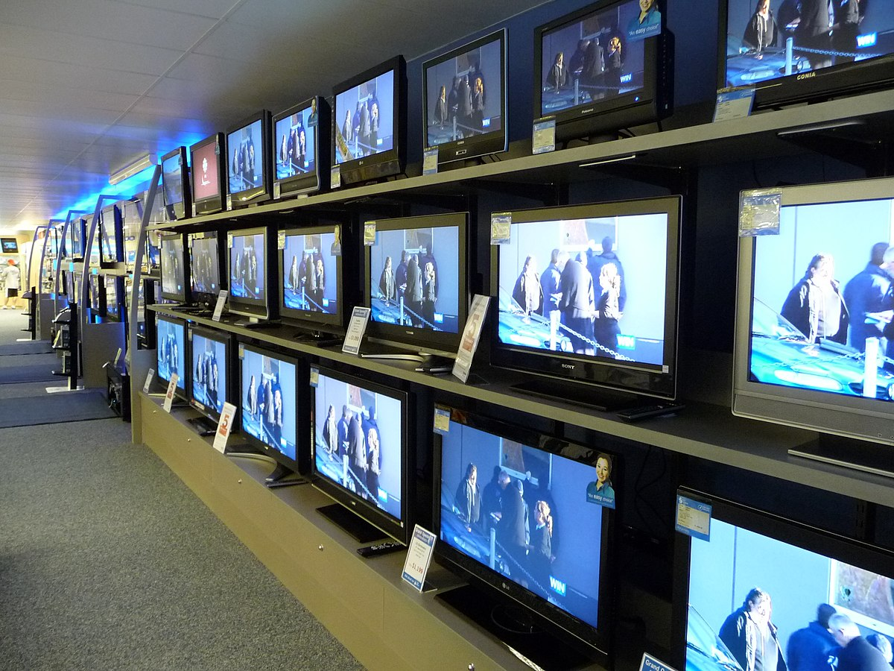
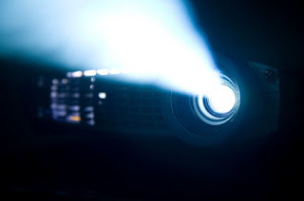



Visual media is seen on
Requirement 1:
billboards,
smartphones,
newspapers,
screen projectors,
posters,
televisions,
computers and various other mediums and devices.

Slide 18
Types of Visual Media
Photography and video
Painting, and drawing
Graphic design and drafting use computer-aided imaging software to create visual representations of life or art.
Architecture relies on visual guidelines and appeals to visual senses, as does fashion.
Requirement 1:

Slide 19



Types of Visual Media
All these mediums can be used to spread the gospel message.
Some examples include
3ABN,
Adventist World Radio,
Hope Channel,
or PraizeVision.
Requirement 1:

Slide 20

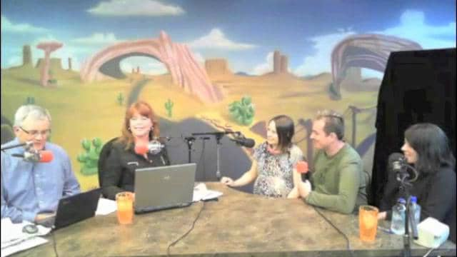

Types of Visual Media
In addition,
media technology,
live streaming broadcasting,
archived media services,
radio webcasting
are also mediums that are used to spread the Word.
Requirement 1:

Slide 21
Requirement 2:
2. Read Patriarchs and Prophets, chapter 41, The Apostasy at Jordan, the two paragraphs beginning with “Keep thy heart with all diligence …”. Discuss how this relates to visual media consumption and how your senses and your awareness of the surroundings are impacted.

Slide 22
Patriarchs and Prophets, chapter 41
“Keep thy heart with all diligence,” is the counsel of the wise man; “for out of it are the issues of life.” Proverbs 4:23. As man “thinketh in his heart, so is he.” Proverbs 23:7. The heart must be renewed by divine grace, or it will be in vain to seek for purity of life. He who attempts to build up a noble, virtuous character independent of the grace of Christ is building his house upon the shifting sand. In the fierce storms of temptation it will surely be overthrown. David's prayer should be the petition of every soul: “Create in me a clean heart, O God; and renew a right spirit within me.” Psalm 51:10. And having become partakers of the heavenly gift, we are to go on unto perfection, being “kept by the power of God through faith.” 1 Peter 1:5.
Requirement 2

Slide 23
Patriarchs and Prophets, chapter 41
Yet we have a work to do to resist temptation. Those who would not fall a prey to Satan's devices must guard well the avenues of the soul; they must avoid reading, seeing, or hearing that which will suggest impure thoughts. The mind should not be left to wander at random upon every subject that the adversary of souls may suggest. “Girding up the loins of your mind,” says the apostle Peter, “Be sober, ... not fashioning yourselves according to your former lusts in ... your ignorance: but like as He which called you is holy, be ye yourselves also holy in all manner of living.” 1 Peter 1:13-15, R.V. Says Paul, “Whatsoever things are true, whatsoever things are honest, whatsoever things are just, whatsoever things are pure, whatsoever things are lovely, whatsoever things are of good report; if there be any virtue, and if there be any praise, think on these things.” Philippians 4:8. This will require earnest prayer and unceasing watchfulness.
Requirement 2

Slide 24
Patriarchs and Prophets, chapter 41
We must be aided by the abiding influence of the Holy Spirit, which will attract the mind upward, and habituate it to dwell on pure and holy things. And we must give diligent study to the word of God. “Wherewithal shall a young man cleanse his way? by taking heed thereto according to Thy word.” “Thy word,” says the psalmist, “have I hid in mine heart, that I might not sin against Thee.” Psalm 119:9, 11.
Requirement 2

Slide 25
How does this relate to visual media consumption, how are your senses and your awareness of the surroundings impacted?
Ellen G. White uses several biblical passages to remind us that our thoughts become who we are. We must guard our hearts from unholy things, since Satan will use everything he can, including visual media, to distract us and destroy us.
As for our senses, a large screen, such as those found in a movie theatre combined with its loud volume can subdue the senses of attentiveness, rendering a person unaware of their immediate surroundings.
Requirement 2

Slide 26
Requirement 3:
3. Compare and contrast the various ratings systems for video games, movies, and television programs with the guidance provided in Philippians 4:8.

Slide 27

The various ratings systems for video games, movies, and television programs.
Requirement 3

Slide 28

Games
Requirement 3
Suitable for all age groups.
Some violence in a comical context or child-friendly setting is acceptable, as is nudity when shown in a completely natural and non-sexual manner such as breast feeding.

Slide 29

Games
Requirement 3
Same as 3 but contains some possibly frightening scenes or sounds.
A little more violence is permissible at PEGI 7. It is always unrealistic and often directed towards fantasy characters, though very mild non-realistic violence to humans may also feature. Implied violence (for example the bombing of a city where violence is not seen directly) is also dealt with at this level.

Slide 30

Games
Requirement 3
More detailed and realistic looking violence towards fantasy characters is allowed. Any violence towards human characters must look unrealistic unless it consists of only minor or trivial injury such as a slap.
Sexual posturing of the type often seen in music videos is also allowed at this level as is sexual innuendo.
Some bad language is allowed but it can be no more than mild swearing.
At PEGI 12, games may provide some instruction on casino-style gambling, for example they can feature an explanation of the rules for Blackjack or Poker. This descriptor also appears on PEGI 16 and PEGI 18 games.
A game at this level may feature horror content such as strong threat and dread or graphic injury details.

Slide 31

Games
Requirement 3
In addition to the numerical PEGI ratings, you will also see the ‘Parental Guidance Recommended’ rating for some non-game apps, introduced by PEGI for storefronts that use IARC (https://www.globalratings.com/).
This serves as a warning that these apps can offer a broad variety of user generated or organised content.
Typically, this applies to products such as Facebook, Twitter or YouTube.

Slide 32

Games
Requirement 3
At the 16 level you can expect to see more mature and realistic violence against human characters.
The game may deal heavily with death and injury to humans.
Sexual activity can be shown but it must not include visible genitals. Depictions of erotic nudity may feature.
The worst forms of bad language can be heard and will often include sexual expletives.
Prominent use of tobacco and alcohol may be featured, as well as the use of illegal drugs. The game could glamorise crime.

Slide 33

Games
Requirement 3
The adult classification is applied when the level of violence is both realistic or severe in nature, often being graphic with blood and gore.
The game may include detailed descriptions of criminal techniques, or it may in some way glamorise the use of illegal drugs. Encouragement of tobacco or alcohol may also be included.
Sexual activity with visible genital organs may be shown. If a game is released physically in the UK and is likely to attain an R18 rating, the game will be referred to the BBFC for classification.

Slide 34
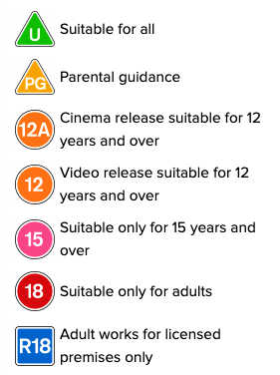
Movies
Requirement 3

Slide 35
Philippians 4:8 says the following:
Finally, brethren, whatever things are true, whatever things are noble, whatever things are just, whatever things are pure, whatever things are lovely, whatever things are of good report, if there is any virtue and if there is anything praiseworthy—meditate on these things.
Requirement 3

Slide 36
Compare and contrast the various ratings systems for video games, movies, and television programs with the guidance provided in Philippians 4:8.
Mankind has attempted to develop a rating system for much of its visual media content. However, this is a manmade system and was not created with spiritual matters or God in mind. Some of these rating systems might consider a particular program "safe" for a general audience, but Christians would disagree with much of the content.
The Bible gives us a good and clear list of what we should ponder and think about when we consume visual media. It tells us to fill our minds with things that are true, lovely, pure, etc. When determining what kind of content to watch, don't let yourself be guided by the world's standard of morals, but by God's standard of truth and purity.
Requirement 3

Slide 37

Discuss the importance of parental involvement in the selection of media.
Requirement 4

Slide 38
Discuss the impact violence in visual media plays in shaping society and its expectations.
Nearly two-thirds of TV programs contain some physical violence. Most self-involving video games contain some violent content, even those for children.
Requirement 5

Slide 39
Discuss the impact violence in visual media plays in shaping society and its expectations.
The more we see violence on screen in our recreation, the more we become dulled to the effect of violence.
On the age ratings for games and movies, 5 out of the 6 categories include violence.
Requirement 5

Slide 40
Discuss the impact violence in visual media plays in shaping society and its expectations.
A report in the US, which examined 37 incidents of targeted school shootings and school attacks, found that “over half of the attackers demonstrated some interest in violence through movies, video games, books, and other media.”
They said, “Extensive research evidence indicates that media violence can contribute to aggressive behaviour, numbness to violence, nightmares, and fear of being harmed.”
Requirement 5

Slide 41
Discuss the impact violence in visual media plays in shaping society and its expectations.
In 2012, a worldwide study said, “Over the past 50 years, a large number of studies conducted around the world have shown that watching violent television, watching violent films, or playing violent video games increases the likelihood for aggressive behaviour.”
Requirement 5

Slide 42
Discuss the impact violence in visual media plays in shaping society and its expectations.
In 2007, a study into violent video games. The study questioned children and their friends, as well as teachers, on aggressive behaviours and violent media consumption twice during a school year. The researchers found that boys and girls who played a lot of violent video games changed over the school year, becoming more aggressive.
Requirement 5

Slide 43




Requirements
6. Follow the current news for three days and evaluate the sources and accuracy of what has been reported. Evaluate on a scale of one to five where each report falls, with one representing pure entertainment and five representing strictly informational news. Prepare and present your findings to your group.
Requirement 6

Slide 44
News Evaluation
 | 1 | 2 | 3 | 4 | 5
Requirement 6

Slide 45
7. Search the writings of Ellen White for counsel on the wise use of time. Select and read a passage discovered during your search.
"The talent of time is precious. Every day it is given to us in trust, and we shall be called upon to give an account of it to God. It is to be used to God's glory, and if we would prolong our lives, if we would gain the life that measures with the life of God, we must give the mind pure food. No time should be wasted that might have been used to good account. Jesus Christ is our spiritual touchstone. He reveals the Father. Nothing should be given as food to the brain that will bring before the mind any mist or cloud in regard to the Word of God. No careless inattention should be shown in regard to the cultivation of the soil of the heart." -- Manuscript 15, 1898.
Requirement 7

Slide 46
7. Search the writings of Ellen White for counsel on the wise use of time. Select and read a passage discovered during your search.
"It is wrong to waste our time, wrong to waste our thoughts. We lose every moment that we devote to self-seeking. If every moment were valued and rightly employed, we should have time for everything that we need to do for ourselves or for the world. In the expenditure of money, in the use of time, strength, opportunities, let every Christian look to God for guidance." -- The Ministry of Healing, pg. 208
Requirement 7

Slide 47
Requirement 8
8. Keep a detailed record of the amount of time and types of all visual media you consume during a four-day period. Include the following data in your records:
a. Time spent viewing
b. Media rating and rating organization (if available)
c. The plot or theme
d. Purity of content vs sexual and/or violent themes
e. The message that was presented by the media

Slide 48
Requirement 8
 | Time Spent viewing | Media rating | Plot or theme | Purity of content vs sexual and/or violent themes | The message that was presented by the media
Day 1
Day 2
Day 3
Day 4

Slide 49
Requirement 8
Prepare a graph or chart illustrating your findings. What changes, if any, do you need to make to your viewing habits? Evaluate how being a Christian should affect your use of media. Be detailed and honest, taking into account what you have experienced in this honour. Share your evaluation in a letter, report, or journal with a trusted friend or leader.

Slide 50
Requirement 9
View a media presentation with your family. After the viewing, interview your family members using the following questions:
a. Did you find the presentation entertaining?
b. Did you learn anything valuable?
c. Would you watch the presentation again? Why or why not?
d. Did you feel your time was well spent in watching the media?

Slide 51
Visual media is seen on
Requirement 1:
billboards,
smartphones,
newspapers,
screen projectors,
posters,
televisions,
computers and various other mediums and devices.

Slide 52


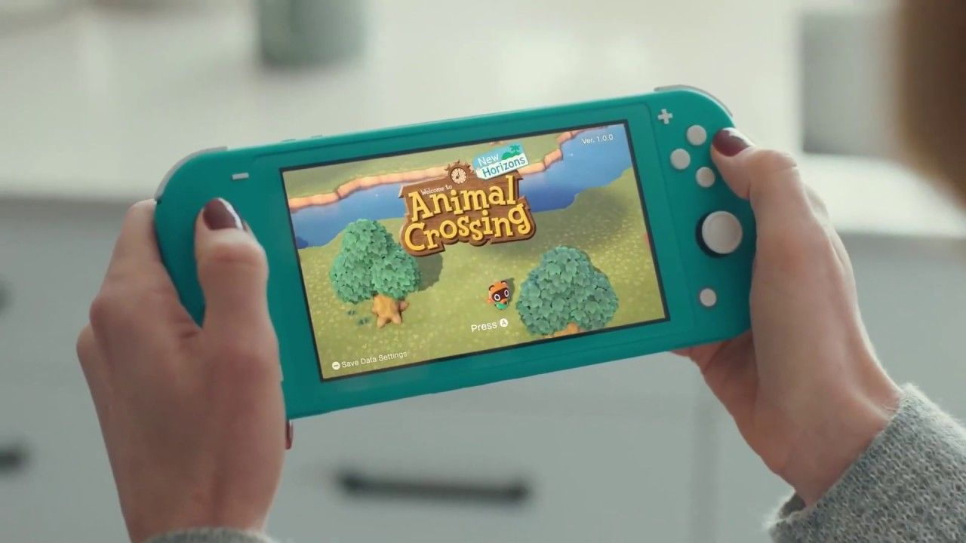
Requirement 9
View a media presentation with your family.

Slide 53
Requirement 10
Create a speech, presentation, or game that shows what you have learned about the critique of visual media while earning this honour. Share this presentation with a group.
Speech | 500 Words
Presentation | Poster, photo, Powerpoint, video, VLOG
Game | Design board game, Design something on tablet

Slide 54
Requirement 1: Recap
As a group, create a list of the various types of visual media. Then participate in an in-depth discussion on how varying types of media can be used to spread the gospel of Christ. Present a summary of your discussion to a different group, or share your conclusions online.
Photography, video, Painting, drawing, Graphic design, Architecture
3ABN, Adventist World Radio, Hope Channel, PraizeVision.

Slide 55
Requirement 2: Recap
2. Read Patriarchs and Prophets, chapter 41, The Apostasy at Jordan, the two paragraphs beginning with “Keep thy heart with all diligence …”. Discuss how this relates to visual media consumption and how your senses and your awareness of the surroundings are impacted.
We must guard our hearts from unholy things.
The use of wrong media can distract us from immediate surroundings.

Slide 56
Requirement 3: Recap
3. Compare and contrast the various ratings systems for video games, movies, and television programs with the guidance provided in Philippians 4:8.
Man made vs. Godly values

Slide 57
Discuss the importance of parental involvement in the selection of media.
Requirement 4

Slide 58
Requirement 5: Recap
5. Discuss the impact violence in visual media plays in shaping society and its expectations.
Violence in games has an affect on aggressive behaviour
Can be linked to violent acts
Presents itself in a subtle way which can affect relationships

Slide 59
News Evaluation
 | 1 | 2 | 3 | 4 | 5
Requirement 6

Slide 60
Requirement 8
 | Time Spent viewing | Media rating | Plot or theme | Purity of content vs sexual and/or violent themes | The message that was presented by the media
Day 1
Day 2
Day 3
Day 4

Slide 61
Requirement 9
View a media presentation with your family.

Slide 62
Requirement 10
Create a speech, presentation, or game that shows what you have learned about the critique of visual media while earning this honour. Share this presentation with a group.
Speech | 500 Words
Presentation | Poster, photo, Powerpoint, video, VLOG
Game | Design board game, Design something on tablet

