Slide 1
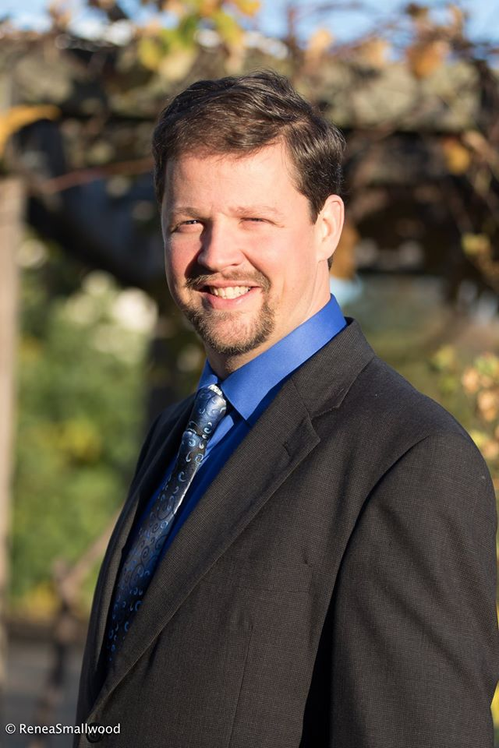
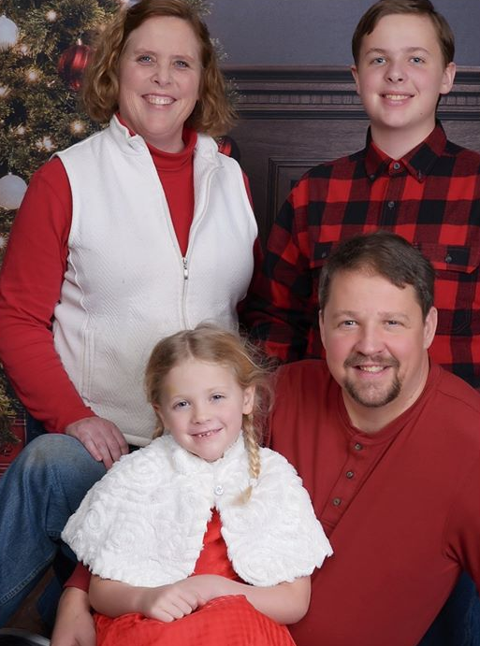
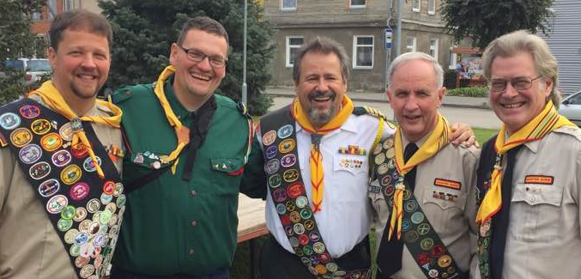
Pastor/Teacher
Mark O’Ffill
NAD Honors Task-force Chair
Wiki.pathfindersonline.org

Slide 2
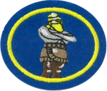
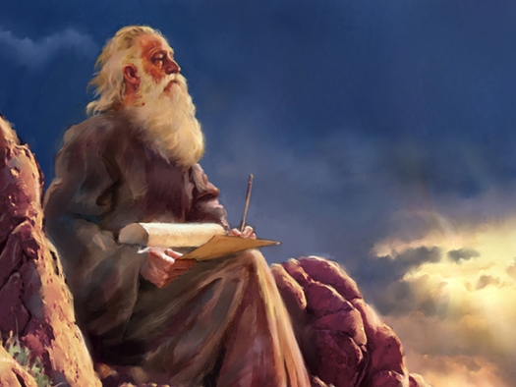
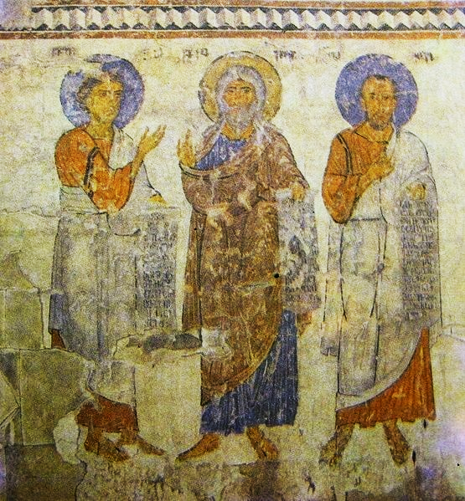
P
R
O
P
H
E
T
S
P
R
O
P
H
E
C
Y
E-Honour

Slide 3
Goals:
Earn the Prophets and Prophecy honor
Learn about what PRINCIPLES the Bible uses to define and “perform” prophecy
Learn about the jobs of Prophets
Evaluate prophecies that have come true
Explore prophecies of events still in the future
Find out what the Bible really says about the end times.

Slide 4
Brainstorm -
What words come to mind….
When you think about “Prophets and Prophecy”?
(include names and Bible books as necessary)
https://www.wordclouds.com/

Slide 5
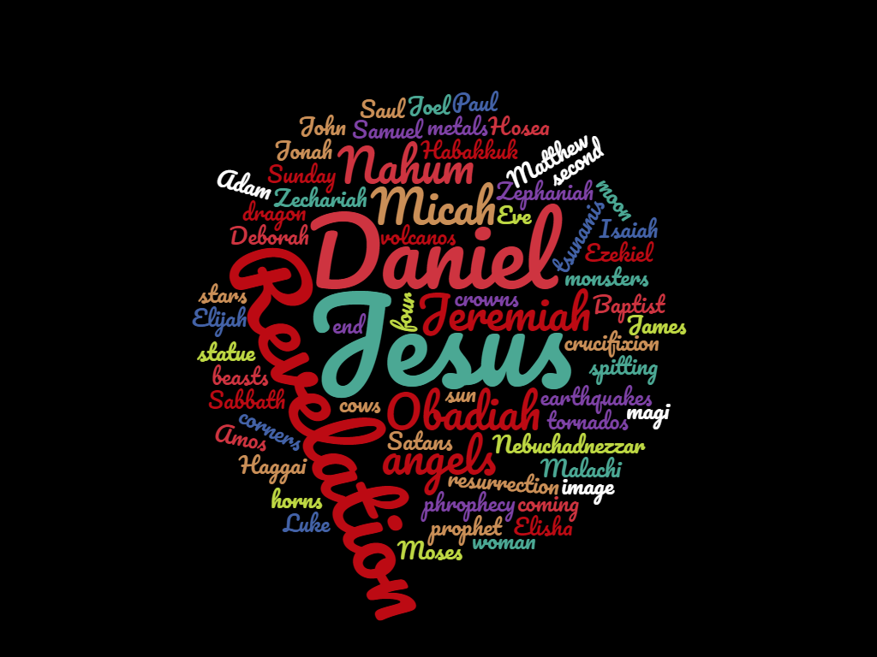
<Put word cloud here>

Slide 6
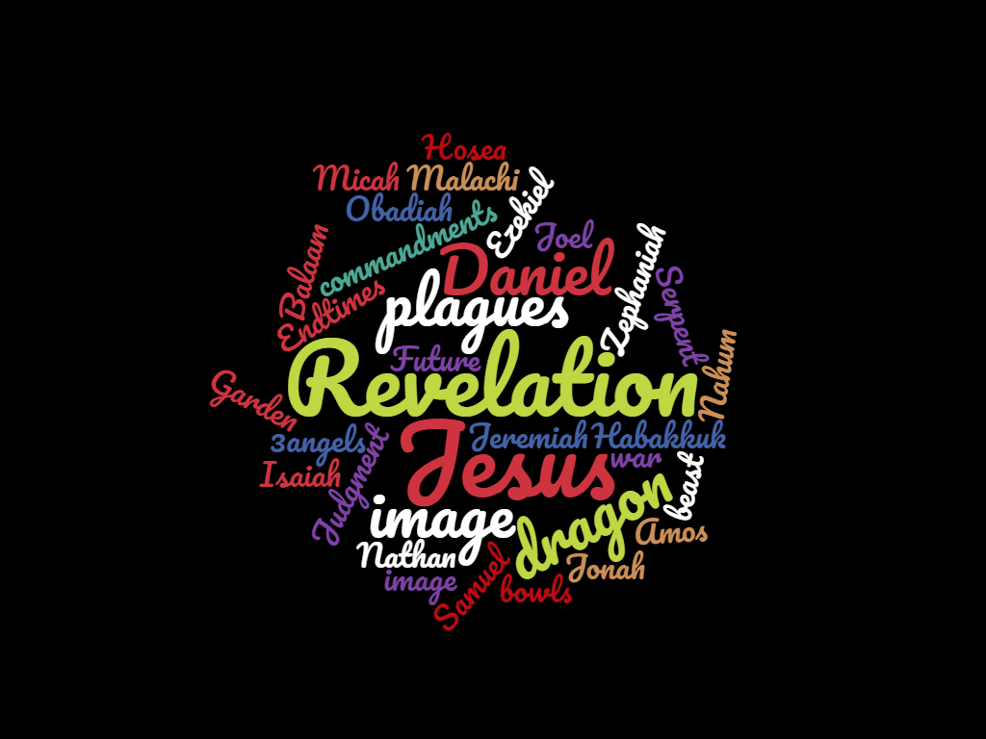

Slide 7
Define: Prophet
Webster's dictionary defines prophet as
"one who utters divinely inspired revelations."
The role of the prophet is laid out in the Bible: "I will raise up for them a Prophet like you from among their brethren, and will put My words in His mouth, and He shall speak to them all that I command Him. And it shall be that whoever will not hear My words, which He speaks in My name, I will require it of him" (Deuteronomy 18:18-19, NKJV).
Req #1

Slide 8
Define: Prophet
Responsible godly messenger
Warns people
Carries difficult messages
Helps people get closer to God
Tells future
Has vision/dreams
Non gender-specific / non age-specific
Listens to God and reflects His character
Req #1
Notes:
Notice that this is a big list, not JUST about telling the future. “Messenger” would be the key word!

Slide 9
Define Prophecy
Prophecy is the foretelling or prediction of what is to come
or something that is declared by a prophet, including a prediction, instruction, or exhortation (think Jonah).
God uses prophecy to send a divine message to His church. Sometimes the message is for the church when it is given; other times the message is to be opened to the understanding of a people at a later time.
Req #6

Slide 10

Prophecy for God’s church
God promises that he will communicate with His people
Every time something is going to happen!
He values His people and His church too much to surprise them!
“Surely the Sovereign Lord does nothing
without revealing his plan
to his servants the prophets.”
~Amos 3:7
Req #6

Slide 11
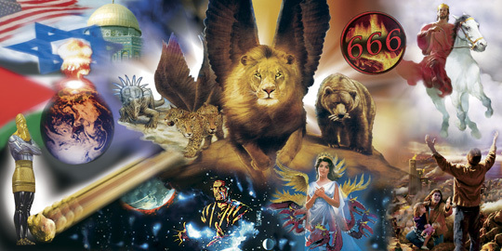
Notes:
Sometimes we have equated prophets and prophecy to fear and foreboding. God has intended the opposite -- he wishes to give us prophets and prophecy to “inform” us so that we do not need to be anxious how the future.

Slide 12

Sometimes we have equated prophets and prophecy to fear and foreboding. God has intended the opposite -- he wishes to give us prophets and prophecy to “inform” us so that we do not need to be anxious about the future.
1 Corinthians 14:3 (NLT)
But one who prophesies strengthens others, encourages them, and comforts them.
Notes:
Sometimes we have equated prophets and prophecy to fear and foreboding. God has intended the opposite -- he wishes to give us prophets and prophecy to “inform” us so that we do not need to be anxious how the future.

Slide 13
Who are some of the Prophets?
Old Testament
non-Writers (1 Chronicles 29:29)
  brainstorm
Writers
  Major
  Minor
Req #2

Slide 14
Open Your Bible to the Title Page
Find the list of “prophets books” in the Old Testament

Slide 15
Who are some of the Prophets (OT)?
Major: Isaiah, Jeremiah, Ezekiel, Daniel
Minor: Hosea, Joel, Amos, Obadiah, Jonah, Micah, Nahum, Habakkuk, Zephaniah, Haggai, Zechariah, Malachi
Non-writers: Samuel, Nathan, Gad (1 Chron. 29:29), Elijah, Elisha, Enoch, Moses, Abraham...
Req #2

Slide 16
What is the difference?
How much they chose to write down (or have written down for them)!
Ex. Isaiah has 66 chapters whereas
Obadiah has 1 chapter
Req #3

Slide 17
New Testament Prophets
Find the Prophet / Why a prophet?
Req #4

Slide 18
New Testament Prophets
Matthew 11:8-10
  John
Acts 21:10
  Agabus
Acts 15:32
  Silas
Revelation 1:1-4a
  John (the Revelator)
Matthew 21:11 / Luke 24:19 (and 23 other places in the NT)
  Jesus
Req #4
Notes:
Requirement 8
https://www.ellengwhitetruth.com/her-ministry/10-tests-of-a-prophet

Slide 19
Women Prophets
Micah 6:4
  Miriam
Judges 4:4
  Deborah
2 Kings 22:14
  Huldah
Isaiah 8:3
  Isaiah’s wife (yeah, betcha didn’t know that!)
Nehemiah 6:14
  Noadiah
Req #5
Notes:
Requirement 8
https://www.ellengwhitetruth.com/her-ministry/10-tests-of-a-prophet

Slide 20
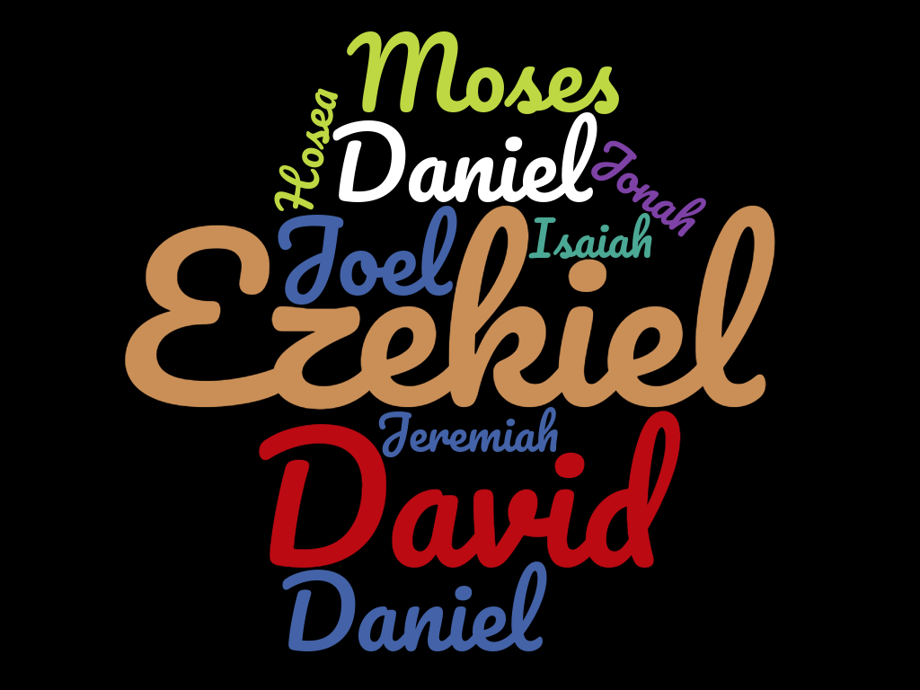
80+ Prophecies About Jesus
Fulfilled!

Slide 21
Are All “Prophets” Legitimate?
NO!
Throughout history God challenges us to “test” those who claim to be His messengers!
Deuteronomy 18:22, 1 John 4:1-3, Jeremiah 23:28-32
Req #8a

Slide 22
Summary of Biblical Prophet Tests
Give messages that harmonize with the Bible (Isaiah 8:20)
Make predictions that “come to pass” (Jeremiah 28:9)
Teach that Jesus came in the flesh (1 John 4:1–3)
Have a Christ-like character (Matthew 7:16–20).
Glorify God rather than themselves (John 16:13)
Do not give their own private interpretations (2 Peter 1:20, 21)
Point out sin (Micah 3:5–8)
Warns of coming judgment (Matthew 24:20-21)
Edify the church (1 Corinthians 14:3, 4)
Are obedient to the will of God (Deuteronomy 18:18)
Req #8b
Notes:
Requirement 8
https://www.ellengwhitetruth.com/her-ministry/10-tests-of-a-prophet

Slide 23
Applying the Tests
Do these prophets qualify?
10a (partial)

Slide 24
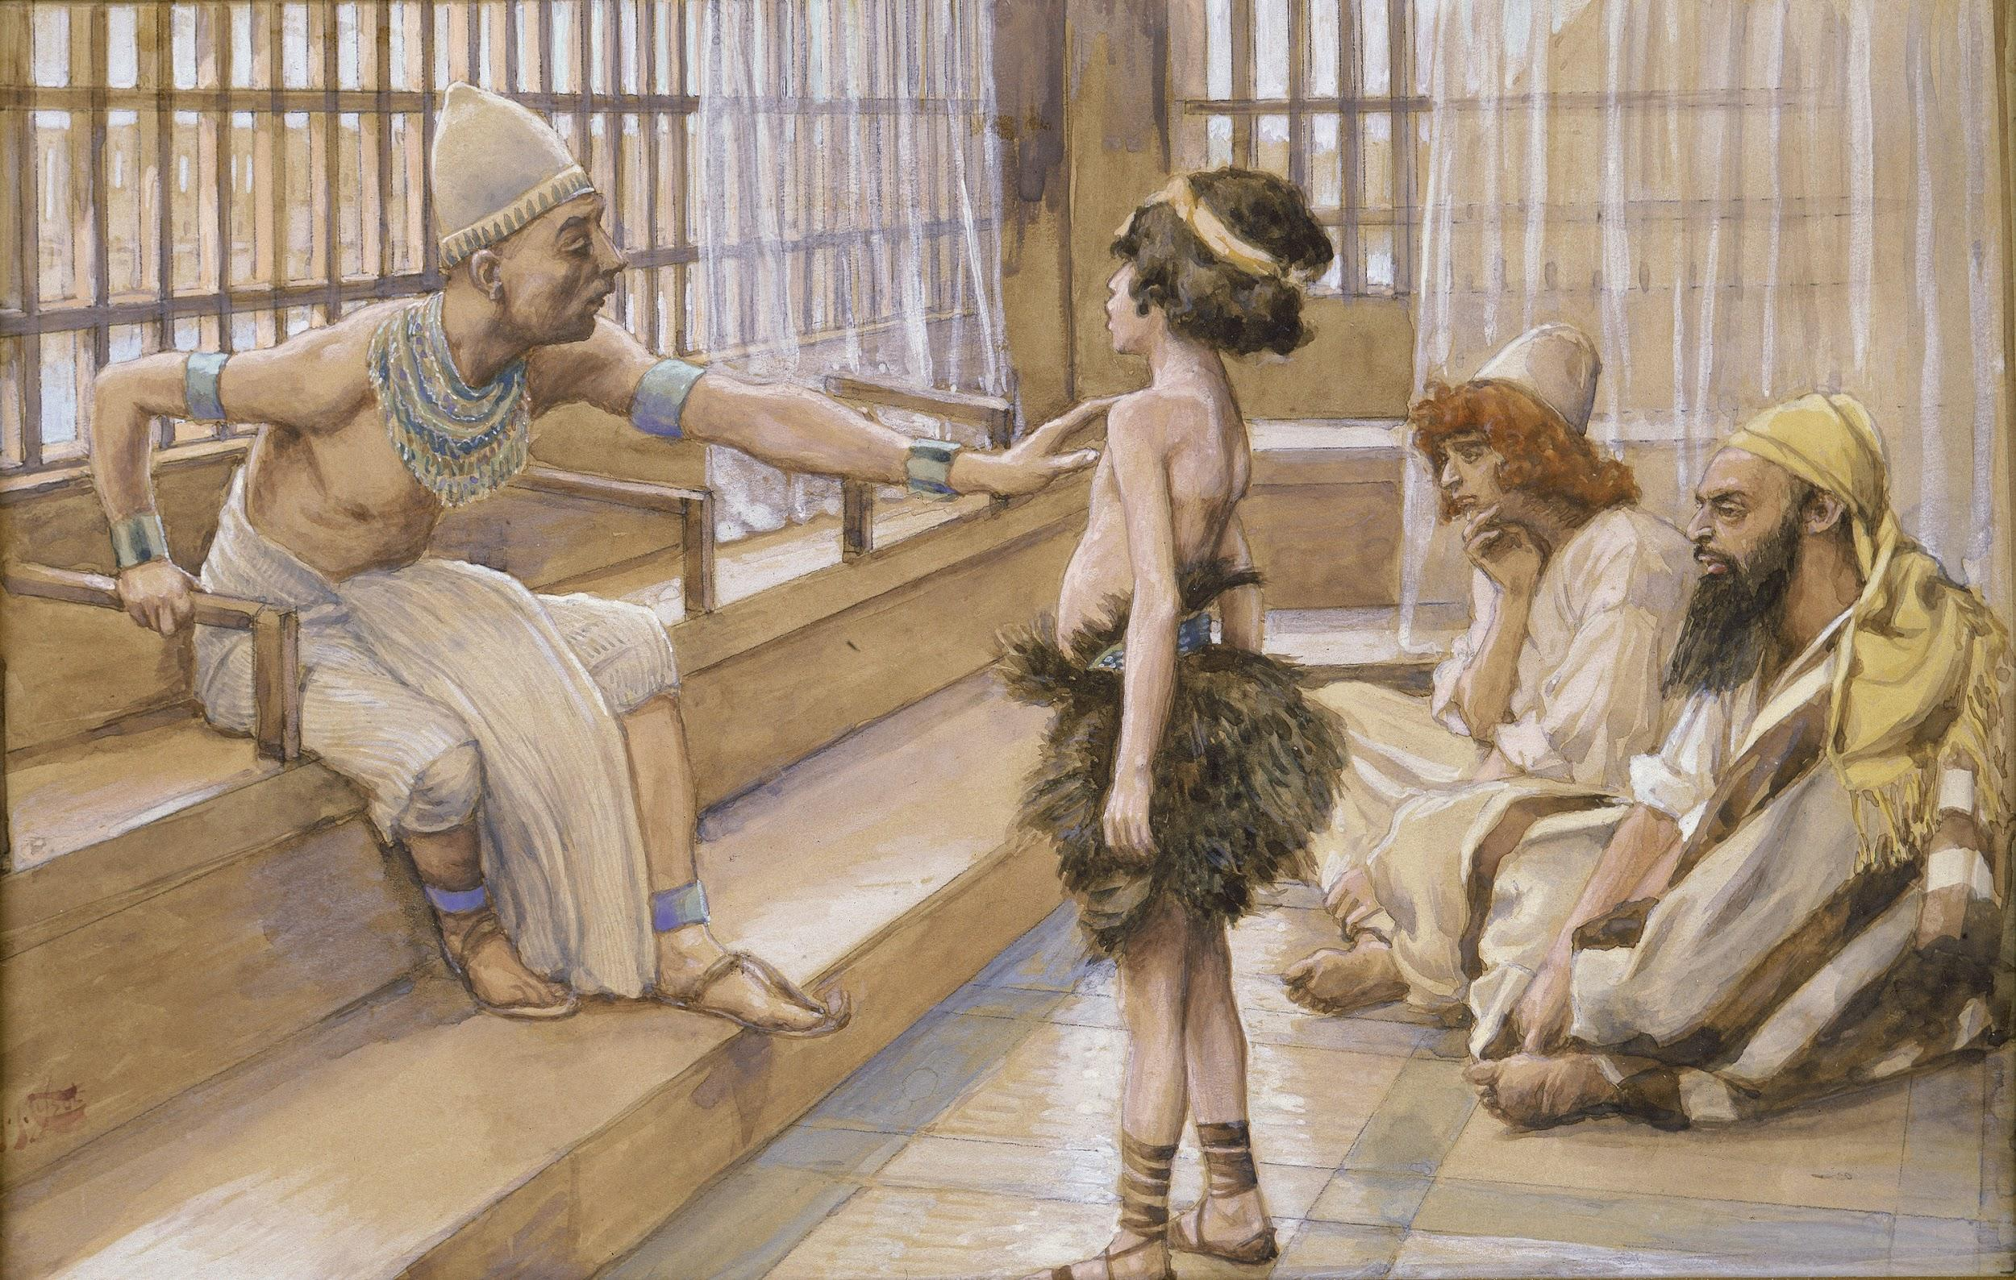
Joseph
Genesis 41:25-32 (along w/ chp 40)
Read story
Apply tests (note, some are not mentioned one way or the other)
Req #10a

Slide 25
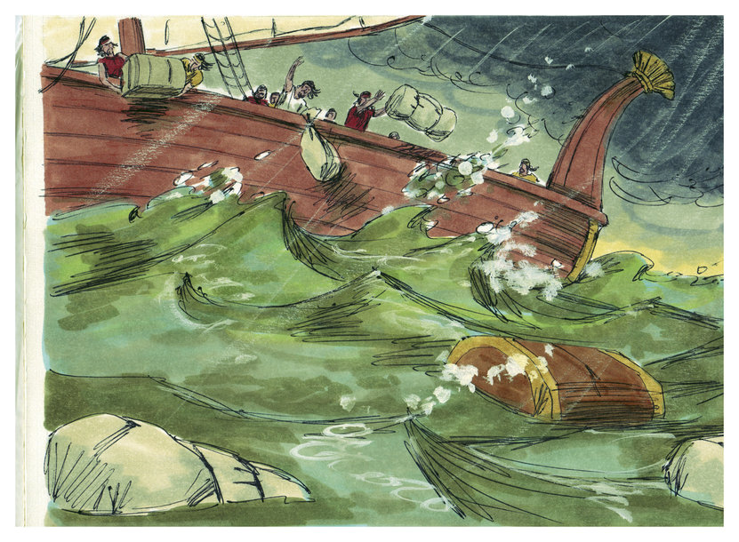
Jonah
Jonah 3-4
SUMMARIZE story
Apply tests (note, some are not mentioned one way or the other)
Does Heart and Attitude affect the validity of a prophet?
Biblical illustrations by Jim Padgett, courtesy of Sweet Publishing, Ft. Worth, TX, and Gospel Light, Ventura, CA. Copyright 1984. R under new license, CC-BY-SA 3.0
https://commons.wikimedia.org/wiki/File:Book_of_Jonah_Chapter_1-3_(Bible_Illustrations_by_Sweet_Media).jpg
Req #10b

Slide 26
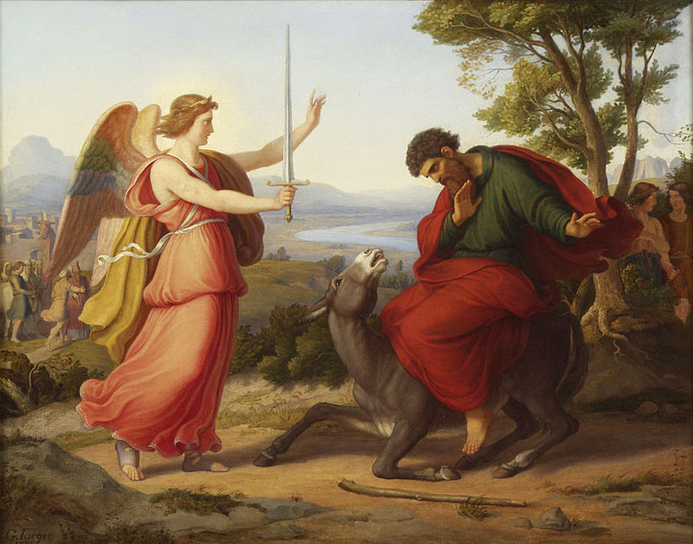
Balaam
Numbers 22; Numbers 24:5-7; Num 24:17; 2 Peter 2:15, Revelation 2:14
Read story
Apply tests (note, some are not mentioned one way or the other)
By «Валаам и ангел». Художник Густав Йегер. - http://www.duesseldorfer-auktionshaus.planetactive.com/, Public Domain, https://commons.wikimedia.org/w/index.php?curid=652778
Req #10c

Slide 27
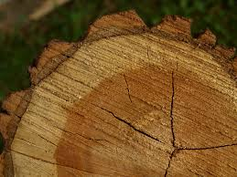
Daniel
Daniel 4
Read story (and peak into Daniel 5 for its fulfillment)
Apply tests (note, some are not mentioned one way or the other)
https://pxhere.com/en/photo/1105085
Req #10d

Slide 28
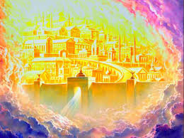
John
Revelation 21:1-8 (+ Gospel of John)
Read passage
Can we apply the tests?
Trust the author? Why?
Req #10e

Slide 29
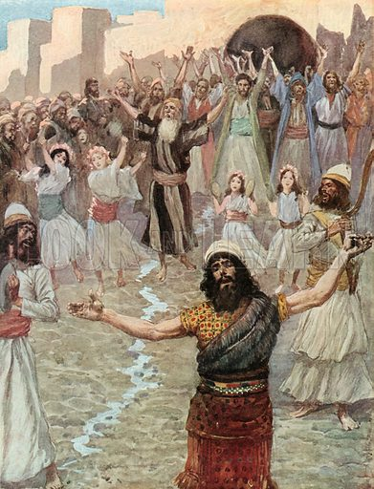
When God talks ...
Sometimes God has a bigger goal and uses prophecy with non-prophets.
Check out King Saul’s crazy story (1 Samuel 20:18-24)
Req #9
https://www.lookandlearn.com/history-images/M830068/Saul-Prophesies-with-the-Prophets

Slide 30
Matthew 24 Prophecy
READ/DISCUSS in a group the dual (two purpose)
prophecy made by Jesus in Matthew 24, which covers both the fall of Jerusalem and the end of time.
Create a chart showing how each phrase can apply to each time frame.
*** Combine this requirement with Requirement #14b for a great learning experience with your pastor!****
Req #11

Slide 31
Matthew 24 Prophecy
The DISCIPLES saw “the end of time” and the “end of Jerusalem/temple” as being the SAME event. (vs.3 “what will be the sign of Your coming, and of the end of the age?” )
****Jesus KNEW BETTER**** but didn’t mess with their heads too much. He knew he would inspire understanding in his followers at the right times in the future!
Req #11

Slide 32
Mt. 24 Chart Directions
Read and UNDERLINE the passage
  Red = Jerusalem Prophecy
  Blue = End times Prophecy
  Purple = BOTH times Prophecy
Put “Jerusalem” ID in the left part of the Venn, “End times” in the right part, and those that seem to apply to both in the middle.
Show your Venn Diagram to your instructor/supervisor
Req #11

Slide 33
Mt. 24 Chart Sample
JERUSALEM BOTH END TIMES
Vss 1 - no stones left
Vss 5 “many will say I am Christ”
Vss 6 “wars and rumors of wars”
Req #11

Slide 34
Common Symbols Used in Prophecy
Animals = nations
Waters = separation/ lack of population
Earth = populations
Women = church (sometimes the true church, sometimes those pretending to be God’s church)
And what they mean
Req #12

Slide 35
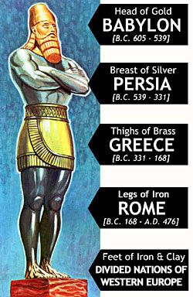
The Image Activity!
Read & Discuss - Daniel chapter 2.
Make a multi-dimensional model of the image in Nebuchadnezzar’s dream. Label what each section represents.
Explain/Display your project
Develop ONE “critical thinking” question to ask the group.
Do from home tip for earning from home during the pandemic: discuss live via video conferencing technology.
Req #13

Slide 36
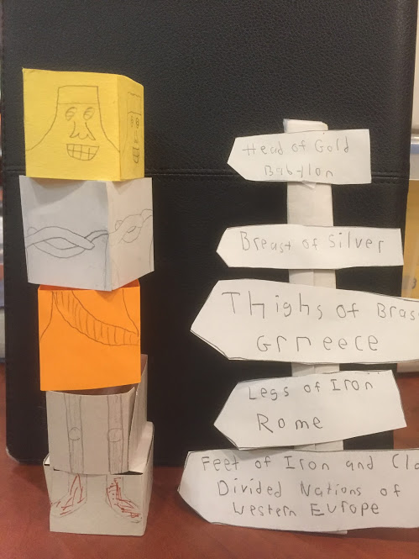
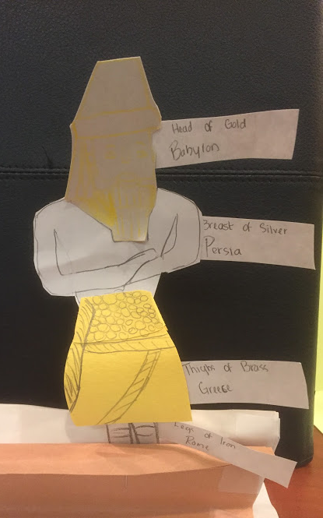
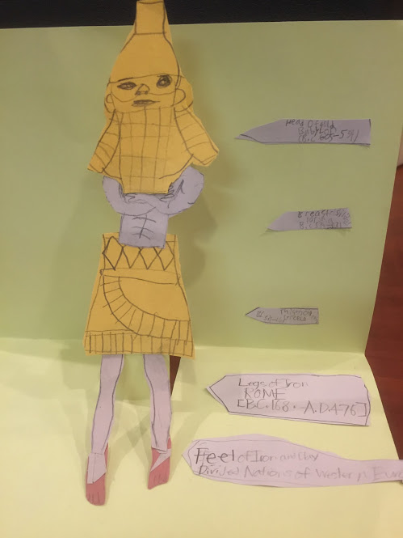
The Image Activity Samples!
Req #13

Slide 37
The Image Activity!
Write:
  What part of the dream is missing in this picture?
  Why do you think God thought Nebuchadnezzar NEEDED to know about the future?
  Where is OUR time period in this image? (circle)
  What does this tell us about the Second Coming?
Req #13

Slide 38
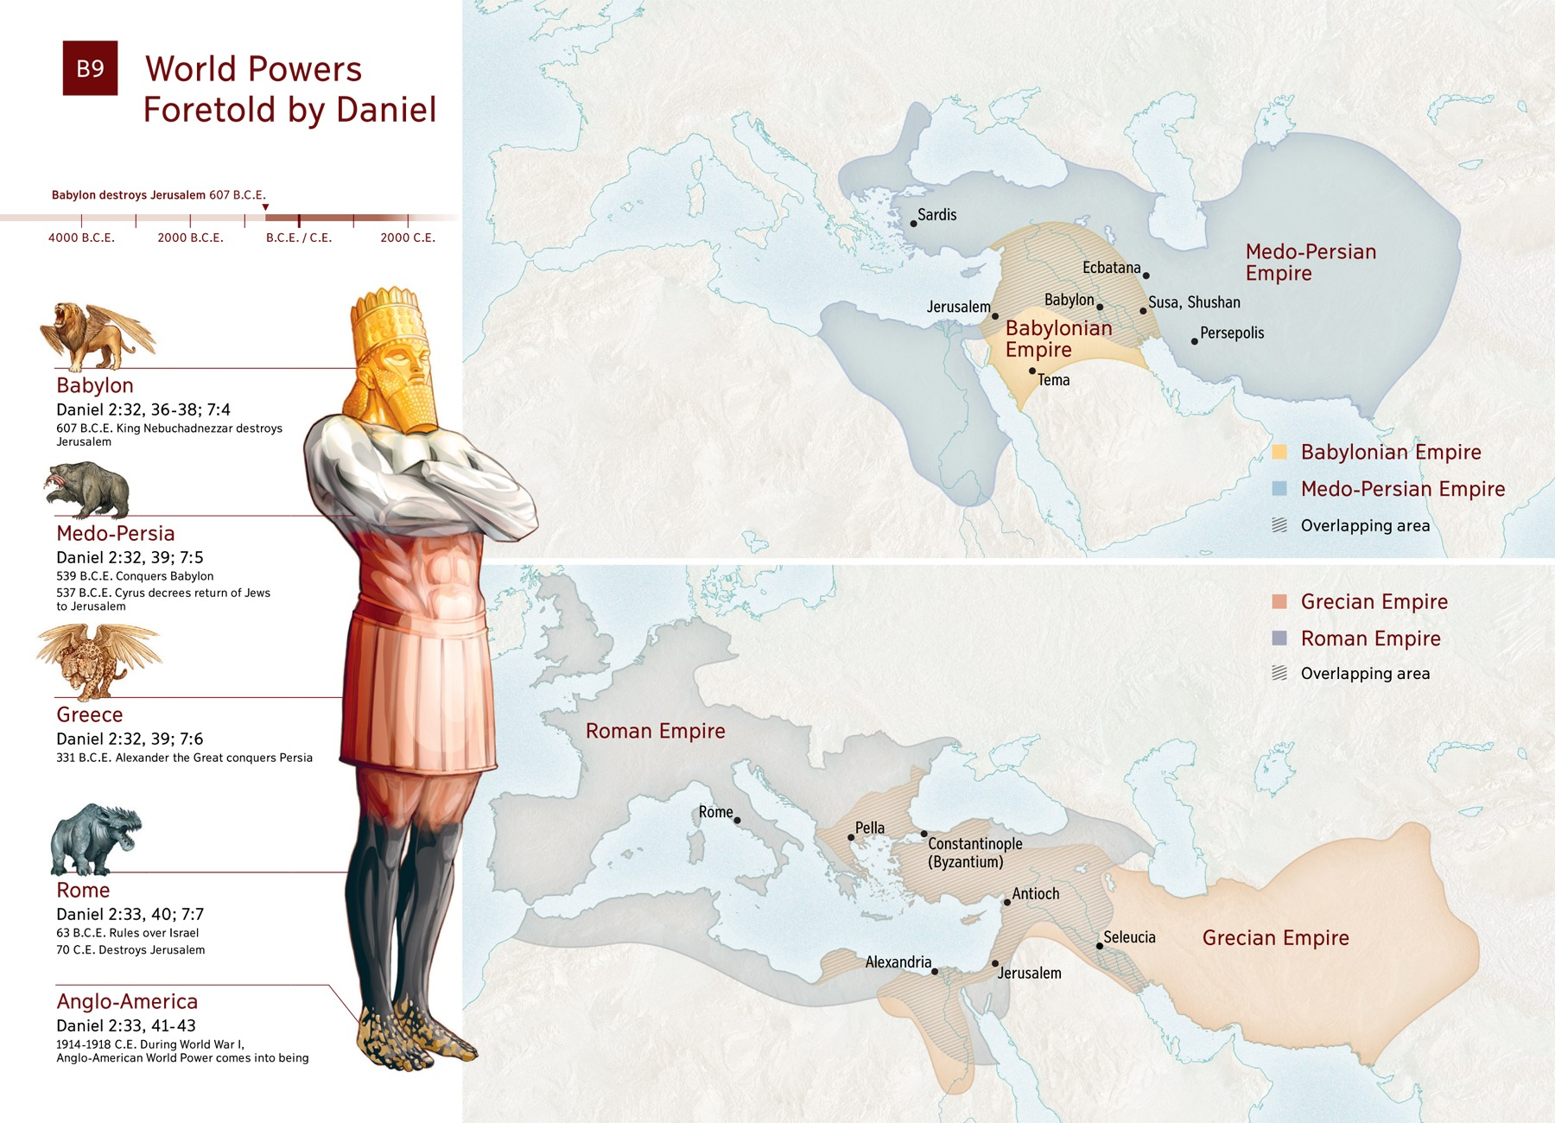
Req #13

Slide 39
Do the following activities:
Req #14
a. Give a short talk or skit for vespers or prayer meeting
(or any appropriate gathering) about one of your favorites prophets.
b. Complete a Bible study on prophecy with a leader in your church.
Do from home tip for earning from home during the pandemic: The presentation can be prerecorded or presented live via video conferencing technology.
Do from home tip for earning from home during the pandemic: live study via video conferencing technology.

Slide 40
Left to Do Summary
Requirement #10 (media experience)
Requirement #11 (chart/Venn diagram)
Requirement #13 (image model)
Requirement #14 (talk/skit; Bible study with Pastor)
Active Learning!

Slide 41


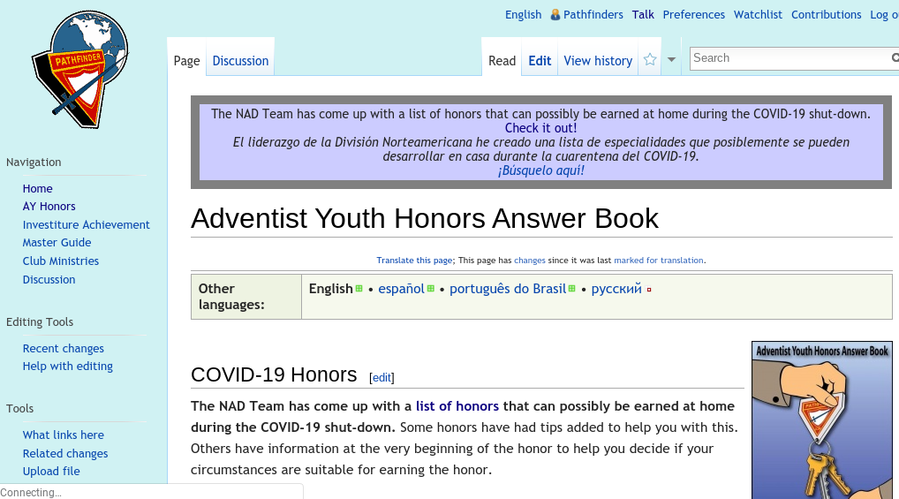
If you are enjoying this honour...
Prophets & Prophecy
Advanced
God’s Messenger
wiki.pathfindersonline.org
There’s more!

Slide 43
Works Cited
10 Tests of a True Prophet. https://www.ellengwhitetruth.com/her-ministry/10-tests-of-a-prophet
“Prophets and Prophecy.” Pathfindersonline Wiki. wiki.pathfindersonline.org. Accessed August 2018.

