Slide 1

STARS
Pathfinder Honour
Credit: Janelle C, NAD

Slide 2
STARS

Slide 3
What you will need: Starchart App

Slide 4
What you will need: What’s Out Tonight? June 2020 Sky Chart - http://whatsouttonight.com

Slide 5
Some Mind-blowing Facts about Stars

Slide 7
There are over 10,000 in this image, each one containing around 100 billion stars

Slide 8
Our sun is no exception—the closest star to us, Proxima Centauri, is 4.24 light years away, or 70,000 years away in our fastest spacecraft.

Slide 9
How huge are some stars?

Slide 10
1,420 of our suns on top of each other, you’d have the diameter of VY Canis Majoris

Slide 11

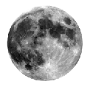
Q: What is the earth’s nearest celestial neighbour?
A: The moon
Q: What is its distance from the earth?
A: about 240,000 miles
Click for Q & A

Slide 12

Q: What (object) governs the tide?
A: The moon
Click for Q & A

Slide 13
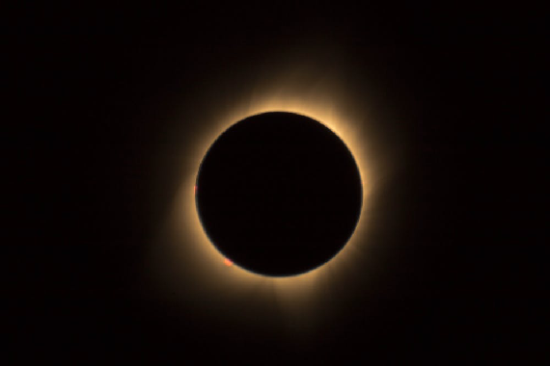
Q: What causes an eclipse?
A: A shadow of one celestial object falls on another
Click for Q & A

Slide 14
Do it: Showing the relative positions and movements of the earth, sun and moon.
Show how an eclipse happens

Slide 15
https://study.com/academy/lesson/lunar-eclipse-lesson-for-kids-definition-facts.html
What eclipse is this?

Slide 16
https://photographingspace.com/total-lunar-eclipse/

Slide 17
https://www.mathworks.com/matlabcentral/mlc-downloads/downloads/ae5b6768-c679-4887-9116-170d6a8136cf/d8723bb2-5b74-4851-b6a5-d282ab5e4ba4/images/screenshot.png
What about this?

Slide 18
Solar eclipse

Slide 19
Solar eclipse and Eye health

Slide 20
For a young woman who stared too long on August 21st, the partially eclipsed Sun left a lasting impression — on her retinas.
Solar eclipse and Eye health

Slide 21

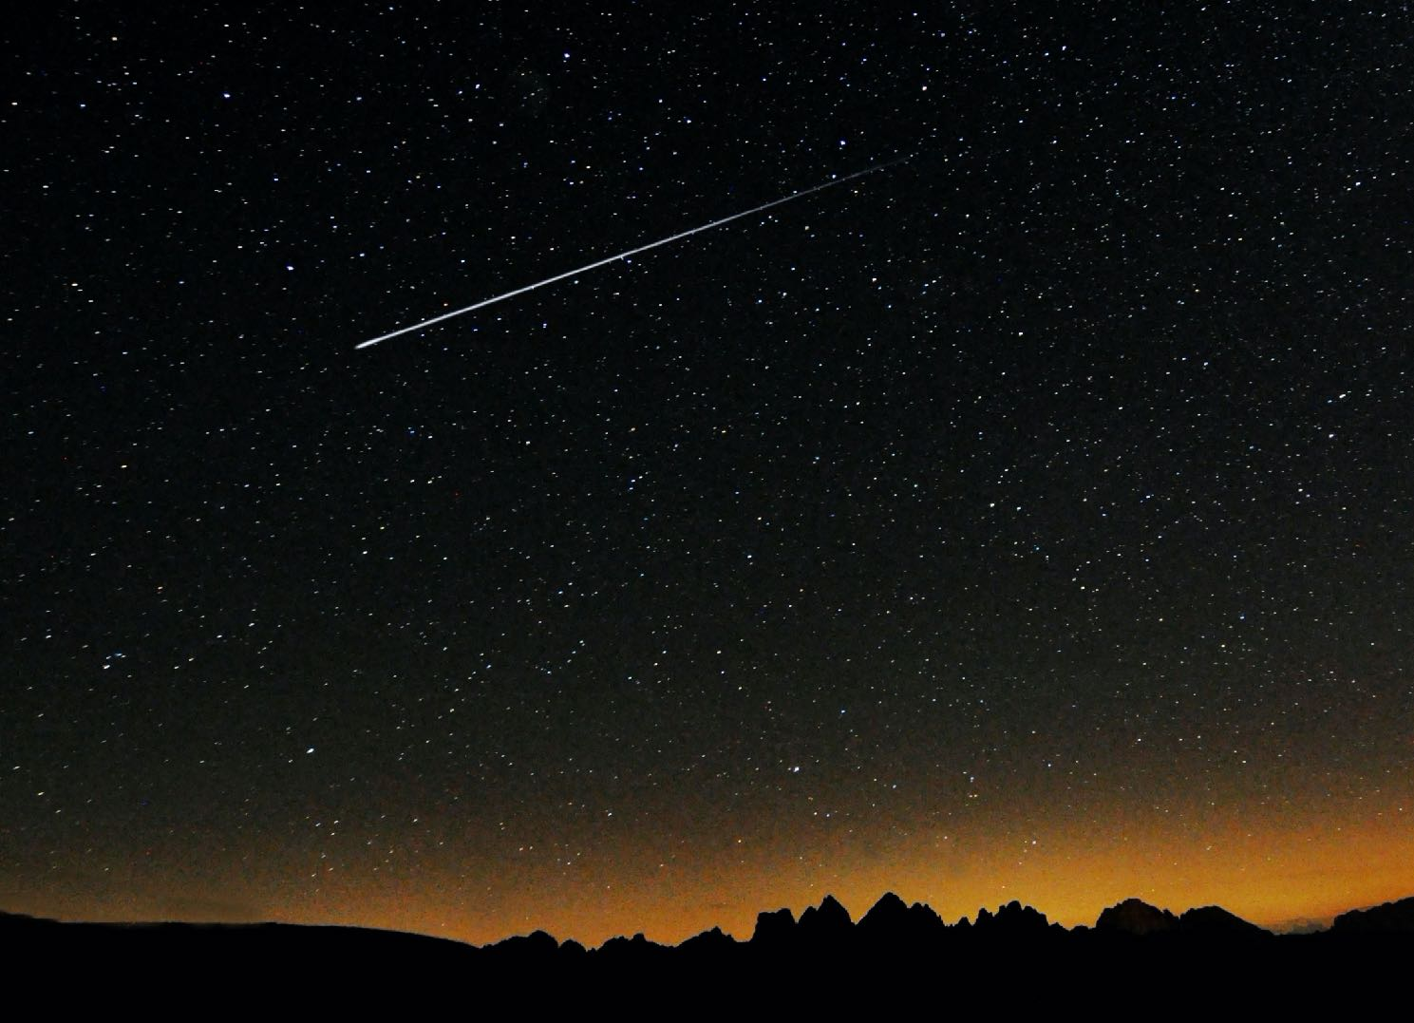
Q: What is a shooting star?
A: Actually it’s not a star. It is a meteor that falls to the earth. When they burn up in the atmosphere they leave a bright, short-lived streak in the sky.
Click for Q & A

Slide 22
Q: How fast does light travel?
Clue: 90x2+6 x1000
A: 186,000 miles per second
Q: How far does light travel in a year?
A: 5.88 trillion miles (Which is a light year)
Click for Q & A

Slide 23
Q: What are the planets? Make a diagram

Slide 24
Remembering the planets: My Very Educated Mother Just Showed Us Nine Planets but one

Slide 25
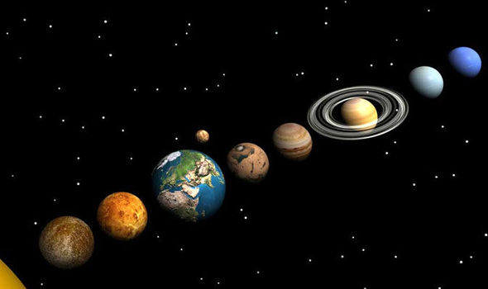
Q: What is the difference between planets and fixed stars?
A: Planet (means wanderer) each have their own orbit around the sun. Stars don’t
Click for Q & A

Slide 26
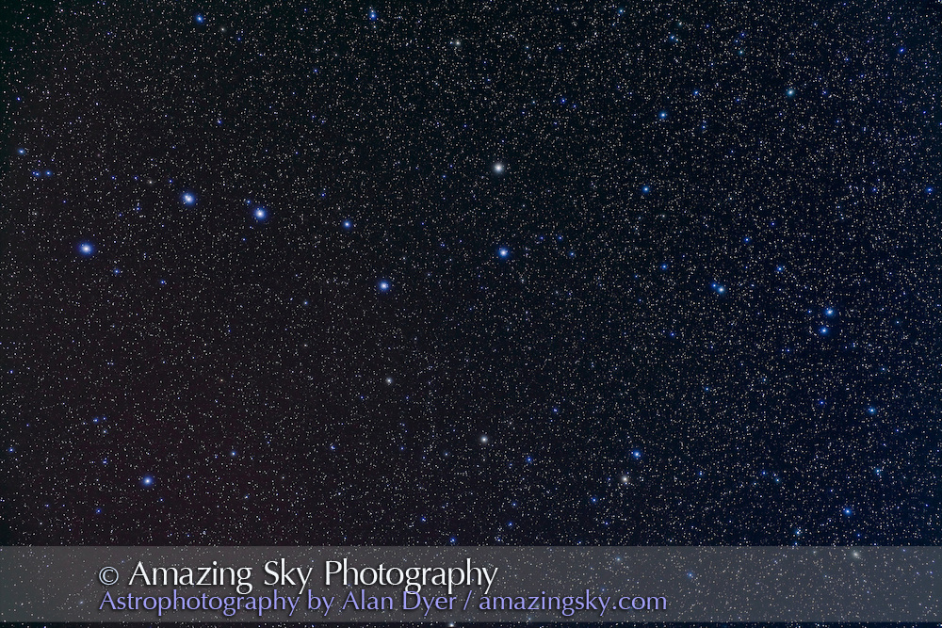
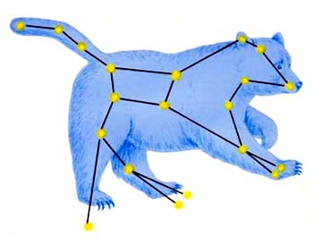
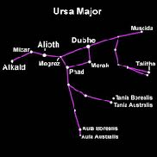
Can you find it?
Big Dipper
Ursa Major
Click for Answer

Slide 28
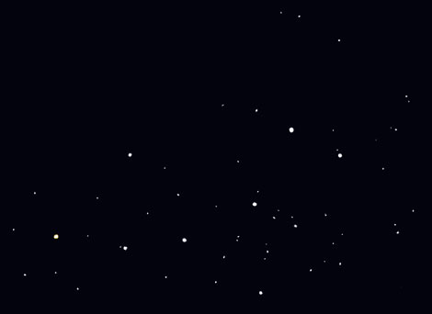
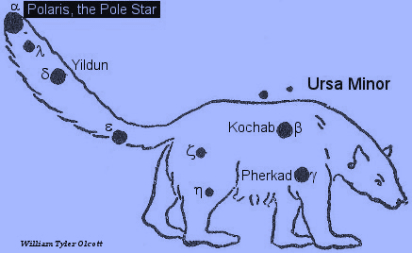
Can you find it?
Little Dipper
Polaris – North Star
Click for Answer
Ursa Minor

Slide 29
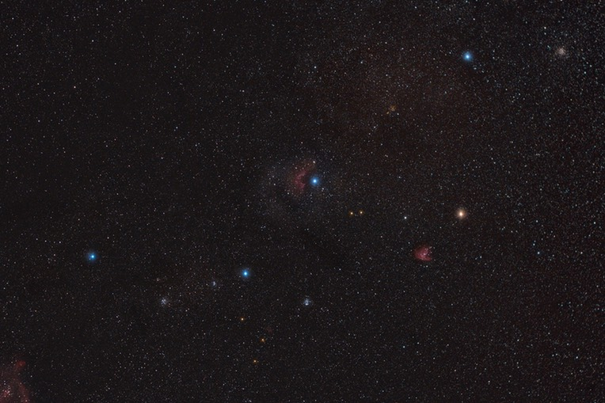
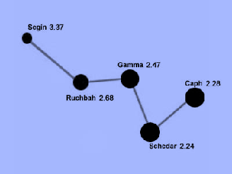
Can you find it?
Gamma
Cassiopeia
Click for Answer

Slide 30
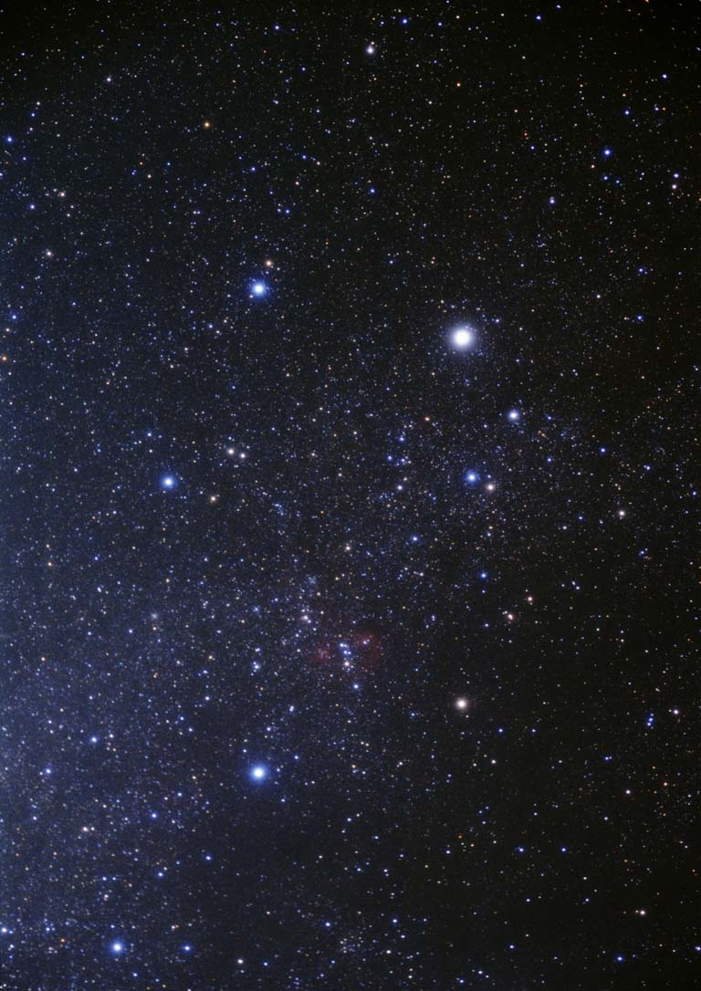

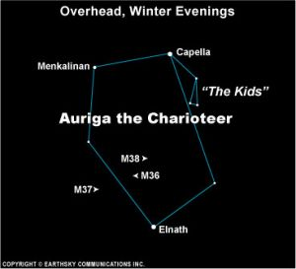
Can you find it?
Auriga
Capella
Click for Answer

Slide 31
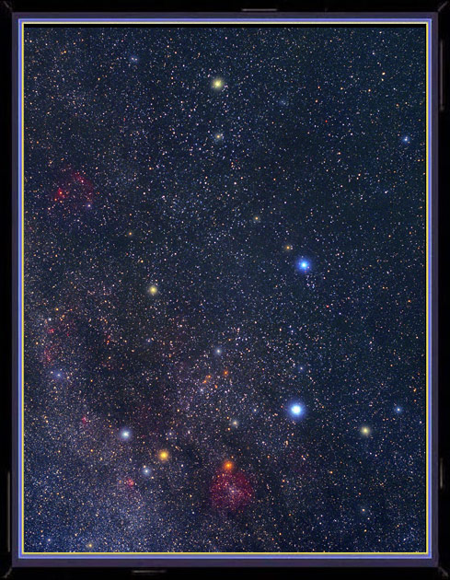
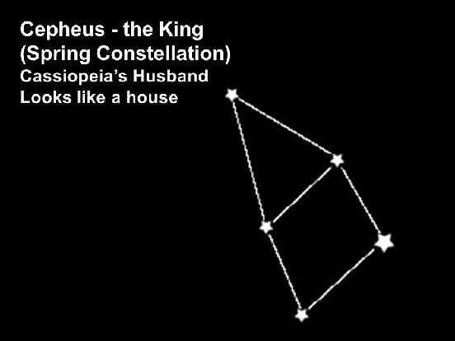
Errai
Can you find it?
Cepheus
Click for Answer

Slide 32
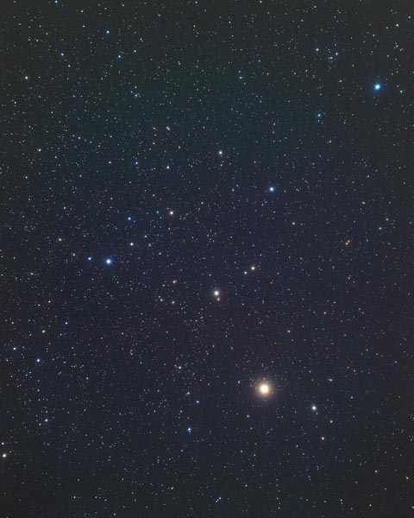
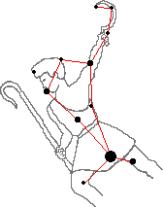
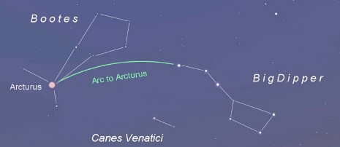
Can you find it?
Bootes
Arcturus
Click for Answer

Slide 33
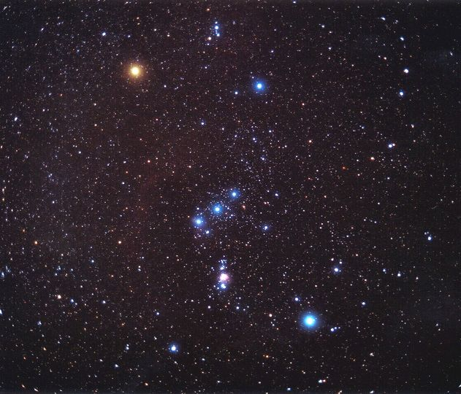
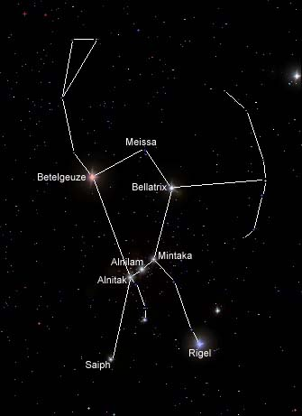
Betelgeuse
Bellatrix
Can you find it?
Orion
Rigel
Click for Answer

Slide 34
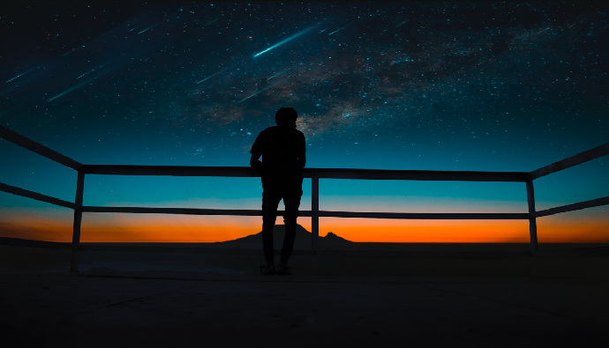
From Ellen White Early Writings p. 41
“The atmosphere parted and rolled back; then we could look up through the open space in Orion, whence came the voice of God. The Holy City will come down through that open space.”

Slide 35
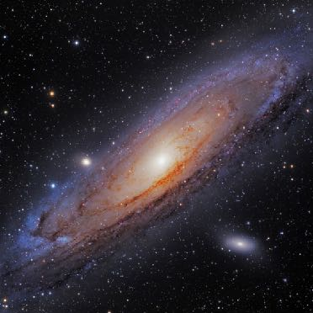
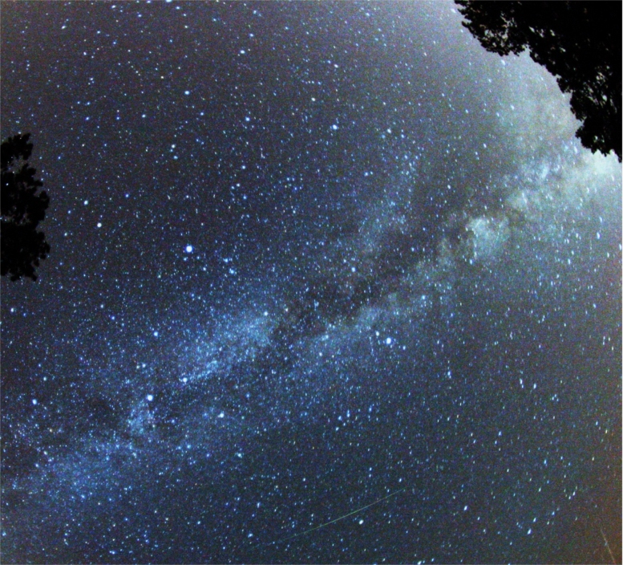

Can you find it?
The Milky Way
Click for Answer

Slide 36
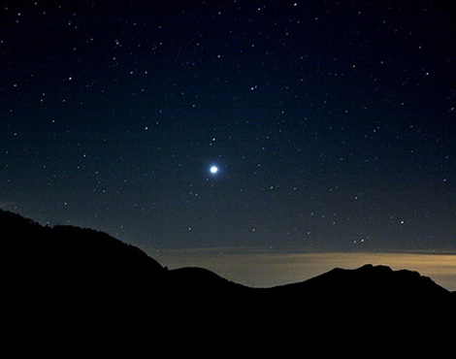
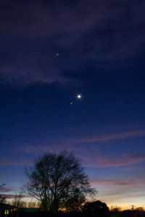
The Morning Star
The Evening Star
Can you find it?
It is actually Venus. It never appears on the opposite horizon from the sun due to its relative location to the sun.
Click for Answer

Slide 37
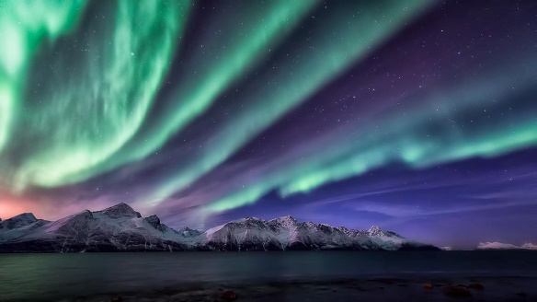
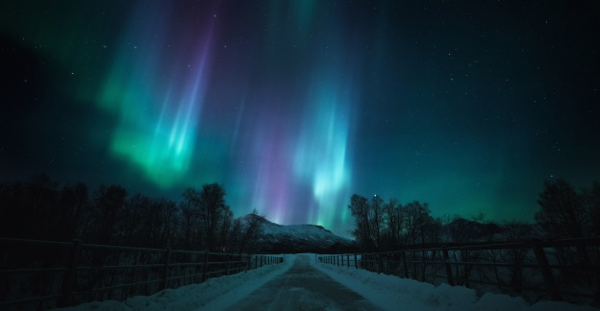
Q: What is the aurora borealis?
Q: What causes it?
The Aurora Borealis (Northern Lights) and Aurora Australis (Southern Lights) are the result of electrons colliding with the upper reaches of Earth's atmosphere. (Protons cause faint and diffuse aurora, usually not easily visible to the human eye.)

Slide 38

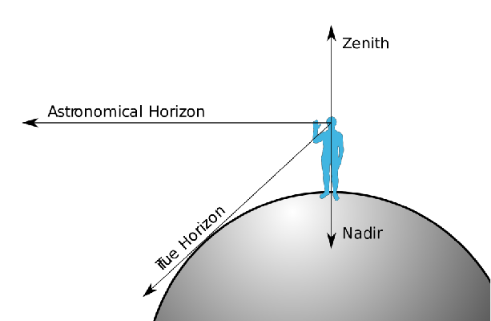
Explain zenith and nadir

Slide 39




Congratulations!
You earned the STAR HONOR

Slide 40
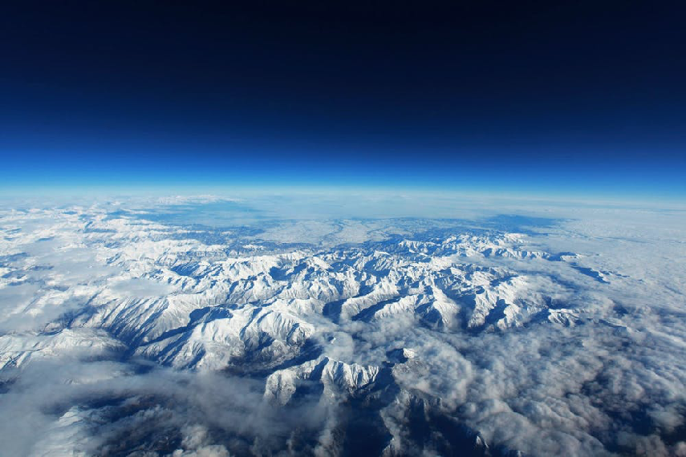
Our Great Creator loves YOU

