Slide 1

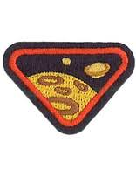
UNiverse award
Eric Jean-Baptiste Lake union Club Ministries Academy

Slide 2
1
Read Bible verses about God creating the universe and heaven.
2
Discuss what Heaven will be like and draw a picture depicting your view of Heaven.
3
Find Bible verses about the universe, stars, moon, planets, and/or sun.
4
Make a craft of our solar system and name the 8 planets.
5
What is the universe?
6
What is the Milky Way?
7
Play a space game.
contents

Slide 3
Psalm 147:4
Genesis 1:1
Nehemiah 9:6
1.

Slide 4
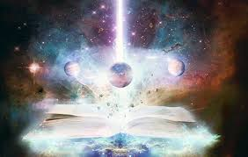
Psalm 147:4
He Counts the number of the stars he calls them all by name.
1.

Slide 5
Genesis 1:1
In the Beginning God Created the Heavens and the Earth
1.

Slide 6
Nehemiah9:6
You alone are the lord;You made heaven, The heaven of heavens, the earth and everything on it, the seas and all that is in them, and you preserve them all. the host of heaven worships you.
1.

Slide 7
Discuss what Heaven will be like and draw a picture depicting your view of Heaven.
2.

Slide 8
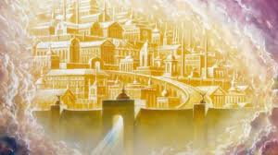
What Will it be Like?

Slide 9
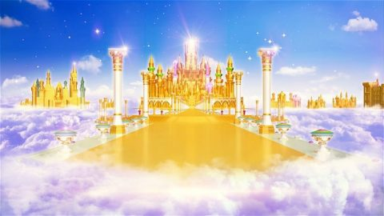

Slide 10
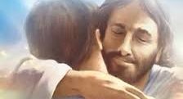

Slide 11
Find Bible Verses about the Universe Sun, Moon, Stars, and planets
3.

Slide 12
Psalm 8
1 O Lord, our Lord, your majestic name fills the earth! Your glory is higher than the heavens. 2 You have taught children and infants to tell of your strength, silencing your enemies and all who oppose you. 3 When I look at the night sky and see the work of your fingers— the moon and the stars you set in place— 4 what are mere mortals that you should think about them, human beings that you should care for them? 5 Yet you made them only a little lower than God and crowned them with glory and honor. 6 You gave them charge of everything you made, putting all things under their authority— 7 the flocks and the herds and all the wild animals, 8 the birds in the sky, the fish in the sea, and everything that swims the ocean currents. 9 O Lord, our Lord, your majestic name fills the earth!

Slide 13
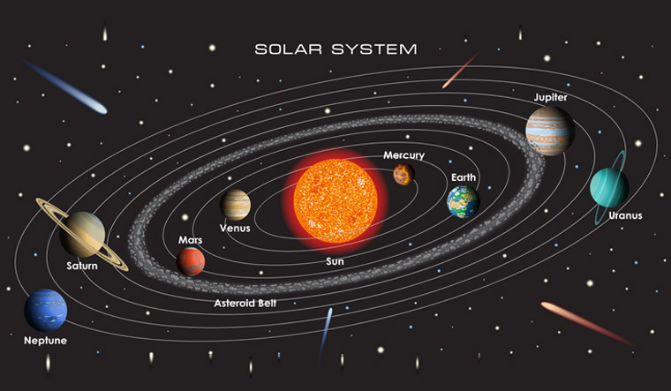

Slide 14
Planet closest to the Sun?

Slide 15
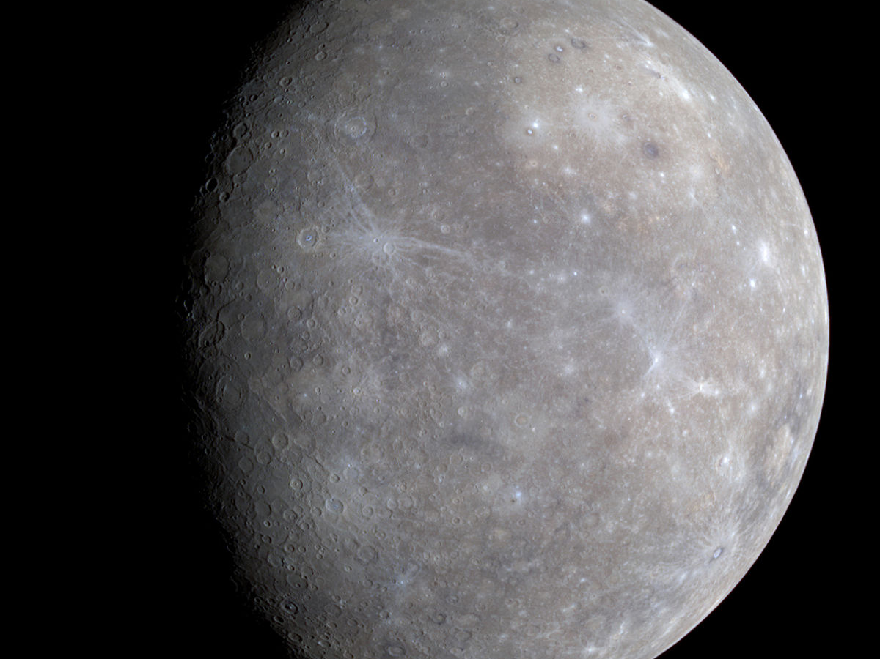

Slide 16
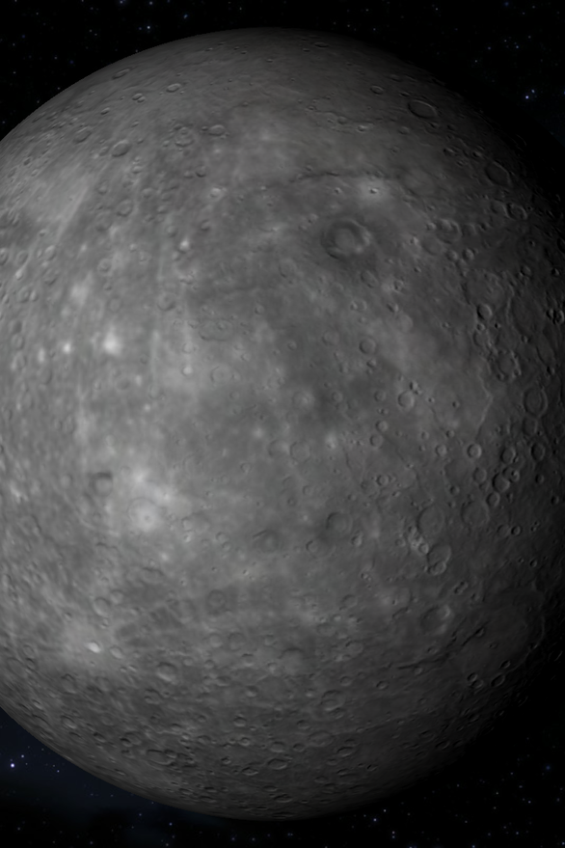
Smallest Planet
No Atmosphere
Mercury

Slide 17
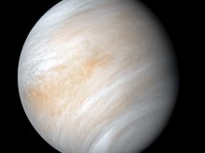

Slide 18

Thick Atmosphere almost the same size of Earth
Venus

Slide 19
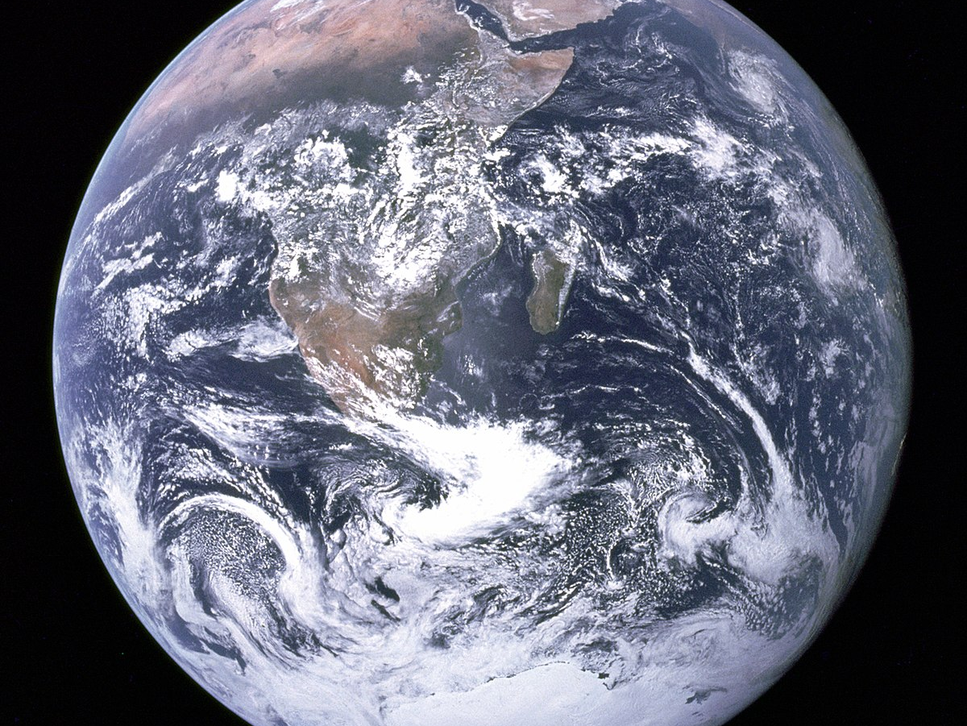

Slide 20
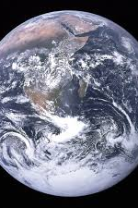
You are here
Earth

Slide 21
What Planet is next?

Slide 22
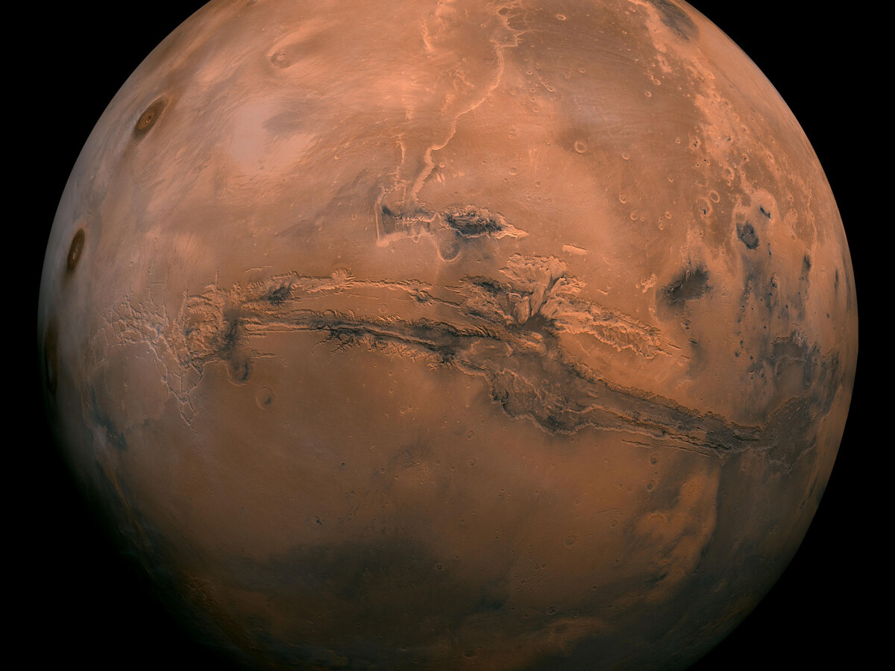

Slide 23
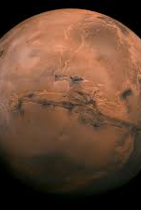
largest volcano
Mars

Slide 24
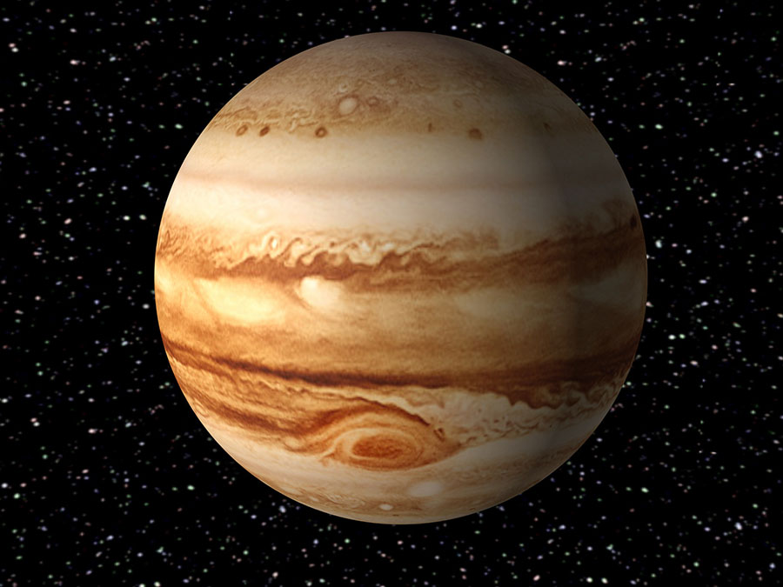

Slide 25
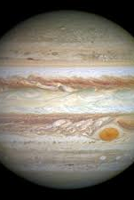
largest planet Gas giant
Jupiter

Slide 26
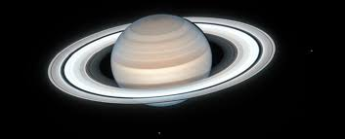
known for its rings
saturn

Slide 27
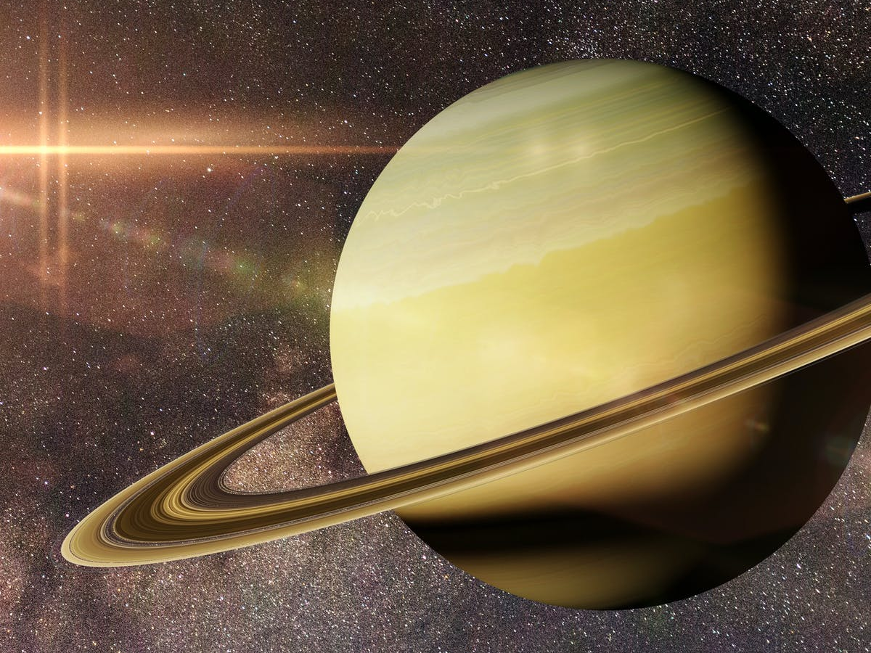

Slide 29
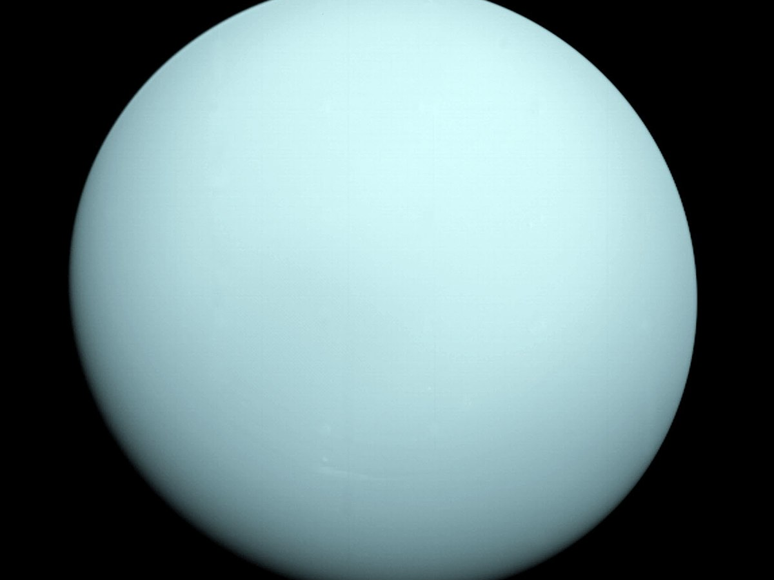

Slide 30
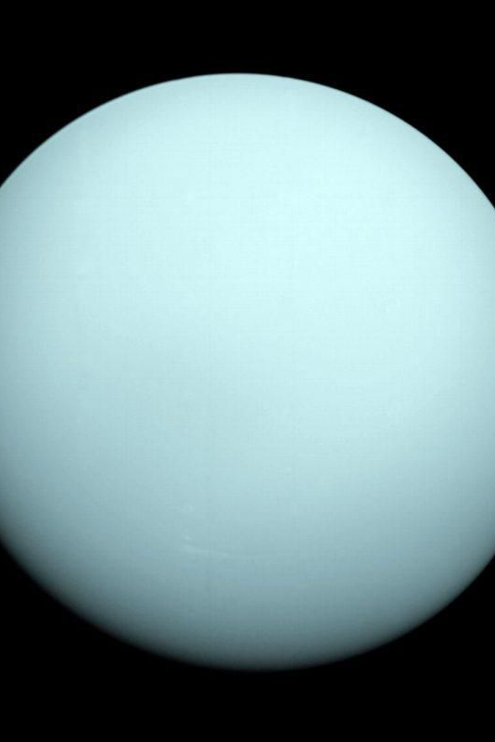
Axis is on its side
Uranus

Slide 31
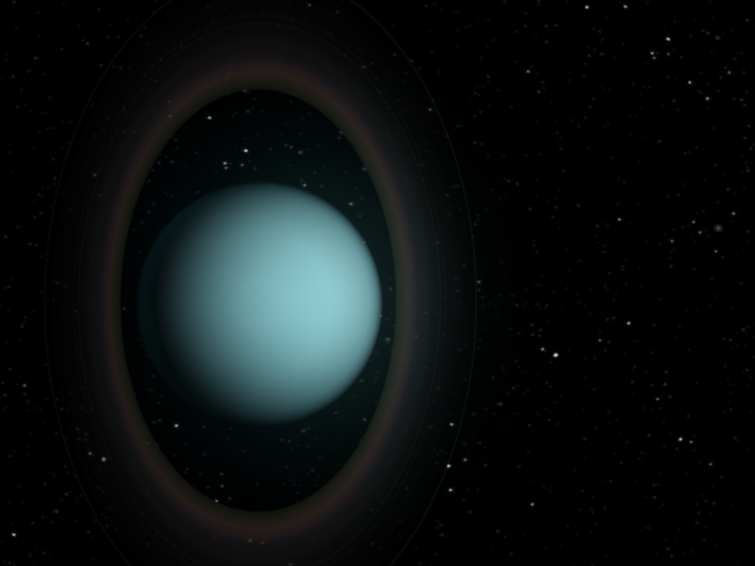

Slide 32
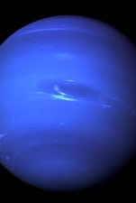
last planet
Neptune

Slide 33
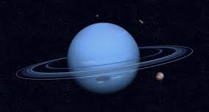

Slide 34
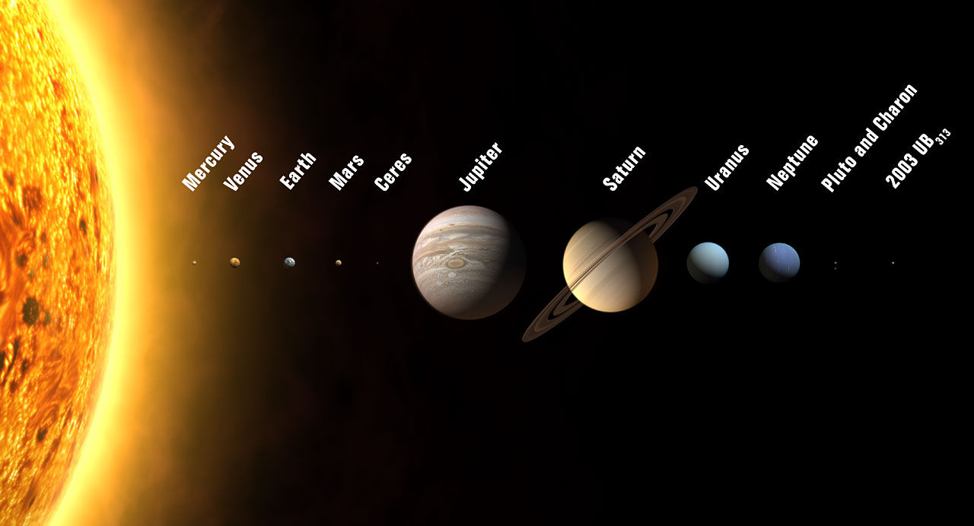
The Solar System

Slide 35
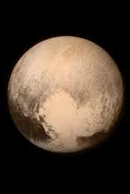
Dwarf planets Don’t have clear paths
Pluto is one of these and no longer a main planet in the solar system

Slide 36
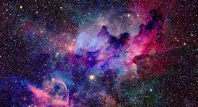
The Universe

Slide 37
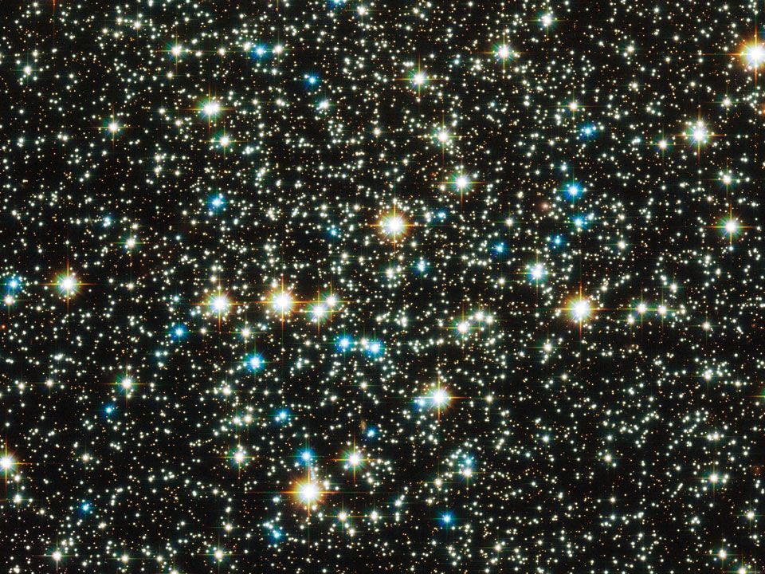

Slide 38
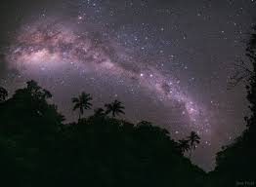
our Galaxy

Slide 39
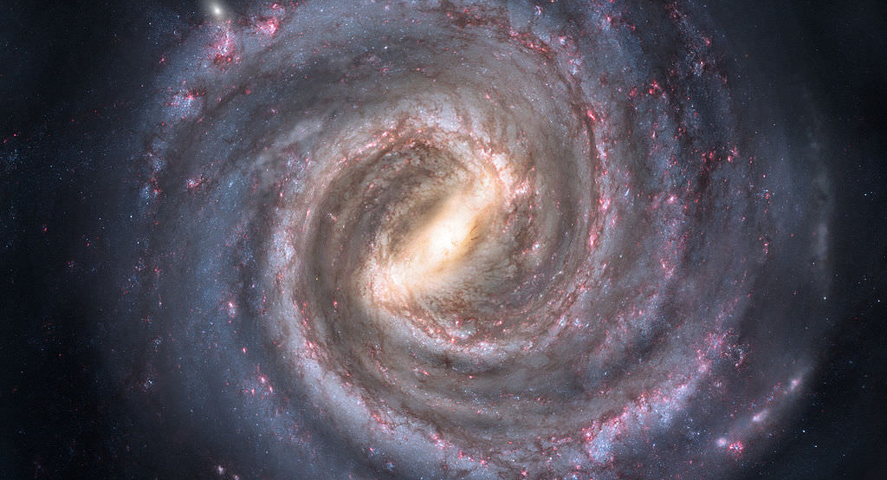
The Milky Way

Slide 40


