Slide 1
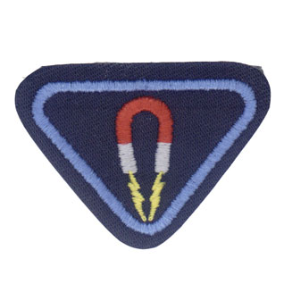
Magnet Fun
By
Desire Sonder

Slide 2
Desire Sonder Glasgow 5/12/2020

Slide 3
Requirements
What is a magnet made of?
Read the Greek story/legend of how the first magnet was found and named.
Describe the three main types of magnets
What are magnets used for?

Slide 4
Continued
Complete three magnet experiments
Magnet treasure hunt
Mineral rocks with iron
Move an object with a magnet
Create a magnet
Read and memorize Hebrews 7:19 and James 4:8.

Slide 5
What is the Magnet made of?

Slide 6
A magnet is made of magnetite, a natural magnetic material that will create a magnetic field. A magnetic field is the force surrounding a magnet that draws objects to the magnet. You can feel this force when using a magnet.

Slide 7
History

Slide 8
What is a Magnetic field?

Slide 9
If you put a bar magnet under a sheet of paper and sprinkle iron powder lightly over the top, you will suddenly see the invisible magnetic field as the particles stick to it.

Slide 11
Fun facts

Slide 12
Did you know? One end of a 'bar' magnet is a north pole, and the opposite end is a South Pole

Slide 13
The North Pole of one magnet will repel and push away the North Pole of another magnet.

Slide 14
The South Pole of one magnet will repel and push away the SouthPole of another magnet.

Slide 15
The North Pole of one magnet will attract and stick to the South Pole of another magnet.

Slide 16
what are the Three main types of magnets?

Slide 17
Permanent once it is magnetized, it retains a level of magnetism

Slide 18
Example Bar Magnet, Horseshoe Magnet

Slide 19
What do most people have in their kitchen which acts as a large magnet?
Clue – you can display things on it which are attached using magnets

Slide 20
You are Right It’s a Fridge!!!

Slide 21
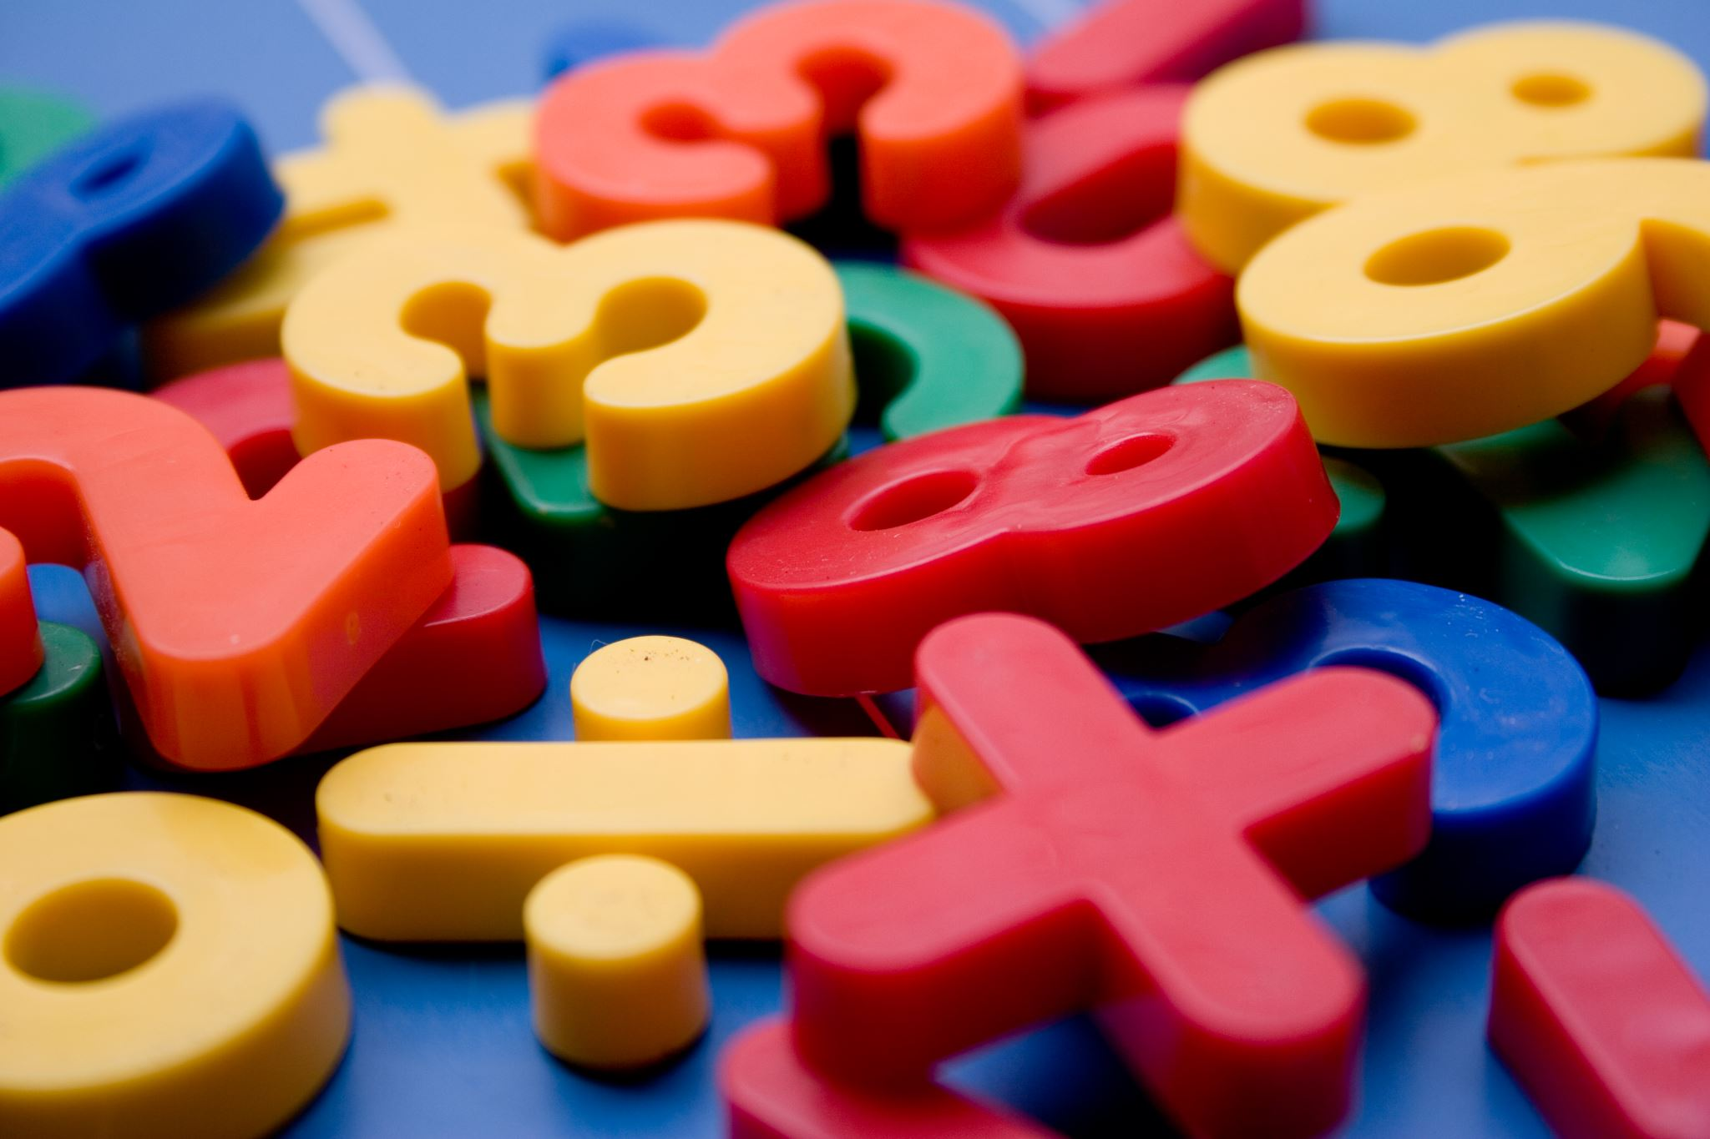
Second type of Magnet

Slide 22
Temporary
Temporary: acts like a permanent magnet when it is within a strong magnetic field, but loses its magnetism when the magnetic field disappears

Slide 23
Example of Temporary Magnet

Slide 24
Third type of Magnet

Slide 26
A special wire which acts like a permanent magnet when electrical current is flowing in the wire
Electromagnets use electricity to create their power of magnetism. They can be turned on and off when the electricity is turned on and off.

Slide 27
Cranes use huge electromagnets to pick up scrap metal in junkyards.

Slide 28
Powerful electromagnets are used in high-speed trains, called Maglev trains. These trains will float over its track, reducing friction and allowing the train to run very efficiently

Slide 29
What are Magnets used for?

Slide 30
Magnets are being used by people in many devices

Slide 31
Let us have a Quiz. Can you tell me which of these items do you think has a magnet inside?

Slide 33
Vacuum Cleaners

Slide 34
Telephone

Slide 36
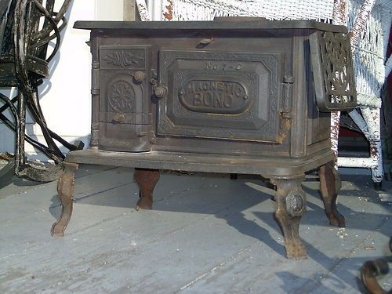

Slide 38
Experiments with magnet

Slide 39
Magnet treasure hunt

Slide 40
Place objects around the room that will and will not magnetize. See how many different objects they can pick up with their magnet
You can use items such as
Nuts
Bolts
Tin foil
Safety pins
Clips

Slide 41
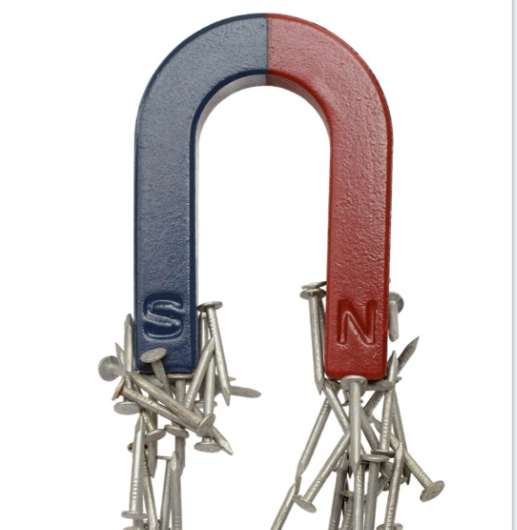
Move an object with a Magnet

Slide 42
Have a friend hold a sheet of paper between his/her two hands, place paper clip on top of the paper and a magnet below. Move the paper clip from one end to the other and back again with your hand. Be creative and use different items such as cardboard, plastic ruler etc.

Slide 43
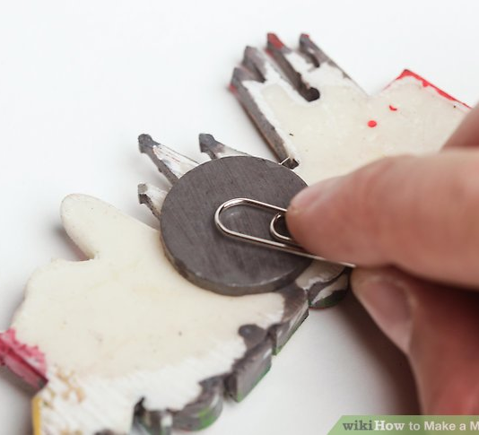
Create a Magnet

Slide 44
Stroke a steel nail against the magnet 25-30 times. Stroke it in only one direction
How many paper clips can you pick up at one time?
Is the nail as strong as your magnet?

Slide 45
Fun Magnetic Sculptures you can do!

Slide 51
Remember to ask an adults to make a video or take pictures of you doing your experiments and send to your club directors with your worksheet for assessment.

Slide 52
Memorise Hebrews 7:19

Slide 53
(for the law made nothing perfect), and a better hope is introduced, by which we draw near to God.

Slide 54
Memorise James 4:8

Slide 55
Come near to God and he will come near to you. Wash your hands, you sinners, and purify your hearts, you double-minded.

Slide 56
Adventurers you have been Awesome!!

