Slide 1
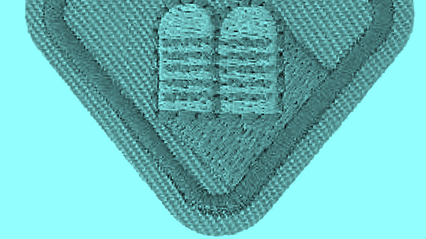
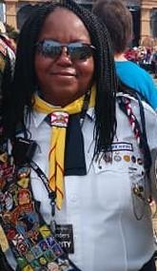
10 Commandments
PRESENTED BY:
CHERRIE BETAUDIER
NORTH AREA ADVENTURER ADMINISTRATOR
FLORIDA CONFERENCE OF SEVENTH DAY ADVENTISTS

Slide 2
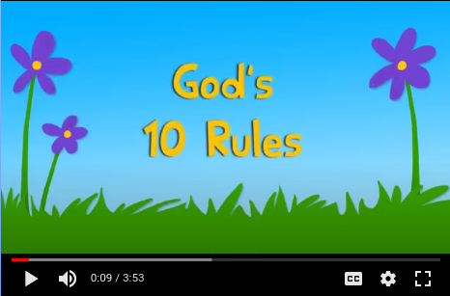
Video
Gracelink
https://youtu.be/Yr4FP4mJj2Y

Slide 3
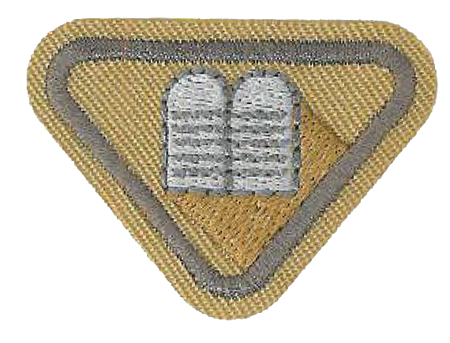
Requirement 1
Who wrote the 10 Commandments?

Slide 4
ANSWER: God
Exodus 20:1

Slide 5
Requirement 2
What did God use to write the 10 commandments

Slide 6
ANSWER: His Finger
Exodus 31:18

Slide 7
Requirement 3
WHERE CAN WE FIND THE 10 COMMANDMENTS IN THE BIBLE?

Slide 8
Requirement 3 Answer:

Slide 9
Requirement 4
WHAT ARE SOME OTHER NAMES FOR THE 10 COMMANDMENTS?

Slide 10
Requirement 4 Answer
1. Decalogue
2. Law of God
3. God’s Happiness Rules
4. Aseret HaDibrot (Ten Sayings) in Hebrew

Slide 11
Requirement 5
What is the name of the mountain on which the 10 commandments were given? To whom were they given? Who was he?

Slide 12
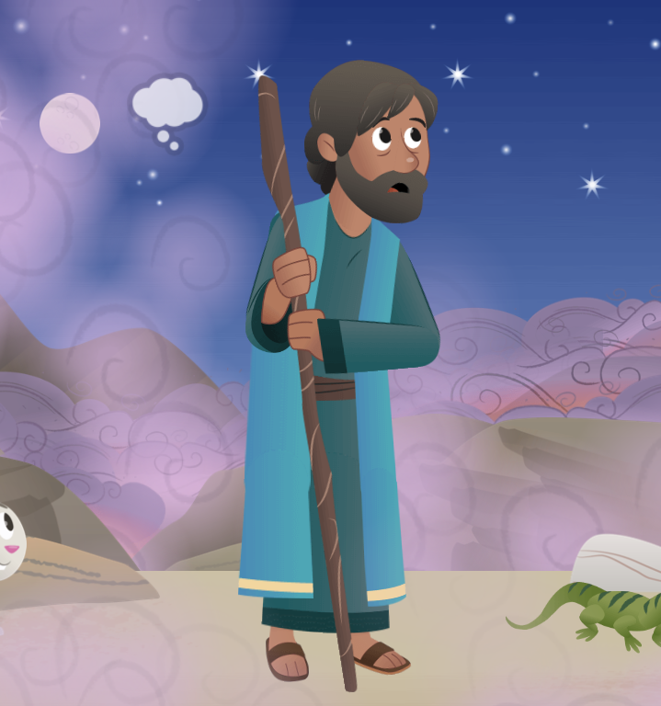
Requirement 5 Answers

Slide 13
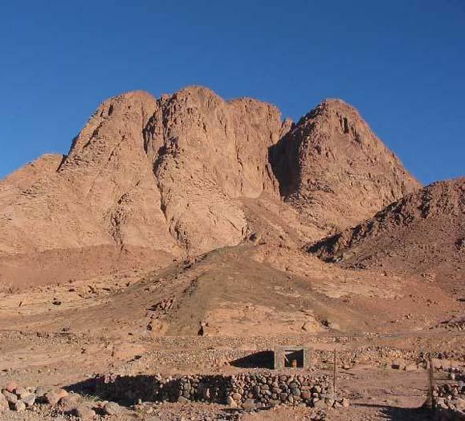
Requirement 5 Answer A
What is the name of the mountain on which the 10 commandments were given?
Mount Sinai
This is the REAL Mount Sinai!

Slide 14
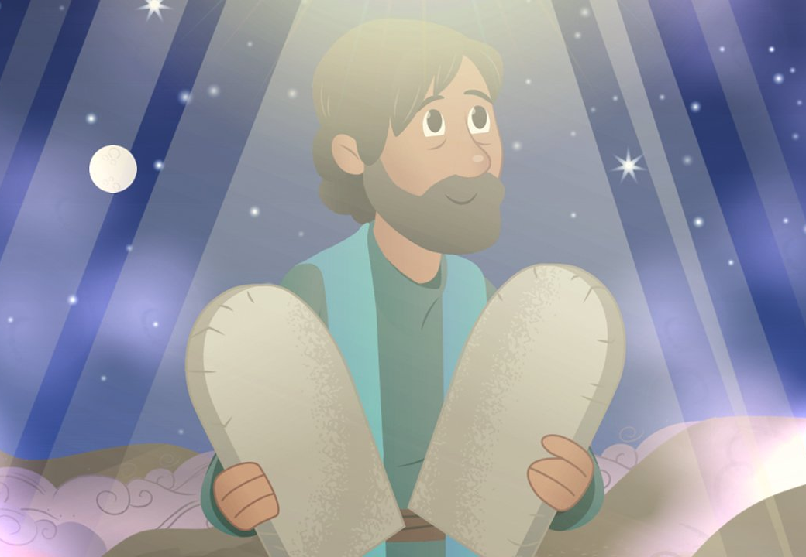
Requirement 5 Answer B
To whom were they given? Who was he?
Moses - The Leader of the Children of Israel
Exodus 19:20-21a

Slide 15
Requirement 5 Answer C
Who was Moses?
What are some things about Moses’ story BEFORE the 10 Commandments that you remember learning about?
Clues:
Egypt
Basket
Burning Bush
Plagues
Red Sea
Ten Commandments
CHAT WINDOW!
Notes:
According to the Book of Exodus, Moses was born in a time when his people were increasing in number and the Egyptian Pharaoh was worried that they might help Egypt's enemies. Moses' Hebrew mother, Jochebed, hid him when the Pharaoh ordered all newborn Hebrew boys to be killed, and he ended up being adopted into the Egyptian royal family. After killing an Egyptian slave-master, Moses fled across the Red Sea to Midian where he tended the flocks of Jethro, a priest of Midian on the slopes of Mt. Horeb. After the Ten Plagues were unleashed on Egypt, Moses led the Hebrew people out of Egypt, across the Red Sea, where they based themselves at Horeb and compassed the borders of Edom. It was at this time that Moses received the Ten Commandments.

Slide 16
Requirement 5 Answer C
Who was Moses?
Moses was God’s Leader
He led the Hebrews to the Promised Land!
Notes:
According to the Book of Exodus, Moses was born in a time when his people were increasing in number and the Egyptian Pharaoh was worried that they might help Egypt's enemies. Moses' Hebrew mother, Jochebed, hid him when the Pharaoh ordered all newborn Hebrew boys to be killed, and he ended up being adopted into the Egyptian royal family. After killing an Egyptian slave-master, Moses fled across the Red Sea to Midian where he tended the flocks of Jethro, a priest of Midian on the slopes of Mt. Horeb. After the Ten Plagues were unleashed on Egypt, Moses led the Hebrew people out of Egypt, across the Red Sea, where they based themselves at Horeb and compassed the borders of Edom. It was at this time that Moses received the Ten Commandments.

Slide 17
Requirement 6
WHAT ARE THE 10 COMMANDMENTS AND WHY DID GOD GIVE THEM?

Slide 18
Requirement 6a Answer
What are the 10 Commandments?
instructions from God to His People

Slide 19
Requirement 6b Answer
Why did God give the 10 Commandments?
They bring us closer to God
They help us treat others well

Slide 20
Requirement 7
WHY SHOULD WE OBEY THE 10 COMMANDMENTS?

Slide 21
Requirement 7 Answer
MATTHEW 22:36-40

Slide 22
Requirement 7 Answer
"The teacher asked, 'Teacher, which command in the law is the most important?'
Jesus answered, ‘"Love the Lord your God with all your heart, soul and mind." This is the first and most important command. And the second command is like the first: "Love your neighbor as you love yourself." All the law and the writings of the prophets depend on these two commands.'”
MATTHEW 22:36-40

Slide 23
Requirement 8
LIST THE TEN COMMANDMENTS
AND WRITE WHAT THEY MEAN TO YOU

Slide 24
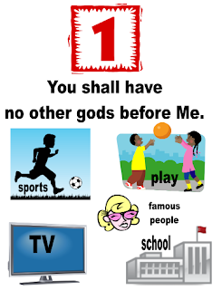
1st Commandment
Exodus 20:3
“There’s one God! Listen to Him.”
“Worship the one true God—no one else.”

Slide 25
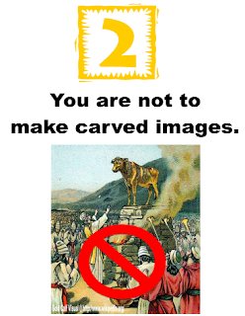
2nd Commandment
Exodus 20:4-6
“Respect God. Don’t make pretend gods.”
“Don’t make idols and worship them instead of God. God wants us to give Him all our worship.”

Slide 26
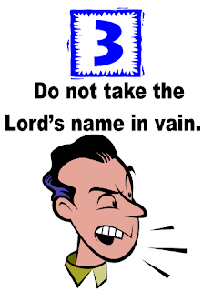
3rd Commandment
Exodus 20:7
“God’s name is special. Respect God’s name.”
“Respect God’s name. Don’t use it like any other word.”

Slide 27
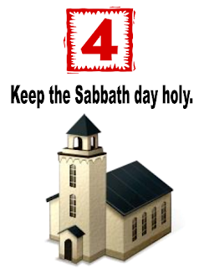
4th Commandment
Exodus 20:8-11
“Take time to rest and show respect for God. What’s one way we do that? We go to church!”
“Honor God with your time.”

Slide 28
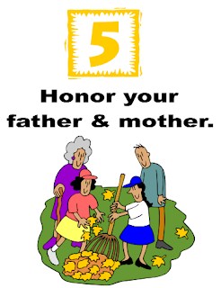
5th Commandment
Exodus 20:12
“Respect and obey your mom and dad.”
“Respect your parents—live in a way that will bring them honor, not shame or trouble.”

Slide 29
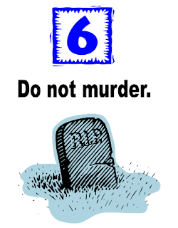
6th Commandment
Exodus 20:13
“Respect life! Don’t take away anyone’s life.”
“Don’t kill anyone on purpose and unlawfully.”

Slide 30
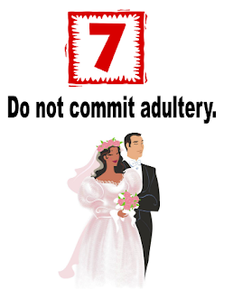
7th Commandment
Exodus 20:14
“Respect and be faithful to your husband or wife.
If you get married, keep your promises to each other.”

Slide 31
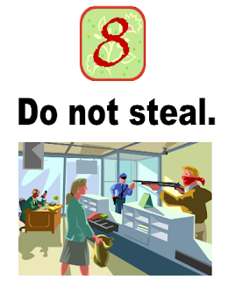
8th Commandment
Exodus 20:15
“Respect other people’s stuff.
Don’t take things without asking.”

Slide 32
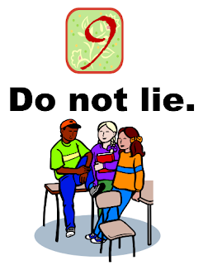
9th Commandment
Exodus 20:16
“Respect others. Don’t tell lies about anyone.
Don’t twist the truth, or hide the facts, or act in a way to deceive.
Be honest.”

Slide 33
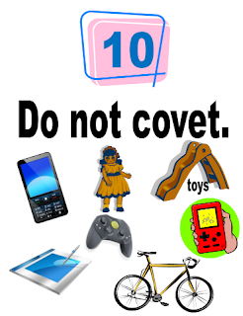
10th Commandment
Exodus 20:17
“Respect others. Be happy with what you have.”

Slide 34
Requirement 9
Do one of the following:
Make a 10 Commandment craft.
Sing a song about God’s love.
Play a 10 Commandment game.

Slide 35
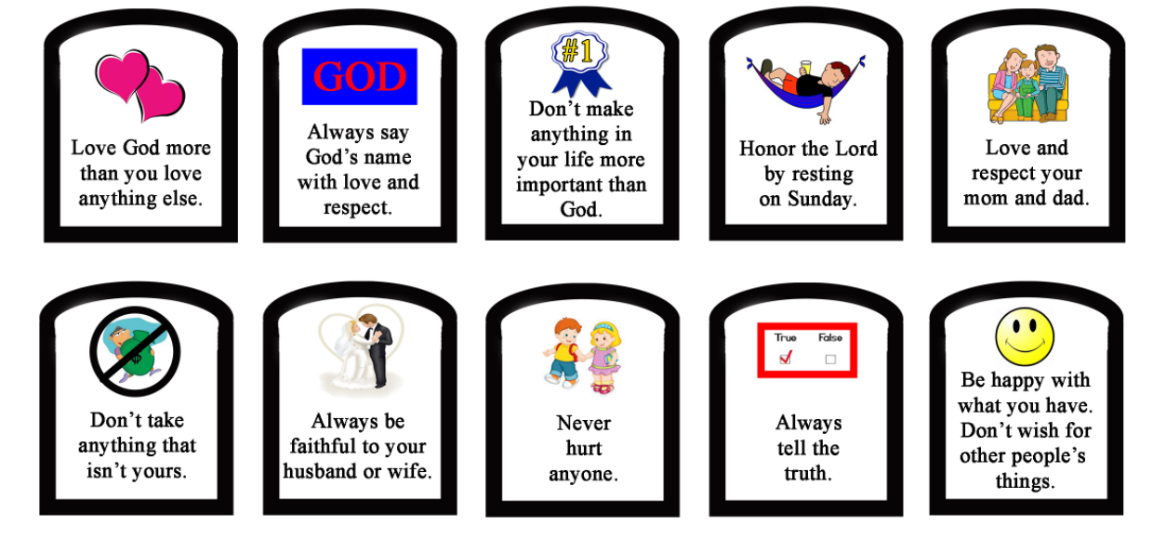
Craft Ideas
Finger Commandments
Trace hands/finger on construction paper
cut out each commandment (see link)
https://kidsministrythoughts.files.wordpress.com/2014/07/10-commandments.jpg
Glue a commandment to each finger!

Slide 36
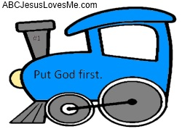
Craft Ideas
Link -- 10 Commandments Train

Slide 37
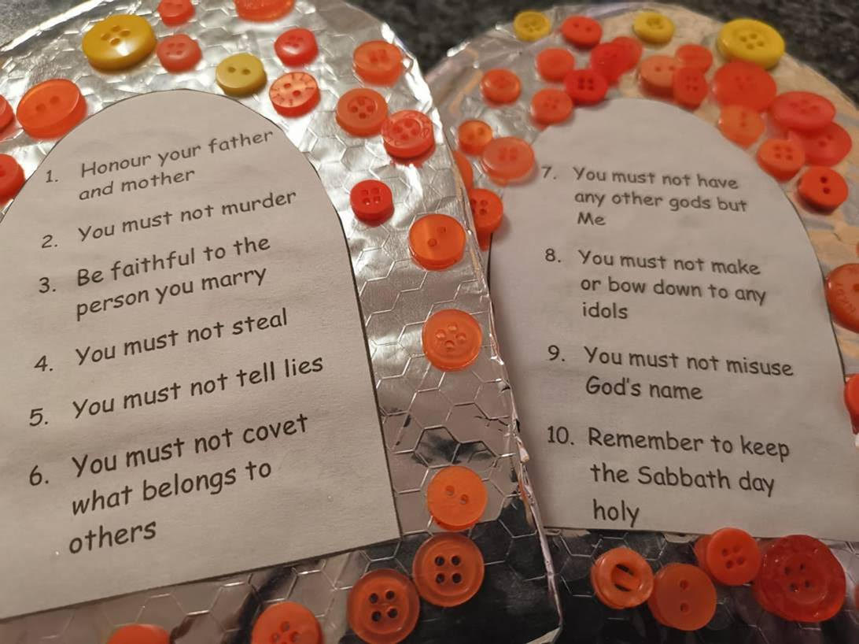
Craft Ideas
Button Commandments:
Cut two “tablets” out of cardboard 2-5 cm (1-2”) larger than equivalent construction paper tablets also cut out.
Wrap cardboard with foil
Glue on buttons to decorate

Slide 38
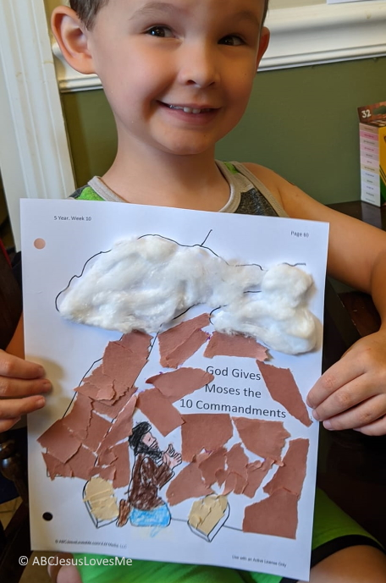
Craft Ideas
Link - Moses on the Mountain Torn Paper Craft

Slide 39
Game Ideas
Link - Jesuslovesme.com

Slide 40
Songs About Jesus’ Love
Youtube - Jesus Loves Me Cedarmont Kids
Youtube - Jesus Love the Little Children - Caleb & Kelsey
What other ones are YOUR favorites?

