Slide 1
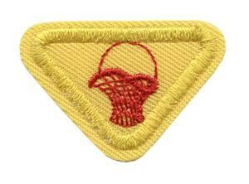
BASKET MAKER AWARD
By Caroline O’Brien

Slide 2
Requirements
1. Explain what a basket is.
2. Describe several baskets found in your home and tell how they are used
3. Name and describe the tools of a basket maker.
4. Describe how materials are prepared for basket weaving.
5. Make a simple basket of natural grasses, reeds, or other local material, OR decorate a basket to be used in a practical way in your home, such as those used for sewing, trash, berries, or flowers.
6. Decorate a basket to be given as a gift.
7. What are some ways baskets were used in the Bible. Give at least one text.

Slide 3
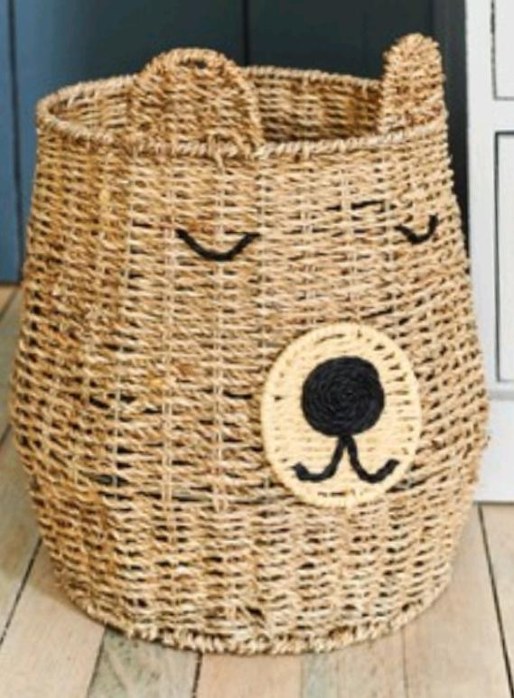
1.What is a basket?
A container made from stiff fibres being woven together, in different shapes and sizes. Usually woven by hand

Slide 4
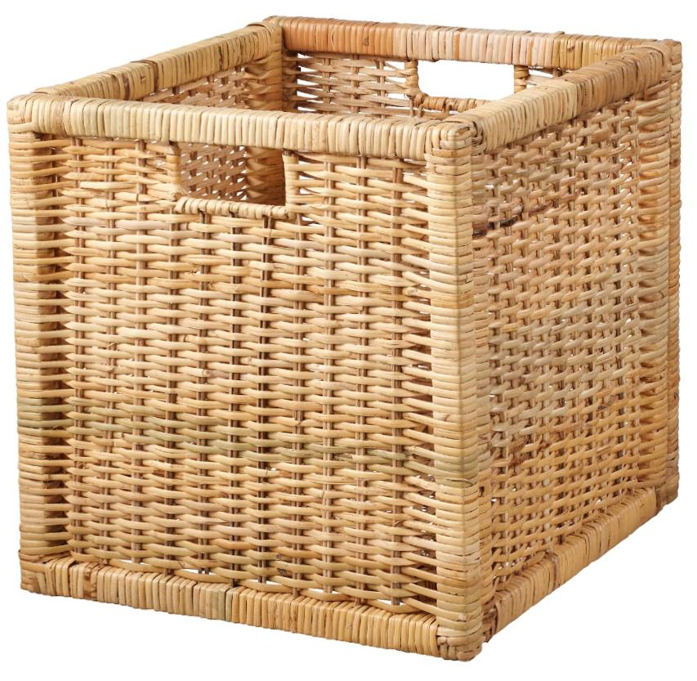
2. Describe several baskets found in your home and what they are used for.

Slide 5
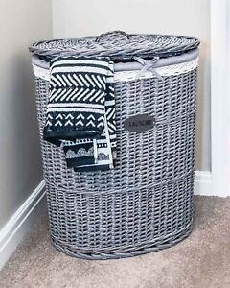
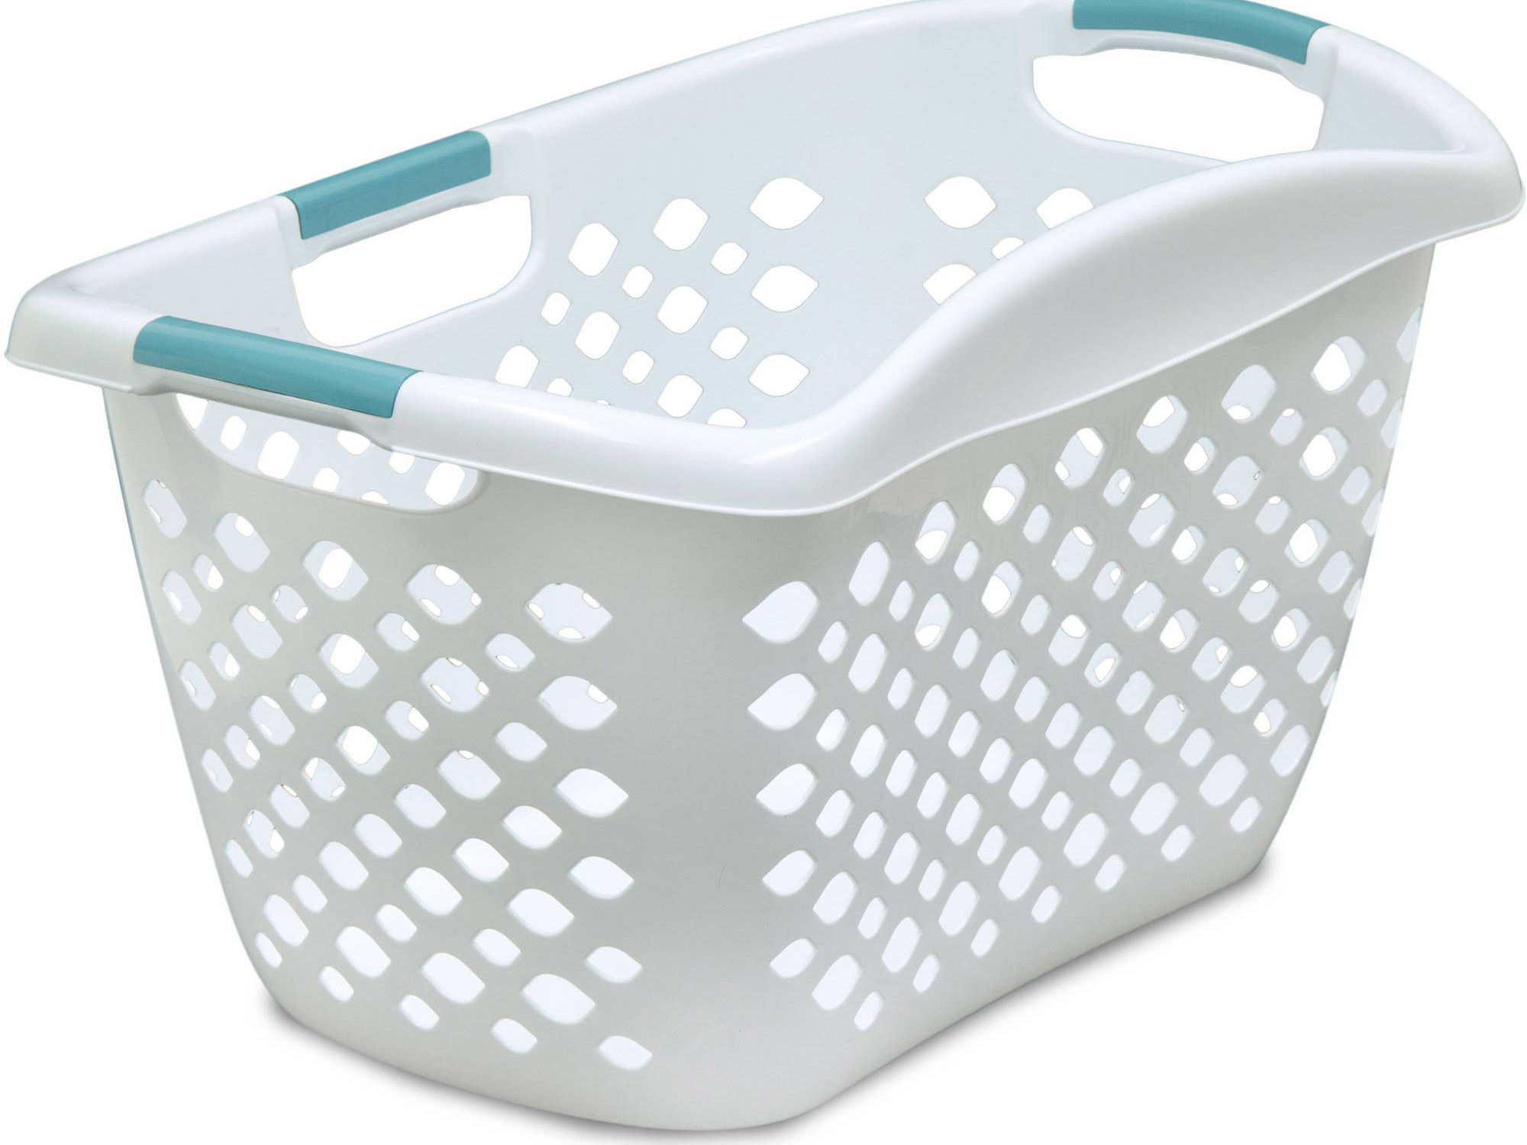
Laundry Basket

Slide 6
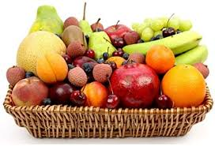
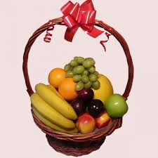
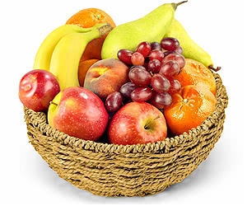
Fruit basket

Slide 7
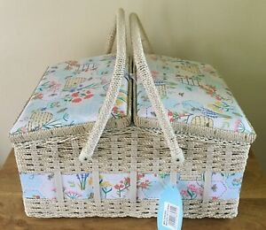
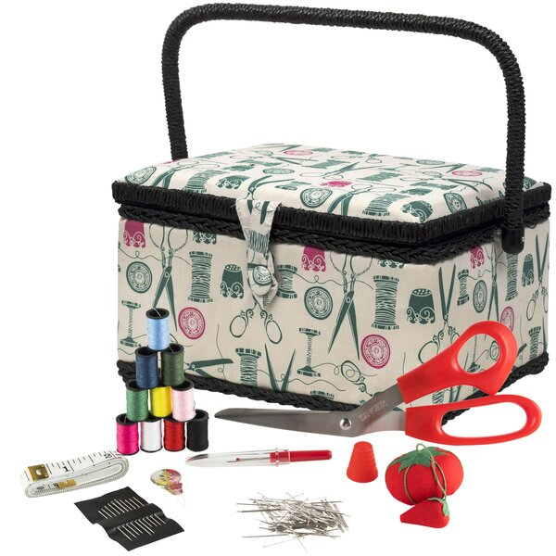
Sewing Basket

Slide 8
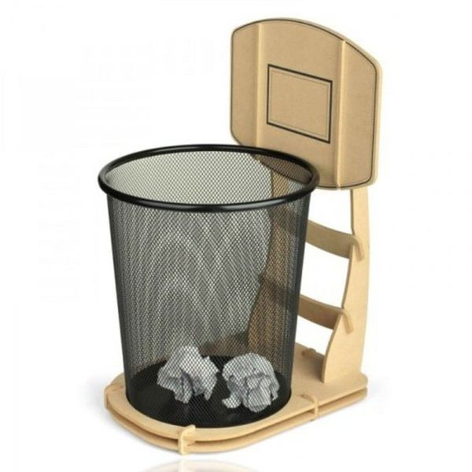
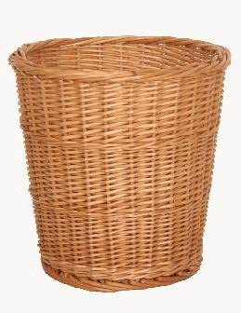
Rubbish Basket

Slide 9
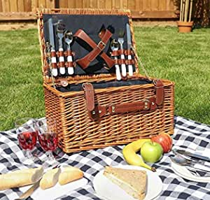
Picnic Basket

Slide 10
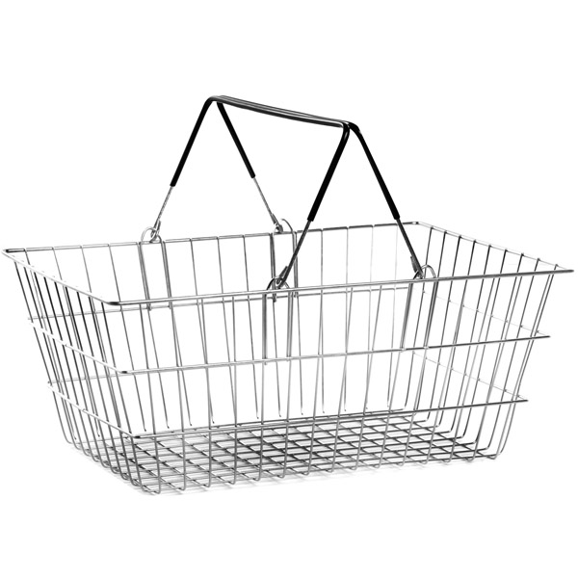
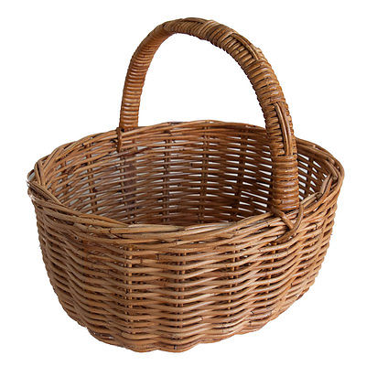
Shopping
Basket

Slide 11
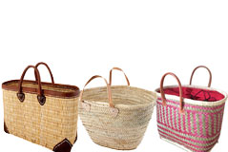
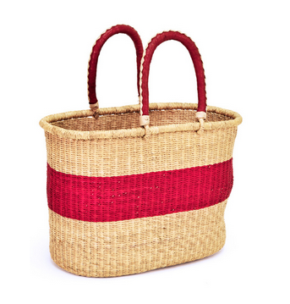
Hand Baskets

Slide 12
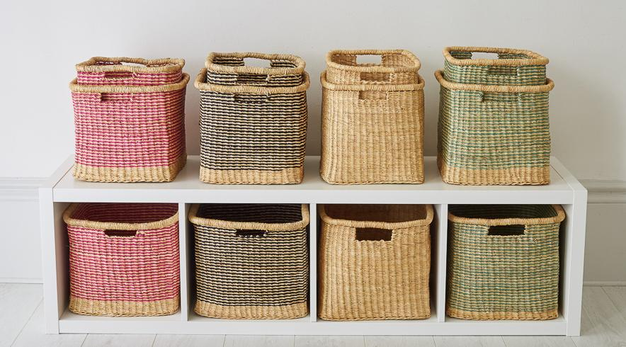
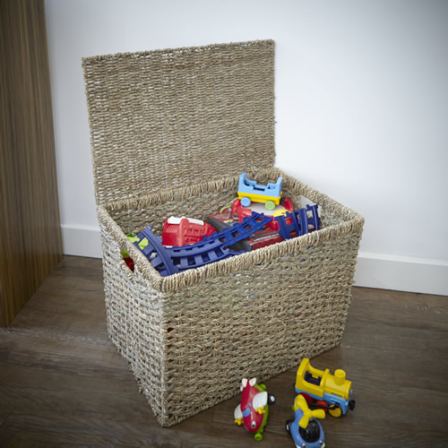
Storage Baskets

Slide 13
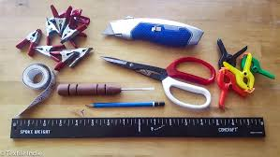
3. Name and describe the tools of a basket maker

Slide 14
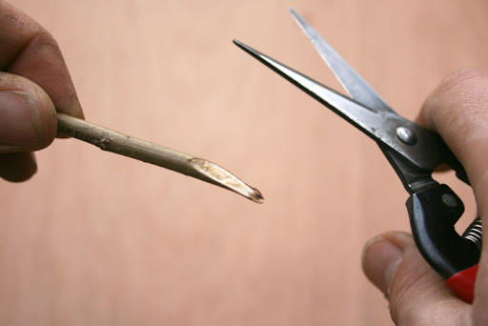
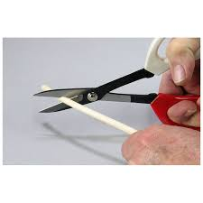
Sharp Scissors

Slide 15
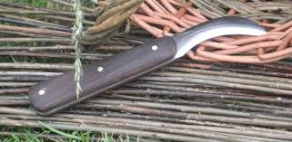
Sharp Knife

Slide 16
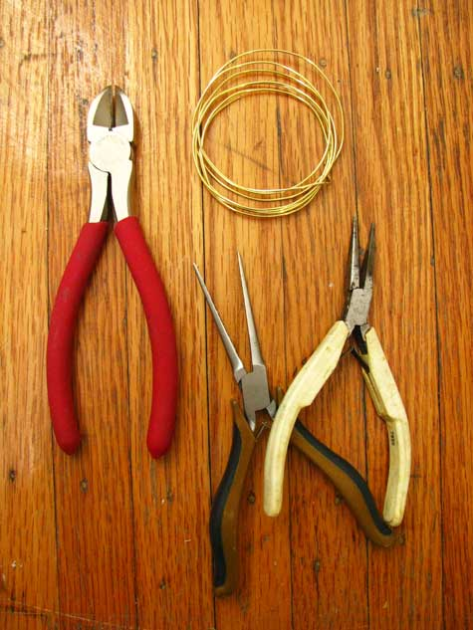
Round or Flat nose pliers

Slide 17
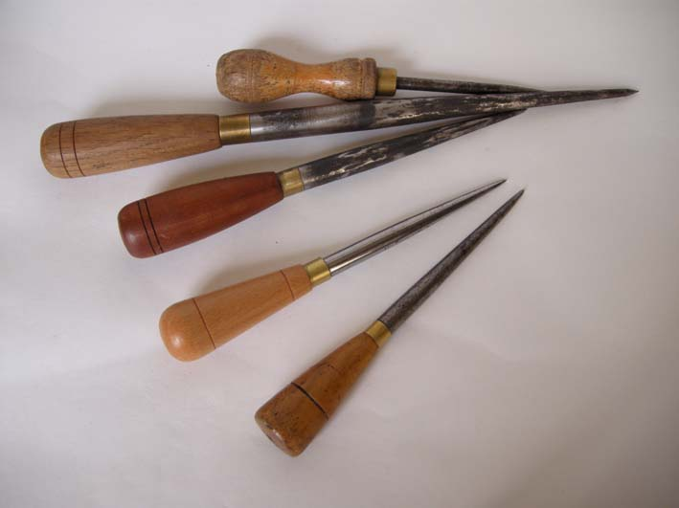
Awl or Bodkin

Slide 18
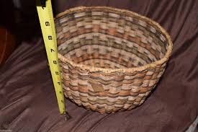
Measuring tape

Slide 19
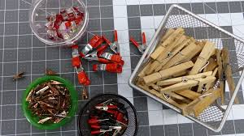
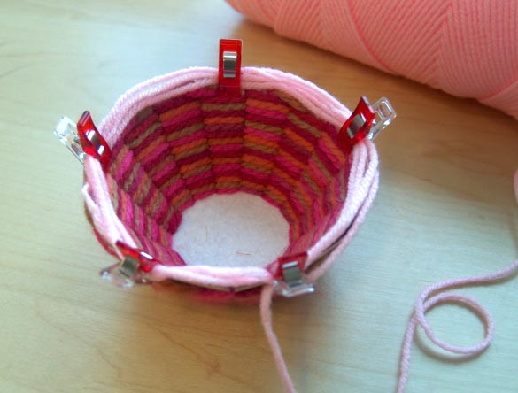
Clothes Pins or Crocodile clips

Slide 20
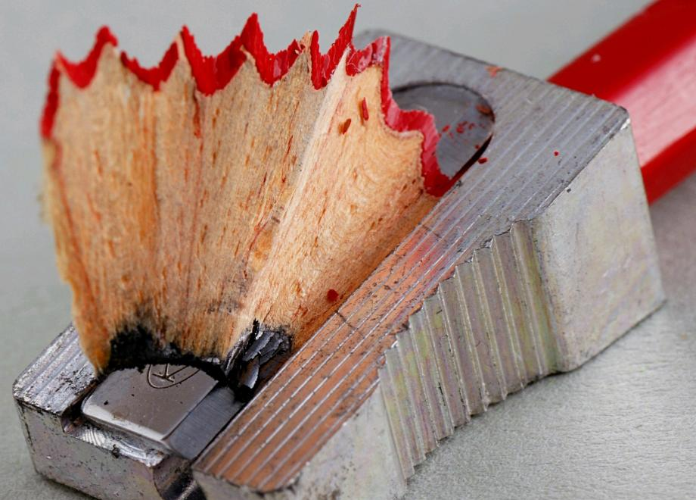
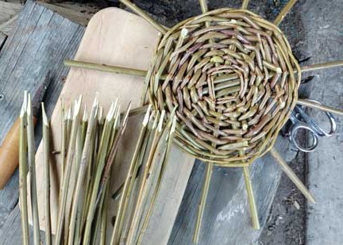
Pencils and sharpener
Pencils to help mark patterns and the sharpner to sharpen the ends of the reeds or willows if needed

Slide 21
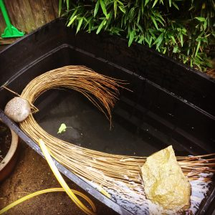
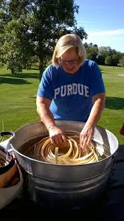
Towel and Water Buckets

Slide 22
4. Describe how materials are prepared for basket weaving.

Slide 23
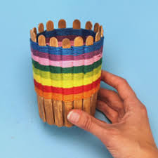
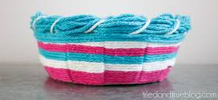
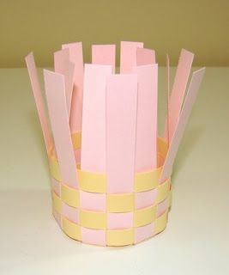
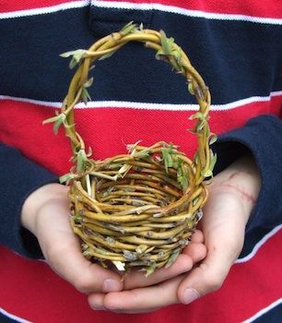
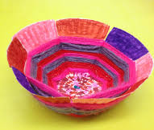
1. Choose the Style of basket you want to make

Slide 24
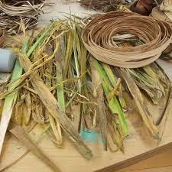
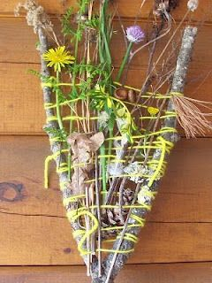
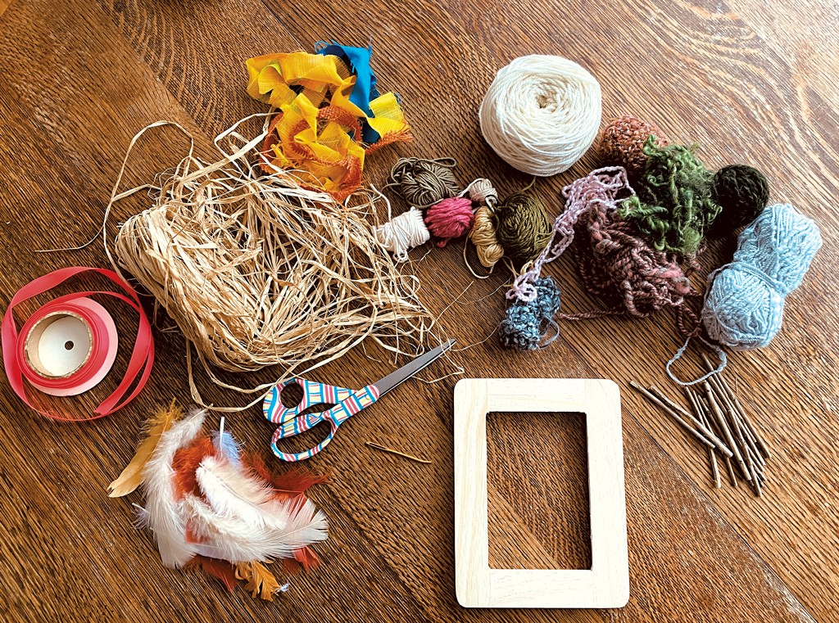
2. Choose the right materials for your basket

Slide 25
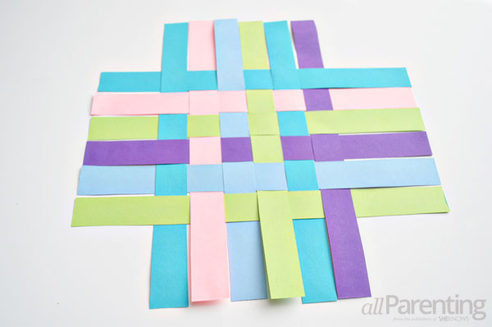
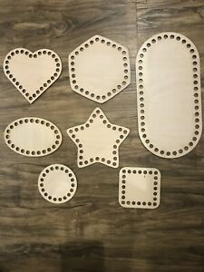
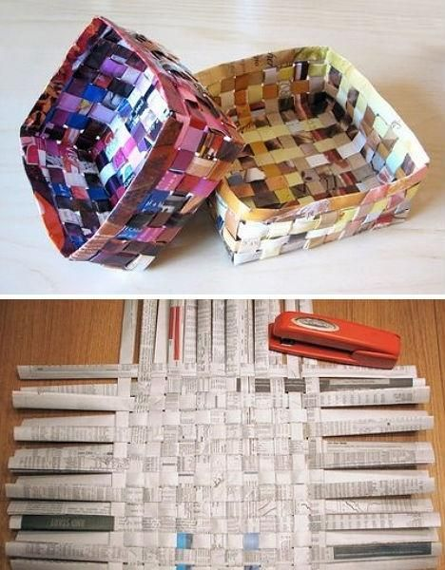
3. Choose the base of your basket

Slide 26
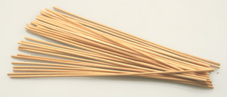
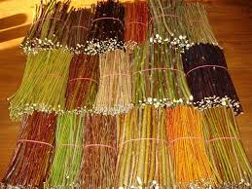
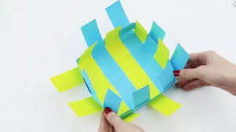
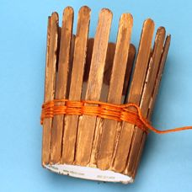
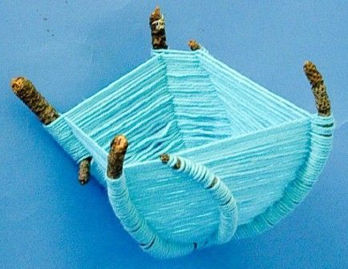
4. Choose your Spokes

Slide 27
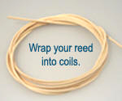
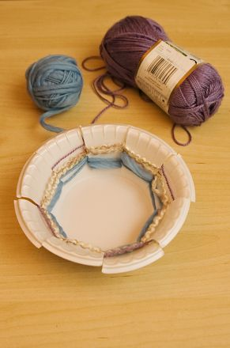
5. Choose your weaving material

Slide 28
If using reeds you will need to soak them in water so they can be softened for weaving

Slide 29
5. Make a simple basket of natural grasses, reeds, or other local material, OR decorate a basket to be used in a practical way in your home, such as those used for sewing, trash, berries, or flowers.

Slide 31
How to Weave a Paper Plate Bowl:
Supplies:
paper plate
pencil
something round to trace
yarn
scissors
glue and paintbrush (for inside base of bowl)

Slide 32
Mark your plate:Trace a circle in the center of your paper plate. This will be the base of your bowl. Next, make an uneven number of marks, evenly spaced, around the edge of the paper plate. Then draw a straight line to connect each mark to the circle that you drew.
.

Slide 33
Cut along each line, stopping at the circle that you drew. Now, make cuts on either side of each cut to form a V.

Slide 34
Fold each section at the pencil circle line and bend the sections up to form shape of your bowl. If any of the sections overlap, trim to make the V wider so there’s no overlap when the bowl is formed

Slide 35
Begin weaving
Slip a piece of yarn between one of the cuts, leaving a tail, which you can hold down with your thumb while you get started. Weave in and out of the cuts, around and around the bowl.
NOTE: Keep the sections of your bowl folded upwards as you weave.

Slide 36
Continue weaving until 1.5 cms from the top. Cut the yarn, leaving a tail to be tucked in.
Fold the top if the paper plate over to secure the woven yarn.
Tuck in any loose yarn ends.

Slide 37
Decorate the bottom of the basket

Slide 38
Video with instructions for a simple basket

Slide 39
Decorate a basket as a gift for someone.

Slide 40
7. What are some ways baskets are used in the Bible.
Give at least one text

Slide 41
Can you guess how many times baskets are mentioned in the bible?
46

Slide 42
Baskets in the bible

