Slide 1
Identifying Community Needs
Pathfinders e-Honour

Slide 2
Requirements
1. Read Matthew 9:35-38
2. Select an area
3. File that area
4. Awareness the area
5. Check the needs of the community
6. Share your research

Slide 3
Requirements
1. Read Matthew 9:35-38

Slide 4
Requirements
Matthew 9:35-38
35. Then Jesus went about all the cities and villages, teaching in their synagogues, preaching the gospel of the kingdom, and healing every sickness and every disease [i]among the people.
36. But when He saw the multitudes, He was moved with compassion for them, because they were [j]weary and scattered, like sheep having no shepherd.
37. Then He said to His disciples, “The harvest truly is plentiful, but the laborers are few.
38. Therefore pray the Lord of the harvest to send out laborers into His harvest.”

Slide 5
Requirements
After reading what Jesus did, what do you think the needs of your community are?
You can answer by writing in the chat

Slide 6
Requirements
2. Select an area
Example - Mission to the Cities – London 2013
https://am.adventistmission.org/mission-to-the-cities-london-focus-for-october
Example - Adventist Community Services – Dublin 2021
https://acsdublin.org/about/#jp-carousel-393

Slide 7
Requirements
3. File that area
a. A map of the area
b. A demographic profile
c. Public health statistics
d. Economic indicators
e. Housing information
f. Environment and transportation

Slide 8
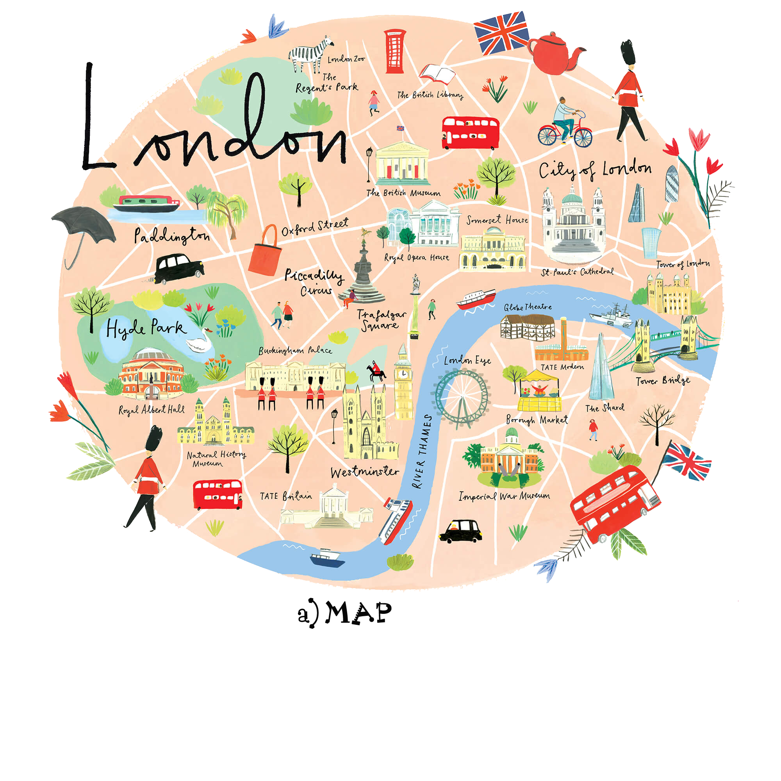
Requirements
3. File that area
a. A map of the area

Slide 9
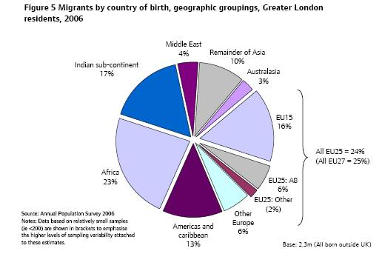
Requirements
3. File that area
b. A demographic profile

Slide 10
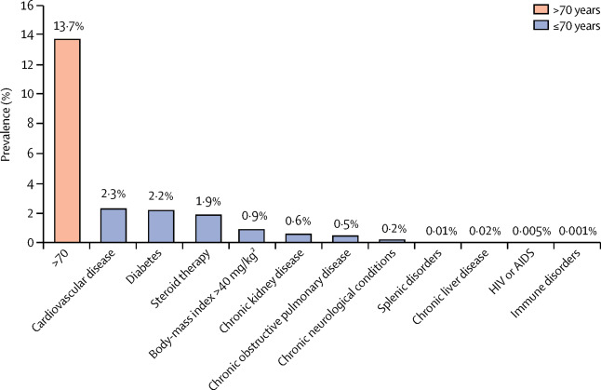
Requirements
3. File that area
c. Public health statistics

Slide 11
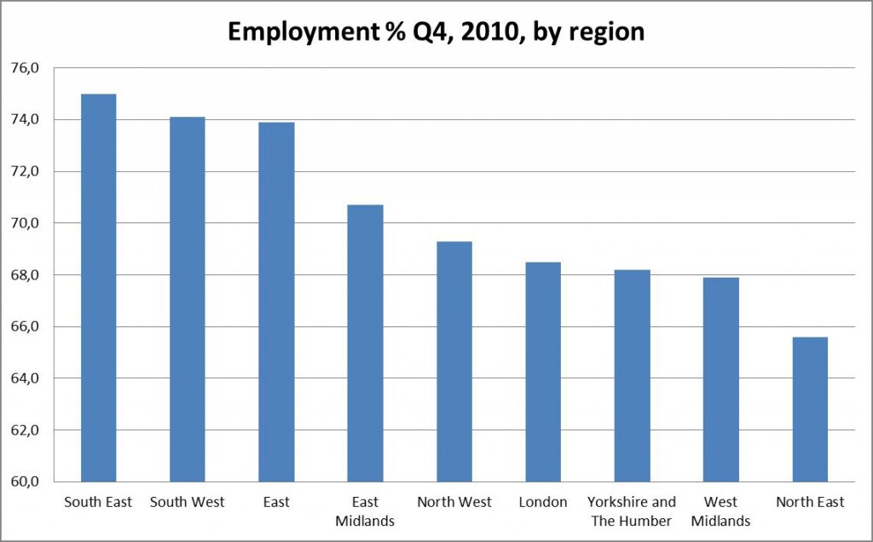
Requirements
3. File that area
d. Economic indicators

Slide 12
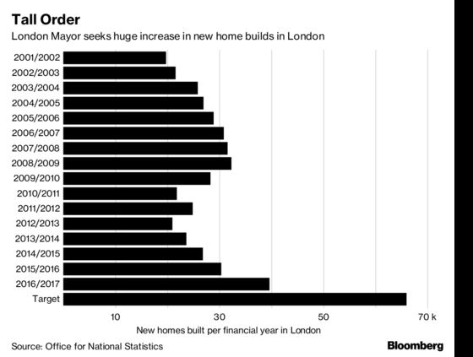
Requirements
3. File that area
e. Housing information

Slide 13
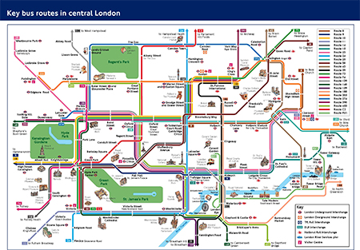
Requirements
3. File that area
f. Environment and transportation

Slide 14
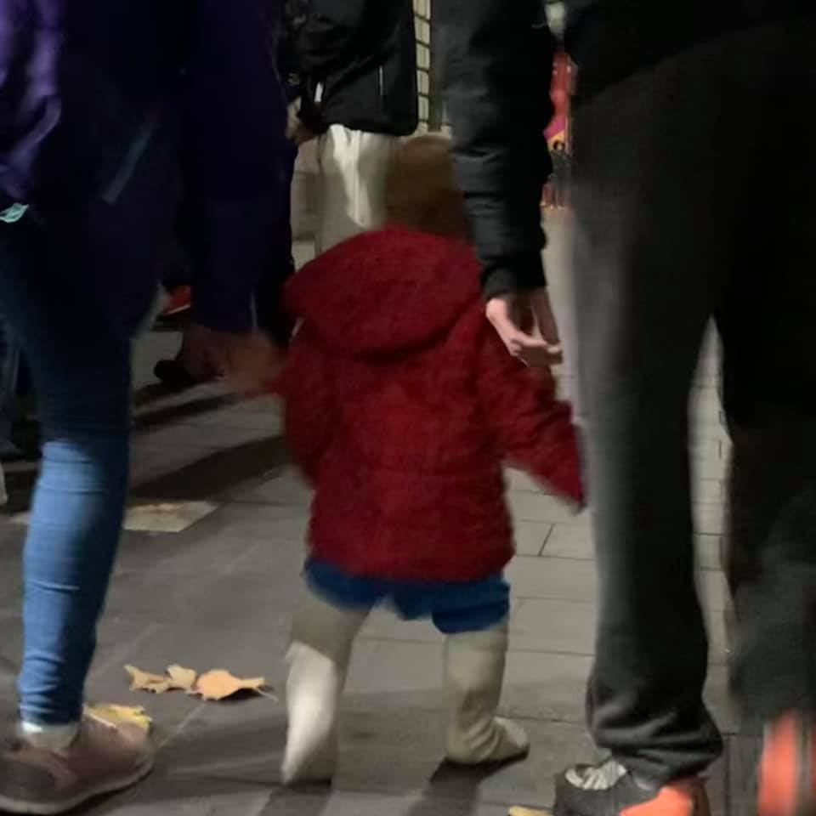
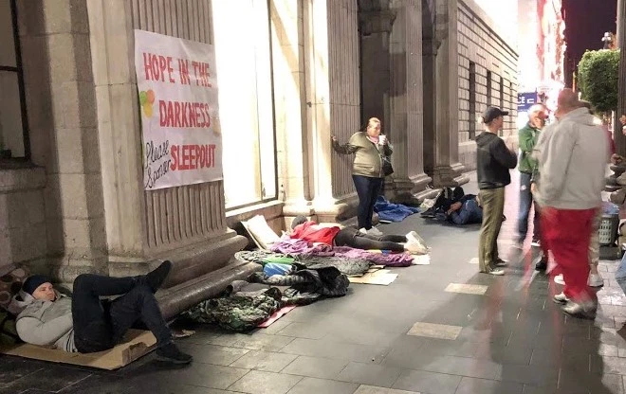
Requirements
4. Awareness of the area
take an awareness walk of or drive around a specific part of the selected community with the goal in mind of seeing human needs

Slide 15
Requirements
5. Check the needs of the community
Invite a civic leader or community professional to make a presentation to your Pathfinder Club
Ask acivic leader or community professional about the needs in the community

Slide 16
Requirements
5. Check the needs of the community
Organize a survey in a local shop or online

Slide 17
Requirements
6. Share your research
Make a presentation of at least 10 minutes to a local church committee, community service organization / Pathfinder Club

Slide 18
RESULT

Slide 19
RESULT

Slide 20
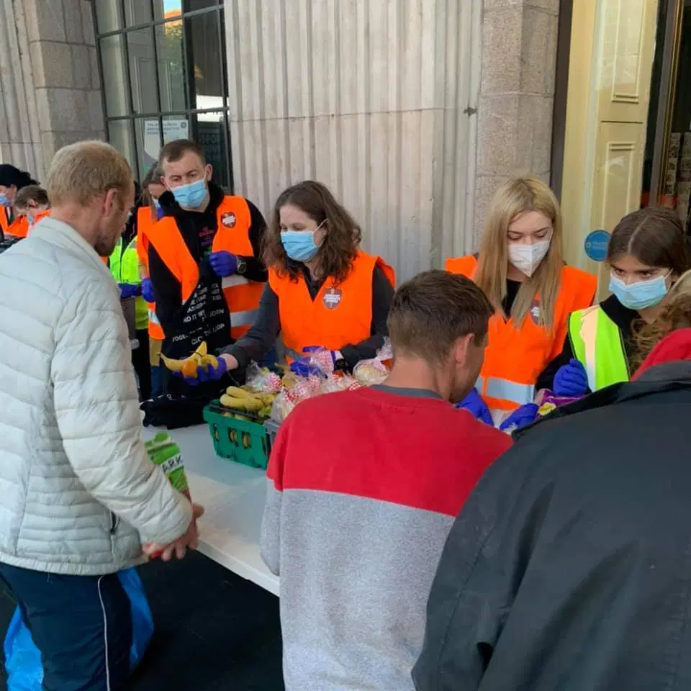
RESULT

Slide 21
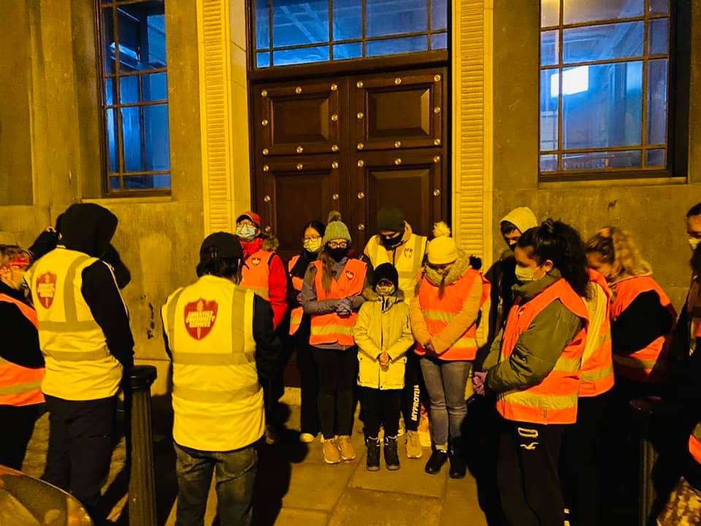
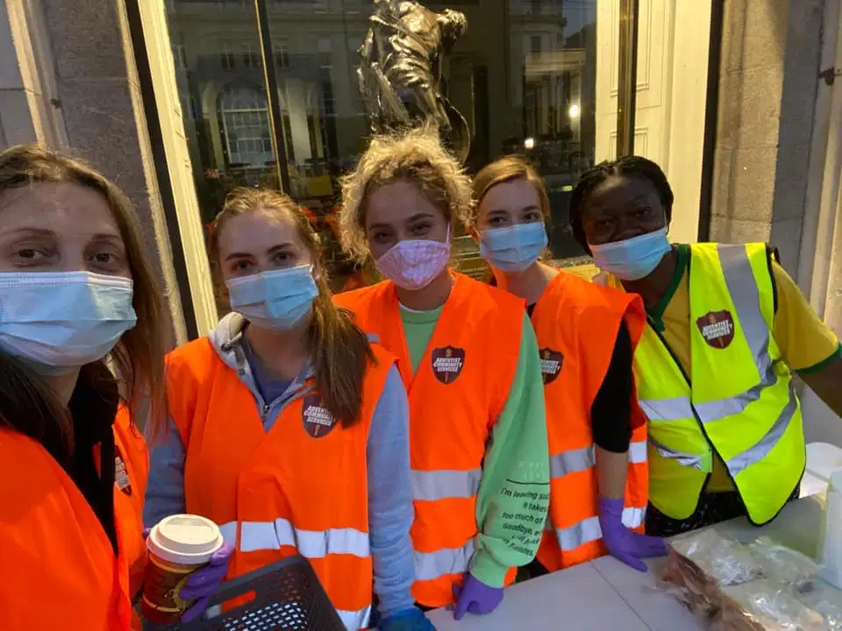
RESULT

Slide 22
Requirements
After all the examples presented today, can your club fulfil any community needs ?
You can answer by typing in the chat

Slide 23
Identifying Community Needs
THANK YOU
Presentation Links
https://am.adventistmission.org/mission-to-the-cities-london-focus-for-october
https://www.youtube.com/watch?v=RcpHiuLg5IM
https://www.youtube.com/watch?v=5EauIPVd2UM
https://acsdublin.org/about/

