Slide 1
Sign Language Award
presented by Jessica Perea

Slide 2
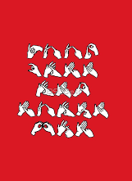
Requirements
1. Learn the manual alphabet used by the deaf
and the rules pertaining to it.
2. Learn how to send and receive words using
the manual alphabet.
3. Learn at least fifty words.
4. Learn and present at least one simple
Christian song.
5. Sign a simple Bible verse.
6. Meet a deaf person and sign with them.

Slide 3
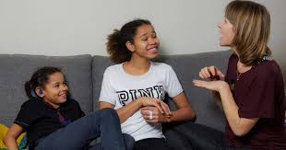
Who uses
Sign Language?
-Deaf
-Hard of Hearing
-people with a speech
disability, such as mute
-anyone

Slide 4
Quick Note:
Many different sign languages used around the world.

Slide 5
Requirement 1
Learn the manual alphabet used by the deaf,
and the rules pertaining to it.

Slide 6
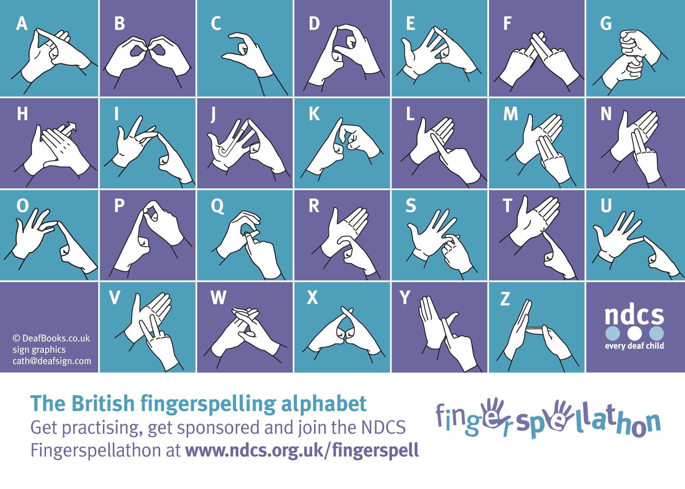

Slide 8
Requirement 2
Learn how to send and receive words using
the manual alphabet.

Slide 9
Let’s Spell
back
mug
friend
quilt
dizzy
xray
Jesus
worship

Slide 10
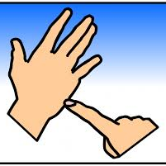
Let’s Spell Together
Type or write down what word you think is being spelled.

Slide 11
CAT

Slide 12
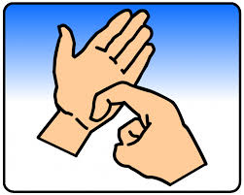
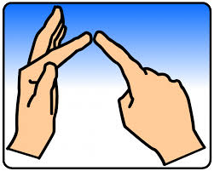
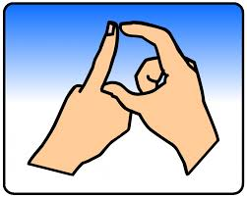
Let’s Spell Together
Type or write down what word you think is being spelled.

Slide 13
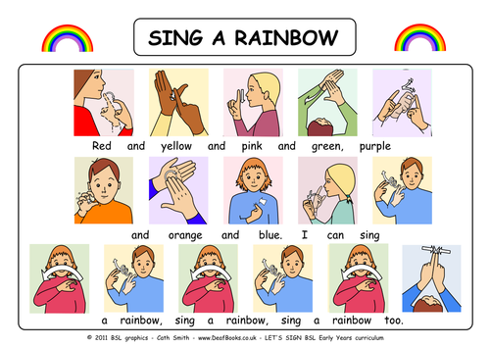
RED

Slide 14
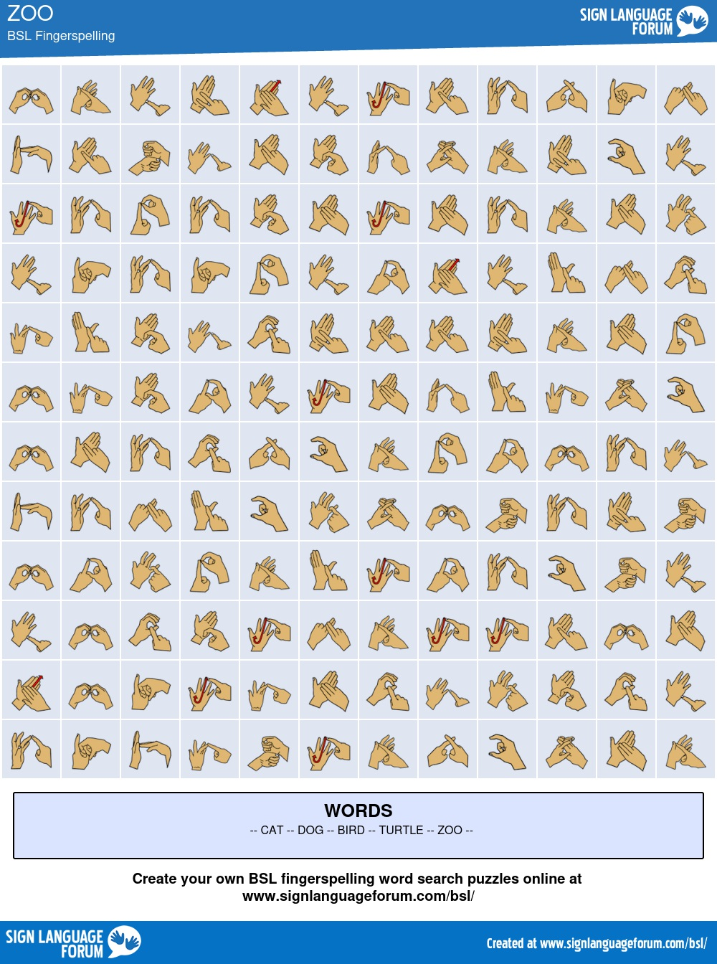
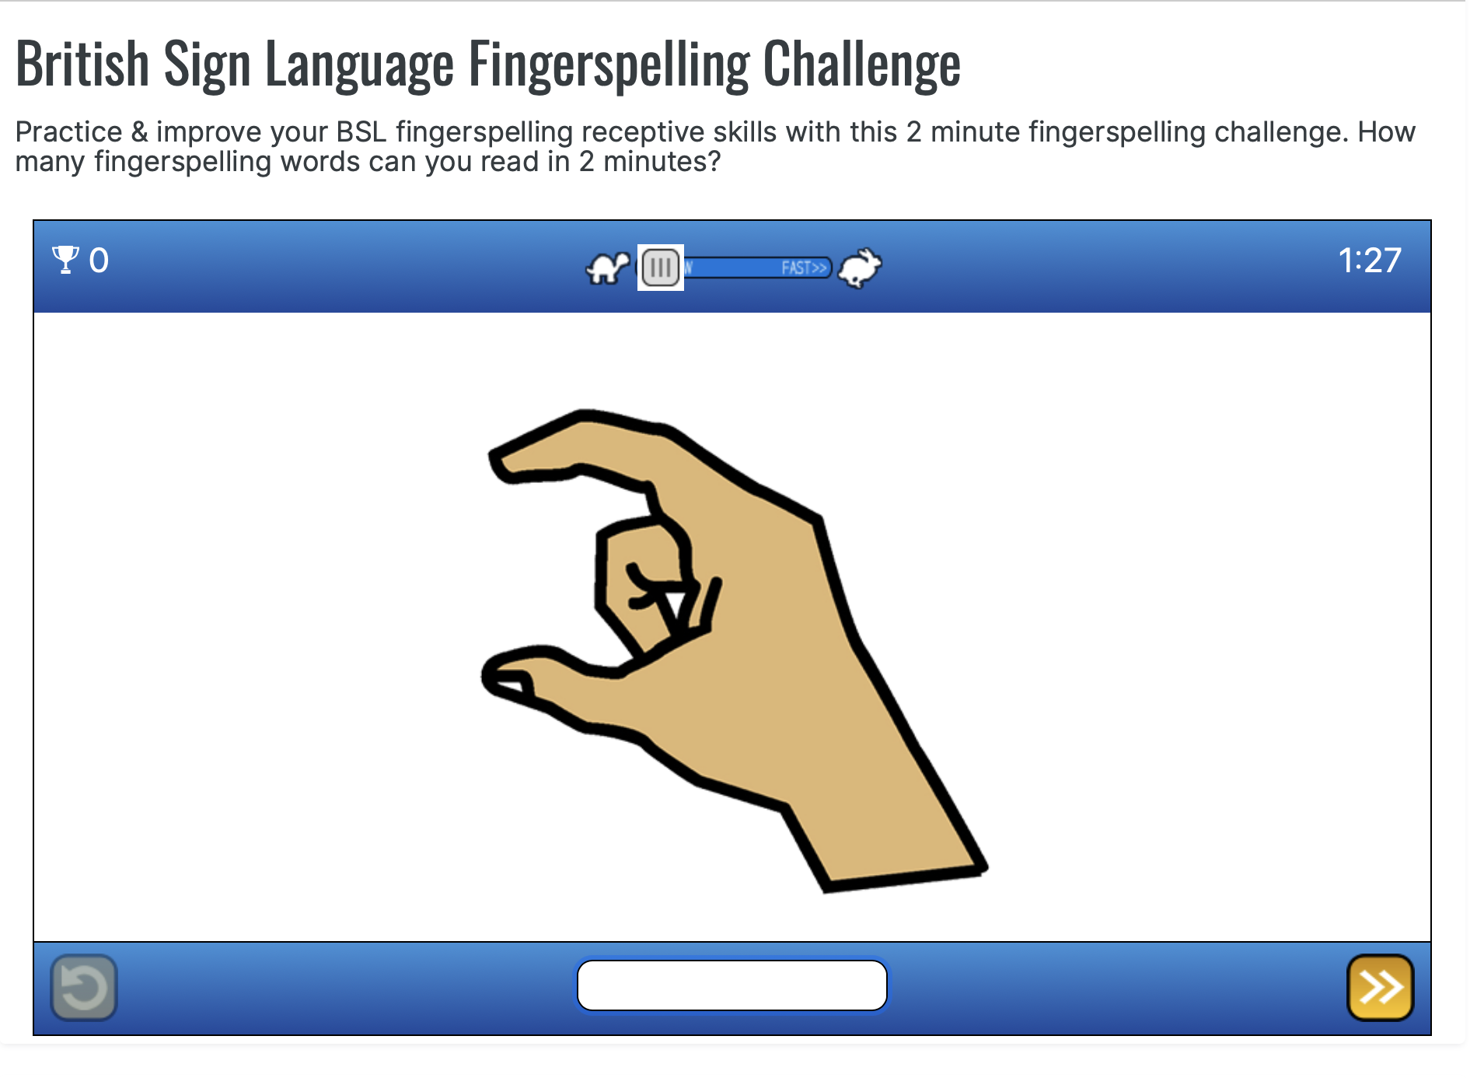
Fingerspelling Games
www.signlanguageforum.com/bsl/
https://www.signlanguageforum.com/bsl/fingerspelling/fingerspelling-game/

Slide 15
Requirement 3
Learn at least 50 words

Slide 16
Learn 50 words
Greetings
Family
Colours
Feelings
Food
School
Clothes
Verbs
Polite Words
Questions

Slide 17
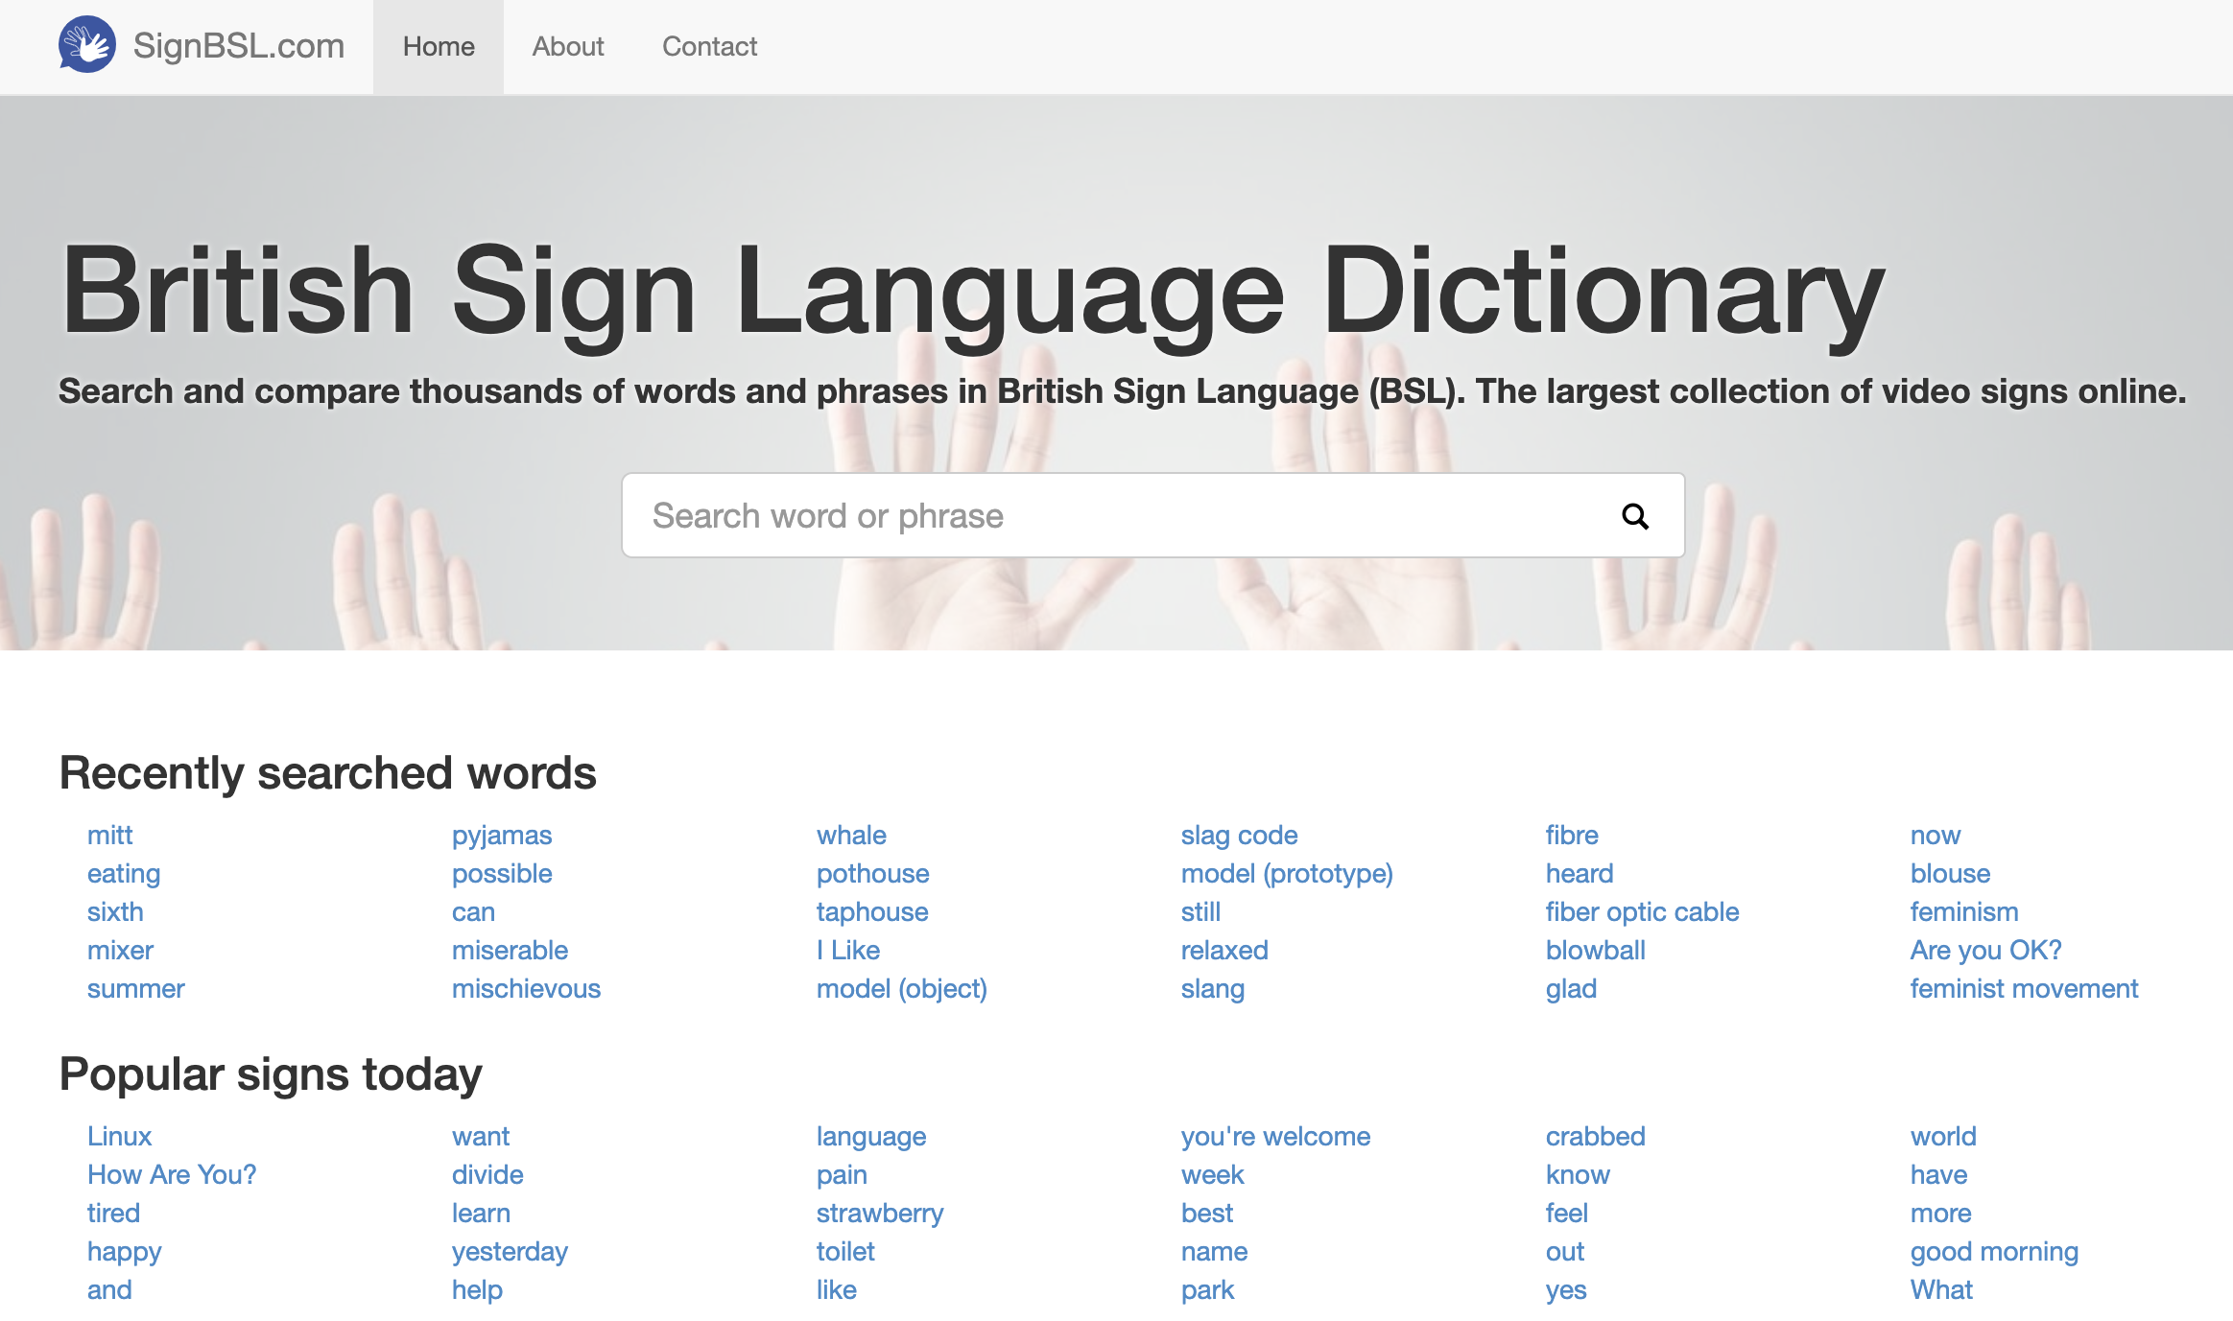
Video Dictionary
signbsl.com

Slide 18
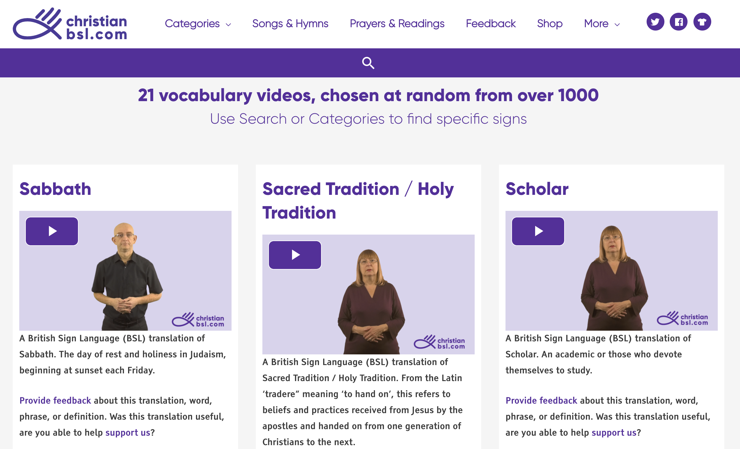
Christian Dictionary
christianbsl.com

Slide 20
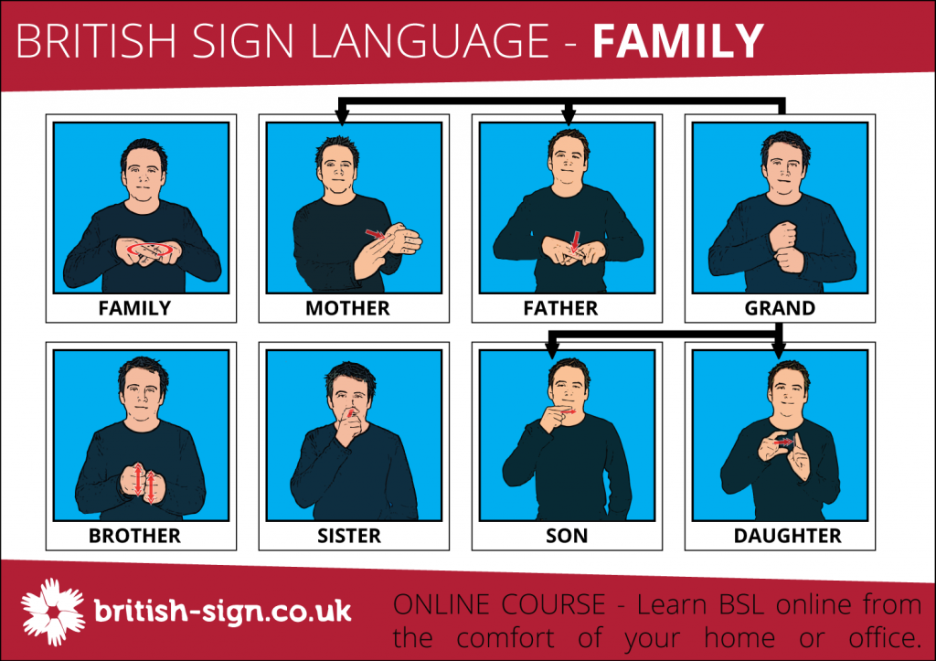

Slide 21
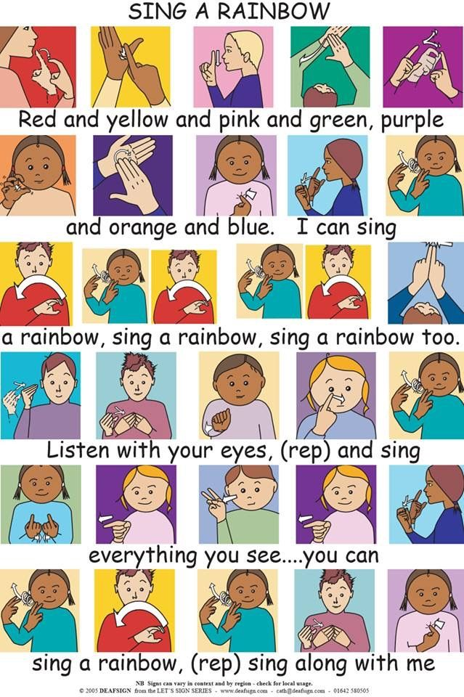

Slide 22
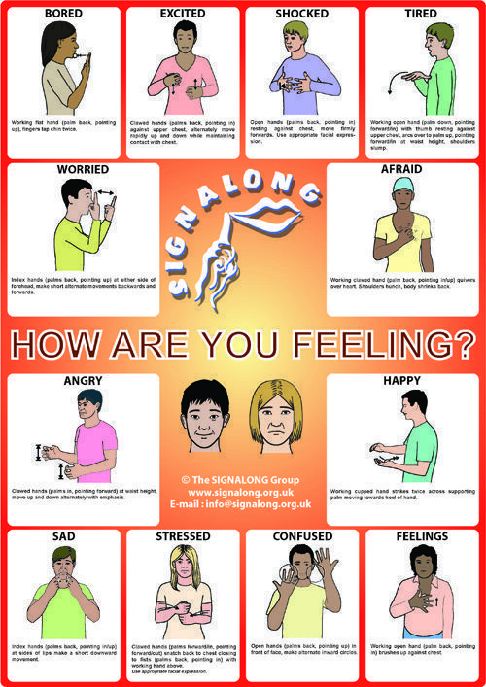

Slide 23
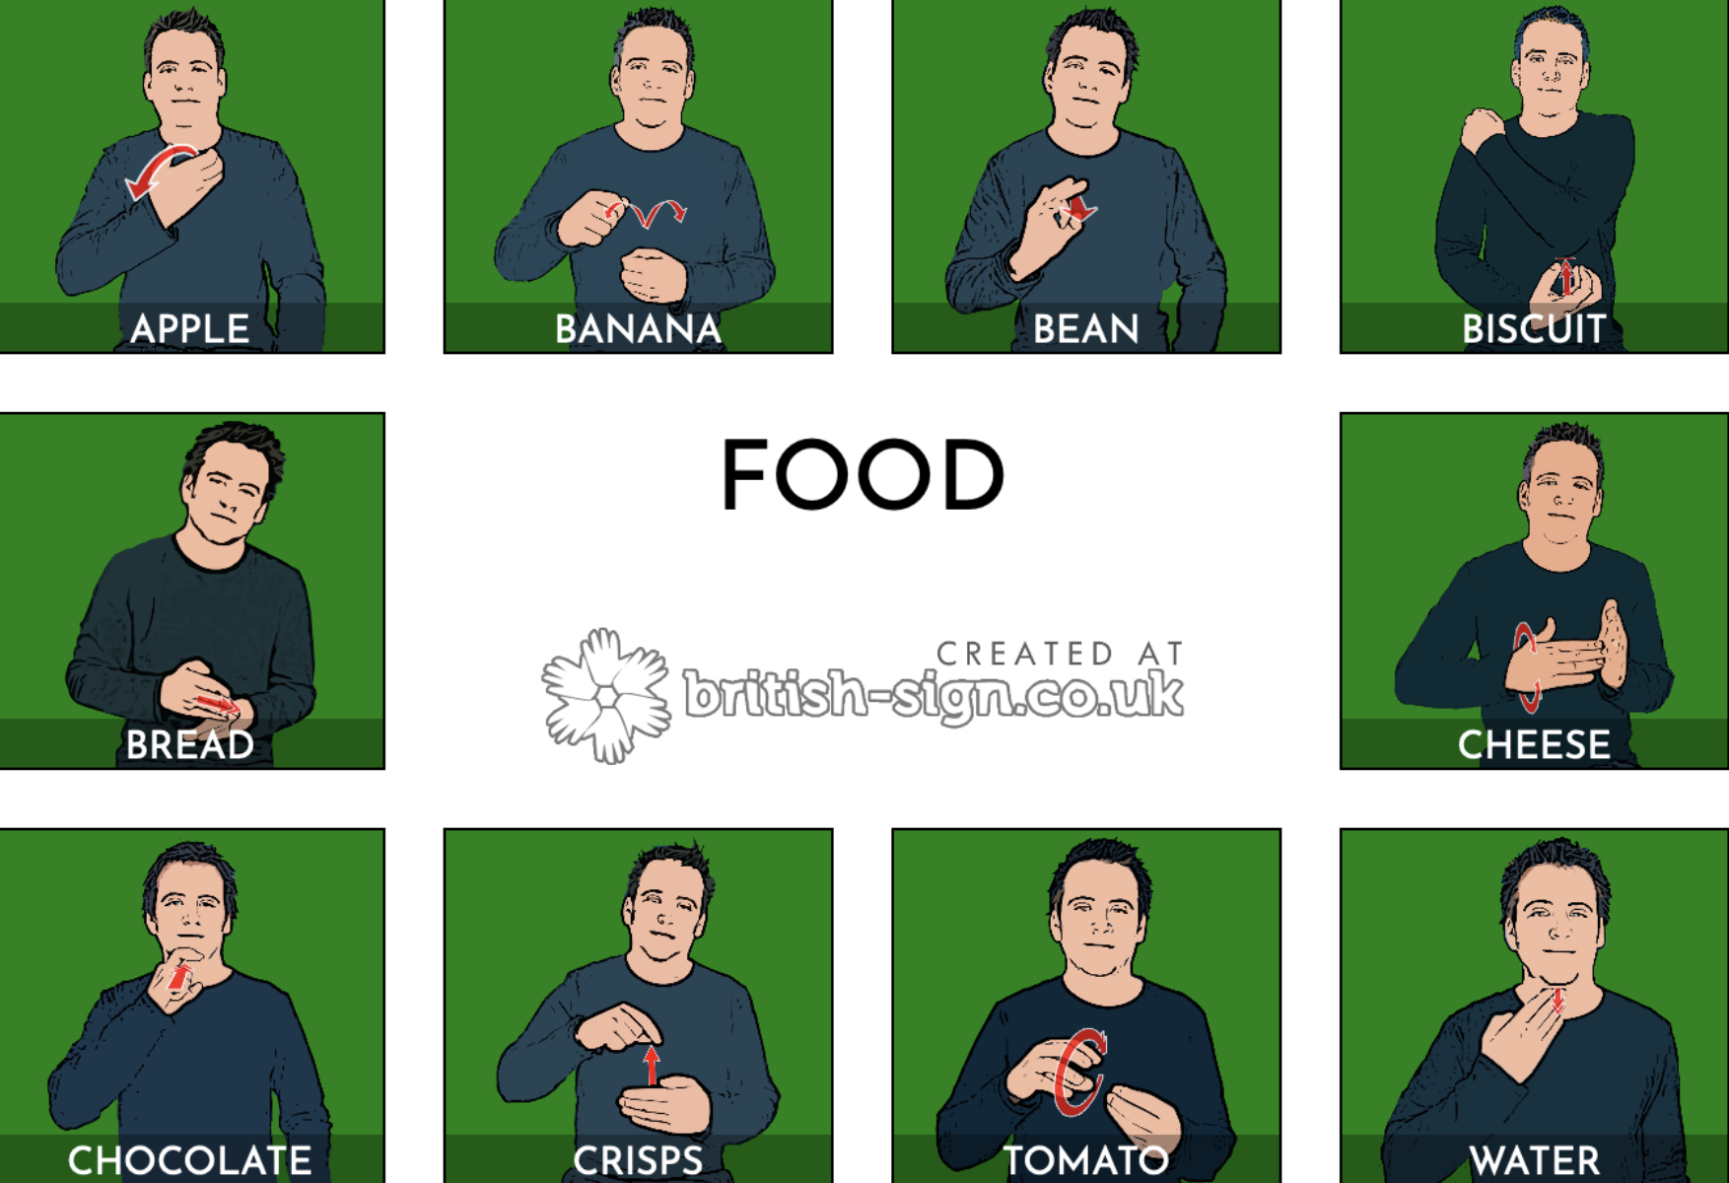

Slide 25
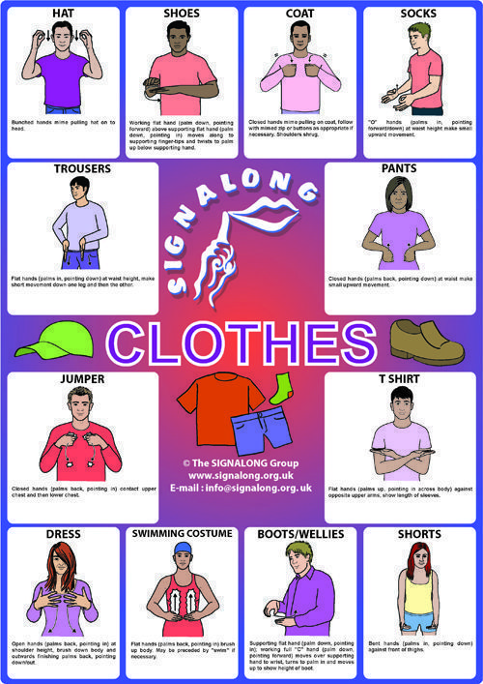

Slide 26
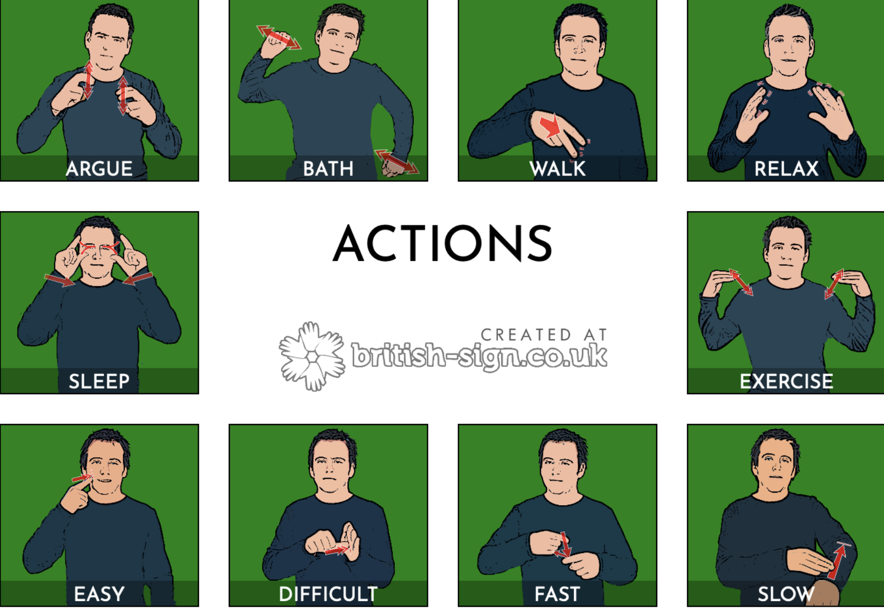

Slide 28
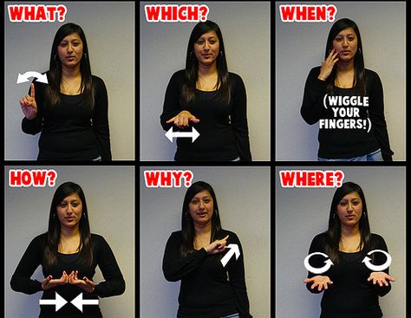
Question
Words

Slide 29
Requirement 4
Learn and present at least one simple
Christian song.

Slide 30
Into My Heart
in BSL Sign Supported English (SSE)
Into
my
heart
(repeat 2 times)

Slide 31
Come,
Into
my
heart

Slide 32
Lord
Jesus

Slide 33
Come
in
today

Slide 34
Come
in
to stay

Slide 35
Come,
Into
my
heart

Slide 36
Lord
Jesus

Slide 37
2nd Verse
Out of
my
heart
(repeat 2 times)

Slide 38
Shine
out of
my
heart

Slide 39
Lord
Jesus

Slide 40
Shine
out
today

Slide 41
Shine
out
alway

Slide 42
Shine
out of
my
heart

Slide 43
Lord
Jesus

Slide 44
Requirement 5
Sign a simple Bible verse.

Slide 45
Romans 12:12 ESV (BSL SSE)
Rejoice
in
hope.

Slide 46
Romans 12:12 ESV (BSL SSE)
Patient
in
tribulation.

Slide 47
Romans 12:12 ESV (BSL SSE)
Constant
in prayer.

Slide 48
Requirement 5
Meet a deaf person and sign with them.

Slide 49
Ways to Find Deaf Friends
Keep your Eyes Open
Contact the BUC Disabilities Ministries Department
Contact Adventist Deaf Ministries International
Southern Deaf Fellowship (Adventist Church) https://deafchurchonline.org
Do an internet search for Deaf people/organisations in your area. Join an online social.

Slide 50
Helpful Websites
https://everydaybsl.wordpress.com
signBSL.com - video dictionary
www.british-sign.co.uk - dictionary, fingerspelling games
christianbsl.com
https://bslsignbank.ucl.ac.uk - video dictionary
youtube.com

Slide 51
Helpful Apps
Sign BSL
BSL Hands (One and Two)
BSL Zone
Spread Signs
ITV Signed Stories
Nursery Rhymes with Scarlett

