Slide 1
My Picture Book Award
Presented by Semone Pollard

Slide 2
What are we going to learn ?
What is a picture book?
What are the benefits of picture books?
What are different types of picture books?
What can be found in picture books?
What materials do we need for making a picture book?
Learn Joel chapter1:3.
How to make a picture book?

Slide 3
What is a picture book?
A picture book is a book that is made specially by children, which is designed with lots pictures and decorations.
This book can be made about an event, occasion or memory that you have experienced.

Slide 4
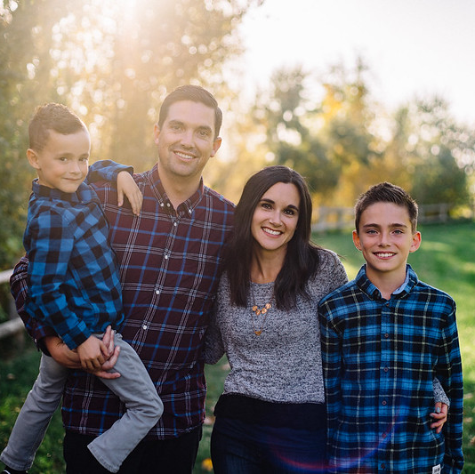
A picture book can be about your family.
https://foter.com/f6/photo/22064685858/3dcacb1c08/

Slide 5
https://foter.com/f6/photo/33070370920/607acd6806/?fbclid=IwAR3HrYgONNSpcWxHQrnPCV0-XCaDSOd6aBrqwD3kqBCwOuUpIcNK5oteUq0

Slide 6
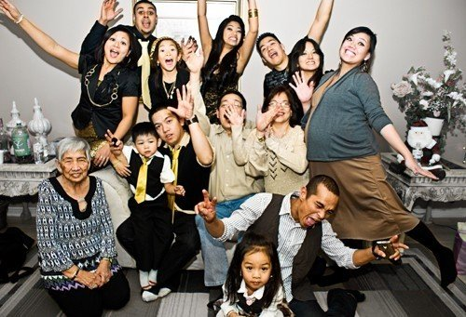
https://foter.com/photo5/family-love-3/
https://foter.com/photo5/person-fun-family/

Slide 7
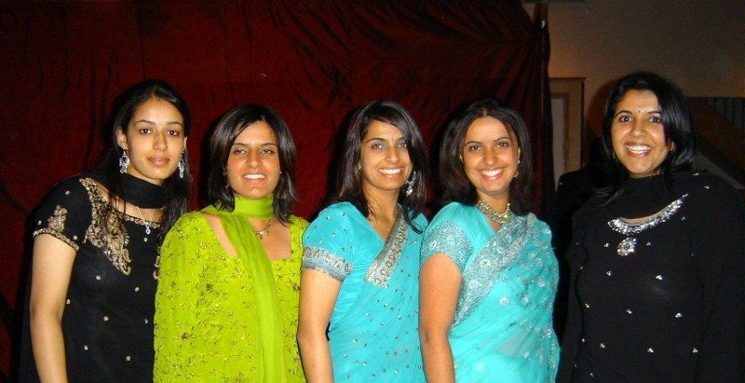
https://foter.com/photo5/family-shot-o/

Slide 8
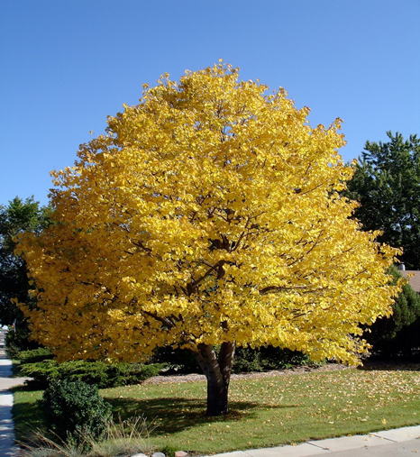
A picture book can be about trees.

Slide 9
Butterflies…

Slide 10
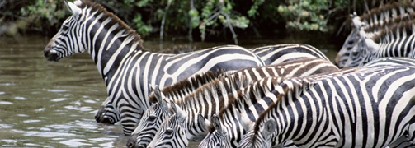
Wild animals…

Slide 11
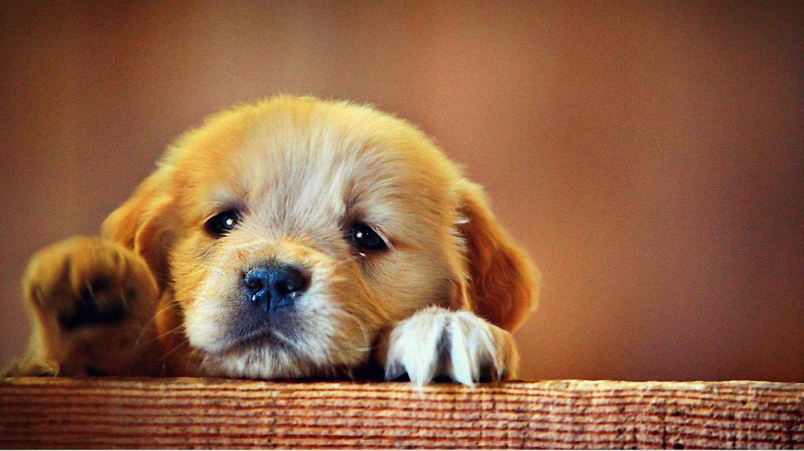
Pets…

Slide 12
Flowers…

Slide 13
Fish…

Slide 14
The starry heaven…

Slide 15
Picture books are useful for learning…

Slide 16
Good morals and behaviours.

Slide 17
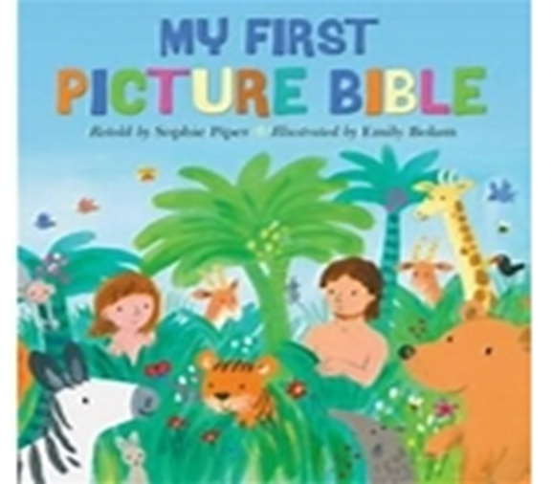
Stories such as bible stories.

Slide 18
New words.

Slide 19
To read.

Slide 20
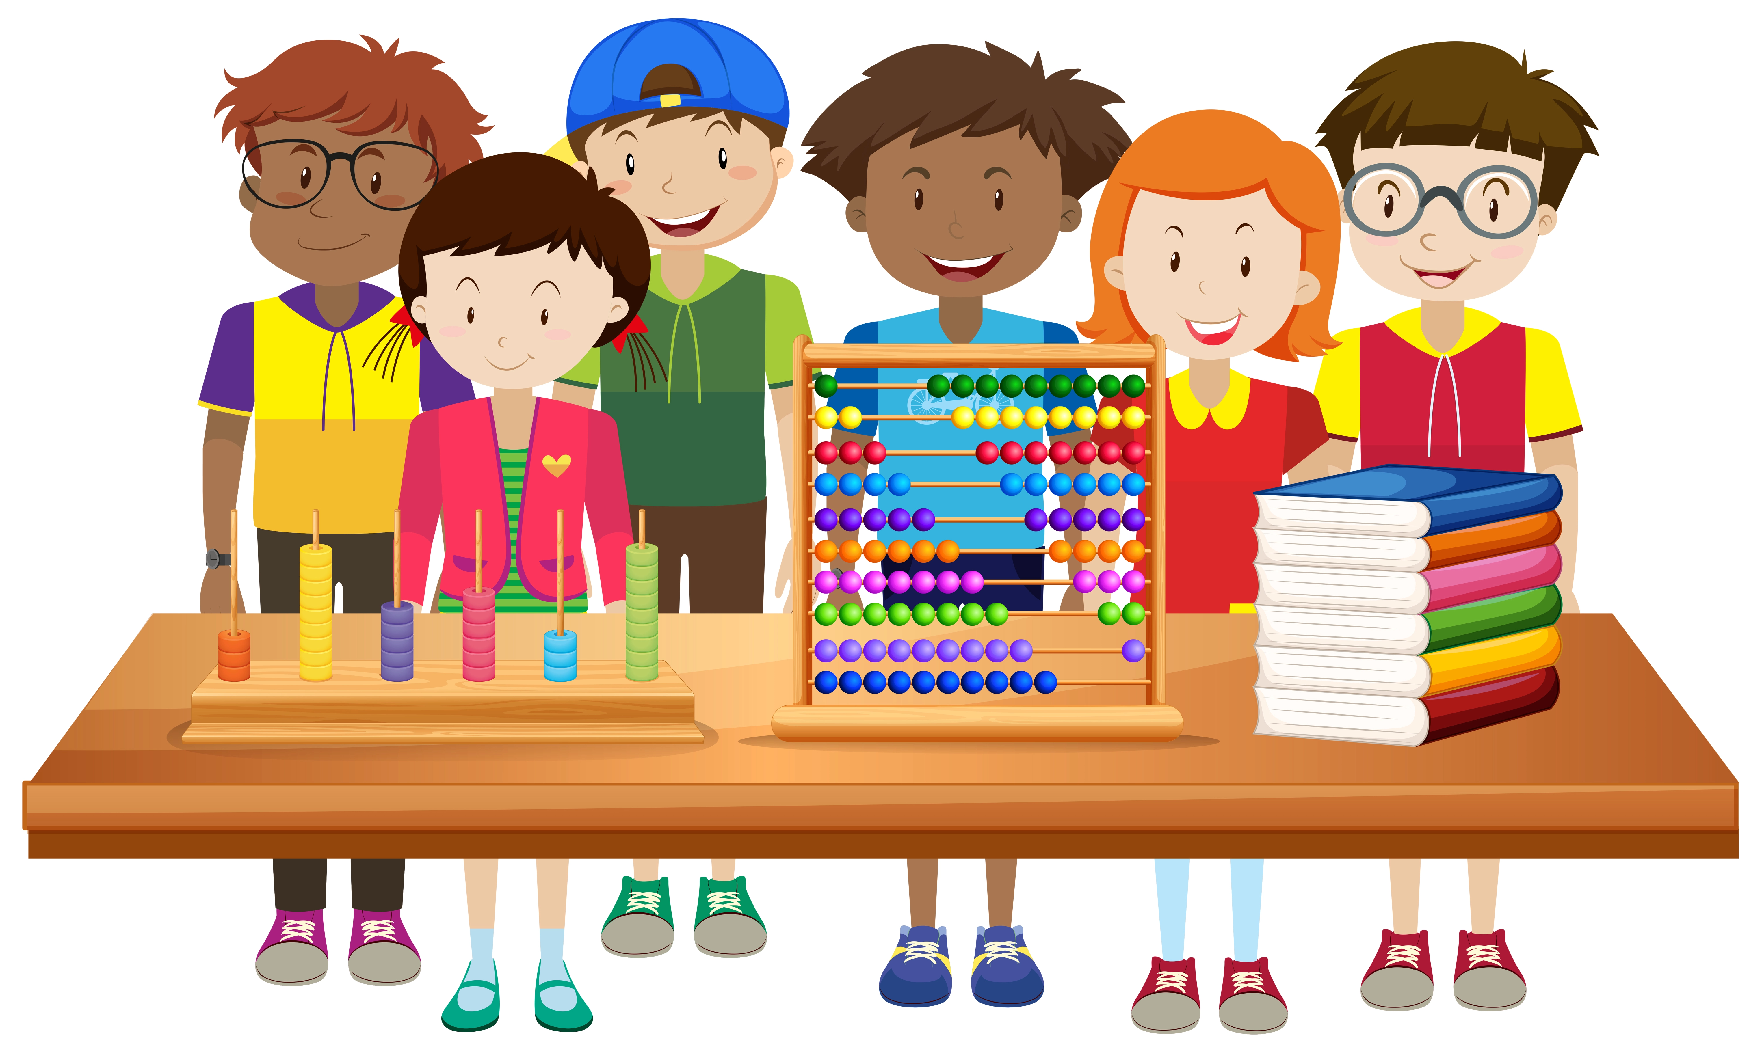
Concepts.

Slide 21
What are the different types of picture books?

Slide 22
Fairy-tales
Fairy-tales are stories that includes magic, fantasy and make belief characters.
There is a problem or conflict in the story, and a happy ending when it is solved.
The story is set in the past and often begins, ‘Once upon a time.’
Animals can talk and have other special abilities.

Slide 23
Fiction Stories
Fictions are stories that are invented and untrue.
They are based on imaginary people, events or places.

Slide 24
Factual stories
Factual picture books are true stories.
They are based on real life people, events or places.

Slide 25
What can be found in picture books?

Slide 26
Lots of beautiful colours

Slide 27
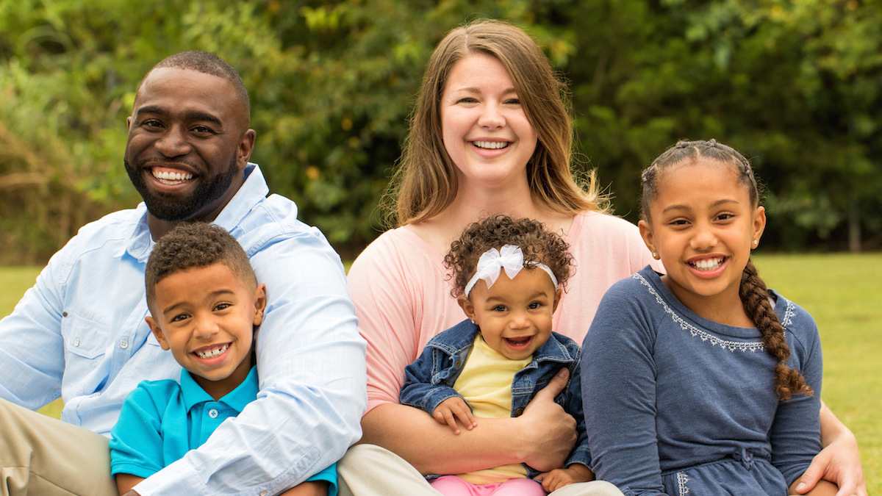
Photos

Slide 28
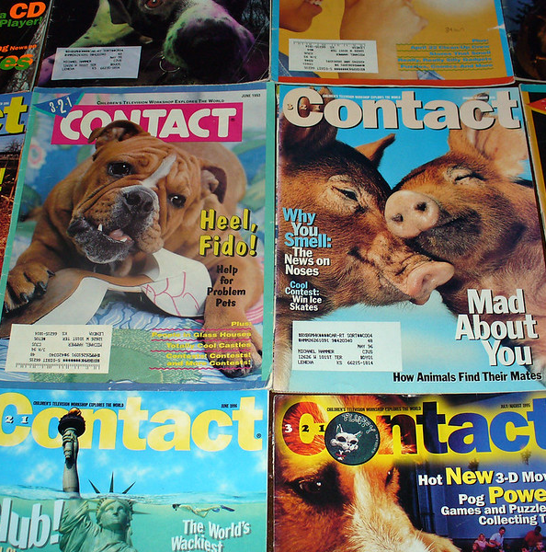
Magazine pictures
https://foter.com/f6/photo/5313060216/7b98b5b1b9/

Slide 29
Drawings or Art work

Slide 30
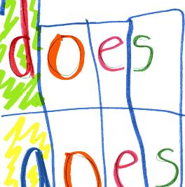
Words or sentences
https://foter.com/f6/photo/2377030986/4287b527d9/

Slide 31
Bible verses

Slide 32
Decorations

Slide 33
What materials do you need for making your picture book?

Slide 34
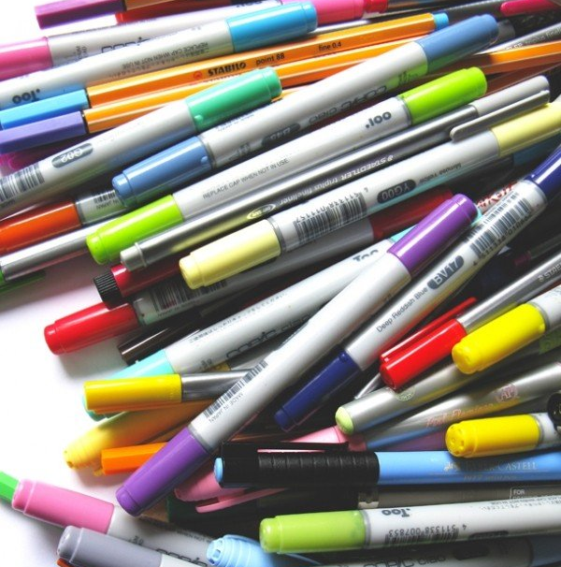
Markers, crayons, pencils or paints.

Slide 35
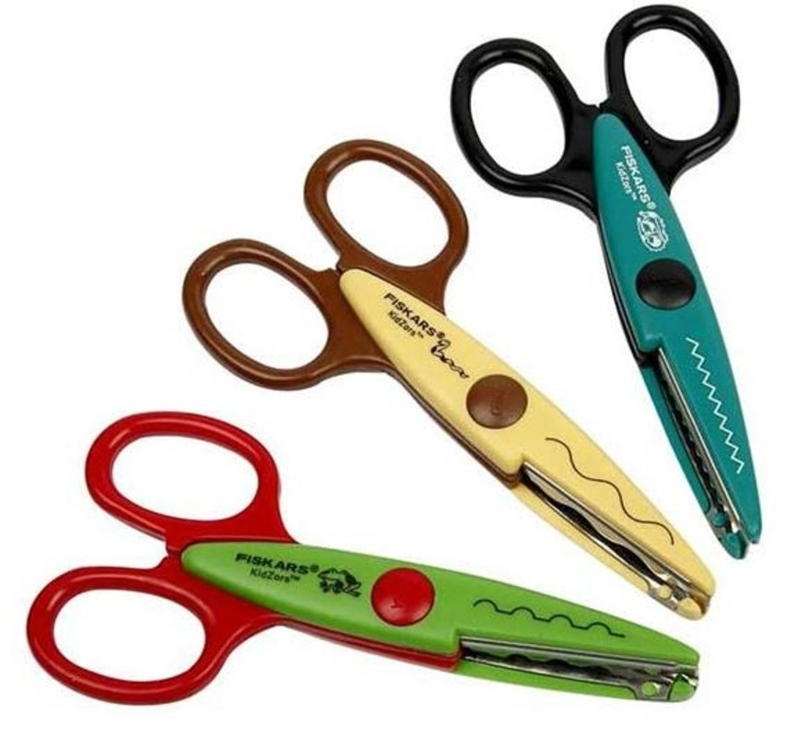
A pair of scissors.

Slide 36
Glue or paste.

Slide 37
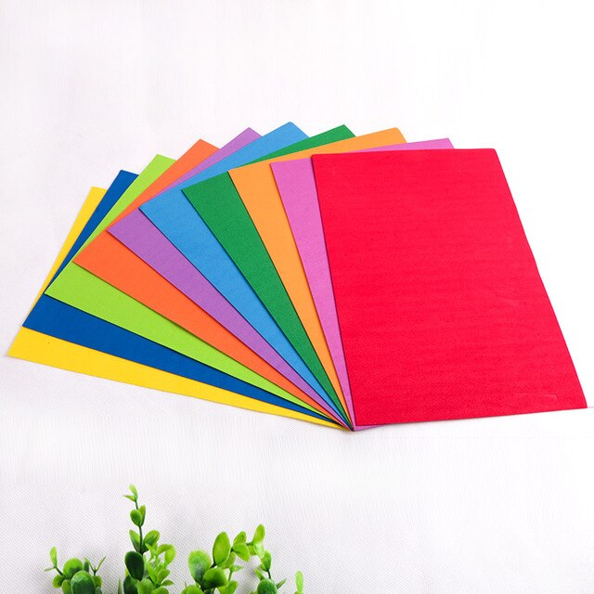
Cardboard and papers.

Slide 38
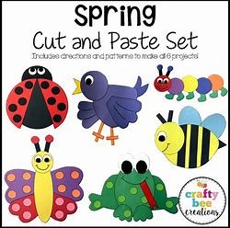
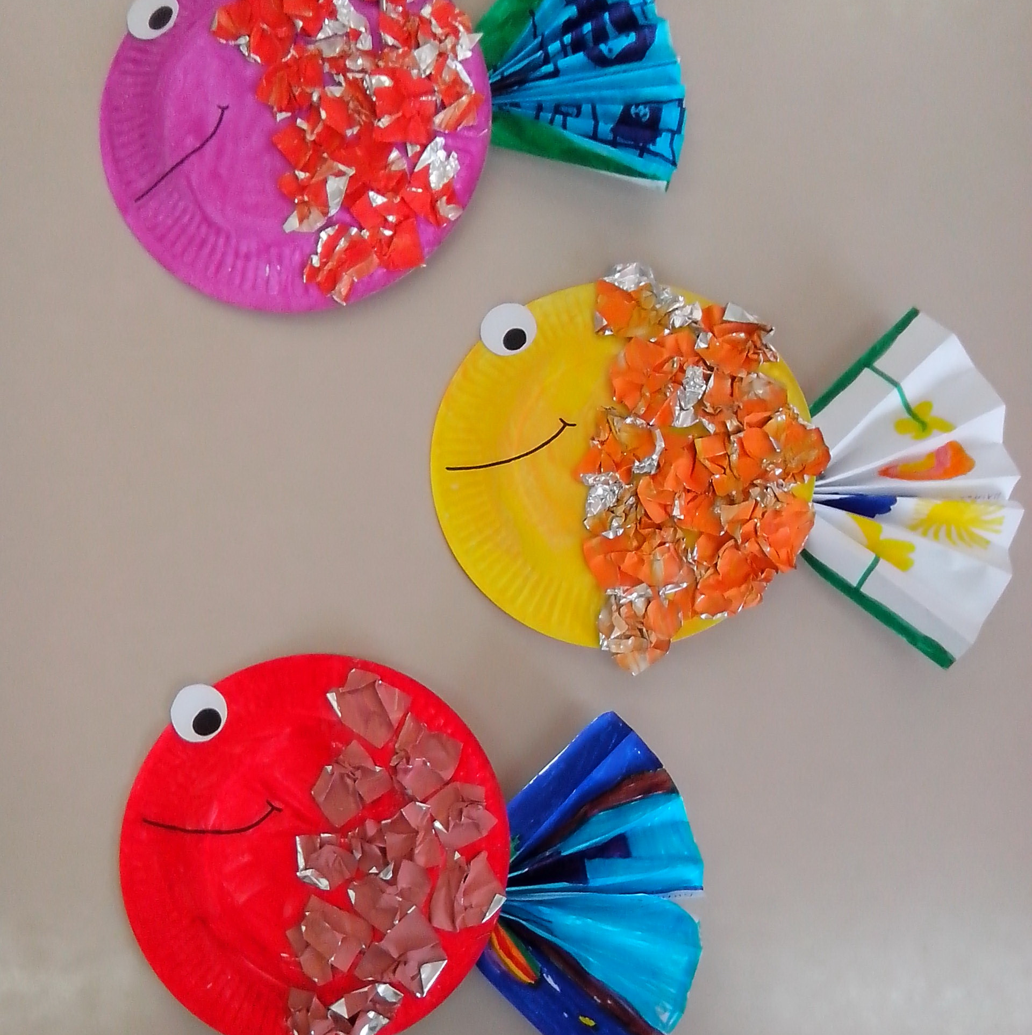
Pictures
Photos.
Drawings.
Magazine pictures.
Decorations.

Slide 39
Book binders

Slide 42
What does the bible says?
Tell it to your children, and let your children tell it to your children, and their children to the next generation.
Joel 1:3 NIV

Slide 43
My picture book
Now make your own picture book and share it with someone.
Explain to them why you have chosen to do your picture book.

Slide 44
Demonstration video
The presenter’s picture story book on the creation story from the bible.

