Slide 1


Bully
Prevention II
Presenter:
Gregory Carmichael
Wiki.pathfindersonline.org

Slide 2
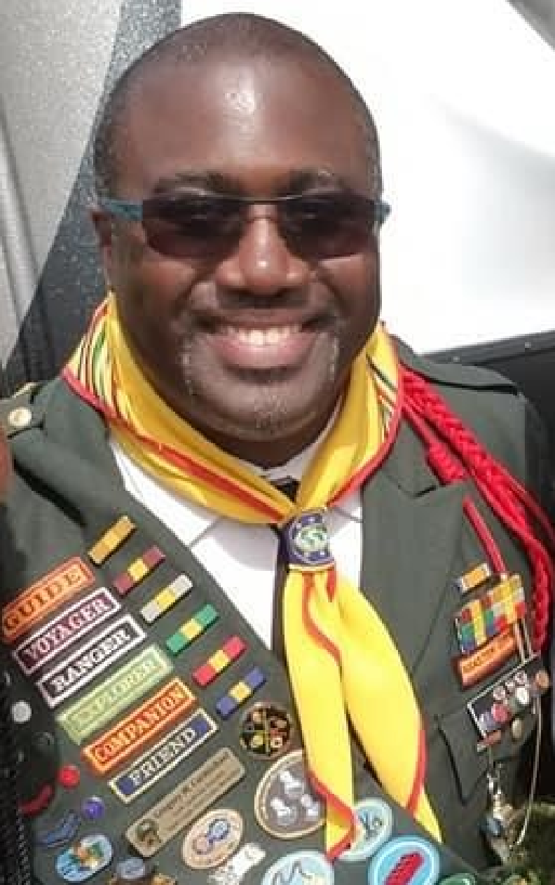
Gregory Carmichael
NAD Honors Task-Force
Committee Member

Slide 3
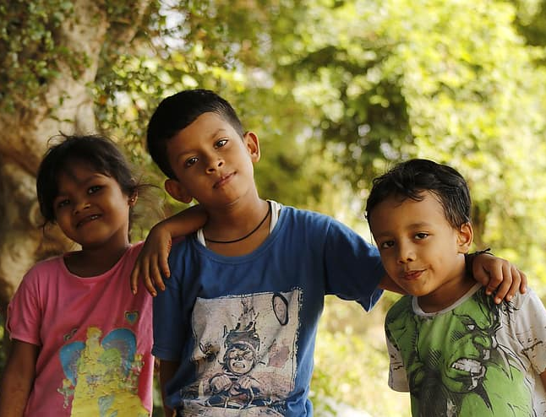
Big Idea:
Bullying is a human BEHAVIOR,
You can choose to change your role

Slide 4
Requirement #1
Review and explain four basic rules of bully prevention.

Slide 5
- We will not bully others
- We will try to help students who are bullied
- We will try to include students who are left out
- If we know somebody is being bullied, we will tell an adult at school/church and an adult at home

Slide 6
Requirement #2
Review some of the signs to look for that could determine if an individual is suffering from some form of bullying.

Slide 7
What is Bullying?
Bullying is unwanted, aggressive behavior among school aged children that involves a real or perceived power imbalance. The behavior is repeated, or has the potential to be repeated, over time. Both kids who are bullied and who bully others may have serious, lasting problems.
Young people often describe bullying as when “someone makes you feel less about who you are as a person.”

Slide 8
Signs?
If someone is repeatedly doing these things from a positions of power, this is bullying:
making threats
spreading rumors
attacking someone physically or verbally
excluding someone from a group on purpose.

Slide 9
Requirement #3
Review what the different roles people play when being part of a bullying situation (often described as the Bully Circle)? Which roles have you witnessed happen in situations you have seen or been involved in?

Slide 10
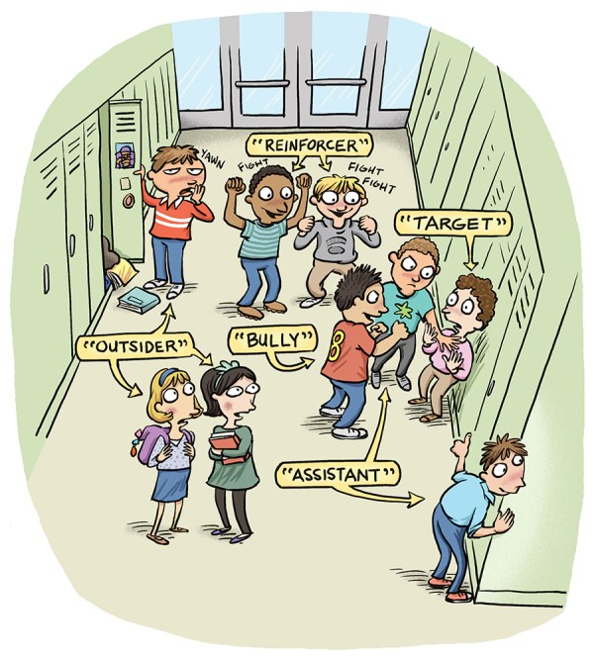

Slide 11
Those who Bully - These are individuals who actively bully others.
The Target – The Target is the victim of the bullying.
Those who Reinforce - They support the bully by creating an audience
Those who are Outsiders – They watch but choose not to play any role in the bullying.
Those who Assist - These are individuals that willfully encourage the bullying behavior, although they did not start or played a leading role.

Slide 12
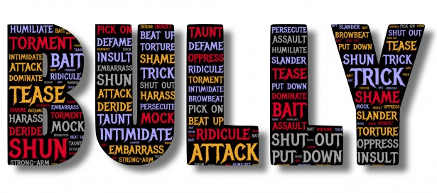
What words belong here that aren’t already here?
Remember: Bully behavior is a CHOICE. Empathy breaks the bully circle!

Slide 13
Requirement #4
Explain the following types of bullying and evaluate ways that you would know that the following are happening within your friendship community.

Slide 14
Some Types of Bullying
Relational Aggression
Verbal Bullying
Physical Bullying
Cyber Bullying
Prejudicial Bullying
Sexual Bullying

Slide 15
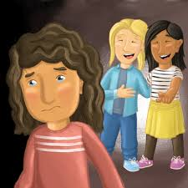
Relational Aggression
Relational Aggression is used to harm an a person’s social standing by spreading rumors and damage relationships with other.

Slide 16
Relational Aggression
Indicators:
Leaving someone out on purpose
Telling others not to be friends with someone
Spreading rumors about someone
Embarrassing someone in public

Slide 17
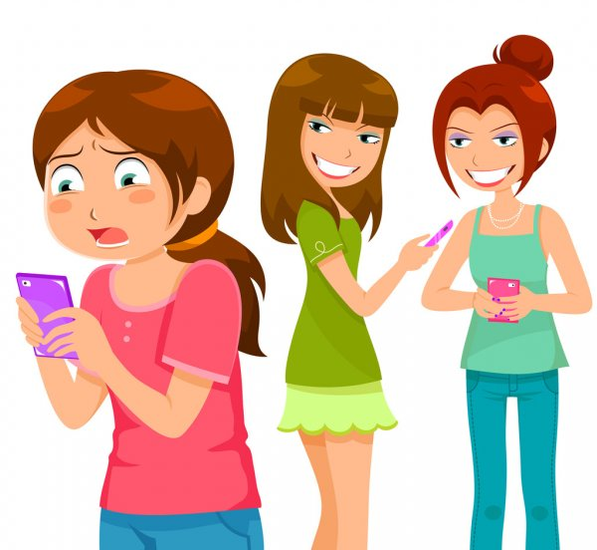
Cyber Bullying
Cyberbullying is the use of social media or an internet capable device to harass or embarrass someone in the presence of a larger audience who is familiar with that person, called the target.

Slide 18
Cyber Bullying
The most common places where cyberbullying occurs are:
Social Media, such as Facebook, Instagram, Snapchat, and Tik Tok
Text messaging and messaging apps
Instant messaging, direct messaging, and online chatting over the internet
Online forums, chat rooms, and message boards, such as Reddit
Email
Online gaming communities

Slide 19
Types of Cyber Bullying
Prohibiting: Keeping one person out of the information loop.
Deception: Befriending the target for the purpose of acquiring information that can be used against them by forwarding it to others.
Denigration: Attacking the target’s character by deliberately sending messages or posting false information or rumors about the person to infilcit damage on reputation and character.

Slide 20
Types of Cyber Bullying
Cyberstalking: Repetitive messaging tools to send painful, malicious and/or false information or threatening messages.
Flaming: Fights between individuals conducted online using strong, harsh and ill-mannered language.
Impersonation: Acquiring some form of access to a person’s email or social media account, and then using it to send derogatory or humiliating material to others under that person’s identity.

Slide 21
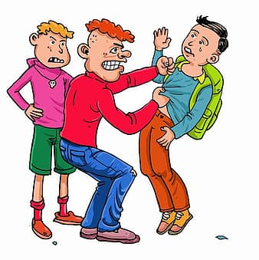
Sexual Bullying
Sexual bullying is the use of hurtful and demeaning acts towards a person that target their sexually. This may involve sexually oriented name calling, comments, gestures, and unwelcomed touching.

Slide 22
Examples of Sexual Bullying
Making sexual jokes, comments, or gestures to or about someone
Using various online or face to face methods to spread unwelcomed rumors
Writing sexual messages about people in public areas
Showing inappropriate sexual pictures or videos to
someone of themselves or another person
Posting sexual comments online of videos or
pictures on social networks
The act of touching, grabbing, or pinching
someone in a deliberately sexual way

Slide 23
Requirement #5a
Briefly describe the differences between flirting and sexual harassment.

Slide 24
Flirting
Sexual Harassment
It is a welcomed action
The attention is appreciated
It is not welcomed
The attention is unwanted and not appreciated

Slide 25
Requirement #5b
Briefly describe some characteristics of cyberbullying that make it different from other common types of bullying.

Slide 26
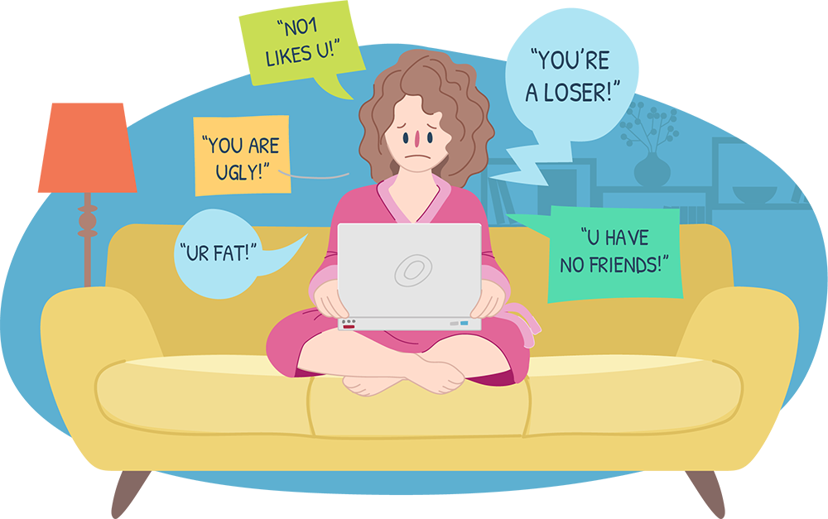
- Messages posted do not go away
- Messages can mean different things to different people.
- Anyone can do it at any time

Slide 27
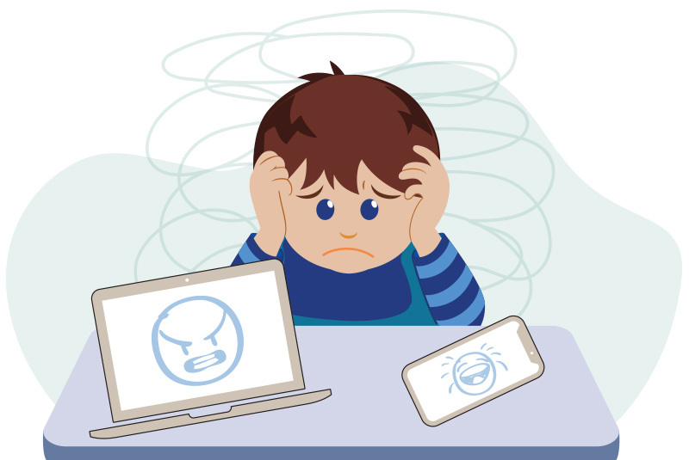
- Anyone can fall victim
- Online activity is more difficult to trace
- Simple tools like email can be used to do a lot of harm

Slide 28
Bullying is a BEHAVIOR
You can choose
to change your role!
Crush the circle!

Slide 29
What’s Next?
Complete the activity Requirements.

Slide 30
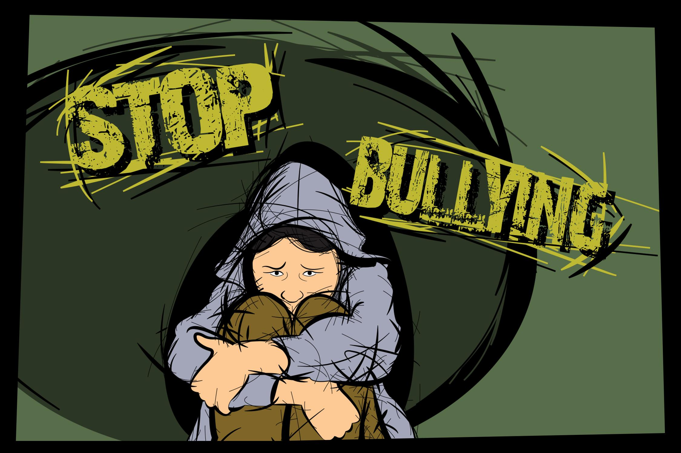
Finish Activity Requirements
  Discuss with a group the following texts as each relates to bullying:
    Deuteronomy 31:6
    Proverbs 12:18
    James 3:1-11
    Ephesians 4:29
    Mark 12:31

Slide 31
Finish Activity Requirements
7. Discuss with an individual or in a group some of the ways to protect oneself from the following:
  - Relational Aggression
  - Cyberbullying
  - Sexual Bullying

Slide 32
Finish Activity Requirements
8. Reflect on a moment when you or someone you know experienced being a target of relational aggression. As a first- hand witness or from a close acquaintance, briefly answer the following:
Explain in as much detail as possible
what took place.
What actions were sought
to address the issue?
What lessons were learned
from that experience?

Slide 33
Finish Activity Requirements
9. Demonstrate a profound understanding of the vulnerabilities, accountabilities, and pitfalls of spreading rumors by doing one of the following
- Carefully observe the front pages of popular print and online media that contain articles about popular people. Take note of the rumors that are stated about them for the sole purpose of selling magazines. Discuss why such false information sells magazines. Discuss the challenges to a Christian’s lifestyle of participating in this practice.
- Lead a discussion on some of the consequences individuals may face after they are caught spreading false rumors about others.
- Conduct a group research project on the local and/or state laws regarding defamation (libel and slander), and the possible penalties for each. Refer to recent cases and be prepared to share your findings with a group.

Slide 34
Finish Activity Requirements
10. Cyberbullying -- often includes elements that endanger the life and safety of someone else, and thus may require reporting to officials. Determine what steps or actions are needed at each stage listed below to work to resolve cyberbullying situations.
Evidence Collection
Reporting to parents/schools
Reporting to Law Enforcement
Reporting cyberbullying to online
service providers

Slide 35
Finish Activity Requirements
11. Discuss each of the following scenarios as a group. 1) Read the situation, 2) evaluate whether sexual bullying is taking place, and 3) based on your observation, discuss potentially appropriate responses.
  Someone at school says you look great today
  Someone at a party says your clothes look nice on you,
  making comments on particular body parts
  Someone compliments the design of your tie and then
  takes the liberty to adjust it
  A friend begins to pressure you to send sexually
  oriented pictures of yourself
  Someone begins to show up wherever you are to say
  hello, on several occasions
  Someone tries to hold or hug you unexpectedly each
  time they see you
Idea: Do as small group skits
(can be done Zoom or in person)
Then discuss!

Slide 36
Finish Activity Requirements
12. Discuss from a Christian's perspective how bullying has been and continues to be used as a means to hinder spreading the gospel of Christ.
Questions you could ask:
Is it possible to love Jesus when you have never experienced love?
How has fear hindered people from saying “yes” to Jesus?
How do kids who wish to accept Jesus find “honor your father and mother” hard when their parents attempt to prevent them from accepting Jesus? Is this action ‘bullying’?

Slide 37

What’s Next?
Earn the Bully Prevention I honor too!

Slide 38

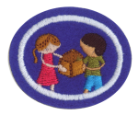






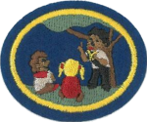
Other Cool Honors
Left to Right
Bully Prevention I
Christian Visitation
Serving Communities
Family Life
Christian Team Building
Visual Media Critique
Small Group Bible Study (and Advanced)
Social Media
Peace Maker (and Advanced)
Missionary Life (and Advanced)

Slide 39
Web / App Resources
Youtube.com “bully prevention”or “bully prevention strategies” - a great resource for videos and awareness
Interesting Sites:
Stopbullying.gov
https://www.pbis.org/topics/bullying-prevention
https://ibpaworld.org/
Bully Prevention II

