Slide 1
Acts of Kindness Award
Juliette Steele
Florida Conference

Slide 2
Acts of Kindness
What does the Bible say?
What is Kindness and Love?
Do a skit about acts of kindness
Bible Stories
Kindness Craft
What can your Club do?

Slide 3
Bible Texts about
Acts of Kindness

Slide 4
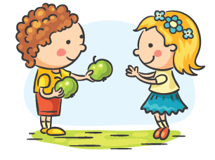
Romans 12: 10
Be devoted to one another in love. Honour one another above yourselves.

Slide 5
Proverbs 12:25
Anxiety weighs down the heart, but a kind word cheers it up.

Slide 6
Bible Story Skit about Kindness!

Slide 7
Bible story pictures
Identify the Bible Story
State / Discover which act of kindness happened
OR
What unkind behaviour happened (And how it could have been different

Slide 8
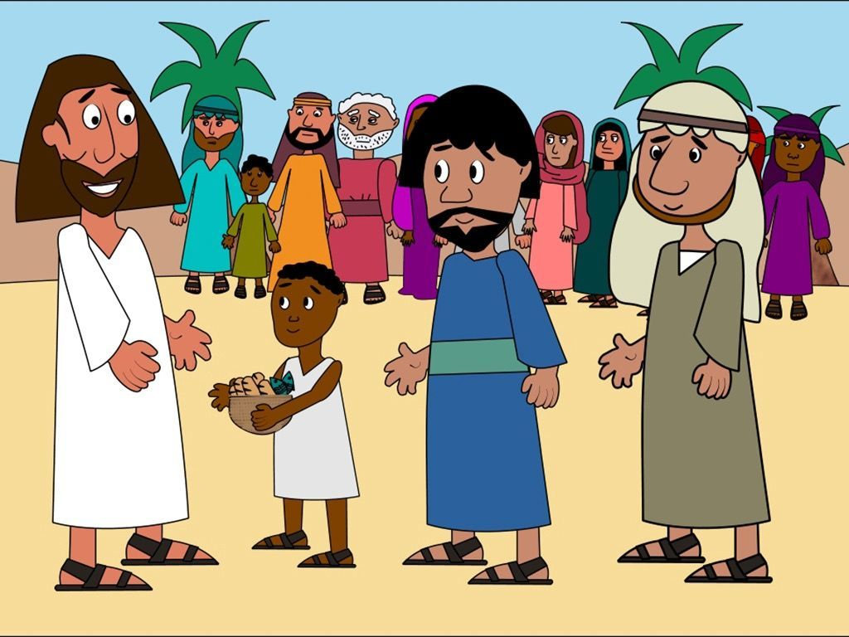
Which Bible Story is this?
Acts of Kindness or unkindness?

Slide 9
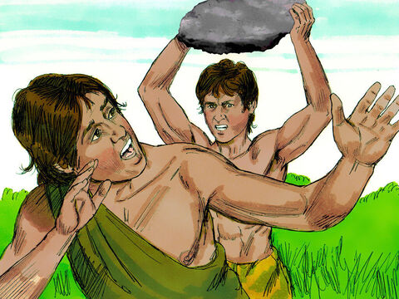
Which Bible Story is this?
Acts of Kindness or unkindness?

Slide 10
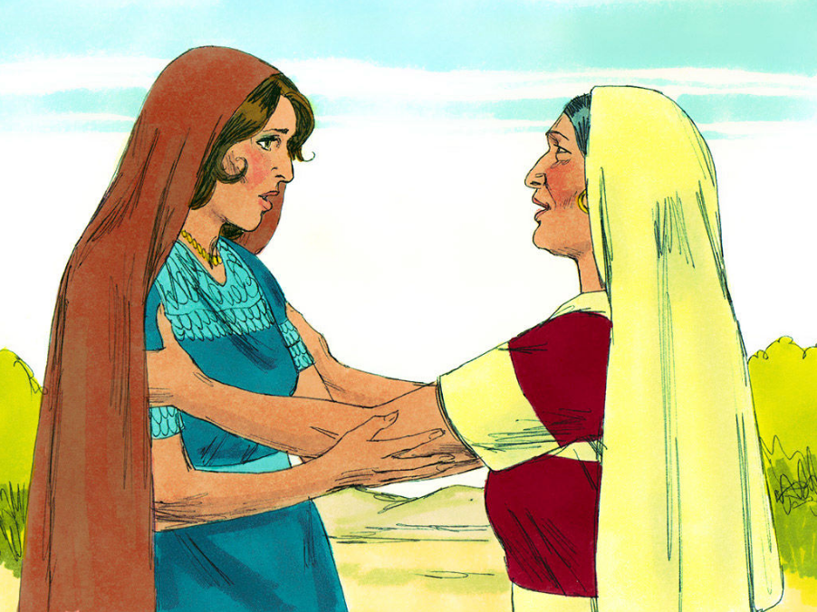
Which Bible Story is this?
Acts of Kindness or unkindness?

Slide 11
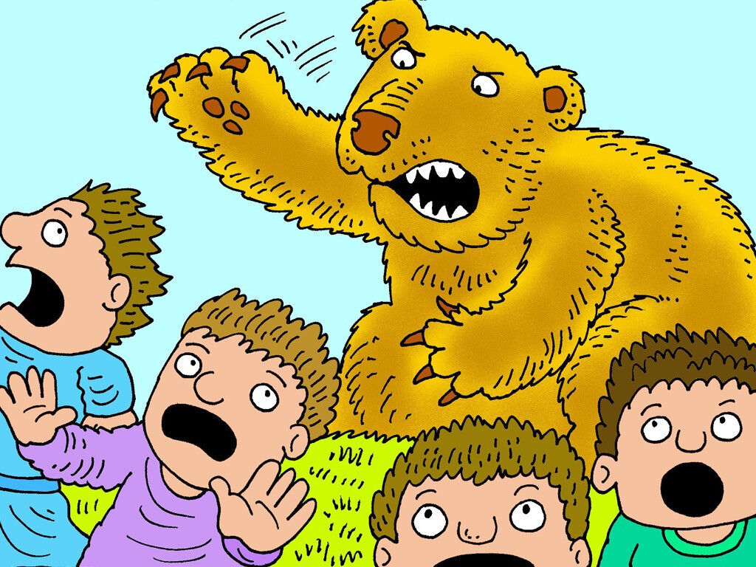
Which Bible Story is this?
Acts of Kindness or unkindness?

Slide 12
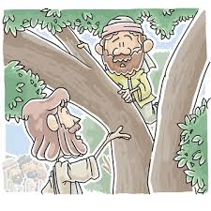
Which Bible Story is this?
Acts of Kindness or unkindness?

Slide 13
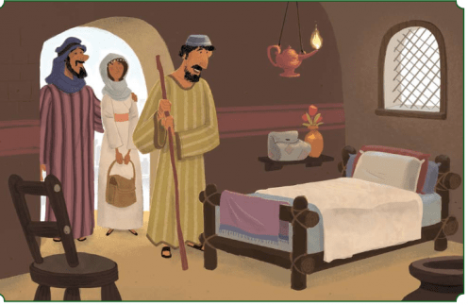
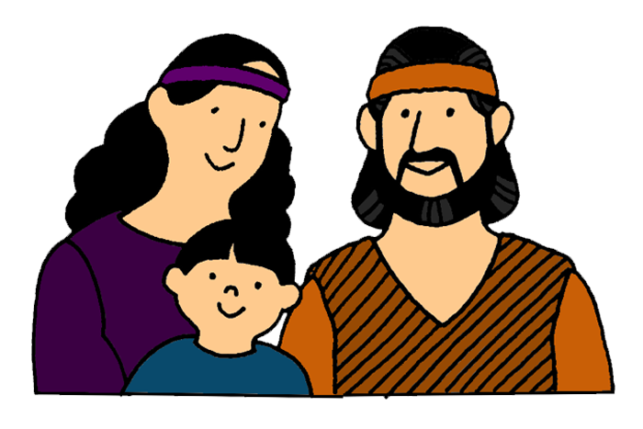
Which Bible Story is this?
Acts of Kindness or unkindness?

Slide 14
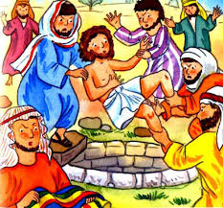
Which Bible Story is this?
Acts of Kindness or unkindness?

Slide 15
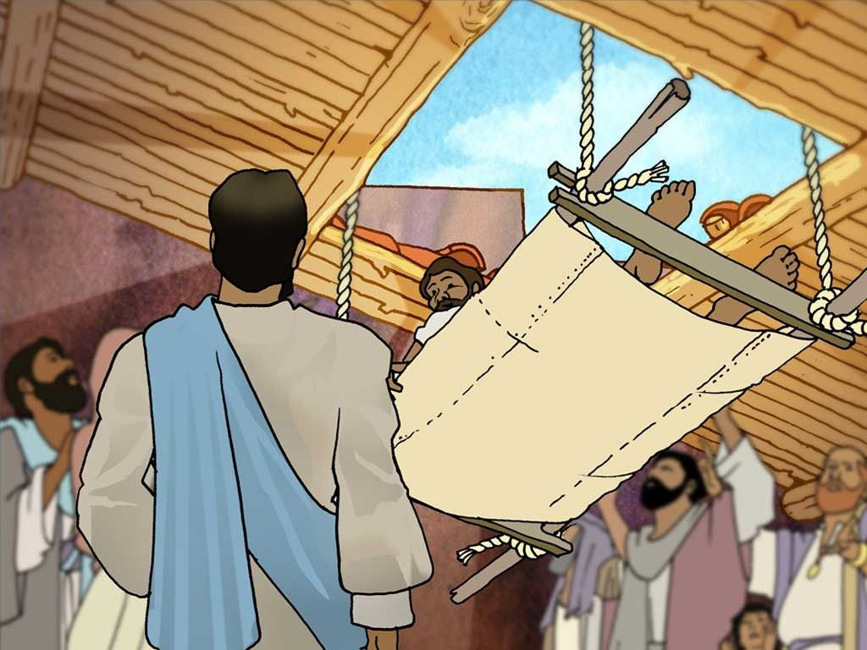
Which Bible Story is this?
Acts of Kindness or unkindness?

Slide 16
Craft
Kindness Paper Chain

Slide 17
Act of Kindness Brainstorm
We have given you a list of things you can do
Let’s go and be kind ☺

