Slide 1

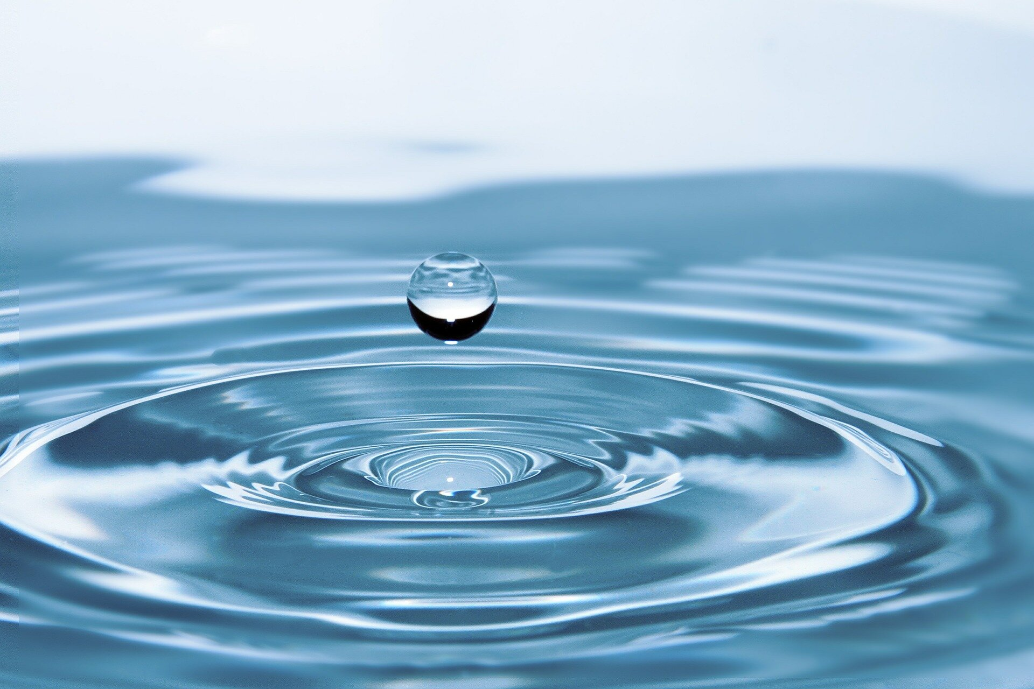
Safe Water Award
Sophia Lindsay
Riverway Club Director
Area 4 South England Conference
Safe Water Award
Sophia Lindsay
Riverway Club Director
Area 4 South England Conference

Slide 2
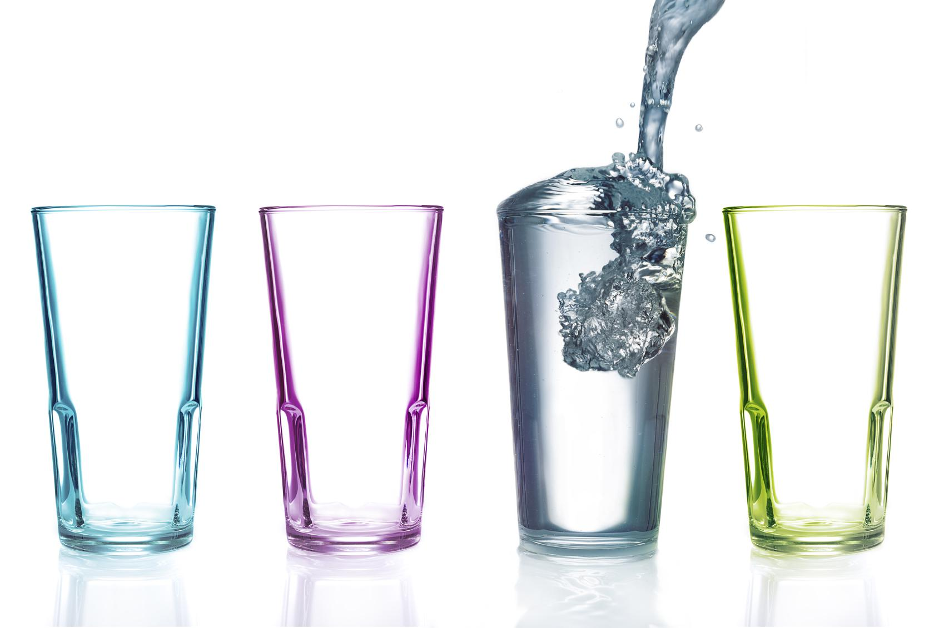
Requirements
1.What stories in the Bible refer to drinking water?
2.What places do we get safe drinking water?
3. Ways to purify water
4.Why is water so important?
5.Talk about the scarcity of water in areas.
6.Do an outreach project to help people be able to have safe drinking water.

Slide 3
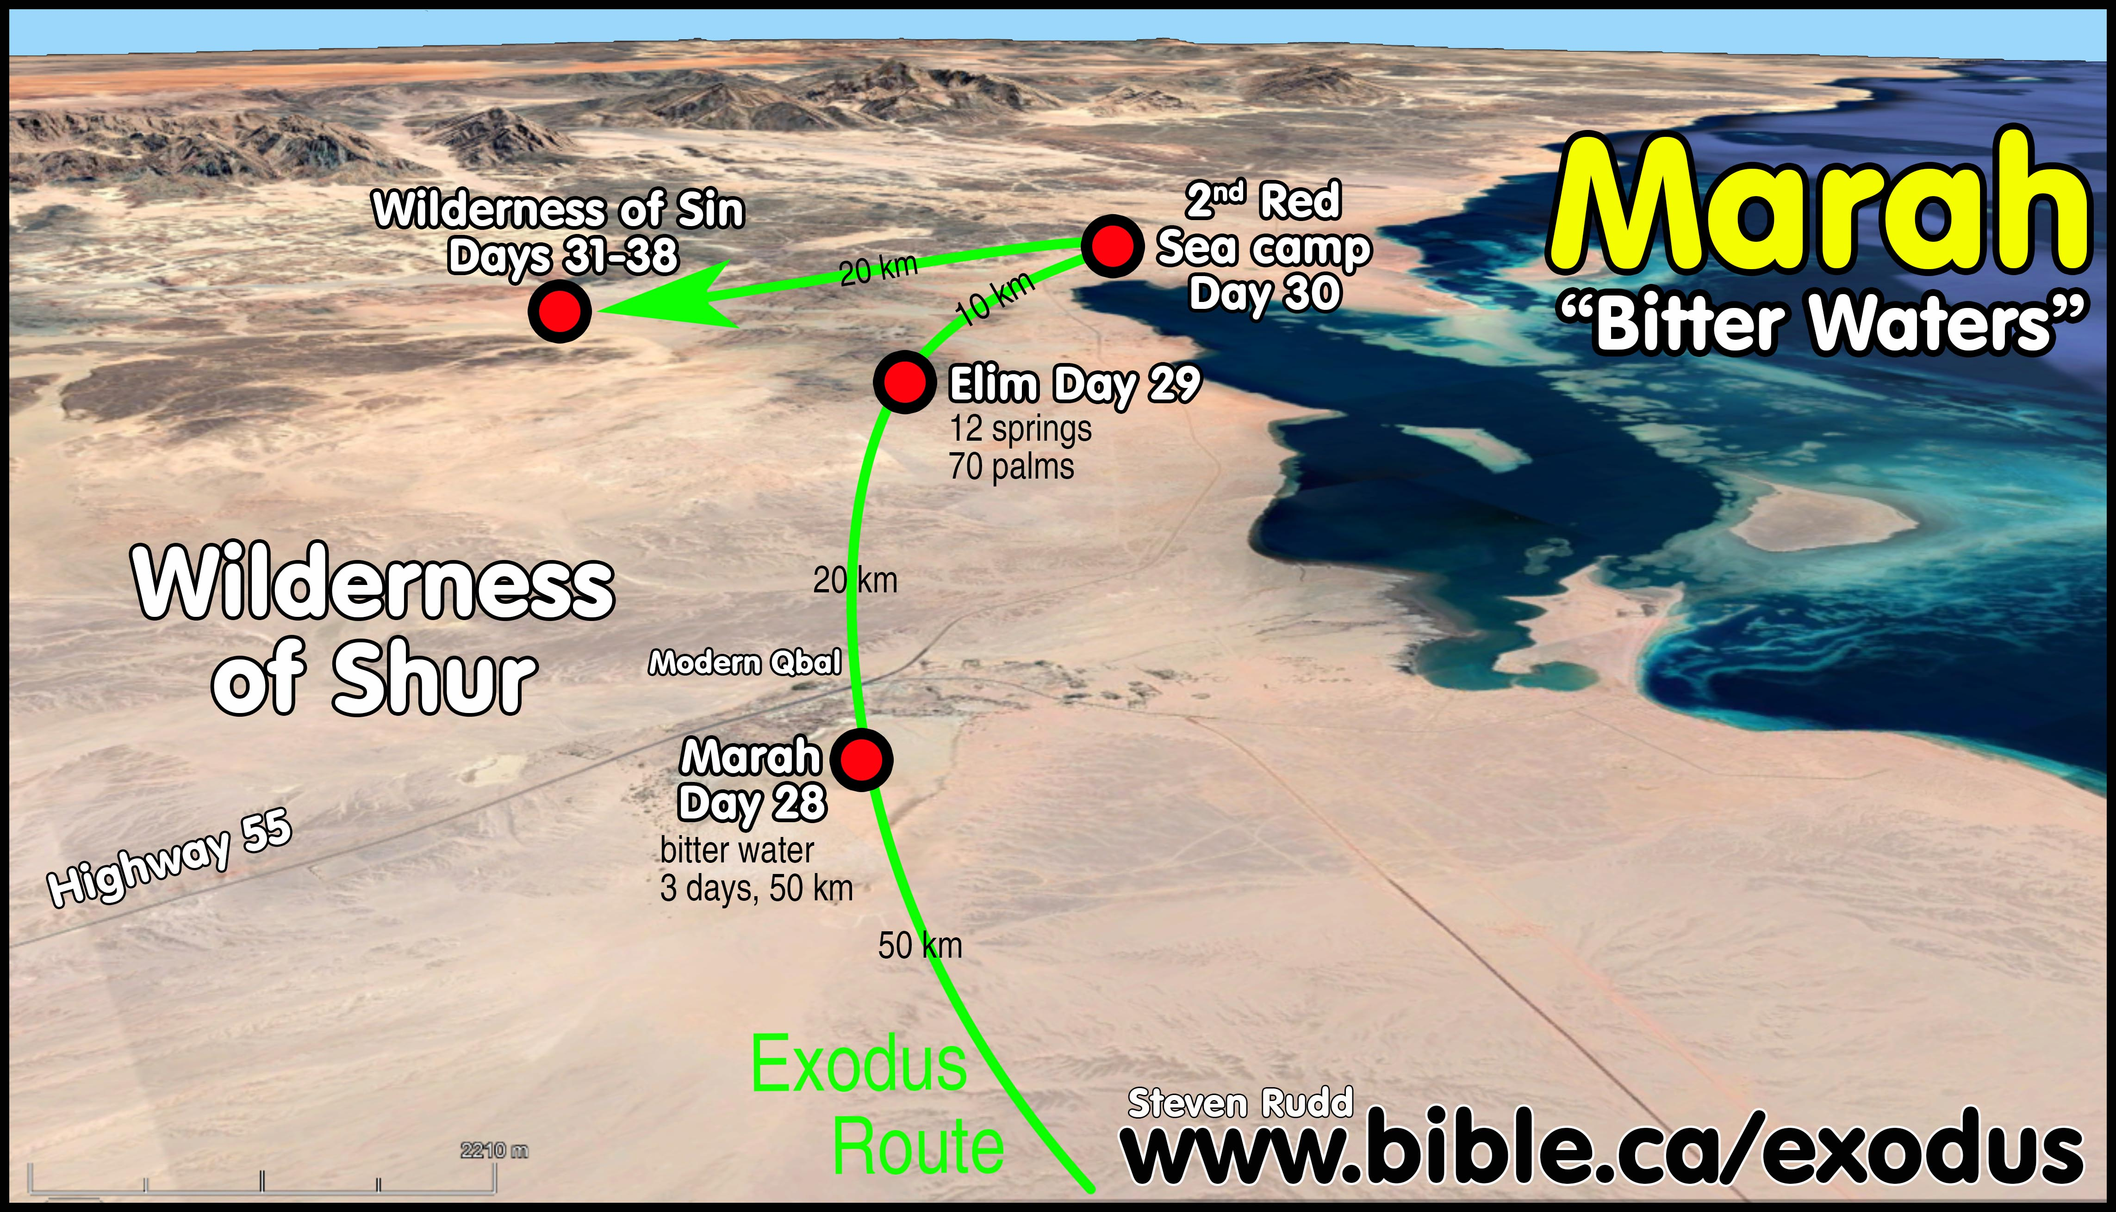
1. What stories in the Bible refer to drinking water?
Waters of Marah
in
Exodus 15:23,

Slide 4
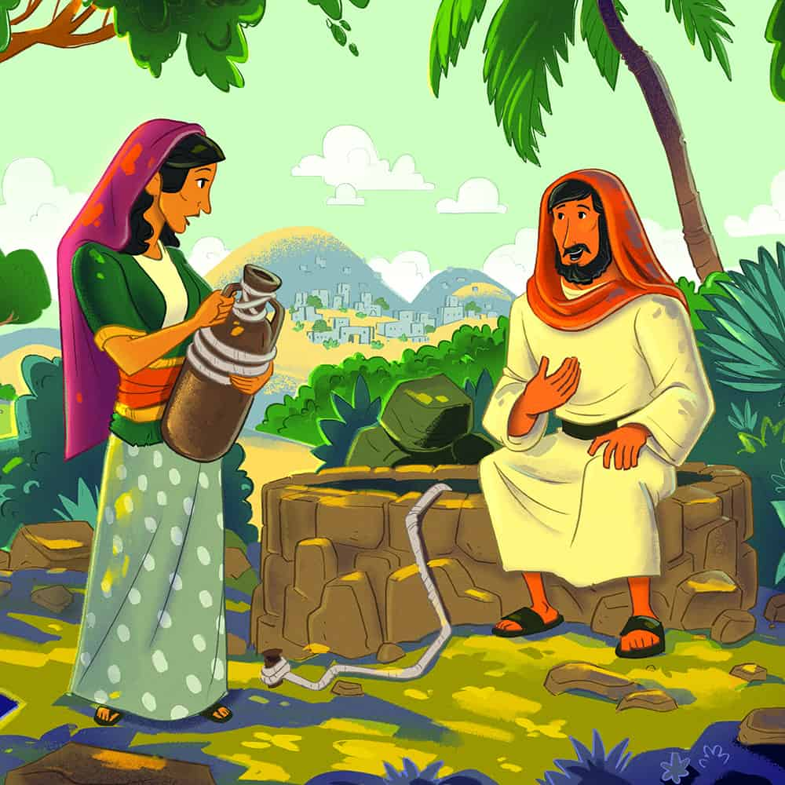
1. What stories in the Bible refer to drinking water?
Jesus & Woman at the well
in
John 4:1-26

Slide 5
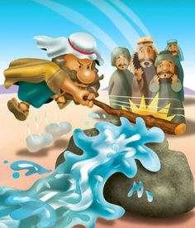
1. What stories in the Bible refer to drinking water?
Moses striking the rock
in
Numbers 20:1-29

Slide 6
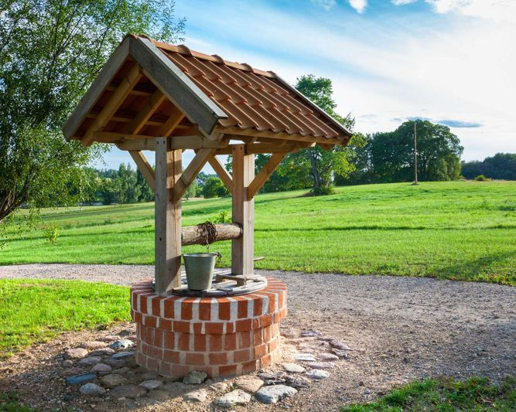
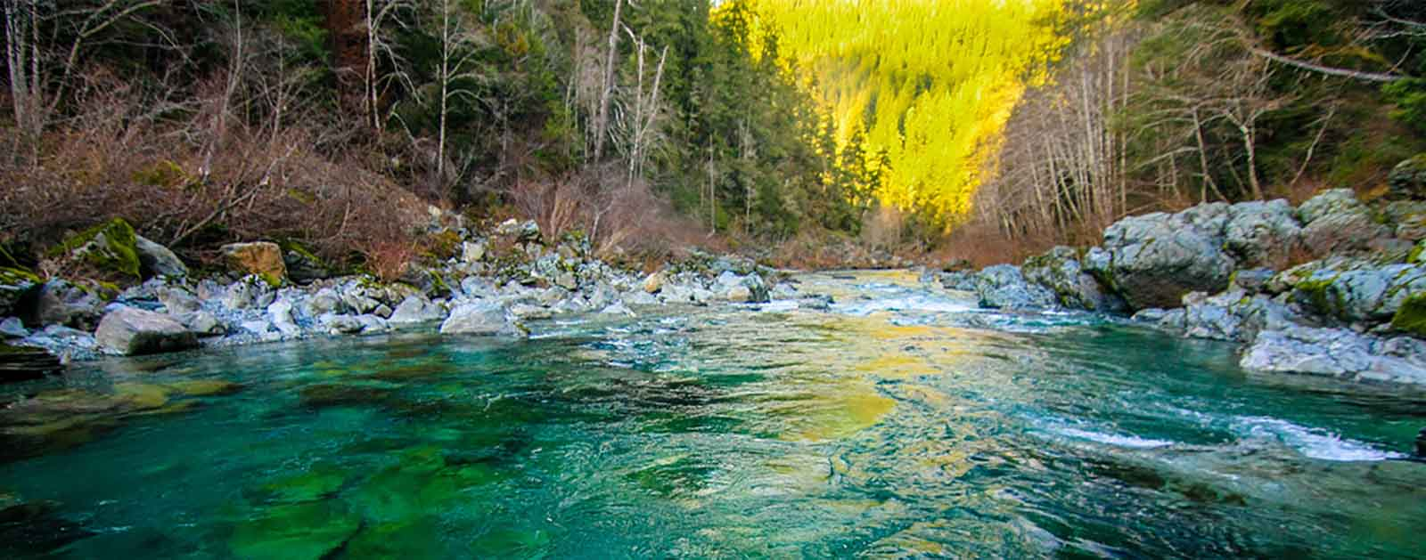
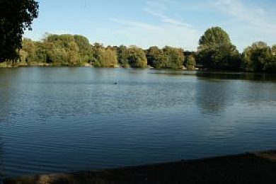
2.What places do we get safe drinking water from?
RIVERS
WELLS
LAKES
Notes:
city water towers,

Slide 7
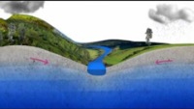
2.What places do we get safe drinking water?
https://youtu.be/Ddhx9mQc5oY
Notes:
underground aquifers

Slide 8
Quiz time
How much drinking water does Thames Water provide to London and the South East each day?
1.6 billion litres
2.6 billion litres
3.6 billion litres

Slide 9
Answer
How much water does Thames water provide each day to London and the South East each day?
2.6 billion litres

Slide 10
Quiz time
Which season is most important to replenish water?
Spring
Summer
Autumn
Winter

Slide 11
Answer
Which season is most important to replenish water?
d) Winter

Slide 12
Fill in the blanks…..
Water found deep in the ground comes from reservoirs called
A__U__F__RS.

Slide 13
Answer
Water found deep in the ground comes from reservoirs called
AQUIFERS.

Slide 14
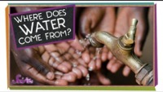
2.What places do we get safe drinking water?
https://youtu.be/cGi4PugN4qY
Notes:
city water towers

Slide 15
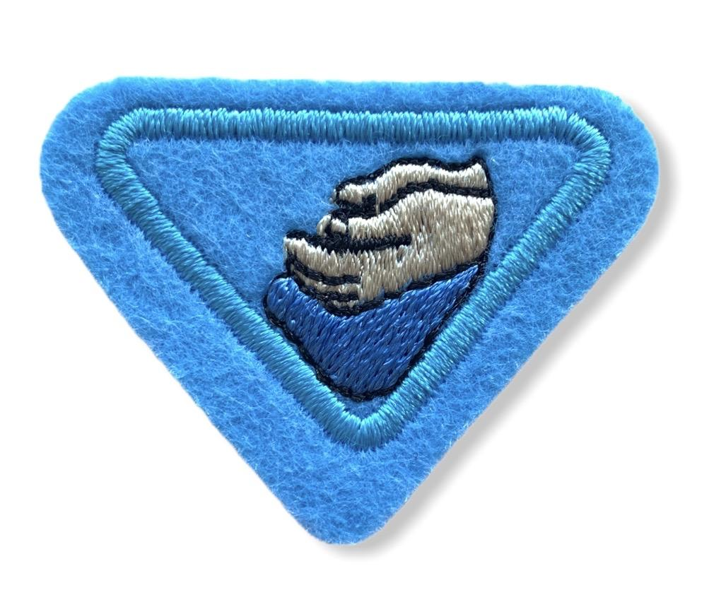
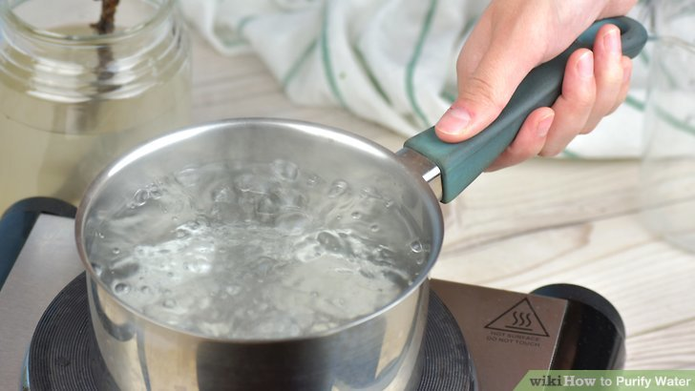
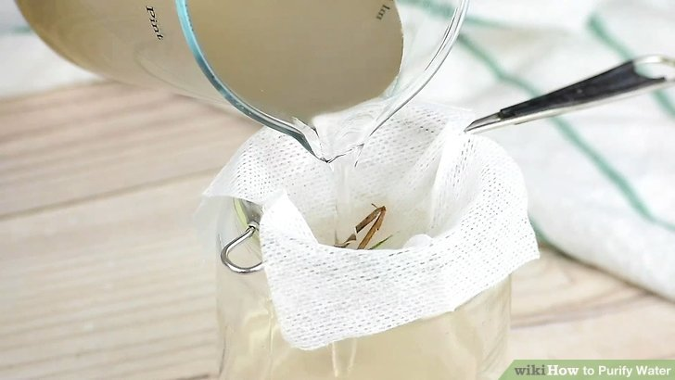
3. Ways to purify water
Strain and boil

Slide 16
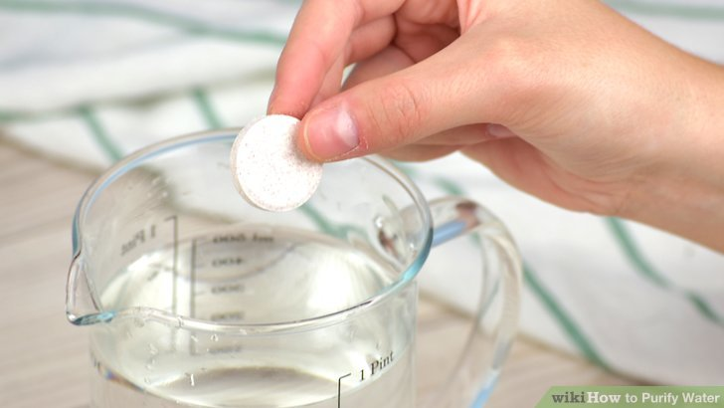
3. Ways to purify water
Water purification tablets kill pathogens (bacteria, germs) in water to make it safe for humans to drink
This prevents people from getting diseases

Slide 17
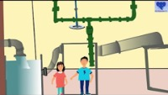
3. Ways to purify water
https://youtu.be/__JWa0ftr5k

Slide 18
QUIZ
What is used to clear the dirt from water before it reaches our taps?
Apples and pears
Mums and dads
Aluminium sulphate and lime added to water in a mechanical pump

Slide 19
Answer
What is used to clear the dirt from water before it reaches our taps?
c) Aluminium sulphate and lime added to water in a mechanical pump

Slide 20
Fill in the blanks….
F_O_S
are large particles of dirt that stick together

Slide 21
ANSWER
FLOCS
are large particles of dirt that stick together

Slide 22
QUIZ TIME
Filtration tanks have _____&______ which helps to make water clean
Salt and pepper
Sand and pebbles
Sweets and pies

Slide 23
ANSWER
Filtration tanks have sand & pebbles which helps to make water clean
b) Sand and pebbles

Slide 24
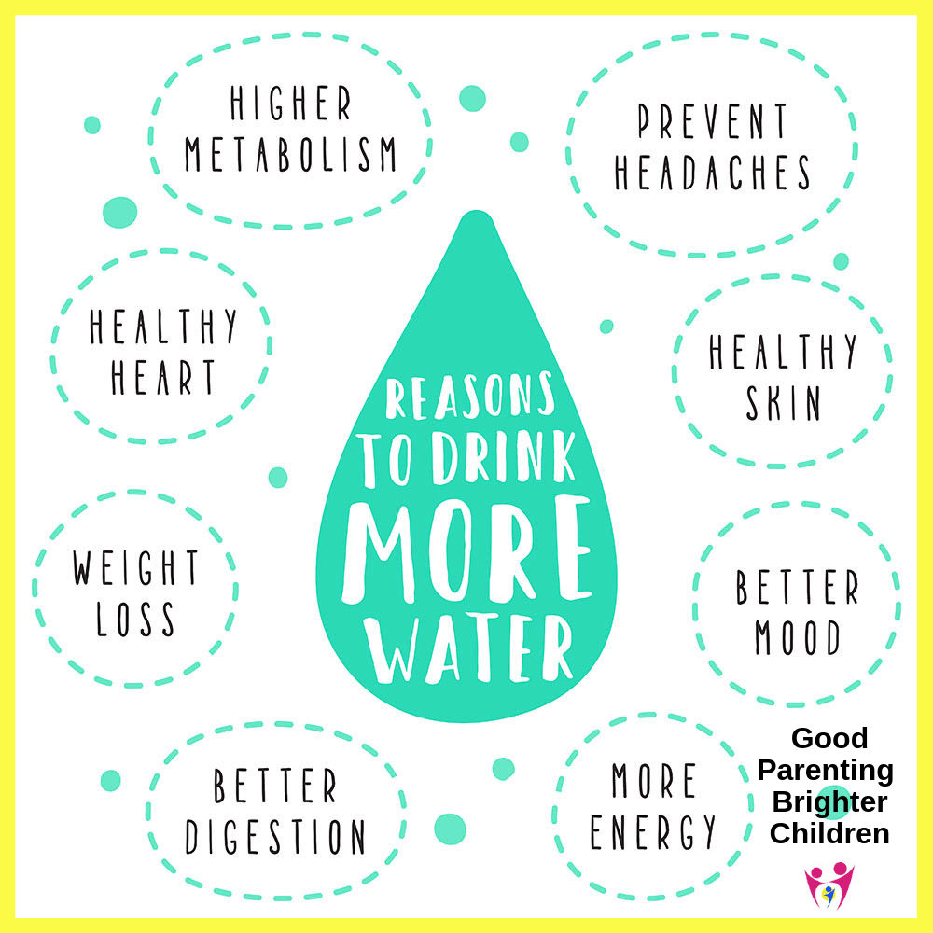
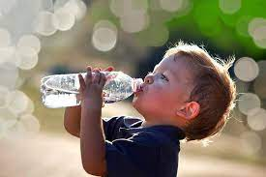
4.Why is water so important?
Healthy Body

Slide 25
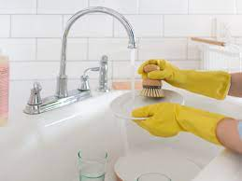
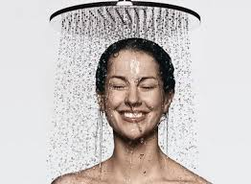
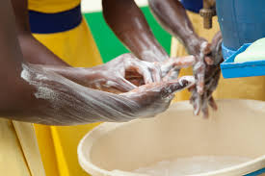
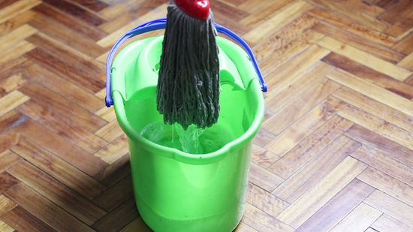
4.Why is water so important?
To promote cleanliness
To maintain good hygiene

Slide 26
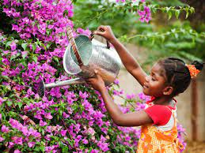
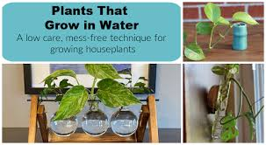
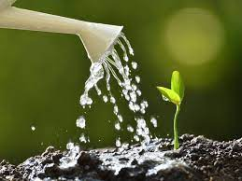
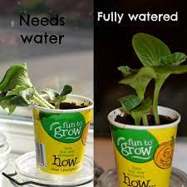
4.Why is water so important?
Plant growth

Slide 27
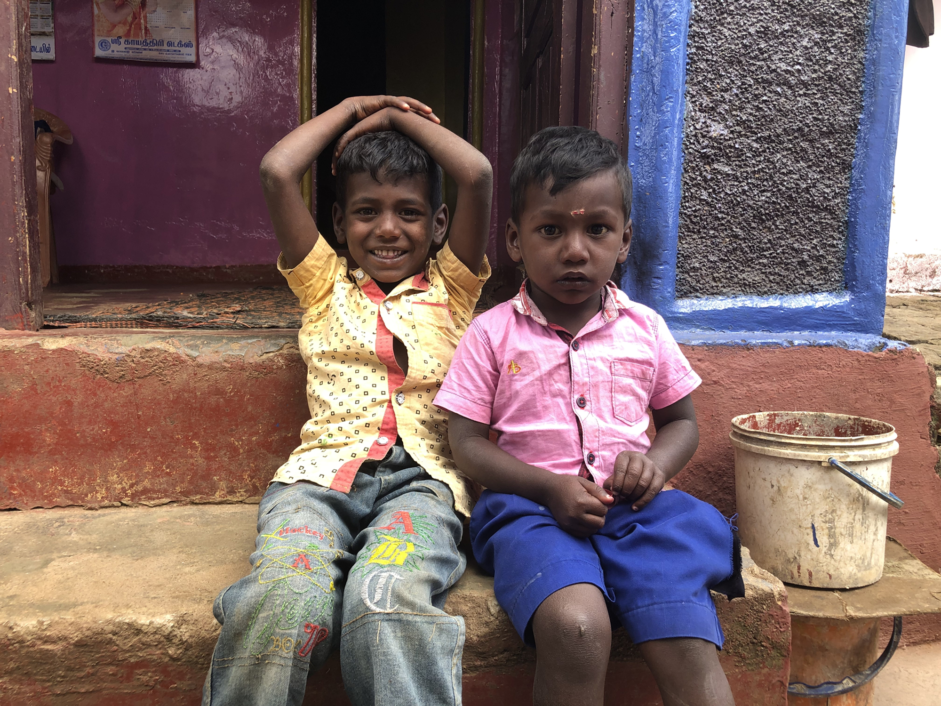
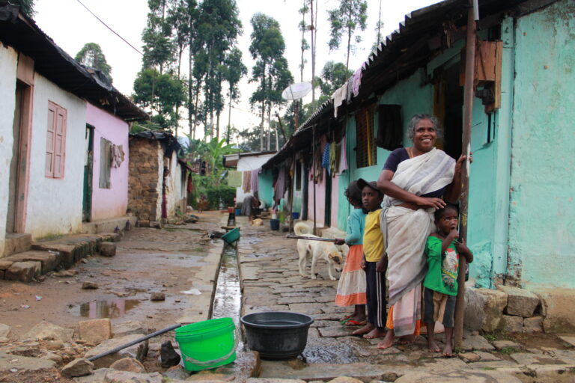
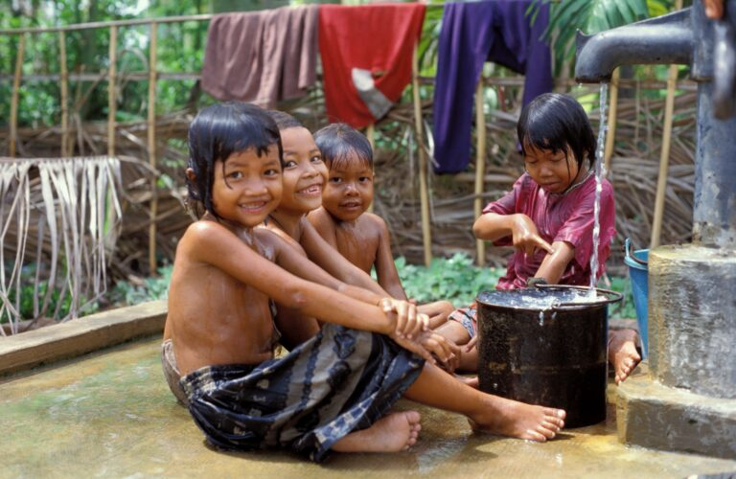

5.Talk about the scarcity of water in areas
ACCEND Sri Lanka

Slide 28
5.Talk about the scarcity of water in areas
Adventist Development and Relief Agency International (ADRA)
& Assisting Communities in Creating Environmental and Nutritional Development (ACCEND) are working together to help communities in Sri Lanka between 2017 to 2021
The goal of the project is to provide means for the communities to work towards better sanitary, health and hygiene standards.

Slide 29
5.Talk about the scarcity of water in areas
& (ACCEND) are working together to help communities in Sri Lanka between 2017 to 2021
A well with a pump is used in a community in the central province in Sri Lanka, where for 150 years fertiliser was used in the tea plantations. The ground water became chemically poisoned.
installed a gravity fed water system which collects water from clean sources high up in the hills. is also filtering the water so it is very clean and healthy to drink

Slide 30
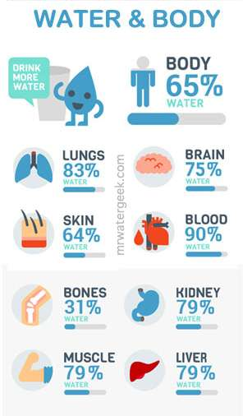
FUN FACTS ABOUT WATER

Slide 31
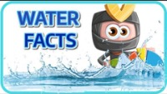
Fun facts about water

Slide 32

6. Do an outreach project to help people be able to have safe drinking water.
Sponsored book read
Sponsored walks
Bake sales
Sponsored bike ride
Paid Chores

Slide 33
QUIZ TIME
1. Who struck the rock in the Bible story?
Abraham
Moses
Isaac

Slide 34
ANSWER
b) Moses

Slide 35
QUIZ TIME
2. The places we can get water from are:
Rivers
Lakes True or False
Wells
Aquifers

Slide 36
ANSWER
2. The places we can get water from are:
Rivers
Lakes True
Wells
Aquifers

Slide 37
QUIZ TIME
3. Water can be purified for drinking by:
Straining and boiling True or False
Adding bleach to the water True or False
Water purification pumps True or False

Slide 38
ANSWER
3. Water can be purified for drinking by:
Straining and boiling True
Adding bleach to the water False
Water purification pumps True

Slide 39
QUIZ TIME
4. Water is important because it :
Keeps our home clean True or False
Good for our bodies True or False
Helps plants grow True or False

Slide 40
ANSWER
4. Water is important because it :
Keeps our home clean True
Good for our bodies True
Helps plants grow True

Slide 41
QUIZ TIME
5. Charities that help countries to get clean water are:
ADRA True or False
MIND True or False
ACCEND True or False

Slide 42
ANSWER
5. Charities that help countries to get clean water are:
ADRA True
MIND False
ACCEND True

Slide 43
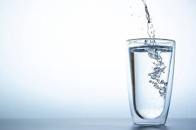
THE END
Thank you for listening
Have a refreshing Sabbath

