Slide 1
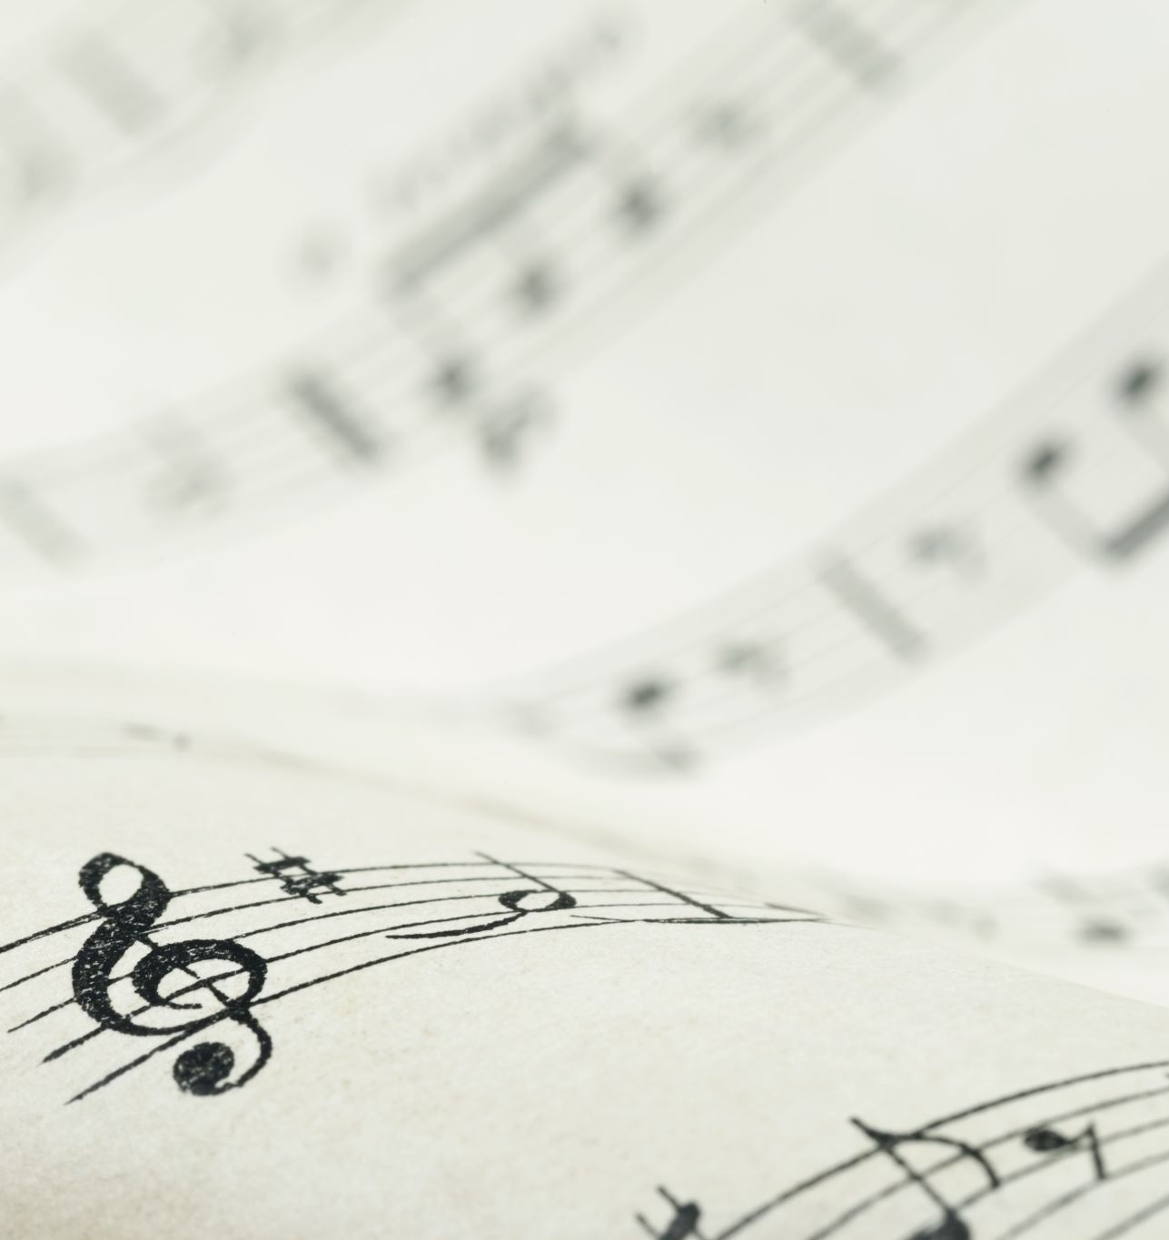
Music Honour
Pathfinder

Slide 2
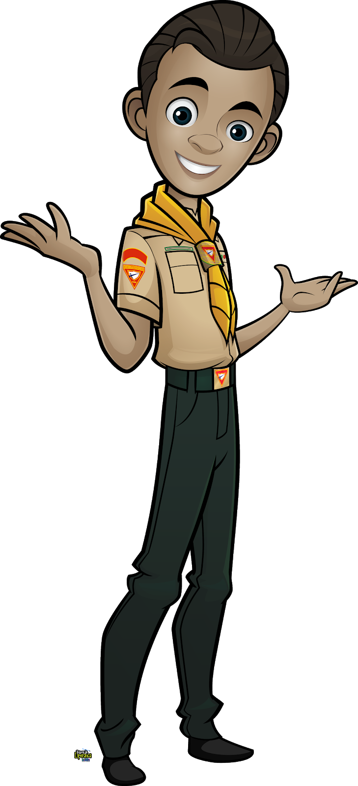
Requirements
Play or sing a scale, and know its composition.
Write a scale in both treble and bass clefs.
Know a half tone, a whole tone, a third, a fifth, and an octave.
Distinguish a march from a waltz, and give the time of each.
What is a quarter note? A half note? A whole note? Draw the symbols.
Name five great composers and one composition of each, including an oratorio, piano composition, and a song.
Play with or without music or sing from memory 15 hymns and/or other sacred songs or choruses and list the composer of each (One verse or Stanza each).
Play or sing from memory one piece of good music other than those used in #7.
For instrumentalists: Be able to sight-read and play a moderately difficult piece of music. Explain all signs and terms in it.
For singers: Show with baton or arm how to lead a group in singing compositions written in 3/4 and 4/4 time.
Define orchestra, and name at least five instruments in an orchestra.
Do a biographical sketch on a famous hymn writer and orally present it to a group.

Slide 3
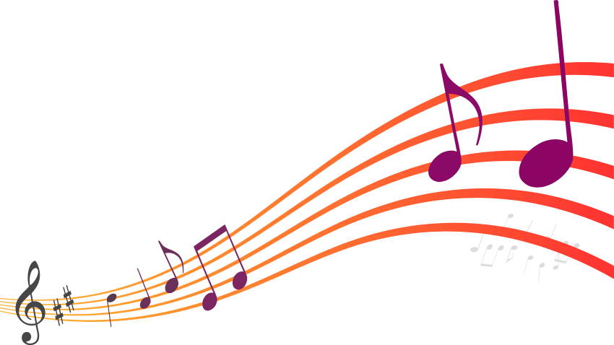
Introduction
The basics of Music Theory

Slide 4
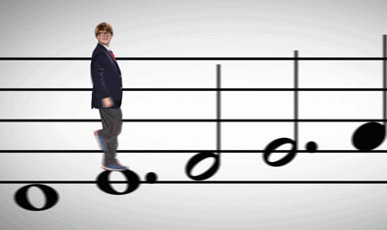

Slide 5
The Staff
Notes:
The staff (plural staves) is written as five horizontal parallel lines. Most of the notes (Section 1.2.1) of the music are placed on one of these lines or in a space in between lines. Extra ledger lines may be added to show a note that is too high or too low to be on the staff. Vertical bar lines divide the staff into short sections called measures or bars. A double bar line, either heavy or light, is used to mark the ends of larger sections of music, including the very end of a piece, which is marked by a heavy double bar.

Slide 6
The staff (plural staves) is written as five horizontal parallel lines.
Most of the notes of the music are placed on one of these lines or in a space in between lines. Extra ledger lines may be added to show a note that is too high or too low to be on the staff.
Vertical bar lines divide the staff into short sections called measures or bars.
A double bar line, either heavy or light, is used to mark the ends of larger sections of music, including the very end of a piece, which is marked by a heavy double bar.
Notes:
The staff (plural staves) is written as five horizontal parallel lines. Most of the notes (Section 1.2.1) of the music are placed on one of these lines or in a space in between lines. Extra ledger lines may be added to show a note that is too high or too low to be on the staff. Vertical bar lines divide the staff into short sections called measures or bars. A double bar line, either heavy or light, is used to mark the ends of larger sections of music, including the very end of a piece, which is marked by a heavy double bar.

Slide 7
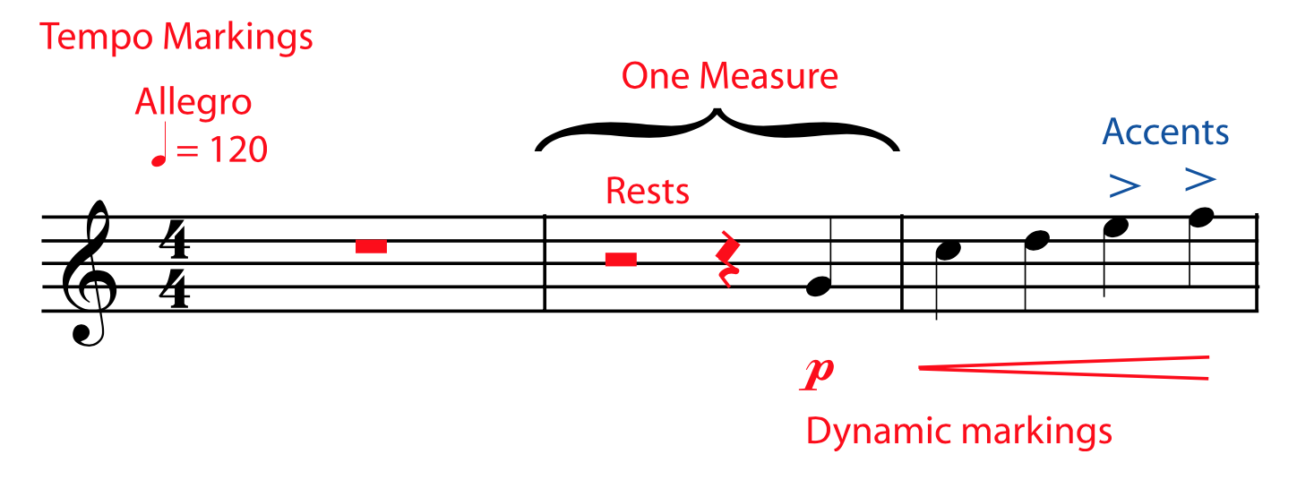
Other Symbols on the Staff
Tempo markings
It tells you how fast the song goes
Notes and rests
A note stands for a sound;
A rest stands for a silence.
Accents
It tells you how to perform particular notes.
Staff, Clef, key signature, time signature
It tells you important information about the notes and measures
Dynamic Markings
It tells you how loud it should be.
Notes:
The staff (plural staves) is written as five horizontal parallel lines. Most of the notes (Section 1.2.1) of the music are placed on one of these lines or in a space in between lines. Extra ledger lines may be added to show a note that is too high or too low to be on the staff. Vertical bar lines divide the staff into short sections called measures or bars. A double bar line, either heavy or light, is used to mark the ends of larger sections of music, including the very end of a piece, which is marked by a heavy double bar.

Slide 8
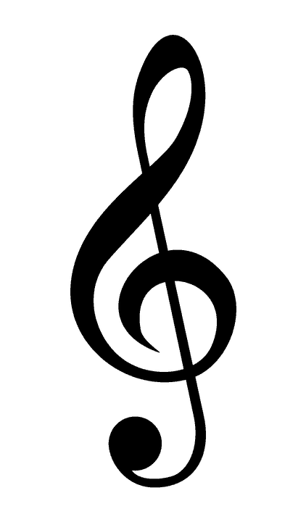
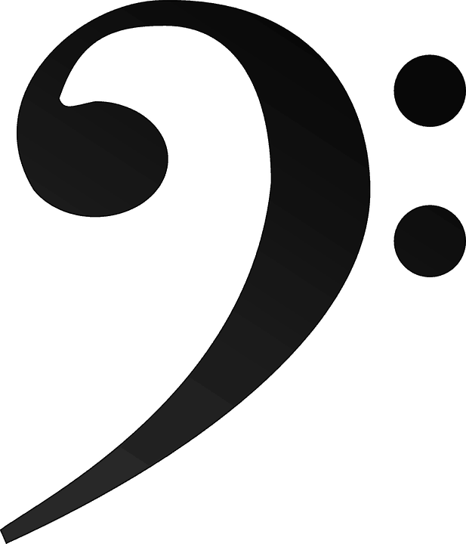
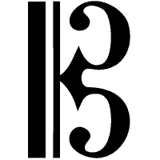
The musical Clefs
The first symbol that appears at the beginning of every music staff is a clef symbol. It is very important because it tells you which note (A, B, C, D, E, F, or G) is found on each line or space.

Slide 9
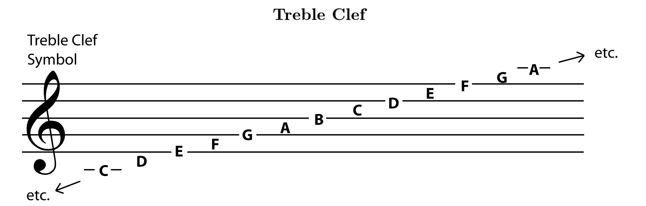
The Treble Clef
For example, a treble clef symbol tells you that the second line from the bottom (the line that the symbol curls around) is "G". On any staff, the notes are always arranged so that the next letter is always on the next higher line or space. The last note letter, G, is always followed by another A.

Slide 10
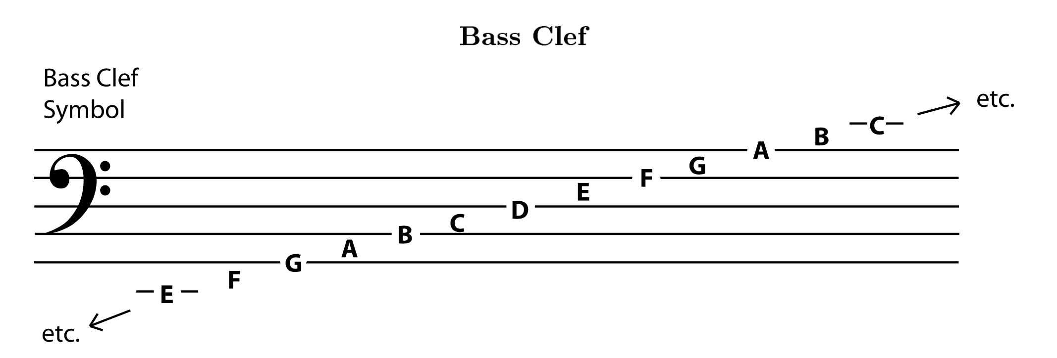
The Bass Clef
A bass clef symbol tells you that the second line from the top (the one bracketed by the symbol's dots) is F. The notes are still arranged in ascending order, but they are all in different places than they were in treble clef.

Slide 11
Memorizing the Notes in Bass and Treble Clef
One of the first steps in learning to read music in a particular clef is memorizing where the notes are. Many students prefer to memorize the notes and spaces separately. Here are some of the most popular mnemonics used.

Slide 12
Memorizing the Notes in Bass and Treble Clef
One of the first steps in learning to read music in a particular clef is memorizing where the notes are. Many students prefer to memorize the notes and spaces separately. Here are some of the most popular mnemonics used.

Slide 13
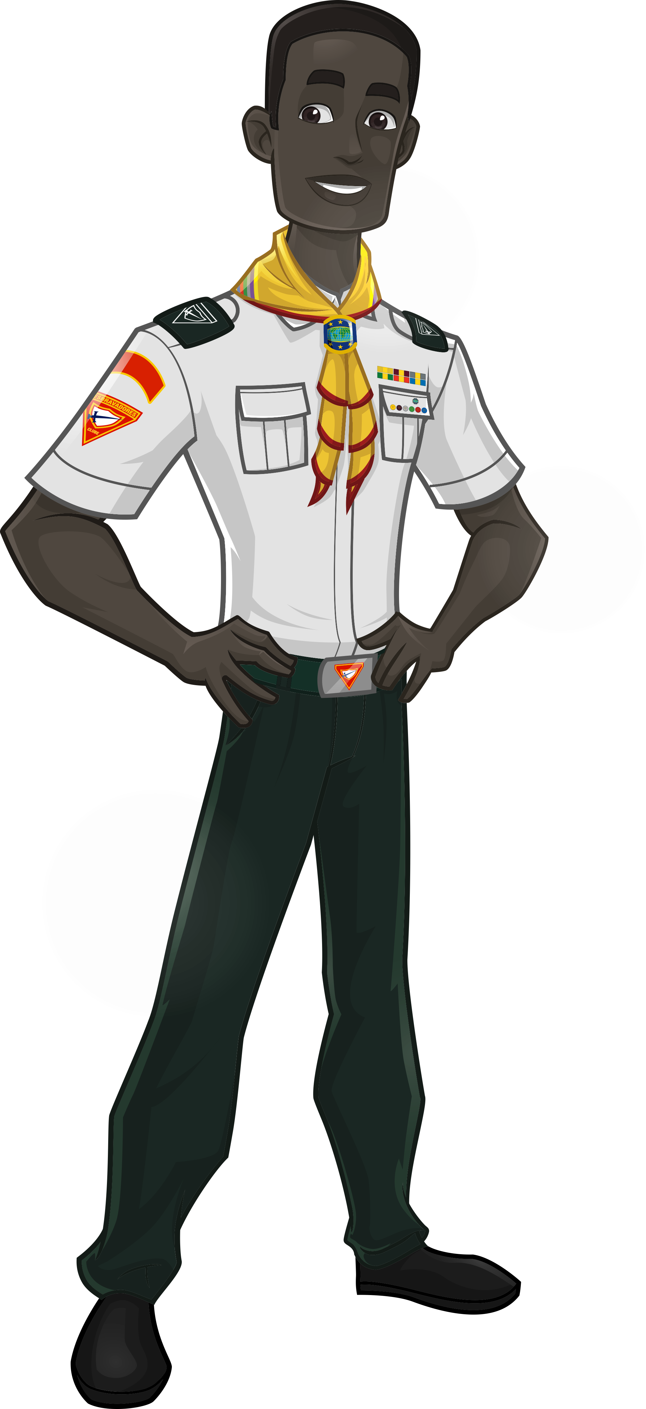
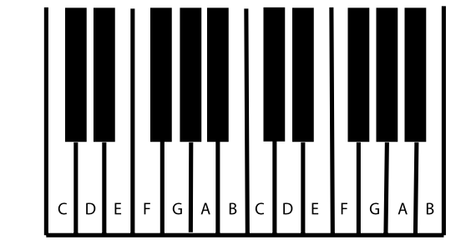
Pitch: Sharp, Flat, and Natural Notes
The pitch of a note is how high or low it sounds. Musicians give the different pitches different letter names: A, B, C, D, E, F, and G. These seven letters name all the natural notes (on a keyboard, that's all the white keys) within one octave. (When you get to the eighth natural note, you start the next octave on another A.)

Slide 14
Pitch: Sharp, Flat, and Natural Notes
But in Western music there are twelve notes in each octave that are in common use.
How do you name the other five notes (on a keyboard, the black keys)?
Notes:
Ask them to type the answer in the chat box.

Slide 15
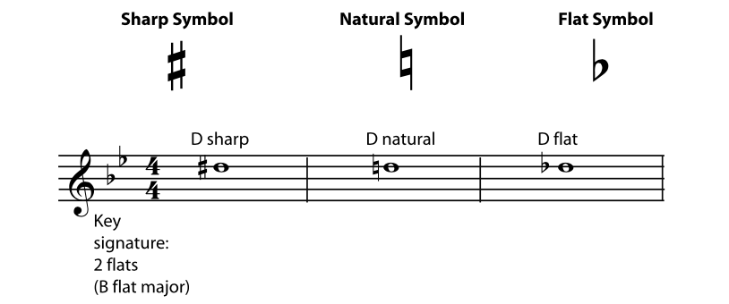
Pitch: Sharp, Flat, and Natural Notes
In this case we have to use sharp and flat signs
What do they mean?
Notes:
Ask them to type the answer in the chat box.

Slide 16
Pitch: Sharp, Flat, and Natural Notes
A sharp sign means "the note that is one half step higher than the natural note". A flat sign means "the note that is one half step lower than the natural note". Some of the natural notes are only one half step apart, but most of them are a whole step apart. When they are a whole step apart, the note in between them can only be named using a flat or a sharp.
Notes:
Ask them to type the answer in the chat box.

Slide 17
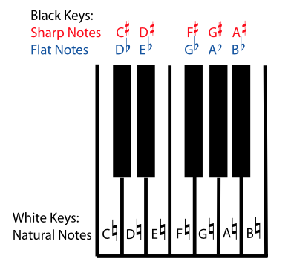
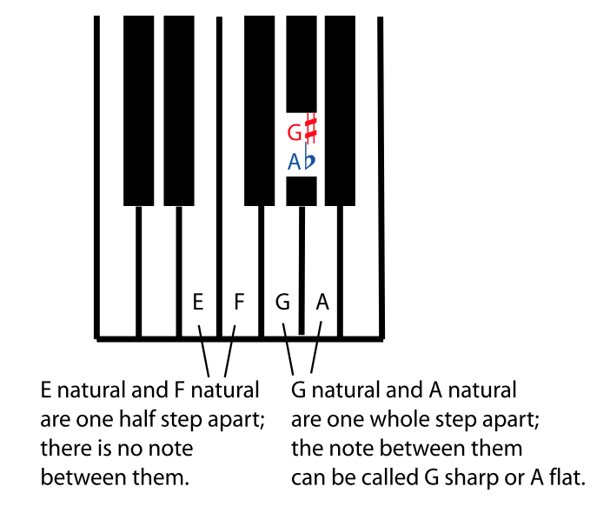
Pitch: Sharp, Flat, and Natural Notes
Look at the following examples:
Notes:
Ask them to type the answer in the chat box.

Slide 18
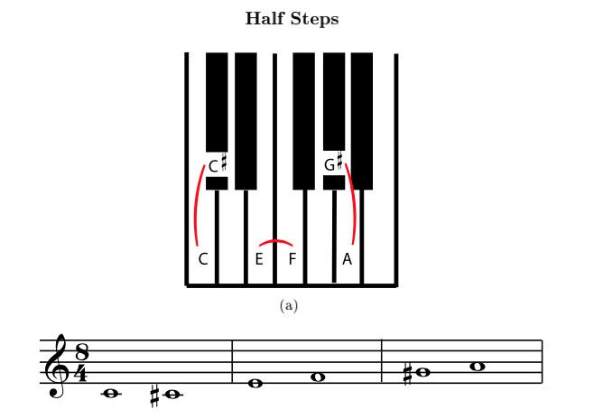
HALF STEPS
In Western music, the small interval from one note to the next closest note higher or lower is called a half step or semi-tone.
Three half-step intervals: between C and C sharp (or D Flat); between E and F; and between G sharp (or A flat) and A.
Notes:
What is the next closest note of E?

Slide 19
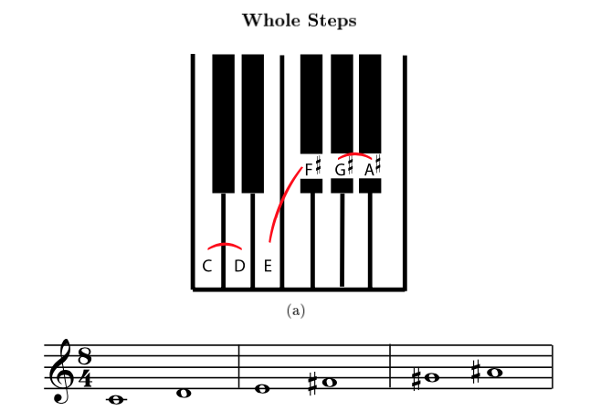
Whole steps
If you go up or down two half steps from one note to another, then those notes are a whole step, or whole tone apart.
What if I go 3, 4 or even 5 steps from one note to another?
Notes:
What is the next closest note of E?

Slide 20
Intervals
That’s a good question!
The interval between two notes is the distance between the two pitches - in other words, how much higher or lower one note is than the other.
What if I go 3, 4 or even 5 steps from one note to another?
Notes:
What is the next closest note of E?

Slide 21
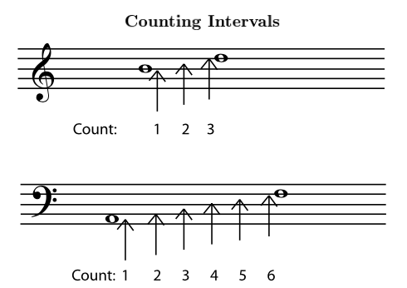
Intervals
The first step in naming the interval is to find the distance between the notes as they are written on the staff. Count every line and every space in between the notes, as well as the lines or spaces that the notes are on. This gives you the number for the interval.
Notes:
What is the next closest note of E?

Slide 22
Intervals
The first step in naming the interval is to find the distance between the notes as they are written on the staff. Count every line and every space in between the notes, as well as the lines or spaces that the notes are on. This gives you the number for the interval.
Notes:
What is the next closest note of E?

Slide 23
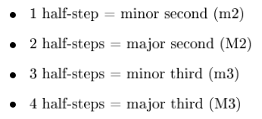
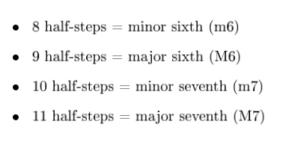
Intervals
The first step in naming the interval is to find the distance between the notes as they are written on the staff. Count every line and every space in between the notes, as well as the lines or spaces that the notes are on. This gives you the number for the interval.
Notes:
What is the next closest note of E?

Slide 24
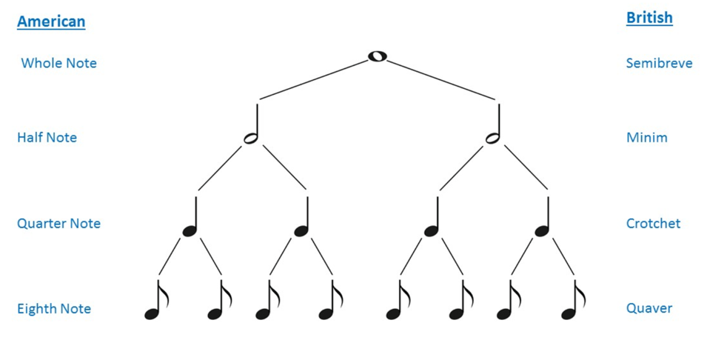
Duration: Note Lengths in Written Music
In standard notation, a single musical sound is written as a note. The two most important things a written piece of music needs to tell you about a note are its pitch - how high or low it is - and its duration - how long it lasts.
Notes:
What would be the next one? Answer: The sixty-fourth notes

Slide 25
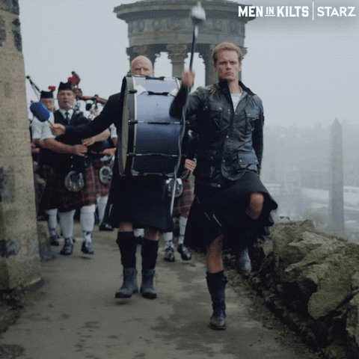
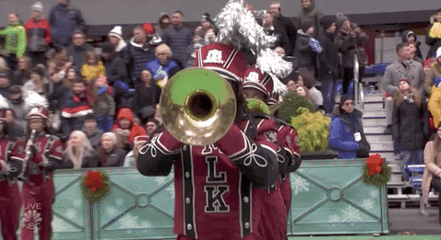
March or Waltz?
Helps you stand in Step during a parade
We count its steps in 2
1 | 2 | 1 | 2 | 1 | 2
Left | Right | Left | Right | Left | Right
Notes:
Anyone guess

Slide 26
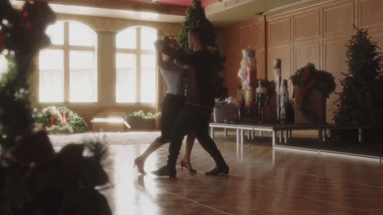
March or Waltz?
Helps you dance with a partner
We count its steps in 3
1 | 2 | 3 | 1 | 2 | 3
Left | Right | Left | Right | Left | Right
Notes:
Anyone guess?

Slide 27
Time signature
$$\frac{3}{4}$$
$$\frac{2}{2}$$
1 | 2 | 3 | 1 | 2 | 3
Left | Right | Left | Right | Left | Right
1 | 2 | 1 | 2 | 1 | 2
Left | Right | Left | Right | Left | Right
Notes:
Anyone guess?

Slide 28
Time signature
The time signature is the symbol that tells you the meter of the piece and how it is written.
What is a time signature?
Notes:
Anyone guess?

Slide 29
Time signature
This time signature means that there are three quarter notes (or any combination of notes that equals three quarter notes) in every measure. A piece with this time signature would be "in three four time" or just "in three four".
Notes:
Anyone guess?

Slide 30
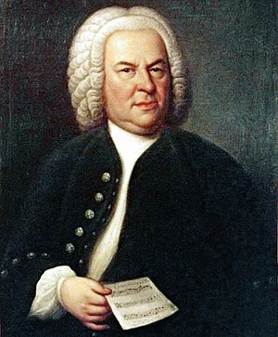
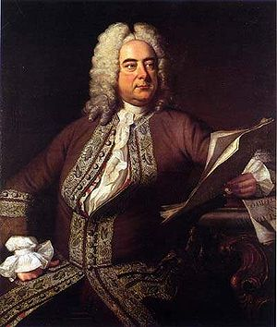
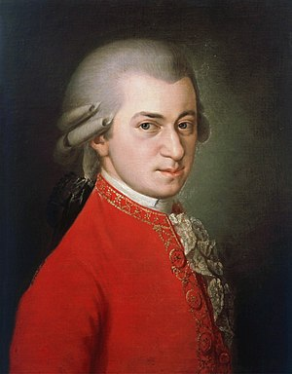
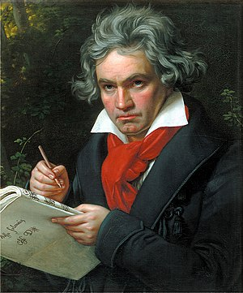
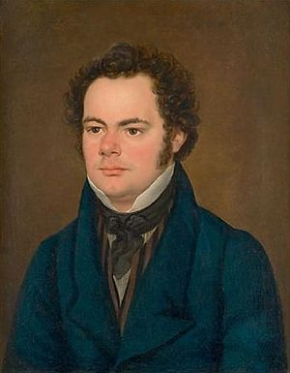
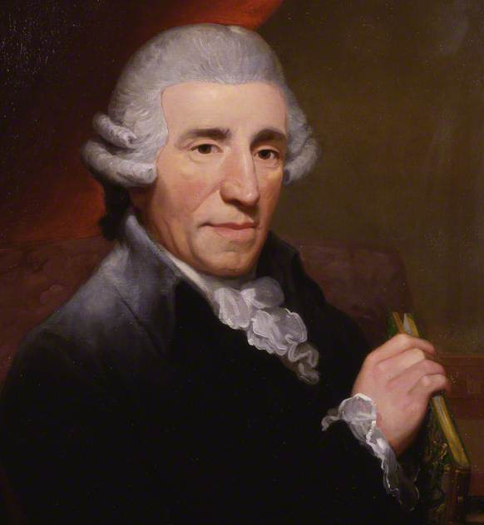
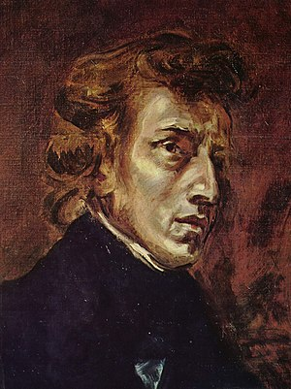
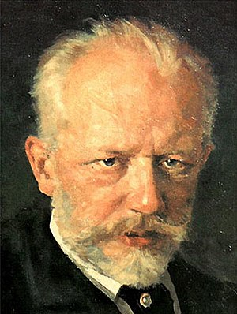
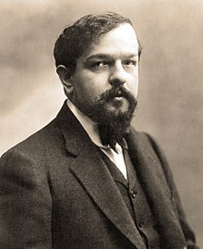
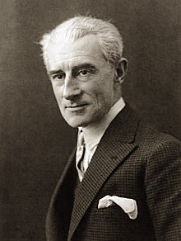
Great composers
Notes:
What is the next closest note of E?

Slide 31
Great composers - Baroque
He is considered one of the greatest religious composers in history.
He believed that music must serve the Glory of God
One of Bach's best known works is a series of six concertos called the Brandenburg Concertos.
“The aim and final reason of all music should be nothing else but the Glory of God and the refreshment of the spirit”
Notes:
What is the next closest note of E?

Slide 32
Great composers - Baroque
His dad did not think that music was a suitable profession for George. He wanted his son to be a lawyer.
Handel composed his first opera at the age of twenty which was a big hit.
Handel then started composing a type of music called Oratorio. Oratorios started out as sacred opera, but changed by dropping the acting parts, the stage scenery and backgrounds, and the costumes. Oratorios became a large piece of music that told a biblical story. Often these were grand works using an orchestra, large choir, organ, and soloist singers.
Handel's most famous oratorio is called “Messiah”, from which almost everyone can remember the “Hallelujah Chorus”.
Notes:
What is the next closest note of E?

Slide 33
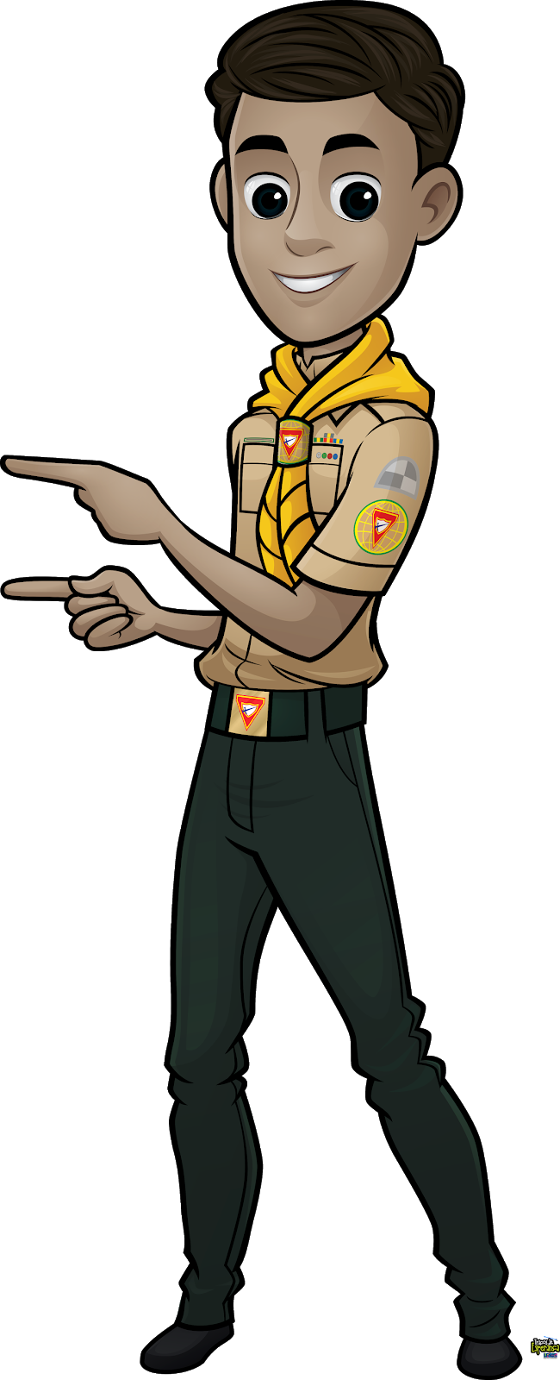
Great composers - Classical
By age eleven and a half he was the assistant organist at the court chapel and by twelve he had published some music.
Beethoven was then shattered to realize that he was losing his hearing. By 1802 at the age of 32, he had decided to retire, but after a while the will to create music was so strong that Beethoven continued to compose without hearing. He envisioned the musical beauty all the more vividly in his mind since he could not hear it.
His two best known compositions are his Fifth and Ninth Symphonies. The entire fifth symphony is united as a musical idea by the four notes heard at the beginning of the piece. His ninth symphony is known for its ending piece which includes a choir singing “Ode to Joy”.
Notes:
What is the next closest note of E?

Slide 34
Great composers - Classical
The son of a schoolmaster, he showed an extraordinary childhood aptitude for music, studying the piano, violin, organ, singing and harmony.
Schubert composed symphonies and chamber music, but is best known for composing over six hundred Lieder (German for “songs”). These songs were composed as a vocal solo with piano accompaniment.
One of Schubert's famous songs is called der Erlkönig, which is written to an eerie poem by Goethe, based on a legend in which anyone who is touched by the king of the elves will die (der Erlkönig is German for the elf king).
Notes:
What is the next closest note of E?

Slide 35
Great composers - Romantic
Chopin is best known as a composer of music for the piano. He is, in fact, called “the poet of the piano”. A piano in a home in Chopin's time was the entertainment centre for the family.
Chopin wrote a number of piano pieces called Nocturnes, meaning “Night Music”. He wrote his most well known Nocturne (in C minor) in 1841.
Notes:
What is the next closest note of E?

Slide 36
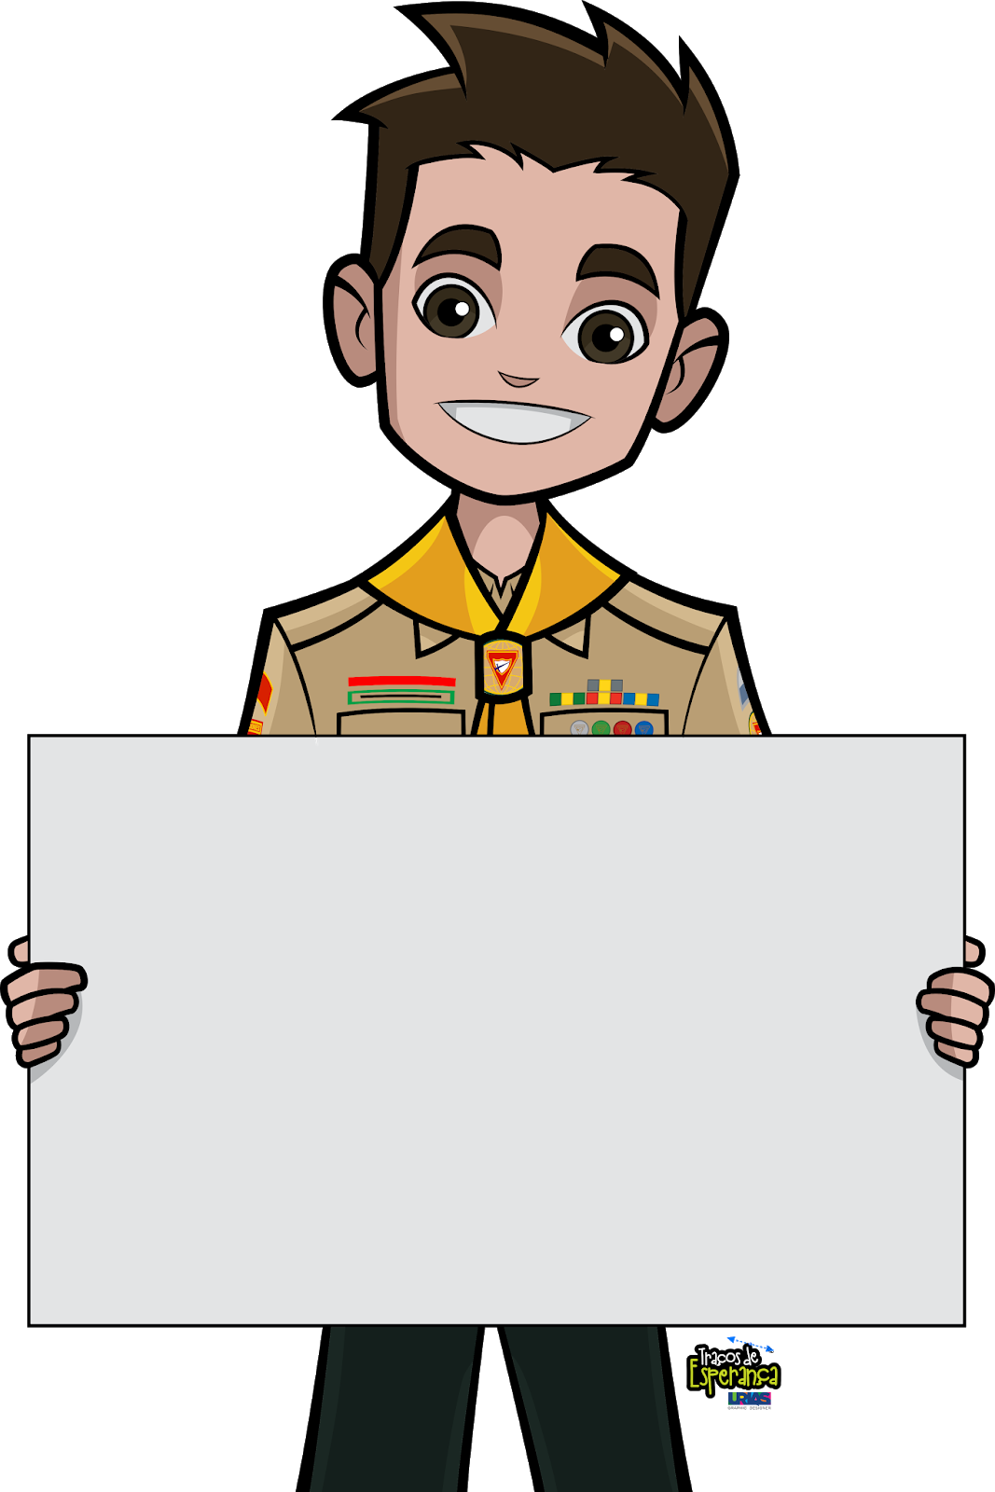
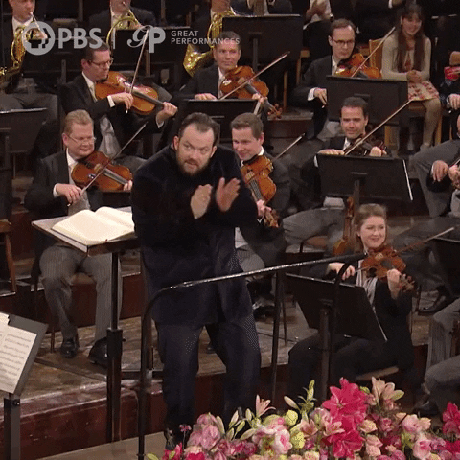
What is an Orchestra?
It is the ensemble of mixed instrumentalists playing music.
Notes:
What is the next closest note of E?

Slide 37
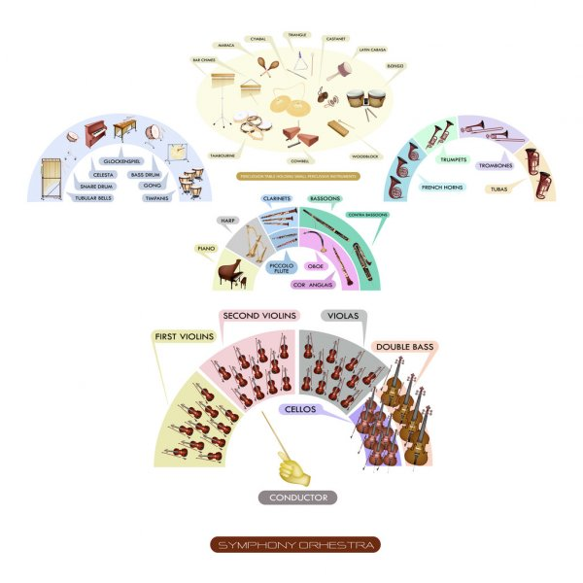
Instruments in an Orchestra
Notes:
What is the next closest note of E?

Slide 38
Instruments in an Orchestra
Notes:
What is the next closest note of E?

Slide 39
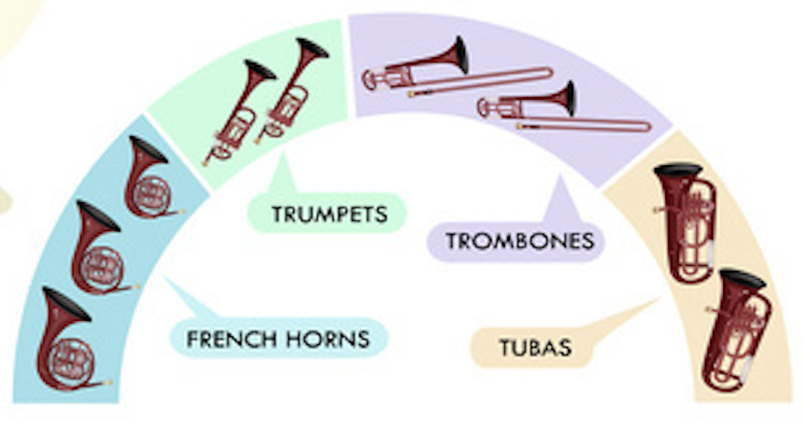
Instruments in an Orchestra
Notes:
What is the next closest note of E?

Slide 40
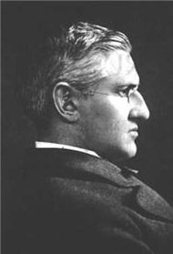
It Is Well with My Soul:
Historical Origins of the Hymn
Horatio Gates Spafford (October 20, 1828, Troy, New York – October 16, 1888, Jerusalem) was a prominent American lawyer and Presbyterian church elder.
He had been a successful lawyer and had invested significantly in property in the area of Chicago that was extensively damaged by the Great Chicago Fire
His business interests were further hit by the economic downturn of 1873, at which time he had planned to travel to England with his family on the SS Ville du Havre, to help with D. L. Moody's upcoming evangelistic campaigns.
In a late change of plan, he sent the family ahead while he was delayed on business concerning zoning problems following the Great Chicago Fire.
Notes:
What is the next closest note of E?

Slide 41
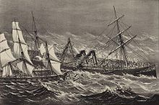
It Is Well with My Soul:
Historical Origins of the Hymn
While crossing the Atlantic Ocean, the ship sank rapidly after a collision with a sea vessel, the Loch Earn, and all four of Spafford's daughters died. His wife Anna survived and sent him the now famous telegram, "Saved alone …". Shortly afterwards, as Spafford traveled to meet his grieving wife, he was inspired to write these words as his ship passed near where his daughters had died. Bliss called his tune Ville du Havre, from the name of the stricken vessel.
When peace like a river, attendeth my way, When sorrows like sea billows roll; Whatever my lot, Thou hast taught me to know It is well, it is well, with my soul. Refrain It is well, (it is well), With my soul, (with my soul) It is well, it is well, with my soul.
Notes:
What is the next closest note of E?

Slide 42
Questions?
Thank you!
Notes:
What is the next closest note of E?

