Slide 1
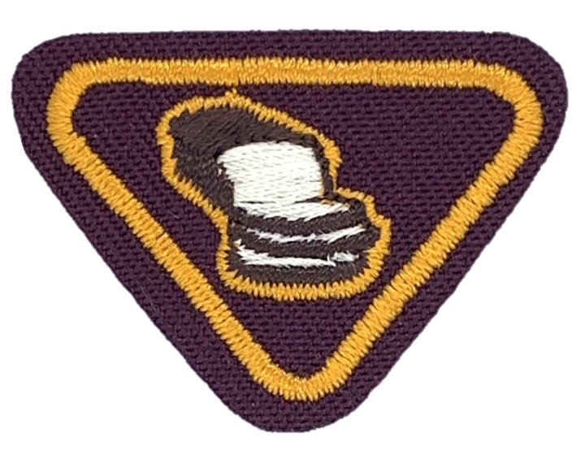
BREAD OF LIFE
Adventurer Award

Slide 2
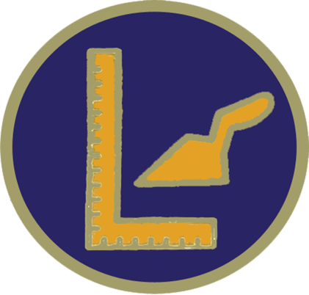
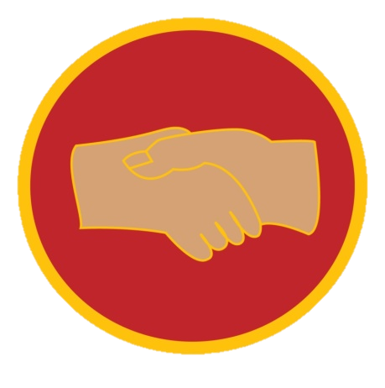
Multi/level Adventurer Award

Slide 3
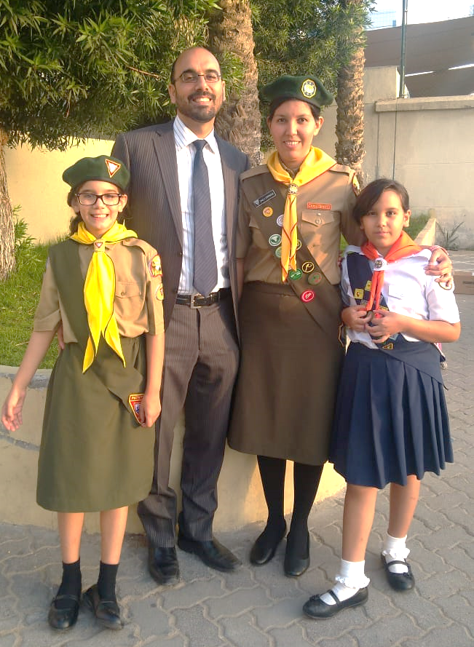
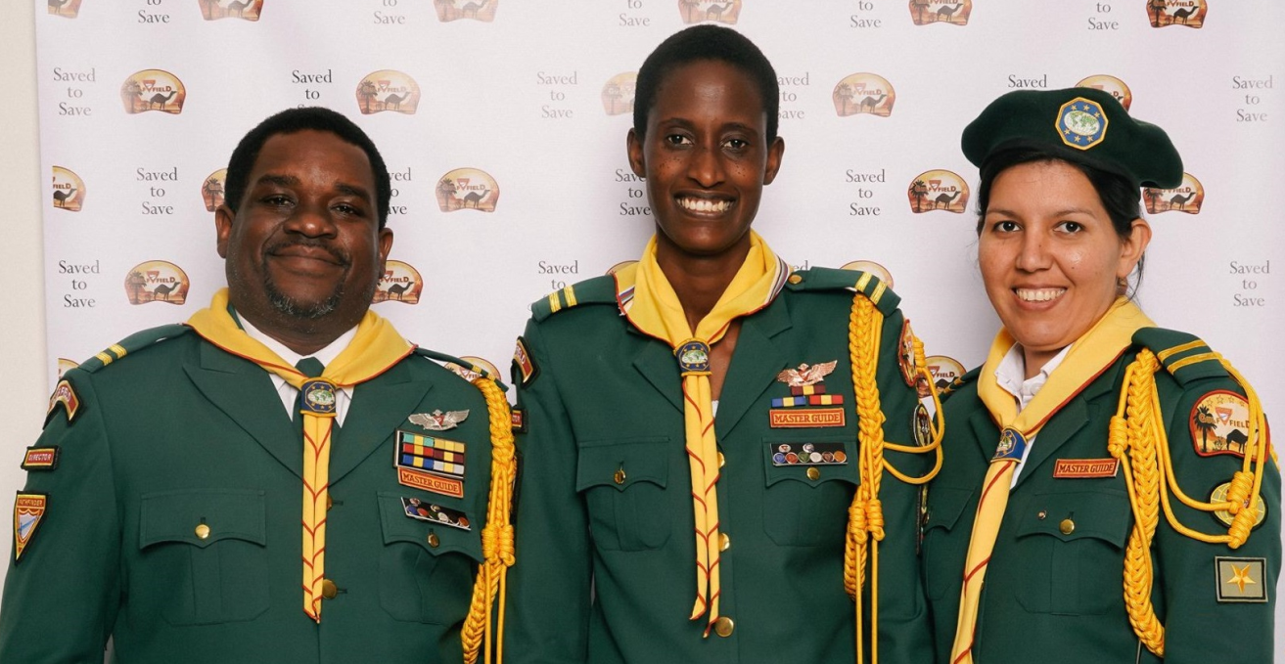
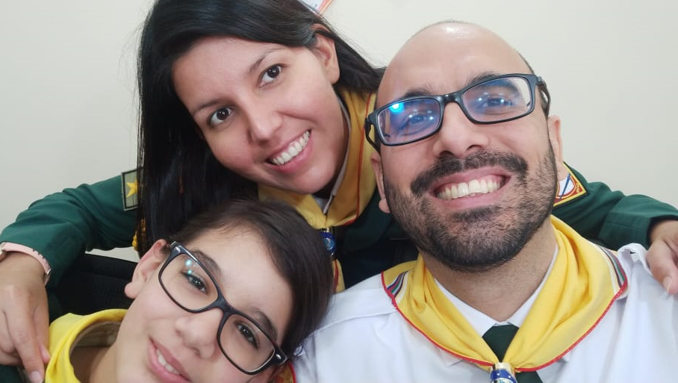
About me
My Name is : Daily Espinoza
Nationality: ?
What do I do? I work as a Volunteer in the Gulf Field
as Associate Pathfinder Director.
Venezuelan
Notes:
Nationality: I live here in Dubai but, I was born in Venezuela.
What do I do? I am a Pastor´s wife, I work as a Volunteer in the Gulf Field as Associate Pathfinder Director.

Slide 4
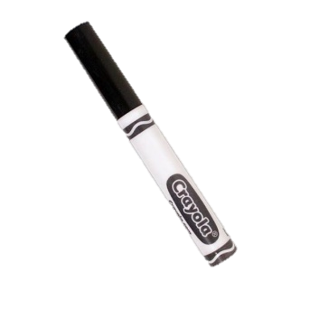
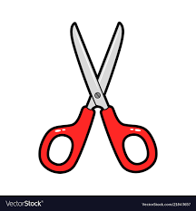
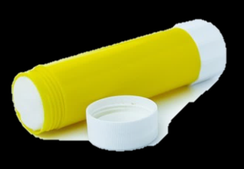
Things you will need
Bible (NIV version preferible)
Worksheet provided
Construction paper /Carboard /or any other paper (White and any other color)
Pencil
Black Marker
Glue
Scissor

Slide 5
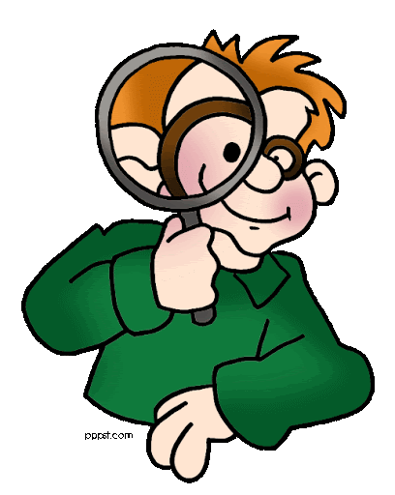
#1 Find, read, and write Matthew 4:4. Discuss its importance with an adult. Write what you learned.
Let´s Find Matthew 4:4
Matthew 4:4
Jesus answered,
“It is written: ‘Man shall not live on bread alone,
but on every word that comes from the mouth of God.’”

Slide 6
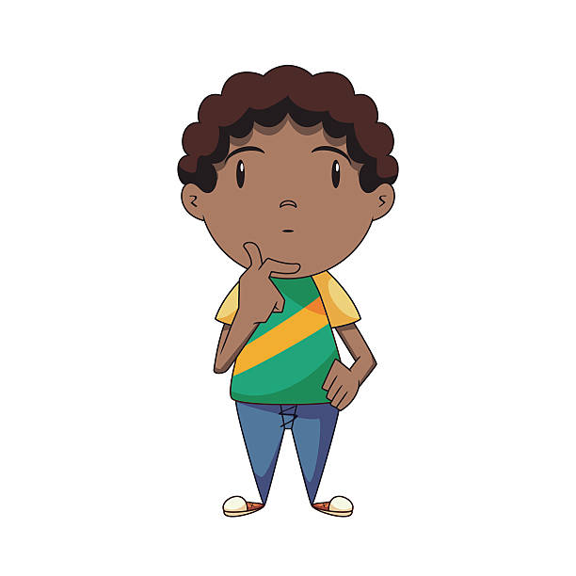
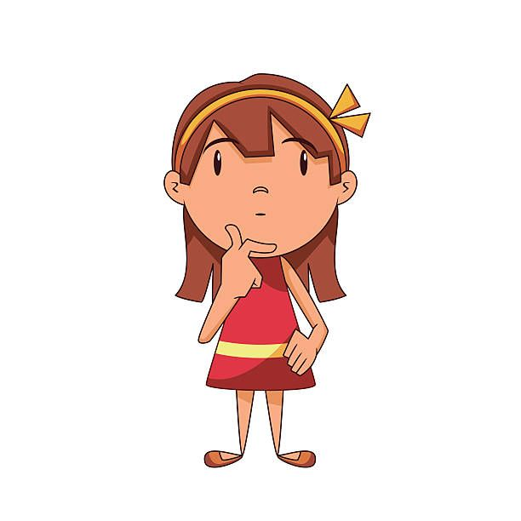
#1 Find, read, and write Matthew 4:4. Discuss its importance with an adult. Write what you learned.
Who said it?
What do you think it means?
Jesus
Satan came to tempt Jesus and
Jesus let him know that Prayer
and meditation on God´s Word
are just as essential as physical
food.
Matthew 4:4
answered,
“It is written: ‘Man shall not live on bread alone,
but on every word that comes from the mouth of God.’”
Jesus

Slide 7
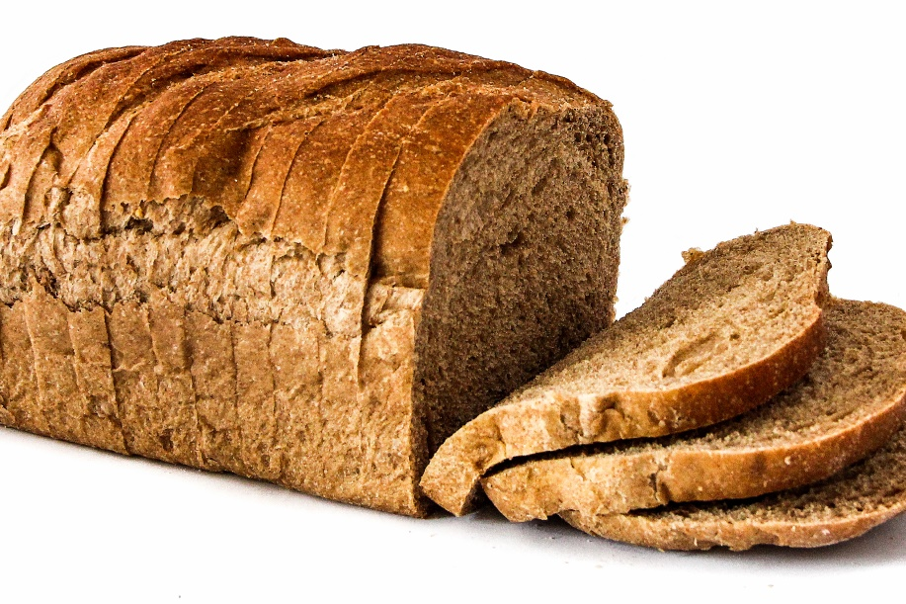
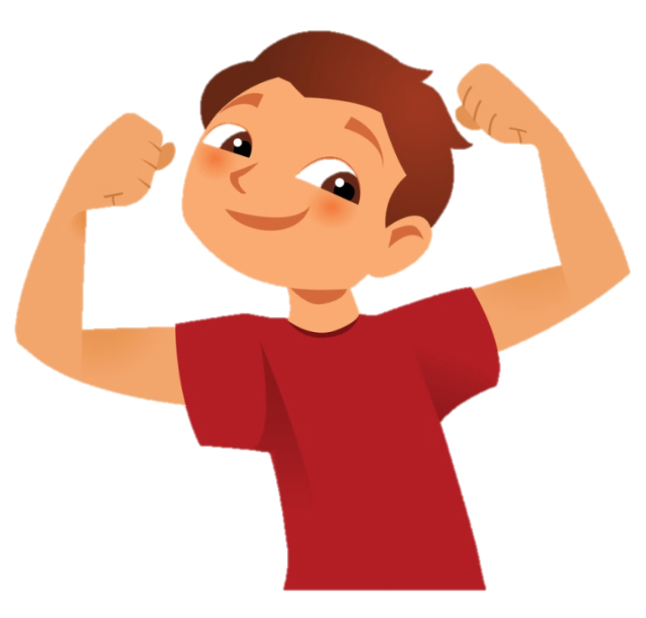
#1 Find, read, and write Matthew 4:4. Discuss its importance with an adult. Write what you learned.
In the same way you need food , you also need to read from the Bible to listen God´s
Word. So, you can be strong spiritually as you are physically.

Slide 8
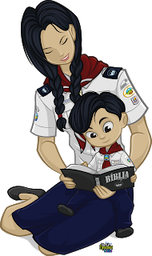
#2 Discuss with an adult the importance of reading God’s word every day. Write down your conclusions
Why is it important to read The Bible every day?
We get to know God more
We get closer to Him and our relationship grows so much that we naturally share Him with others.
We learn how to behave properly
We get strentgh for the day through the promises and we are able to defeat the enemy

Slide 9
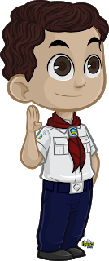
#3 Find and read: 2 Timothy 2:15, Psalm 119:11, and Psalm 119:105 NIV. Why do we study the Bible?
2 Timothy 2:15
“Do your best to present yourself to God as one approved, a worker who does not need to be ashamed and who correctly handles the word of truth”.

Slide 10
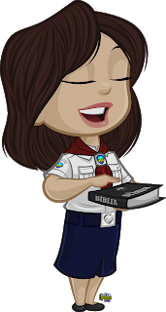
#3 Find and read: 2 Timothy 2:15, Psalm 119:11, and Psalm 119:105 NIV. Why do we study the Bible?
Psalm 119:11
“I have hidden your word
in my heart that I might not sin against you.”

Slide 11
#3 Find and read 2 Timothy 2:15, Psalm 119:11, and Psalm 119:105 NIV. Why do we study the Bible?
Psalm 119:105
“Your word is a lamp for my feet, a light on my path.”

Slide 12
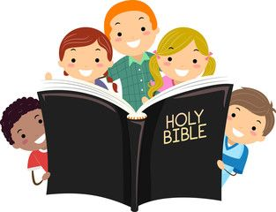
#3 Find and read 2 Timothy 2:15, Psalm 119:11, and Psalm 119:105 NIV. Why do we study the Bible?
Considering those Bible texts, why do we study the Bible?
To know the Truth.
To not sin against God.
To lead us through this
dark World.
2 Timothy 2:15
“Do your best to present yourself to God as one approved, a worker who does not need to be ashamed and who correctly handles the word of truth”.
Psalm 119:11
“I have hidden your word
in my heart that I might not sin against you.”
Psalm 119:105
“Your word is a lamp for my feet, a light on my path.”

Slide 13
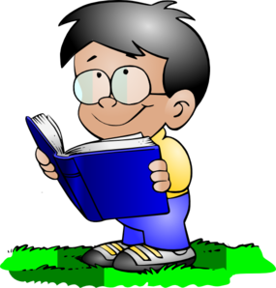
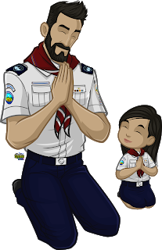
#4 Talk about how to prepare yourself for reading God’s Word. Write down four Bible study habits.
Pray before reading the Bible.
Meditate, think what the text is teaching you.
Set aside time every day to read your Bible.
Finish always with a prayer to ask God help you
remember what you just read.

Slide 14
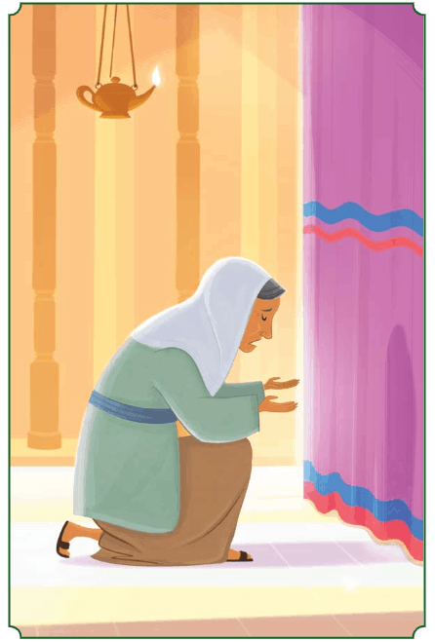
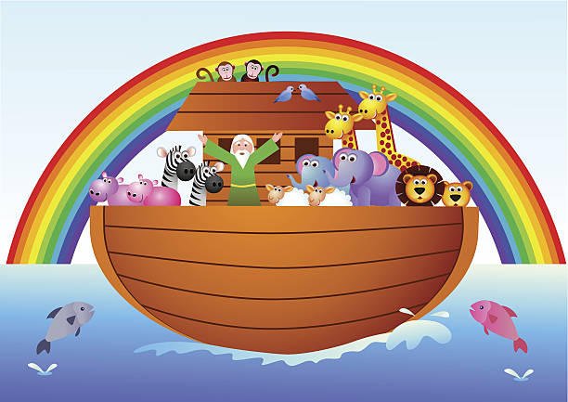
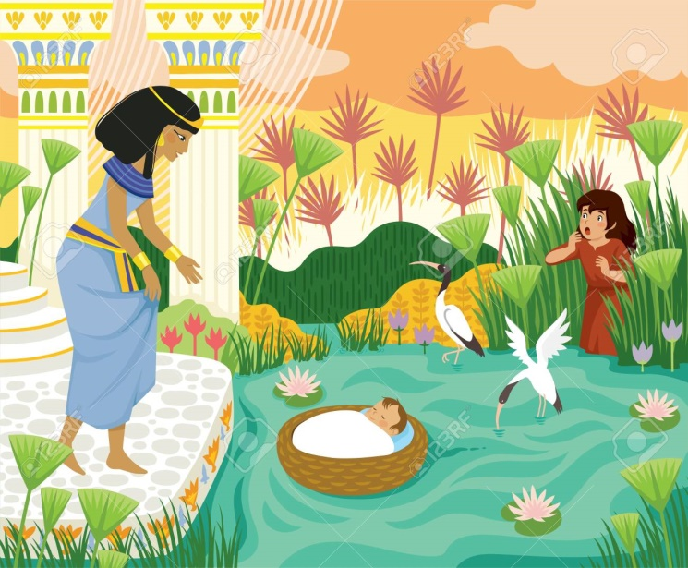
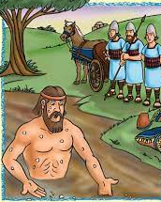
#5 Read one of the following Bible stories:
Hannah prays for a son (1 Samuel 1:1-28)
Noah’s Ark (Genesis 6:5-Genesis 8)
Baby Moses (Exodus1-2:10)
Namaan the Leper (2 Kings 5:1-16)
Notes:
Allow Sarai Espinoza to share screen so she can share the Tablet to present the story from the App “Bible for Kids.” I will narrate.

Slide 15
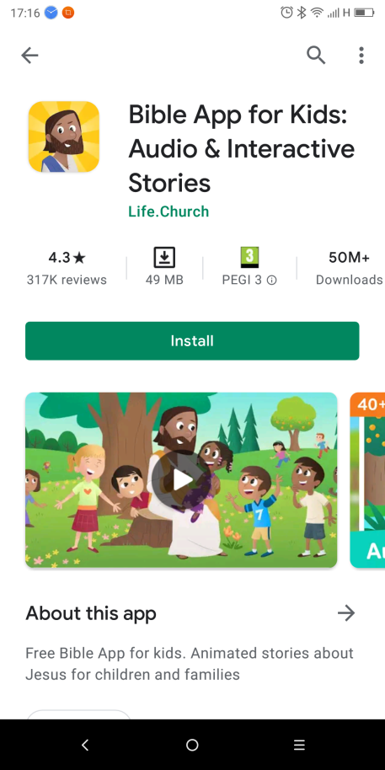
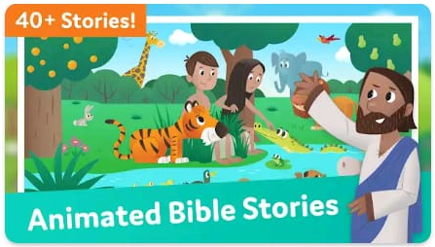
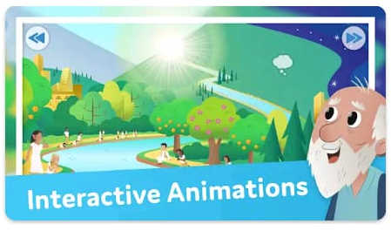
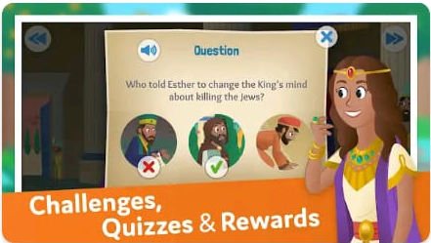
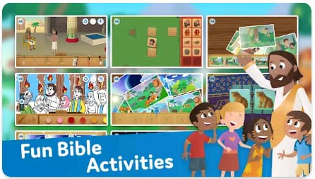
Resource:
“Bible for Kids” App: Download this Bible on your Tablet or Phone.
Notes:
Animated Bible Stories, Interactive Animations, Fun Bible Activities, Challenges, Quizzes & Rewards. 25 +Languages.

Slide 16
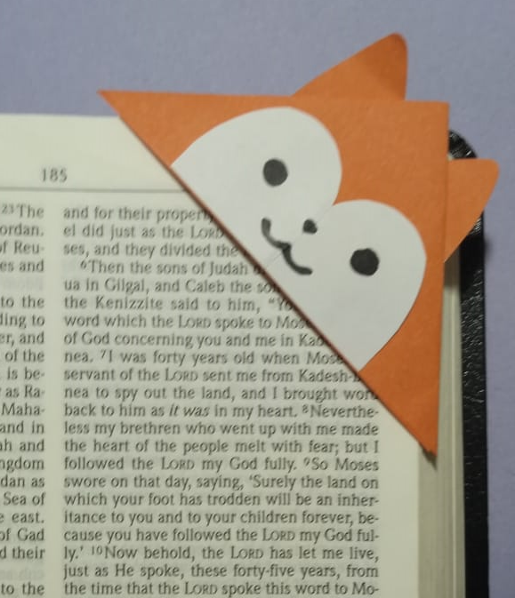
#6 Make a bookmark to use while you study your Bible

Slide 17
#6 Make a bookmark to use while you study your Bible
Instructions:
Cut a square in a piece of color paper.
Fold the square into 4 triangles. Cut one of the triangles.
Paste the 2 sides of the 2 last triangles together. The shape will be like a triangle hat.
1
2

Slide 18
#6 Make a bookmark to use while you study your Bible
Instructions:
Draw the ears in a color paper and cut. Glue them on top of the 2 sides of the triangle.
Draw the face in a white paper and cut. Glue it to the front of the triangle
Draw the eyes, nose and mouth to the face.
Notes:
You could also searh on you tube for “Origami Corner Book Marks”

Slide 19
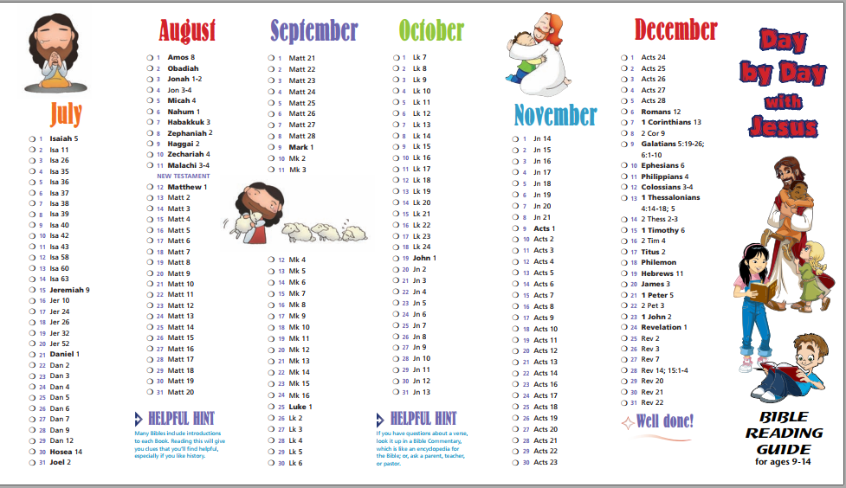
#7 Regularly spend time reading your Bible
You could get a Bible Reading Plan:
www.faithfinders.com/day-by-day-with-jesus-bible-reading-guide.pdf
Notes:
Faith Finders, Bible Studies, Day by Day with Jesus Bible Reading Guide

Slide 20
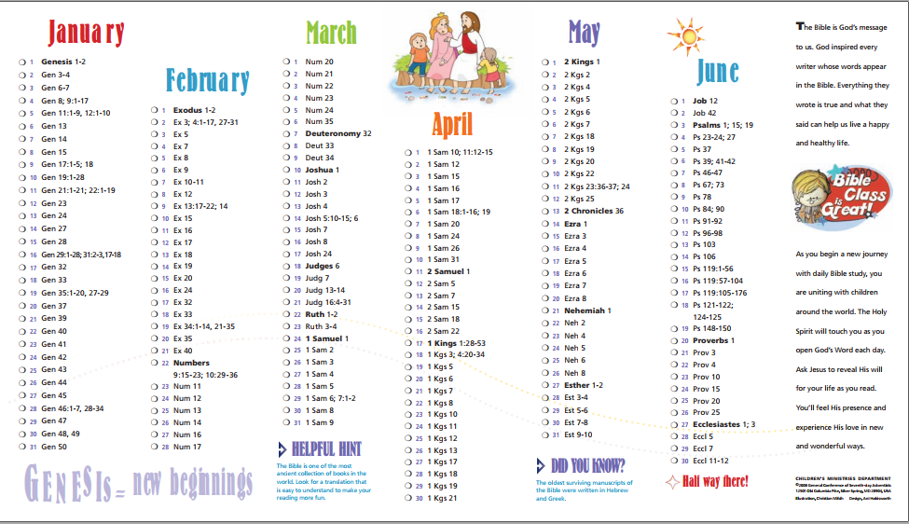
#7 Regularly spend time reading your Bible
You could get a Bible Reading Plan:
www.faithfinders.com/day-by-day-with-jesus-bible-reading-guide.pdf
Notes:
Faith Finders, Bible Studies, Day by Day with Jesus Bible Reading Guide

Slide 21
#7 Regularly spend time reading your Bible
You could get a Bible Reading Plan:
www.sarahtitus.com/super-cute-helpful-printable-bible-reading-plans/

Slide 22
#7 Regularly spend time reading your Bible
You could get a Bible Reading Plan:
Others Bible Reading Plans:
www.sarahtitus.com/super-cute-helpful-printable-bible-reading-plans/
www.wildlyanchored.com
www.confessionsofahomeschooler.com

Slide 23
#7 Regularly spend time reading your Bible
You could study your Sabbath School Lesson every day
www.gracelink.net/primary

Slide 24
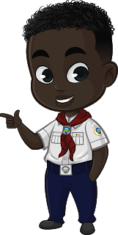
Remember :
Read your Bible every day and Pray!

Slide 25
Thanks !

