Slide 1

The Holy Spirit
Adventurer Award
Presenter: Chrystal Flerchinger,
Othello Mustangs Adventurer Director
Washington State, USA
Notes:
Hello, Boys and Girls

Slide 2

Holy Spirit Award
Requirements
1. Who will send the Holy Spirit?
2. Why was the Holy Spirit sent?
3. The Holy Spirit is part of the Godhead. Who else is included?
4. Find and memorize a verse, or sing a song, about the Holy Spirit.
5. Read Acts 4:23-31. Discuss what happened.
6. Was Jesus filled with the Holy Spirit?
7. What will happen when you receive the Holy Spirit?

Slide 3
#1 – Who will send the Holy Spirit?
John 14:26, NIV
“But the Advocate, the Holy Spirit,
whom the Father will send in my name,
will teach you all things
and will remind you of everything I have said to you.”

Slide 4

#2
Why was the
Holy Spirit sent?

Slide 5
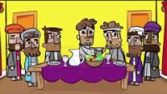

Slide 6
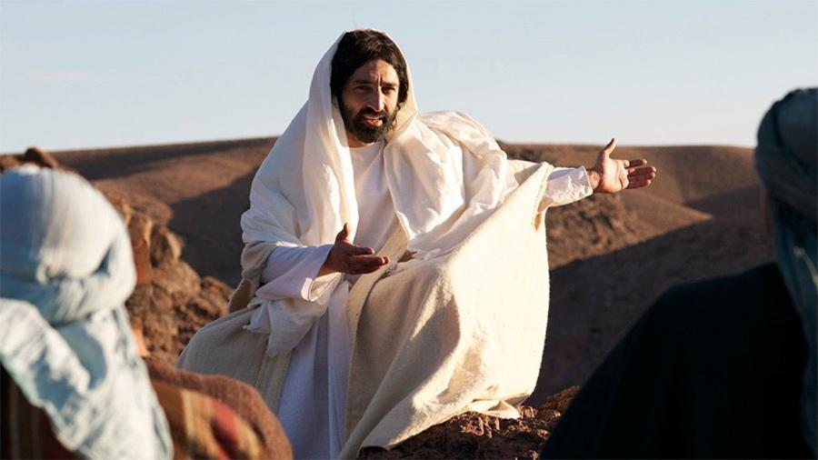
Who does the Holy Spirit tell about?
John 15:26, ICB
I will send you the Helper from the Father. He is the Spirit of truth who comes from the Father. When he comes, he will tell about ME.”

Slide 7

Can we trust what the Holy Spirit tells us?
Notes:
NIV: Verse 12 says we can’t hear everything at once
Verse 14 tells us that the Spirit of truth will bring Glory to Jesus. He’ll take what He has to say and tell it to you!

Slide 8
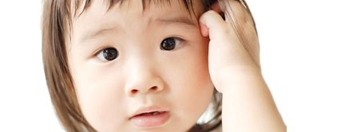
Does the Holy Spirit know me?
Also, the Spirit helps us.
We are very weak,
but the Spirit helps us with our weakness.
We do not know how to pray as we should.
But the Spirit Himself speaks to God for us,
Even begs God for us.
The Spirit speaks to God with deep feelings that words cannot explain.
Romans 8:26 ICB

Slide 9
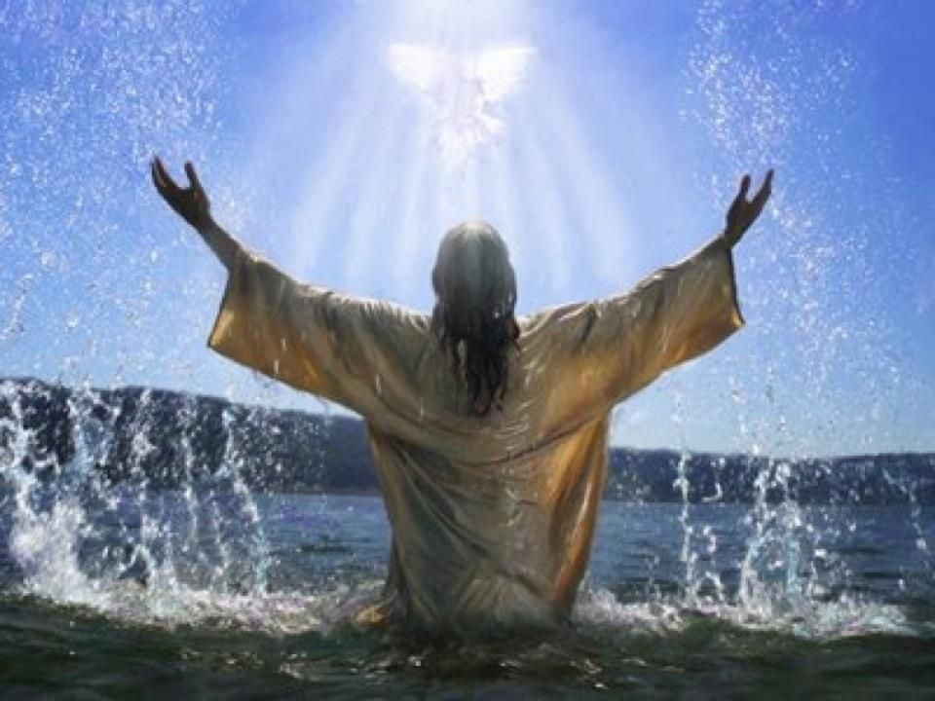
#3
The Holy Spirit is part of the Godhead
Who else is included?
Matthew 28:19

Slide 10
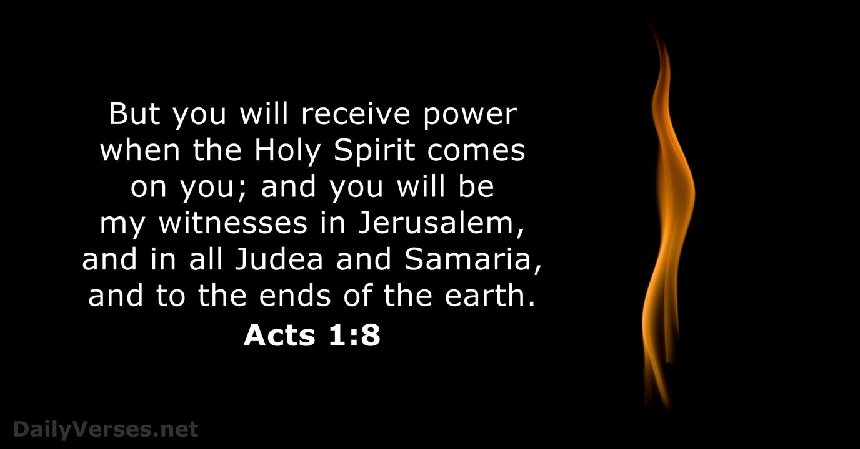
What does the Holy Spirit give us the power to do?

Slide 11
#4
Write and Memorize This verse

Slide 12

Notes:
John 14:26

Slide 13
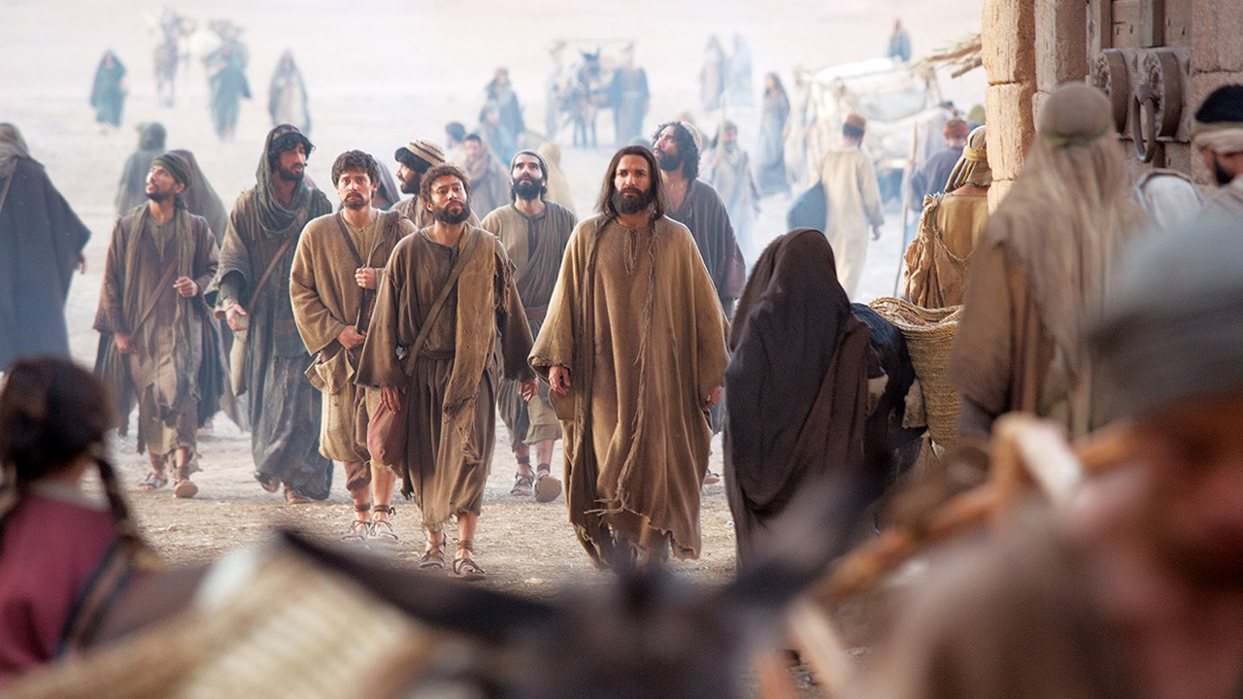
#5 – Bible Time: Acts 4:23-31

Slide 14
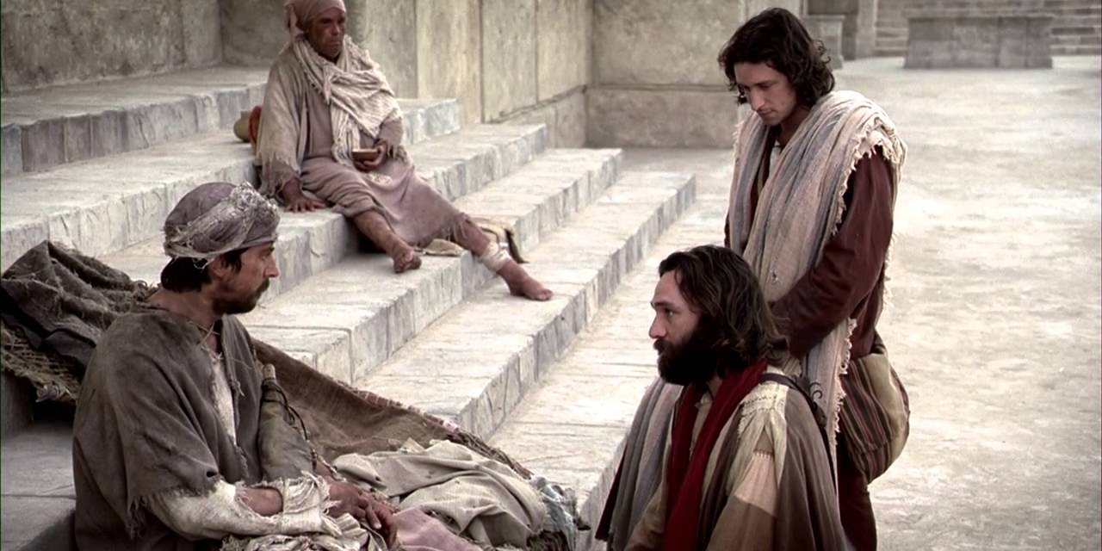
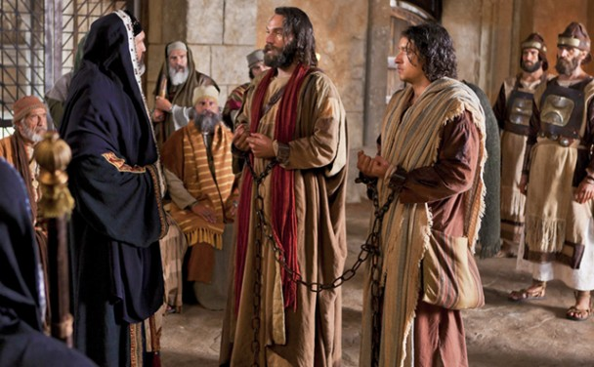

Slide 15
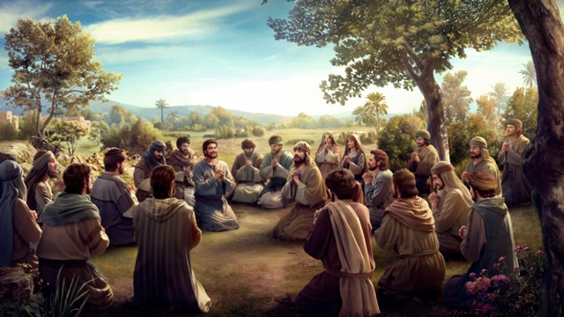

Slide 16
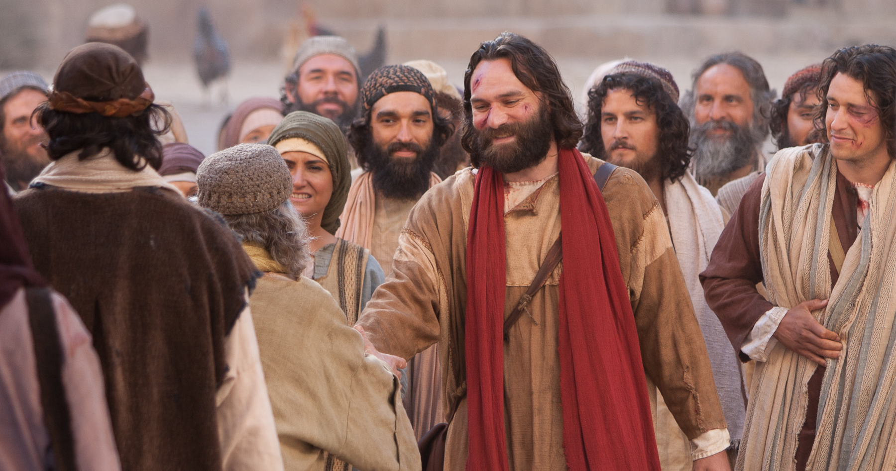

Slide 17

The Holy Spirit Helps us:
BE BOLD for Jesus

Slide 18
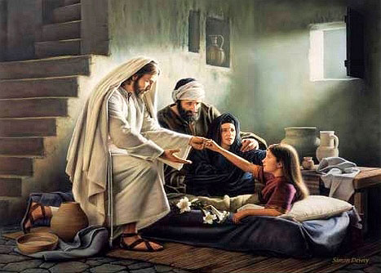

#6 – Was Jesus Filled with the Holy Spirit?
Luke 3: 21-22
Acts 10:38
YES!

Slide 19

#7 – What will happen when you receive the Holy Spirit?
You will receive POWER!

Slide 20
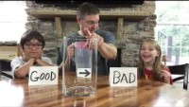

Slide 21
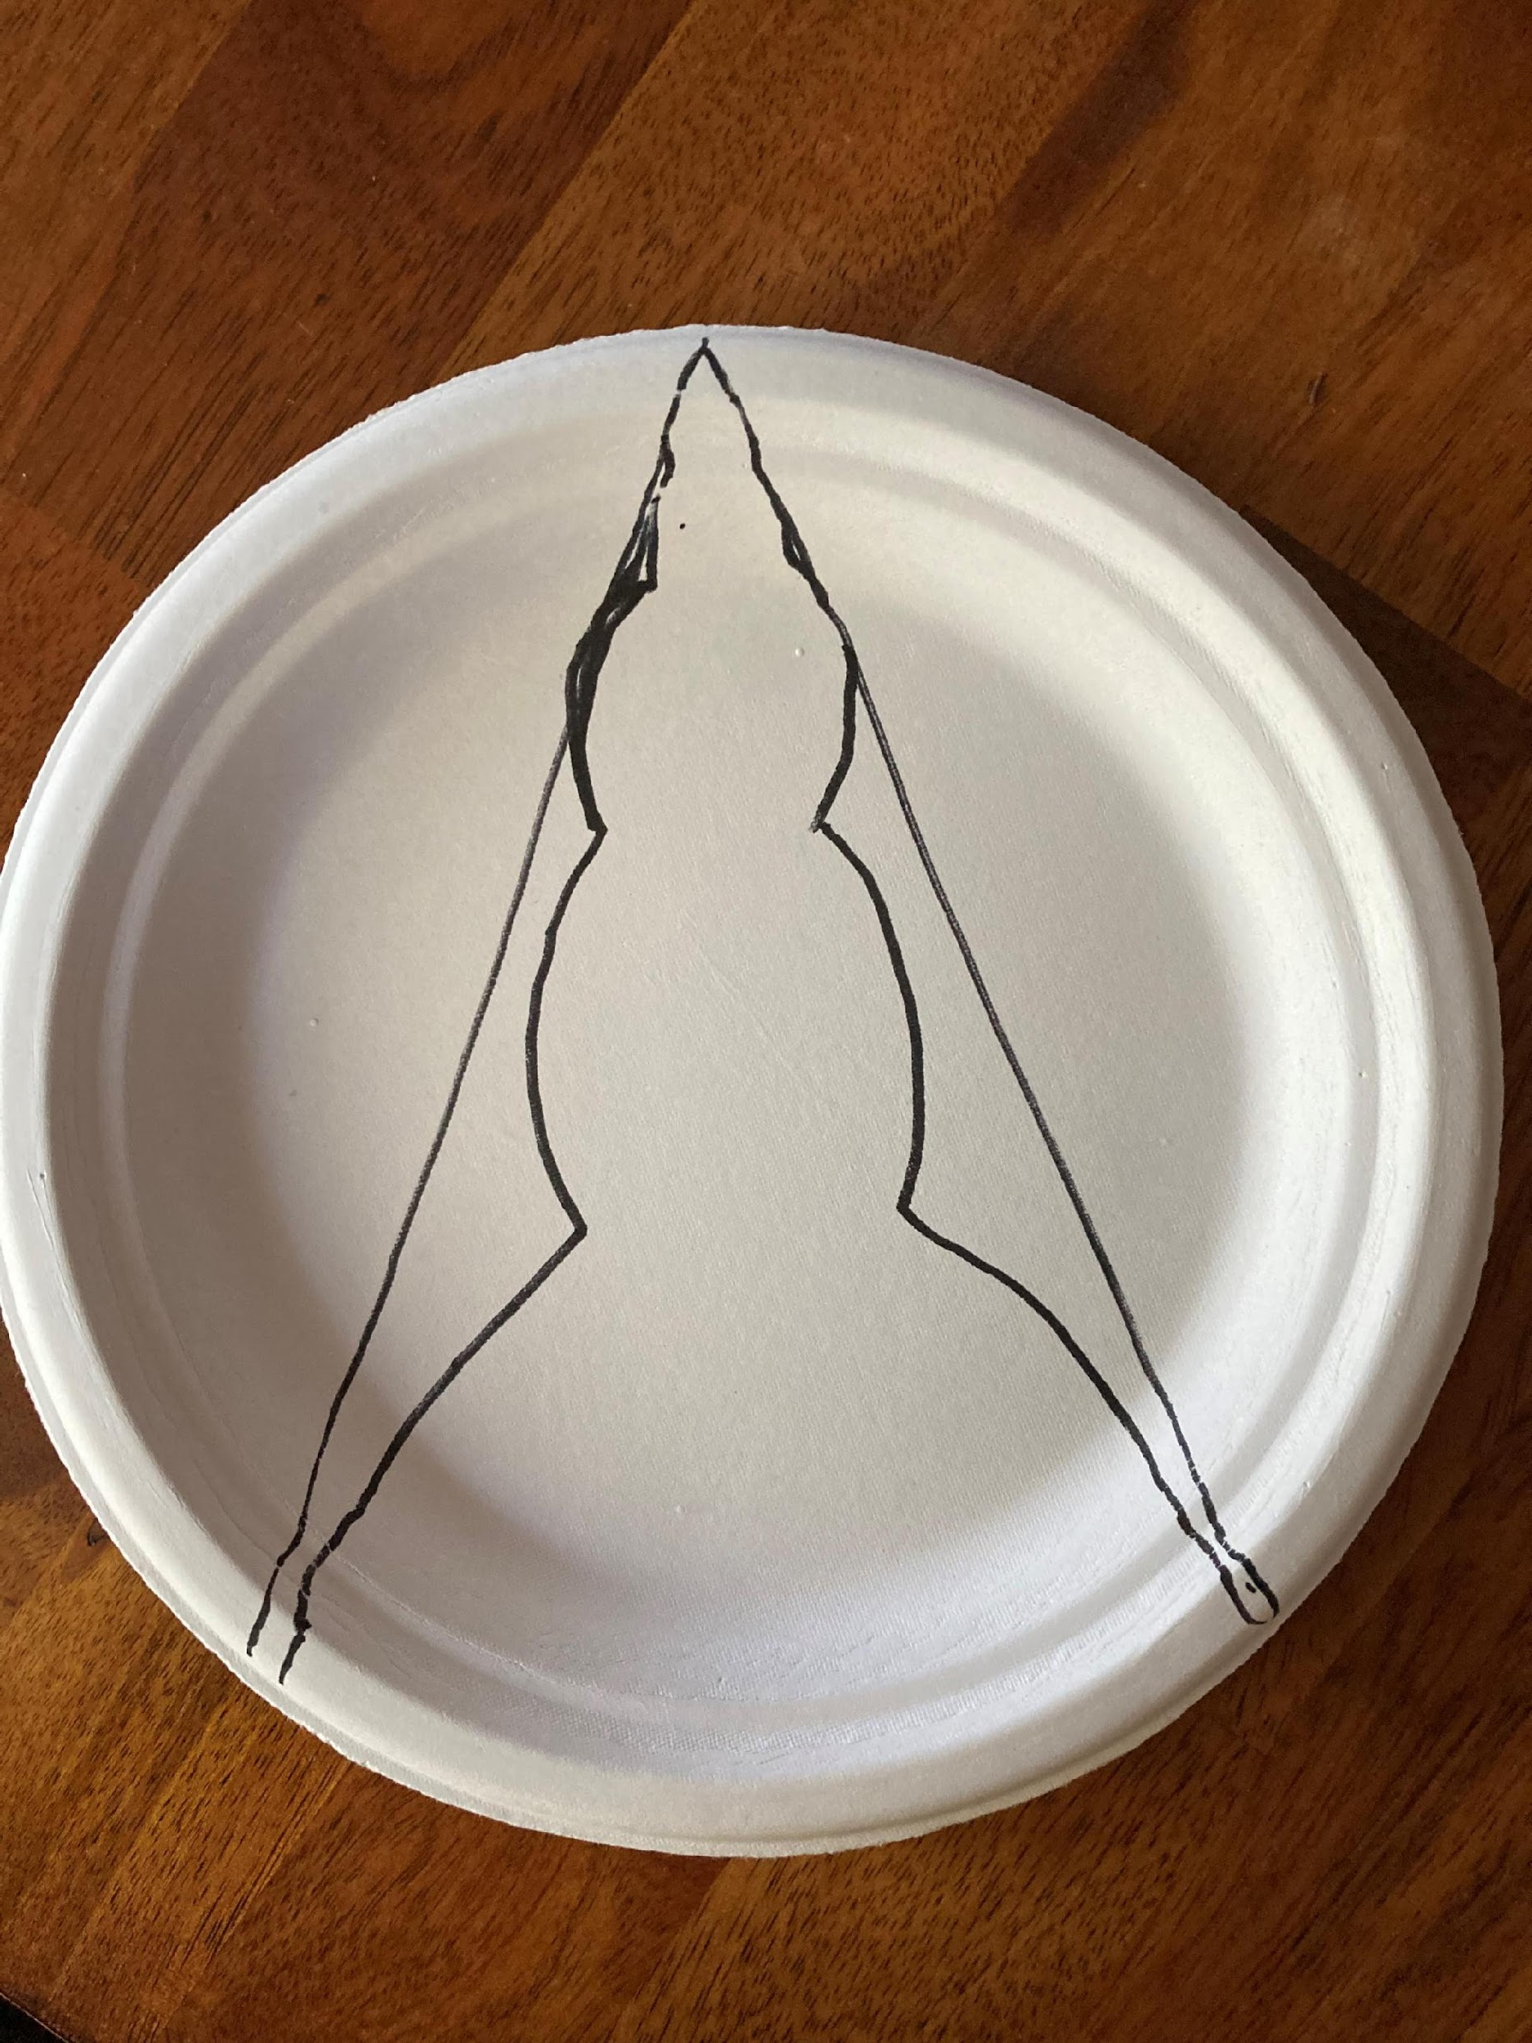
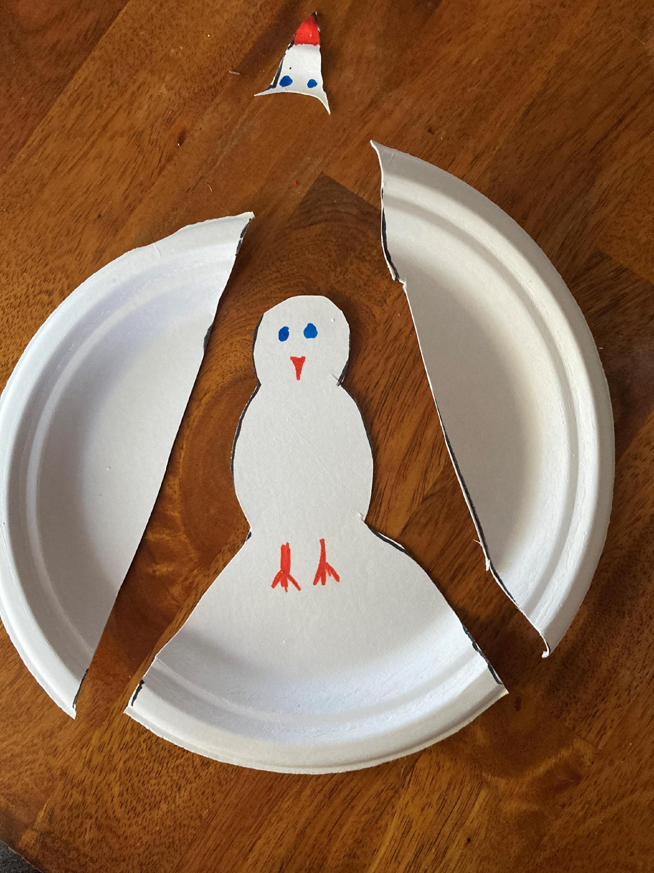
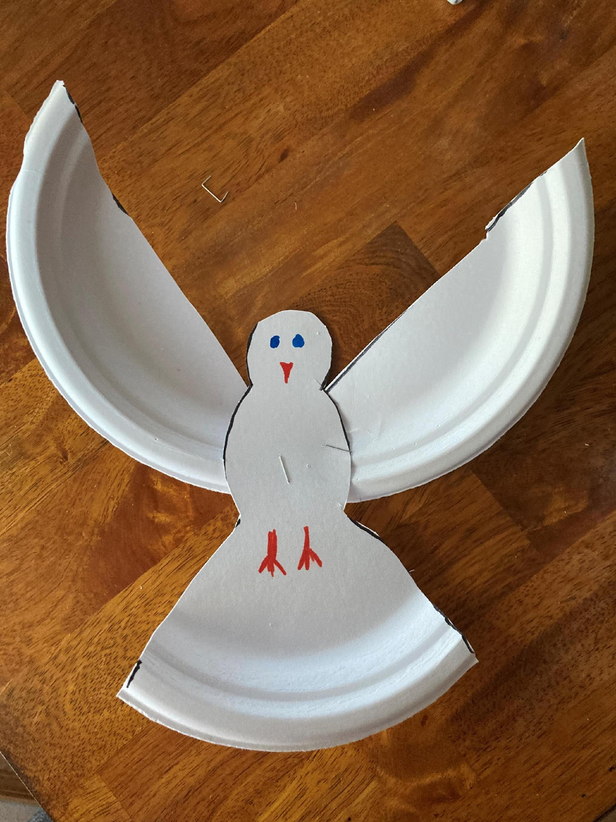
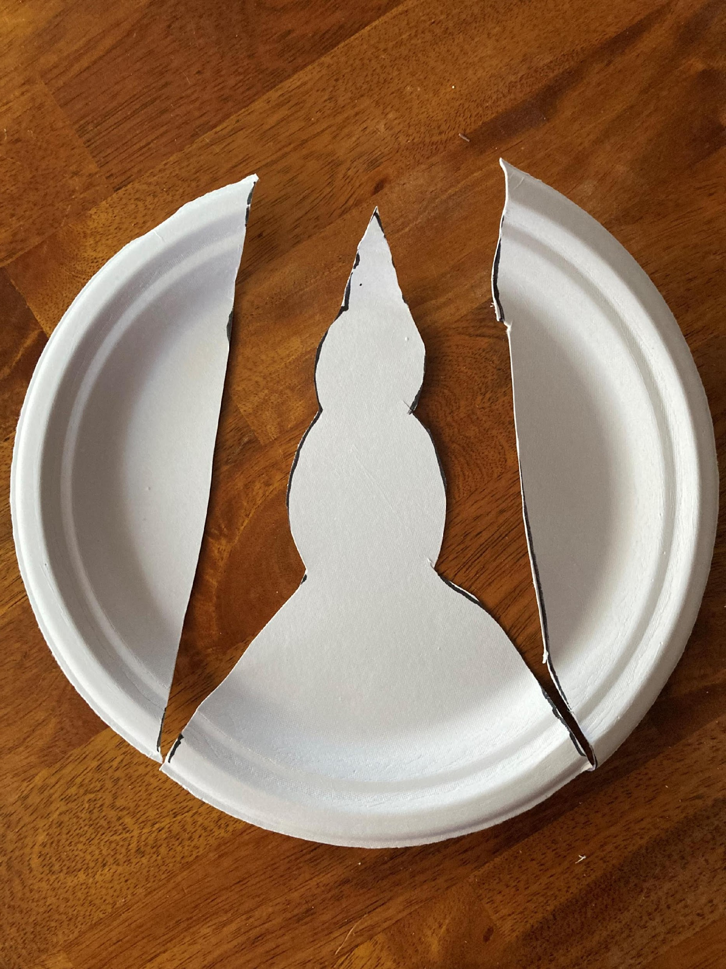
Just for fun

