Slide 1
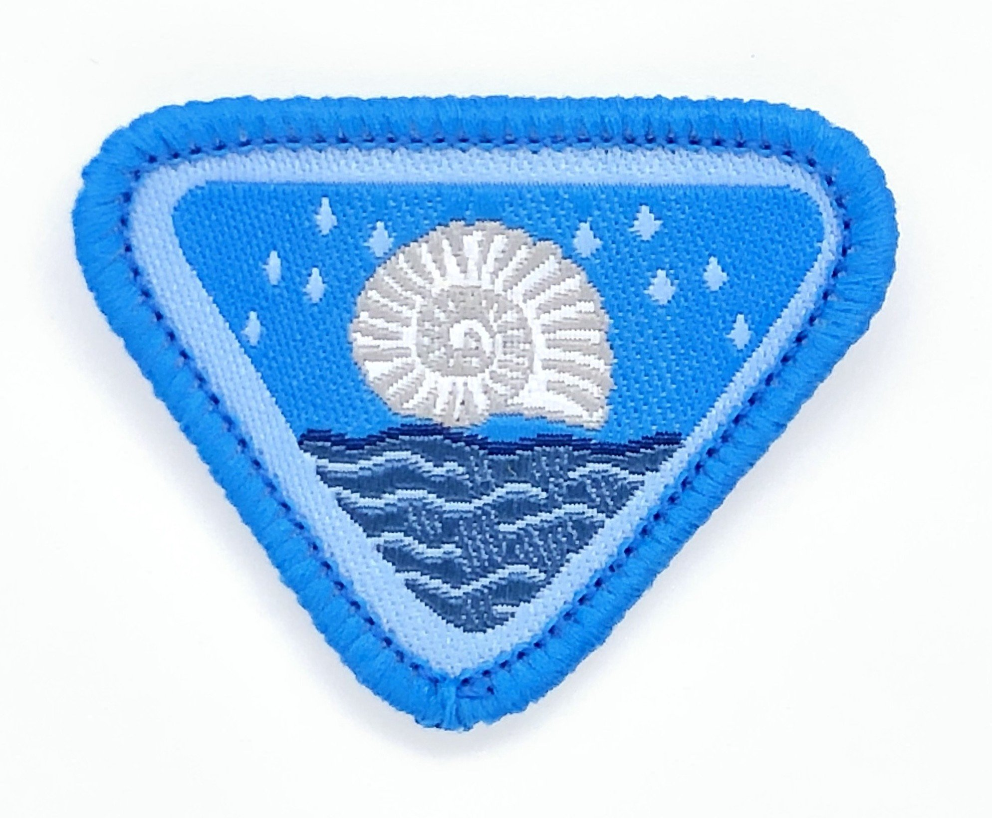
Floods & Fossils Adventurer Award
Vernon Noel – SEC Area Coordinator

Slide 2
Introduction to Flood & Fossils Adventurer Award
Welcome to this exciting Adventurer Award that was especially created for an Adventurer Camporee held on the Jurassic Coast in 2010 with the assistance of my daughter, Cielle, who was an Adventurer at that time.

Slide 3
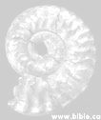
Resources needed
Modelling sand or modelling clay
A few olives (green or black)
Pair of scissors, glue
If possible, Plaster of Paris, water, lolly stick, plastic cup, dinosaur toy
Award worksheet, pen or pencil

Slide 4
Requirements
Re-tell or act out the story of The Flood as told in Genesis 6-9. Name Noah’s children.
In a group, name as many creatures as you can that entered the ark as clean animals, and as un- clean animals. Give both their male and female names.
Make an ark out of sand (or modelling clay).
Repeat the sounds the 2 birds make that Noah used before coming out of the ark.
Taste an olive.

Slide 5
Requirements
Know 3 important rules when hunting for fossils.
Assemble a fish or bird fossil puzzle.
Collect or take photos of at least 3 fossils and 3 different rocks and draw a fossil that you find or have seen.
Describe the work that a palaeontologist does.
Tell how fossils are formed. If possible, make a fossil out of seaweed/sand/twigs etc. Try making one!

Slide 6
The Flood!!! (Genesis chapters 6-9)
Main characters
Setting
Plot
Conflict
Theme

Slide 7
The Flood!!!

Slide 8
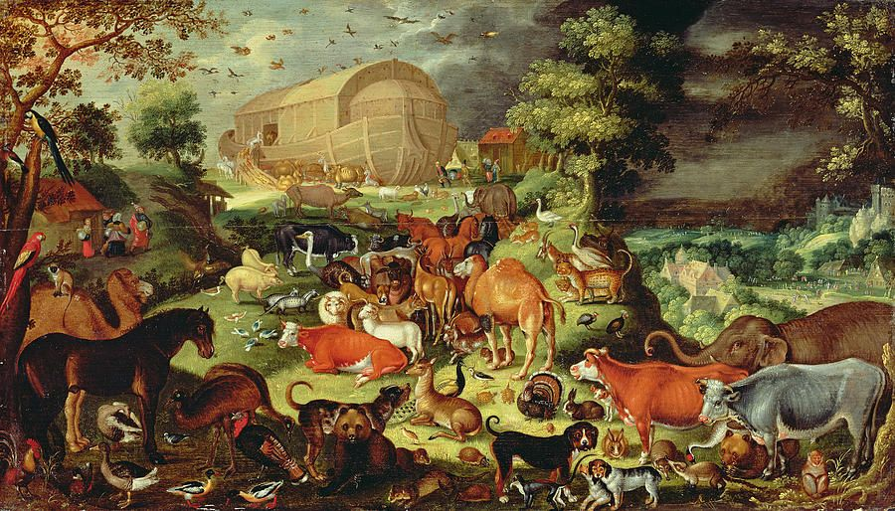
What creatures made it into the ark?
Which ones were clean animals?
Which ones were unclean animals?
Do you know their male and female names?

Slide 9
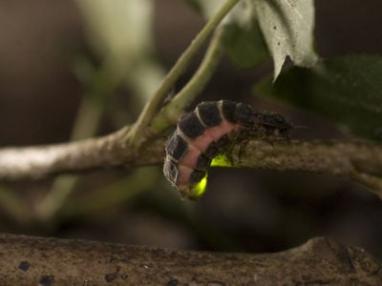
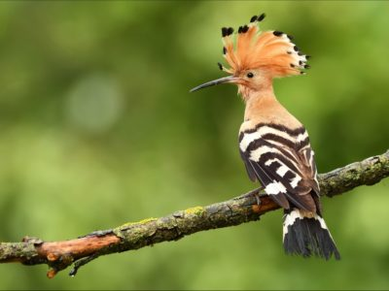
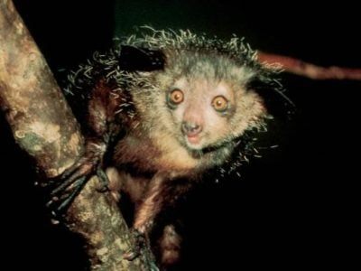
Animals by alphabet
A – Aardvark, Aye Aye, Albatross, Alpaca, Ant
B – Baboon, Bat, Beaver, Bear, Badger
C - Codfish, Cockroach, Cheetah, Centipede, Cicada
D – Dingo, Dolphin, Dormouse, Dragonfly, Duck
E – Eagle, Emperor Penguin, Elephant Shrew, Eastern Bluebird
F – Frog, Fallow Deer, Flamingo, Flying Squirrel, Fur Seal
G – Giraffe, Gerbil, Gila Monster, Glow Worm, Guinea Fowl
H – Hoopoe, Honey Bee, Hummingbird, Hyena, Hammerhead Shark
I – Iguana, Ibis, Impala, Irish Setter, Indochinese Tiger

Slide 10
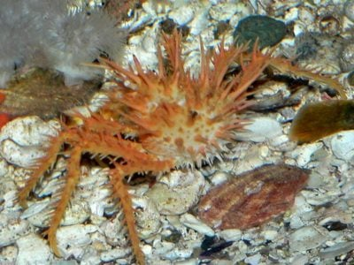
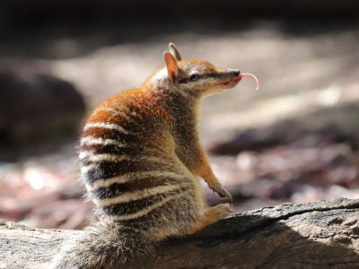
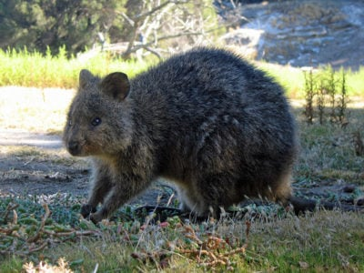
Animals by alphabet
J – Jackal, Jaguar, Jellyfish, Jack Russell, Japanese Macaque
K – Kiwi, Koala, King Crab, Killer Whale, Kingfisher
L – Lemur, Lynx, Ladybug, Lobster, Locust
M – Mink, Mongoose, Meerkat, Magpie, Moth
N – Newt, Nightingale, Numbat, Nurse Shark, Norfolk Terrier
O – Ocelot, Octopus, Otter, Ostrich, Oyster
P – Parrot, Peacock, Porcupine, Platypus, Piranha
Q – Quail, Quoll, Quetzal, Quokka
R – Raccoon, Rottweiler, Red Squirrel, Robin, Rock Hyrax

Slide 11
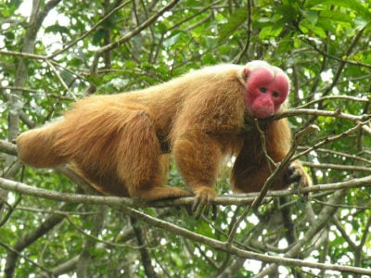
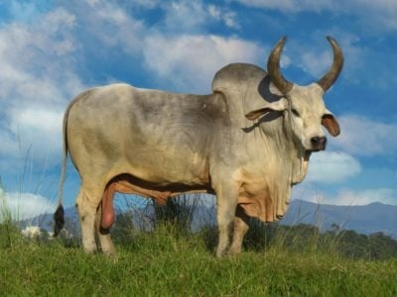
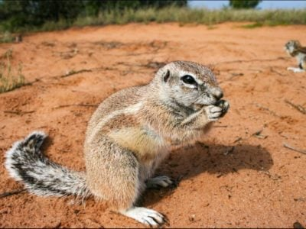
Animals by alphabet
S – Scorpion, Sardine, Siberian Tiger, Skunk, Squid
T – Tortoise, Termite, Tasmanian Devil, Toucan, Tawny Owl
U – Umbrella bird, Uguisu, Uakari, Utonagan
V – Vampire Bat, Vampire Squid, Vulture, Vervet Monkey, Vaquita
W – Wombat, Whippet, Wasp, Walrus, Woodpecker
X – X-Ray Tetra, Xerus
Y – Yak, Yorkshire Terrier, Yellowfin Tuna, Yorkie Bichon, Yellow-Eyed Penguin
Z - Zebra, Zebra Shark, Zebu, Zonkey, Zorse

Slide 12
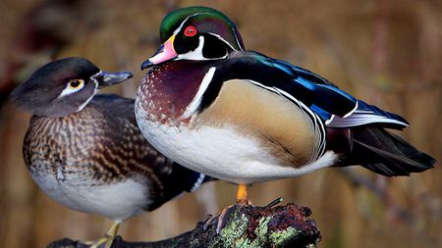
Male and Female Quiz

Slide 13
Clean vs Unclean Animals
Clean
Unclean
7 pairs of each
Sheep
Goats
Deer
1 pair of each
Rabbits
Rats
Crocodiles

Slide 14
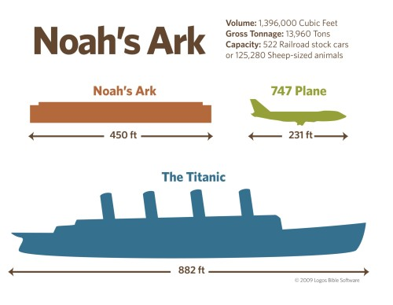
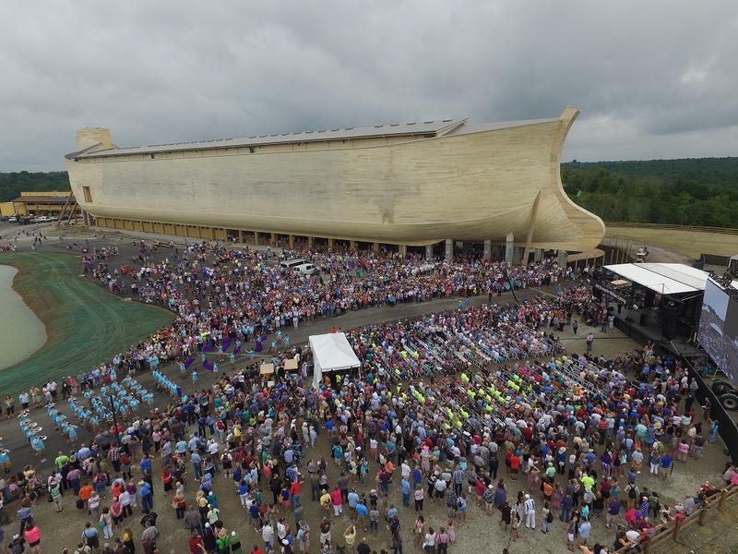
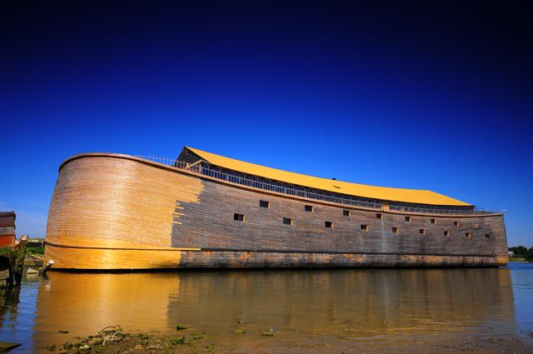
What did the ark really look like?
Make an ark out of sand (or modelling clay). When finished, take a picture and paste it in your worksheet.

Slide 15
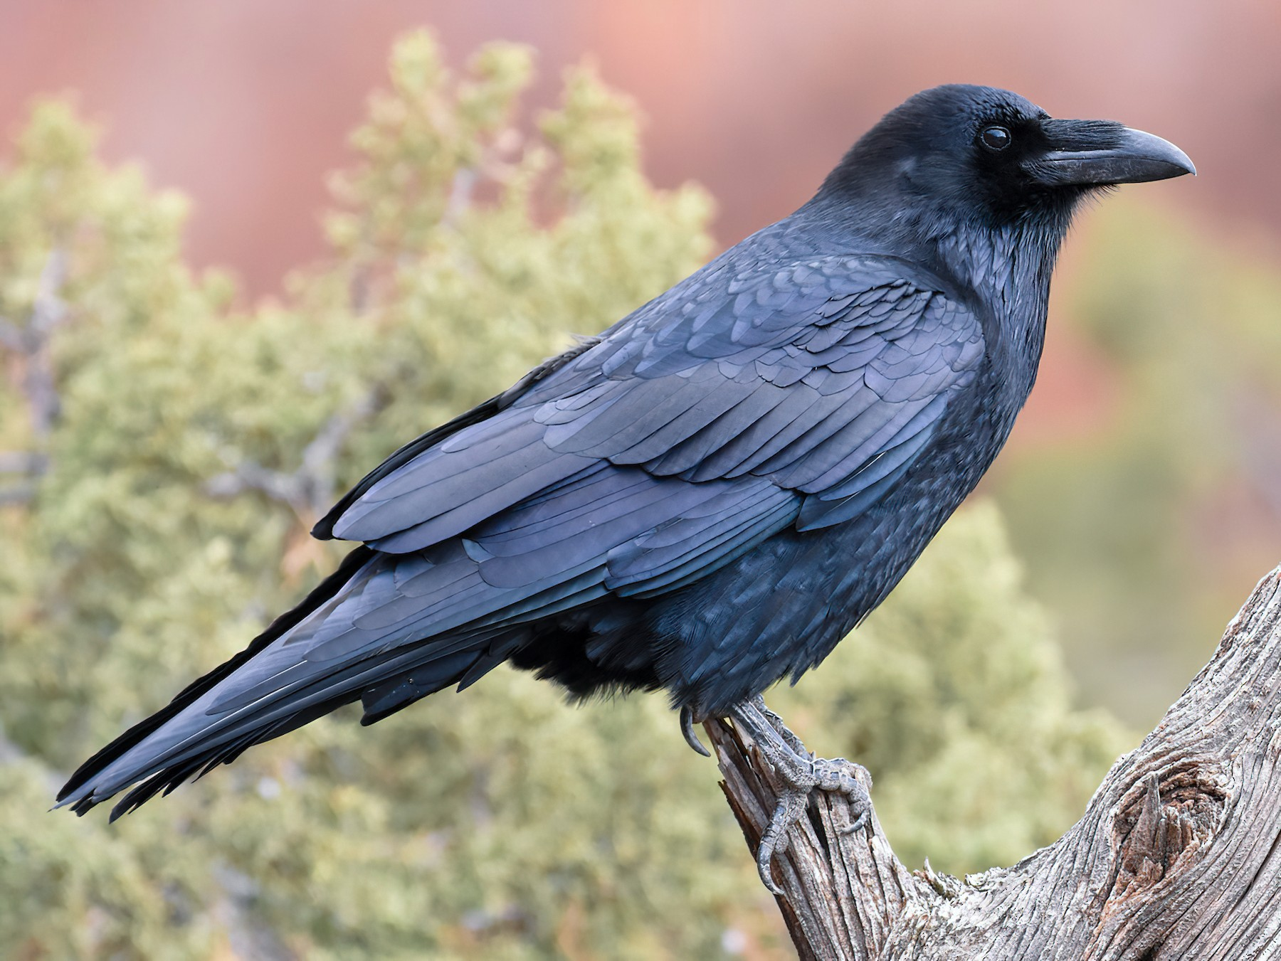
Which 2 birds did Noah send out of the ark?
Do you know what they sound like?

Slide 16
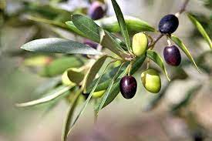
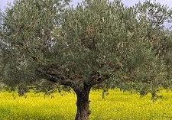
What does an olive taste like?
What can you make from olives?
Oils
Breads
Pickles

Slide 17
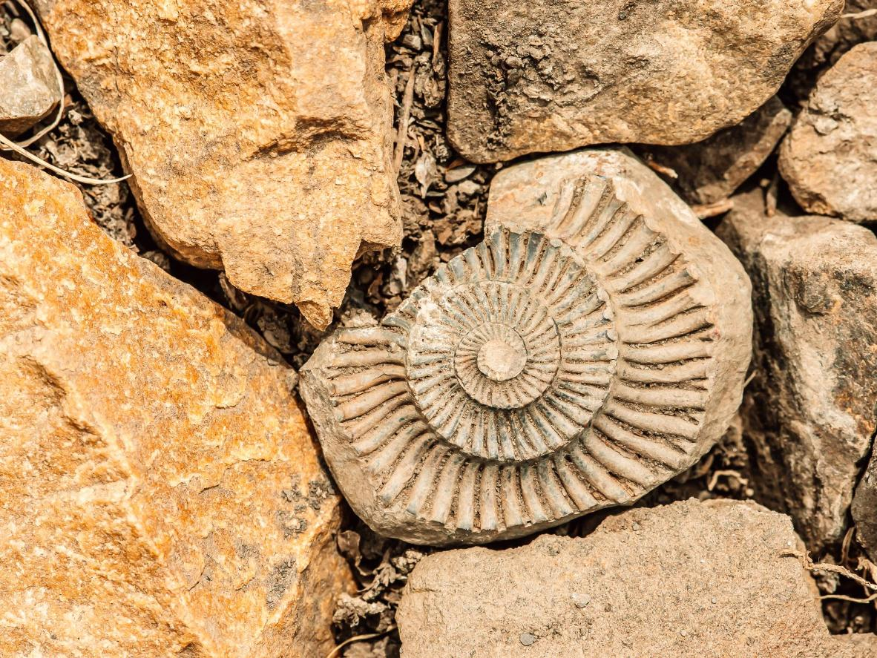
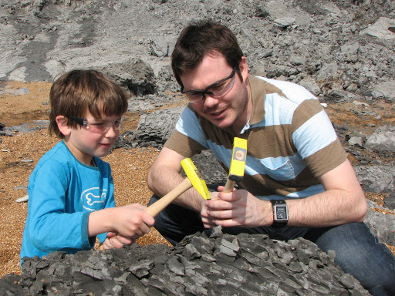
3 Important rules when hunting for fossils
Plan
Be safe
Be patient
Respect your environment
Report finds
Protect your fossils
Leave if possible

Slide 18
3 different fossils

Slide 19
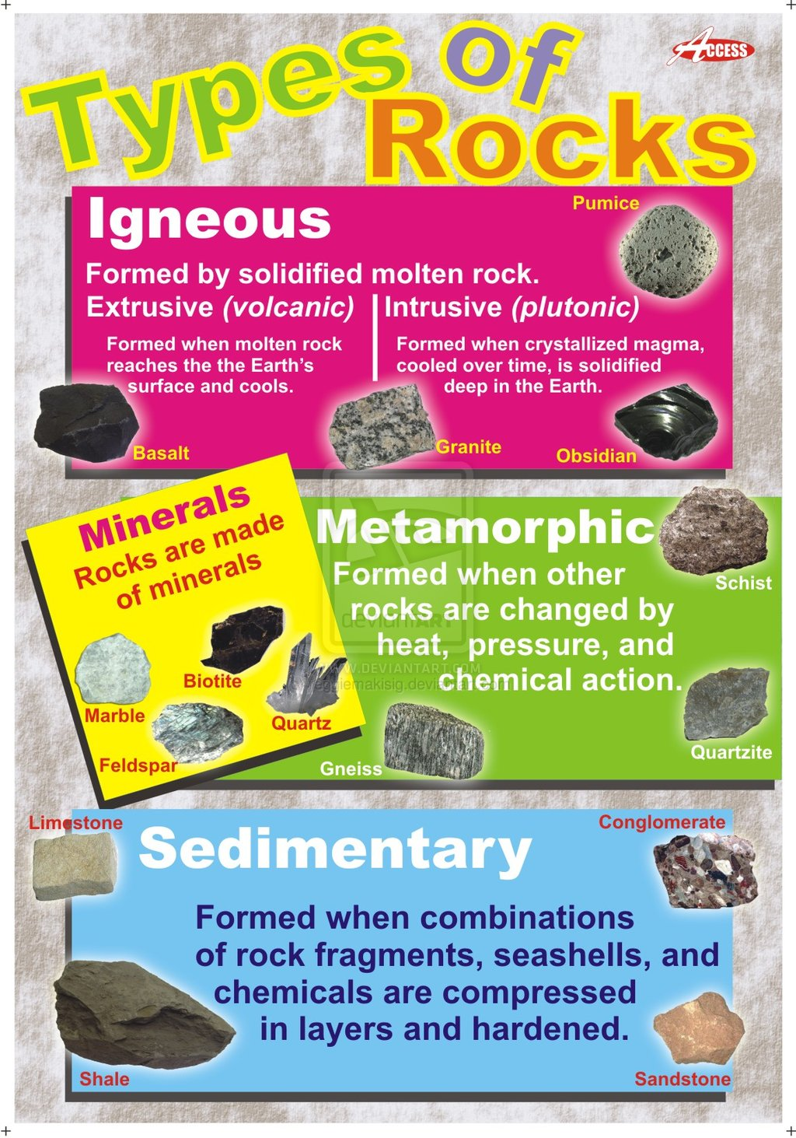
3 different rocks

Slide 20
What does a palaeontologist do?
Studies the fossilized remains of all kinds of organisms (plants, animals, fungi, bacteria and other single-celled living things), and is interested in knowing the history of organic life on earth.

Slide 21
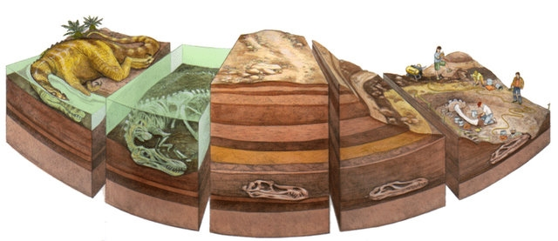
How are fossils formed?
After an animal dies, the soft parts of its body decompose leaving the hard parts, like the skeleton, behind. This becomes buried by small particles of rock called sediment.

Slide 22
How are fossils formed?
As more layers of sediment build up on top, the sediment around the skeleton begins to compact and turn to rock. The bones then start to be dissolved by water seeping through the rock. Minerals in the water replace the bone, leaving a rock replica of the original bone called a fossil.

Slide 23
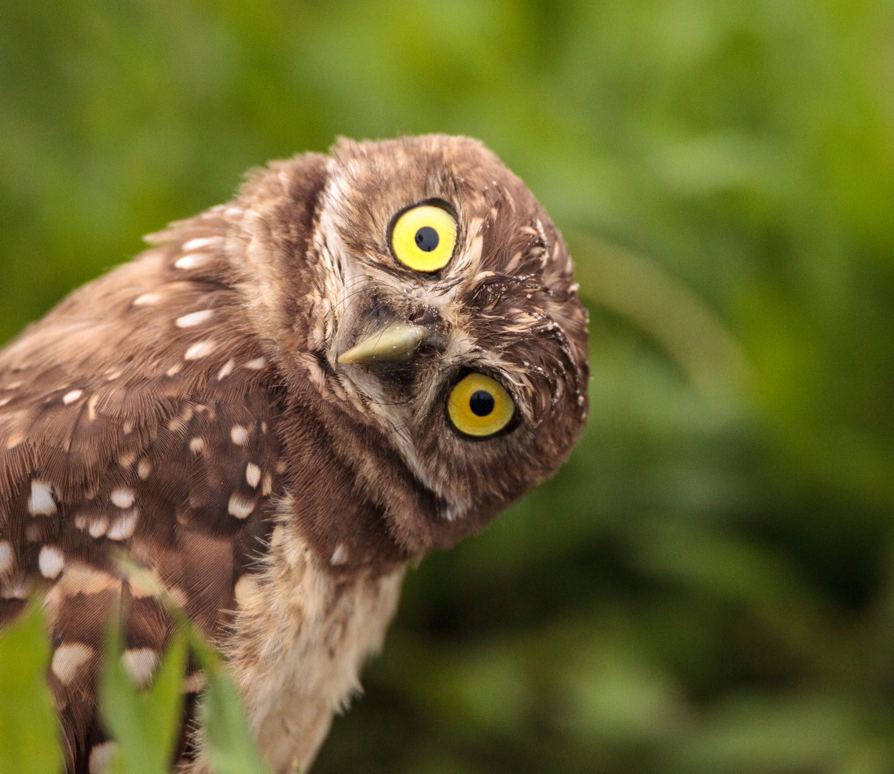
Any Questions?

