Slide 1
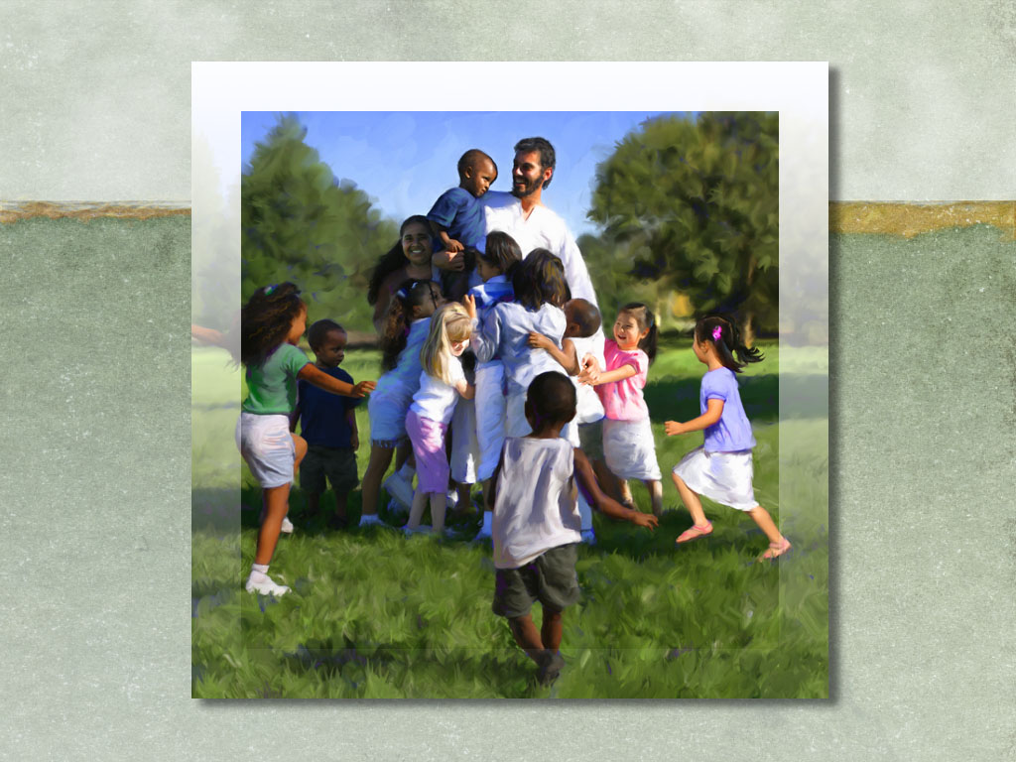
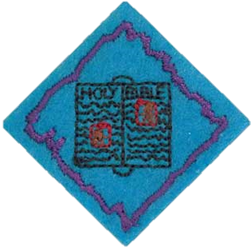
Bible Friends (EB)

Slide 2
Bible Friends
1. What does it mean to be a friend?
2. Name three Bible Friends.
3. Who is your favourite Bible friend?
Tell a story about that person.
4. Dress up and act out a story about a Bible friend.
5. Tell three things you can do to be a friend for Jesus.

Slide 3
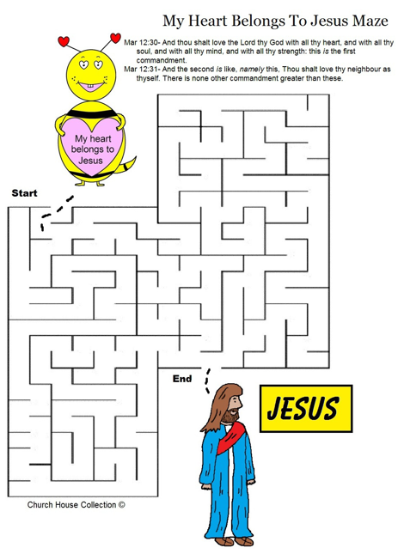
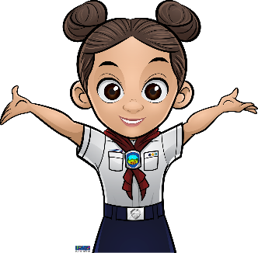

Slide 4
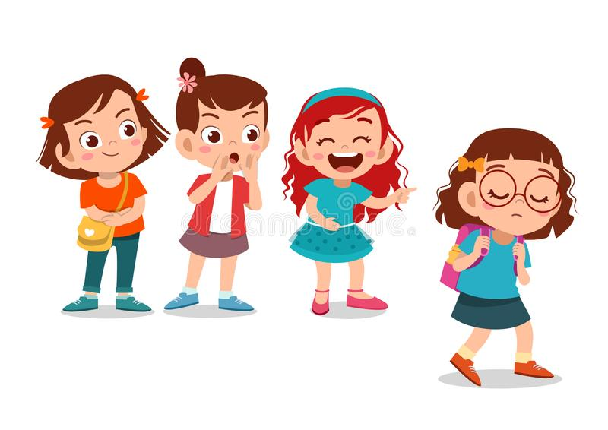
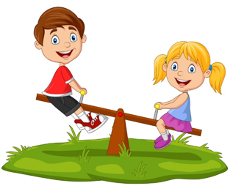
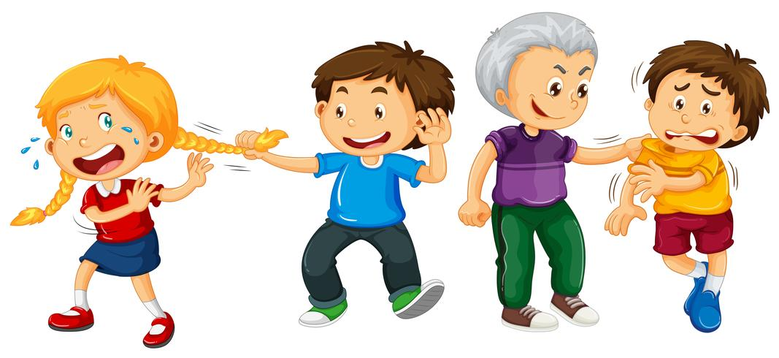
What does it mean to be a friend?
Play together

Slide 5
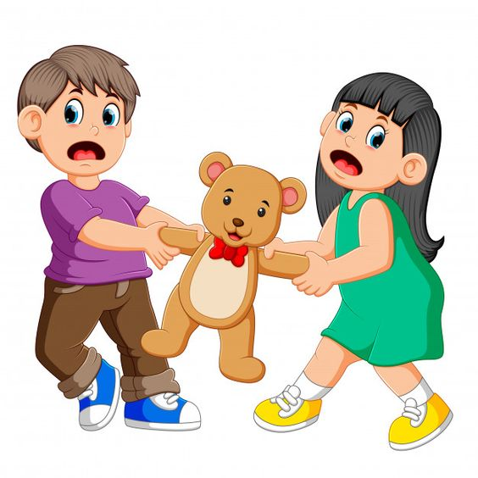
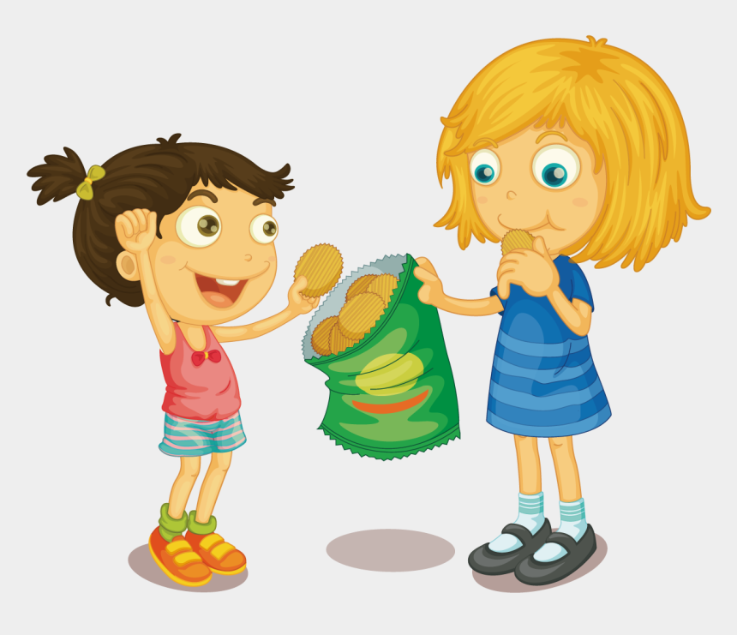
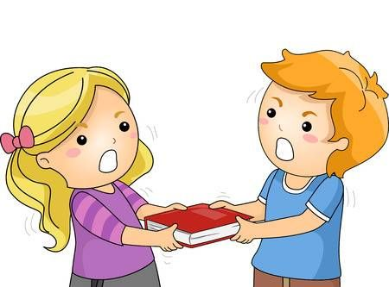
What does it mean to be a friend?
Share with each other

Slide 6
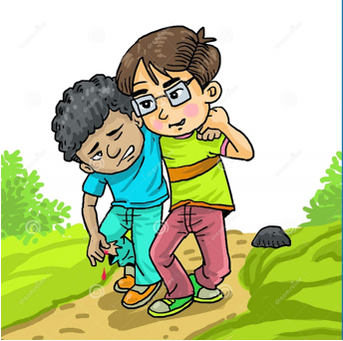
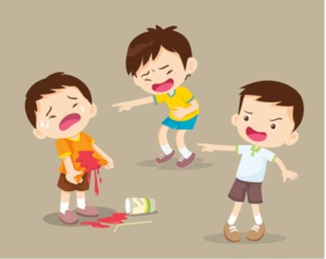
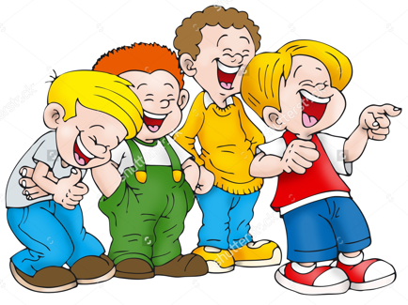
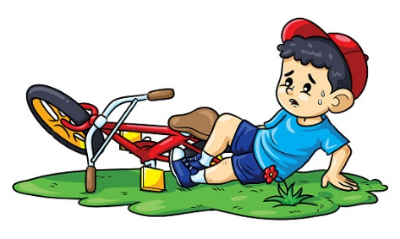
What does it mean to be a friend?
Help each other

Slide 7
What does it mean to be a friend?
Play together
Share with each other
Help each other

Slide 8
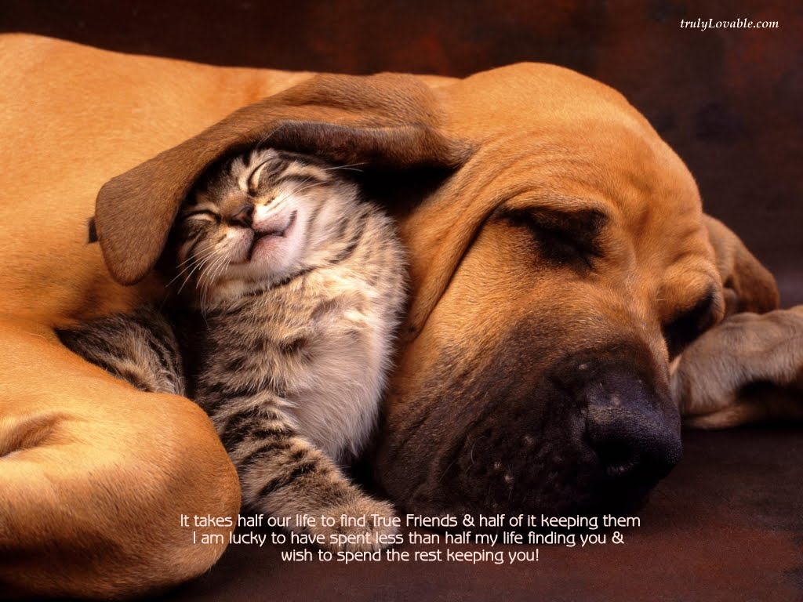
Name THREE friends in the Bible?

Slide 9
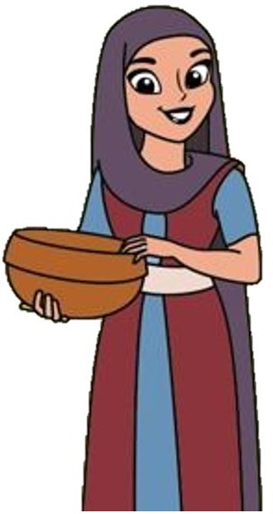
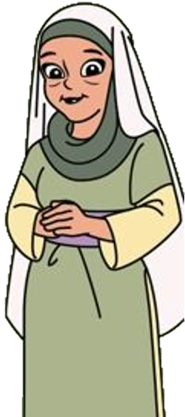
Ruth
Naomi

Slide 10
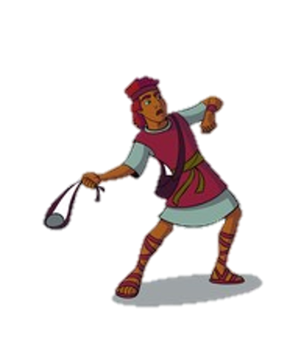
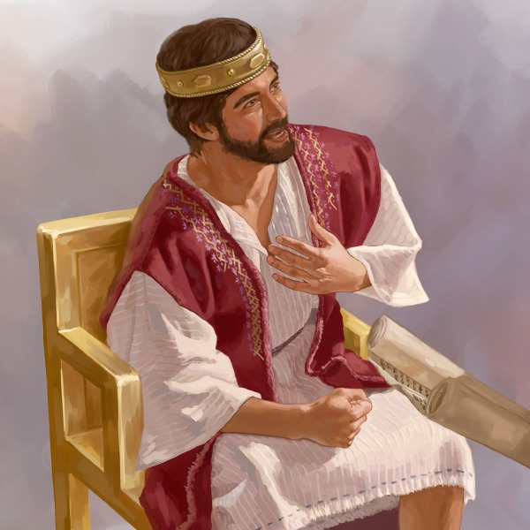
David
Jonathan

Slide 11
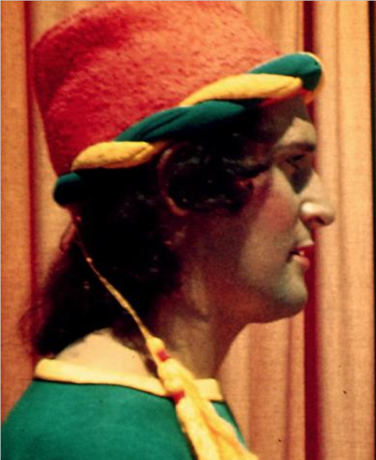
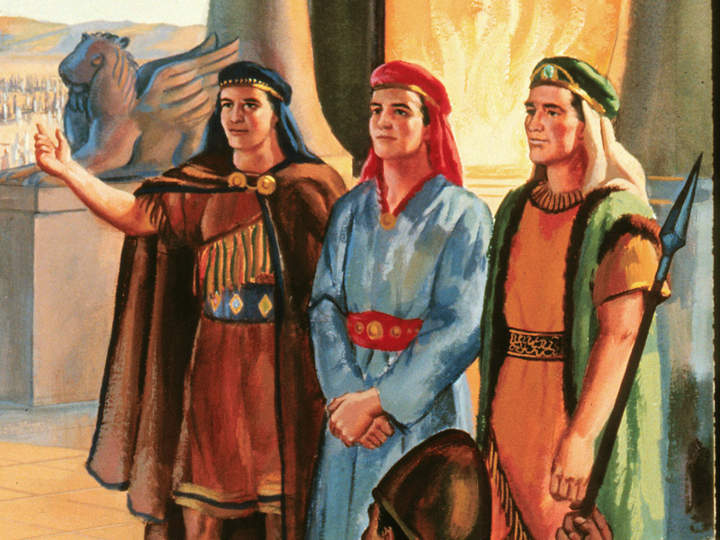
Daniel
Shadrach
Meshach
Abednego

Slide 12
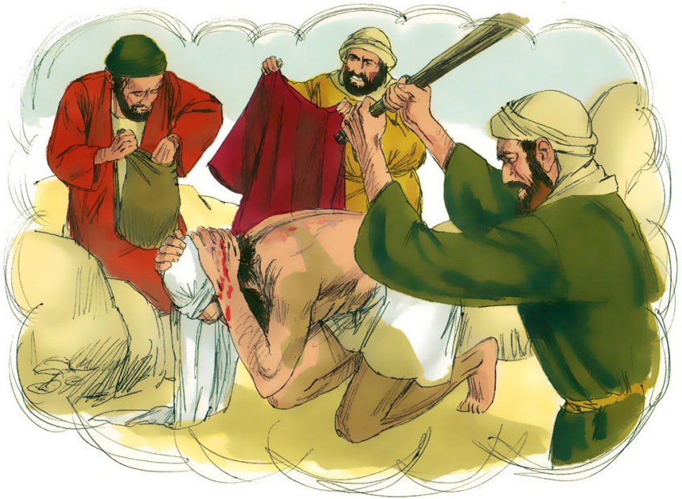
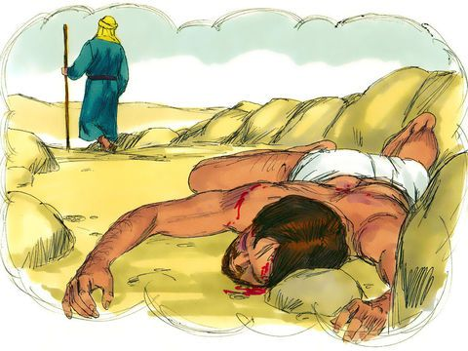
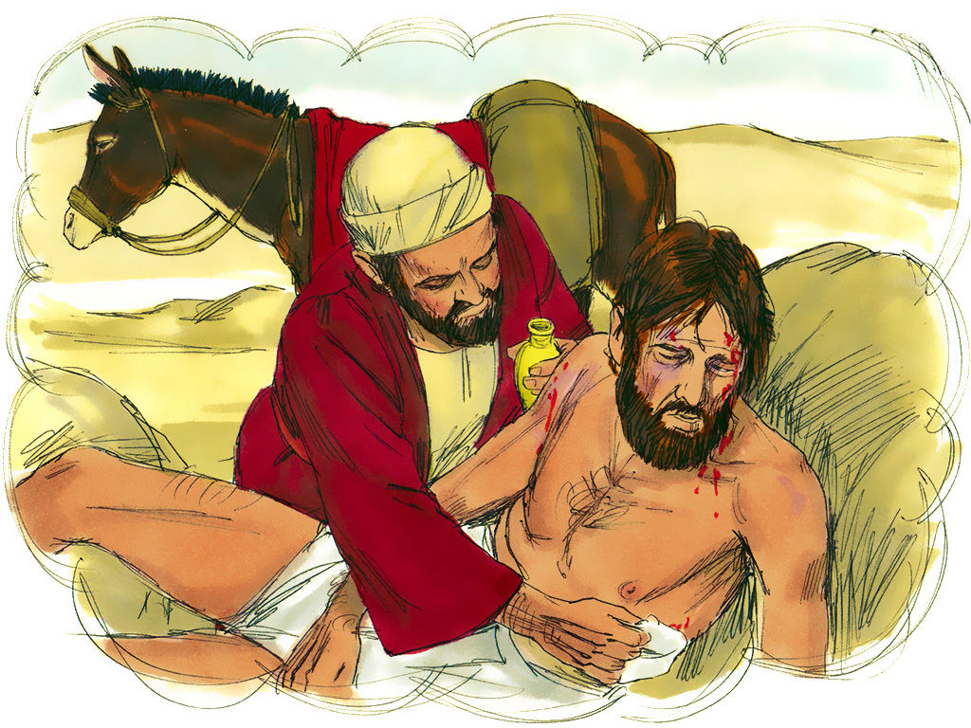
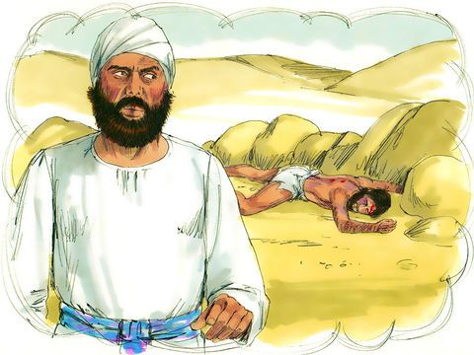
Name three Bible Friends
Priest
Thieves
Samaritan
Levite

Slide 13
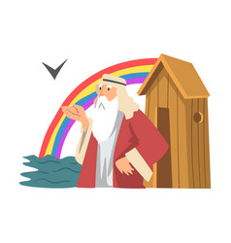
My favourite Bible FRIEND?
God asked me to build a big boat. He told me to fill it with all of my family and all the different animals. Who am I?

Slide 14
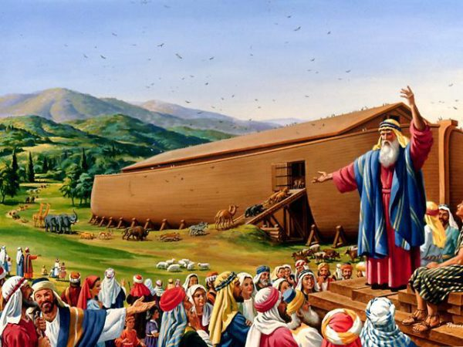
Noah

Slide 15
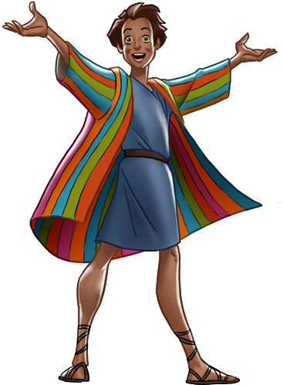
My favourite Bible FRIEND?
My father gave me a beautiful coat made of lots of different colours. My brothers sold me into slavery. Who am I?

Slide 16
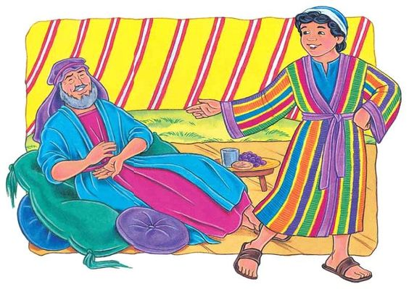
Joseph

Slide 17
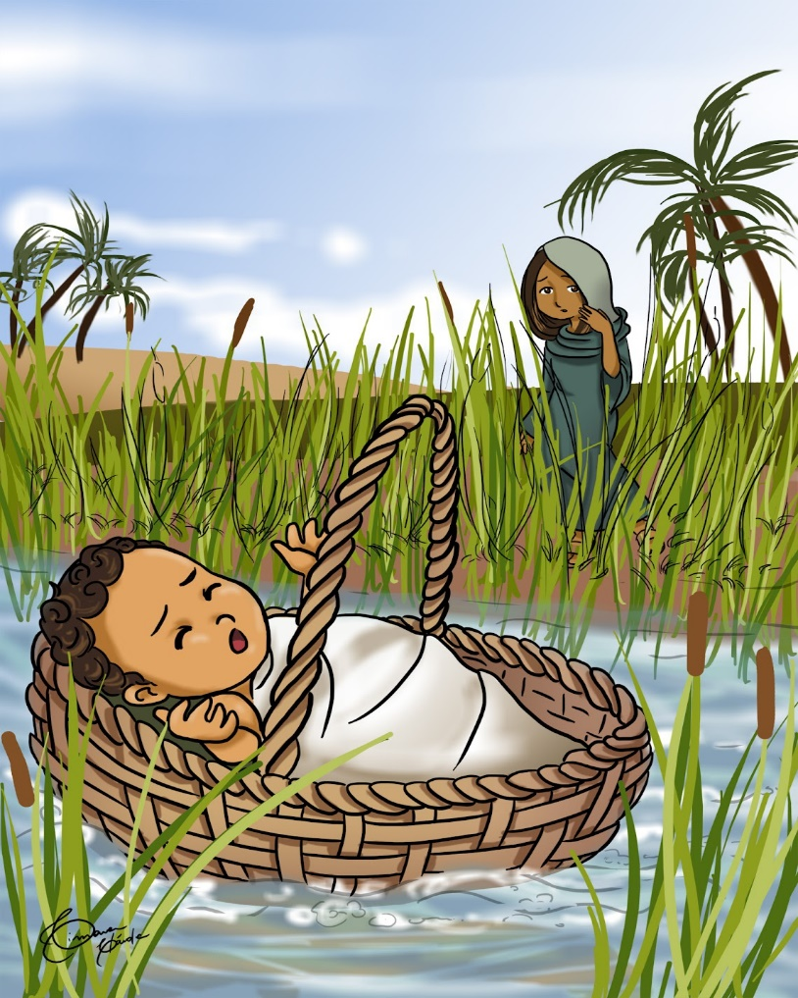
My favourite Bible FRIEND?
To save my life, when I was a baby, my mommy hid me in a basket. Later,
God gave me ten important
commandments. Who am I?

Slide 18
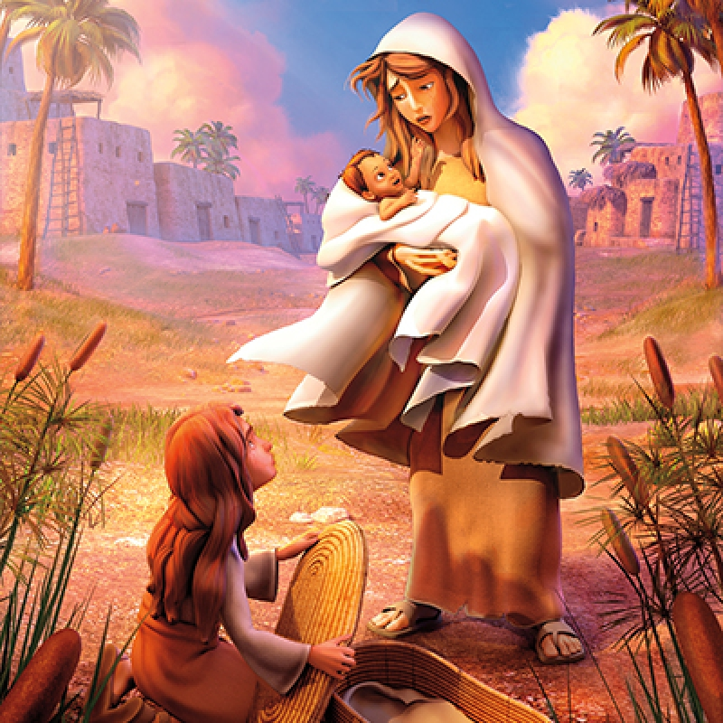
Moses

Slide 19
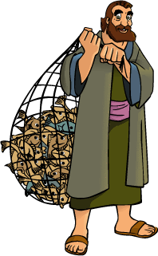
My favourite Bible FRIEND?
I was a fisherman and one of Jesus’ disciples. I was rescued out of prison by an angel. Who am I?

Slide 20
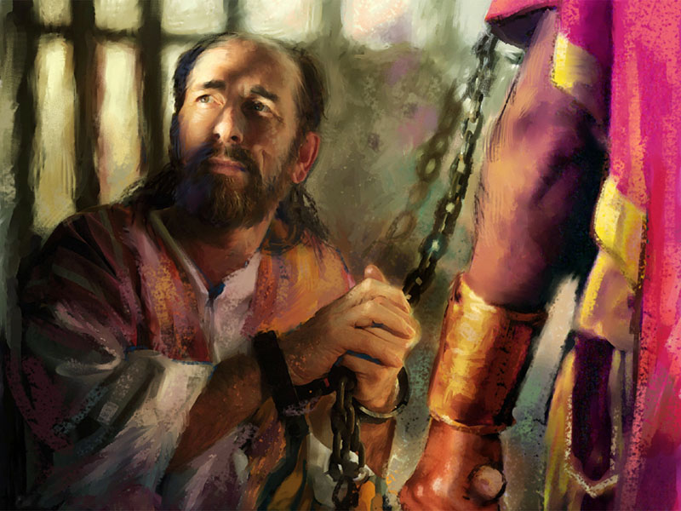
Peter

Slide 21
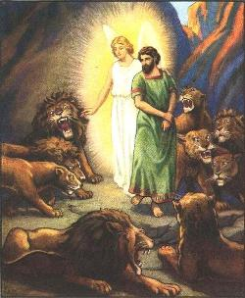
My favourite Bible FRIEND?
I loved to pray to God. Some people didn’t want me to pray, so they threw me into the lion’s den, but God protected me. Who am I?

Slide 22
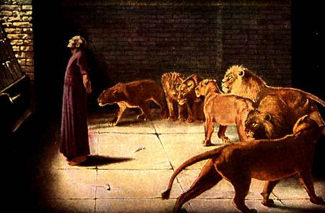
Daniel

Slide 23
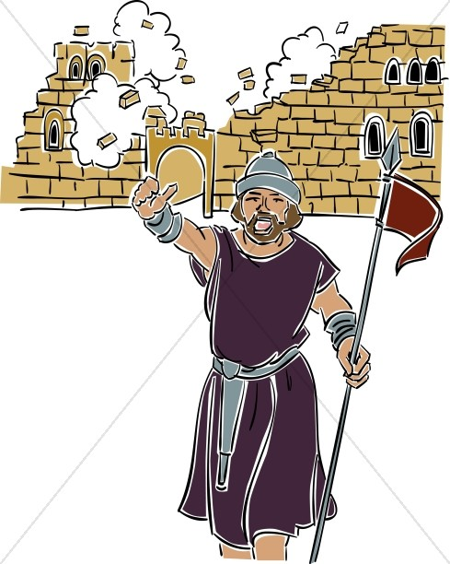
My favourite Bible FRIEND?
I was the leader of God’s people. I marched the people around Jericho and the walls came tumbling down. Who am I?

Slide 24
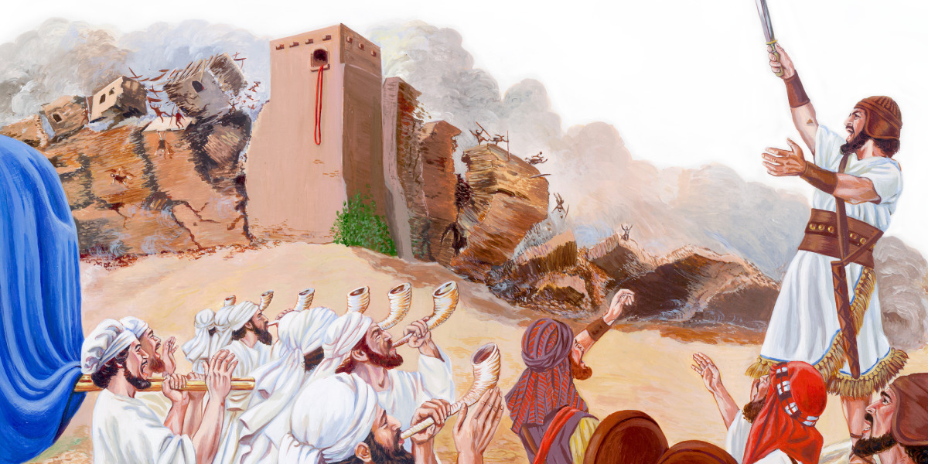
Joshua

Slide 25
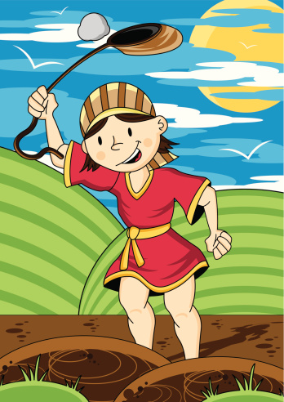
My favourite Bible FRIEND?
It’s amazing what God helped me to do with a pebble and a sling I got rid of a giant and eventually became king
Who am I?

Slide 26
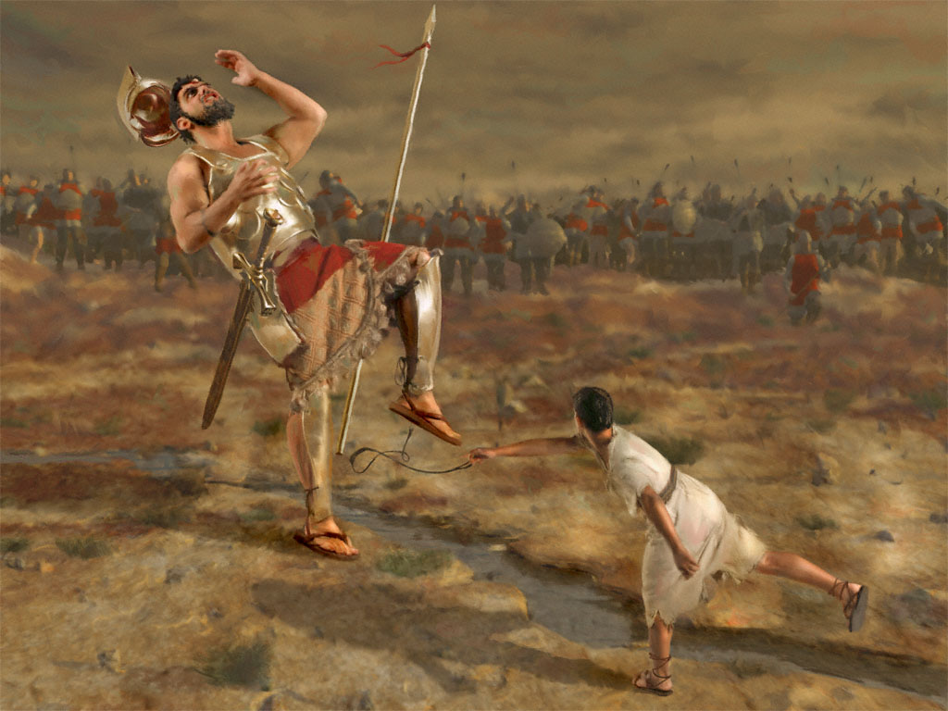
David

Slide 27
Tell a story

Slide 29
Dress up and act a story about a bible friend

Slide 30
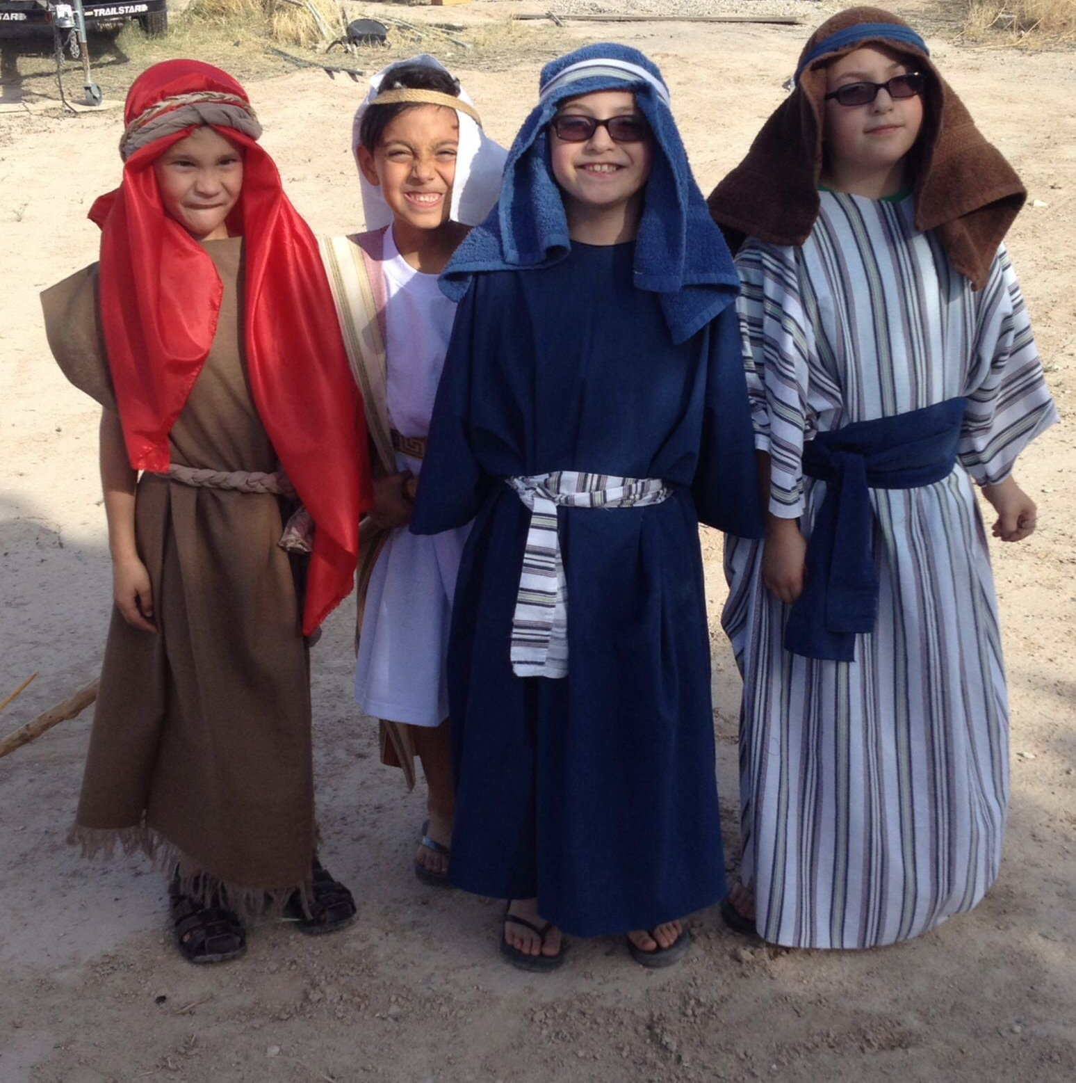

Slide 31
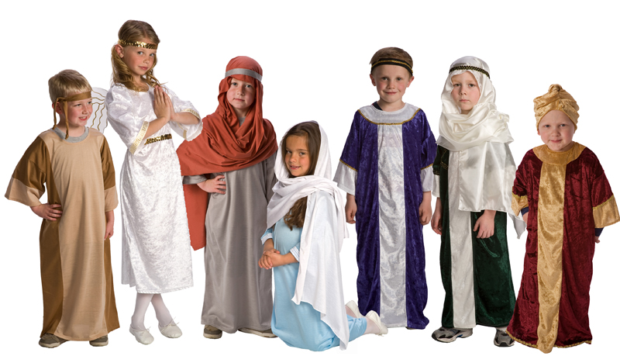

Slide 32
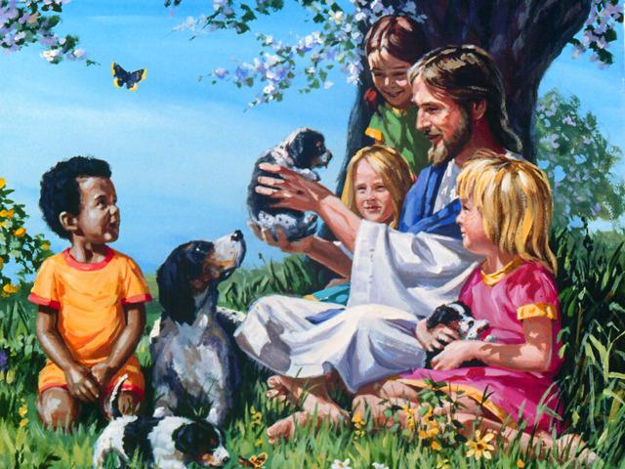
Three ways how we can be a friend for
Jesus

Slide 33
Be Obedient

Slide 34
Noah and the ark

Slide 35
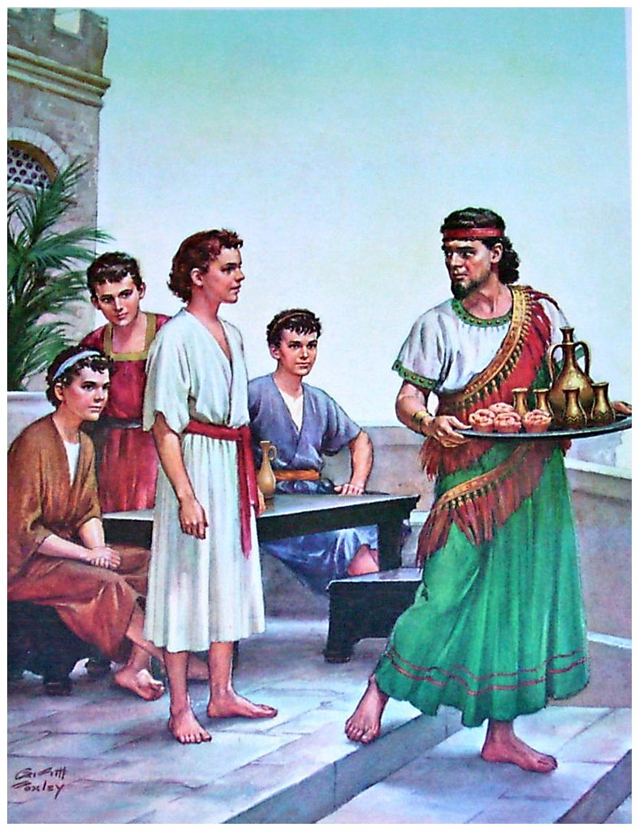
Be Pure

Slide 36
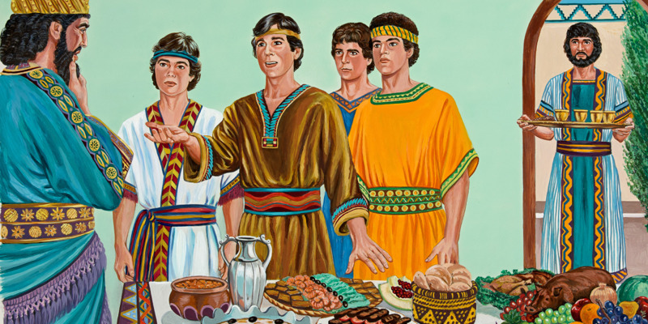
Daniel and his friends

Slide 37
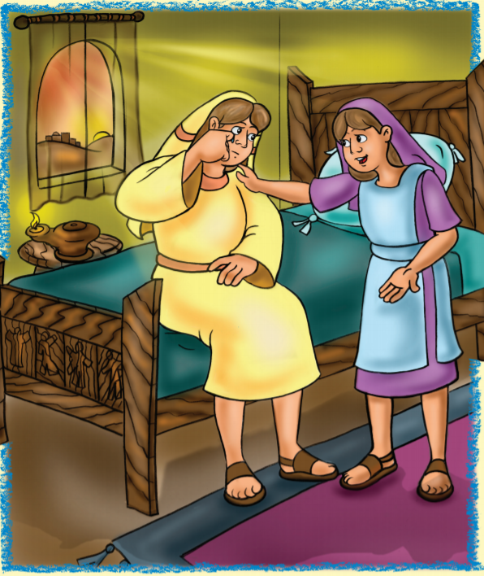
Be Kind

Slide 38
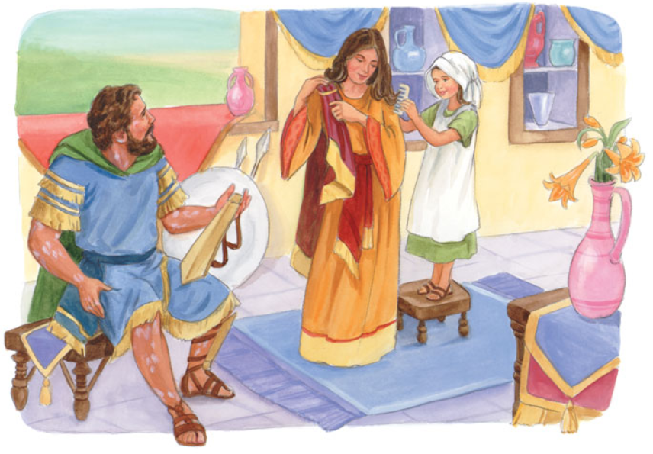
Little maid and Captain Naaman

Slide 39
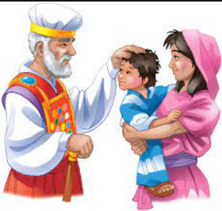
Be Helpful

Slide 40
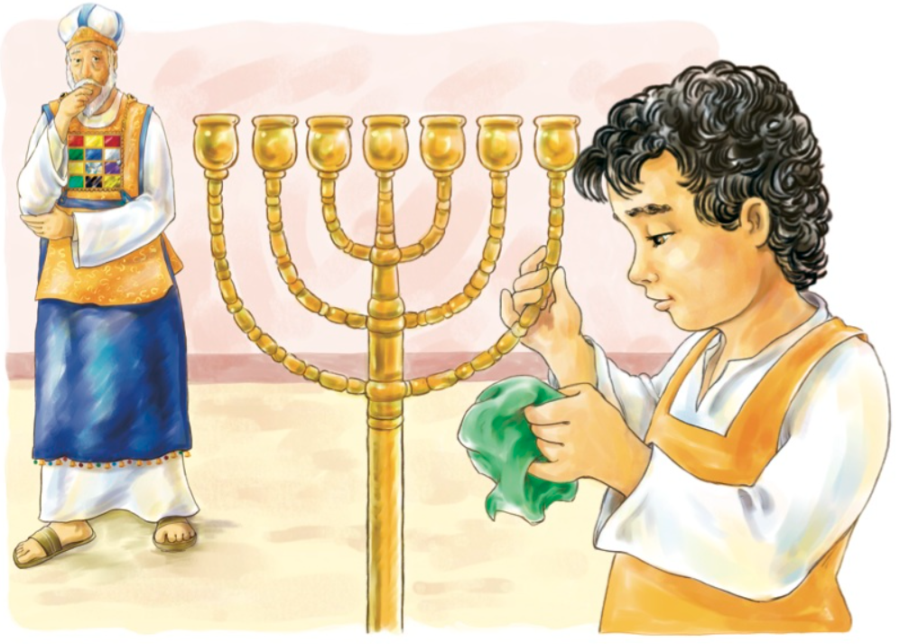
Samuel in the temple

Slide 41
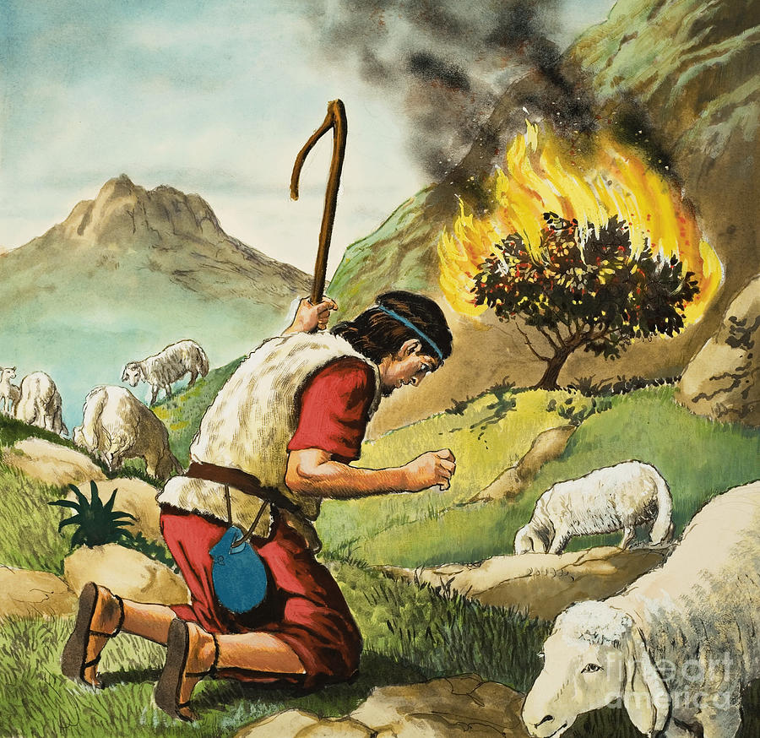
Be Reverent

Slide 42
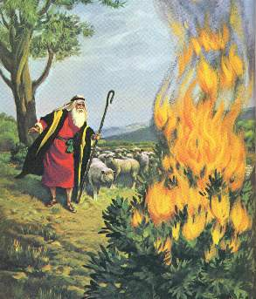
Moses and the burning bush

Slide 43
Jesus can help me to
Be obedient
Be attentive
Be pure
Be helpful
Be true
Be cheerful
Be kind
Be thoughtful
Be respectful
Be reverent

Slide 44
Art & Craft Time

Slide 45
Thank You!
Ilina Miller

