Slide 1
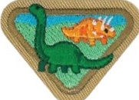
DINOSAURS
Notes:
Hello Adventurers! Are you ready to learn about dinosaurs? If you have a dinosaur toy or stuffed animal, feel free to have them join you while we learn about dinosaurs. Let’s get started.

Slide 2
Award Requirements
1. Make a booklet of at least 5 types of dinosaurs. Draw or find pictures and label them.
2. Read Genesis chapter 1. Find the verse(s) that say God created all the animals and every living thing. Discuss how everything God created at the beginning was perfect and there wasn’t even death.
3. How has sin affected all of nature in the world?
4. Discuss how some dinosaurs seem scary. Make a list or find pictures of other animals seen today that seem scary.
5. Who is a paleontologist and what is their work?
6. Discuss and/or look at the pictures of the evidence of dinosaurs that have been found: a. Bones & teeth b. Fossilized skin impressions c. Coprolite d. Footprints
7. What does the word “extinction” mean?
8. Why are so many creatures found buried and preserved in the fossil record? Read Genesis 7:20-23
9. Play a game
Notes:
Let’s look at our requirements! WOW that looks like a lot of things to complete! But don’t worry, you’ll be able to do pretty much everything in the next 45 minutes. So, let’s see what you will learn today: (read requirement from screen)

Slide 3
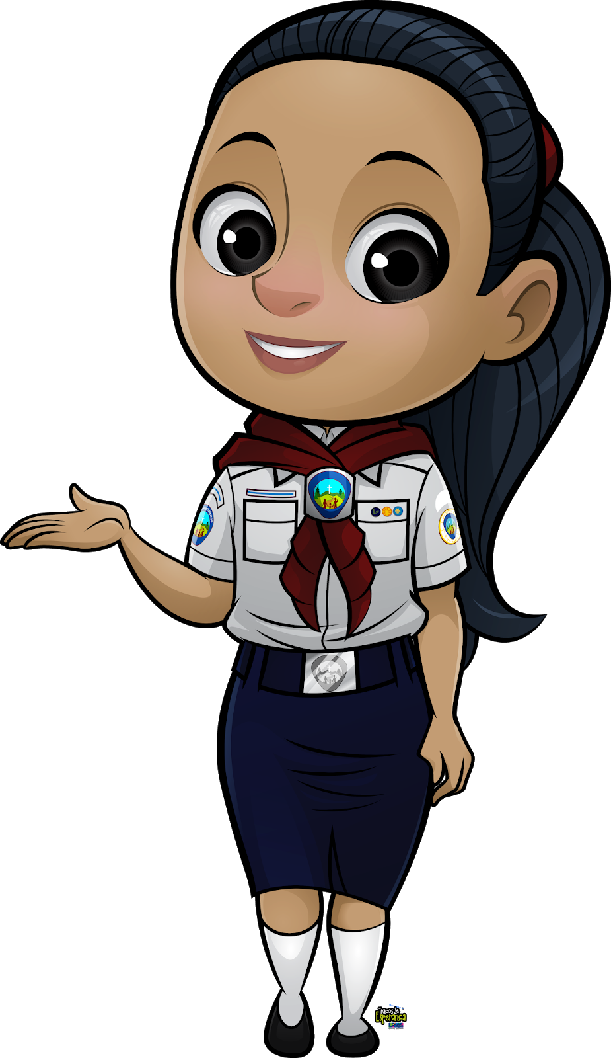
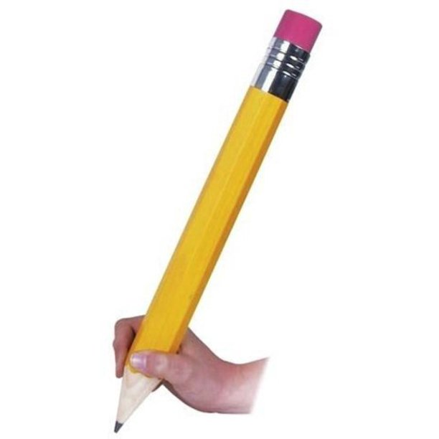
Your Booklet
Notes:
Alright! We are going to have a lot of fun today! I hope everyone has their booklet printed out and ready. If you don’t and you have a printer at home, try and print it out quickly. On each slide I’ve put a picture of the page we will be working on, that will make it easier for you to follow along.
Get your pencils ready, you’ll need something to write with.

Slide 4
Notes:
Through out the presentation I will ask Yes or No questions. For No, you will simply shake your head no. If your answer is Yes, you will Roar like a ferocious dinosaur. Let’s try it. Are you ready to get started? ROAR – Wow I see so many Adventurers roaring. Let’s get started.

Slide 5
Genesis 1
20-25
Notes:
When we start to investigate a topic, it is always good practice to see what the bible has to say. So, If you have your bible close by, we’ll be exploring the first chapter of the first book of the bible. Do you know what the first book of the bible is? ROAR – it’s Genesis. Very good.
²⁰ Then God said, “Let the waters be full of living things. Let birds fly above the earth in the open space of the heavens.” ²¹ God made the big animals that live in the sea, and every living thing that moves through the waters by its kind, and every winged bird after its kind. And God saw that it was good. ²² God wanted good to come to them, saying, “Give birth to many. Grow in number. Fill the waters in the seas. Let birds grow in number on the earth.” ²³ There was evening and there was morning, the fifth day.
²⁴ Then God said, “Let the earth bring into being living things after their kind: Cattle and things that move upon the ground, and wild animals of the earth after their kind.” And it was so. ²⁵ Then God made the wild animals of the earth after their kind, and the cattle after their kind, and every thing that moves upon the ground after its kind. And God saw that it was good.
*If you are completing this at home, please read the whole chapter 1 of Genesis.

Slide 6
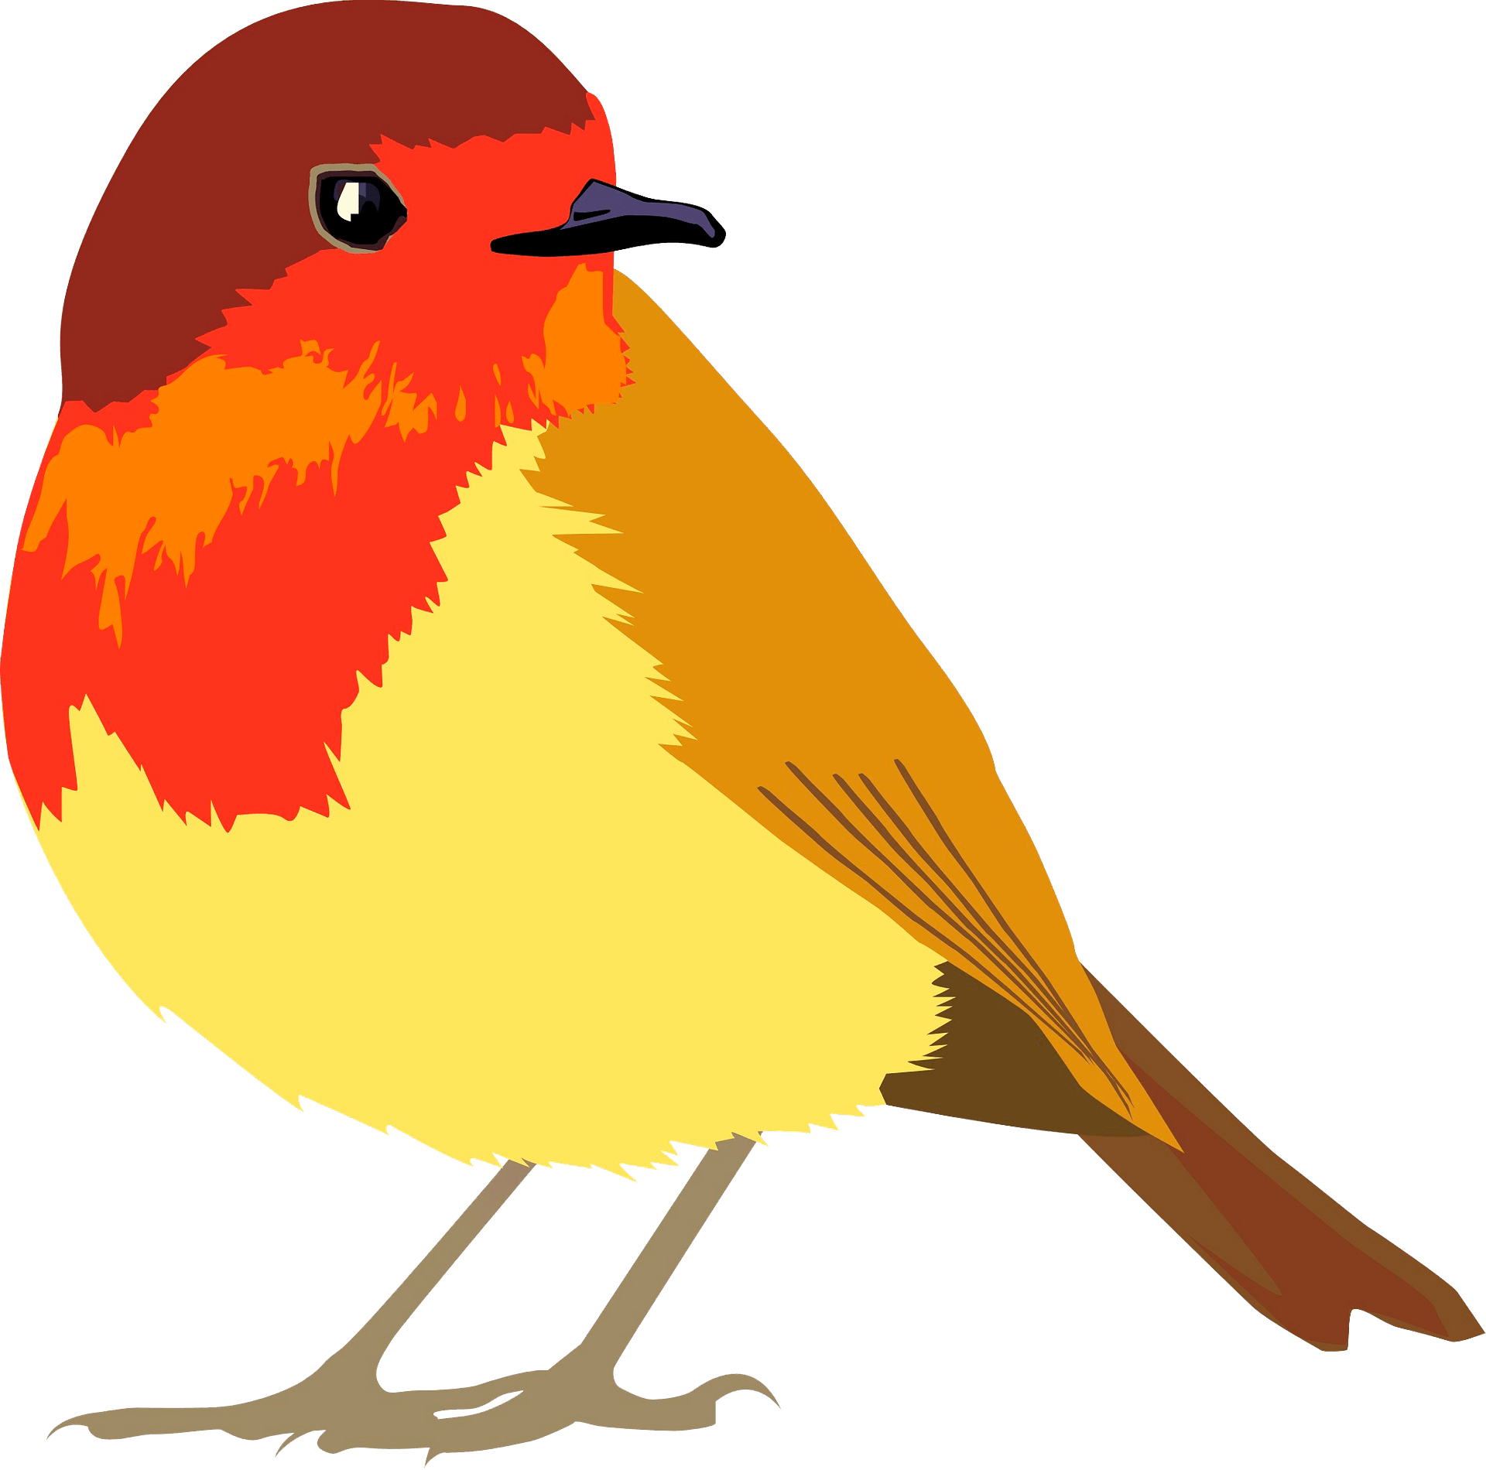
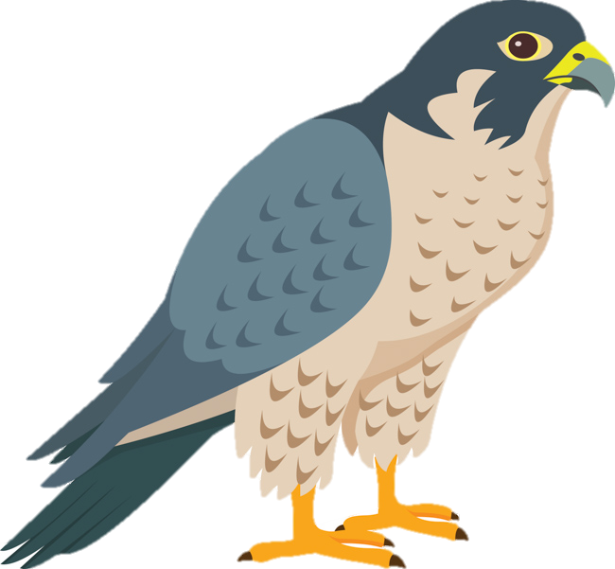
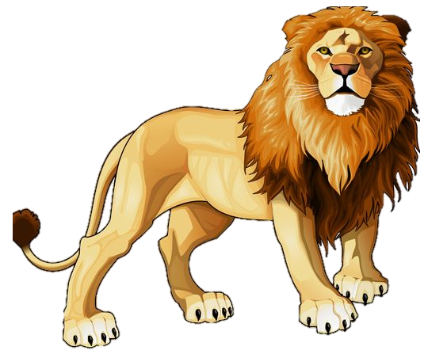
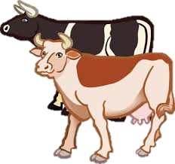
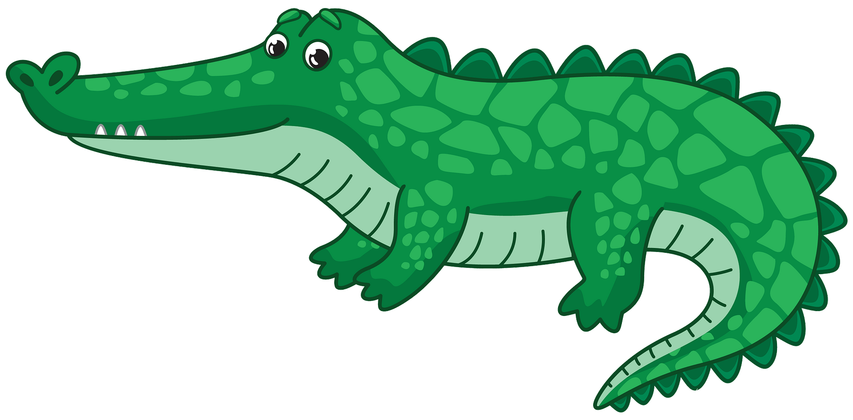
Notes:
Click through this slide as you read Genesis 1:20-25

Slide 7
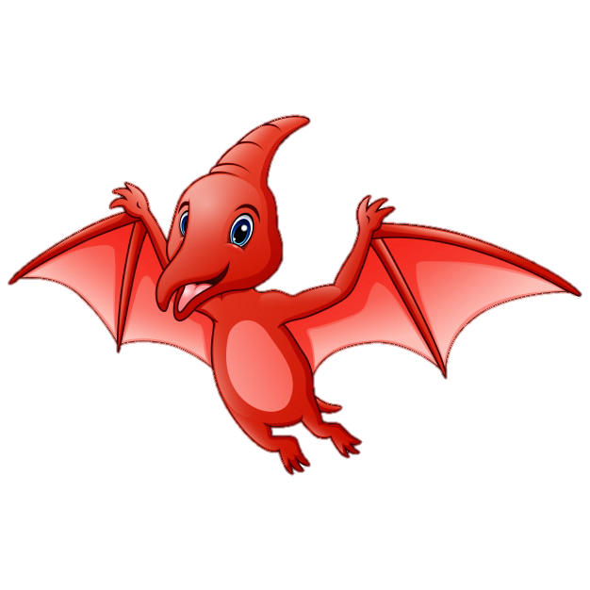
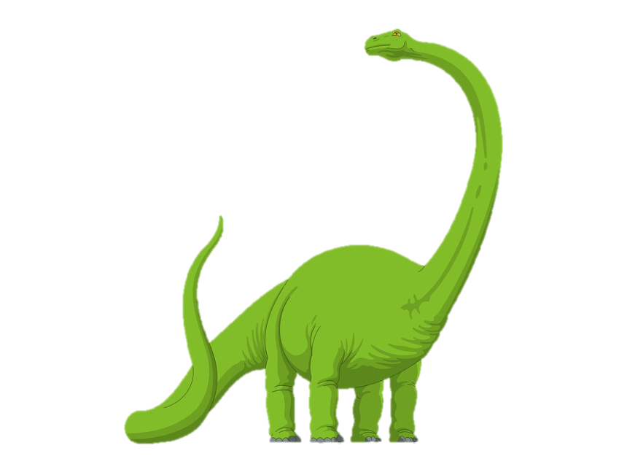
Notes:
God created ALL Creatures. There is no other being in the universe that has the power to create living things!

Slide 8
Notes:
After sin entered the world, everything changed. God’s perfect creation wasn’t perfect anymore. The punishment for sin brought death, disease, pain and suffering. We are going to see in a little bit, how some things seem scary, but let’s take a little break.

Slide 9
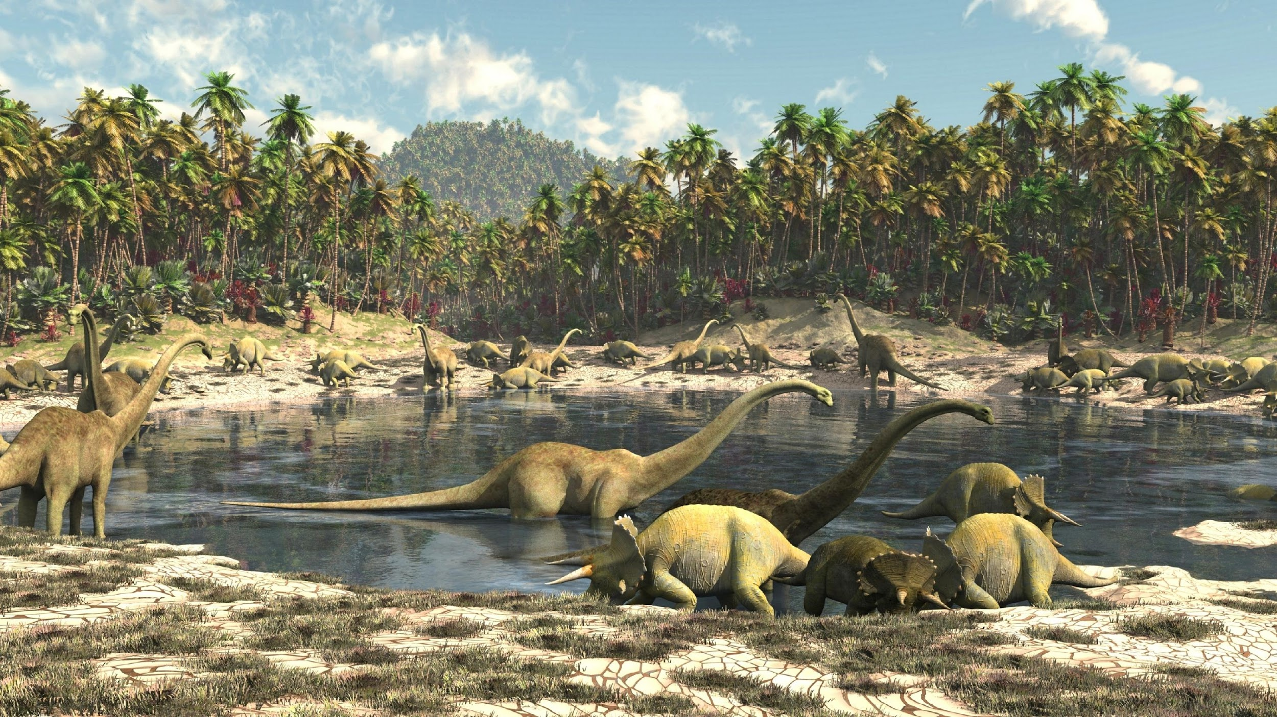
Notes:
Let’s play a little game. Get your HAND Binoculars, look at this image, and count how many dinosaurs can you see.

Slide 10
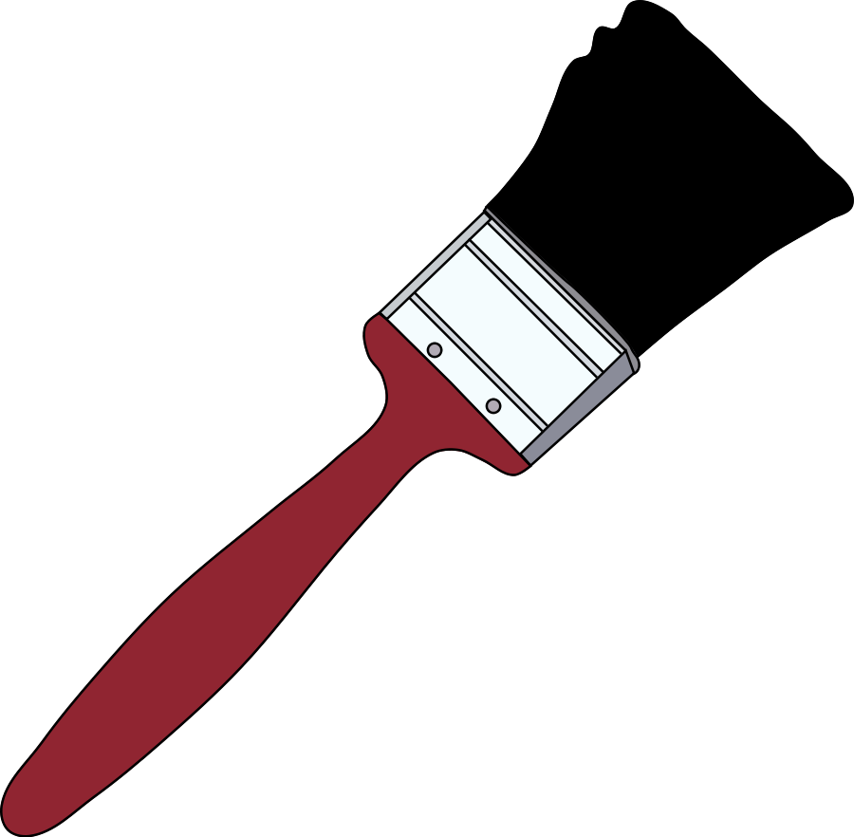
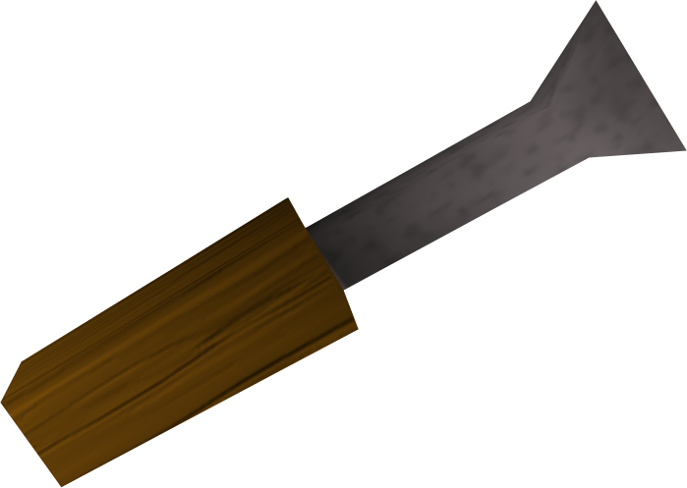
Who is a Paleontologist?
a scientist who studies the history of life on Earth through the fossil record.
Notes:
Who is a Paleontologist? You can write down the answer in your booklet or simply draw items that they use (READ DEFINITION)

Slide 11
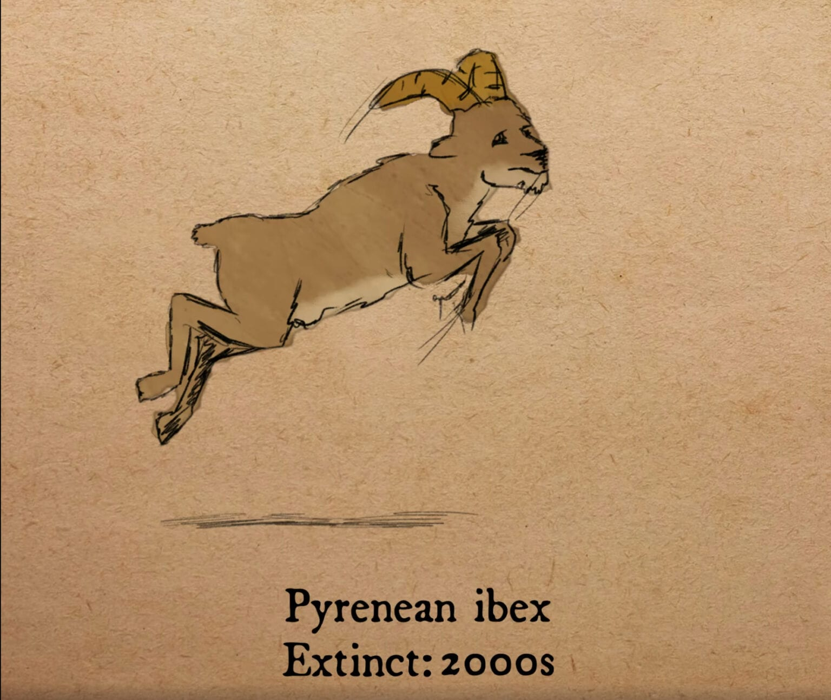
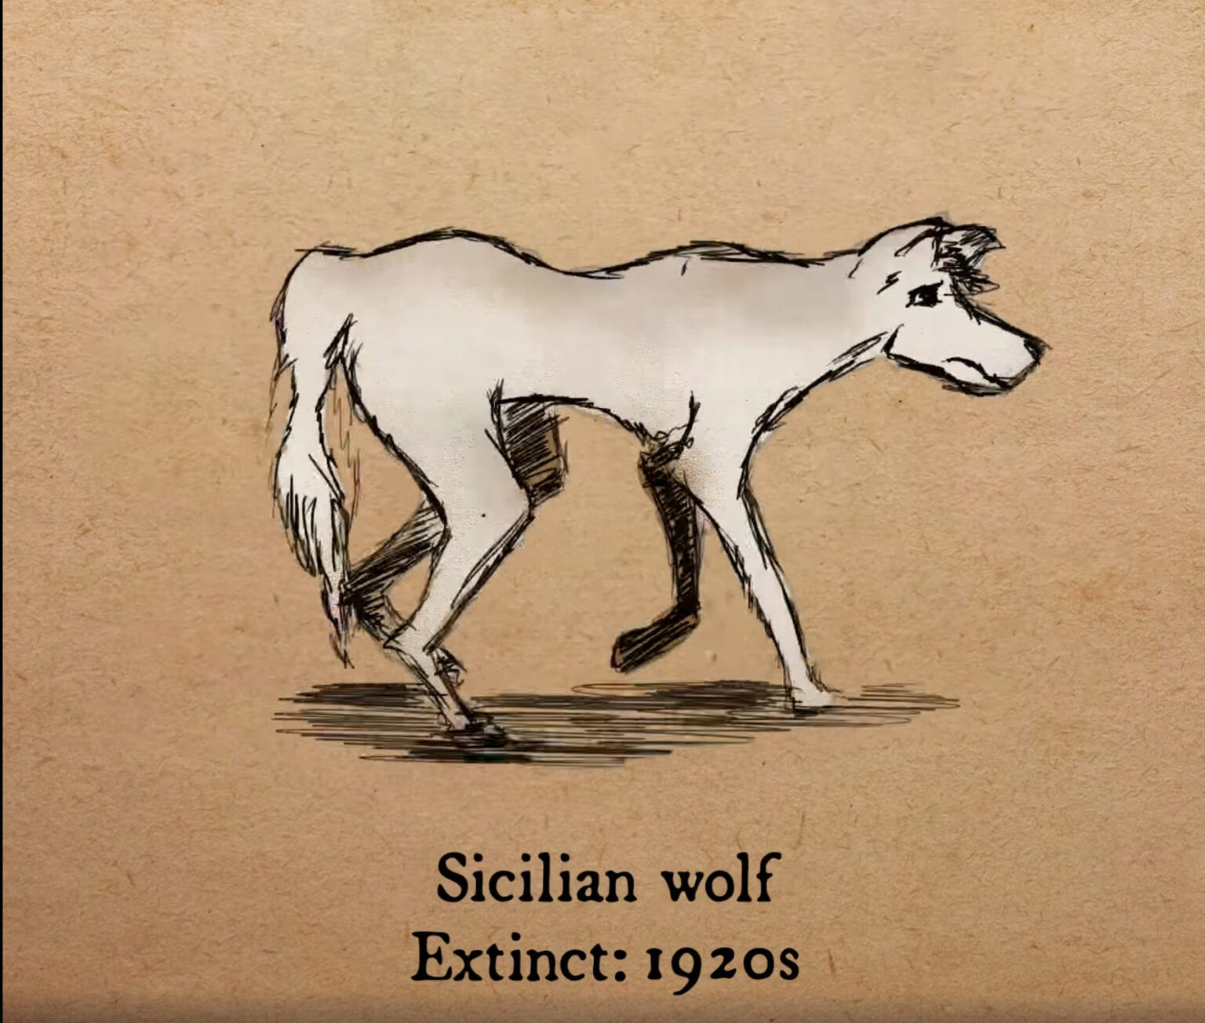
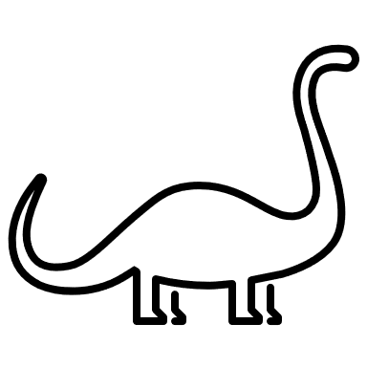
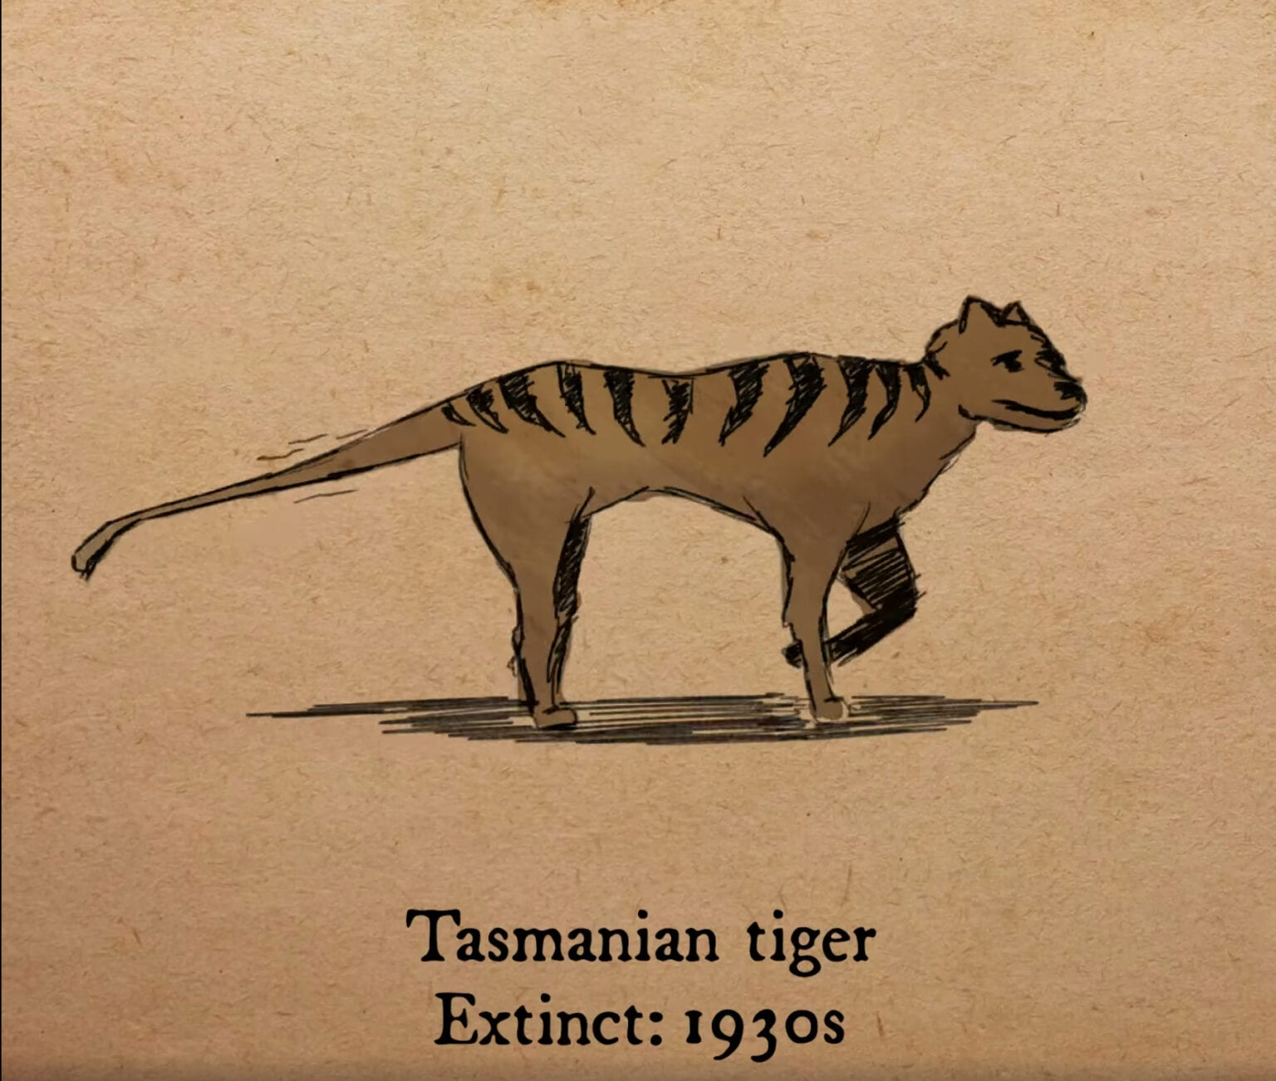
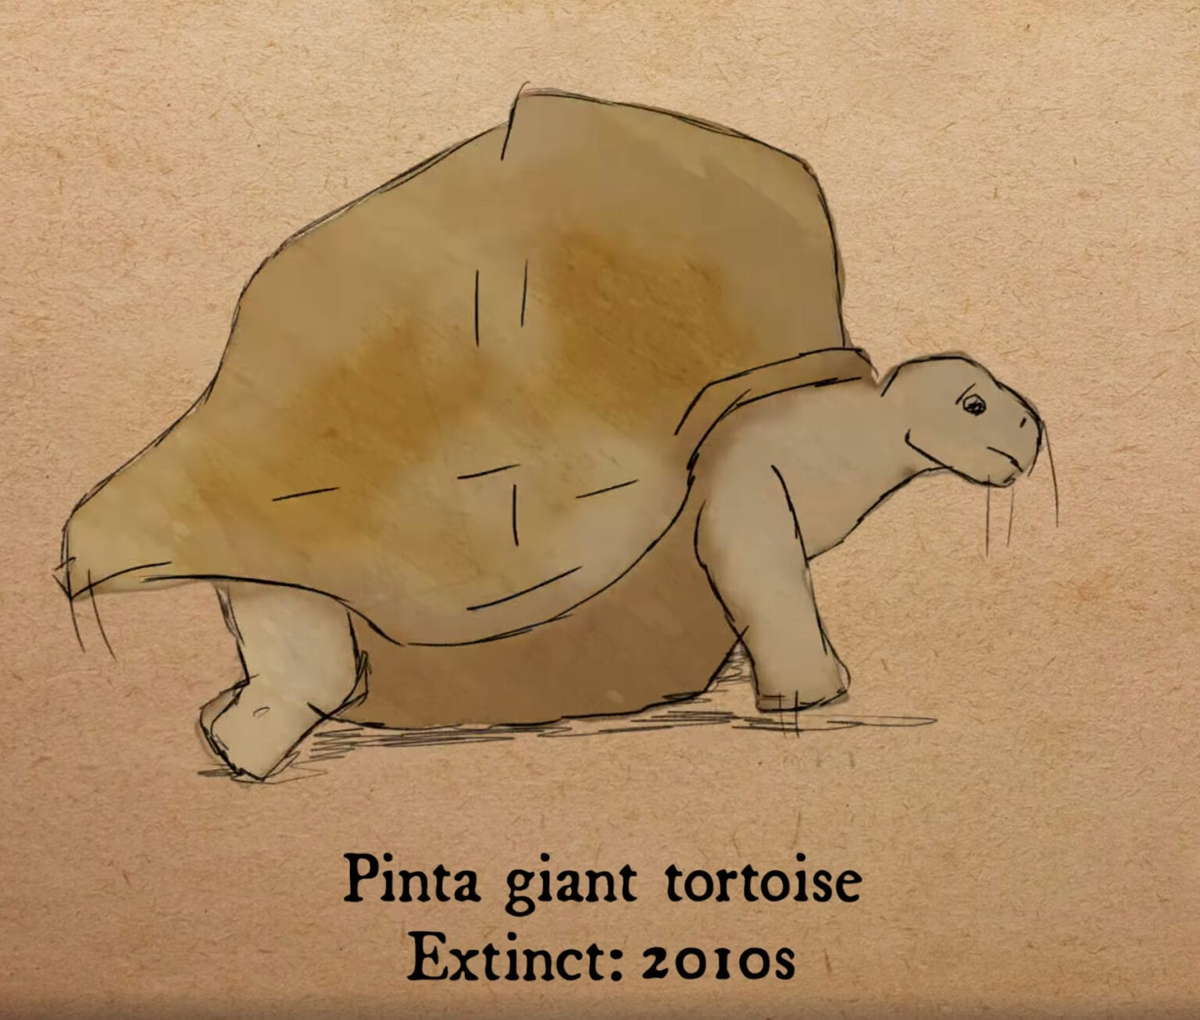
What does Extinct mean?
having no living members;
no longer in existence.
Notes:
What does Extinction mean? You can write out the definition in your booklet if you know your letters, or draw an animal and cross it out. (READ DEFINITION)

Slide 12
Name that Scary Animal
Notes:
Sin really messed things up, and now we live in a world where there are many scary things. Let’s get our HAND Binoculars out again and play a scary game. You will see a silhouette of an animal, if you know what it is, just give a big ROAR. Are you ready? ROAR

Slide 13
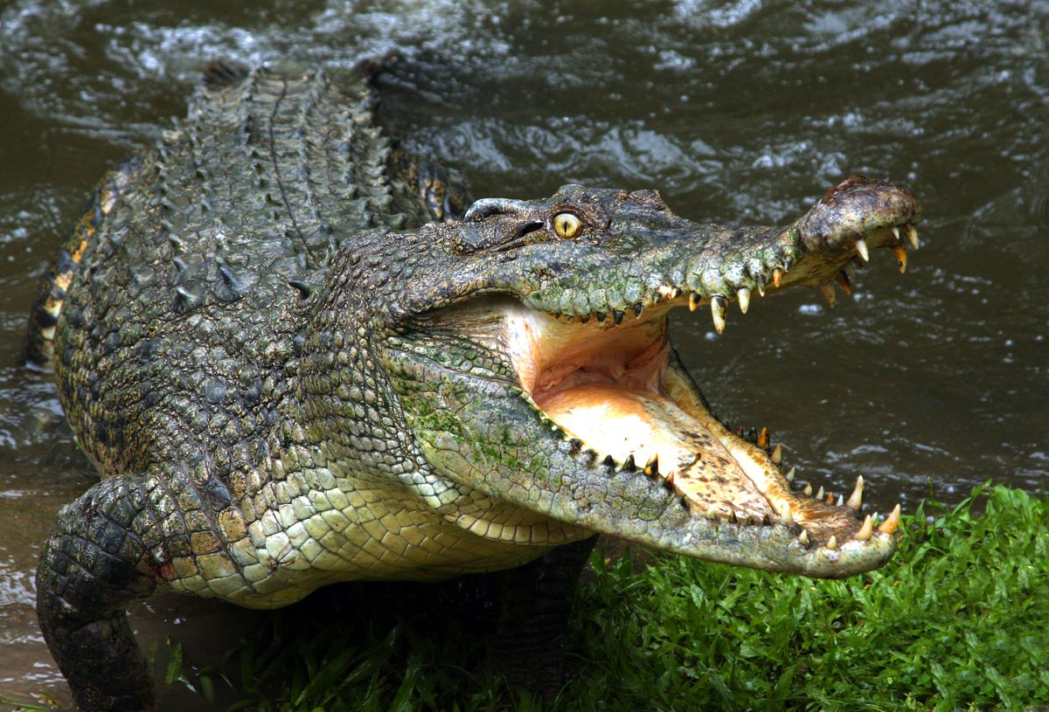
Scary animals today
Notes:
Alligator

Slide 14
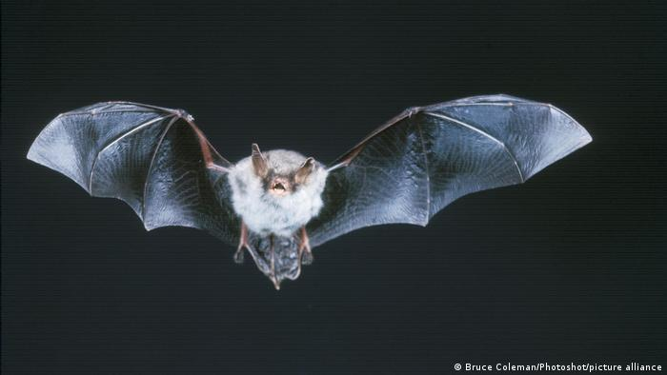
Scary animals today
Notes:
bat

Slide 15
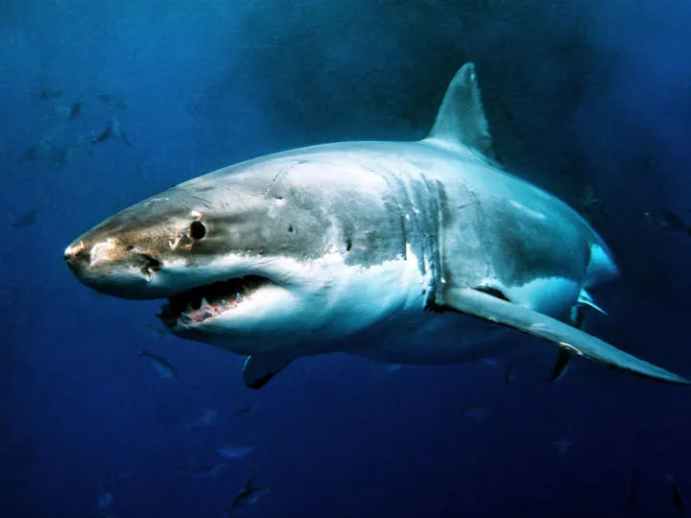
Scary animals today
Notes:
shark

Slide 16
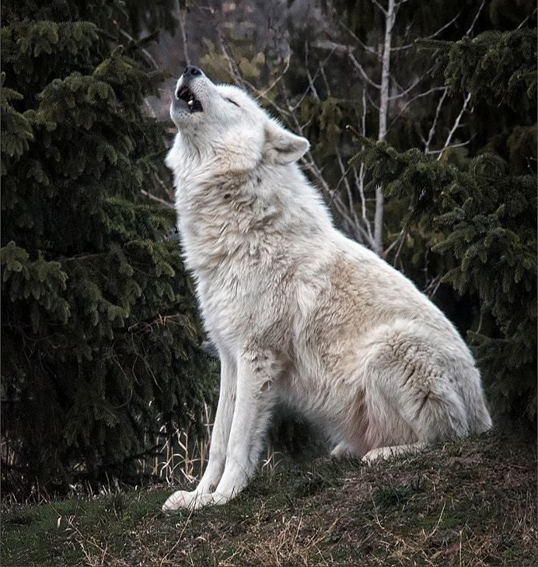
Scary animals today
Notes:
wolf

Slide 17
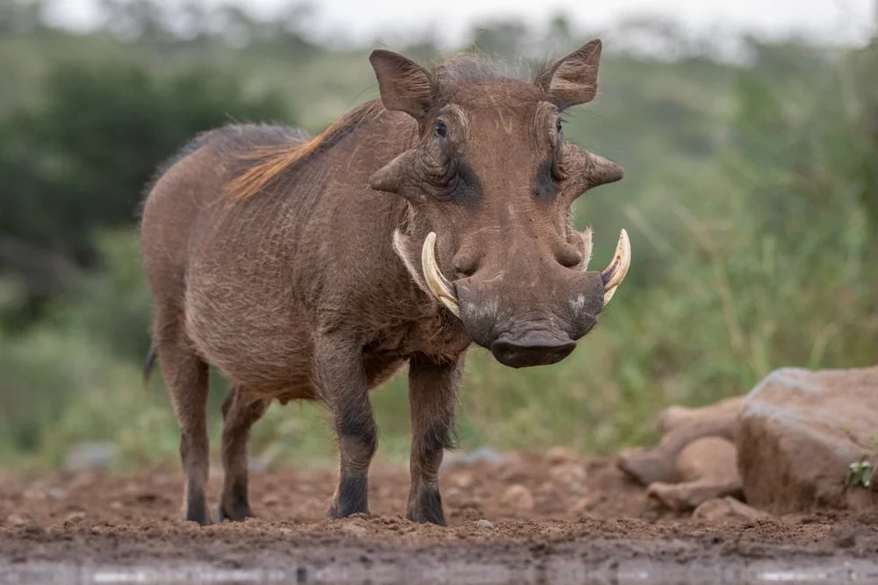
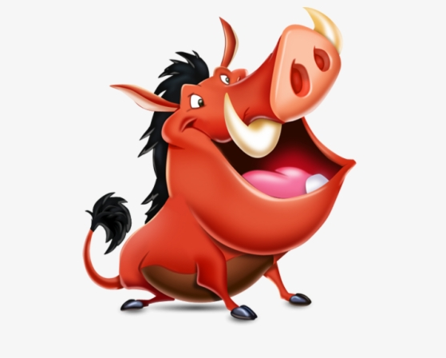
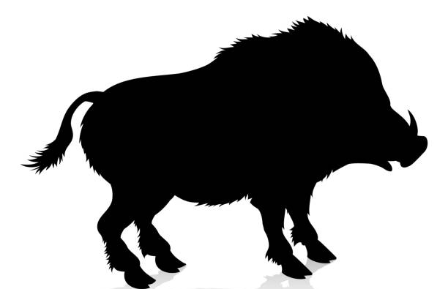
Scary animals today
Notes:
warthog

Slide 18
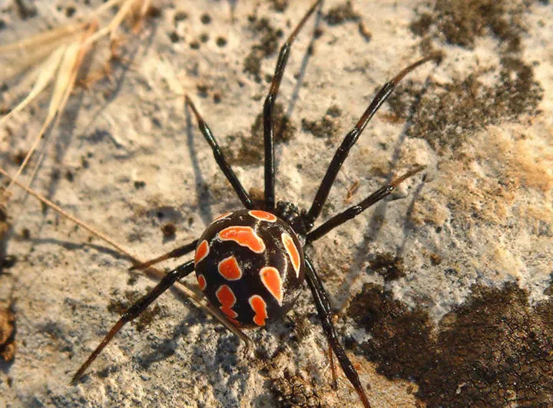
Scary animals today
Notes:
Spider (Mediterranean black widow)

Slide 19
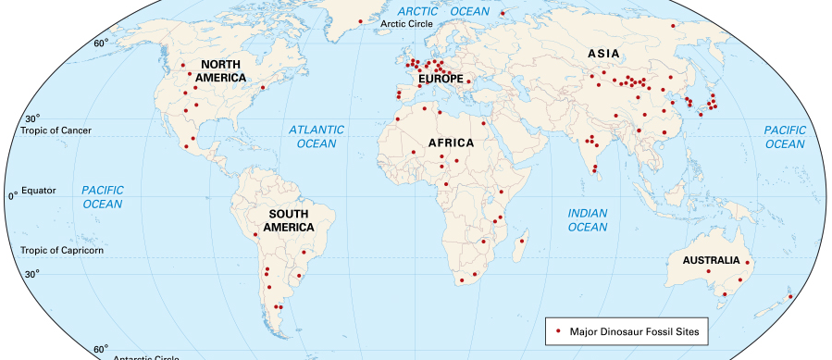
Evidence of Dinosaurs
Notes:
WOW that was scary…. shake it off if you need too! Now let’s jump into some evidence that Paleontologists have found that tell us a little bit of the world before dinosaurs were extinct.

Slide 20
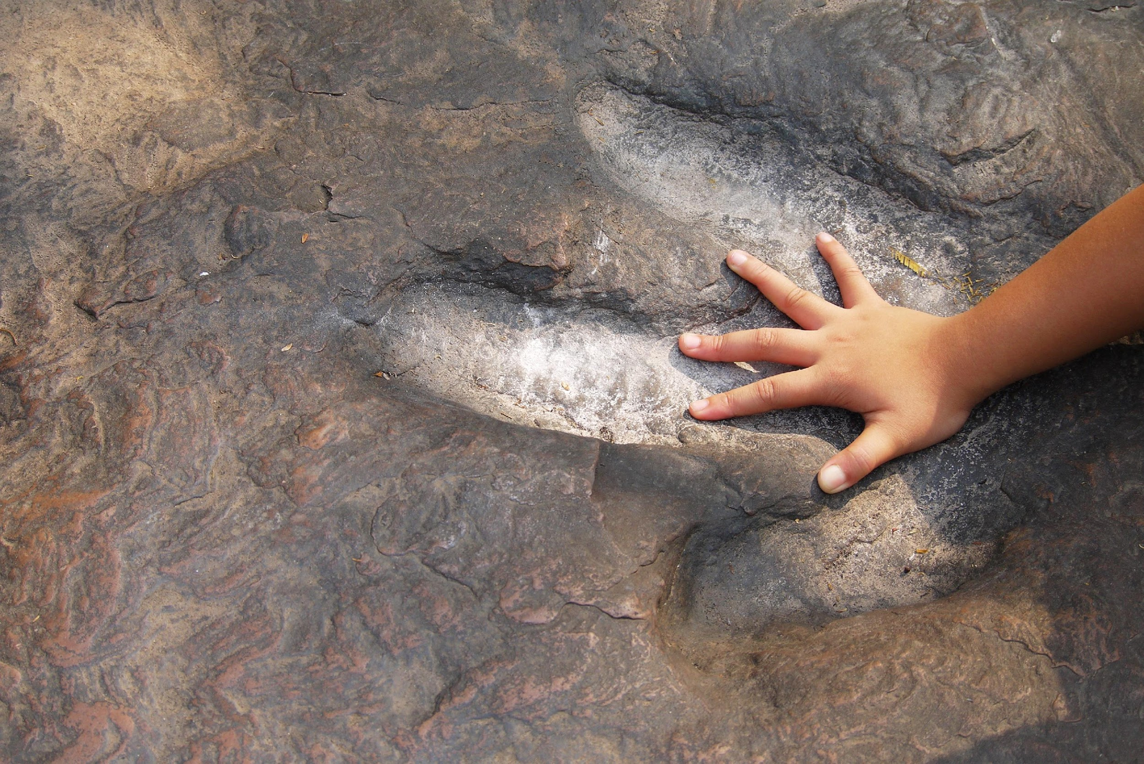
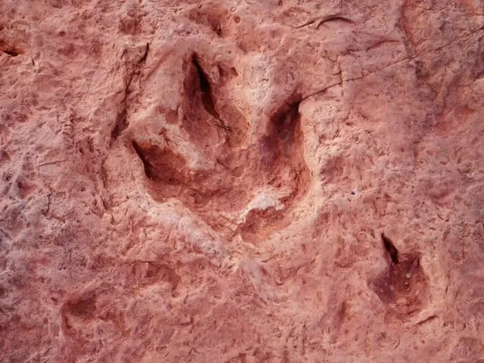
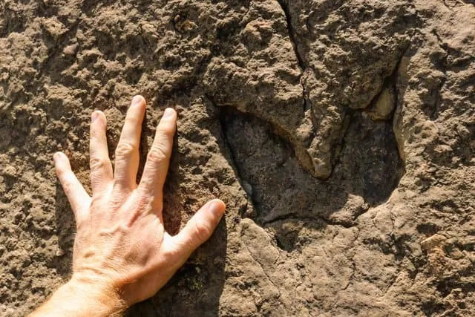
Footprints (ichnite)
Notes:
There have been many footprints found. The most recent footprint, you may have heard in in the news, it was discovered by a four year old girl on a beach with her dad in Wales. There are actually hundreds of tracks that have been found around the world. Over where you live there are quite a bit more than here in America.

Slide 21
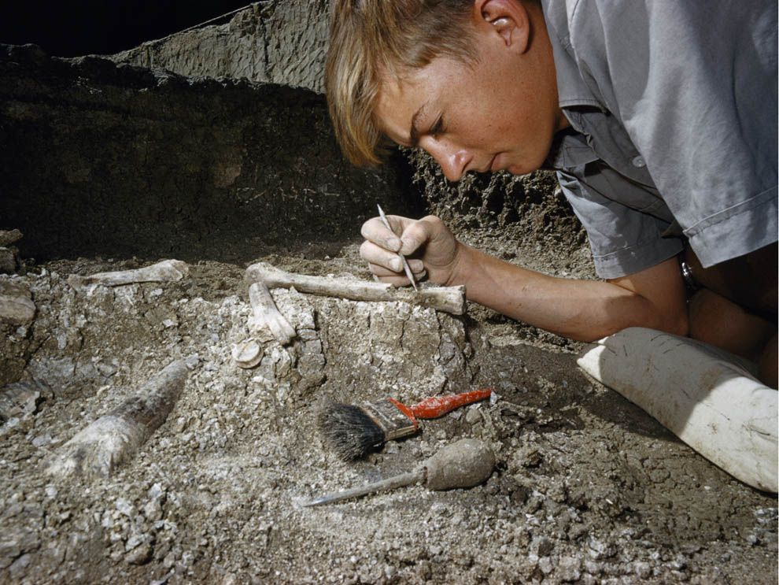
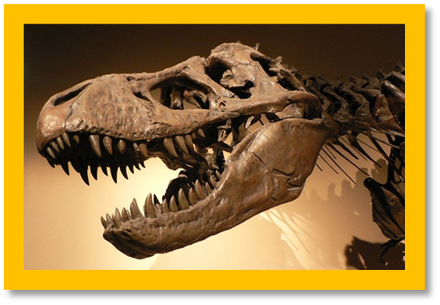
Bone & Teeth
Notes:
Bones: Large bones and partial skeletons have been found throughout the world. The largest belongs to a T-Rex named Sue. She is the most extensive and best-preserved T-Rex ever found. You can find her on display at the Field Museum of Natural History in Chicago.
Teeth: Tyrannosaurus Rex teeth were the longest.
The longest dinosaur tooth ever recorded belonged to a T. Rex, and they were a whopping 12 inches long! (30cm) This measurement includes the tooth’s root though, so the exposed part of the tooth was 6 inches long (15cm)

Slide 22
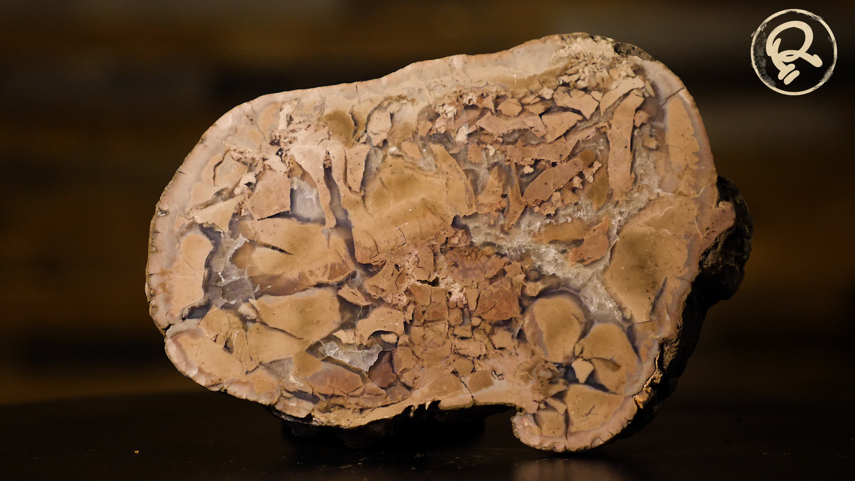
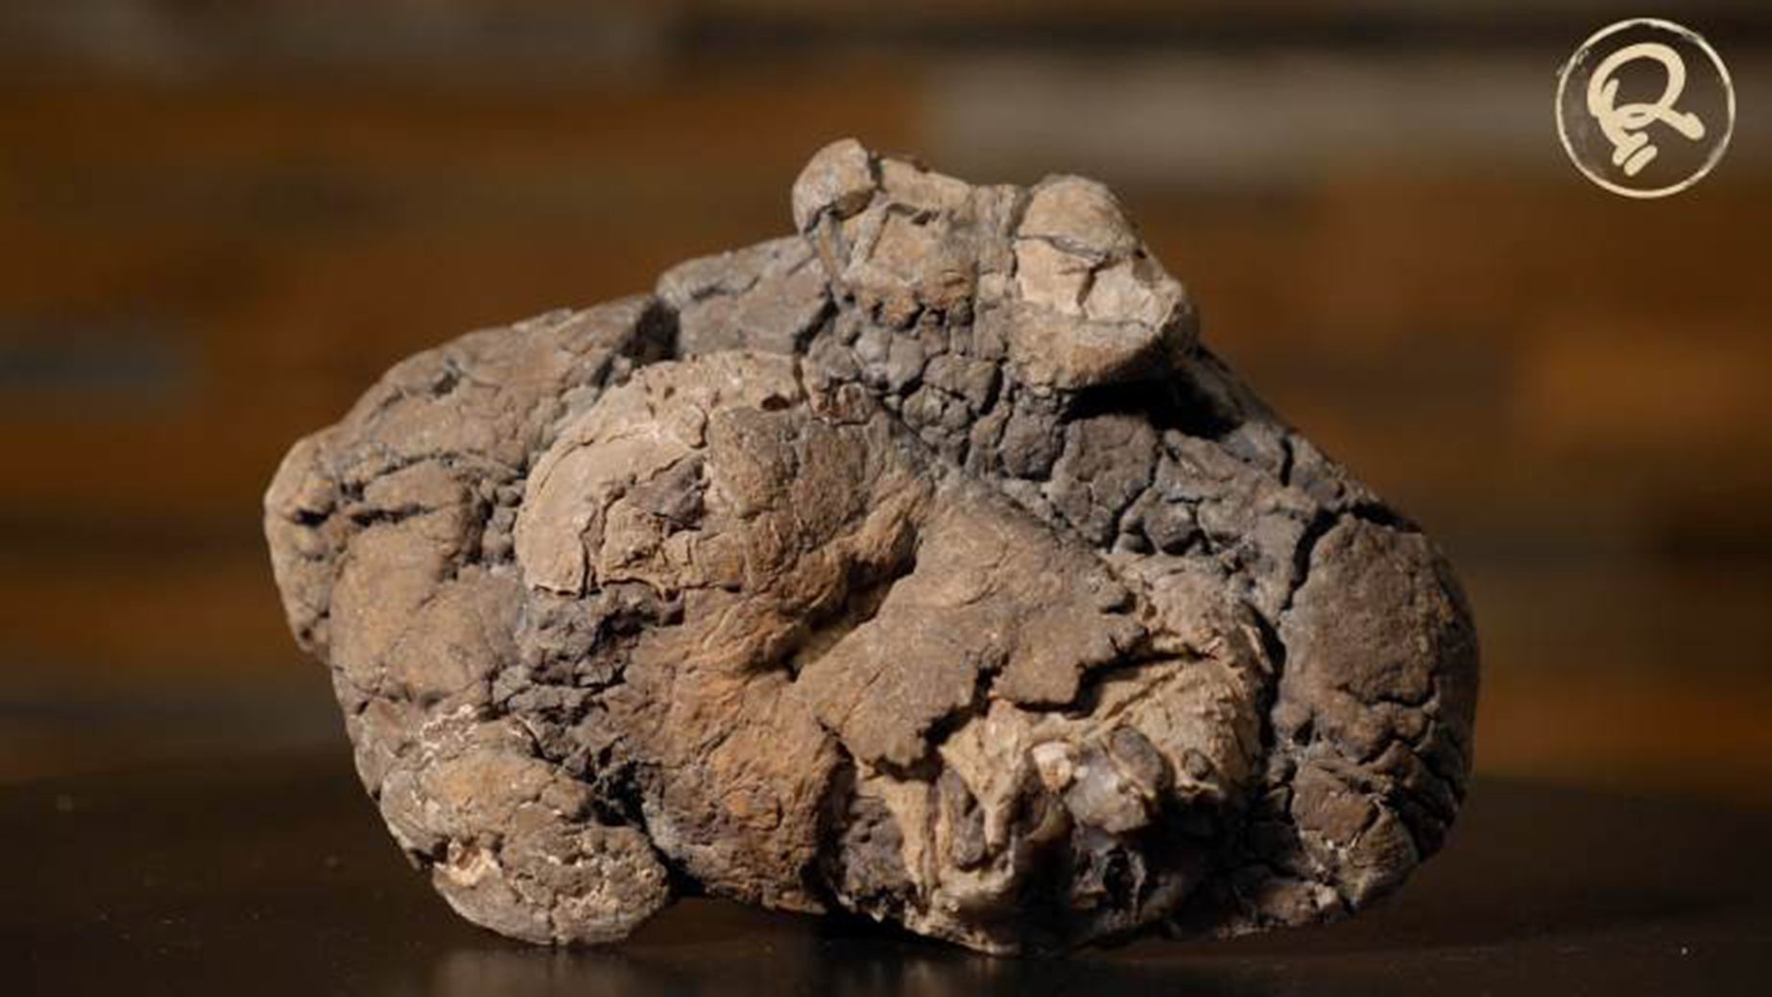
Coprolite
Notes:
Coprolite – They have been found in many shapes, but most of them have fragments of bones, scales, fins, teeth and plants. Compared to bones, it has a high Phosphorus content. They are mostly found near fossilized material. The largest coprolite ever found was 17 inches long and almost seven inches wide. Because it contained a lot of bones, paleontologists think it came from a large carnivore, such as a Tyrannosaurus rex.

Slide 23
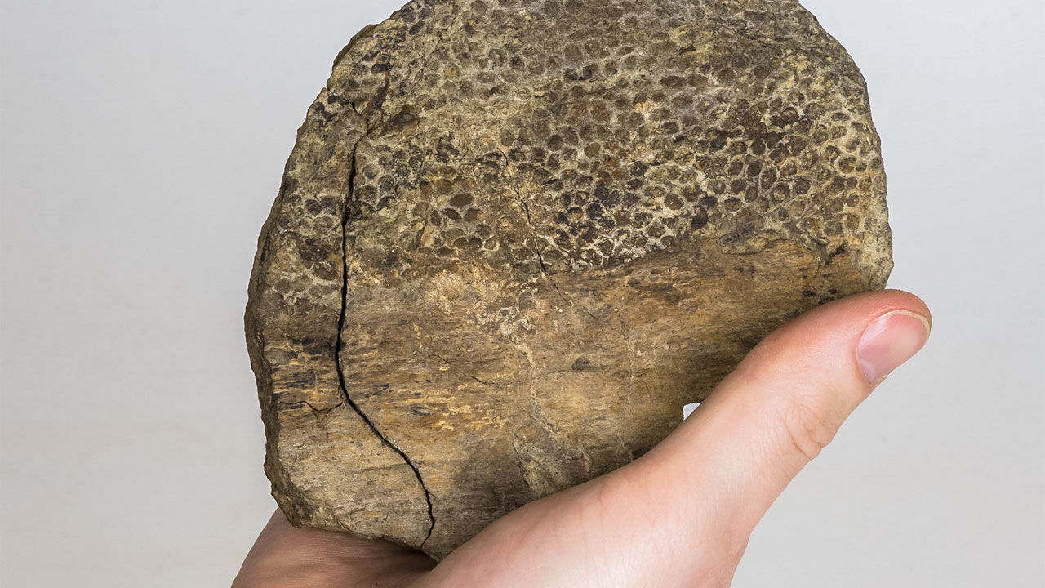
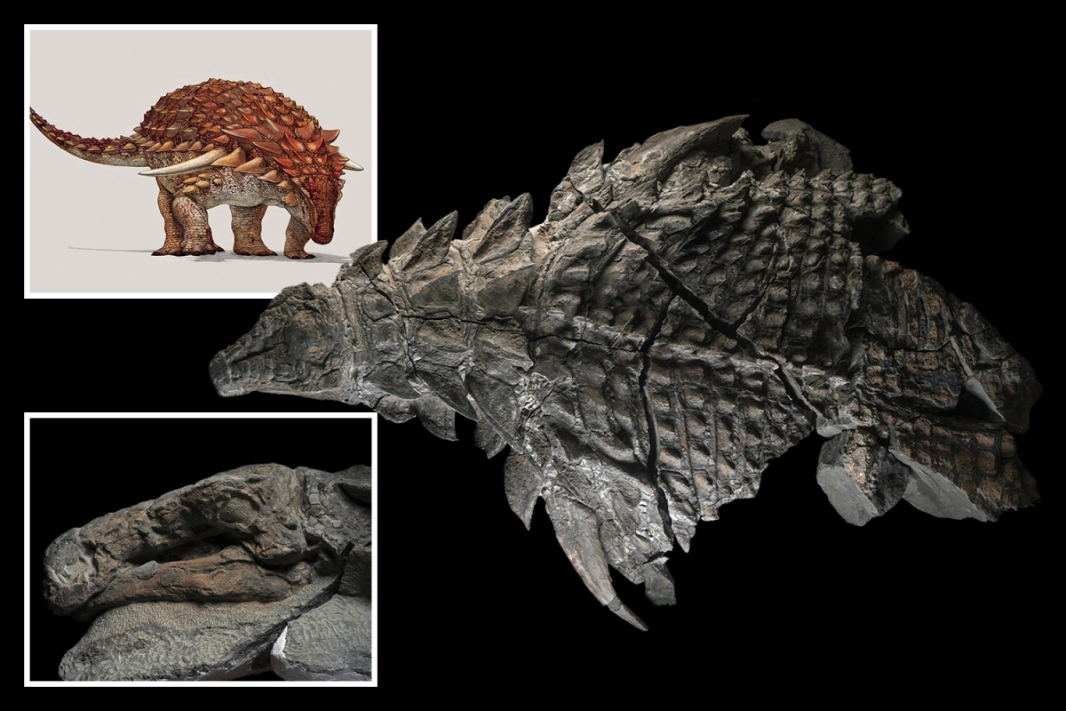
Fossilized Skin Impressions
Notes:
The next evidence is more rare, and it’s fossilized dinosaur skin/skin impressions left on a rocks. In Canada back in 2011 they found an armored dinosaur intact in a mine. Unfortunately, when they tried to lift it, it crumpled from its own weight. But he is still the most complete dinosaur fossil every found. It’s not just the skeleton, but you can see what the dinosaur looked like! It is believed that he drowned when it was swept out to sea during heavy flooding. Hmmm
As technology advances, we can understand a little more of the history of our world.

Slide 24
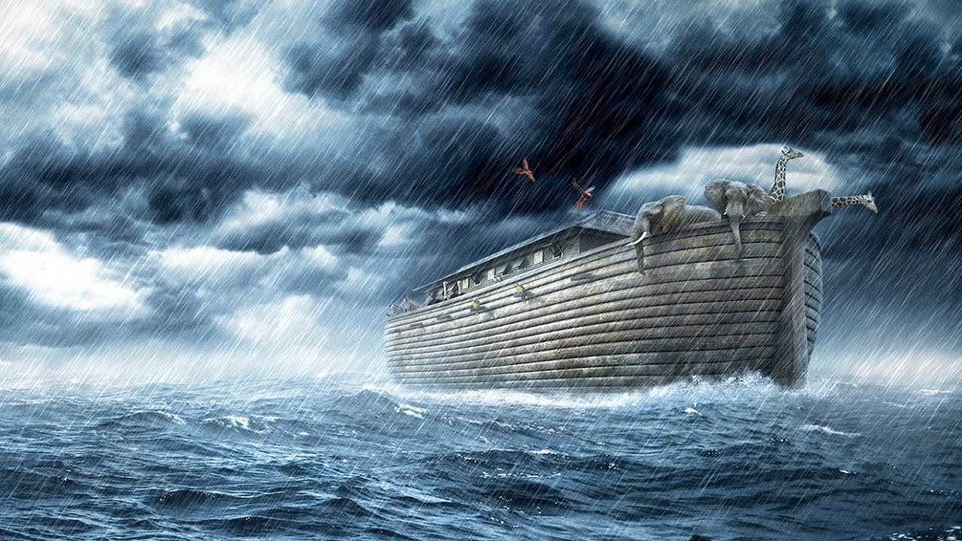
Why are so many creatures found buried and preserved in the fossil record?
The flood killed creatures all over the planet. Some animals may have died from drowning while others may have been buried in the mud layers and became fossils.
Genesis 7:20-23
Notes:
The Flood of the Bible killed creatures all over the planet. For a living thing to become fossilized you need three things: quick burial (before it starts to decompose), Water in the right amounts, and suitable minerals. The conditions during the flood were ideal for “fossilizing” millions of animals and plants. During the flood, some animals may have died from drowning while others may have been buried in the mud layers and became fossils.

Slide 25
5 Dinosaurs
Notes:
Now let’s talk about some dinosaurs! One of the requirements is that you created a booklet with at least five. I’ve included space for you to draw, or glue a picture of a dinosaur and label it. If you choose to draw, I’ve included a picture of a simple drawing for you to copy.

Slide 26
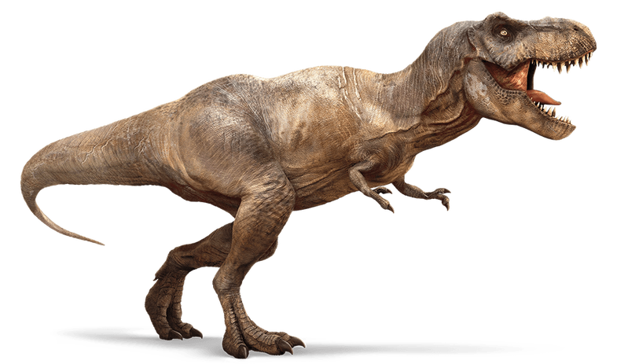
Tyrannosaurus Rex
1902
27km/h
about 8,000 kg
Notes:
Let’s start with a super well known one. Do you know what dinosaur this is? ROAR. It’s the Tyrannosaurus Rex. TRex. Its name means tyrant lizard. In early depictions of it ,they would draw it upright, but now they are believed to have walked head first, and their extremely disproportionate arms were used to prop themselves up from a resting position. The T-Rex was a carnivore, which means they ate meat. The first fossil was found in 1902 in Montana, US. Weight: between 4,500 – 8,000 kg, like a modern helicopter, or small jet!
Let’s act like a T-Rex. I want you to put your arms close to your chest, and then stomp around your chair, or just a circle where you are at. Make sure you use lots of force with those stomps.

Slide 27
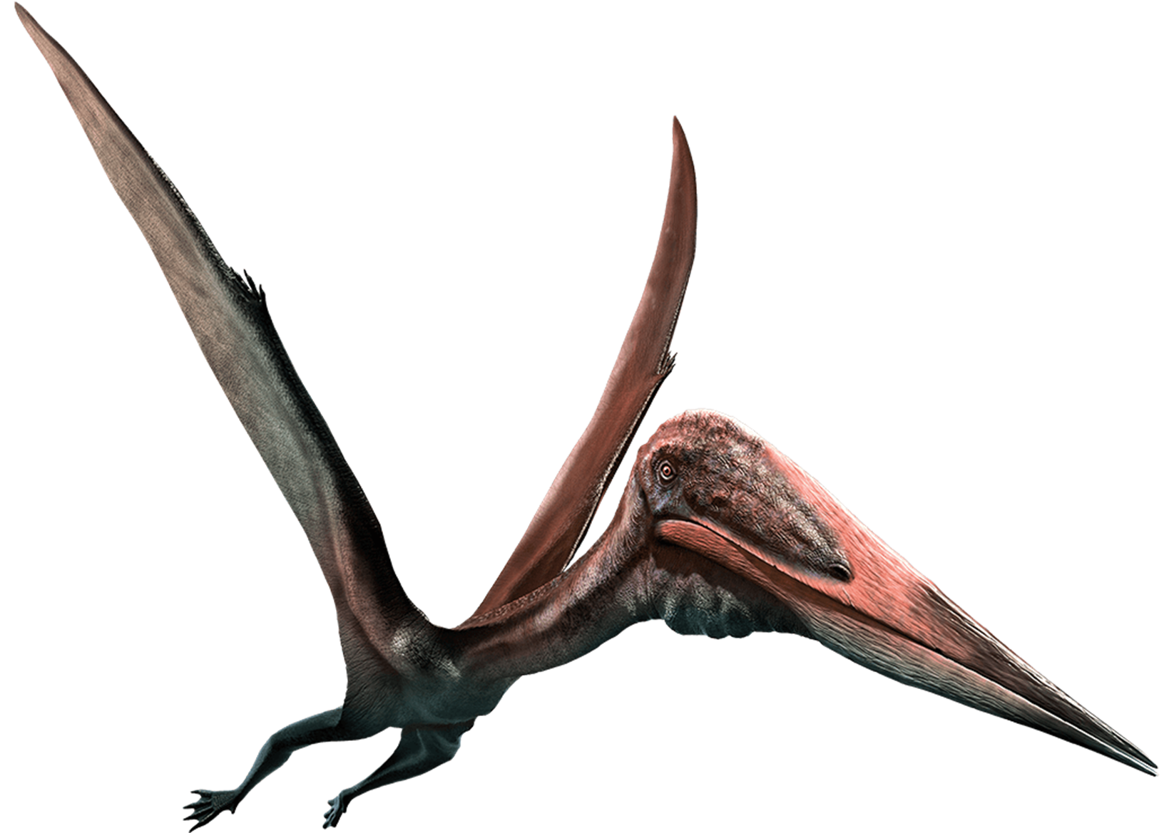
Pterodactyl
108 km/h
70 kg
1809
Notes:
Let us move on to our next dinosaur. This one fly. Do you know what it’s called? ROAR, Pterodactyl. name means Winged Finger. Pterodactyls were carnivores, eating meat and fish. The first fossil was found in 1809 in Bavaria, Germany. Once airborne, the largest pterosaurs could reach speeds of over 67 mph (108 kph) for a few minutes and then glide at cruising speeds of about 56 mph (90 kph), Weight: 70kg. half as heavy as a Panda Bear (about 150kg)
Let’s act like a Pterodactyl and flap our pretend wings

Slide 28
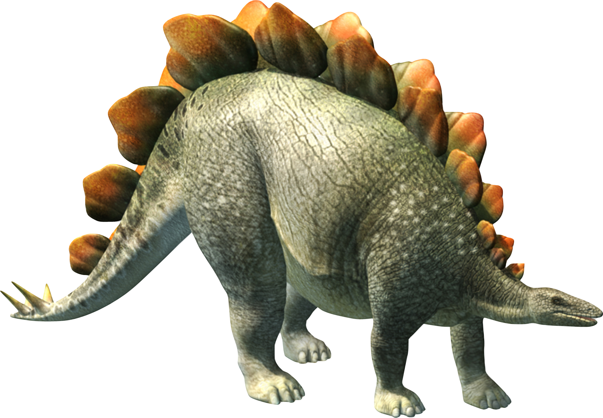
Stegosaurus
7 km/h
3100 kg
1876
Notes:
Are you ready for the next dinosaur? ROAR. This is the Stegosaurus. This animal was about 9 meters long and four meters tall. He is part of the armored dinosaurs. Hi name means Roofed Lizard. Even though he was a big animal, his head was really small, and his brain was the size of ping pong balls! The Stegosaurus was a herbivore, which means they ate plants, occasionally they would eat small rocks, like pebbles, and it is believed that it helped digest all the big plants he would eat. Could it be that it was because their brain was so small? The first fossil was found in 1876 in Colorado, US. Weight: 3100 kg, like an SUV or Truck.
Okay, let’s act like a Stegosaurus, since its name means Roofed Lizard, let’s put our hands over our head creating a roof.

Slide 29
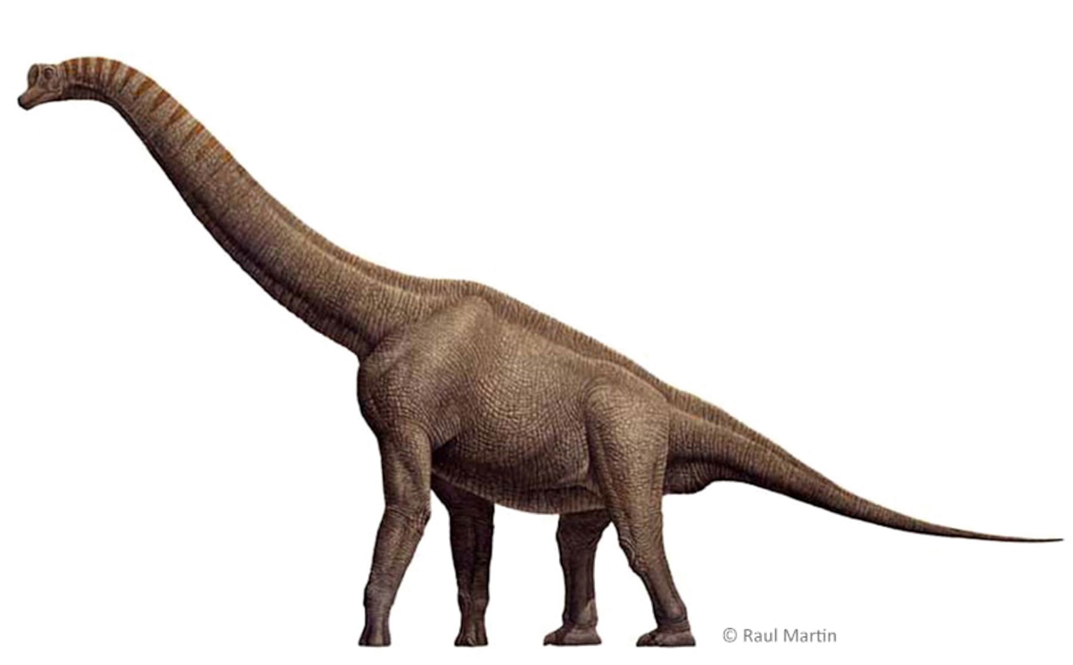
Brachiosaurus
1900
16 km/h
25 tons
Notes:
Let’s move on to our next dinosaur, are you ready? ROAR. The Brachiosaurus walked on four legs, and the front legs were longer than the hind legs. She was a high browsing herbivore. Does that mean that she ate from the bottom of the trees? NO, she ate from the top of the trees. The name means “arm lizard”. The first fossil was found in the US, Colorado in 1900. Weight: 25 tons, like two new London busses (each is about 12.65 tons)
Let’s walk tall like a Brachiosaurs and sway side to side.

Slide 30
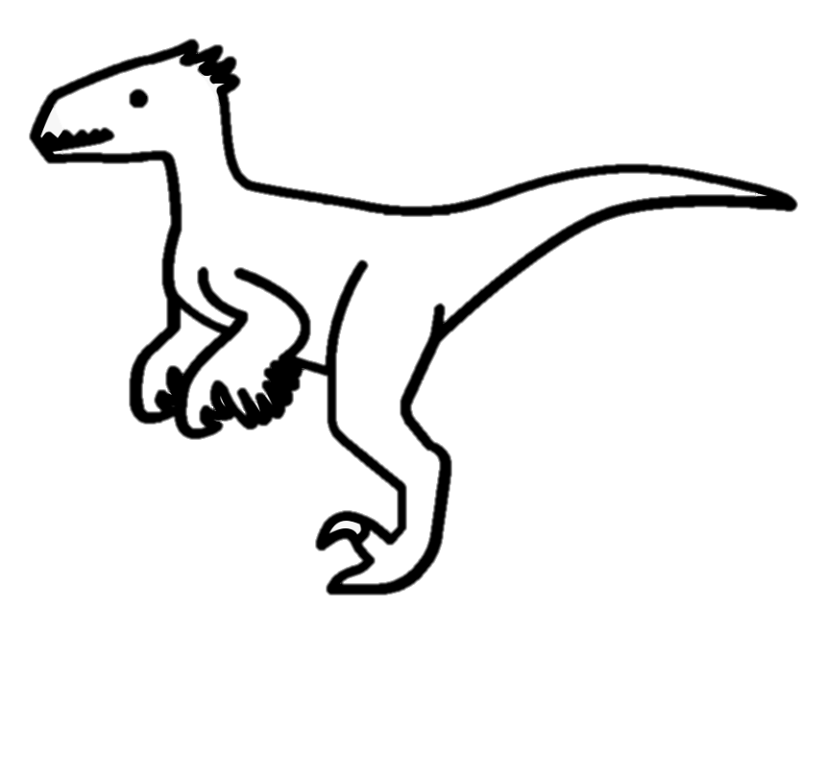
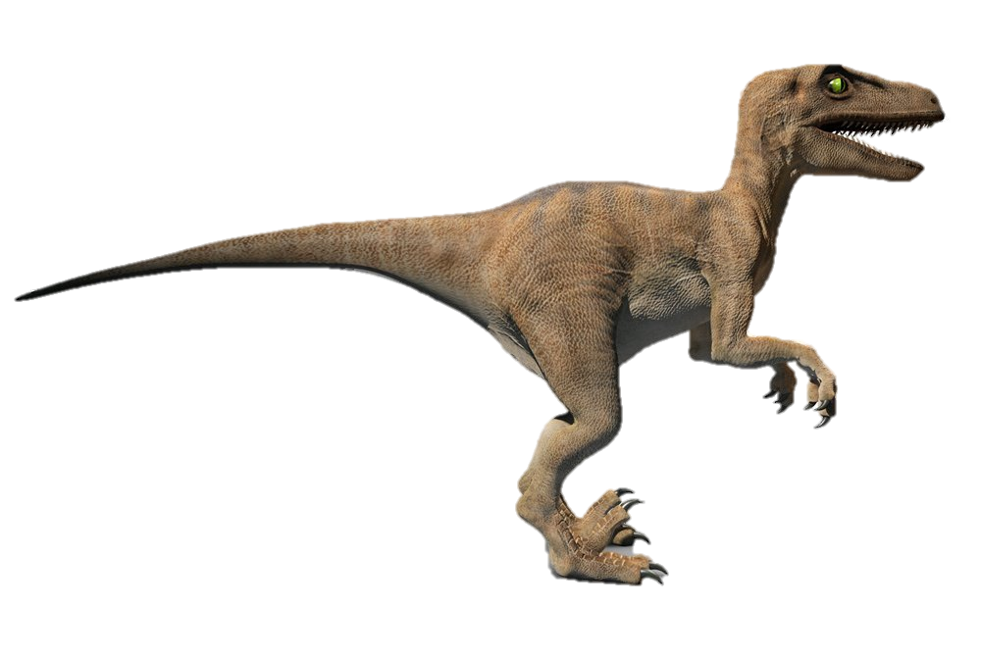
Velociraptor
1923
65 km/h
13 kg
Notes:
Are you ready for our last Dinosaur? ROAR, he is called the Velociraptor
Velociraptor means “swift robber” in Latin. It is one of the most bird-like dinosaurs ever discovered.
Like birds, velociraptors had a wishbone. They had long tails and a large, curved claw on each back foot.
Scientists think velociraptors may have had wings but would not have been capable of flight due to their short forelimbs. Could run up to 40 mph (65kph) The Velociraptor was a carnivore, Their diet included small reptiles, insects and smaller dinosaurs. It was first discovered in Mongolia in 1923. Weight: 13kg, about the size of a two-year-old child. Do you have a baby brother or sister that can run as fast as a Velociraptor?
Let’s be like a Velociraptor and run in place really fast.

Slide 31
Let’s play a game!
Notes:
Let’s Play a game. The arrow will spin and land on a dinosaur we just learned about. You have to say the name and do the motions we just learned for each.
*If you are doing this at home, print and use the game wheel provided in the material list.

Slide 32
Notes:
Let’s Play a game. The arrow will spin and land on a dinosaur we just learned about. You have to say the name and do the motions we just learned for each.
*If you are doing this at home, print and use the game wheel provided in the material list.

Slide 33
Notes:
Let’s Play a game. The arrow will spin and land on a dinosaur we just learned about. You have to say the name and do the motions we just learned for each.
*If you are doing this at home, print and use the game wheel provided in the material list.

Slide 34
Notes:
Let’s Play a game. The arrow will spin and land on a dinosaur we just learned about. You have to say the name and do the motions we just learned for each.
*If you are doing this at home, print and use the game wheel provided in the material list.

Slide 35
Notes:
Let’s Play a game. The arrow will spin and land on a dinosaur we just learned about. You have to say the name and do the motions we just learned for each.
*If you are doing this at home, print and use the game wheel provided in the material list.

Slide 36
Notes:
Let’s Play a game. The arrow will spin and land on a dinosaur we just learned about. You have to say the name and do the motions we just learned for each.
*If you are doing this at home, print and use the game wheel provided in the material list.

Slide 37
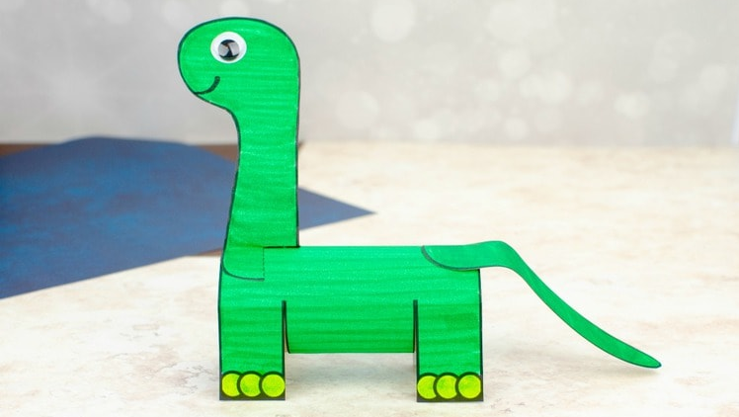
Craft time
Get your materials ready

Slide 38
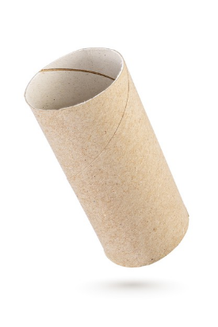
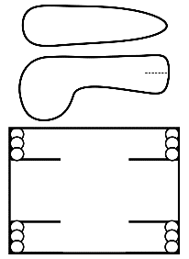
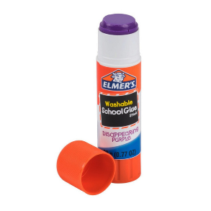
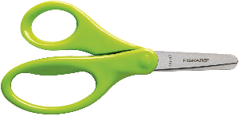
Notes:
*Empty Toilet Paper Roll
*Printed Image on Green Cardstock paper (Or Print in white and color it green before the meeting)
*Glue stick
*Scissors
*Googly Eyes – Or white paper and a black marker

Slide 39
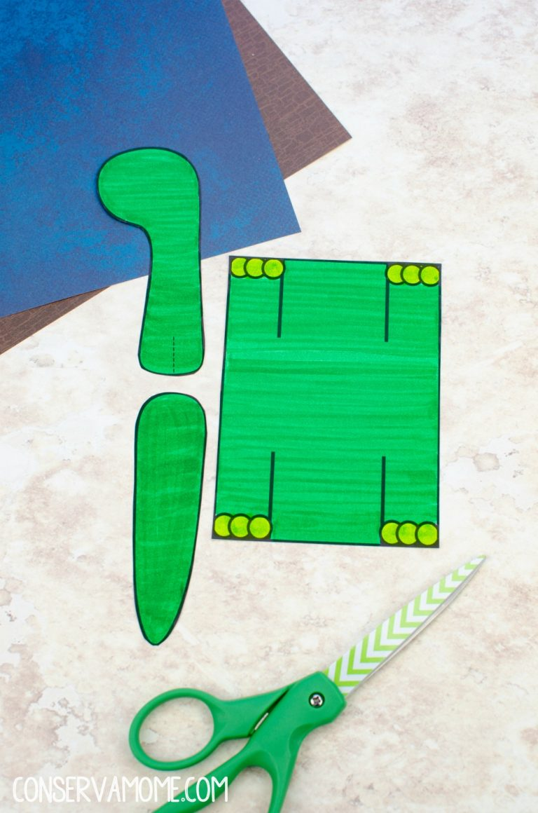
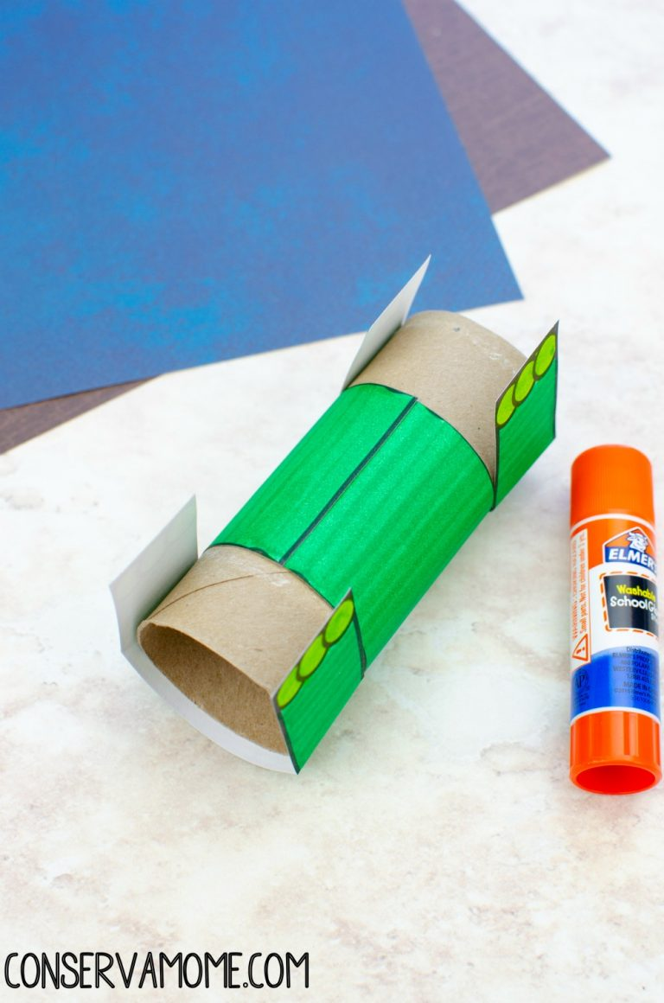
Notes:
https://conservamome.com/dinosaur-toilet-paper-roll-craft-for-kids/

Slide 40
Award Requirements
1. Make a booklet of at least 5 types of dinosaurs. Draw or find pictures and label them.
2. Read Genesis chapter 1. Find the verse(s) that say God created all the animals and every living thing. Discuss how everything God created at the beginning was perfect and there wasn’t even death.
3. How has sin affected all of nature in the world?
4. Discuss how some dinosaurs seem scary. Make a list or find pictures of other animals seen today that seem scary.
5. Who is a paleontologist and what is their work?
6. Discuss and/or look at the pictures of the evidence of dinosaurs that have been found: a. Bones & teeth b. Fossilized skin impressions c. Coprolite d. Footprints
7. What does the word “extinction” mean?
8. Why are so many creatures found buried and preserved in the fossil record? Read Genesis 7:20-23
9. Play a game
Notes:
You will notice in your award booklet, that there are pages that have a border. Those are the requirements that need to be completed before you can show your club director that you completed the award. Make sure you snuggle up with your grown-up today and have them read all of Genesis 1. Finish drawing and labeling 5 different types of dinosaurs, and you are all set.

Slide 41
DINOSAURS
Notes:
Give me one final ROAR to say Goodbye!

