Slide 1
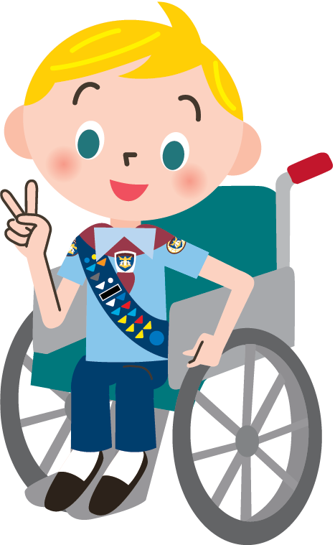
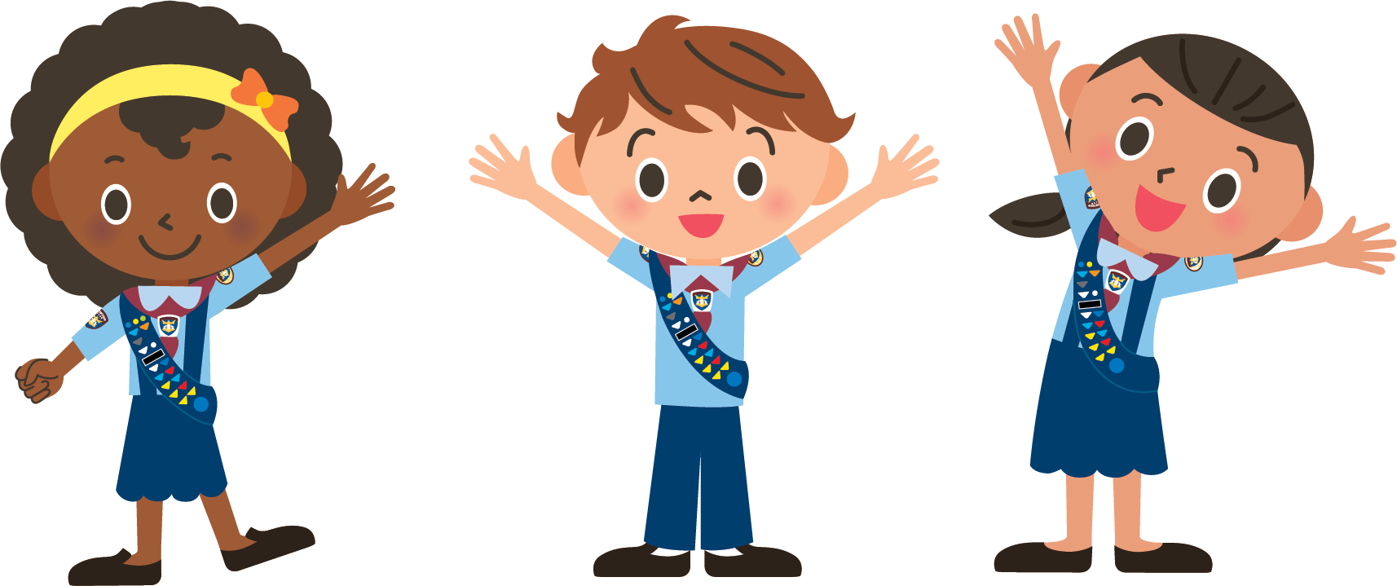
Family Helper Award
Presented by : Lulu Mashonganyika

Slide 2
Welcome
Family Helper
Notes:
Welcome and prayer

Slide 3
Family Helper
Sings Adventurer Song
Notes:
l will say something about singing when helping

Slide 4

Family Helper
Sings Adventurer Song

Slide 5
Family Helper Award
Requirements:
1.Read and discuss the following Bible verses:
Philippians 2:14, John 15:12, Psalm 118:7, Galatians 6:9
2. Who is a family helper
3. Discuss things you can do to be a helper
4. Keep a log for 3 weeks listing how you have been a helper.
4.1 Each week, discuss with your mentor the progress you have made that week
4.2 Discuss the ways you have helped and which was your favorite.
4.3Discuss what ways you could have helped differently
5. Make a thank you card/note for your parent/guardian thanking them for everything they do for you

Slide 6
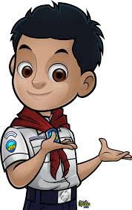

Let’s read the bible verse
Requirement #1

Slide 7
Philippians 2:14
Requirement #1
¹⁴ Do everything without grumbling or arguing

Slide 8
John 15:12
Requirement #1
¹² My command is this: Love each other as I have loved you.

Slide 9
Psalm 118:7
Requirement #1
The Lord is with me; he is my helper. I look in triumph on my enemies

Slide 10
Galatians 6:9
Requirement #1
Let us not become weary in doing good, for at the proper time we will reap a harvest if we do not give up.

Slide 11
Quiz Time
Requirement #1
When mummy or daddy ask us to help set the table we should start arguing with them?
A. True
B. False

Slide 12
Quiz Time
Requirement #1
We must love each other as God has loved us…
True
B.False:

Slide 13
Quiz Time
Requirement #1
According to Psalm 118:17 who is your helper?
David
The Lord
Joseph

Slide 14
Quiz Time
Requirement #1
According to Galatians 6:9 we should not be weary of….?
Laughing
Doing good
Helping at home

Slide 15
Quiz Time
Requirement #1
According to Galatians 6:9 for at the proper time we will reap a harvest if we do not give up
False
True

Slide 16
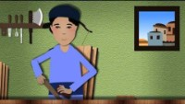
Requirement #1

Slide 17



Who is a family helper in your family?
Requirement #2

Slide 18

Who is a family helper in your family?
Requirement #2
Dad
mum
me

Slide 19
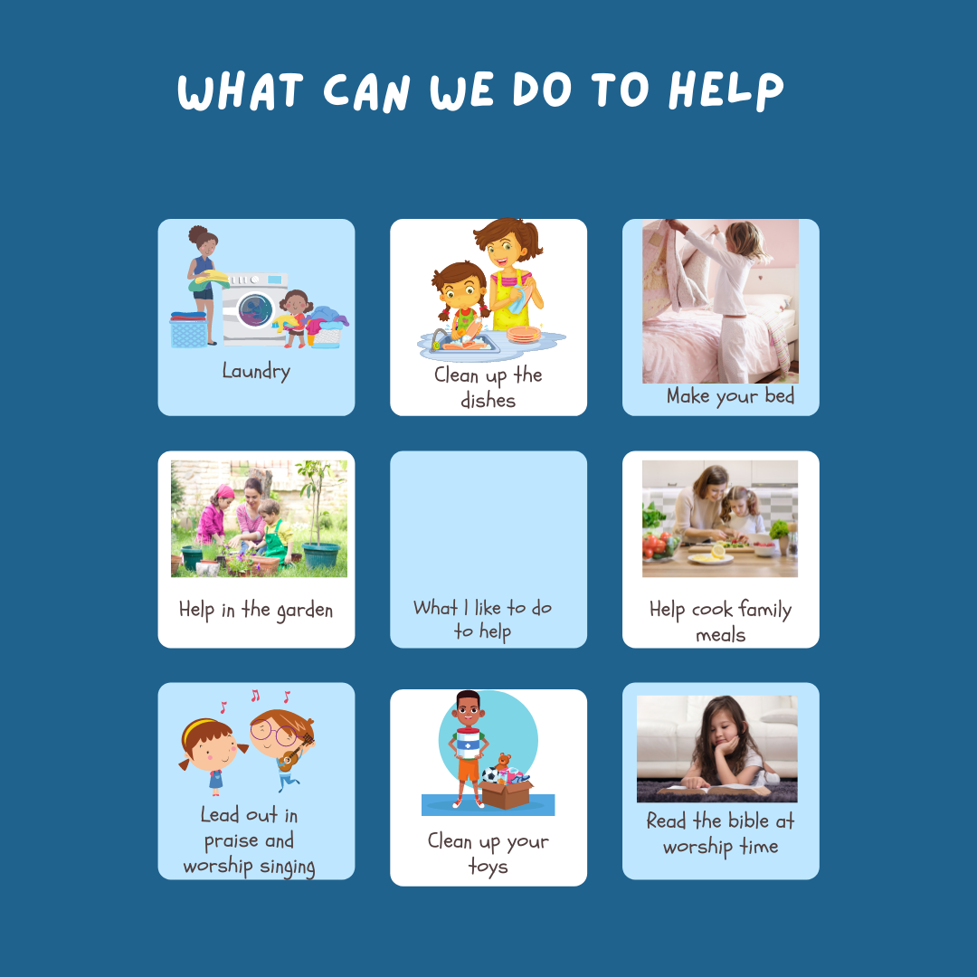
Requirement #3 & 4

Slide 20
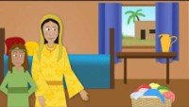
Requirement #1
Notes:
https://youtu.be/8QVDxbBUSYw?t=20

Slide 21

Requirement #3 & 4
Three weeks of being a family helper

Slide 22
Day of the week | Week 1 Tasks | Week 2 Tasks | Week 3 Tasks
Sunday
Monday
Tuesday
Wednesday
Thursday
Friday
Saturday
Requirement #4
Three weeks of being a family helper

Slide 23

Requirement #3 & 4
Notes:
Back up in case there is still time

Slide 24

Requirement #5
Let us make a thank you card using our hands
Notes:
Making the card will take some time

Slide 25
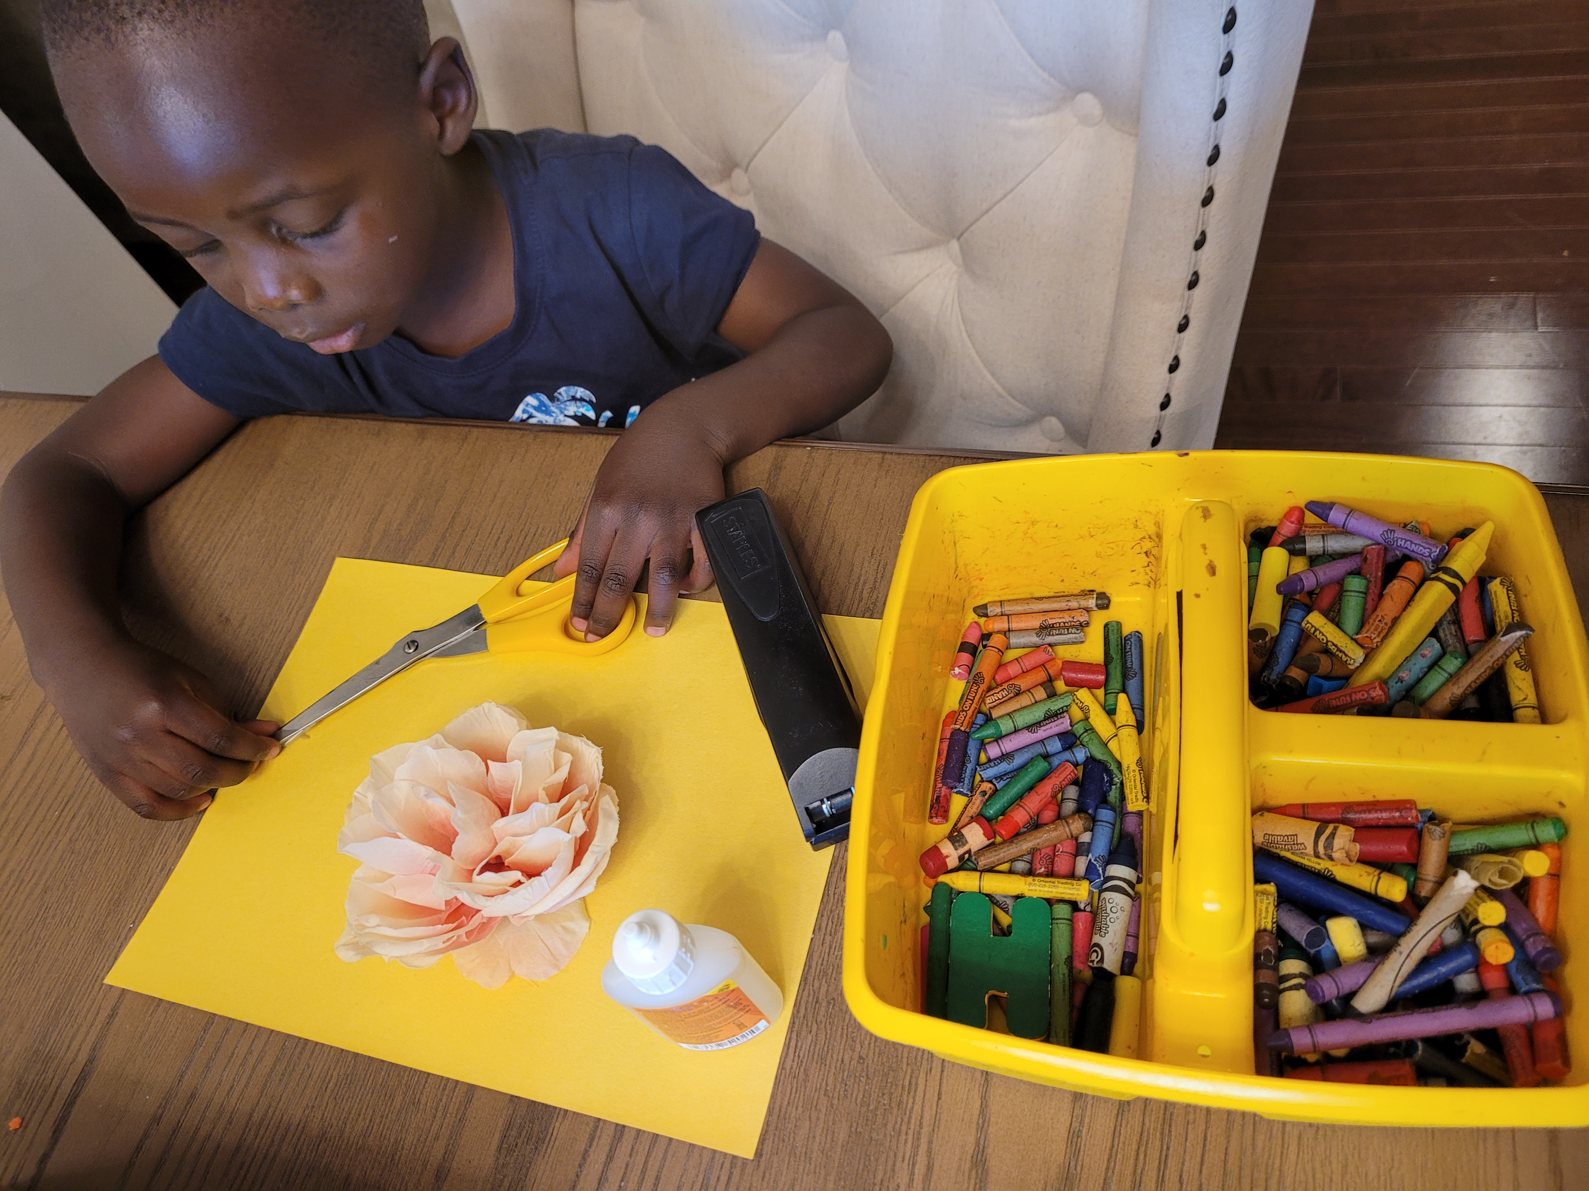
Requirement #5
What do we need:
Card stock/ paper
Scissors
Glue or stapler
Crayons & markers
Extra decorating items , flowers, stickers, etc.
Notes:
Making the card will take some time

Slide 26
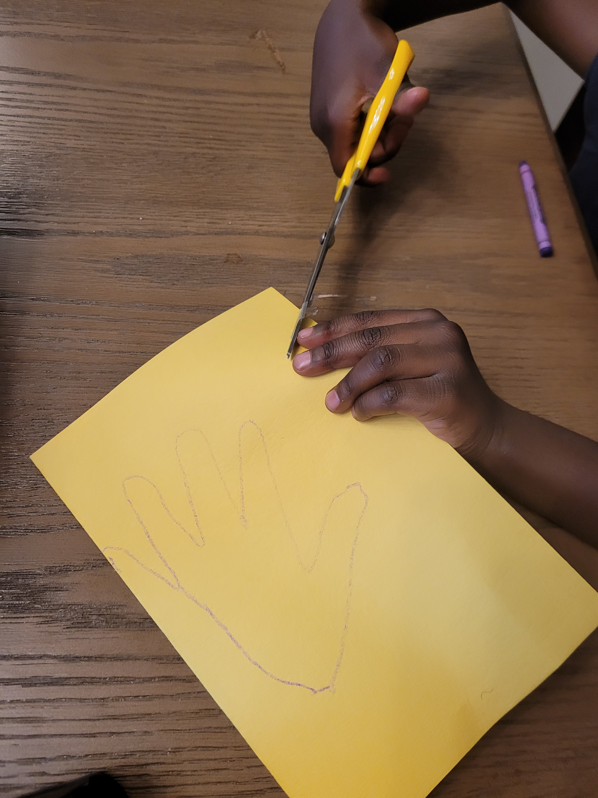
Requirement #5
Cut out your traced hand
Important tip!!! - Do not cut on the fold
Notes:
Making the card will take some time

Slide 27
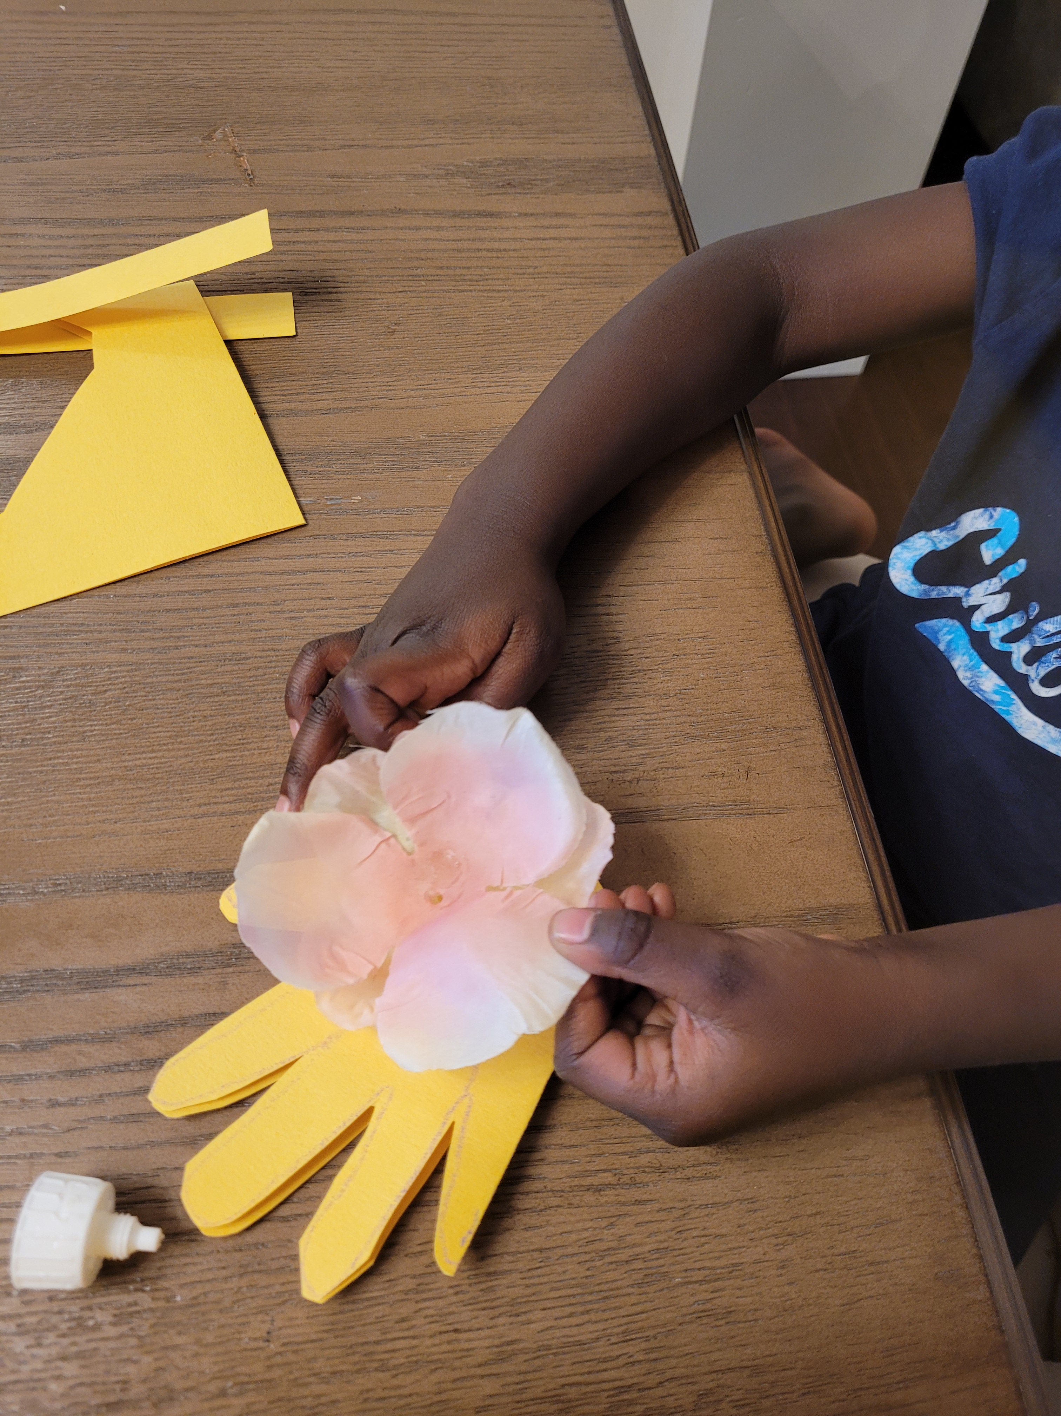
Requirement #5
Add flowers, glitter, make it pretty
Notes:
Making the card will take some time

Slide 28
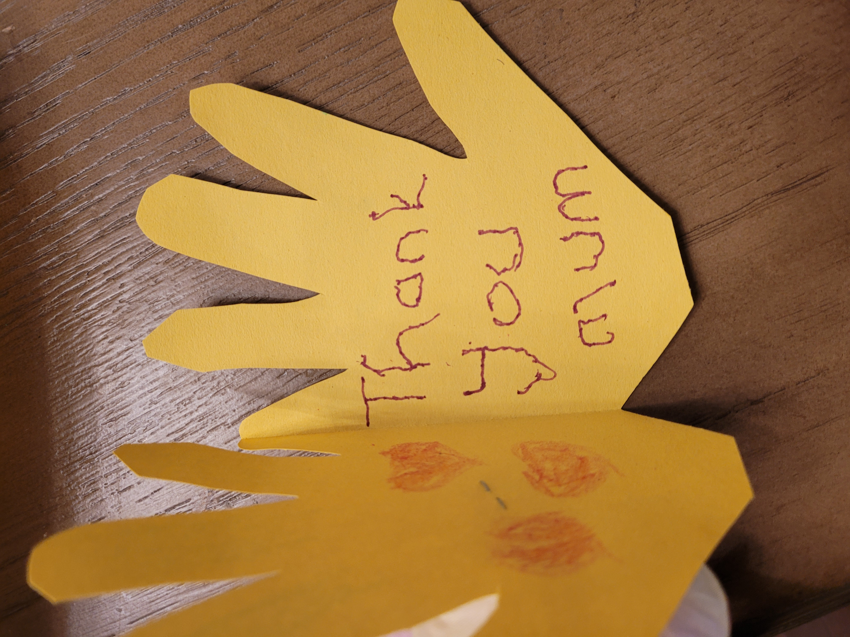
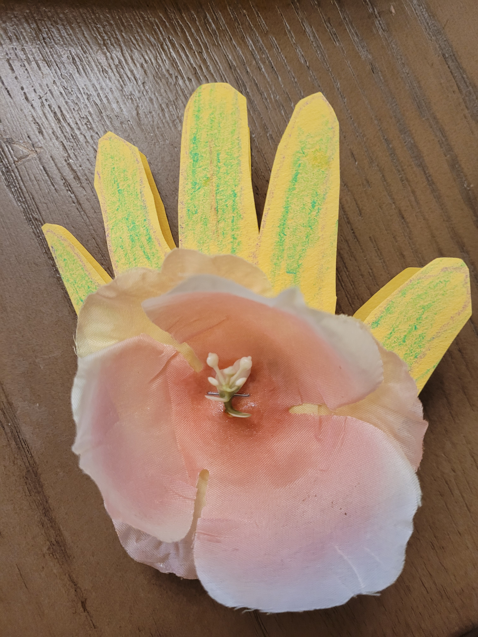
Requirement #5
Finish decorating and write your message
Notes:
Making the card will take some time

Slide 29

https://youtu.be/NsbRIg-ebWg
Notes:
You can let your little light shine by being a good family helper https://youtu.be/NsbRIg-ebWg

Slide 30
How much have we done today?
Requirements check:
1.Read and discuss the following Bible verses:
Philippians 2:14, John 15:12, Psalm 118:7, Galatians 6:9
2. Who is a family helper
3. Discuss things you can do to be a helper
4. Keep a log for 3 weeks listing how you have been a helper.
4.1 Each week, discuss with your mentor the progress you have made that week
4.2 Discuss the ways you have helped and which was your favorite.
4.3Discuss what ways you could have helped differently
5. Make a thank you card/note for your parent/guardian thanking them for everything they do for you
Notes:
Run threw of what we did

Slide 31

Adventurers
Family Helper Award
June 19, 2021
Lulu Mashonganyika
Congratulations you have earned the Family Helper Award
Notes:
Closing remarks and prayer

