Slide 1
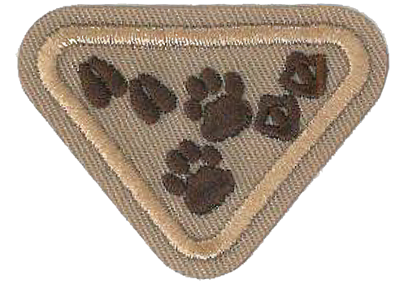
Animal Footprints Award
Adventurers - Sunbeam

Slide 2
Requirements
01
02
03
04
05
06
Bible Texts
Clean & Unclean
IDs
About Animal Footprints
Which footprints help us figure out clean animals?
Learn 12 different wild animal footprints
Footprint Values
Play dough Footprints
Footprint Game
What types of feet work best in what situations?
Playdough craft
Flashcard style helps us remember footprints

Slide 3
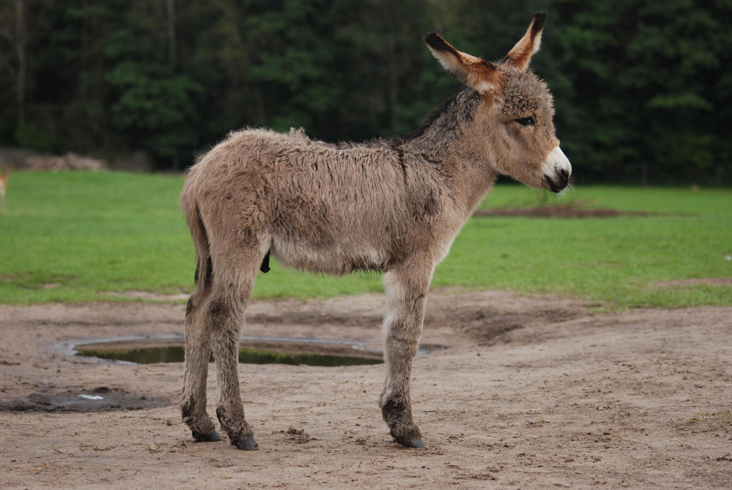
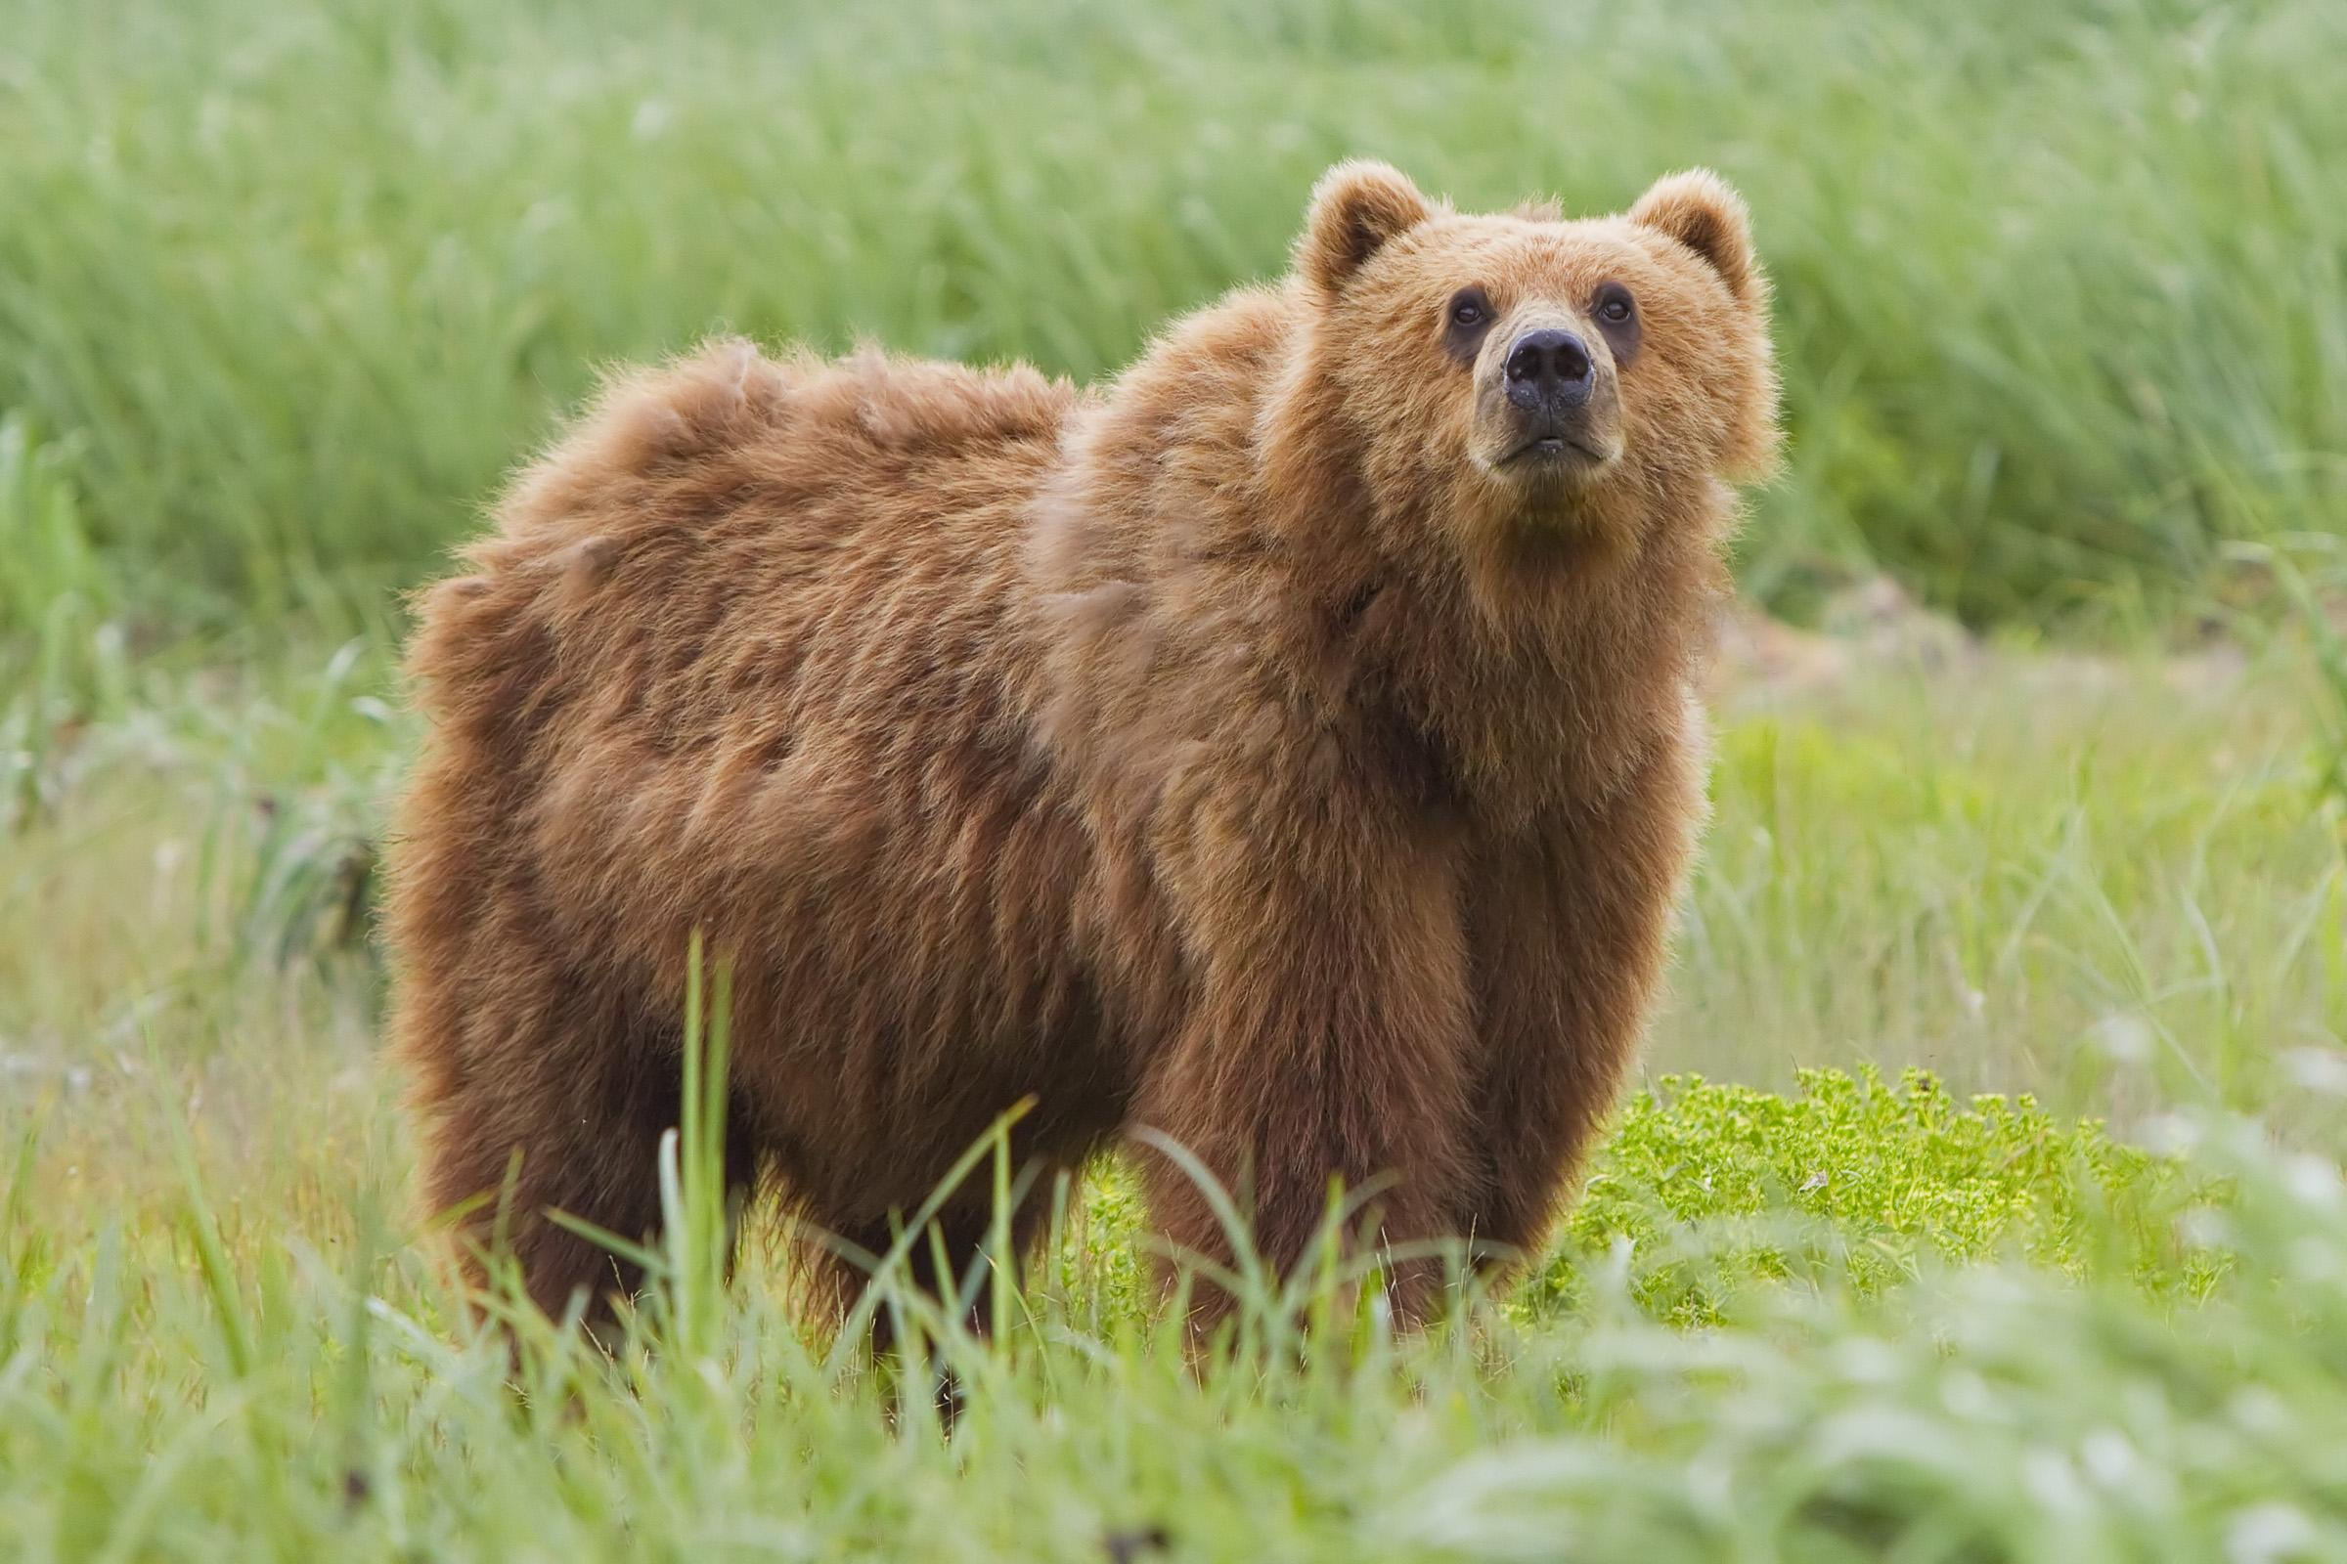
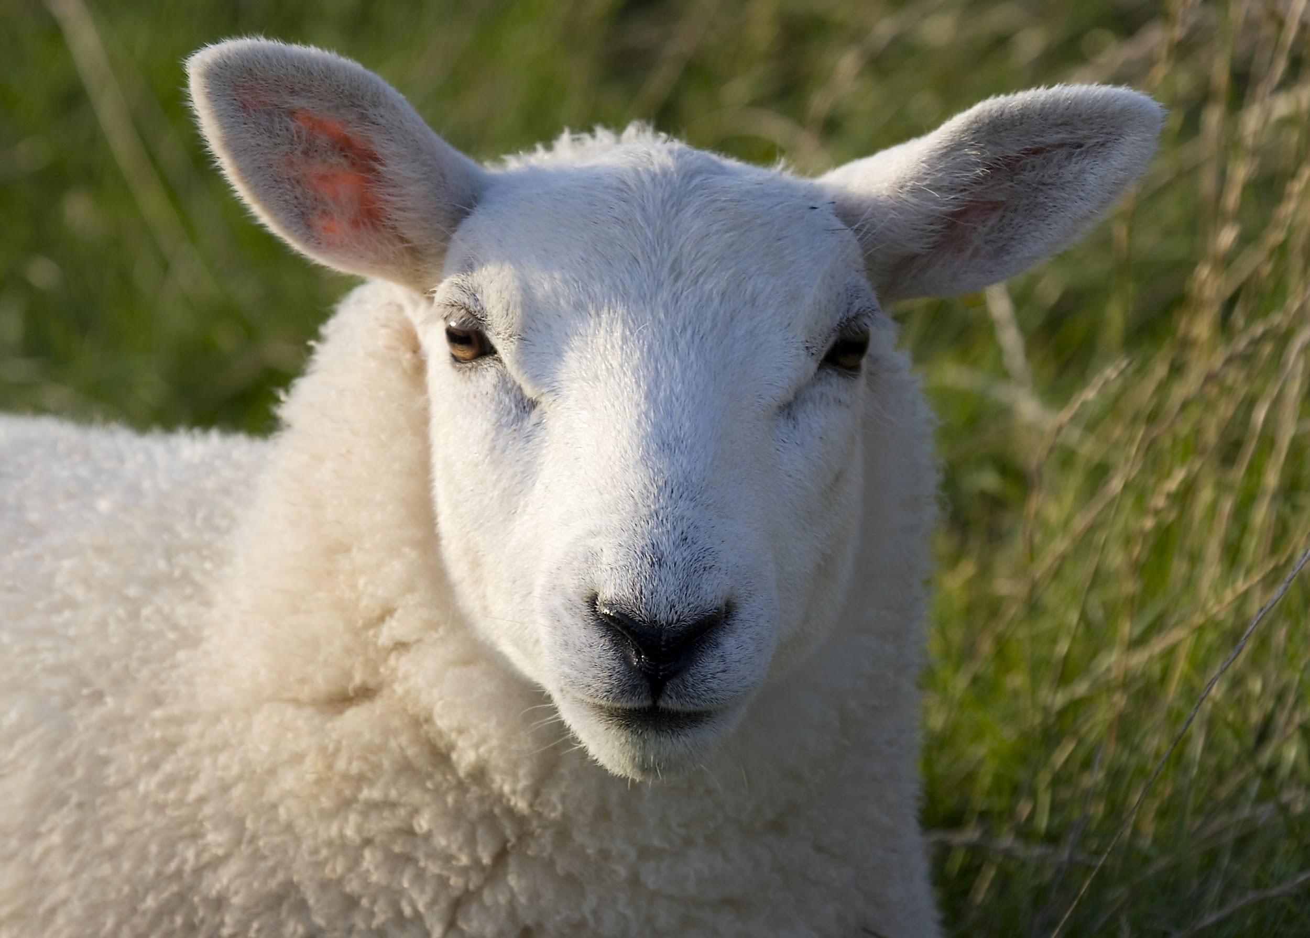
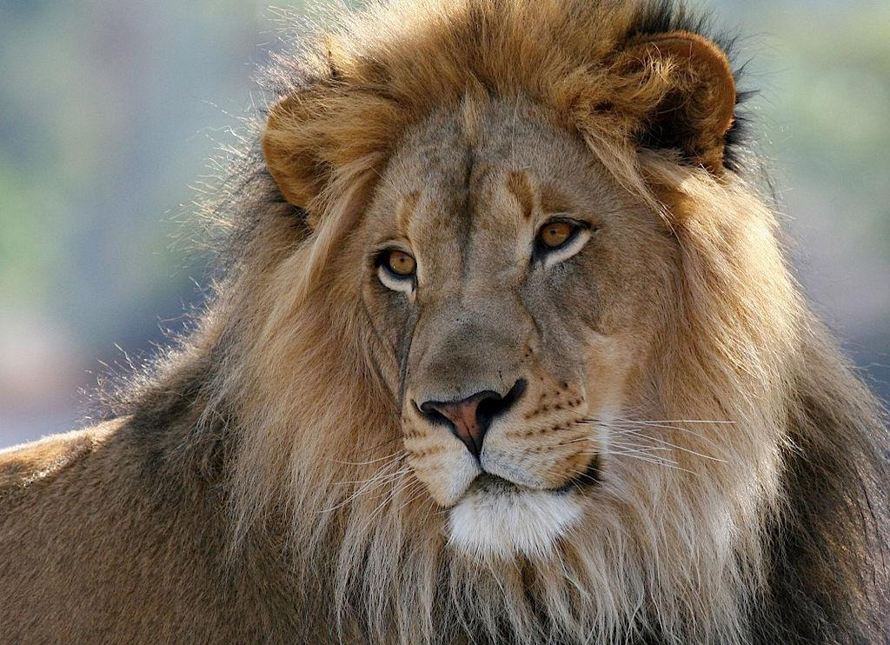
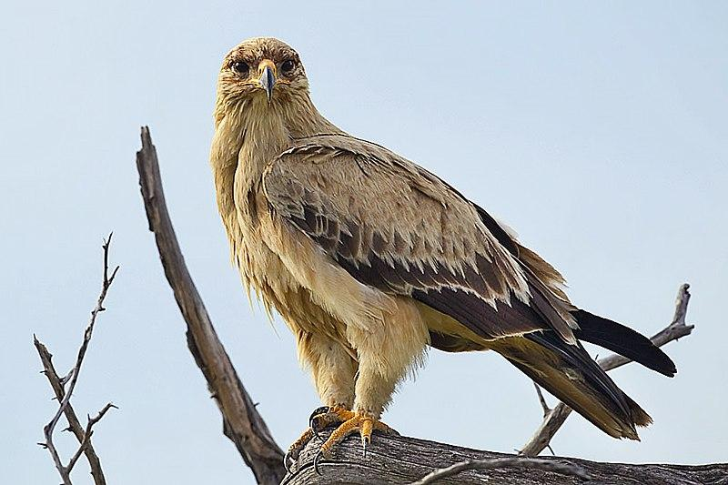
Can you think of “Bible Animals”?

Slide 4
Bible!
01
About Animal Prints

Slide 5
01
Leviticus 11:3
You may eat any animal that has completely split hooves and chews the cud.

Slide 6
01
Revelation 3:2
This beast looked like a leopard, but it had the feet of a bear and the mouth of a lion! And the dragon gave the beast his own power and throne and great authority.

Slide 7
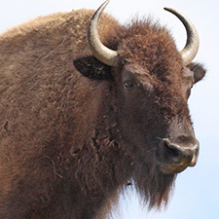
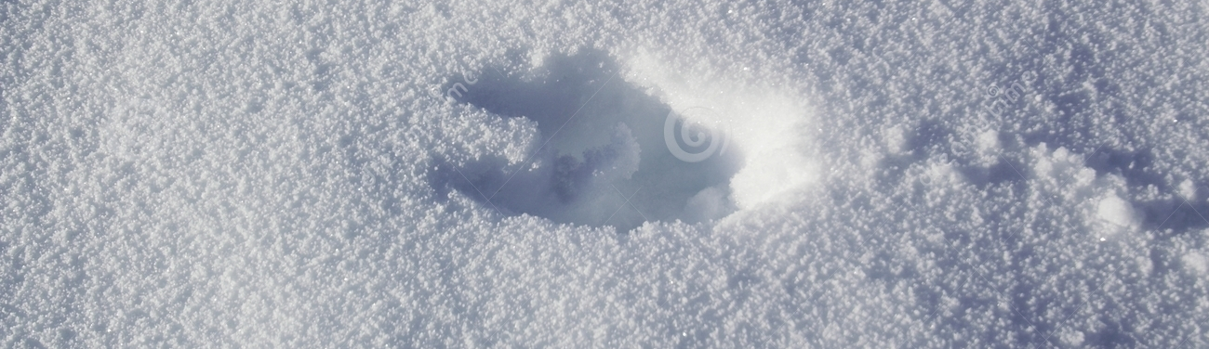
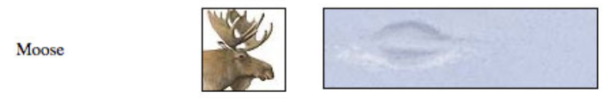
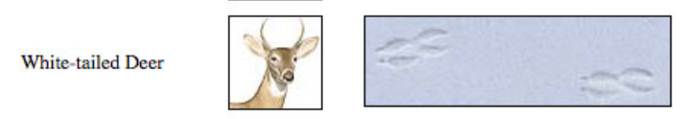
02
Clean Animal Prints
American Bison /
Cattle

Slide 8
02
Clean Animal Prints
American Bison /
Cattle
SPLIT HOOVES (two halves)
& Chew the Cud
Chewing Cud? Video here

Slide 9
04
Why?
Do animals have different kinds of feet?
Guess the animal AND where their feet work best!

Slide 10
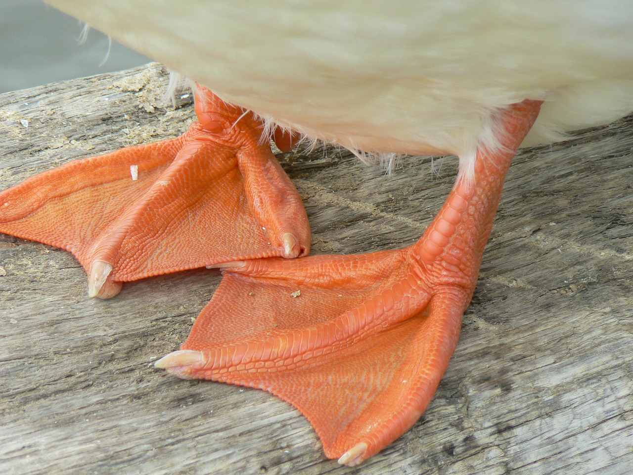
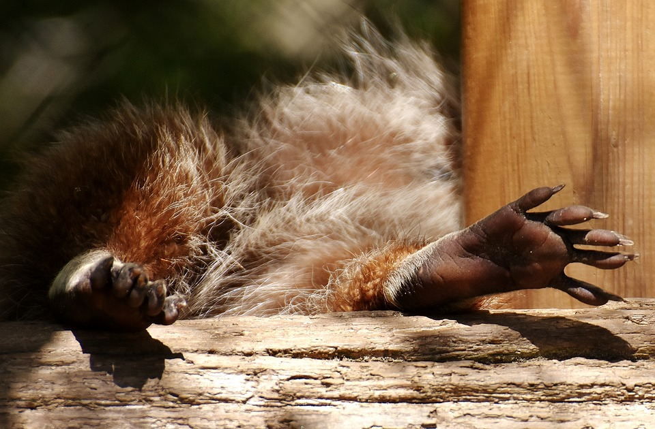
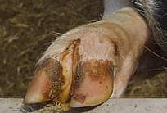
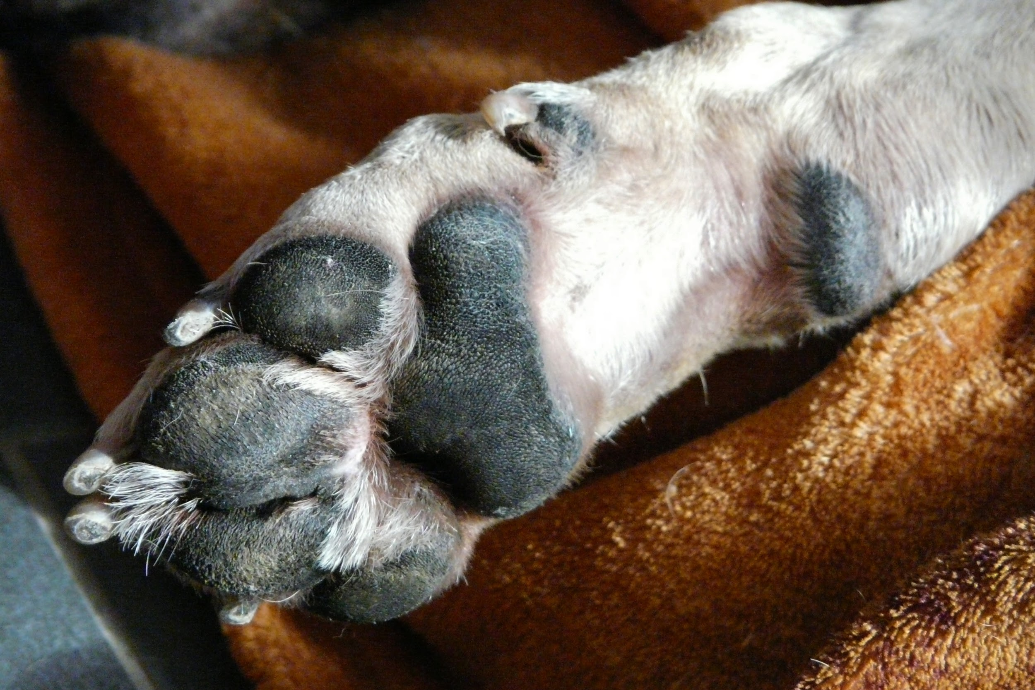
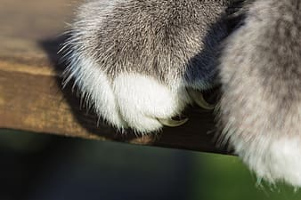
04
Foot close ups

Slide 11
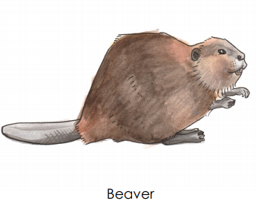
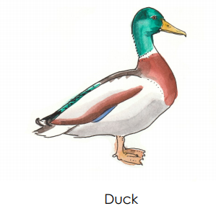
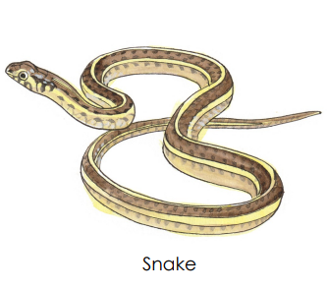
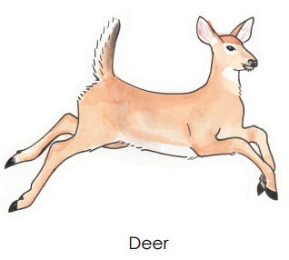
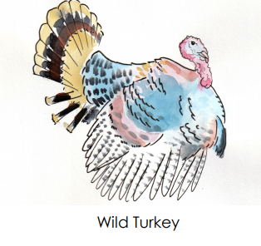
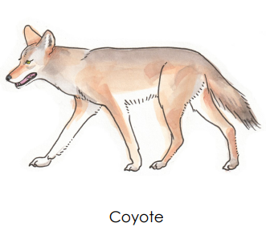
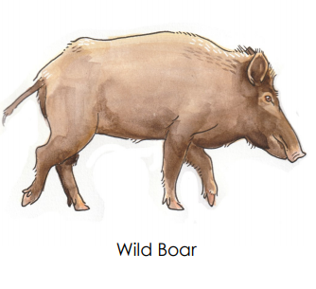
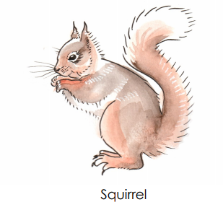
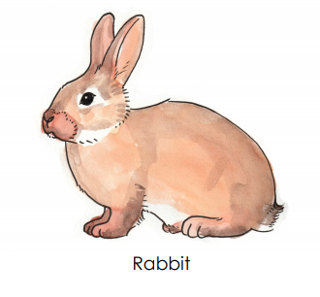
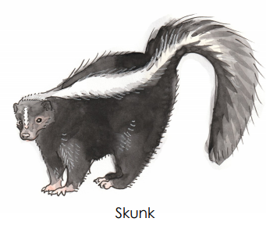
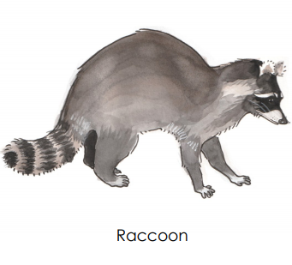
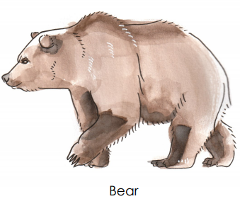
03
06
Game!
Animal Footprints
Guess?

Slide 12
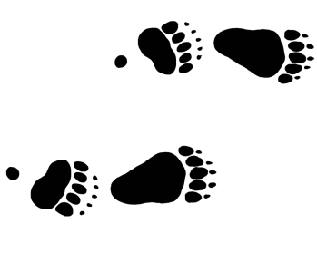

Slide 13
03
06

Slide 14
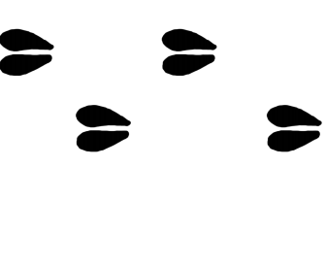

Slide 15
03
06

Slide 16
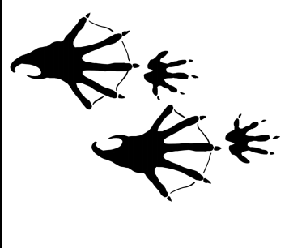

Slide 17
03
06

Slide 18
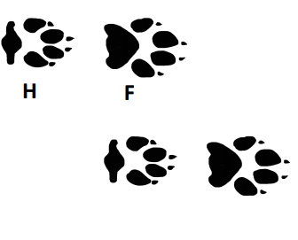
North American ONLY

Slide 19
03
06

Slide 20
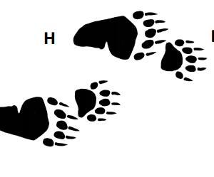
North American ONLY

Slide 21
03
06

Slide 22


Slide 23
03
06

Slide 24
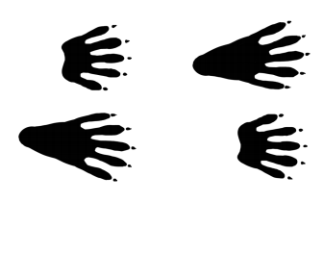

Slide 25
03
06

Slide 26
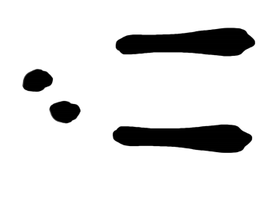

Slide 27
03
06

Slide 28
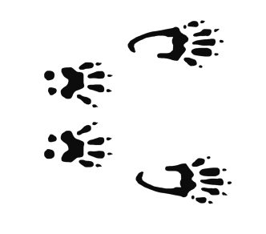

Slide 29
03
06

Slide 30
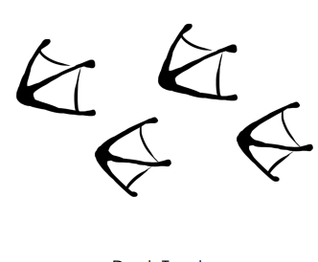

Slide 31
03
06

Slide 32

North American ONLY

Slide 33
03
06

Slide 34
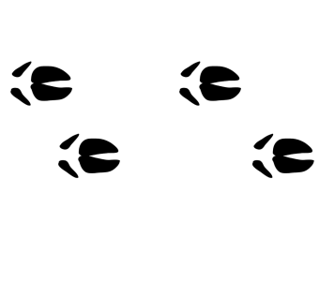

Slide 35
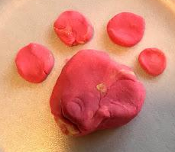
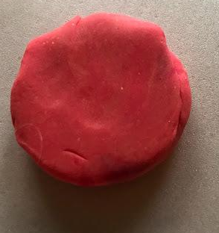
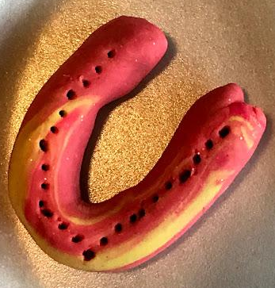
05
Use Playdough
Make an animal track!
Hint: YOUR print counts OR
Racoon or monkey is very similar,
play with it!

Slide 36
dejan@adventist.uk
Post a photo of your PLAYDOUGH PRINT!

