Slide 1
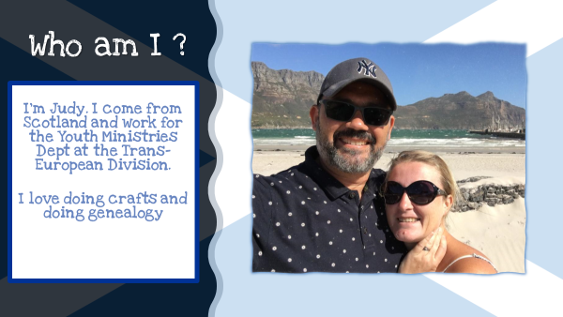

Slide 2

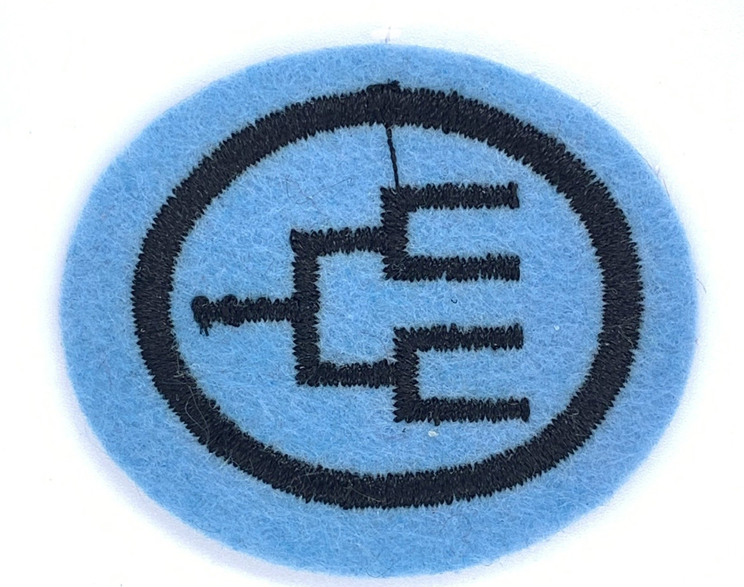

Genealogy Honour
Notes:
Today we are going to look at the genealogy honour - but do any of you know what this is ? Have any of you ever done this before ? So Genealogy is looking into our family history. I understand that we are all from different places and so the information might be different for you and for your families history search. A lot of this presentation is based on my search here in the UK so if you are doing from US or Africa or UAE then it might vary. The internet can help you a lot to find out what is relevant for your country.

Slide 3

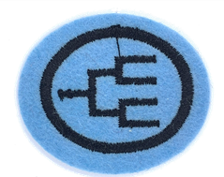
Requirements
Define the following words:
  Genealogy
  Ancestor
  Descendant
  Spouse
  Sibling
Read the genealogy of Christ
  Be able to tell where it is found in the New Testament
  Write out the genealogy of Christ – beginning with Adam
List five ways to obtain family genealogy information
Know at least three societies that help with genealogy research
Learn four steps important to genealogy research
What is the purpose of documentation ?
Define a primary source versus a secondary source for documentation.
Prepare a four-generation family chart – beginning with yourself.
Notes:
We’ll go through the requirements and them look at each one in more detail

Slide 4
Requirements
List ways to record your genealogy information.
10. Research your family history by talking/writing to your oldest living relative.
Ask the following:
  First memory
  When and where you were born ?
  First church you remember attending ? (if applicable)
  Names of schools, and location, you attended.
  Where you lived at age ten and age fourteen.
  From what country did our ancestors emigrate ?
  Where and when were you married (if applicable)
  If you had children please give their names, place and date of birth.
  Write a thank you to your relative for their time and include a photo of yourself. Ask them if they would be willing to share a copy of an older family photo with you.

Slide 5
Requirements
11. Make a historical record of your life including:
  Genealogical chart
  Records that pertain to your life
  Pictures
  Stories
  Share this with your group/club/school
12. Visit a City/County Library – Genealogy Section (or other Genealogy Research Centre) and write a paragraph on your visit including:
  Types of information available
  Any new information you discovered about your family
13. Visit a cemetery and learn by copying the headstones:
  The names of 3 different families
  The dates of birth & death for these family members
  The average length of life for these family members
14. Check with your local cemetery officials to learn how upkeep
is done and ask them how you can help with clean-up in a cemetery in your area. Then do it!

Slide 6

Requirement 1
Define the following words:
a. Genealogy the study of a family's ancestry & history
b. Ancestor a person from whom one has descended; my great- grandmother is my ancestor
c. Descendant the person who is the offspring of a specific ancestor; my brother and I are descendants of my grandfather
d. Spouse either member of a married couple;
husband or wife
e. Sibling a person having at least one parent
in common with another; i.e a brother
or sister

Slide 7
Why research genealogy ?
Personal or Medical reasons
  Curiosity - who am I ? where do I come from ? Are there hereditary diseases in my family
Community or religious obligations
  Some East Asian countries follow the practise of ancestor worship – respect for one’s family is the foundation to a healthy society
  LDS has a doctrine of baptism for the dead
Establishing Identity
  Royal families kept record to establish “right to rule”
  Some countries allow citizenship based on genealogy
Legal and forensic research
  Lawyers in probate cases trace heirs of property
Notes:
My introduction to why I started – personal curiosity of where I come from. I didn’t know too much about my family – I knew my immediate relatives but not my dad’s side of the family and on my mum’s side I didn’t think I would have many ancestors as my mum didn’t have any aunts/uncles or cousins – how wrong I was.

Slide 8
Requirement 2
Read the genealogy of Christ
  Be able to tell where it’s found in the New Testament
Luke 3:23-38 and Matthew 1:1-17
Notes:
If you read them both you might get a little confused – I did when I first looked at it – some of the names were different but you’ll understand why in a minute

Slide 9
Requirement 2
  b. Write out the genealogy of Christ – begin with Adam
From Luke 3:
Adam, S, E, C, M, J, E, M, L, Noah, S, A, C, S, E, P, R, S, N, T, Abraham,
I, J, J, P, H, R, A, N, S, Boaz, O, J, D, N, M, M, M, E, J, J, J, Simeon, L,
M, J, E, J, Er, E, C, A, M, N, S, Z, Rhesa, J, J, J, S, M, M, N, E, N, A, M,
J, J, M, L, M, H, J, Jesus
Notes:
So I’ve chosen Luke for your worksheet but you can choose Matthew’s version if you wish to use it. I didn’t give you all the answers – this time you need to read and research for yourself. Maybe some you can already fill in without reading it. How about Noah’s son starting with S ? Boaz, Obed, Jessie, David – and this is where the 2 account start to differ and the slide will show you why

Slide 10
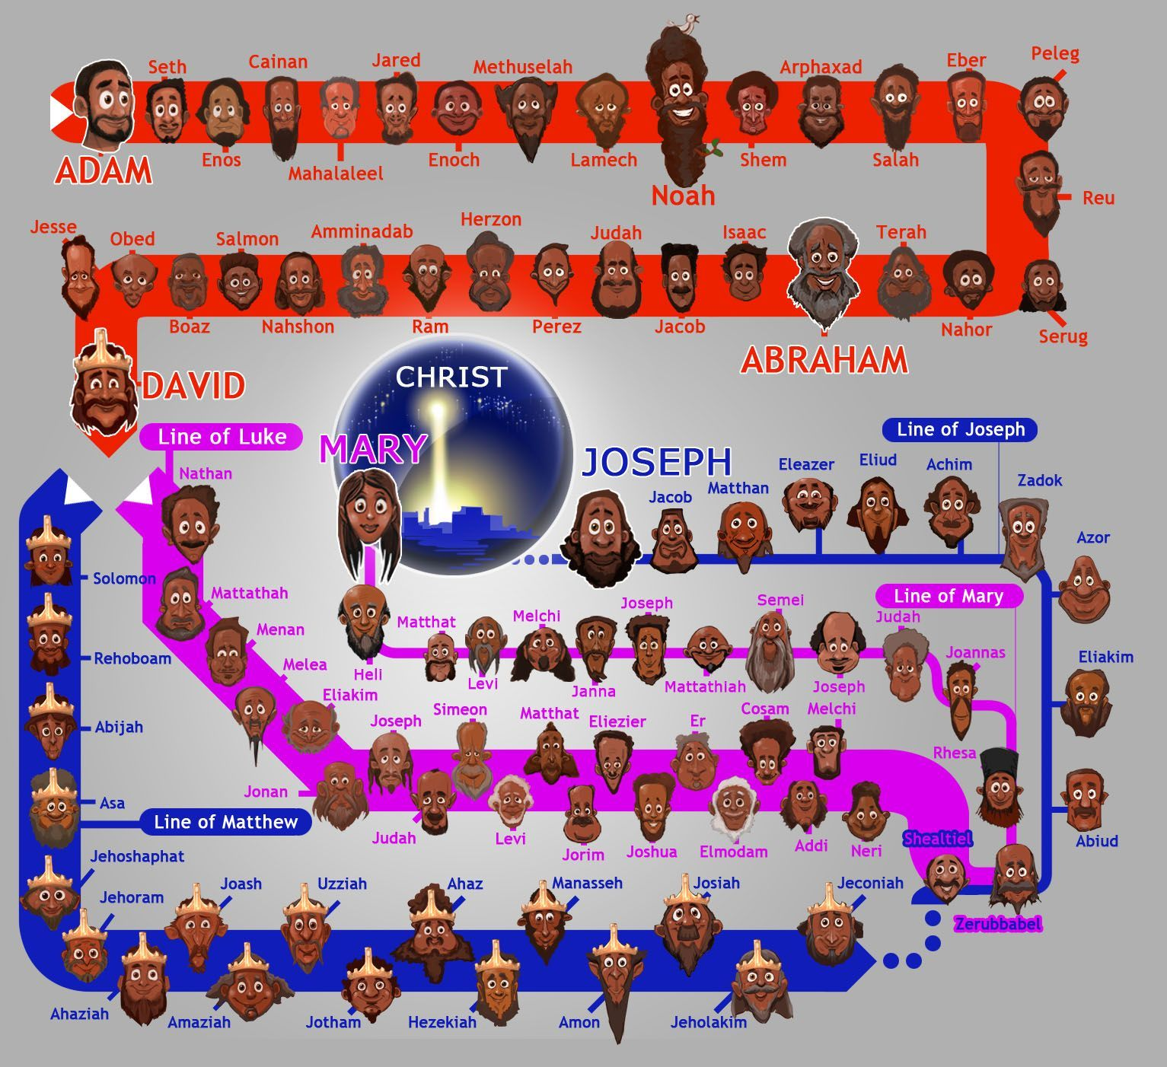
Jesus genealogies - creation.com

Slide 11

Requirement 3
List five ways to obtain family genealogy information
Talk to ancestors/family members
Internet
Library
Vital Records – birth/death/marriage/divorce records
Adoption Records
Religious Records – baptism/marriage/funeral/membership
Immigration/Naturalization records (Ellis Island, USA)
Mormon Church Records
Census data
Cemeteries
Ship Passenger Lists
Military Records
Obituaries
Newspapers
DNA matches ……etc

Slide 12
Requirement 4
Know at least 3 societies that help with genealogy research
The National Archives, London, UK
The Society of Genealogists
Federation of East European Family History Societies
Historical & Genealogical Societies of the U.S
Irish Genealogical Research Society
Family History Federation
The British Association for Local History
See https://en.wikipedia.org/wiki/Family_history_society
for more information

Slide 13



Requirement 5
Learn four steps important to genealogy research
1. Analyse what you already know
  Interview Family
  Check for family records at your house or those of relatives
  Check if previous research was done by other family members
Has someone done this before ?
What do I know already ?
Birth certificate

Slide 14




Requirement 5
Learn four steps important to genealogy research
2. Decide what you want to accomplish from the search
  Do you want to know just their names and when they lived ?
  Are you interested in finding out what occupations they had ?
  Did they travel far/immigrate ? do you have family overseas ?
  Do you have living relatives you know nothing about ?

Slide 15
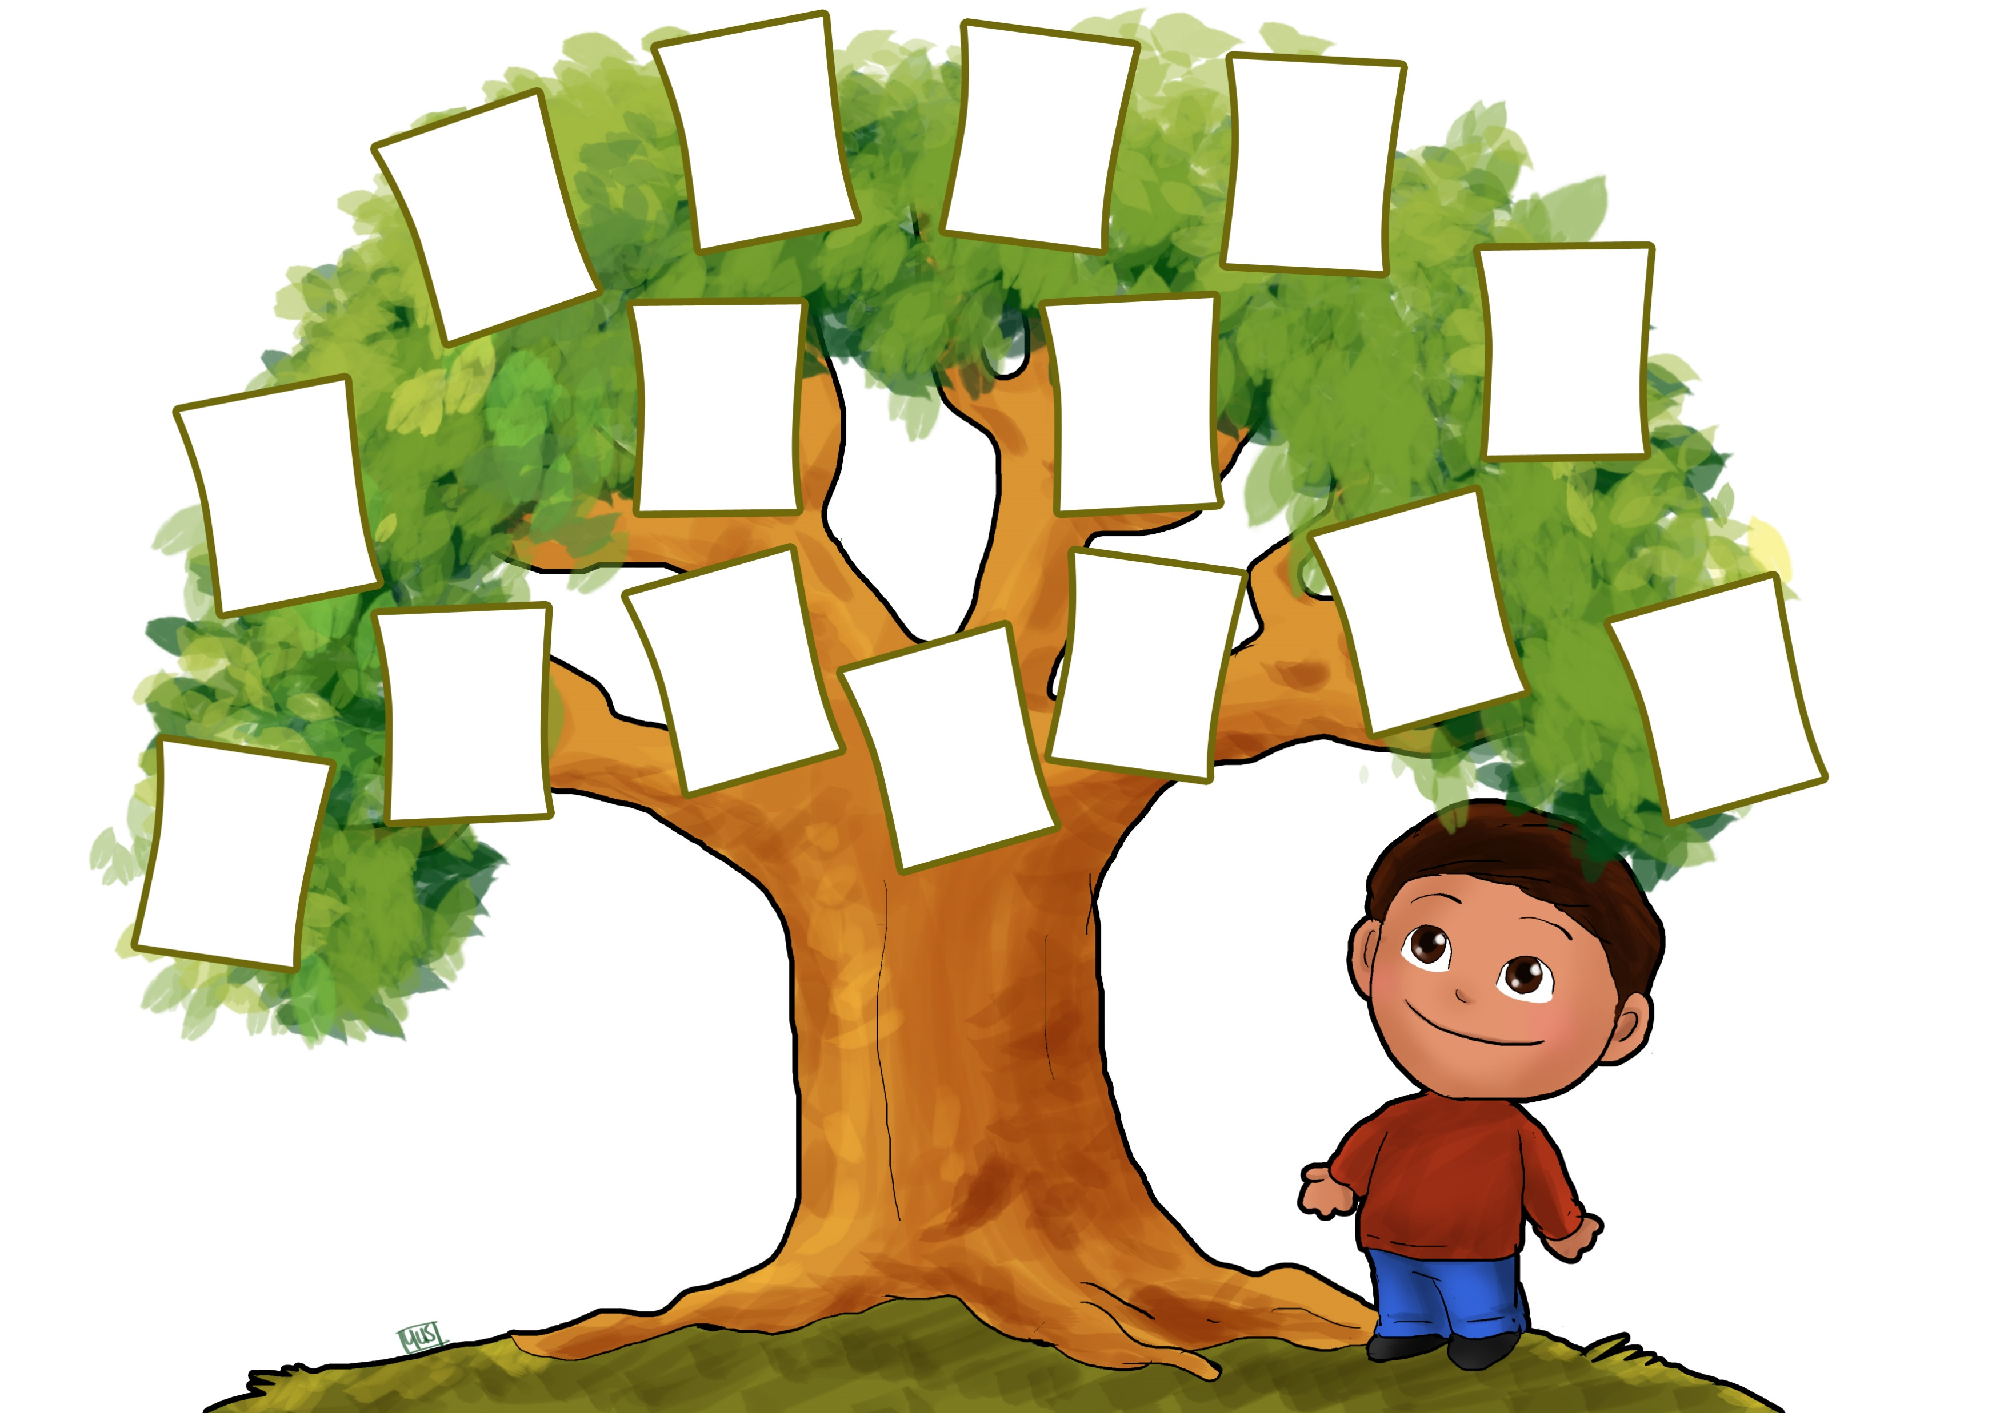
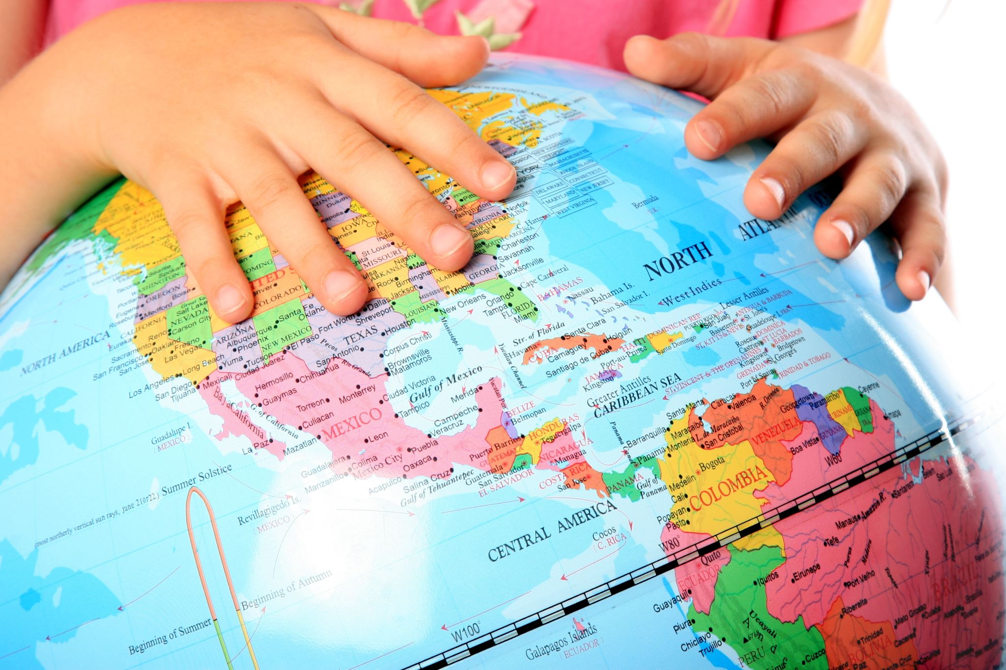

Requirement 5
Learn four steps important to genealogy research
3. Be organised/systematic
  Which side of the family are you researching first ?
  Organise your search by location & concentrate on each
  area until you have all the information you need/want/can find

Slide 16


Requirement 5
Learn four steps important to genealogy research
4. Begin your search
  Search the internet for all the information you can find
  Learn to be a detective to follow all the clues to find the
  information

Slide 17
Requirement 6
What is the purpose of documentation ?
To check and validate the data
By using documented data you won't run the risk of duplicating efforts that someone else has made
To pass on the information to future generations
Satisfaction of viewing actual artifacts
Others can help you continue your search if you reach a “dead end”
So that you don’t get confused or forget anything

Slide 18
Requirement 7
Define a primary source v a secondary source for documentation
Primary source (also called original source) - a document/ recording/other source of information (paper, picture,....etc.) that was created at the time being studied, by an authoritative source, usually one with direct personal knowledge of the events being described.
It serves as an original source of information about the topic.
Examples include:
Birth, Marriage, and Death certificates
Family Bibles (if recorded by someone witnessing the event shortly after it occurred)
Letters describing the events as they are taking place by a person involved

Slide 19
Requirement 7
Define a primary source v a secondary source for documentation
Secondary source – a document/recording that relates/discusses information originally presented elsewhere. It contrasts with a primary/original source of information. Involves generalisation, analysis, interpretation or evaluation of the original information.
Secondary source examples include:
History books
Internet
Letters written well after the event
Oral histories as told by someone without first-hand
knowledge of the event
Primary & secondary are relative terms - some sources
may be classified as primary or secondary, depending on
how they are used.

Slide 20
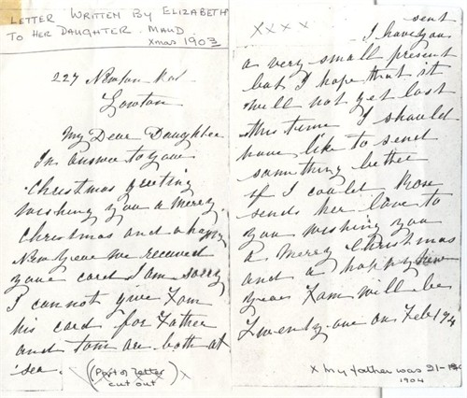
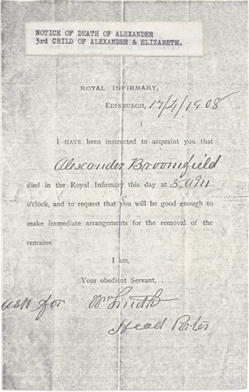
Requirement 7
Notes:
Is primary or secondary ?

Slide 21
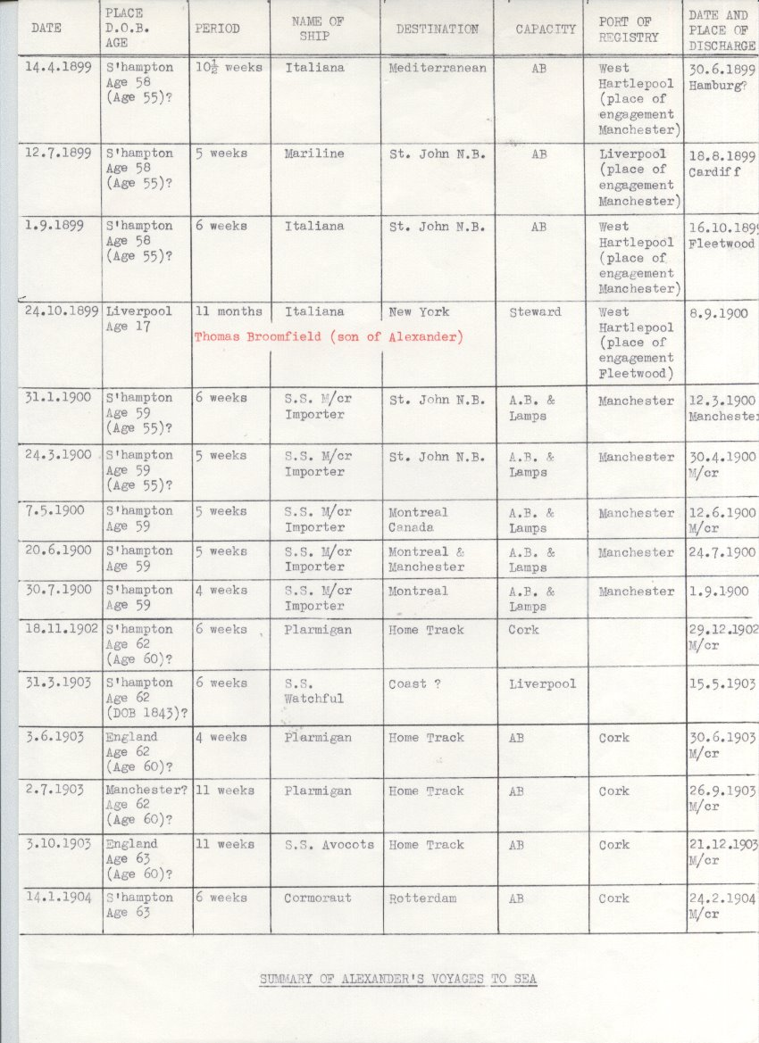
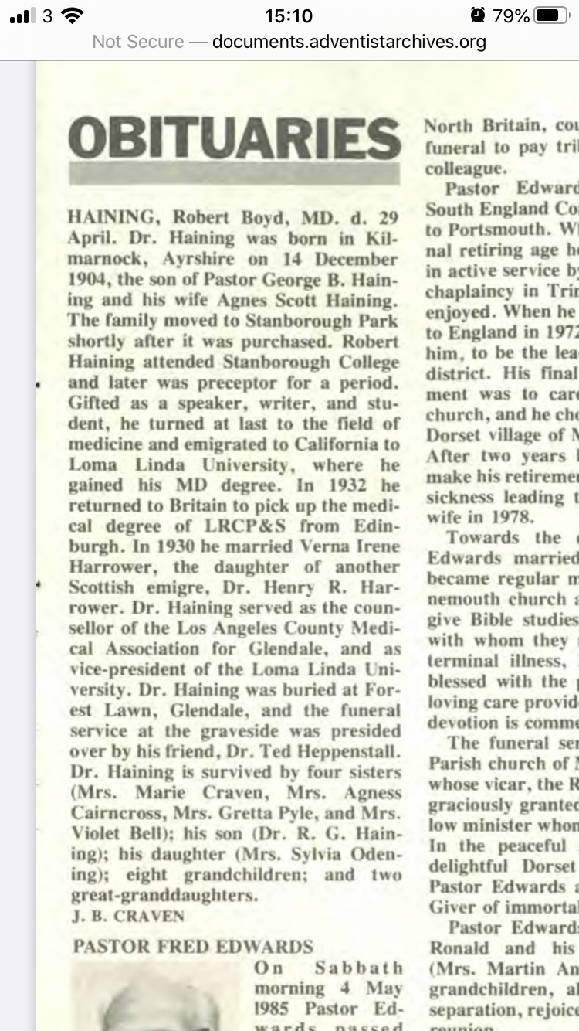
Requirement 7
Notes:
Primary or secondary ?

Slide 22
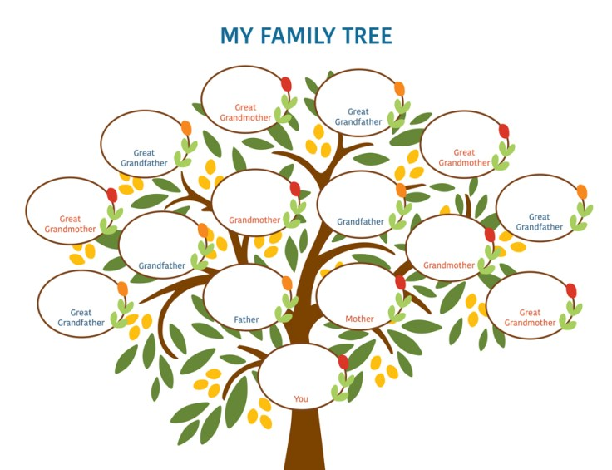
Requirement 8
Prepare a four-generation family chart – beginning with yourself.

Slide 23
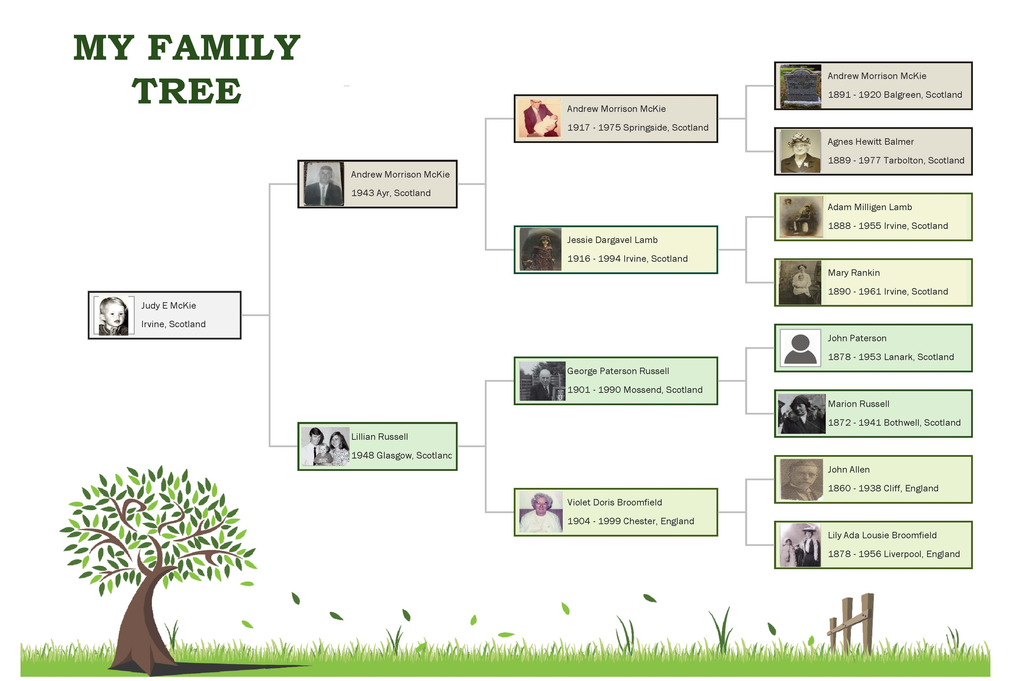

Slide 24
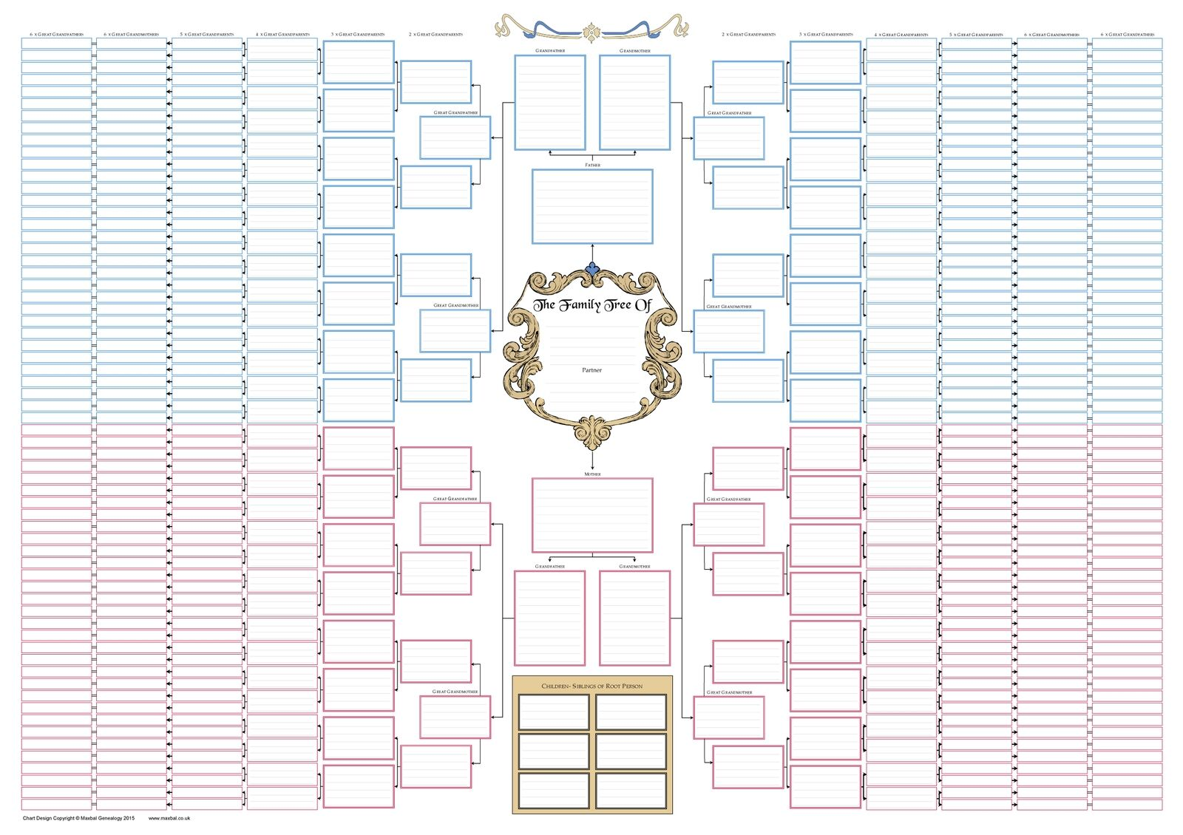
Requirement 9
List ways to record your genealogy information
Family tree chart

Slide 25
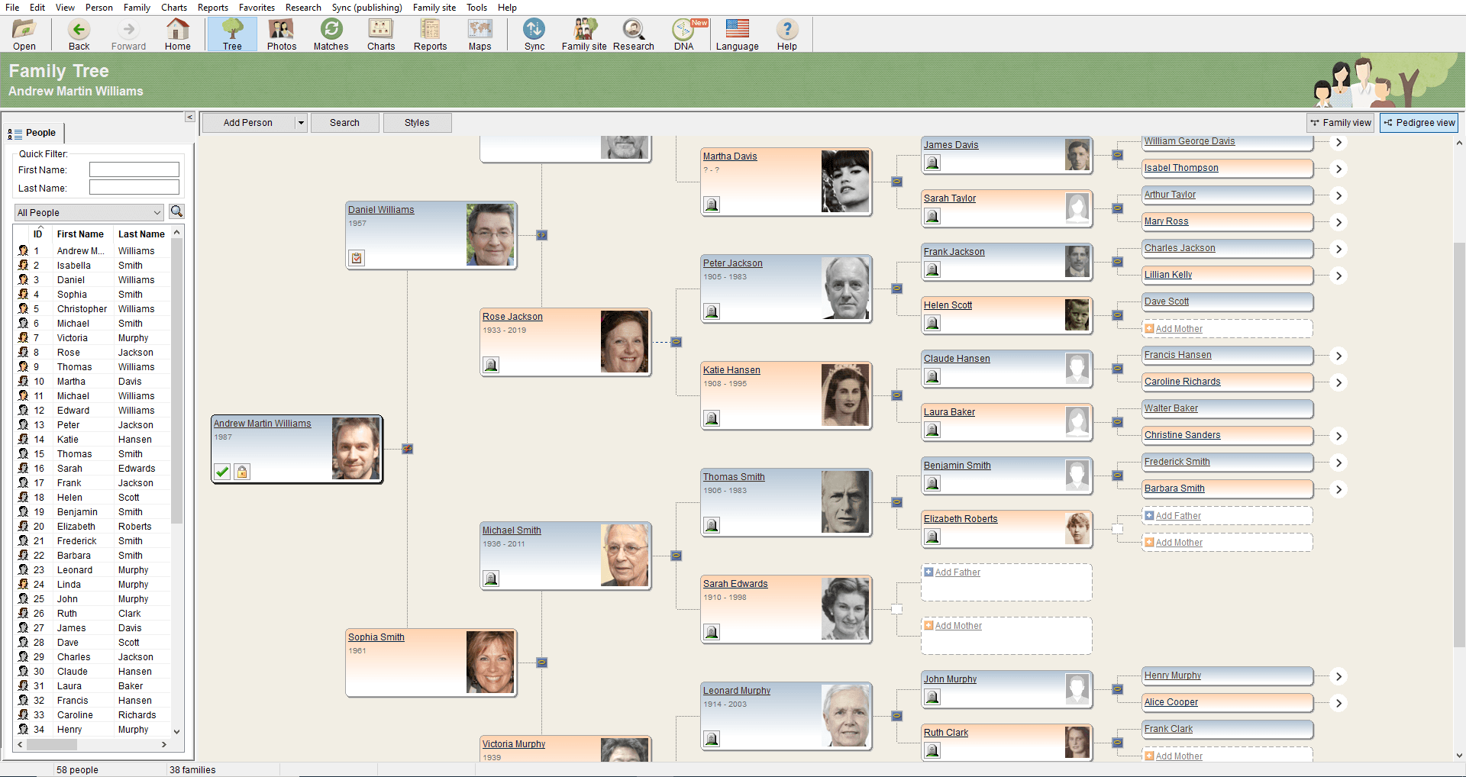
Requirement 9
2. Computer genealogy program

Slide 26
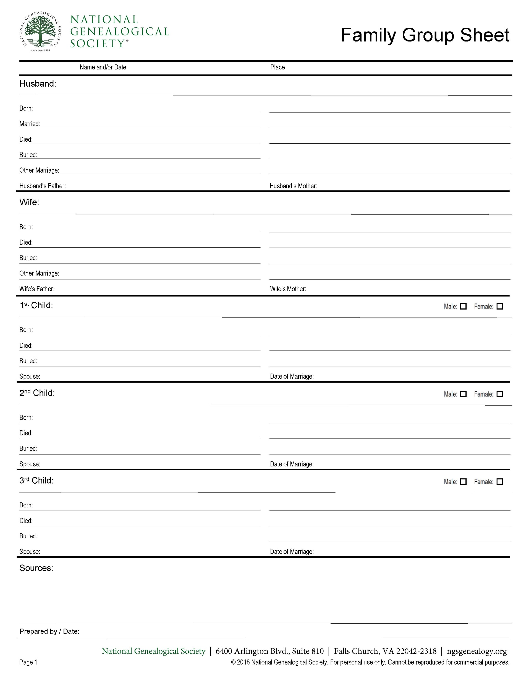
Requirement 9
3. Family group sheets

Slide 27
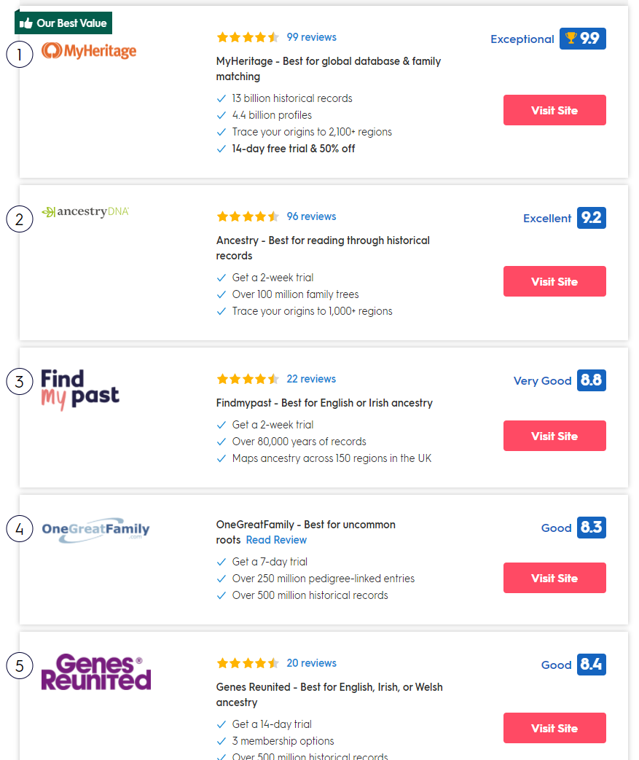
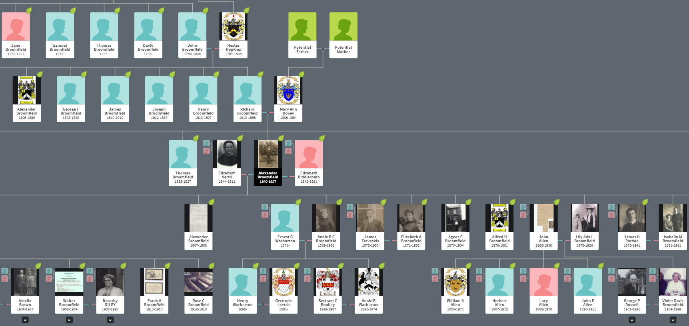
My tree
on Ancestry
Notes:
I have been through a number of the sites but I finally chose Ancestry to do my research and tree

Slide 28
Requirement 10
Research your family history by talking/writing to your oldest living relative.
Let your relative know ahead of time that you’re interested in family history. They may surprise you with a wealth of
documentation, and be happy to share this information with you.
You might get to read love letters your great-grandfather wrote to you great-grandmother
see photos you’ve never seen before
Hear stories of long-dead relatives
learn things you never knew about living relatives (maybe your parents ☺)
It’s a good idea to record what they say so you can listen
to the conversation again. Such a recording will become
a valuable part of your family's history.

Slide 29

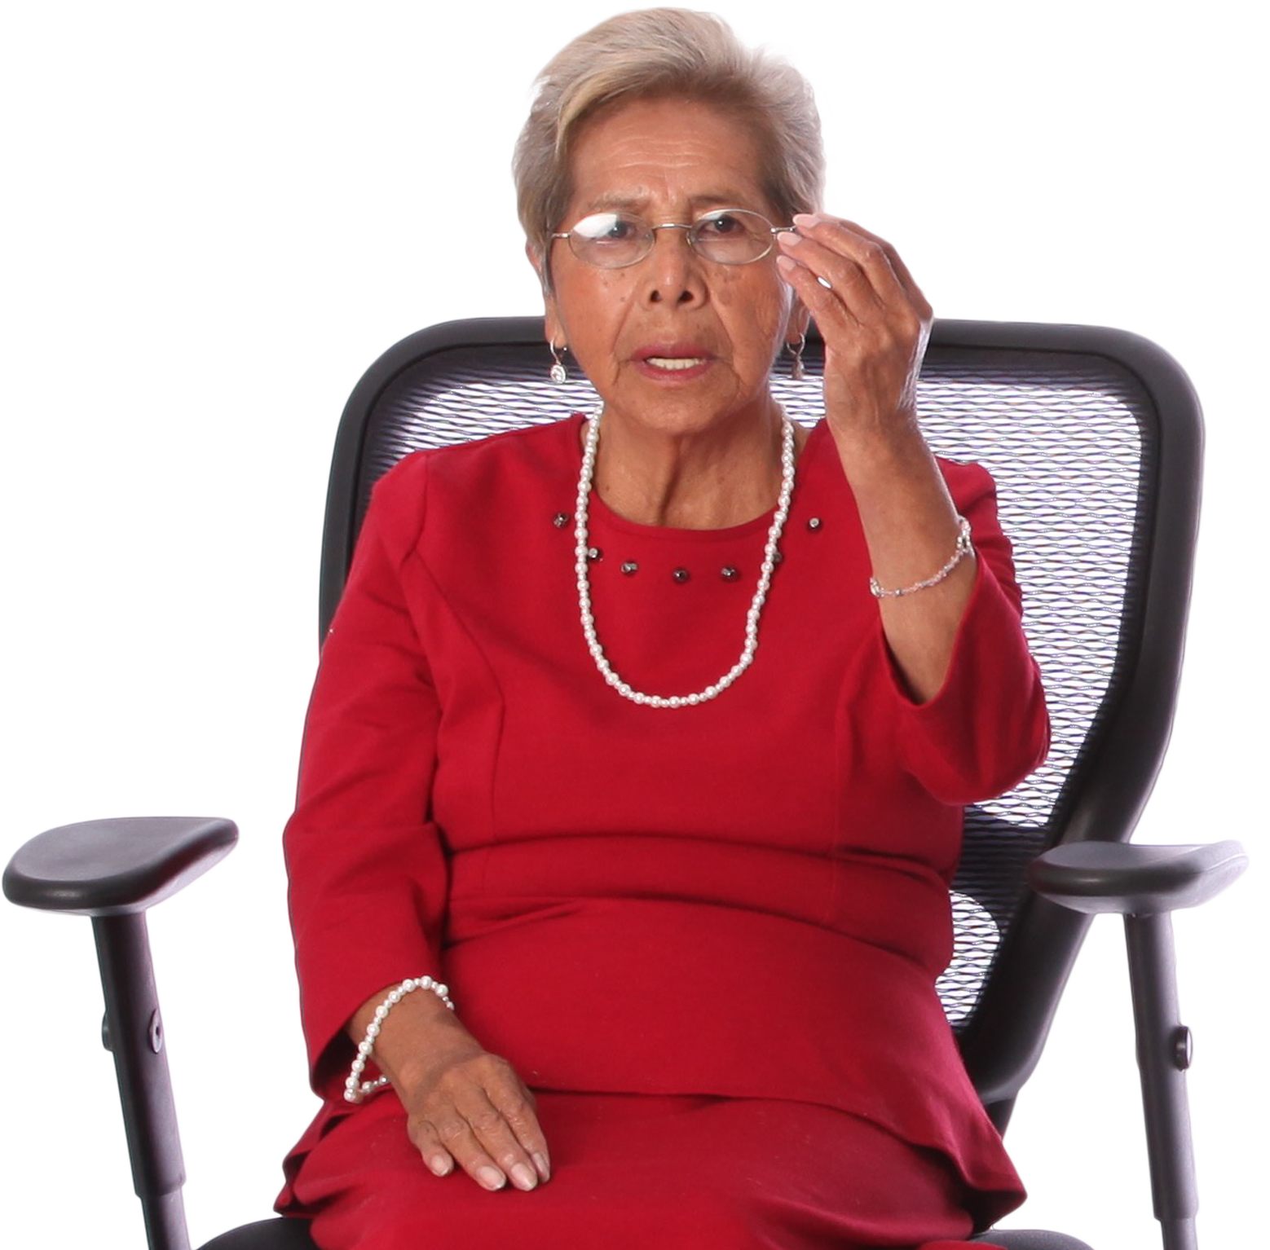
Ask the following:
First memory
When and where they were born ?
First church they remember attending ? (if applicable)
Name of schools, and location, they attended
Where did they live at age 10 & 14 ?
Did our ancestors emigrate? If so, from which country ?
Where and when were they married ? (if applicable)
If they had children please give names, place and date of birth
Write to your relative & thank them for their time - include a photo of yourself. Ask them if they would be willing to share a copy of an older family photo with you.

Slide 30
Things you could investigate with your relative:
With parental permission, use google street maps to see if the schools, early homes and first churches mentioned by your relative still exist.
Print out a modern photo of each setting and compare it with an original photo to see how much has changed.
Look at ordnance survey maps also to see how the general area around homes have changed. Was there more farmland around back then? Were there fewer houses and roads?
If you/your relative are from another country or a distant part of the same country, you may not have seen any of these locations
Most likely your relative(s) will be taken on a trip down memory lane looking at google street maps!

Slide 31
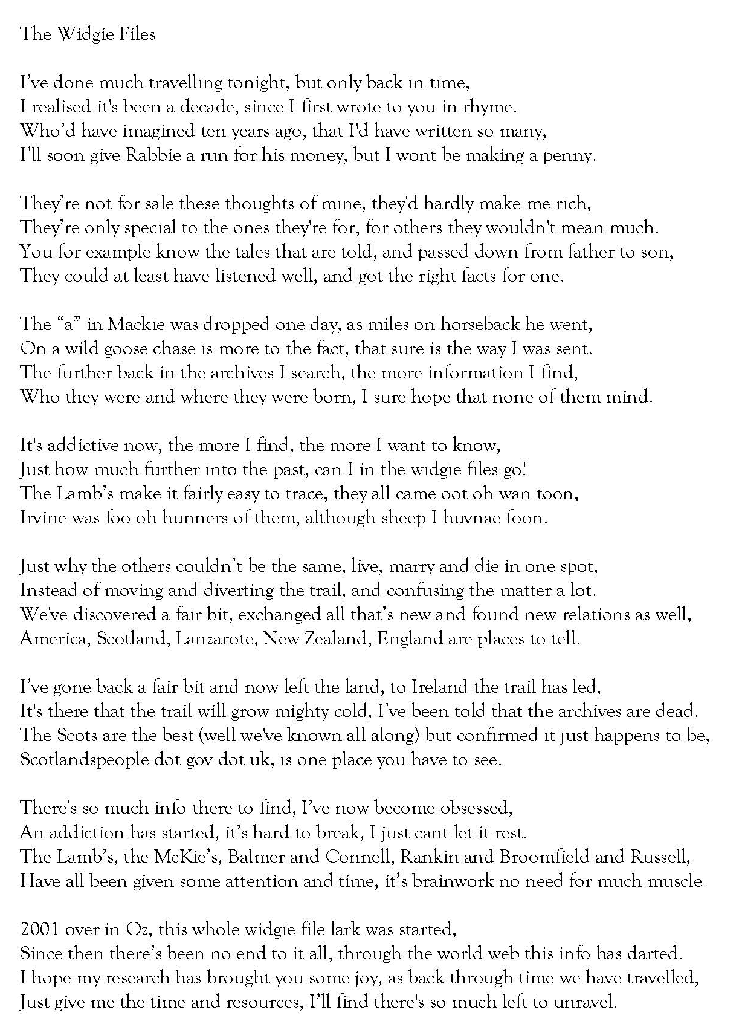
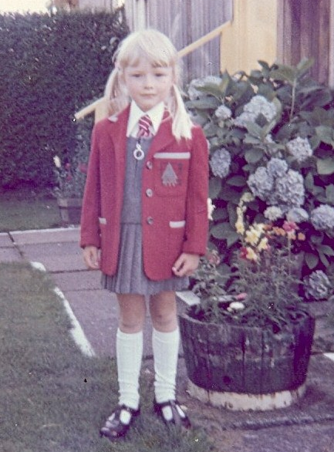
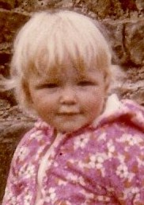
Requirement 11
Make a historical record of your life including:
  Genealogical chart
  Records about your life
  Pictures
  Stories
  Share this with your group/club/school
  Scrapbooking is a useful way to present a personal/family history
  Https://youth.adventistchurch.org.uk/e-club-scrapbooking-honour

Slide 32
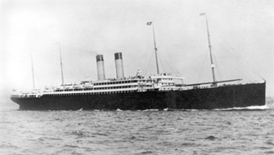
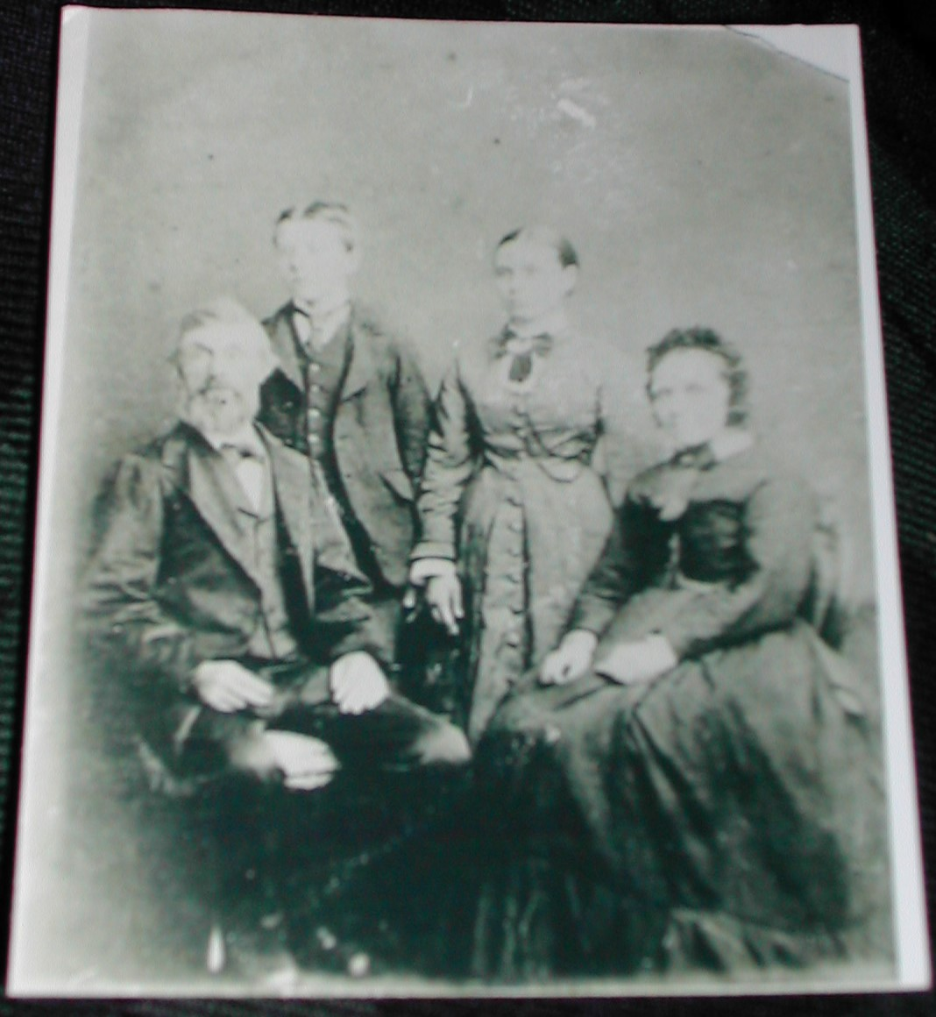
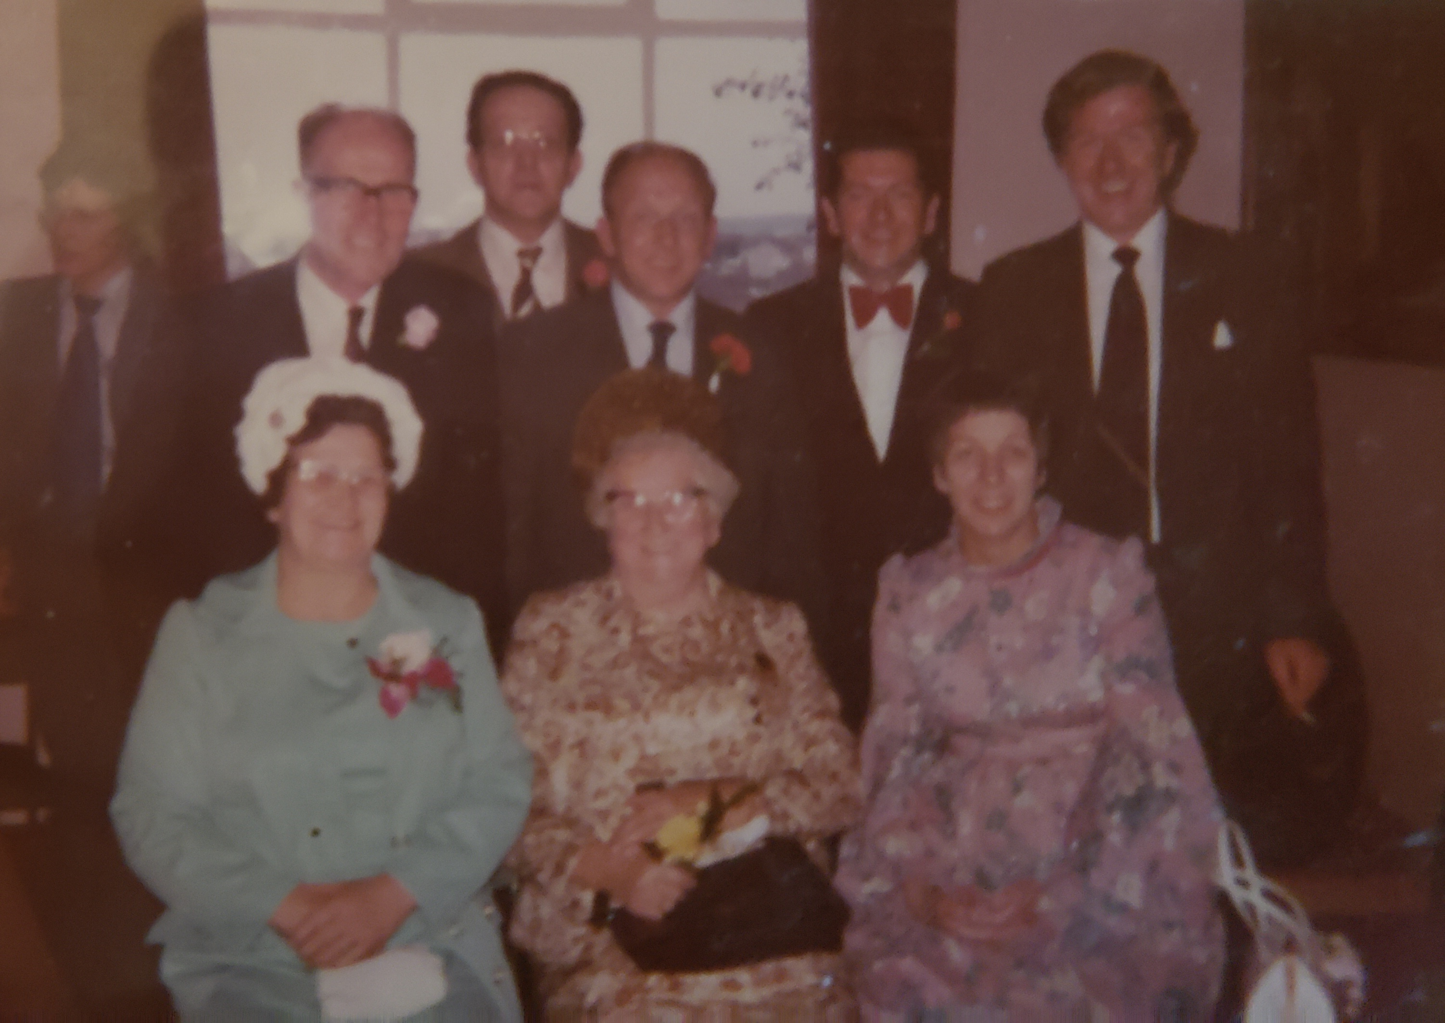
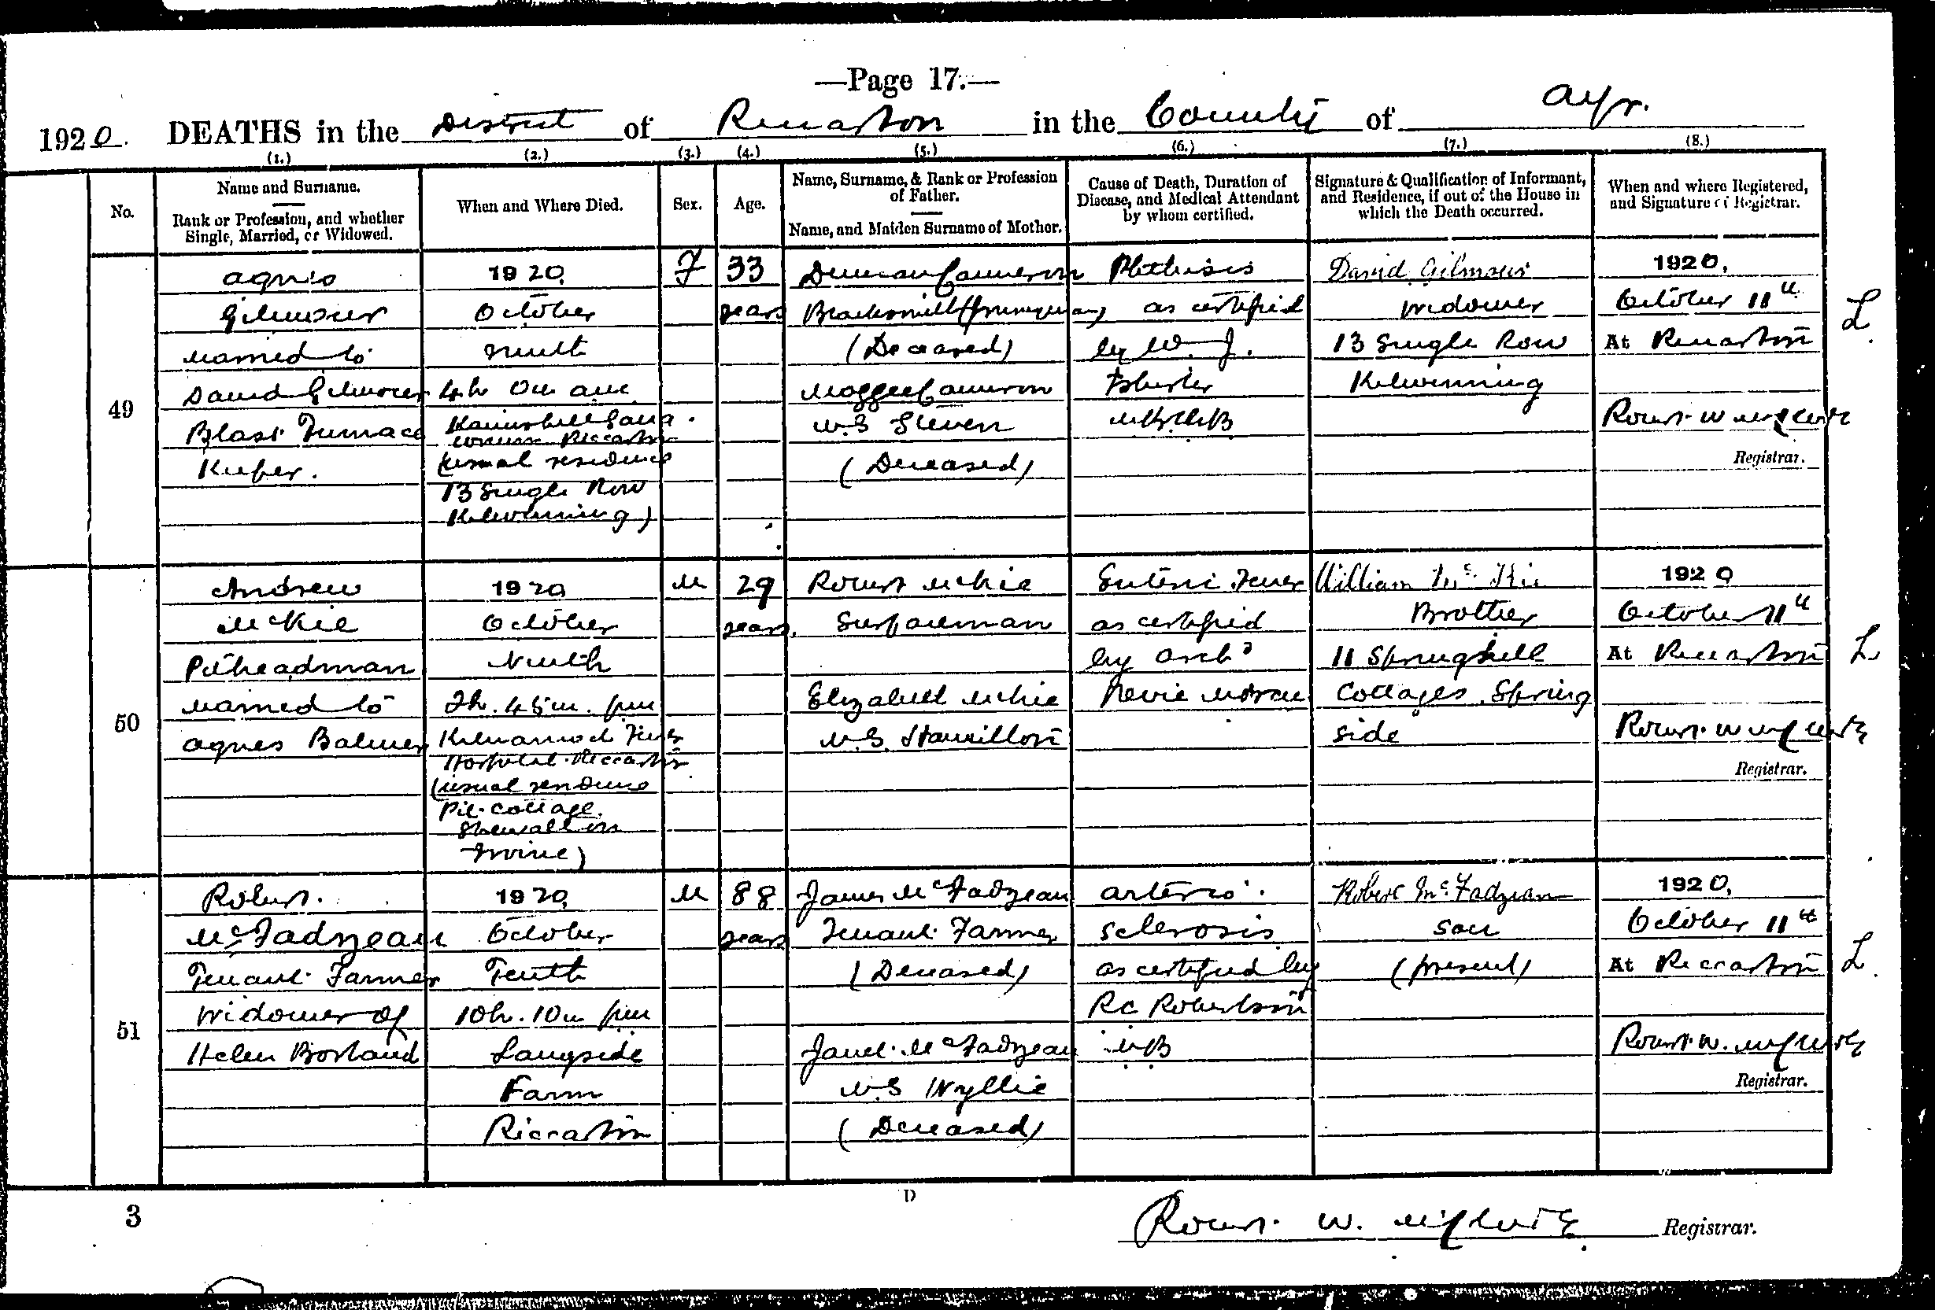
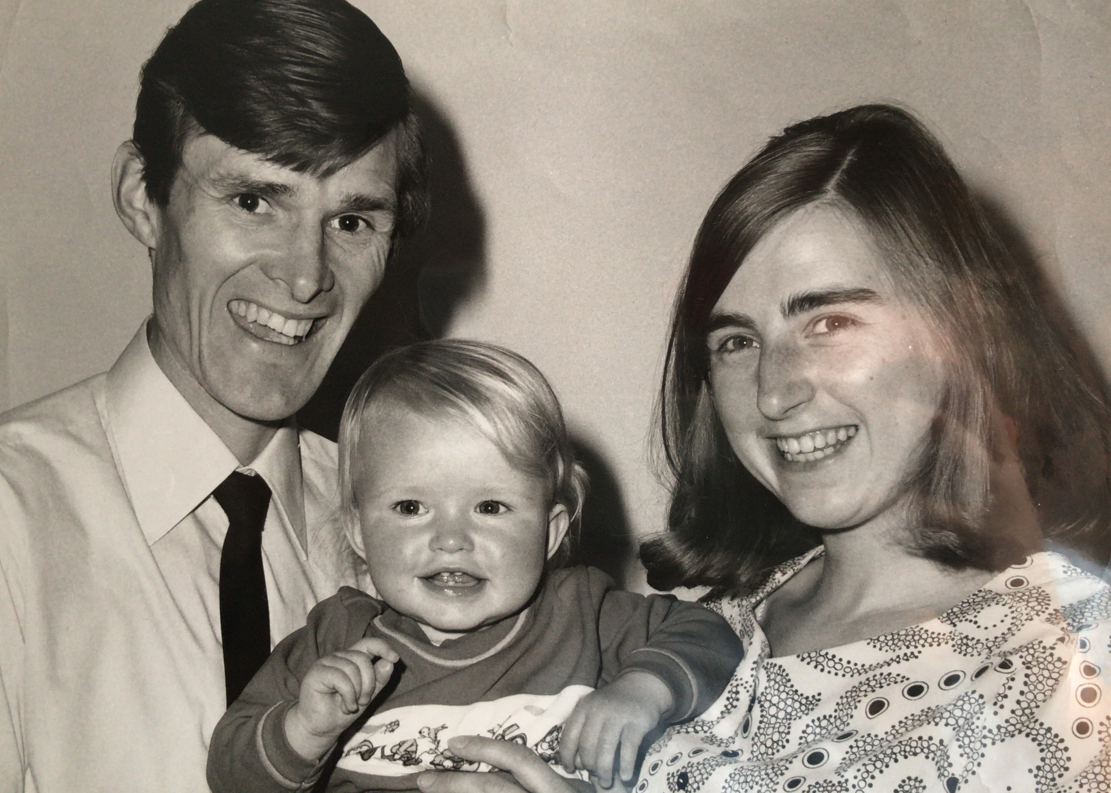
Requirement 11
Notes:
Here you can see a photo of the ship some of my ancestors travelled on; a death certificate of my ggrandfather, my gfather and his siblings, my parents and I and a letter from my gggmother to one of her daughters

Slide 33
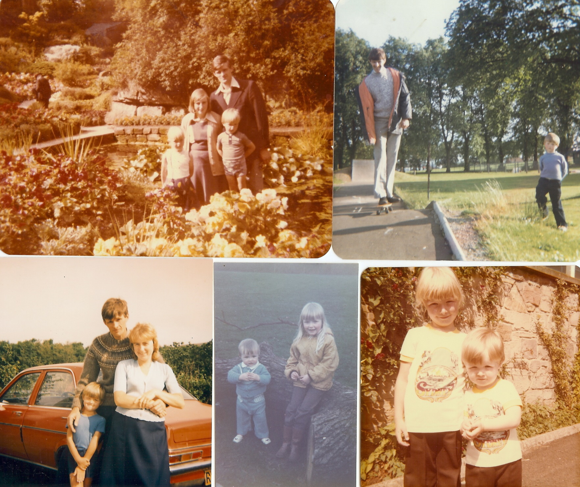
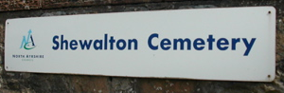
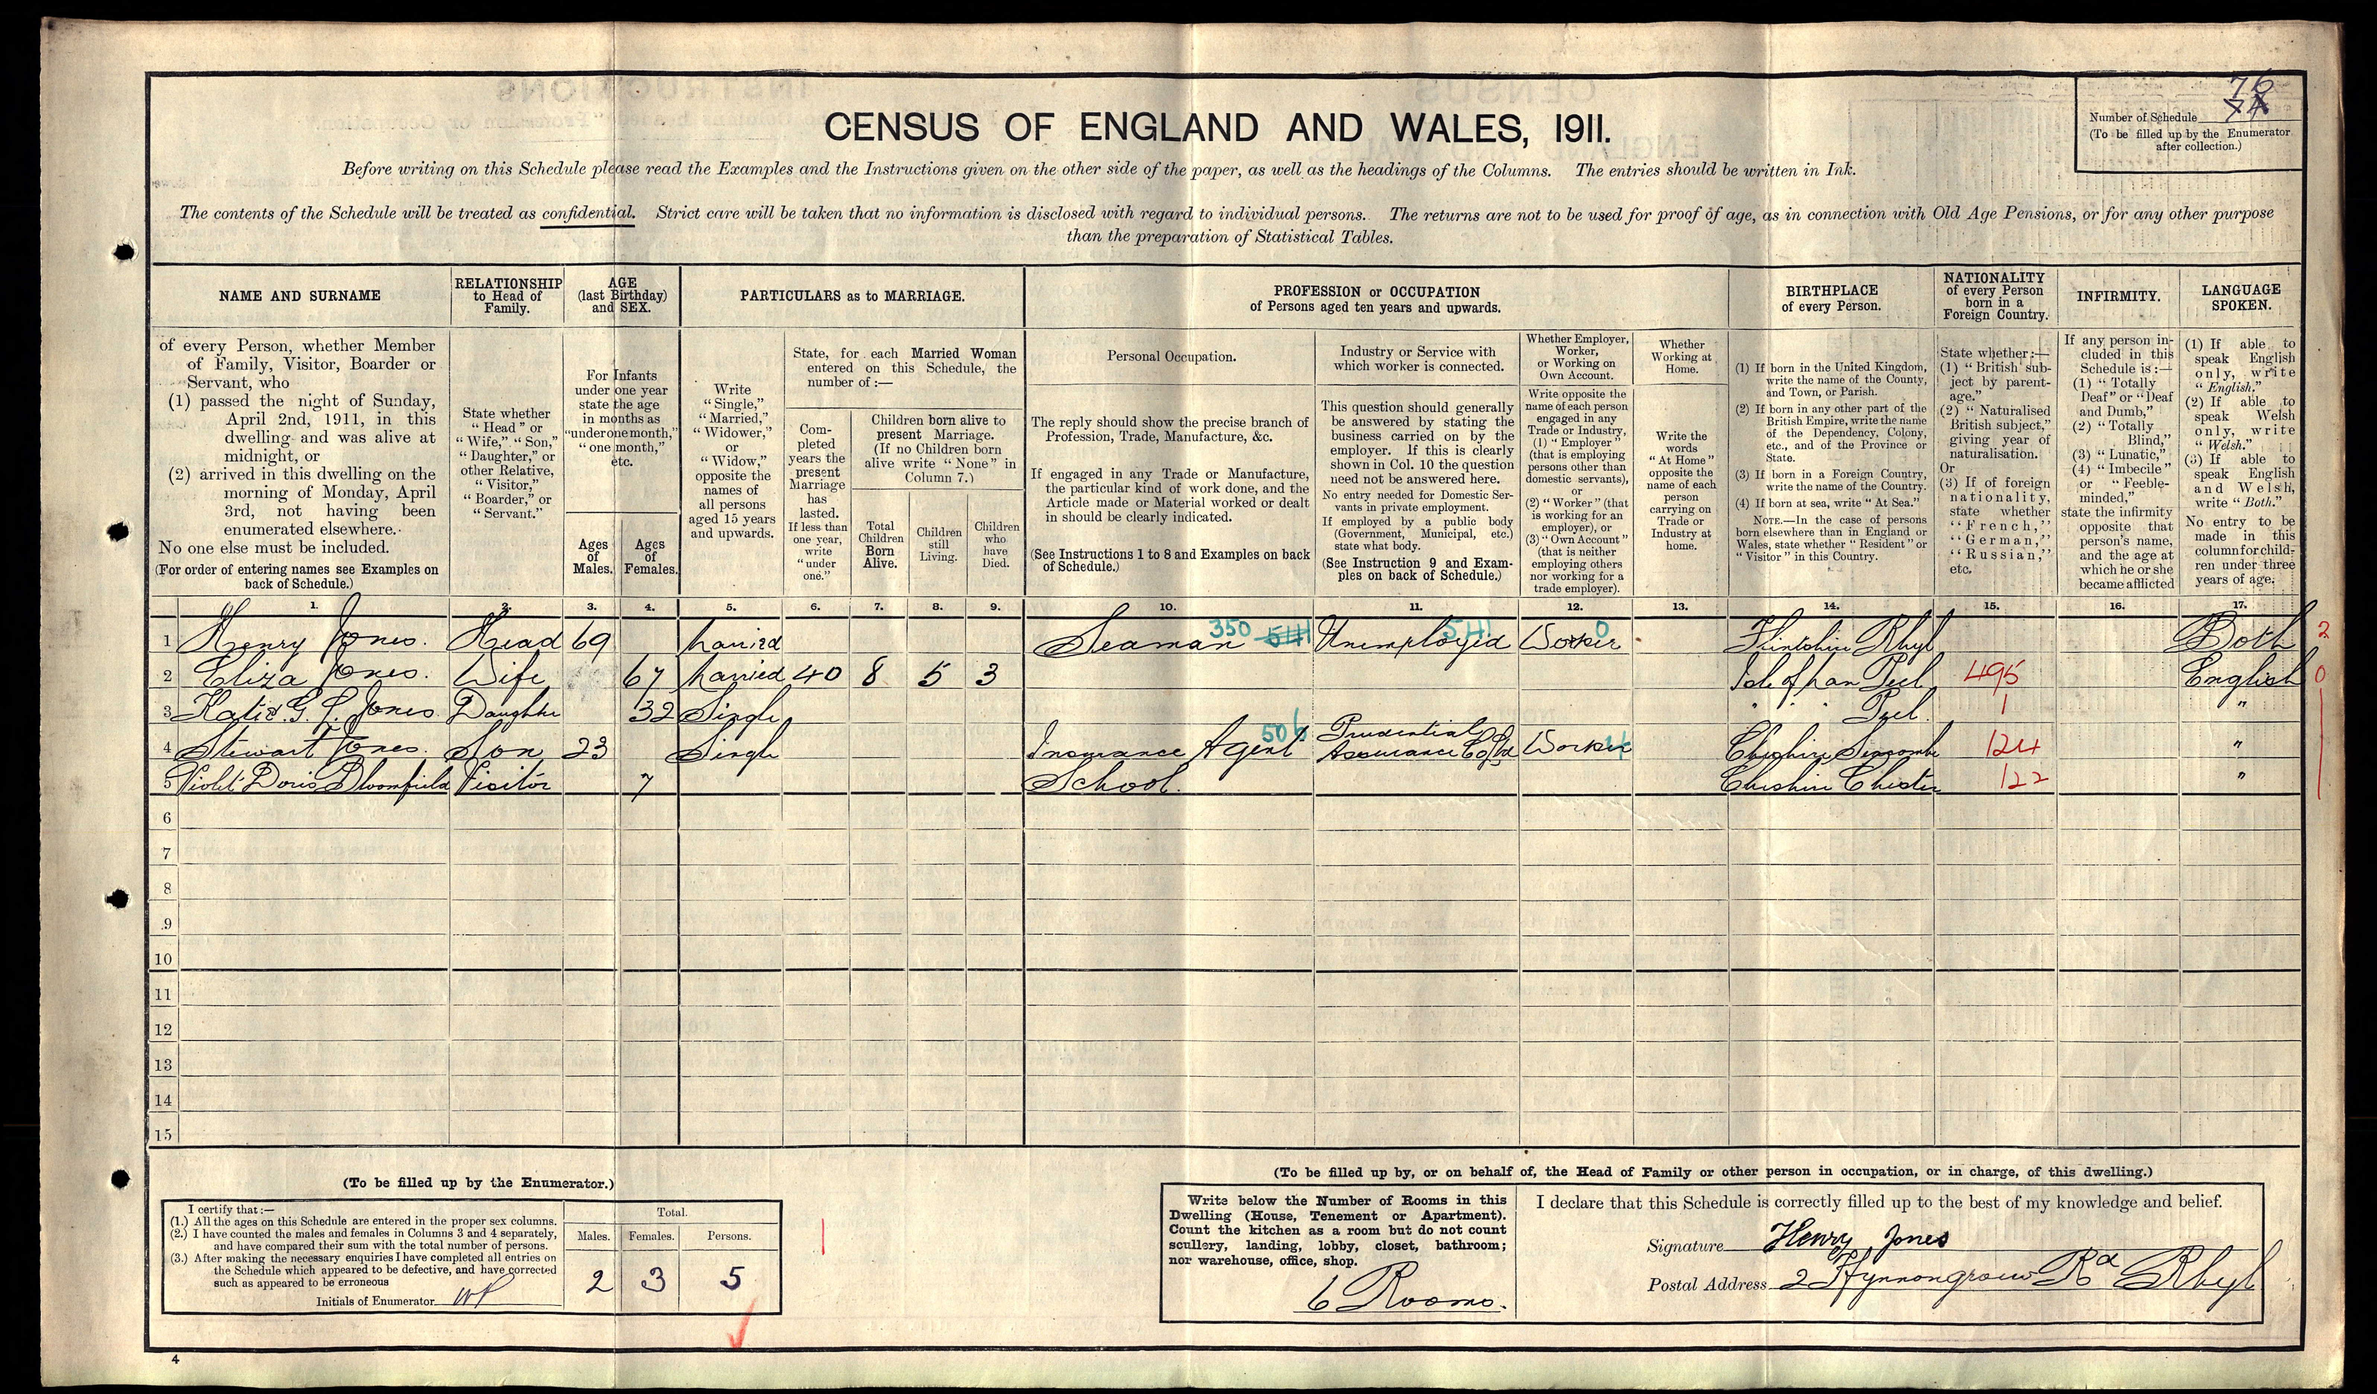
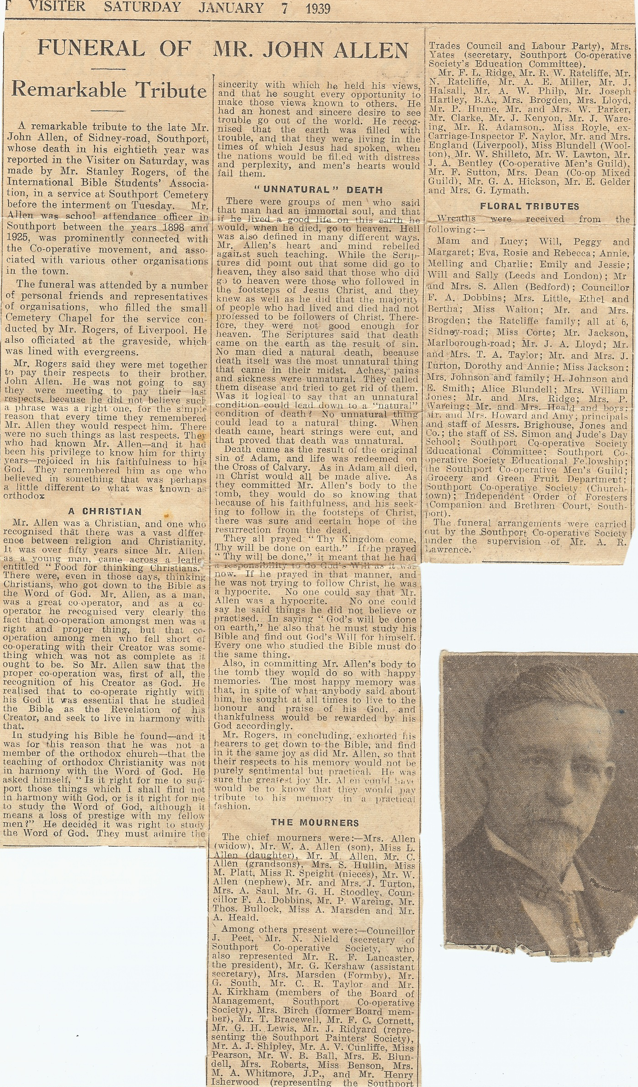
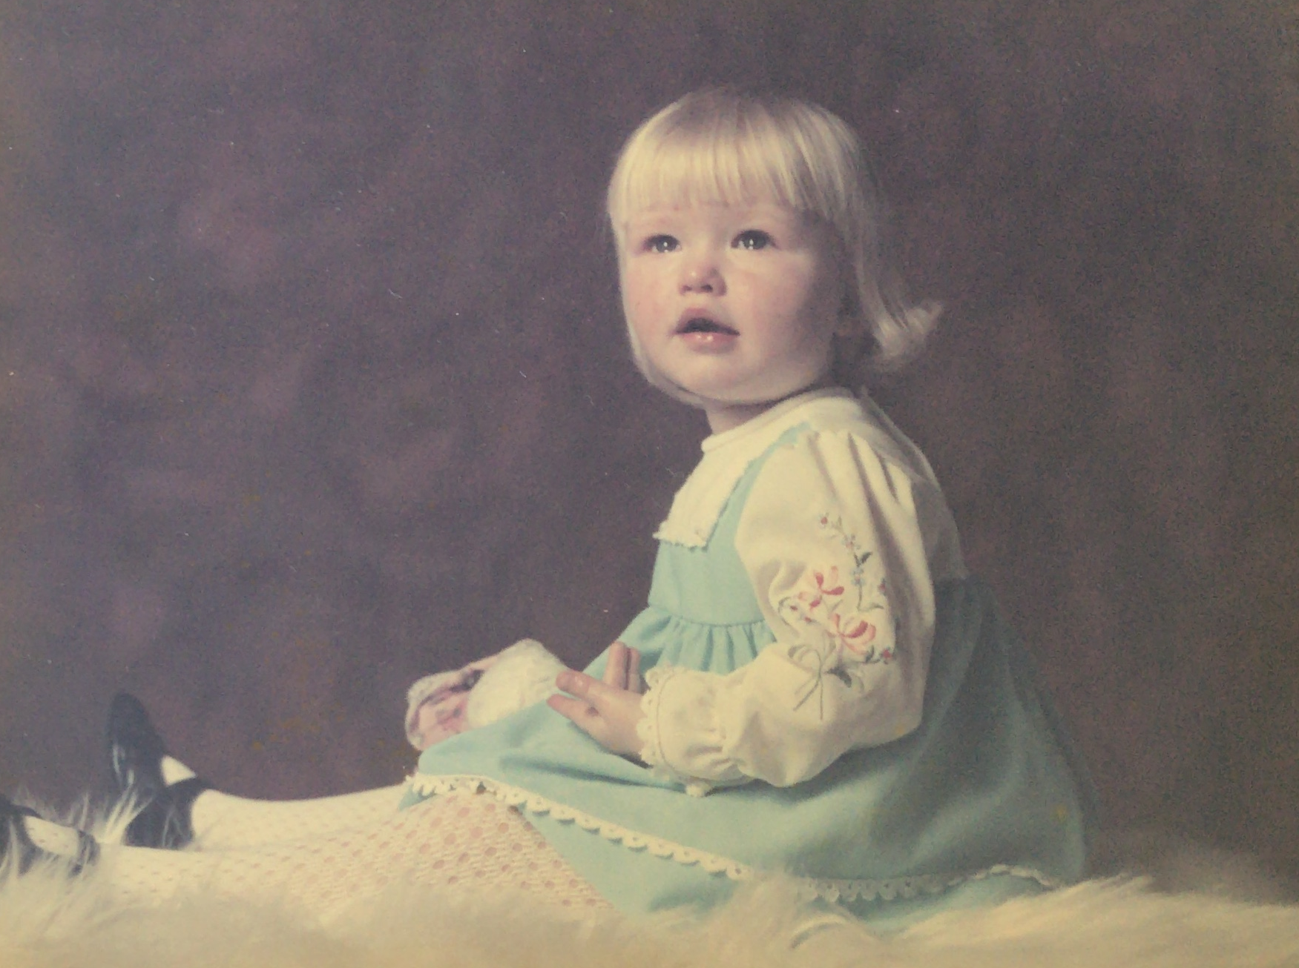
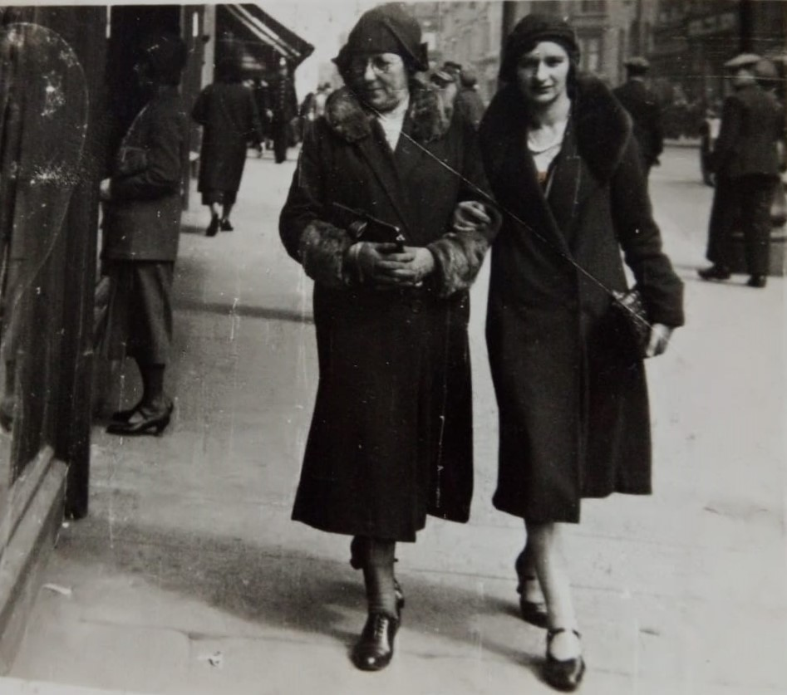
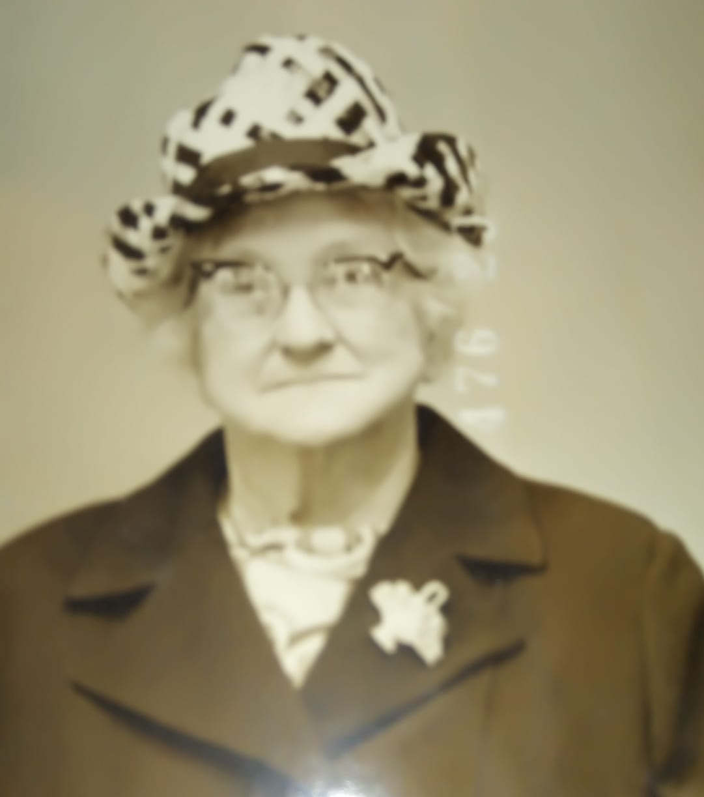
Requirement 11
Notes:
More family photos, census from 1911 of my Nana & a newspaper obituary

Slide 34
Census Records
What is the census and why was it compiled ?
A head count of everyone in the country on a given day. They’ve been taken in England/Wales, and separately for Scotland, every 10 years since 1801 (with the exception of 1941)
The object wasn’t to obtain detailed information about individuals, but to provide information about the population as a whole; listing everyone by name, wherever they happened to be on a single night, was the most efficient way to count everybody once, and nobody twice.
How was it taken ?
Every census year a form (schedule) was delivered to each house in the country & head of the house was instructed to give details of everyone who slept in that dwelling on census night, (always a Sunday).
The completed forms were collected and from 1841 - 1901 the information was copied into enumeration books (this is what we still use today online or on microfilm to check details)
1841 census was the first to list the names of every individual
The General Register Office was responsible as it already had everything in place for the registration of births, marriages and deaths.
https://www.nationalarchives.gov.uk/help-with-your-research/research-guides/census-records/
Notes:
1841 makes it the earliest useful census for family historians. However, less information was collected in 1841 than in later census years.

Slide 35
Census Records
What dates were they taken ?
1841 – 6 June 1851 – 30 March 1861 – 7 April
1871 – 2 April 1881 – 3 April 1891 – 5 April
1901 – 31 March 1911 – 2 April 1921 – 19 June
1931 – 26 April
1941 – no census because WWII. A census took place in 1939 so everyone could be issued with a national identity card
1951 – 8 April 1961 – 23 April 1971 – 25 April
1981 – 5 April 1991 – 21 April 2001 – 29 April
2011 – 27 March 2021 – 21 March
When can I see the details of the census ?
Due to UK privacy laws, 100 years must pass before the public can access census records. The 1921 Census is the next one to be released in 2022.
How do census records help me with genealogy research?
The records contain a lot of information about family members; where they were living; where/when they were born; occupations; whether they were married/could read. Over the years the amount of information gathered increased.
Notes:
Why have I made some of them purple ?

Slide 36
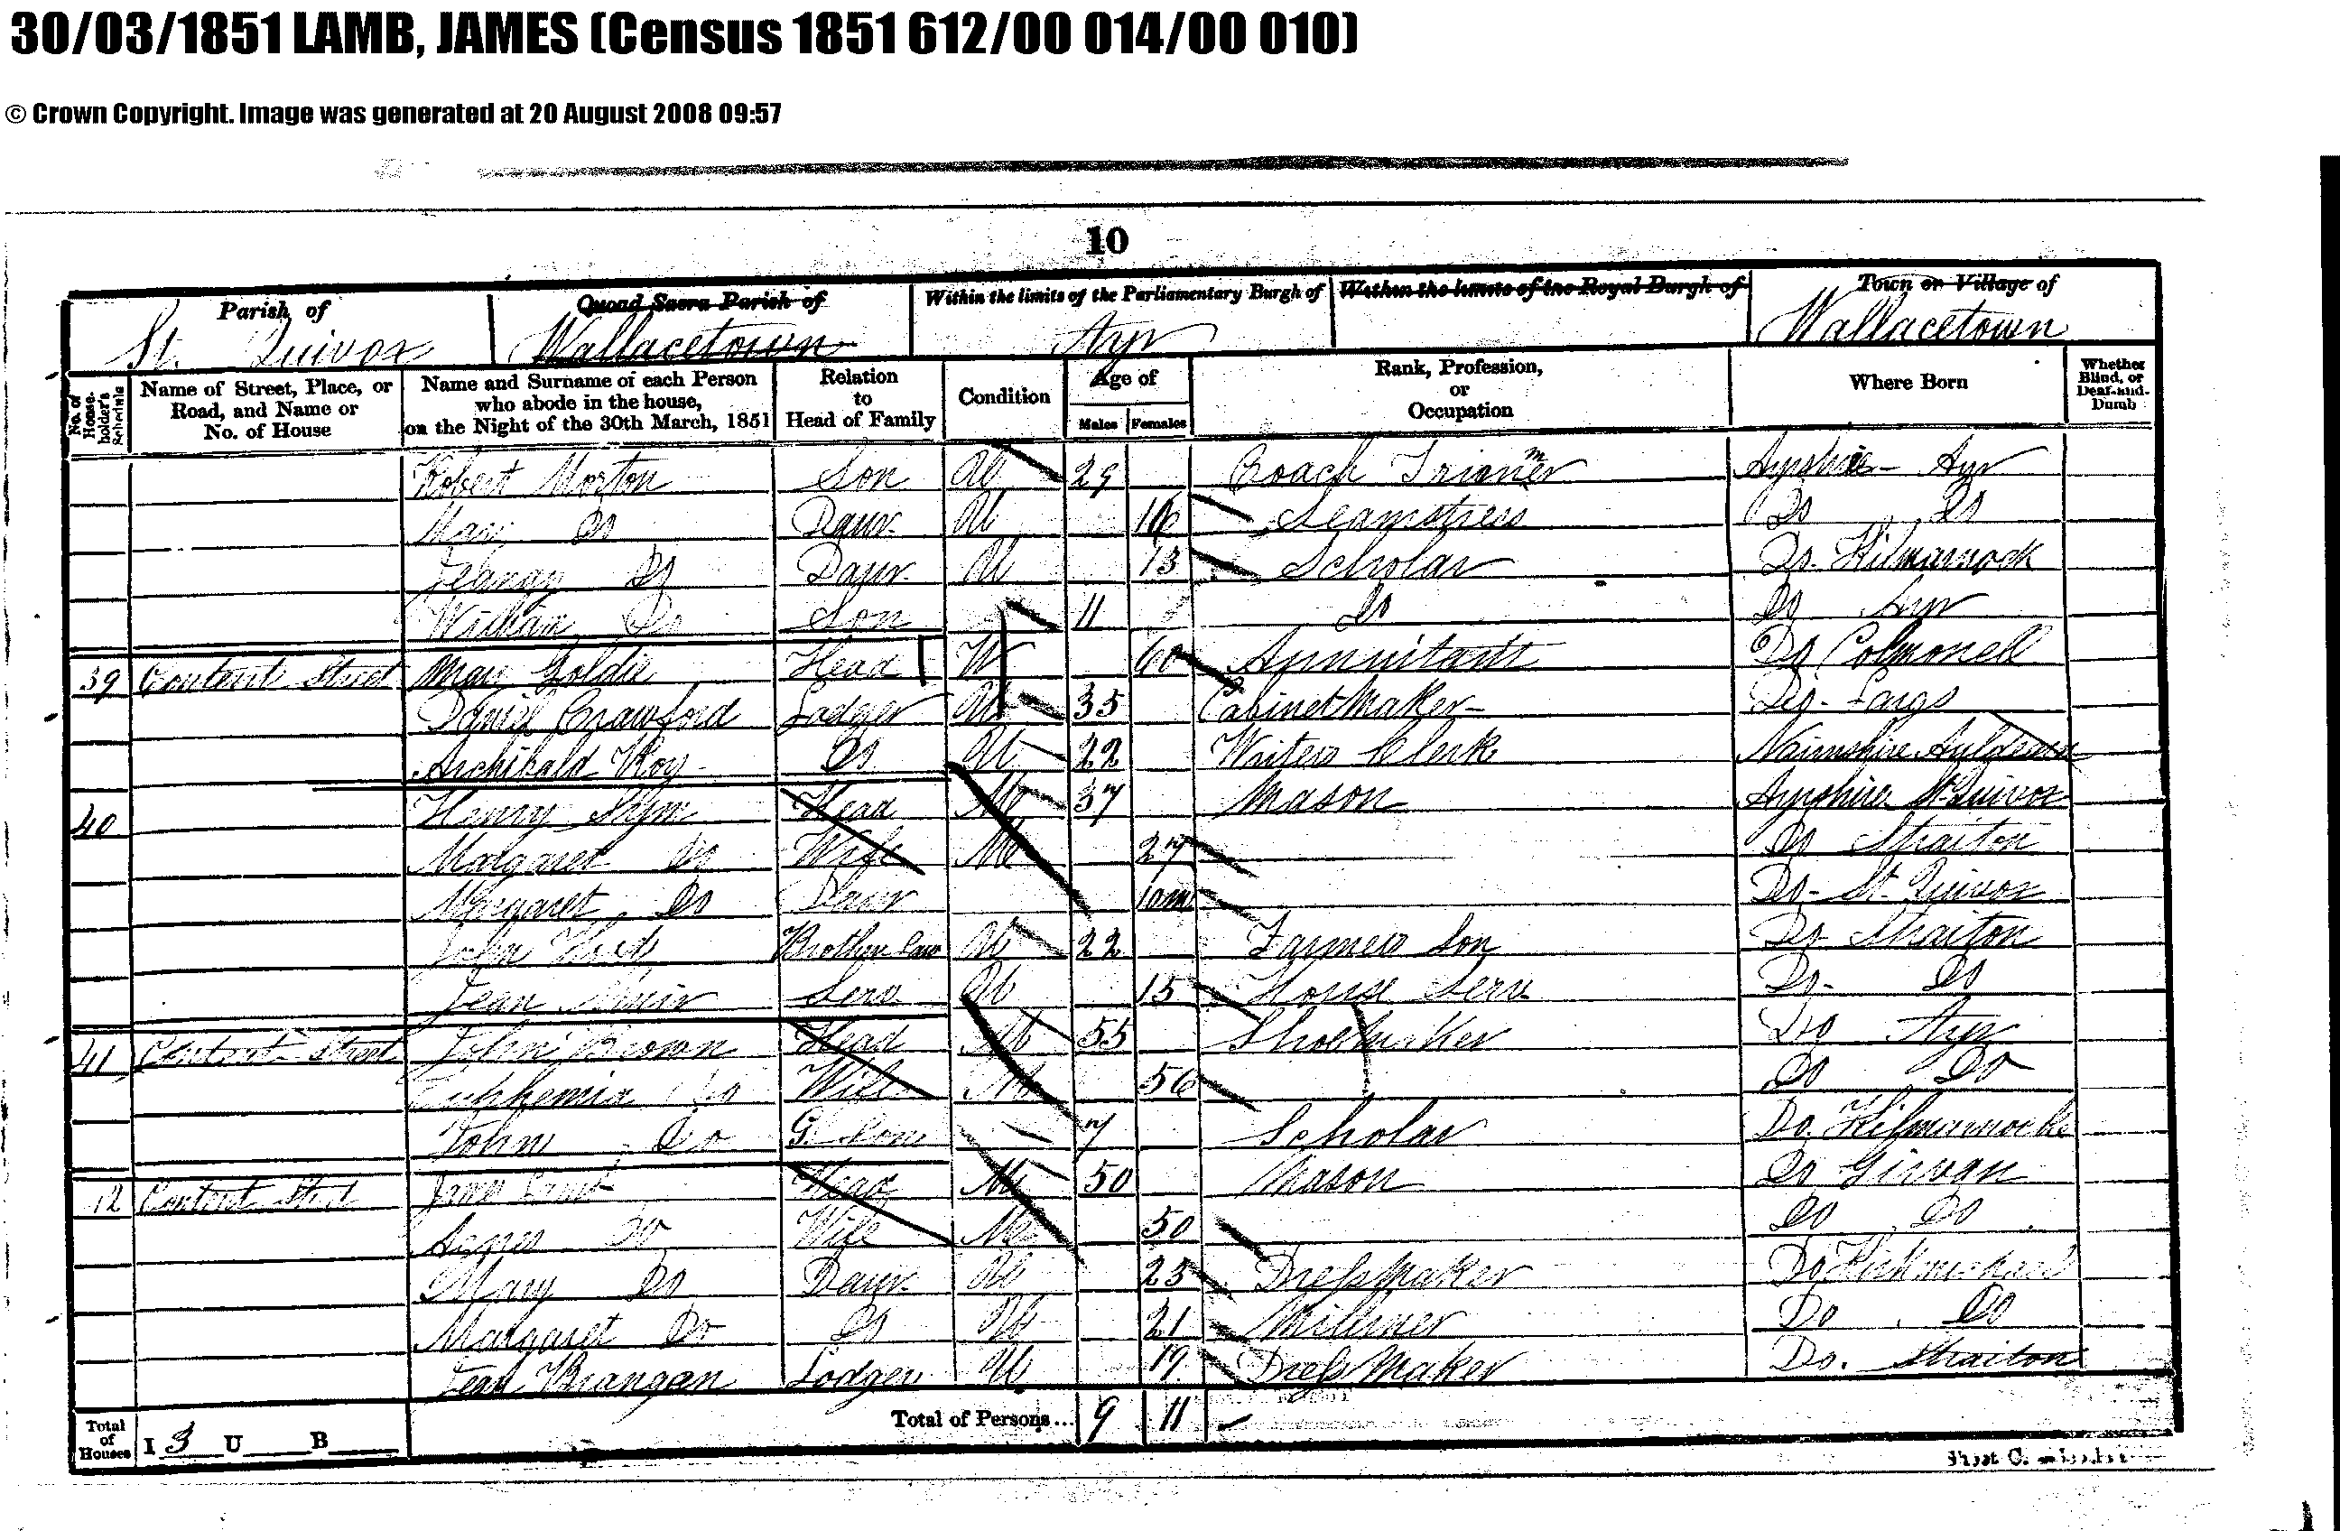
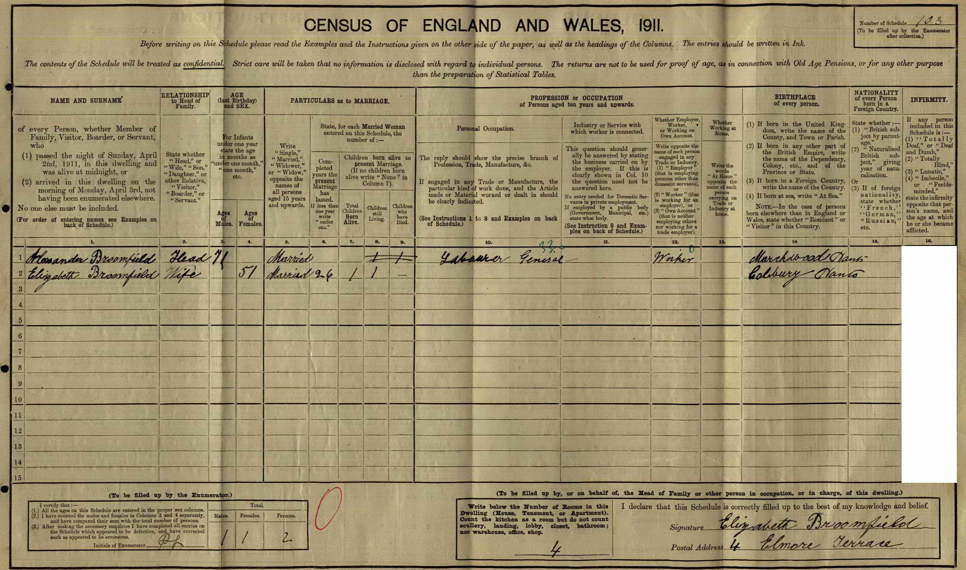
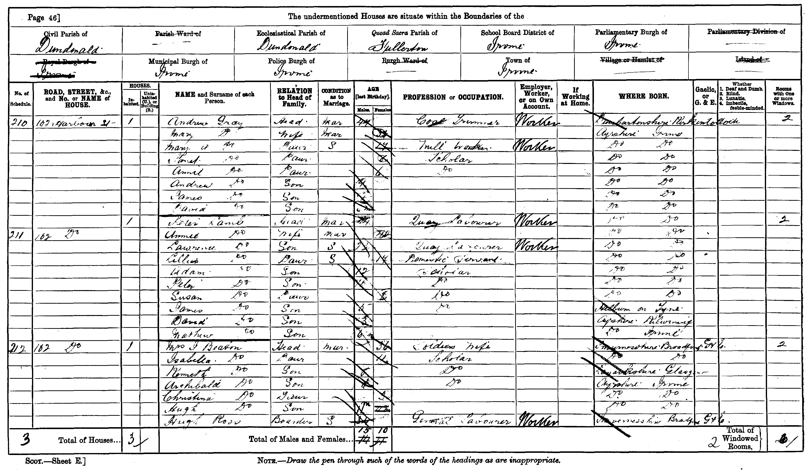
1851
1901
1911
Notes:
The 1911 census is my favourite as it shows the actual handwriting of my relatives who completed the form. This one is my gggrandparents.

Slide 37
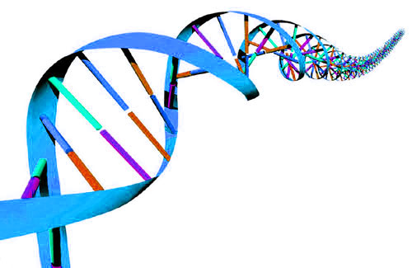
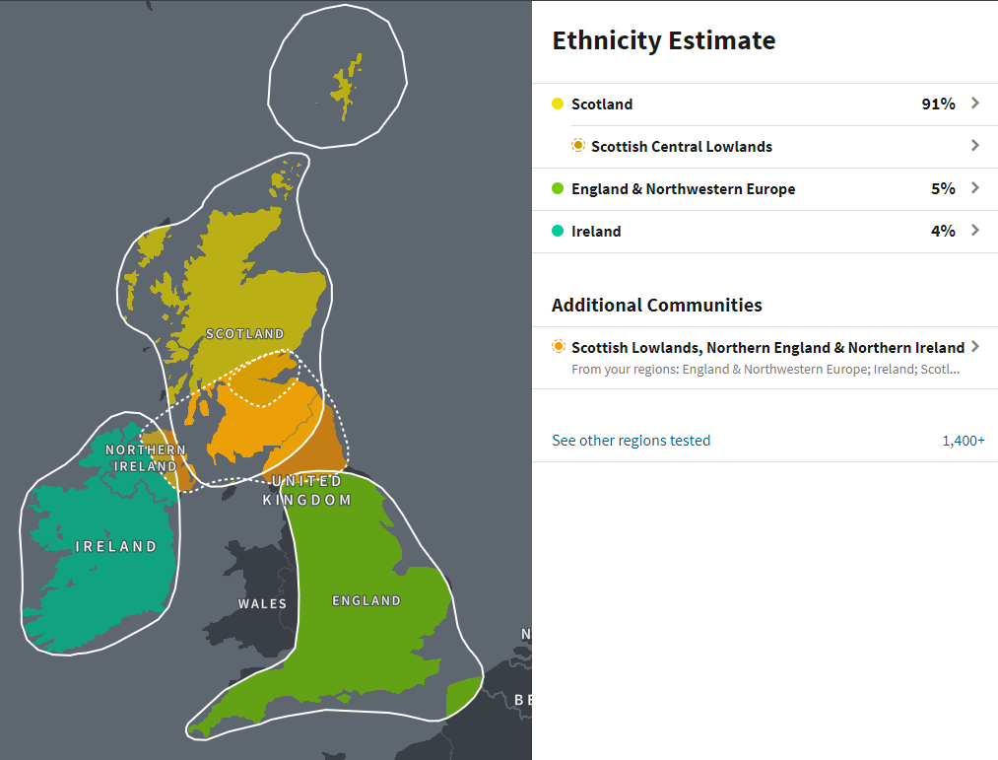
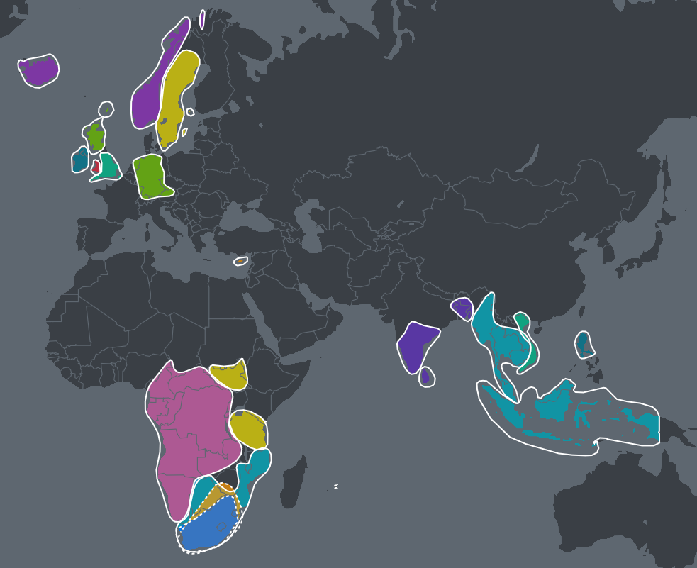
DNA
How does DNA help with tracing your heritage ?
  Confirms the areas your ancestors came from
  Can give you new insight into where to search ☺
  Contact with others who share DNA matches
Others are varied like this
My DNA is very concentrated

Slide 38
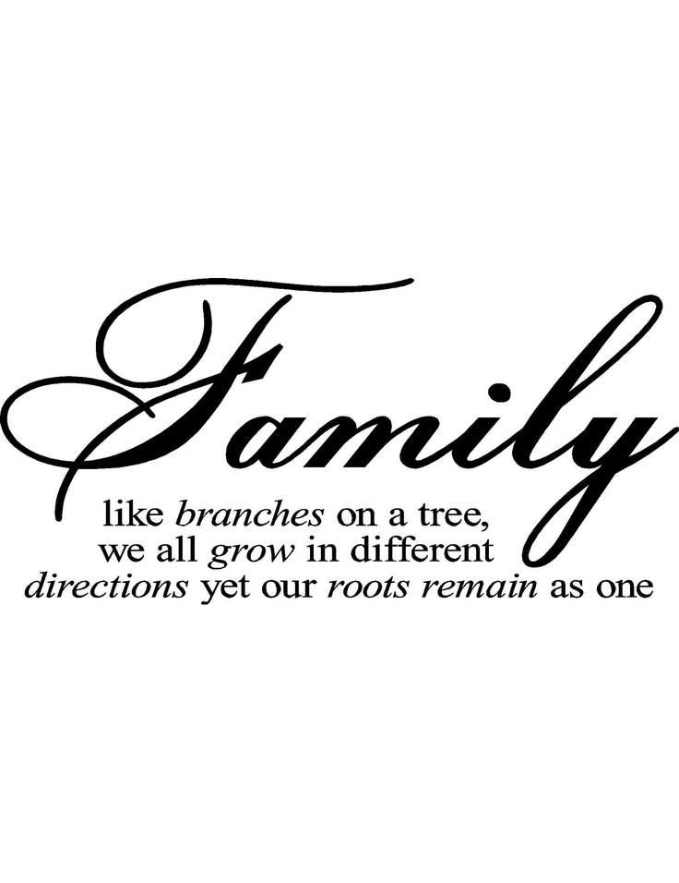
Requirement 12
Visit a City/County Library – Genealogy Section (or other Genealogy Research Centre) and write a paragraph on your visit including:
  Types of information available
  Any new information you discovered about your family
Notes:
Southampton Library to research there records – Librarian helped me. Winchester records office – catalogues and microfiche available of all old records

Slide 39
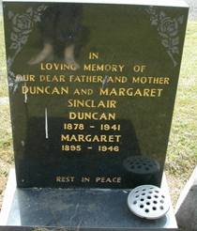
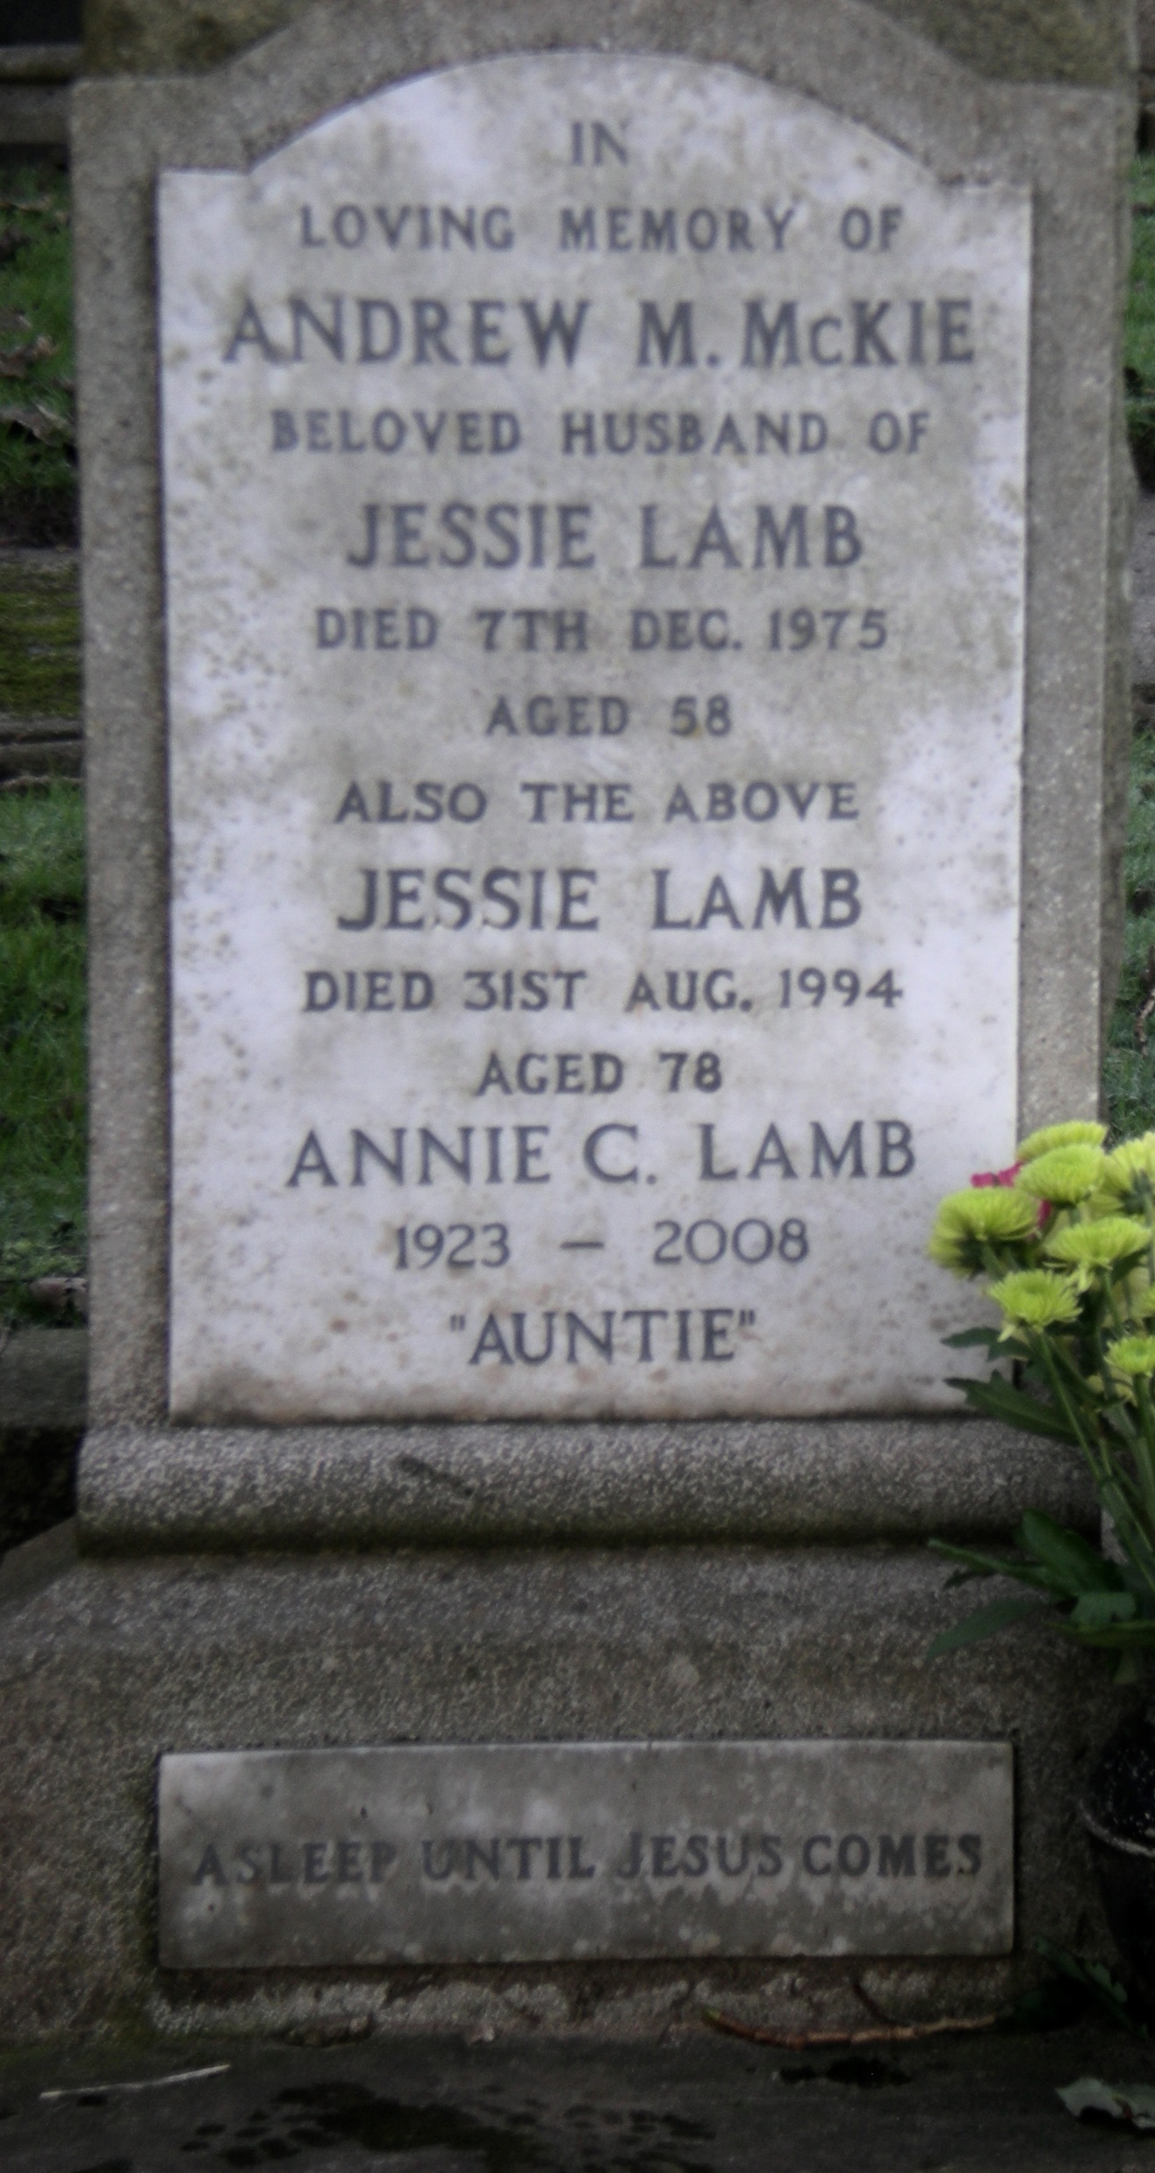
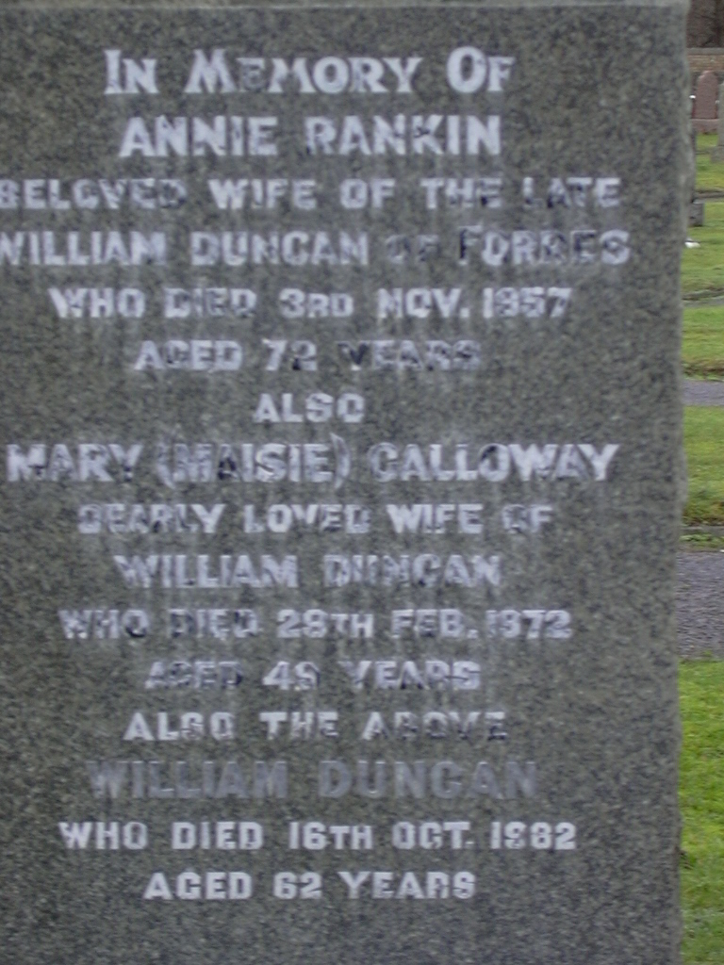
Requirement 13
Visit a cemetery and learn by copying the headstones:
  The names of 3 different families
  The dates of birth & death for these family members
  The average length of life for these family members

Slide 40
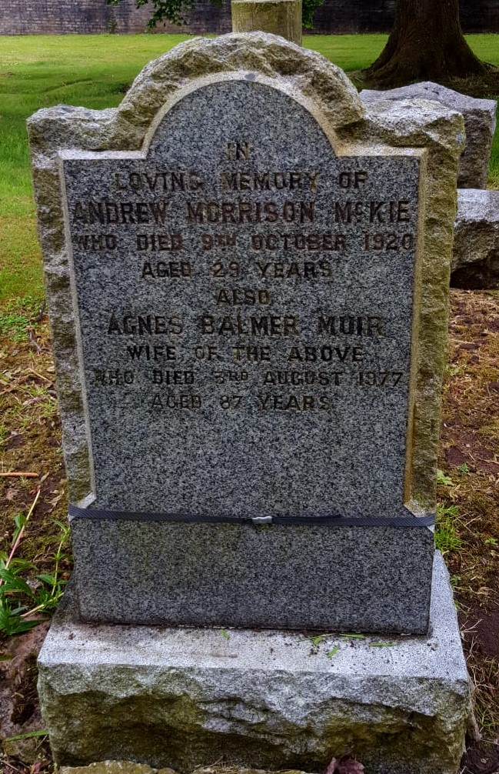
Requirement 13
For example:
  Andrew Morrison McKie
  b.1891 d. 09/10/1920 Age 29
  Agnes Balmer (Muir)
  b. 1889 d. 03/08/1977 Age 87
  * she was born Agnes Hewitt Balmer
  and married again after Andrew died.
  That’s why the name “Muir” appears

Slide 41
Requirement 13
For example:
  Andrew M McKie
  b.1917 d. 07/12/1975 Age 58
  Jessie Lamb
  b. 1923 d. 31/08/1994 Age 78
  Annie C. Lamb
  b. 1923 d. 2008 Age 85
  * I know that the “M” in Andrew’s name stands
  for Morrison - he was named after his father
  who had the same name

Slide 42
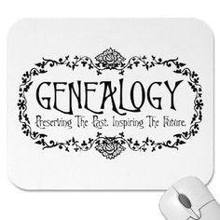
Requirement 14
Check with your local cemetery officials to learn how upkeep is done and ask them how you can help with clean-up in a cemetery in your area.
Then do it!
        * This could be something you do as a Global Youth Day project each March

Slide 43
Resources
Free resources used by Genealogists
www.freebmd.org.uk contains some birth, marriage and death indexes for England/Wales
www.familysearch.org International genealogy website run by the LDS church *
www.rootsweb.com genealogy chat and all kinds of information
www.sog.org.uk Society of genealogists
www.cwgc.org details of servicemen/women who died during the two World Wars
www.genuki.org.uk reference site with information,
advice and valuable genealogical material
www.cyndislist.com contains a wealth of information
and links to hundreds of websites
* I use/have used

Slide 44
Resources
Pay-for sites for Basic Genealogy
www.genesreunited.co.uk birth, marriage, death indexes and census returns for England/Wales *
www.familyrelatives.com birth, marriage, death indexes and census returns for England/Wales
www.ancestry.co.uk birth, marriage, death indexes, census returns for England/Wales & worldwide information *
www.scotlandspeople.gov.uk birth, marriage, death indexes & digitised images of many certificates and census returns for Scotland *
www.findmypast.co.uk birth, marriage, death indexes and census returns for England/Wales
Hint: Often there is a free trial periods so you can decide if it’s really
for you. On special days Ancestry can offer free/cheaper access
Often when you look at a record on a subscription site, you can
return to it for free for a period of time - but make sure you get
a printout of the searches you have done, along with the results
* I use/have used
Notes:
Ancestry offers free access on special days of the year (father’s day, VE day, etc.)

Slide 45
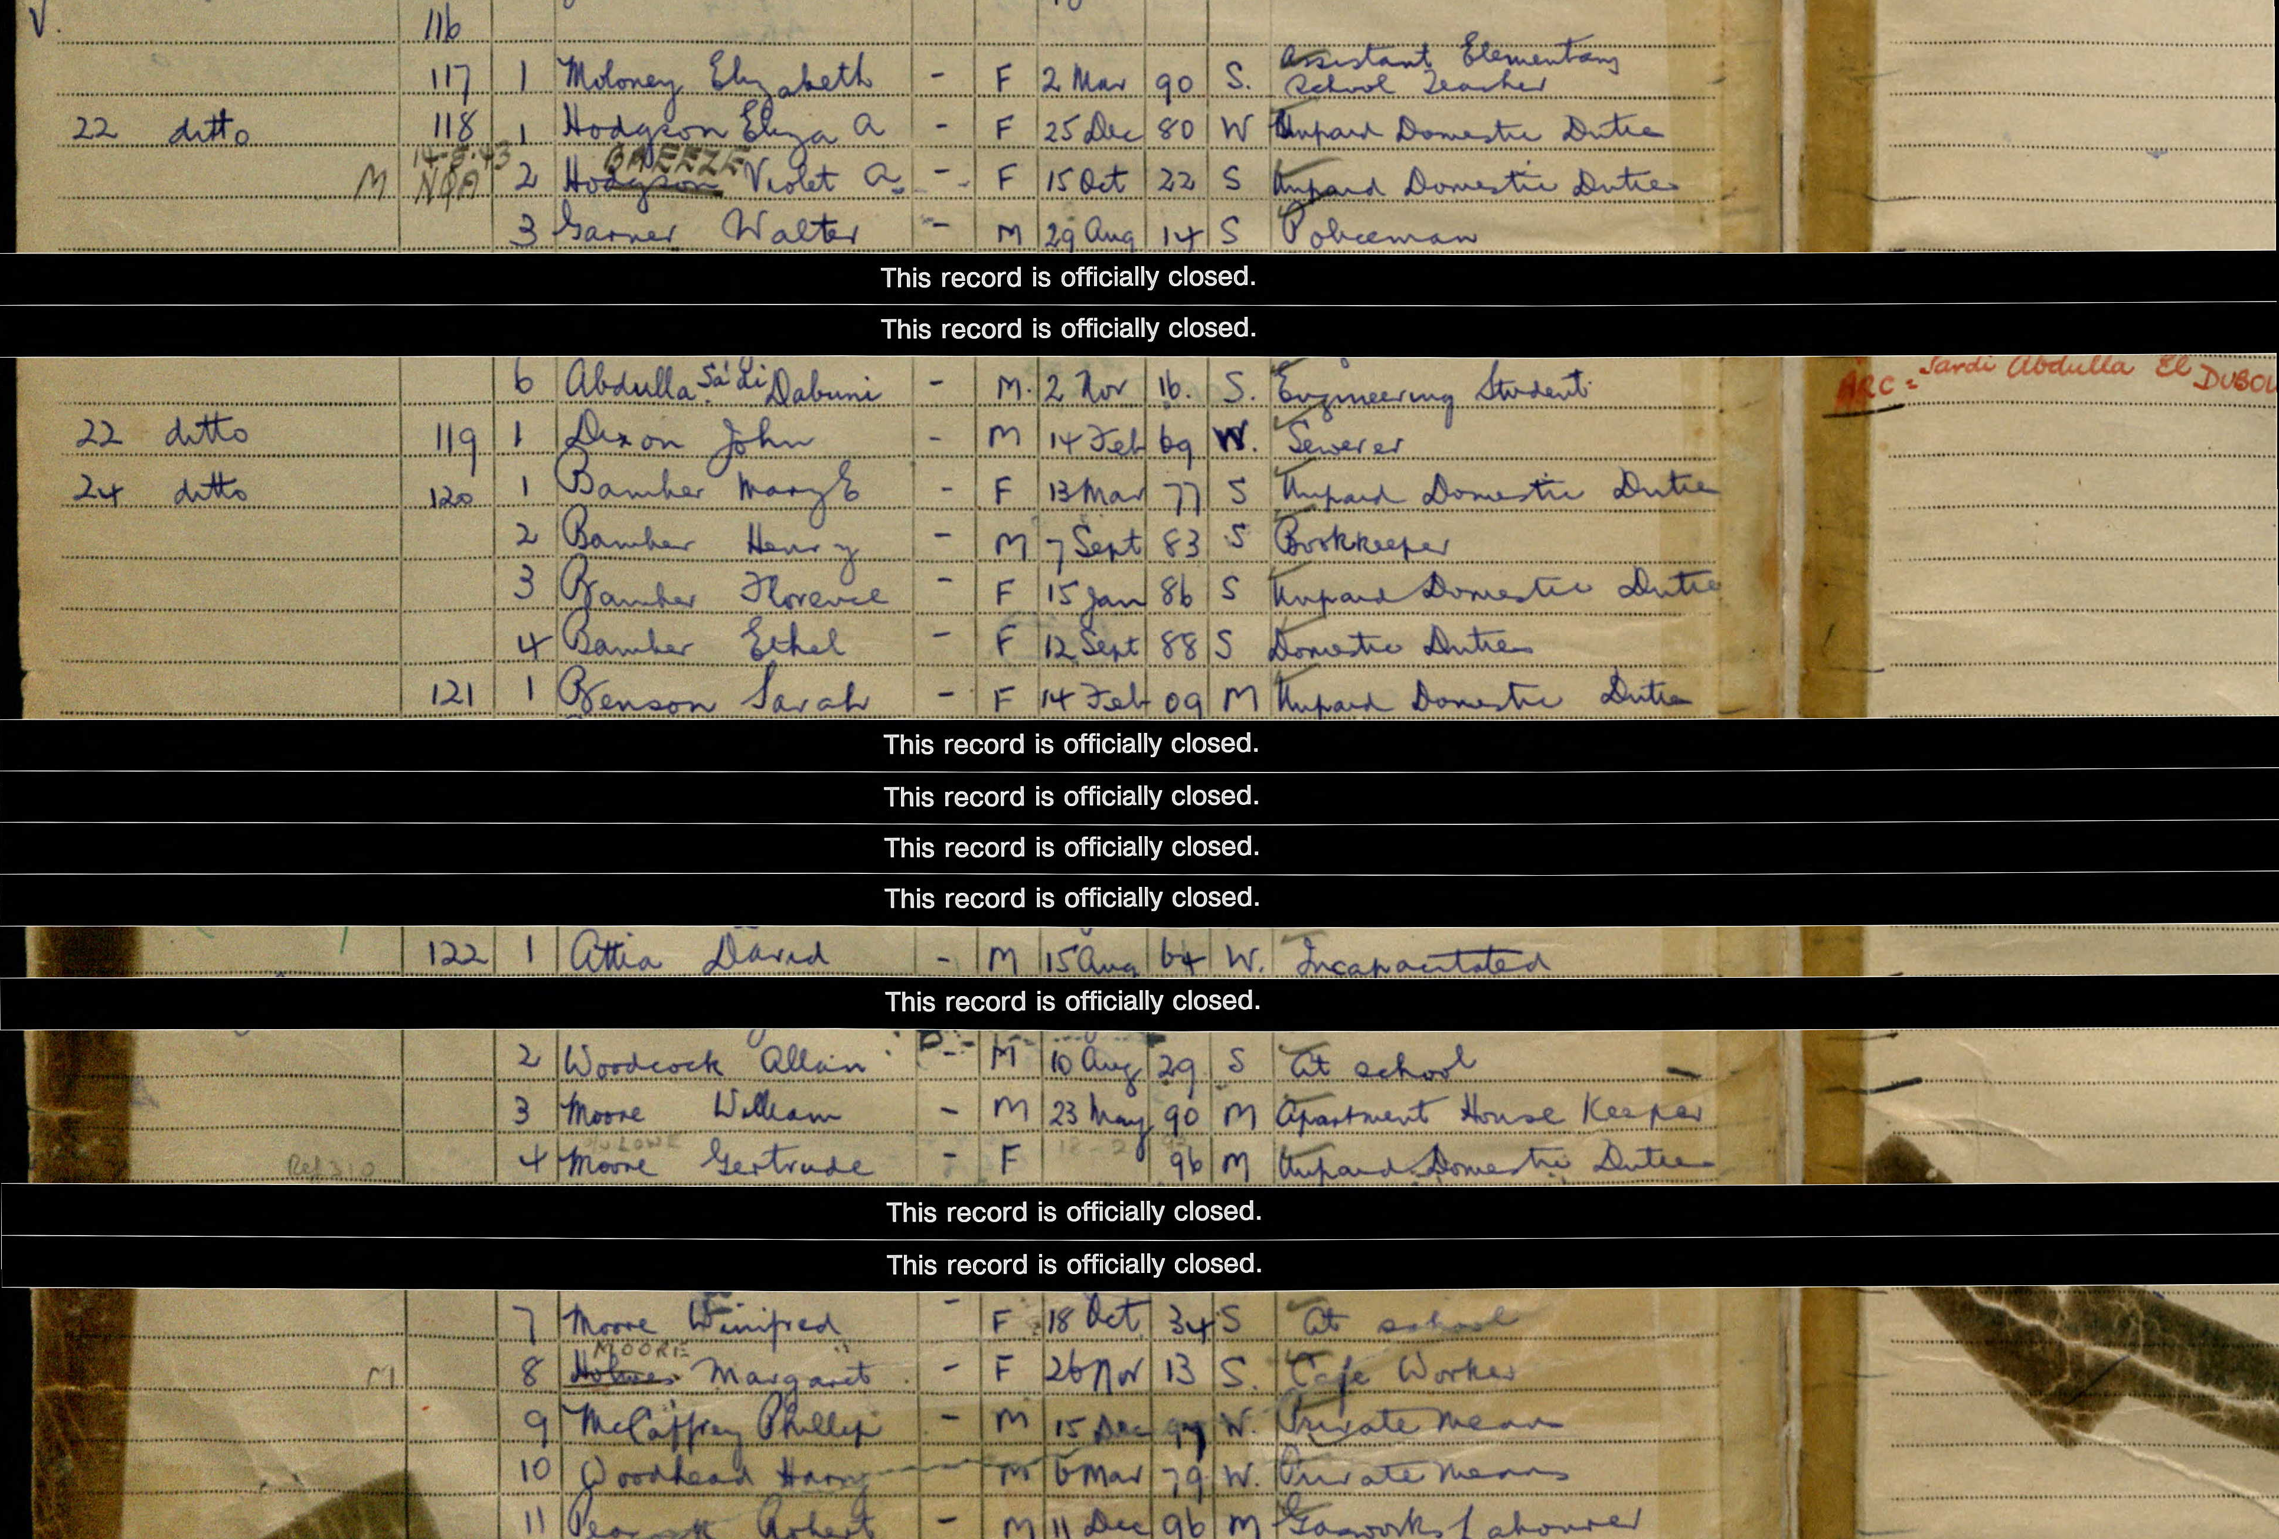
Resources
Pay-for sites for researching specialist information
http://www.nationalarchives.gov.uk/documentsonline wills, WWI Campaign Medal index, several collections of naval records and much more.
http://www.originsnetwork.com specialised records relating to British genealogy, including wills, apprenticeship records, military records and marriage indexes.
http://archive.timesonline.co.uk the Times Digital Archive, can be searched from 1785-1985, is a great place to find ancestors who were sufficiently well-to-do, famous or notorious & got mentioned.
Note: If you have an ancestor who held a political
or special military post in a war, then their records
may be protected by the 100-year secrecy act.

Slide 46
Tips
Don’t always believe what you are told – Double check everything for “fact”
Searching overseas many not be as easy as you think
Accept that family may not wish you to know all the facts/details
Get an adults help/permission to go online. You won't be able to access every website. Some have noticeboards/chat sections where you can ask others for help
Never give up hope – the more people who research, the more information will become available
Back up everything in more than 1 place
Enjoy the journey ☺

Slide 47
Genealogy – preserving the past and inspiring the future

